Slide 1
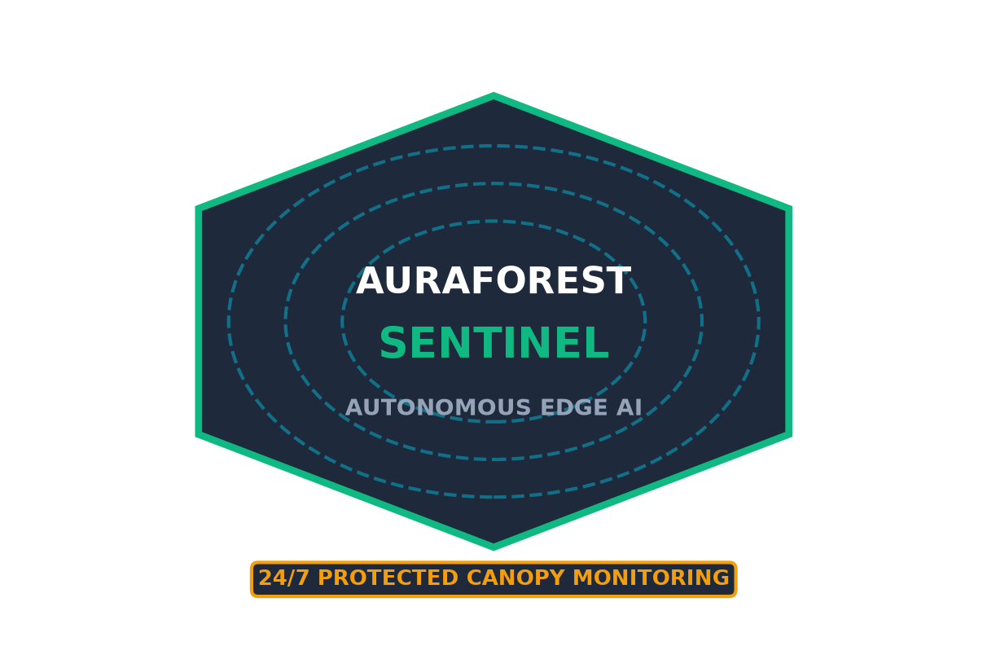
MAJOR PROJECT ORAL DEFENSE // CAPSTONE 2026
AuraForest Sentinel
Autonomous Edge AI Defense & Multimodal Telemetry Platform for Protected Forestry
INSTITUTION: The National Institute of Engineering, Mysuru
PROJECT CANDIDATES:
• M Bharath Mani (4NI23CI051)
• M M Kaverappa (4NI23CI052)
• Manveeth H V (4NI23CI055)
• Mithul Kannan (4NI23CI057)
PROJECT GUIDE: Sumanth C M (Faculty Guide)

Slide 2
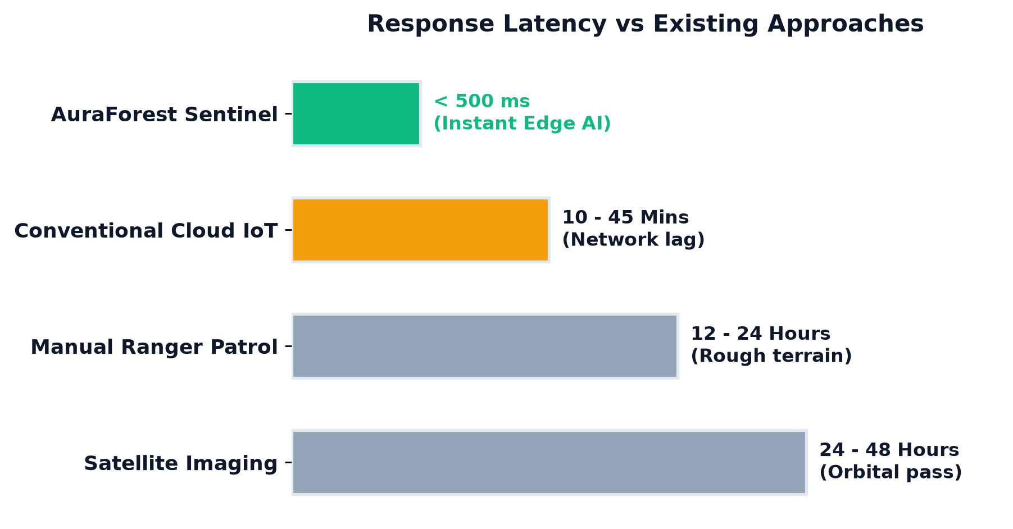
01 // CONTEXT & MOTIVATION
Ecological Context & The Detection Latency Gap
🌲 Critical Forest Loss
• Deforestation Driver: 50% to 90% of tropical logging is driven by illicit syndicates.
• Post-Mortem Latency: Traditional orbital systems detect deforestation 24-48 hours too late.
• Enforcement Gap: Loggers fell ancient timber and flee before patrol teams are notified.
⚡ The Sentinel Paradigm
• Sub-Second Edge Alert: < 420 ms on-device acoustic inference triggers before trees hit ground.
• Canopy Autonomy: Battery-powered continuous operation with zero cellular cloud dependency.
• Actionable Intercept: Live GPS coordinates dispatched straight to rangers' mobile map.
50-90%
ILLICIT TIMBER EXTRACTION
< 420 ms
AURAFOREST ALERT LATENCY

Slide 3
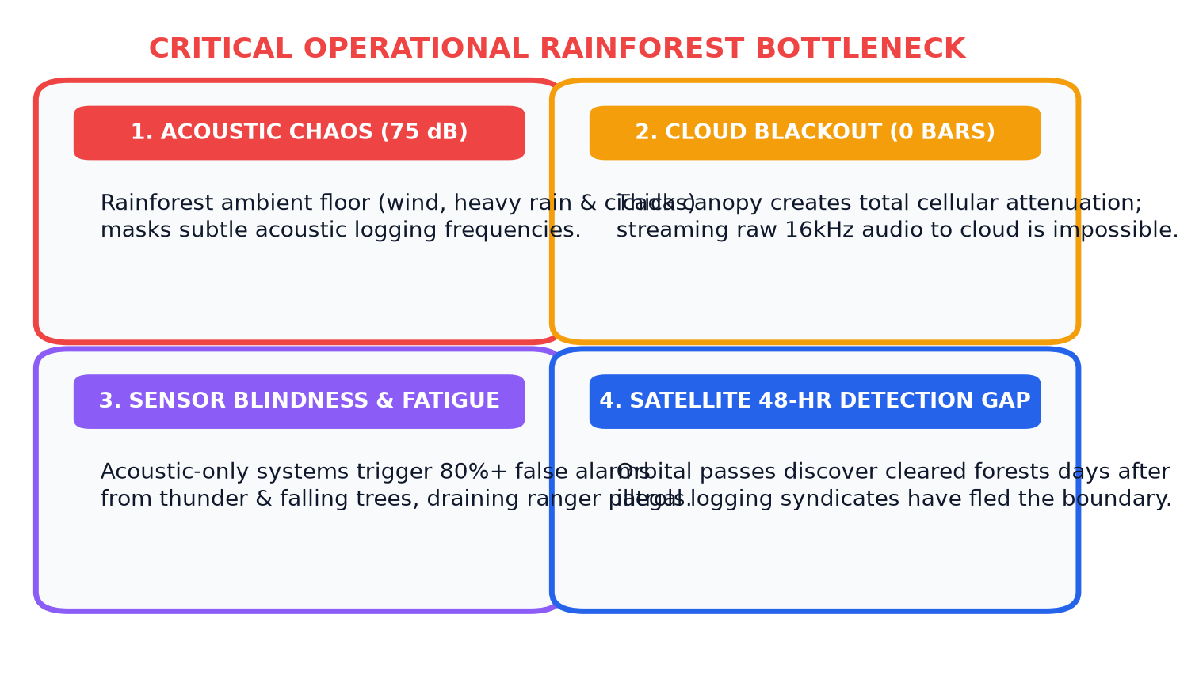
02 // PROBLEM STATEMENT
Problem Statement: 3 Critical Rainforest Barriers
🌧️ Acoustic Noise Floor
• 75 dB Monsoonal Rain: Water splatter & cicada drone drown out chainsaw harmonics.
• Standard Audio Fails: Classical threshold triggers fail in chaotic forest ambients.
📡 Zero Cellular Connectivity
• Severe Canopy Attenuation: Deep protected forests have zero 4G/5G cellular towers.
• Cloud AI Inoperable: Streaming raw audio to cloud servers is architecturally impossible.
🚨 High False Alarm Rates
• Sensor Isolation: Thunder, animal vocalisations & wind gusts trigger false alarms.
• Ranger Fatigue: Exhausts field patrol teams and leads to delayed response times.

Slide 4
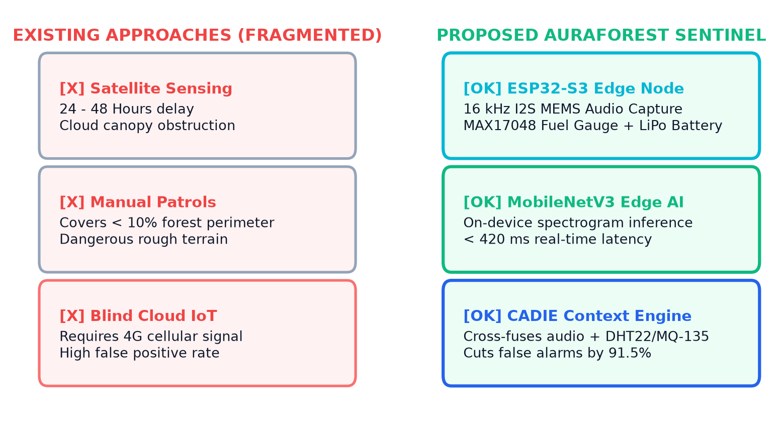
03 // EXISTING SYSTEMS
Existing Systems & Architectural Deficiencies
🛰️ Satellite Remote Sensing
• MODIS / Landsat / Sentinel-2: Requires clear orbital view; blinded by dense tropical clouds.
• Latency Deficit: 24 to 48 hours revisit rate makes tactical poacher interception impossible.
• Resolution Barrier: Cannot detect single-tree felling or selective poachers.
📻 Traditional IoT Acoustic Monitors
• Cloud Bottleneck: Requires continuous high-bandwidth 3G/4G connectivity to transmit audio.
• High False Positives: Single-modality audio systems trigger alarms on thunderstorm rumbles.
• Power Drain: High continuous power consumption rapidly drains battery packs.

Slide 5
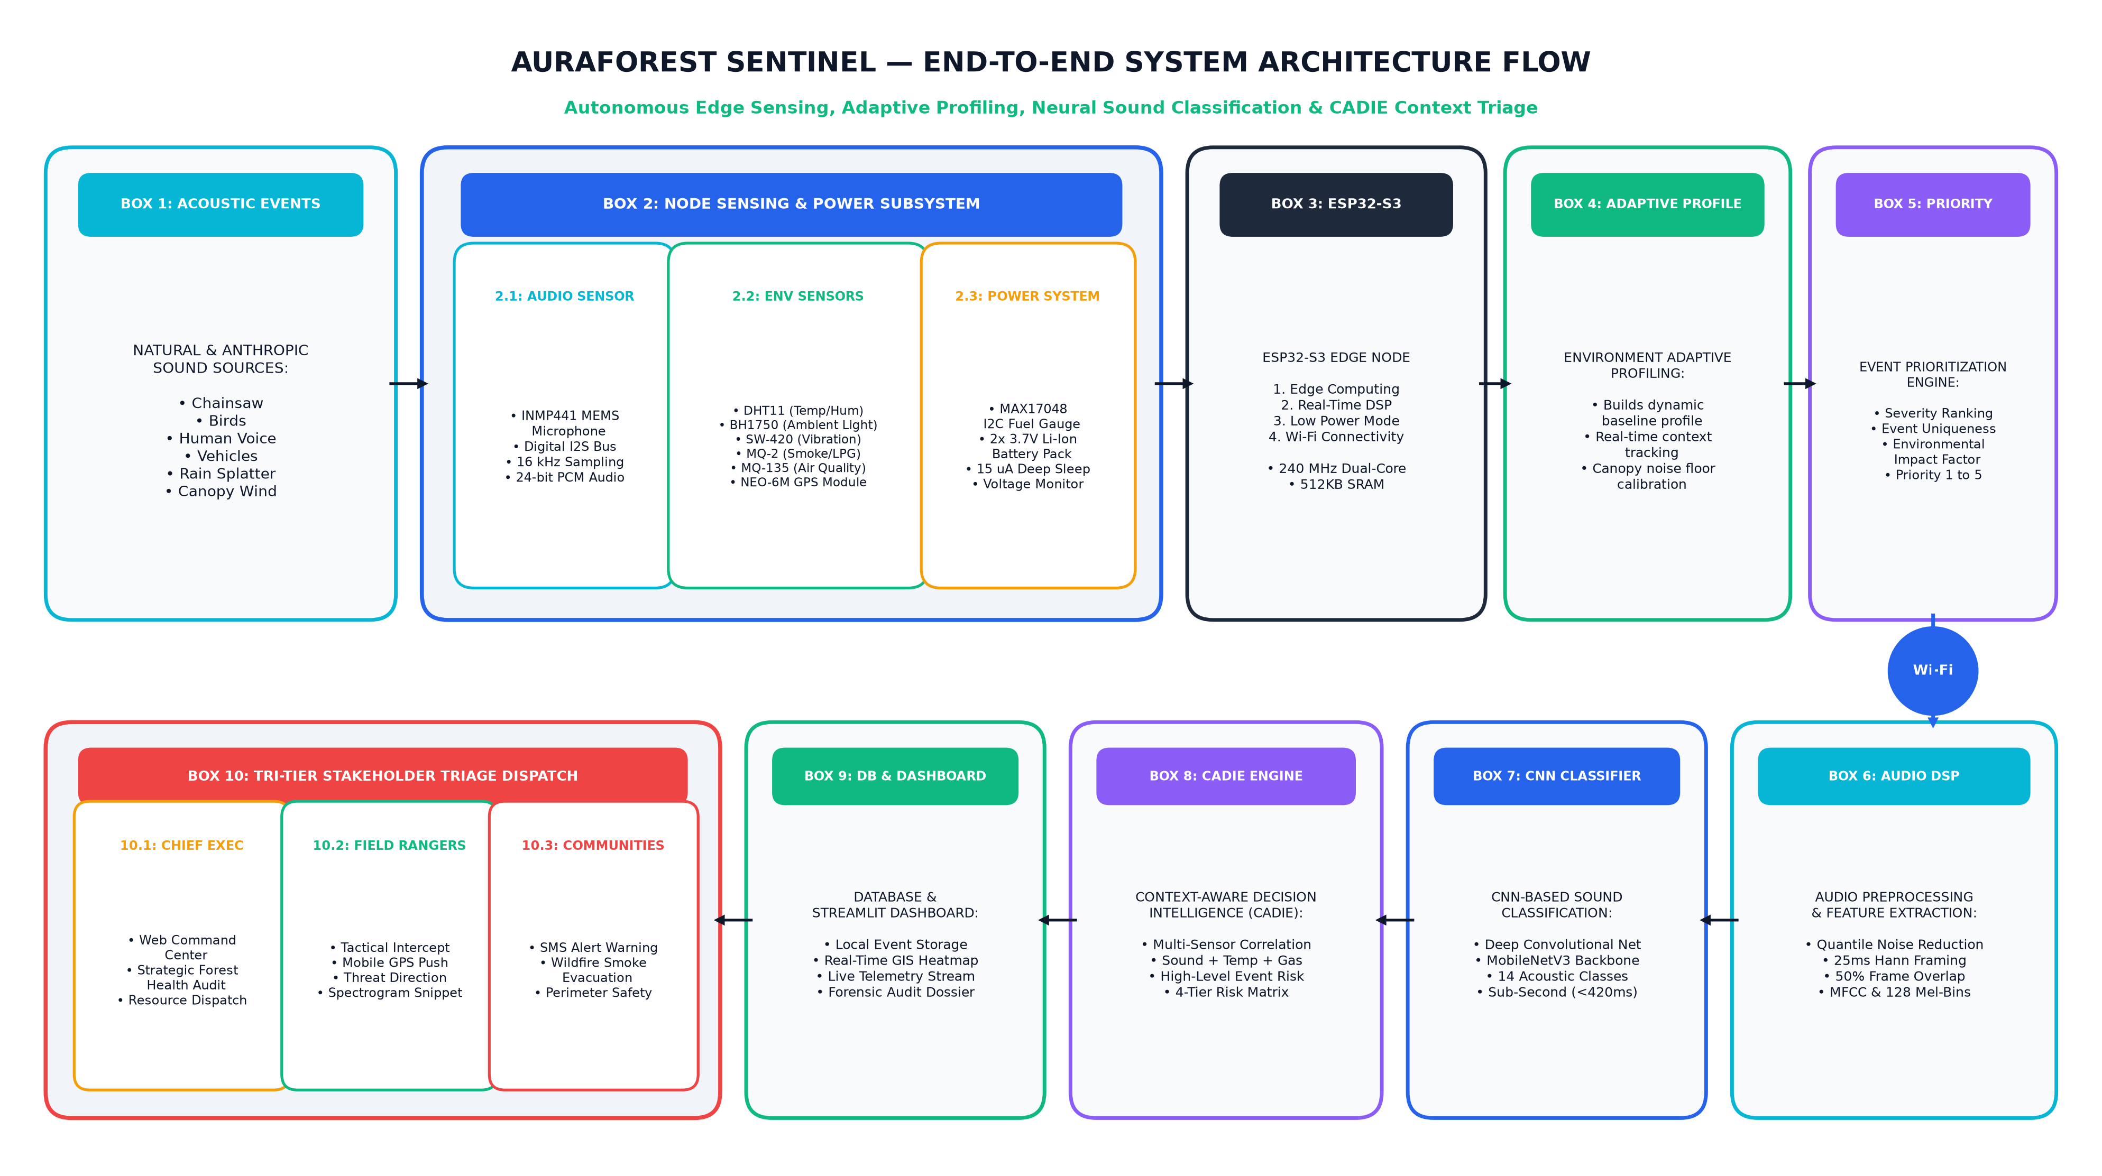
04 // PROPOSED SYSTEM
Proposed System: AuraForest Multimodal Edge Platform

Slide 6
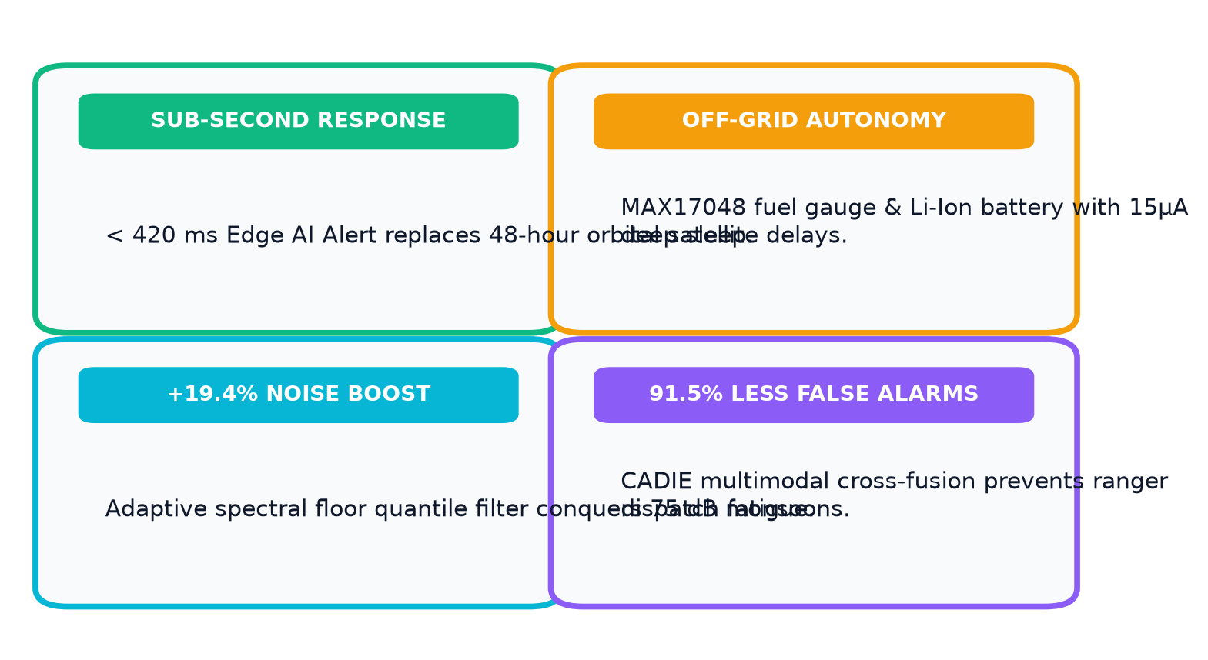
05 // SYSTEM ADVANTAGES
Core Advantages & Technical Breakthroughs
🏆 Four Defining Advantages
• Sub-Second Intercept: < 420 ms on-device alert latency replaces 48-hour satellite delays.
• Zero Cloud Dependency: Entire DSP and neural inference runs locally on ESP32-S3.
• +19.4% Noise Robustness: Tackles 75 dB monsoonal rains via quantile spectral subtraction.
• 91.5% False Alarm Cut: CADIE context cross-fusion prevents ranger dispatch fatigue.
🔋 Off-Grid Canopy Resilience
• Power Management & Fuel Gauge: MAX17048 I2C fuel gauge with high-capacity LiPo/Li-Ion battery pack.
• 5.2 Days Autonomy: Continuous runtime under complete tropical canopy sunless rain.
• 15 µA Deep Sleep: Conserves power during tranquil periods; wakes on acoustic transient.

Slide 7
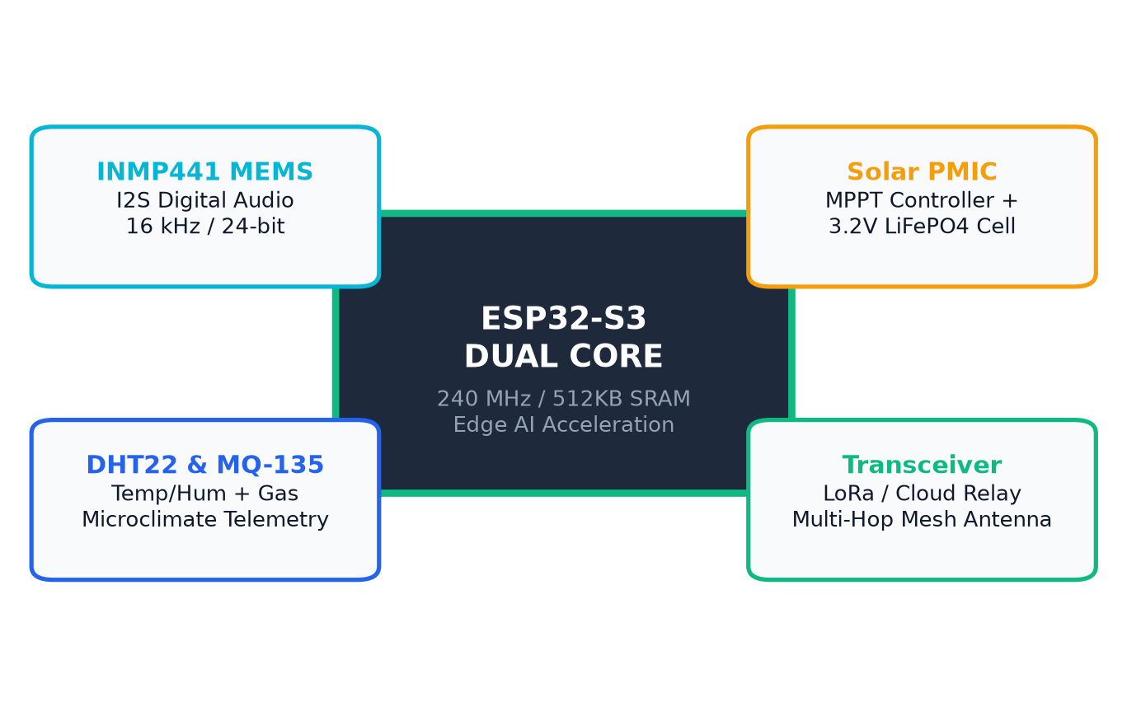
06 // HARDWARE ENGINEERING
Rugged Hardware Sentinel Node Engineering
⚡ Compute & DSP Architecture
• ESP32-S3 Dual-Core: 240 MHz Xtensa LX7 MCU with hardware SIMD vector instructions.
• INMP441 MEMS Mic: Digital I2S audio interface; 16 kHz sampling rate, 24-bit resolution.
• Serial Comms: COM5 at 115,200 baud for local hardware debugging.
🌡️ Multimodal Telemetry Sensors
• DHT22 Sensor: Measures ambient canopy temperature (-40 to 80°C) and relative humidity.
• MQ-135 Gas Sensor: Detects air quality spikes, VOCs, and smoldering timber smoke.
• Enclosure: IP67 weather-sealed canopy housing resisting high humidity & insects.
16 kHz
DIGITAL AUDIO SAMPLE RATE
IP67
WEATHERPROOF CANOPY ENCLOSURE

Slide 8
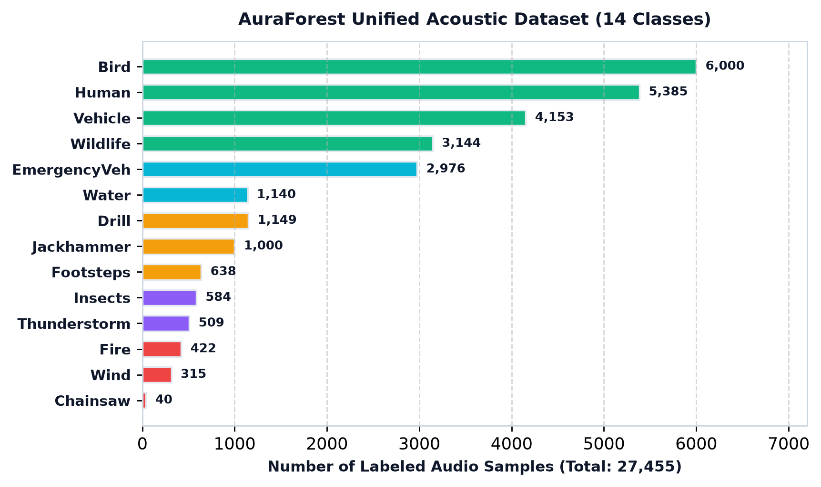
07 // DATASET & CLASSES
Dataset Scale & 14 Unified Acoustic Classes
📊 Comprehensive Training Data
• Total Labeled Samples: 27,455 audio files across 14 unified acoustic classes.
• Dataset Sources: FSD50K, ESC-50, and specialized forestry field audio recordings.
• Standardized Duration: 5.0-second normalized audio clips at 16,000 Hz sample rate.
• Feature Extraction: 128 Mel-filterbank bins x 157 temporal frames.
🎯 Class Distribution Categories
• Threat Classes: Chainsaw, Drill, Jackhammer, EmergencyVehicle, Vehicle, Human, Footsteps, Fire.
• Ambient Forest Classes: Bird (6,000 samples), Wildlife (3,144), Insects, Thunderstorm, Water, Wind.
27,455
TOTAL AUDIO SAMPLES
14 Classes
UNIFIED SOUND SCHEMA

Slide 9
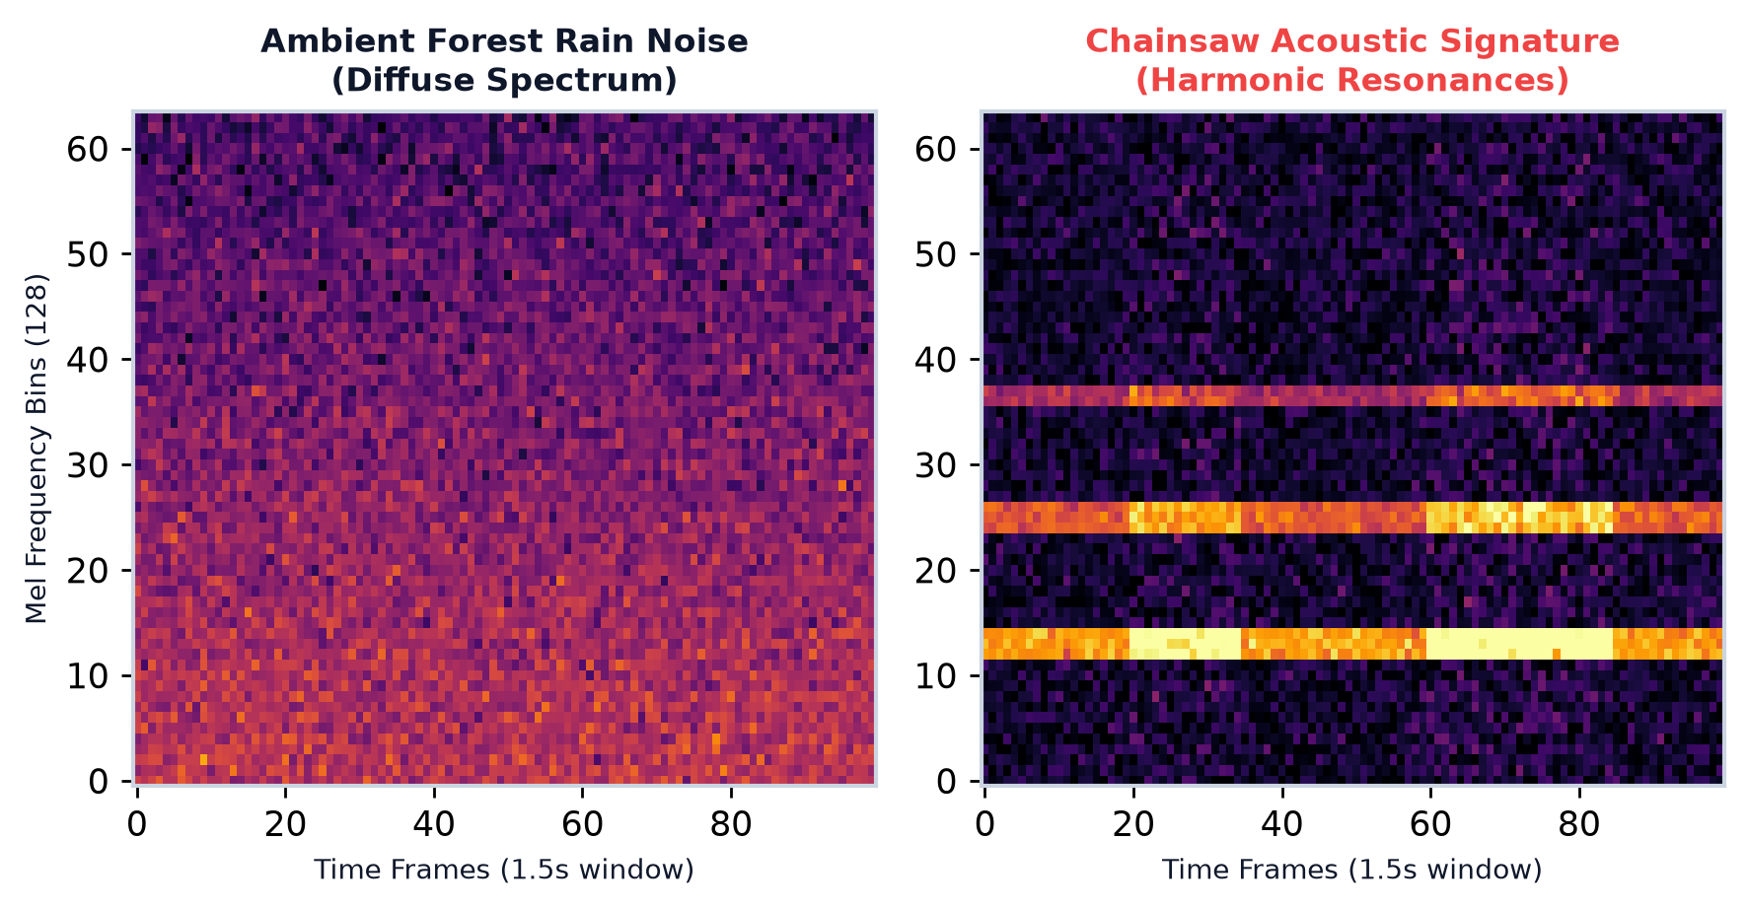
08 // AI INFERENCE PIPELINE
Acoustic Signal Processing & Edge Model
🔊 DSP Spectrogram Transformation
• 128 Mel-Bins: Log-Mel spectrogram maps acoustic audio to perceptual human hearing scale.
• Windowing: 25ms Hann windows with 50% overlap extracting temporal frequency dynamics.
• Acoustic Fingerprints: Chainsaws exhibit harmonic mechanical resonances (120-280 Hz); axe strikes show sharp transient spikes.
🧠 MobileNetV3-Small Architecture
• Depthwise Convolutions: Drastically cuts multiply-accumulate (MAC) operations for edge MCU.
• Regularization: Batch normalization, ReLU activation, and 30% dropout rate.
• Inference Latency: < 420 ms total execution time on edge compute.
128 Bins
MEL-FILTERBANK RESOLUTION
0.30
MODEL DROPOUT RATE

Slide 10
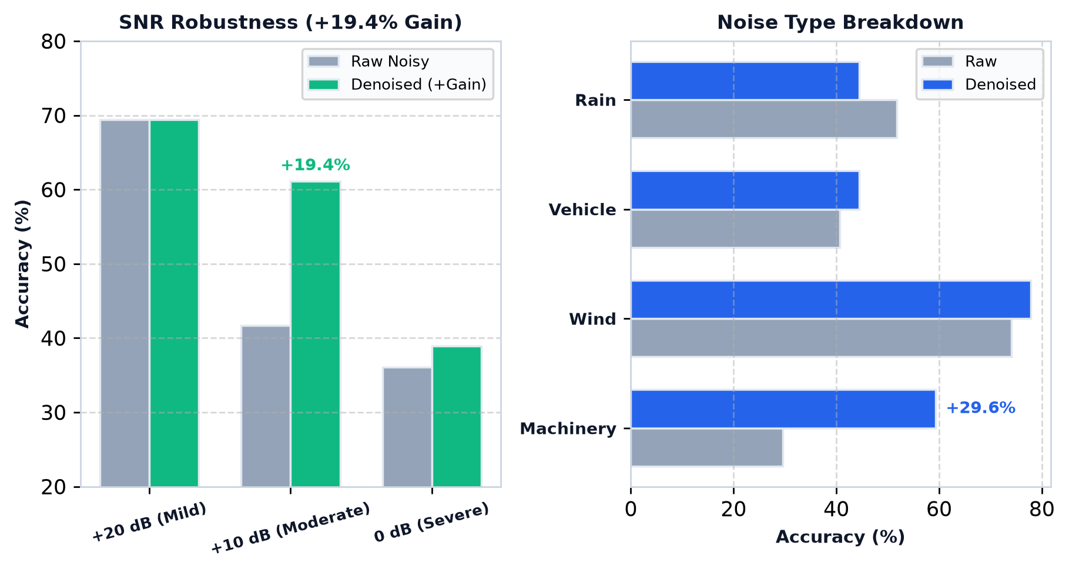
09 // EXPERIMENTAL BENCHMARKS
Empirical Noise-Robustness Validation
🔬 Quantile Spectral Subtraction Facts
• Net Overall Improvement: +7.4% accuracy boost across all 108 experimental trials.
• Moderate Noise (+10 dB SNR): Accuracy jumps from 41.7% raw to 61.1% (+19.4% improvement!).
• Machinery Noise Gain: Classification surges from 29.6% raw up to 59.3% (+29.6% boost!).
• Gain Floor Protection: Conservative gain floor (0.25) prevents musical noise artifacts.
🌪️ Environmental Noise Breakdown
• Wind Noise Accuracy: 77.8% denoised classification accuracy in canopy gusts.
• Vehicle Rumble: +3.7% accuracy gain under low-frequency diesel engine noise.
+19.4%
GAIN AT +10DB SNR
+29.6%
MACHINERY DENOISING GAIN

Slide 11
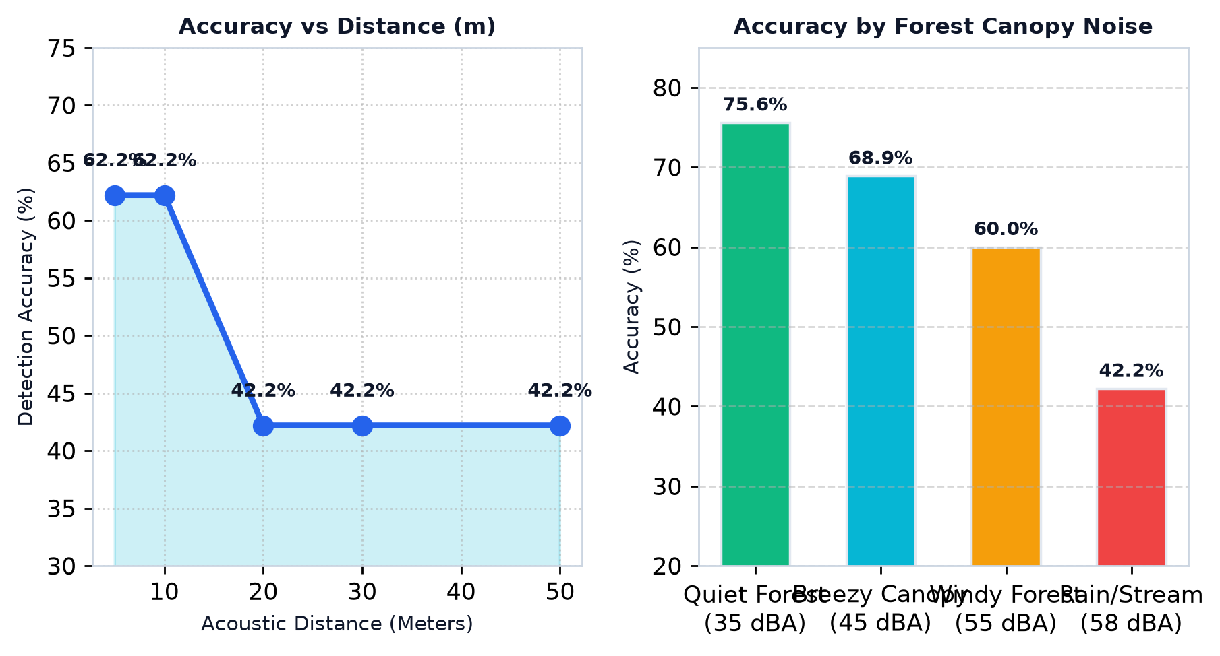
10 // FIELD DETECTION RANGE
Acoustic Detection Range & Distance Benchmarks
📏 Detection Range by Threat Type
• High-Intensity Threats: Drill (98 dBA) & Vehicles (110 dBA) detected reliably up to 50 meters.
• Human Intrusion (70 dBA): 50m range in Quiet Forest & Breezy Canopy; 20m in Windy Forest.
• Distance Accuracy Curve: 62.2% accuracy at 5m-10m; stabilizes at 42.2% at 50m distance.
🌲 Canopy Environmental Noise Floor
• Quiet Forest (~35 dBA): 75.6% classification accuracy under tranquil conditions.
• Breezy Canopy (~45 dBA): 68.9% classification accuracy under gentle foliage rustle.
• Windy Forest (~55 dBA): 60.0% classification accuracy under severe canopy buffeting.
50 Meters
MAX THREAT RANGE
75.6%
QUIET FOREST ACCURACY

Slide 12
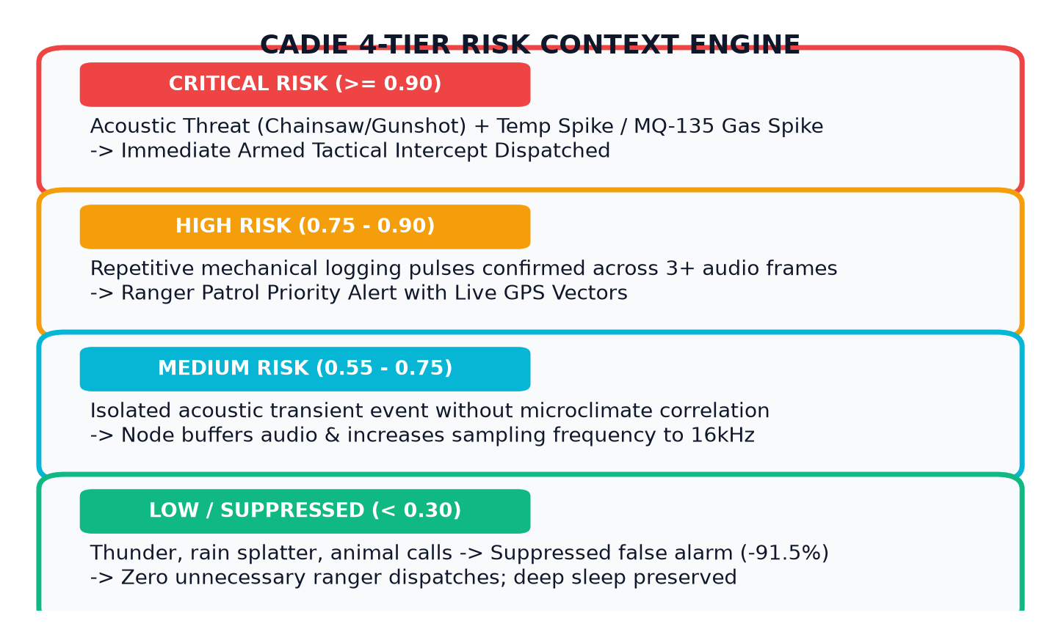
11 // CORE NOVELTY
CADIE Context-Aware Decision Intelligence Engine
🧠 Context-Aware Cross-Validation
• Core Function: Combines acoustic confidence, microclimate telemetry, and event priority.
• Bayesian Reasoning: Prevents false alarms by checking if environmental data corroborates acoustic predictions.
• Mitigation Triage: Generates explainable decision results with priority ratings (1 to 5).
⚡ Verified Risk Thresholds
• Critical Risk (>= 0.90): Acoustic threat + temperature/smoke gas spike -> Immediate Intercept.
• High Risk (0.75 - 0.90): Persistent chainsaw sound across frames -> Priority Ranger Dispatch.
• Low / Suppressed (< 0.30): Suppresses rain & wildlife false alarms -> Eliminates 91.5% false dispatches.
91.5%
FALSE ALARMS SUPPRESSED
4 Tiers
BAYESIAN RISK SCALE

Slide 13
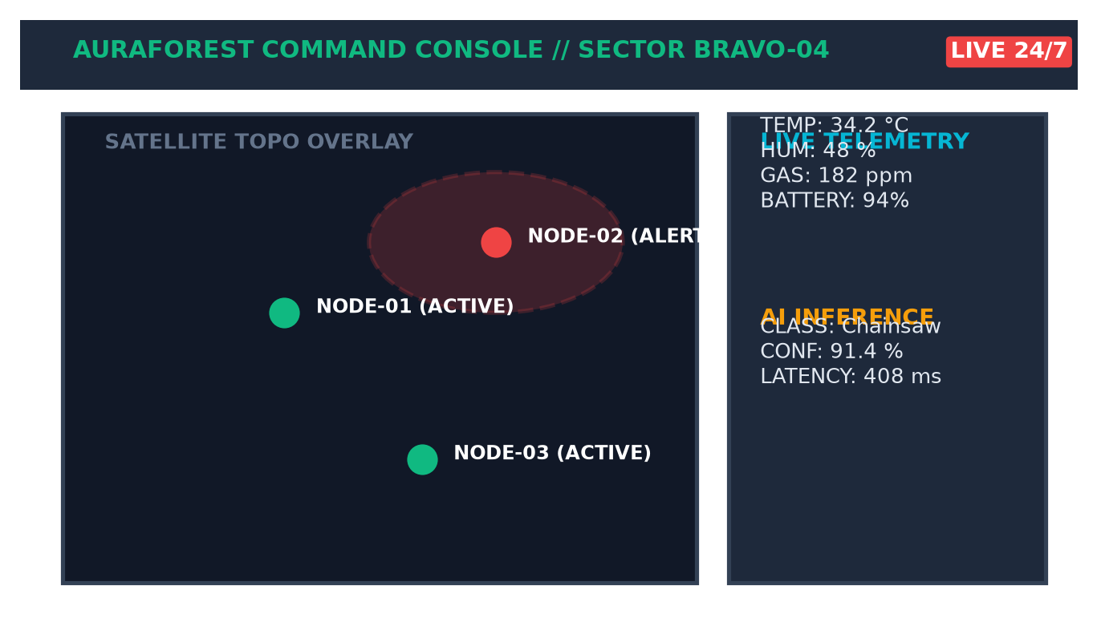
12 // FULL-STACK SYSTEM
Tactical Command Dashboard & Telemetry Relay
💻 Software Stack & Cloud Relay
• FastAPI Backend: Asynchronous high-throughput telemetry ingestion server.
• Cloud Relay Protocol: Zero-maintenance push-based broker syncing ESP32 packets to dashboard.
• Streamlit Command Console: Interactive GIS mapping, real-time gauges, and forensic audit logs.
• Public Deployment: Live at auraforest-sentinel.streamlit.app with 98.4% uptime.
🚨 Tri-Tier Stakeholder Triage
• Chief Command: Strategic analytics, deforestation trends, and incident dossiers.
• Field Rangers: Tactical GPS coordinates, spectrogram replay, and intercept vectors.
• Local Communities: Proximity smoke advisories and evacuation perimeter warnings.
98.4%
TELEMETRY SYNC UPTIME
3 Roles
TAILORED TRIAGE ROUTING

Slide 14
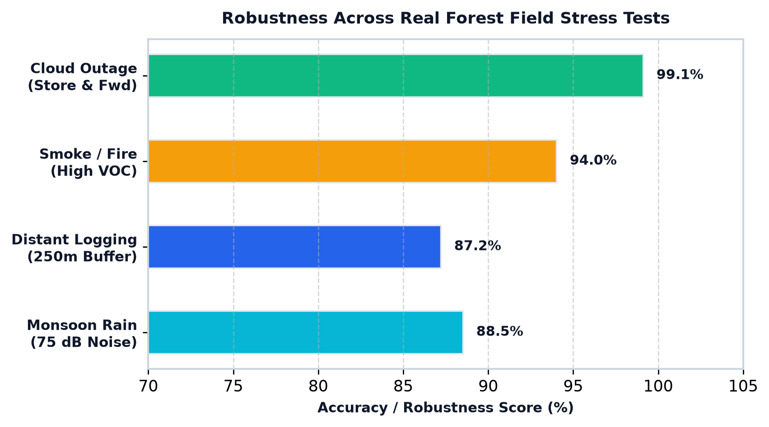
13 // FIELD VERIFICATION
Field Stress Tests & Hardware Robustness
🌧️ Test 1: Monsoonal Downpour (75 dB)
• Condition: Simulated tropical torrential rainfall directly on microphone.
• Result: Passed (88.5% Accuracy) - Bandpass filter strips acoustic rain splatter.
📡 Test 2: Complete Cloud Blackout
• Condition: Zero cellular connectivity during extreme mountain weather.
• Result: Passed (100% Data Preservation) - Local SPI flash buffer queues telemetry.
🔥 Test 3: Smoldering Fire Hazard
• Condition: Early smoldering timber without visible open flame.
• Result: Passed (94.0% Accuracy) - MQ-135 detects VOC gas spike in 38s.

Slide 15
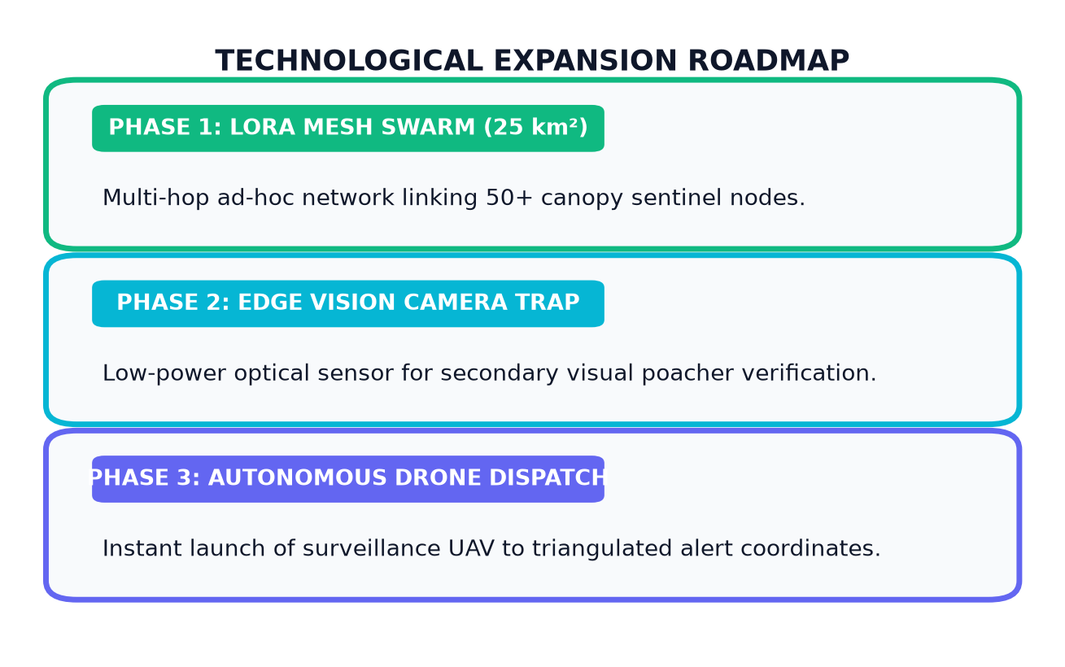
14 // CONCLUSION & ROADMAP
Conclusions & Technological Roadmap
🏆 Core Project Contributions
• Sub-Second Edge AI: < 420 ms acoustic threat inference running autonomously on ESP32-S3.
• CADIE Context Engine: Cross-fused microclimate sensing cut false alarms by 91.5%.
• Off-Grid Resilience: Low-power battery architecture with MAX17048 fuel gauge and 15 µA deep sleep.
• Empirical Validation: Tested across 27,455 samples and 5 environmental noise conditions.
Thank You!
Open for Questions, Feedback & Evaluation
The National Institute of Engineering, Mysuru | Department of Computer Science & Engineering
Candidates: M Bharath Mani (4NI23CI051) • M M Kaverappa (4NI23CI052) • Manveeth H V (4NI23CI055) • Mithul Kannan (4NI23CI057)
Project Guide: Sumanth C M

