Slide 1

Loan Default Prediction model (Classification Model)
Using:
Classification & Regression Tree (CART)
Random Forrest Technique of Classification
Gradient Boosting Method &
Generalized linear Method (Logistic Regression)
PGP-BABI, Hyderabad, :
Mithun Radhakrishnan

Slide 2
Table of Contents
Business Problem Defined
Approach to cleaning data [Task 1].
How the Unbalanced data was addressed [Task 2].
Model building [Task 3]
CART [Model & Test performance]
Random Forest [Model & Test performance]
GBM [Model & Test performance].
GLM[Model & Test performance].
Evaluation of various Model performance on test data [Task 4]

Slide 3
Business problem Defined
Loan Default Prediction (Classification problem)

Slide 4
Business Problem
Financial institutions who have interest in personal loans face risk from customers who default. With the advent of predictive analytics, the risk to the Financial Institutions can be reduced by being able to predict the outcome of these loans. Accurate prediction and decisions based on these predictions can result in increased profitability and help the Financial Institution maintain healthy lending book.
Problem statement
Multiclass classification problem for predicting loan status from the data set provided. The problem can be reduced into a binary classification problem to build a loan approval pre-check system for potential customers.
This submission is an attempt at exploratory data analysis and predictive modelling on a training data and subsequent performance of the models on the unknown test data.

Slide 5
Approach to Cleaning the data
Loan Default Prediction (Classification problem)

Slide 6
Dataset & Features
Variable Name | Description | Type
SeriousDlqin2yrs | Person experienced 90 days past due delinquency or worse | Y/N | Dependent variable
RevolvingUtilizationOfUnsecuredLines | Total balance on credit cards and personal lines of credit except real estate and no instalment debt like car loans divided by the sum of credit limits | percentage | Independent variable
DebtRatio | Monthly debt payments, alimony, living costs divided by monthly gross income | percentage | Independent variable
NumberOfOpenCreditLinesAndLoans | Number of Open loans (instalment like car loan or mortgage) and Lines of credit (e.g. credit cards) | integer | Independent variable
NumberOfDependents | Number of dependents in family excluding themselves (spouse, children etc.) | integer | Independent variable

Slide 7
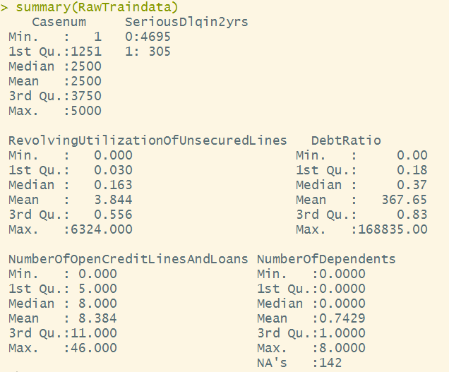
Structure of Raw Training data:
Data Dimension
Rows : 5000
Columns : 6

Slide 8

Steps in Cleaning and preprocessing of data:
Case number: is a unique identifying number for each loan application. It’s a nominal variable and have no use in model building. Hence we will ignore this variable in model building.
Revolving utilization of unsecured Credit lines : the revolving utilization measurement is used to determine how leveraged the applicants credit cards and personal lines of credit are at a point of time. The more money that is charged on the credit cards or personal lines in relation to available credit limit the higher your credit utilization percentage is.
This number by the variable definition cannot be more than 1
However we have 87 observation (of which 35 are class 1 cases) with more than 1 as revolving utilization.
This looks like a data entry issue but, any kind of data imputation will add more noise to the data. Hence we have omitted these variables form model building.
Dropped Revolving Utilization more than 1 from model building.

Slide 9
Steps in Cleaning and preprocessing of data:
Debt Ratio: intuitively a debt ratio as defined in the dataset also should not go more than 1 or 100% as your payments cannot be more than your income. However there can be cases where the applicant is making this payment form his past earnings or any other source. We have maintained this variable to its fullest and not filtered any observation.
Number of Dependents : there are 142 missing values of NA’s in this variable (of which only 7 belong to class 1). We could have used a mode to impute this data, however we omitted these NA’s cause imputing data would not have added much value.
We could have also removed observations where Revolving utilization of unsecured credit lines and Number of credit lines are zero, however we have maintained these as in such cased the model will draw intelligence from other 2 variable that is the “debt ratio” and “number of dependents”.

Slide 10
Unbalanced data
Loan Default Prediction (Classification problem)

Slide 11
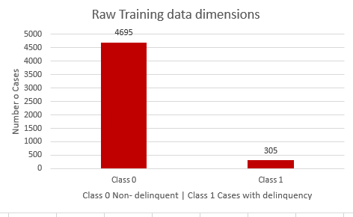
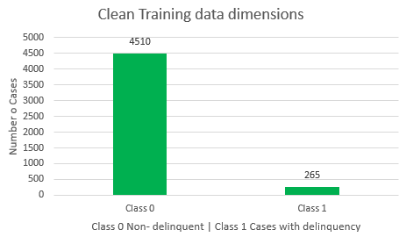
Data Dimension (pre-post cleaning)
We lost 40 delinquent cases while cleaning and pre-processing the raw data.
Only 5.87 % cases in the clean pre-processed data is of class 1 – delinquent.
We need to resort to some method of oversampling for the algorithms to learn.

Slide 12
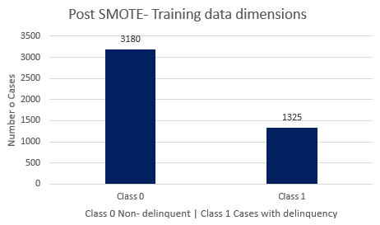
Resorted to SMOTE function to correct the balance:
We intended to achieve a minimum class weightage of 3:1.
We over sampled the minority event (265) 4.5 times.
To compensate for the excess data points that will generated by SMOTE function we resorted to a under sampling of Majority event and maintained at 3 times of majority.
Formula:
frasmotedata<- SMOTE(SeriousDlqin2yrs~.,data = traindata,perc.over = 450,k=5,perc.under = 300)
We achieved a class weightage very close to 2:1
Minority class is now 29.4% of the whole.

Slide 13
Predictive Models
Loan Default Prediction (Classification problem)

Slide 14
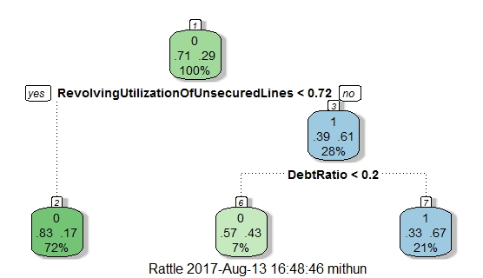
Model No. 1 CART
Variable Importance as per CART
Ranking | Variable Name
1 | Revolving utilization of unsecured loans.
2 | Number of Open credit lines and loans.
3 | Debt Ratio.
4 | Number of Dependents.
*Most variable and their splits are not clear in this image. I

Slide 15
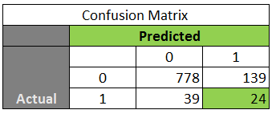
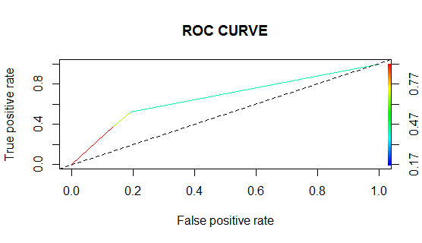
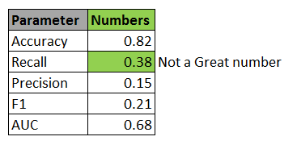
CART model performance in Test Data
With specificity or recall at 38% this is not a good model to have.

Slide 16
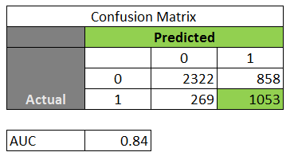

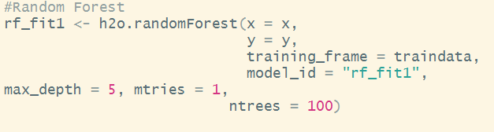
Model No. 2 RANDOM FOREST
Performance on Training data
Formula :
Variable Name | Scaled –Importance
Revolving utilization of unsecured lines | 1
Number of open credit lines | 0.18
Debt ratio | 0.1

Slide 17
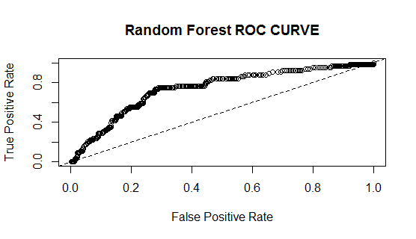
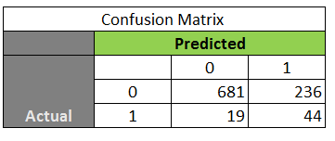
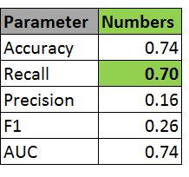
Random Forest model performance in Test Data
With specificity or recall at 70% this is a good model to have. But we are making to many predictions and overall accuracy is down.

Slide 18
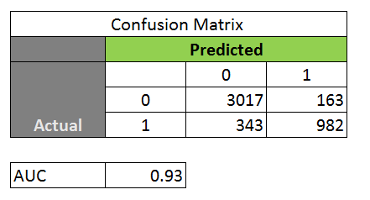
Model No. 3 GBM
Performance on Training data
Formula :
Variable Name | Scaled –Importance
Revolving Utilization of unsecured lines | 1
No. of open credit lines and loans | 0.93
Debt Ratio | 0.12

Slide 19
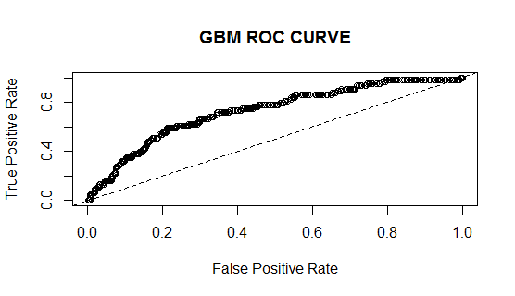
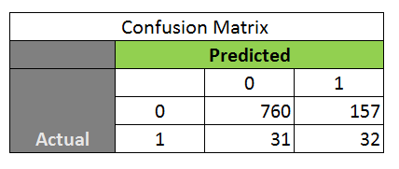
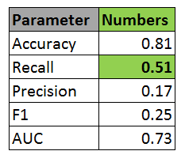
GBM model performance in Test Data
With specificity or recall at 51% this is not a good model to have.

Slide 20
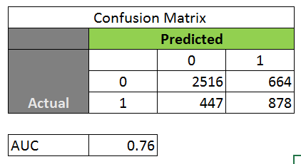
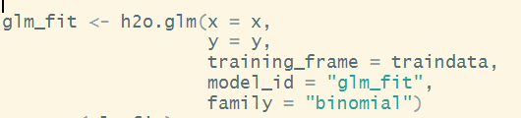
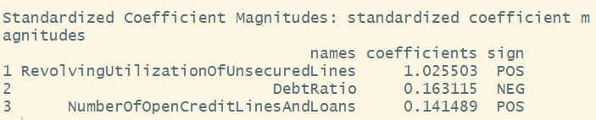
Model No. 4 GLM – Making linear model can help in inference about the variables.
Performance on Training data
Formula :

Slide 21
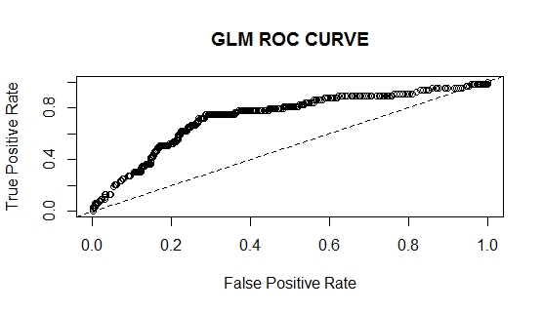
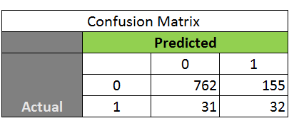
GLM model performance in Test Data
With specificity or recall at 51% this is not a good model to have.

Slide 22
Evaluation of model performance
Loan Default Prediction (Classification problem)

Slide 23
Comparative Model performance on test data
Logistic regression
 | 0 | 1
0 | 762 | 155
1 | 31 | 32
Random Forest
 | 0 | 1
0 | 681 | 236
1 | 19 | 44
Gradient Boosting
 | 0 | 1
0 | 760 | 157
1 | 31 | 32
Decision Tree
 | 0 | 1
0 | 778 | 139
1 | 39 | 24
MODEL COMPARISON
Parameter | Logistic regression | Random Forest | Gradient Boosting | Decision Tree
Accuracy | 0.81 | 0.74 | 0.81 | 0.82
Recall | 0.51 | 0.70 | 0.51 | 0.38
Precision | 0.17 | 0.16 | 0.17 | 0.15
F1 | 0.25 | 0.26 | 0.25 | 0.21
AUC | 0.73 | 0.74 | 0.73 | 0.68
The best Recall/TPR was achieved using Random Forest

Slide 24
Appendix R files (Attached)

