Slide 1
Machine Learning at Central Bank
Chiranjit Chakraborty
Date 13th November, 2016
* The views expressed in this presentation are those of the author(s), and not necessarily those of the Bank of England or its committees

Slide 2
Who we are
Advanced Analytics (AA) are at the forefront of helping the Bank of England make creative use of data analytics to promote the public good by:
1. Developing new Bank-wide data analysis capabilities
2. Applying advanced analytical techniques
3. Enhancing the data and expertise at the disposal of the Bank and the public

Slide 3
Why Machine Learning
“Machine learning explores the study and construction of algorithms that can learn from and make predictions on data. Such algorithms operate by building a model from example inputs in order to make data-driven predictions or decisions, rather than following strictly static program instructions.” - Wikipedia
Exponential growth of data, more granular regulatory data availability
Substantial advances in processing capacities, algorithm design and a wide proliferation of skills
Opening of new dimensions to all kinds of analyses, including macro, finance and policy

Slide 4

Prediction and Causal Inference
Following Kleinberg et al. (AEA Proceedings, 2015), imagine the payoff π(X,Y) with in/dependent variables X/Y, respectively.
Decisions on X depend on the total derivative
The second term requires causal inference, while the first a prediction of Y.

Slide 5
The Machine Learning Recipe
0) Problem & Idea
1) Data (big or small): collection & cleaning, feature selection.
2) Learning hypothesis: decision trees, neural networks, random forests, support vector machines, ...
3) Optimisation Algorithm: gradient descent, genetic algorithms, simulated annealing, ...
4) Model testing: cross-validation, regularisation, bagging, boosting, feature re-selection, ...
5) Out-of-sample testing
6) Inference
Steps 1-5 constitute your learning system.

Slide 6
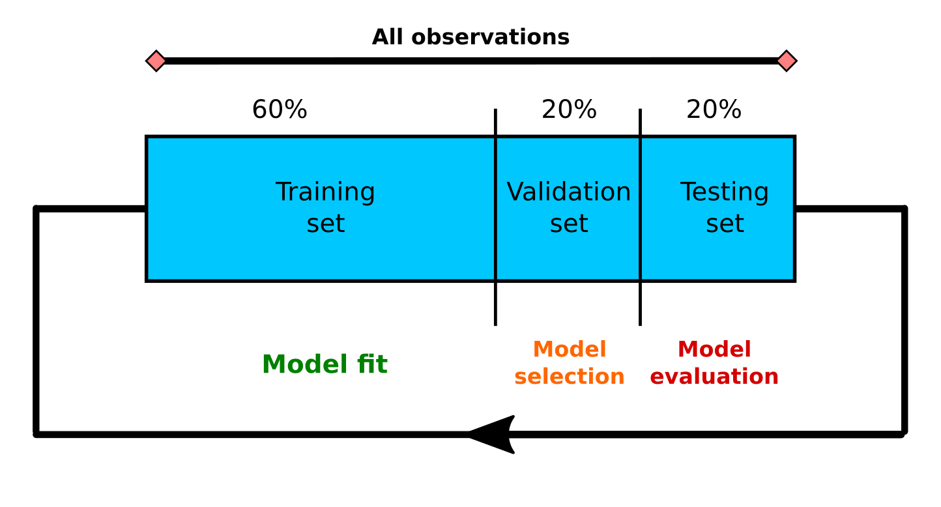
Data Split-up and the Modelling Cycle

Slide 7
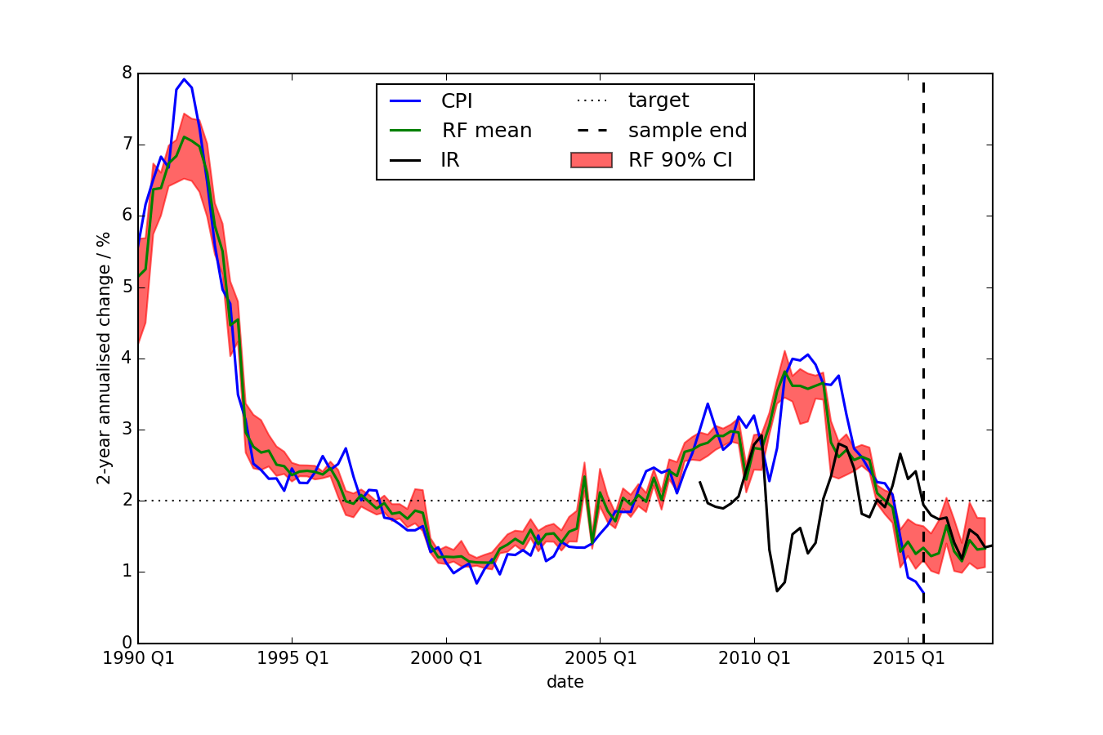
Model Nowcasting performance

Slide 8
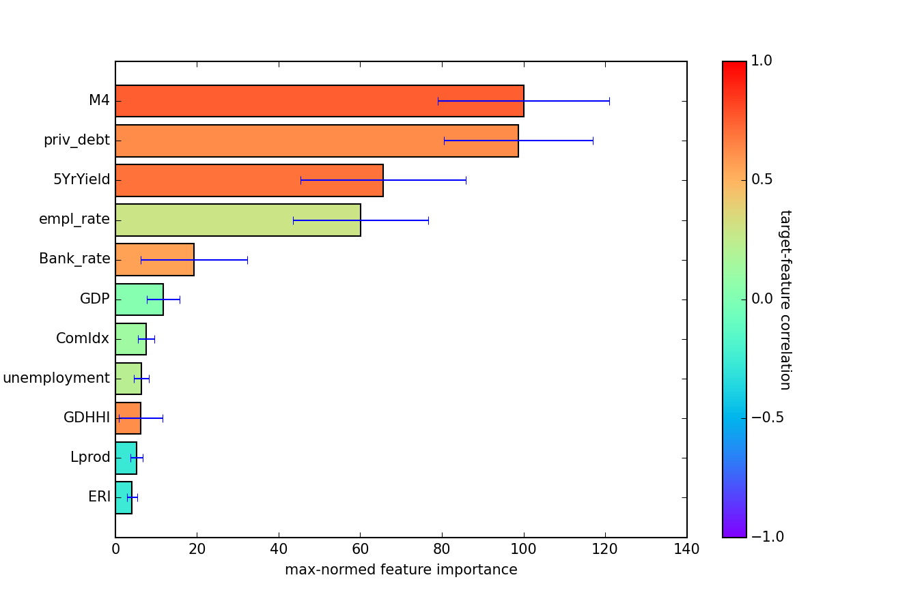
Feature Importance

Slide 9
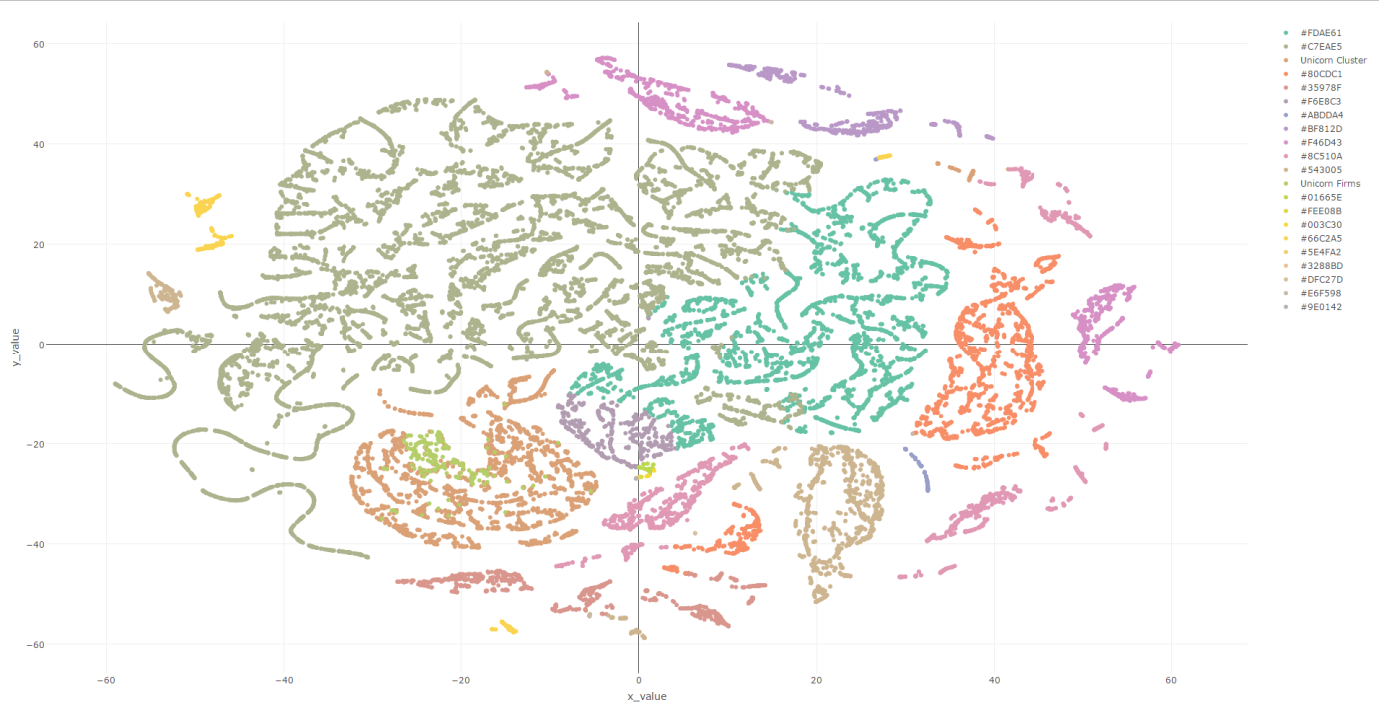
FinTech Unicorn detection - CrunchBase analyses
Identify firms of interest in order to assess them for risks to monetary and financial stability
Unicorn Firms

Slide 10
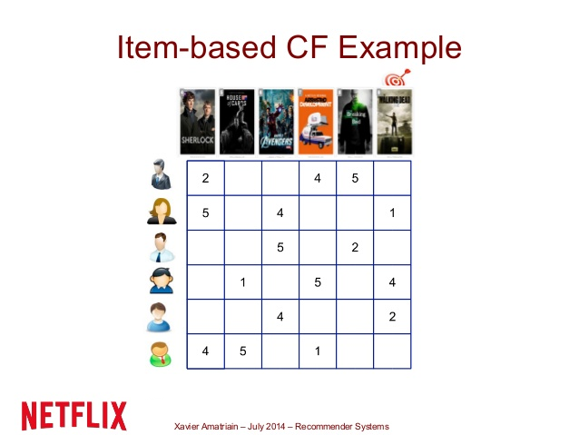
Output
We have short-listed 700 new firms out of which there are around 60 Financial Technology firms
Used the technique inspired by Recommendation system

Slide 11
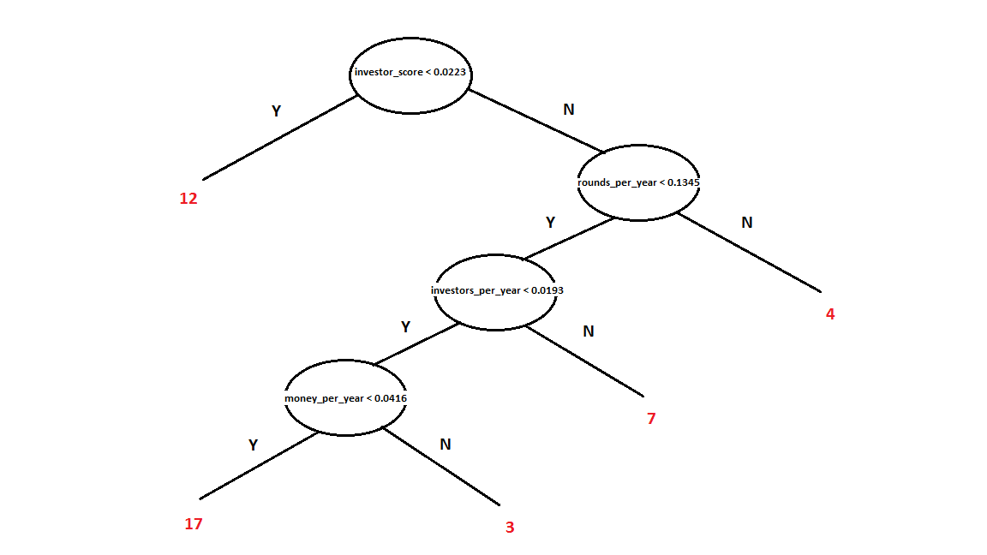
Unicorns tend to raise more money in fewer rounds
Out of Sample performance | Predicted Unicorn cluster | Predicted not Unicorn Cluster
Unicorn Cluster | 1044 | 5 | Recall = 99.5%
Not Unicorn Cluster | 6 | 10431
 | Precision = 99.4% |  | Accuracy = 99.9%

Slide 12
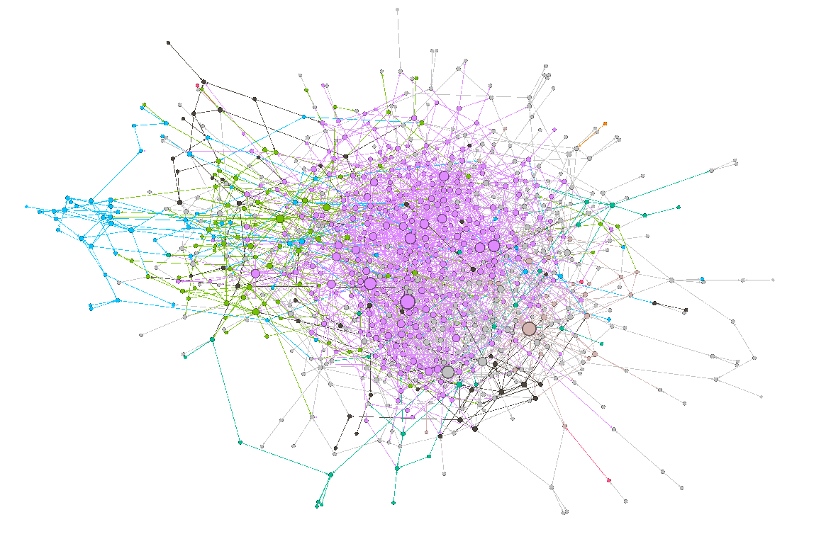
Investor-firm pair network diagram
Big Investors are looking well connected and part of the same community
Potential future unicorn firms are present in the same community with big investors

Slide 13
Conclusion – Future Direction
How the predictive power of machine learning algorithms can be better utilised without compromising model interpretability?
How the machine learning based approaches are compared with existing forecasting models used for policy decisions?
Can we use more sophisticated algorithms to understand FinTech evolution more quantitatively combining more granular data ?

Slide 14

Thank You !!

