Slide 1
Introduction:
Pod Failure Prediction using Machine Learning
- Objective: Predict potential pod failures using machine learning techniques.
- Approach: Use historical data to train a binary classification model.
- Tools Used: Python, TensorFlow, Pandas, Scikit-Learn.

Slide 2
Data Loading and Preprocessing
- Load data using `pandas.read_csv()`.
- Convert time columns from string format to numerical values (seconds).
- Handle missing values and ensure data consistency.

Slide 3
Feature and Target Selection
- Feature Columns: Numerical columns excluding categorical and target variables.
- Target Columns: Failure indicators (e.g., `Pod_Status_Failure`, `Resource_Failure`).
- Combined Target: `Any_Failure` column indicating whether any failure occurred.

Slide 4
Model Architecture
- Input Layer: Dimension based on feature count.
- Hidden Layers: 128 and 64 neurons with ReLU activation.
- Dropout Layers: 30% to prevent overfitting.
- Output Layer: Single neuron with sigmoid activation.
- Loss Function: Binary cross-entropy.
- Optimizer: Adam.

Slide 5
Model Training and Evaluation
- Training: Early stopping with patience of 5 epochs.
- Validation Split: 20% of training data used for validation.
- Metrics: Accuracy and Validation Loss.
- Save Model: Saved as `model.h5` and scaler as `scaler.pkl`.

Slide 6
Prediction and Conclusion
- Forecast failures for sample pods using historical data.
- Model predicts future failures with probabilities.
- Conclusion: Effective ML pipeline for proactive failure detection.
- Future Work: Improve prediction accuracy with additional features and hyperparameter tuning.

Slide 7
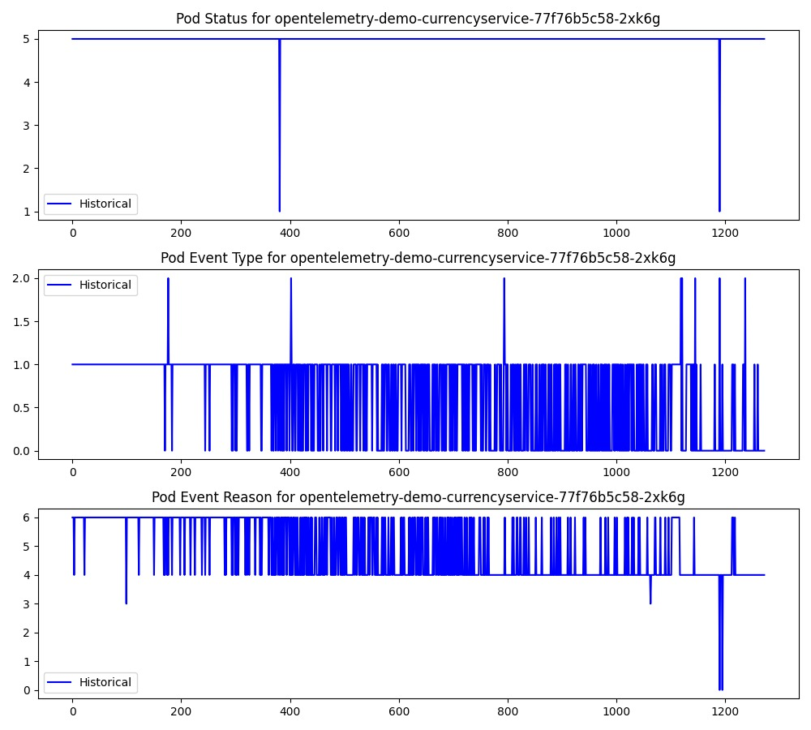
Results:

Slide 8
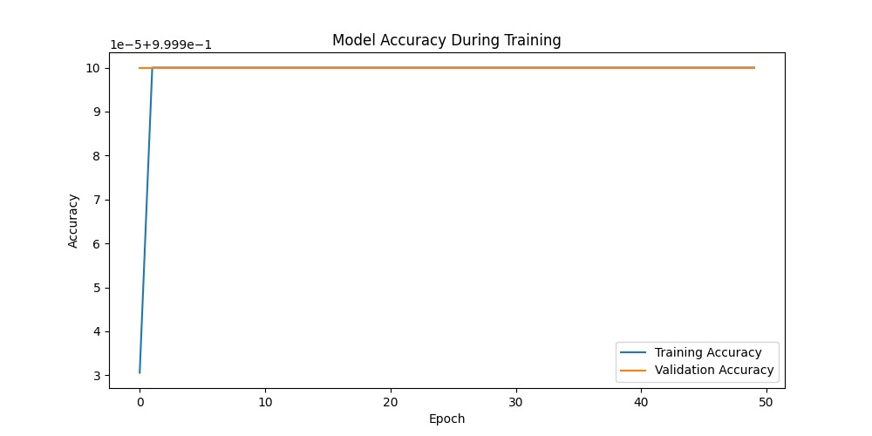
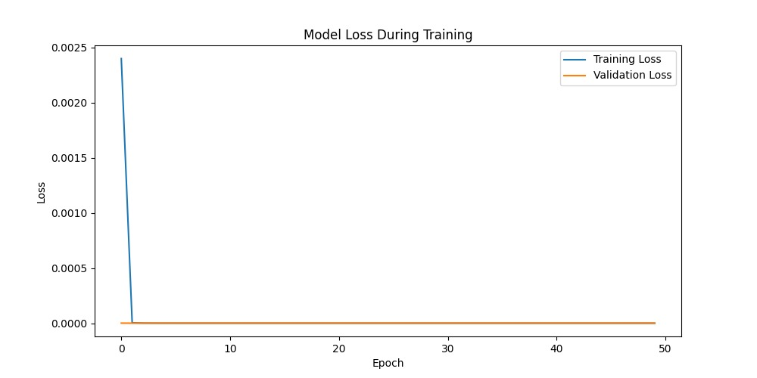
Results:

