Slide 1
DATA SCIENCE AND ARTIFICIAL INTELLIGENCE | PROJECT
HEALTHCARE DATA ANALYSIS
AND DISEASE RISK PREDICTION
Alzheimer’s disease classification using clinical and lifestyle data
Submitted by: [Team member names]
Under the guidance of: [Guide name]
Department of Information Technology • NITK

Slide 2
Project overview
A data-driven approach to exploring disease-related patterns
What we study
What we build
Case study
Healthcare records contain clinical, cognitive, demographic and lifestyle information.
An analysis pipeline that explores the data and compares machine-learning classifiers.
The supplied dataset and notebook focus on classifying Alzheimer’s diagnosis records.
Important scope note: this is an educational data-analysis project. The model estimates patterns in a dataset; it is not a medical diagnostic tool.
2

Slide 3
Problem statement and objectives
THE CHALLENGE
PROJECT OBJECTIVES
Healthcare datasets are multidimensional. It can be difficult to identify useful patterns, understand feature relationships and compare prediction models consistently.
•
Explore the dataset and its diagnosis labels.
•
Check data quality and summarize key variables.
•
Study relationships between features and diagnosis.
•
Train and compare classification algorithms.
•
Evaluate results and communicate limitations.
3

Slide 4
Dataset at a glance
Based on the uploaded alzheimers_disease_data.csv file
2,149
35
32
0
patient records
columns in source file
model input features
missing values / duplicate rows
Target variable: Diagnosis | 0 = No Alzheimer’s • 1 = Alzheimer’s
The source file contains 35 columns, including PatientID and DoctorInCharge. These two identifier fields are excluded from model inputs; Diagnosis is used as the target.
4

Slide 5
What information does the dataset contain?
Feature groups represented in the 32 model inputs
Demographic
Lifestyle
Age, Gender, Ethnicity, EducationLevel
BMI, Smoking, AlcoholConsumption, PhysicalActivity, DietQuality, SleepQuality
Medical history
Clinical measurements
FamilyHistoryAlzheimers, CardiovascularDisease, Diabetes, Depression, HeadInjury, Hypertension
Blood pressure and cholesterol measures
Cognitive / functional
MMSE, FunctionalAssessment, ADL and memory / behaviour indicators
5

Slide 6
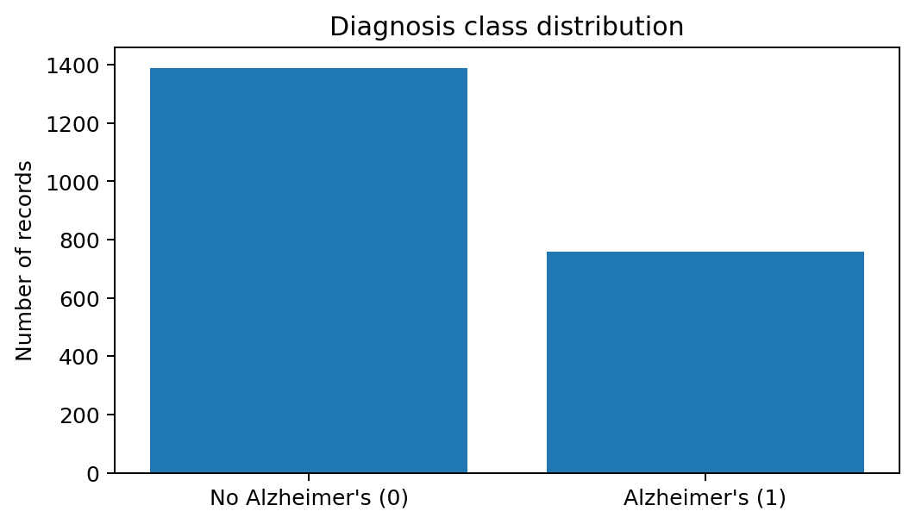
Diagnosis distribution
Class labels in the supplied dataset
1,389
No Alzheimer’s records (64.6%)
760
Alzheimer’s records (35.4%)
The classes are not evenly distributed, so stratified splitting is used to preserve their proportions.
6

Slide 7
Data preparation and exploratory analysis
Data quality
Feature handling
Scaling
Missing values: 0
Duplicate rows: 0
No imputation was required for this file.
PatientID and DoctorInCharge are excluded. Diagnosis is separated as the target.
StandardScaler is applied within the SVM and KNN pipelines.
Selected descriptive statistics
Age
Mean: 74.91 | Range: 60–90
BMI
Mean: 27.66 | Range: 15.01–39.99
MMSE
Mean: 14.76 | Range: 0.01–29.99
7

Slide 8
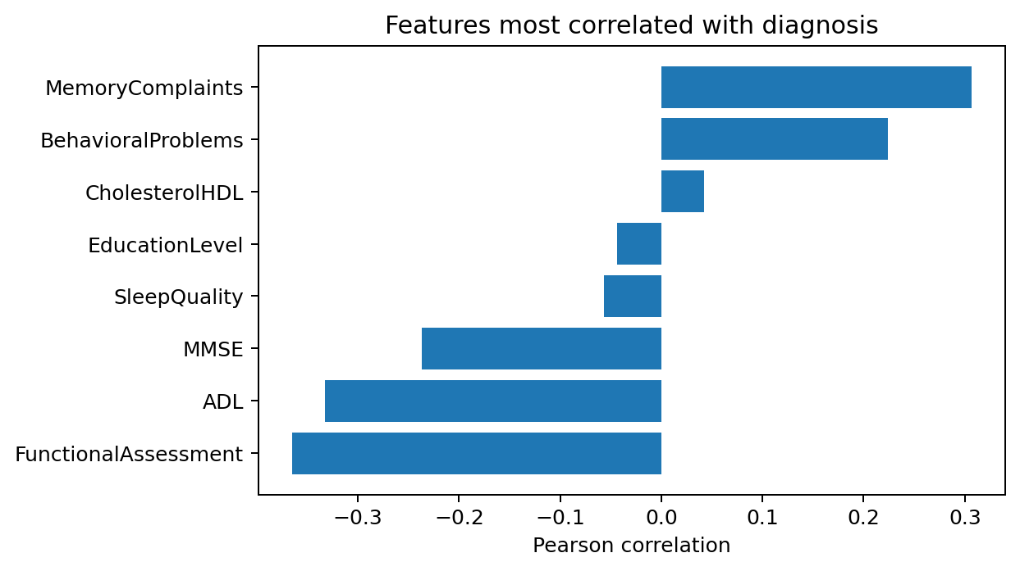
Exploring feature relationships
Pearson correlation with the Diagnosis label
Strongest observed associations
•
FunctionalAssessment: −0.365
•
ADL: −0.332
•
MemoryComplaints: +0.307
•
MMSE: −0.238
•
BehavioralProblems: +0.224
Correlation does not imply causation.
8

Slide 9
Proposed methodology
End-to-end workflow implemented in the notebook
Load CSV
›
Inspect & clean
›
Explore & correlate
›
Split data
›
Train models
›
Evaluate
›
Interpret
Train/test split: 80% training (1,719 records) and 20% testing (430 records), using stratification and random_state = 42.
9

Slide 10
Machine-learning models compared
Five classifiers evaluated using the same train/test split
SVM
K-Nearest Neighbours
RBF kernel; StandardScaler; calibrated probabilities
k = 7; StandardScaler
Decision Tree
Random Forest
Maximum depth = 6
300 decision trees
Gradient Boosting
Sequential boosting of decision trees
10

Slide 11
Model evaluation results
Test-set metrics from the supplied notebook workflow
Model | Accuracy | Precision | Recall | F1 | ROC-AUC
Random Forest | 0.949 | 0.945 | 0.908 | 0.926 | 0.940
Gradient Boosting | 0.947 | 0.927 | 0.921 | 0.924 | 0.946
Decision Tree | 0.928 | 0.895 | 0.901 | 0.898 | 0.912
SVM | 0.835 | 0.772 | 0.757 | 0.764 | 0.896
KNN | 0.709 | 0.645 | 0.395 | 0.490 | 0.765
Random Forest has the highest accuracy (0.949) and F1-score (0.926). Gradient Boosting has the highest ROC-AUC (0.946) and recall (0.921).
11

Slide 12
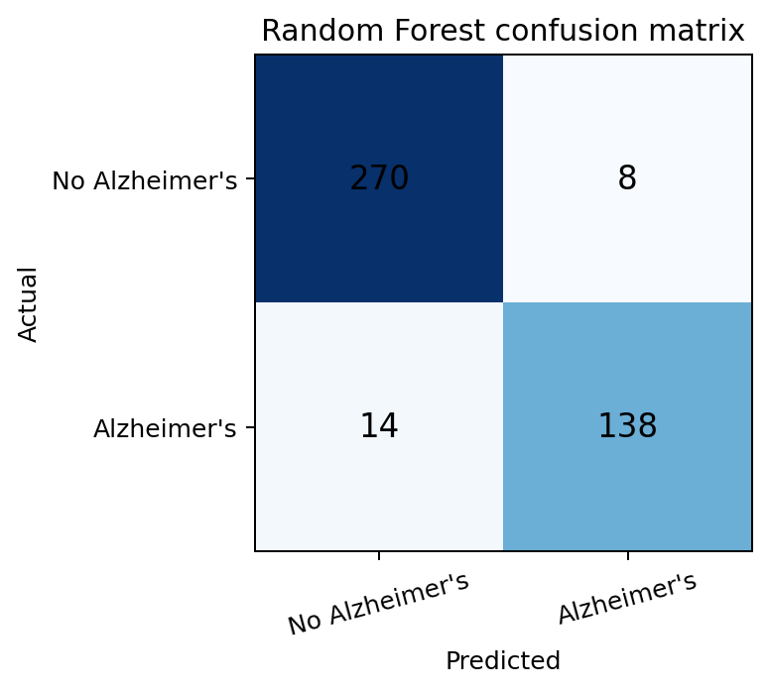
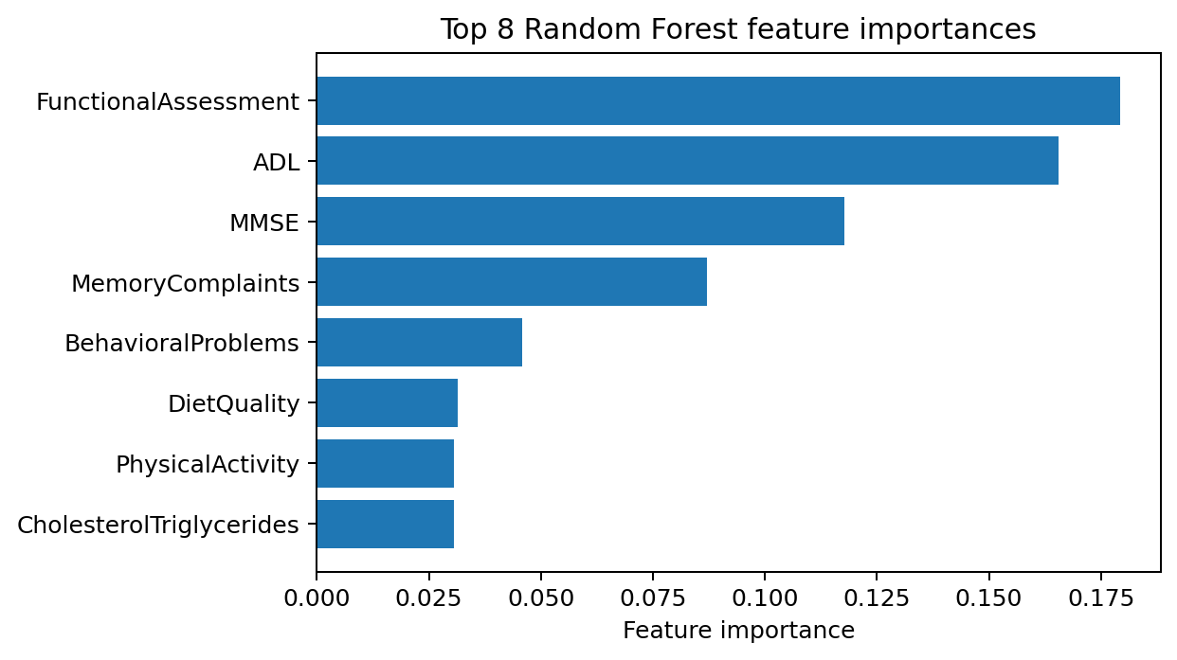
Understanding the strongest model
Random Forest test results and feature importance
Random Forest confusion matrix: TN 270 | FP 8 | FN 14 | TP 138
12

Slide 13
Results: interpretation and limitations
•
Random Forest and Gradient Boosting perform strongly on this held-out test set.
•
FunctionalAssessment, ADL, MMSE and MemoryComplaints rank highly in the Random Forest feature-importance output.
•
The dataset is a single supplied tabular dataset; performance may not generalize to other populations or settings.
•
Associations and model importance are not evidence of cause or clinical validity.
•
Further validation on independent, representative clinical data would be required before any real-world use.
13

Slide 14
Responsible use of healthcare data
Privacy
Fairness
Human oversight
Avoid exposing patient identifiers or sensitive records. Use only authorized, appropriately de-identified data.
Check whether performance differs across demographic groups; avoid assuming one model works equally for everyone.
Predictions must not replace clinical assessment, professional judgement or confirmatory testing.
This project is intended for learning and preliminary pattern analysis only — not for diagnosis, treatment decisions or individual medical advice.
14

Slide 15
CONCLUSION
•
The project analyzes 2,149 records using 32 model input features.
•
Five classification methods were compared on a stratified 80:20 split.
•
Random Forest achieved 94.9% accuracy; Gradient Boosting achieved 0.946 ROC-AUC.
•
The results demonstrate how data analysis and machine learning can identify patterns in healthcare datasets.
Future scope
External validation • fairness analysis • explainable AI • larger and more diverse datasets • clinician-supervised research

Slide 16
THANK YOU
Questions?
Healthcare Data Analysis and Disease Risk Prediction

