Slide 1
Application of Agile Autonomous Robots with Object Recognition
1

Slide 2
Miniature Robots
Sensor Networks
Increases system reliability
Autonomy
Mass-produced & inexpensive
2

Slide 3
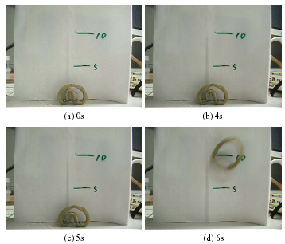
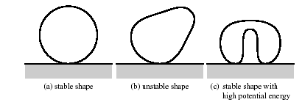
Robot Agility - Deformation
Self-deformation
Storage of potential energy
Use of SMA wires
3

Slide 4
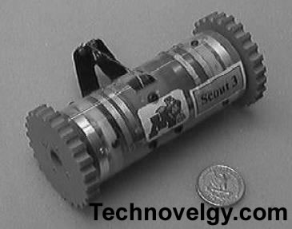
Robot Agility – Scout Bot
115mm in length and 40 mm in diameter
Foot winching
4

Slide 5
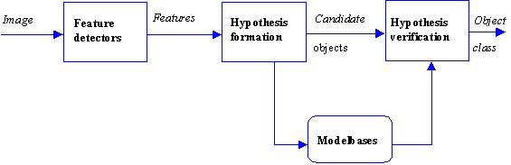
Object Recognition
Model Representation
Feature Extraction
Model Matching
Hypothesis Formation
Object verification
5

Slide 6
Sensor Network
Lack of processing capabilities
Lack of reliable communication links
Compensation with visual feedback
Video transmission
Remote processing computer
Minimum operator interaction
6

Slide 7
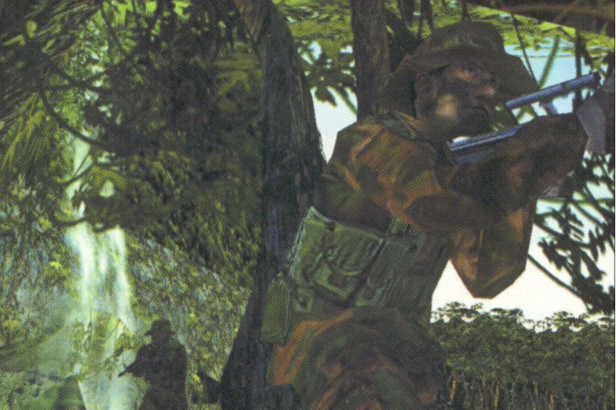

Application of a Miniature Robot
7

Slide 8
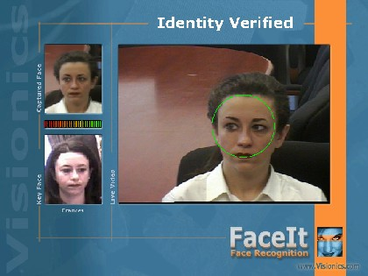
Facial Recognition Systems
8

Slide 9

Object Recognition
Training with multiple 2D views
Using a multi-scale algorithm, the object recognition software stores the images in a model base and uses them to detect the object in any other image.
9

Slide 10
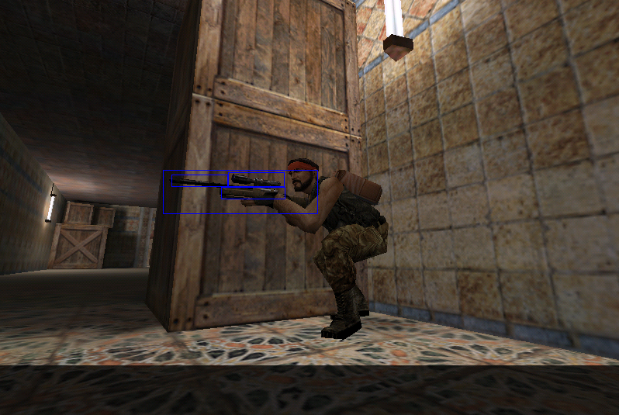
Application
Autonomous Object Recognition
10

Slide 11
Conclusion
Miniature robots are ideal for detecting and transmitting data for covert operations due to their agility and small size.
With a video transmitter, a degree of autonomy is achieved and if the network consisted of a large number of such robots, randomly scanning the area, then a large amount of useful information can be quickly analyzed and sent to the control centre enabling them to assist the law-enforcement officers to perform their jobs more efficiently.
Since these robots are mass-produced and inexpensive, this paper also proposes an economically feasible method to assist these agencies.
11

