Slide 1
Face Morphing
CSE 399 :: Project 2
Mithun Jacob
Snehit Neenakri

Slide 2
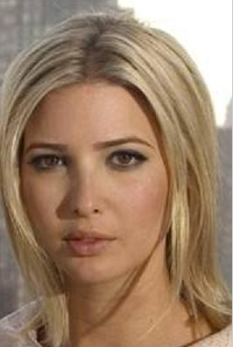
Face Morphing: Triangulation

Slide 3
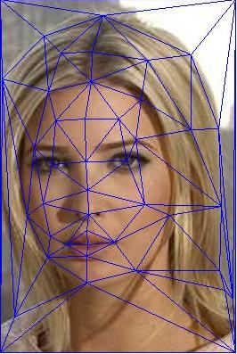
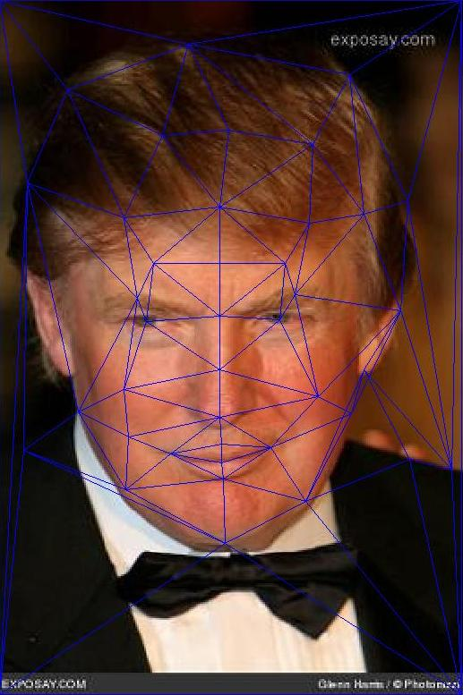
Step 1: Delaunay Triangulation
44 control points => 7s per frame

Slide 4
Step 2: Determine which triangle each pixel falls in
foo=[];
for i=1:nIm(1)
foo=[foo;i*ones(nIm(2),1)];
end
T=tsearch(INTER_SHAPE(:,2),INTER_SHAPE(:,1),tri,repmat( (1:nIm(2))',nIm(1),1),foo);
%Finding the inverse of the triangle coordinates for all the triangles
nTRI=size(tri,1);
for i=1:nTRI
abc=INTER_SHAPE(tri(i,:),:);
INV_TRI(:,:,i)=inv([ abc(:,1)' ; abc(:,2)' ; 1 1 1 ]);
end

Slide 5
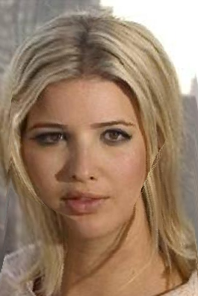
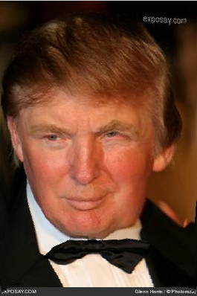
Step 3: Image Warping & Splatting
+
=

Slide 6
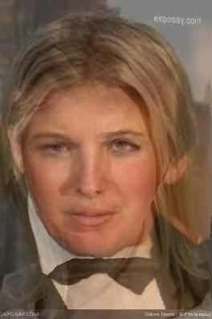
Step 4: Cross-dissolve

Slide 7


And one more..

Slide 8
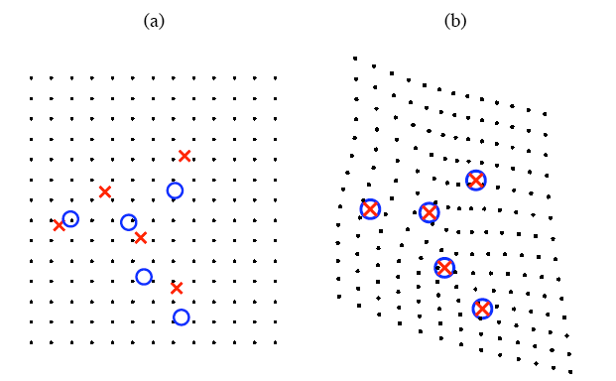
Thin Plate Spline Technique
Thin-plate Spline is a conventional tool for surface interpolation over scattered data. It is an interpolation method that finds a "minimally bended" smooth surface that passes through all given points.
The name "Thin Plate" comes from the fact that a TPS more or less simulates how a thin metal plate would behave if it was forced through the same control points.
In the adjacent figure if blue circles denote source control points and the red marks denote the target control points then the figure (b) gives the warped image of the source to the target such that the points are overlapping.

Slide 9

Thin Plate Spline Model
(primary general equation)

Slide 10
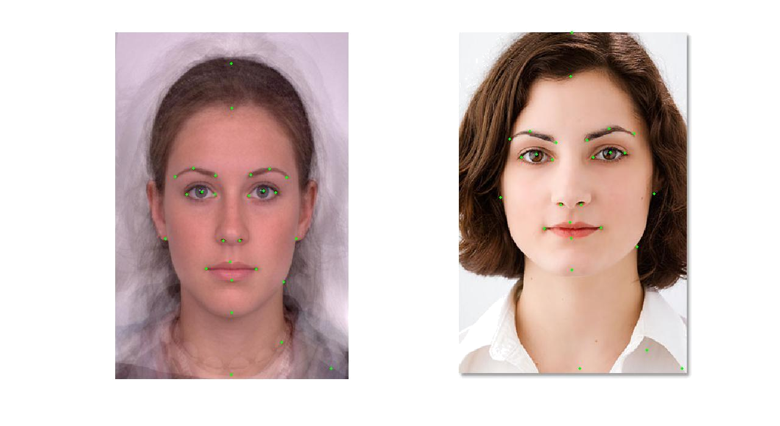
Control Points source target

Slide 11
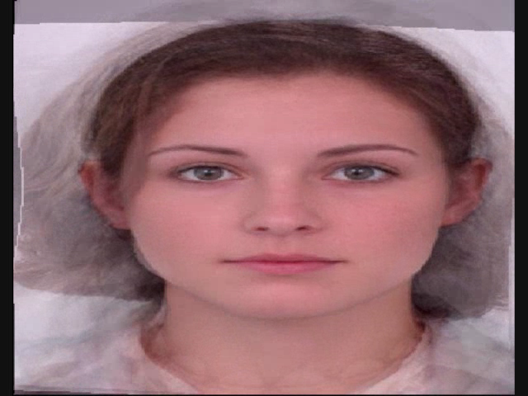
50%

Slide 12
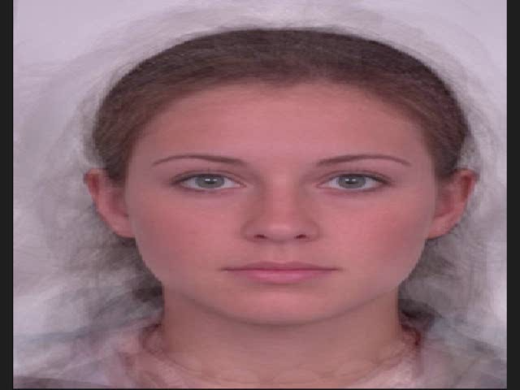

Slide 13
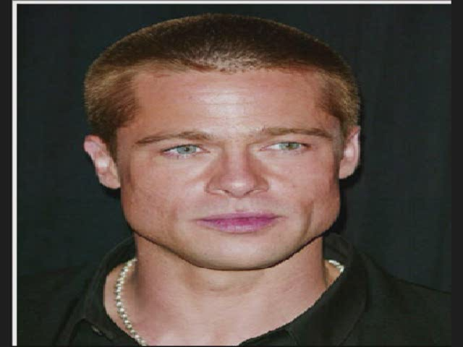
On Popular Demand

Slide 14
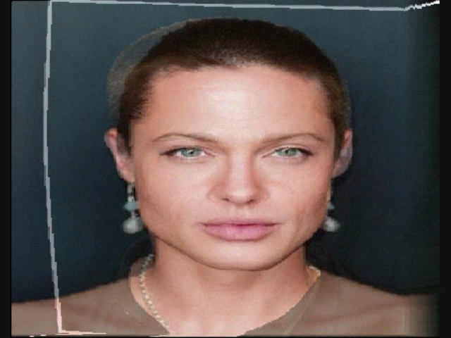
50%

