Slide 1
Vision-based
Quality Inspection of Bottles
Mithun George Jacob
Internal Guide:
Mr. V. G. Sridhar
External Guide:
Mr. Jacob George
Factory Manager
Rawdatain Water Bottling Co.

Slide 2
Introduction
Vision based solutions offer several advantages over conventional quality inspection systems due to their flexibility and convertibility and is generally a low cost solution.
Several applications of machine vision have been discovered and utilized such as quality inspection, object recognition and object tracking.
The solution discussed here concerns itself with quality inspection.

Slide 3
Introduction
Due to the nature of the machine and the fact that the operator has to be away from the machine to perform other tasks related to production, it is possible that at random intervals bottle's could be missing in the tray.
This will be a serious quality issue once the customer finds a tray with partially missing contents.

Slide 4
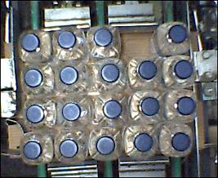
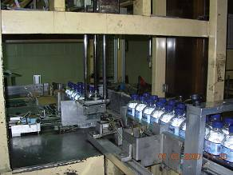
Introduction
Figure: (1) 0.5L Packing Line (2) Sample Defective Carton
(Overhead View)

Slide 5
Introduction
Several industries employ the use of photoelectric sensors, load cells or dual fiber-optic sensors [1] to count and inspect bottles exiting the production line. The disadvantage of using such methods is the high cost incurred and the lack of flexibility.
Hence, a vision-based solution is designed for increased flexibility as well as low cost. It employs an image acquisition device, a PC, and a set of image processing algorithms to process the acquired image. The challenge of designing a vision-based solution for this application lies in the high amounts of specular reflection present in the image due to water present in the bottle which hinders effective segmentation. Therefore, this calls for a novel approach to be used in this solution.

Slide 6
Literature Review
Thresholding operations have been used extensively to separate out regions of the image corresponding to the objects of the interest by analyzing the intensity histogram of the image [2].
Convolution masks designed to remove superfluous data like random noise have proved to be extremely useful in image preprocessing [3].
Gaussian smoothing operators can be used to effectively blur images in for noise reduction [4].

Slide 7
Literature Review
Thresholding operations have been used extensively to separate out regions of the image corresponding to the objects of the interest by analyzing the intensity histogram of the image [2].
Convolution masks designed to remove superfluous data like random noise have proved to be extremely useful in image preprocessing [3].
Gaussian smoothing operators can be used to effectively blur images in for noise reduction [4].

Slide 8
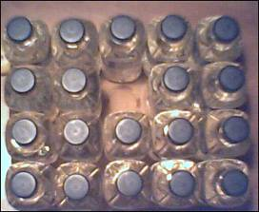
Experimental Setup
An experimental setup was constructed in order to identify the most suitable algorithm to be applied to the acquired image.

Slide 9
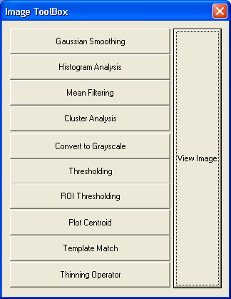

Experimental Setup
In order to test the effectiveness of various algorithms, an image processing toolbox (IPT) was created using Microsoft Visual C++ 6.0. Using this toolbox, it was possible to plot intensity histogram graphs, apply algorithms and observe output images, and record time taken to process images.

Slide 10
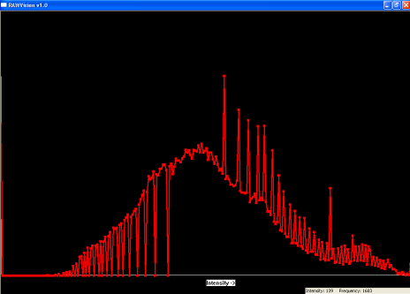
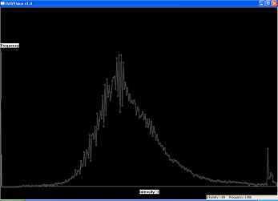
Experimental Setup
Using the IPT, the intensity histogram of several images were obtained and analyzed and suitable intensity thresholds were determined by observing the nature of peaks of the histogram.

Slide 11
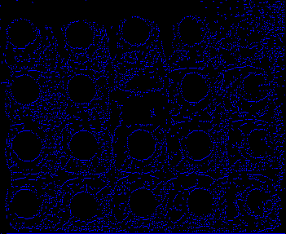
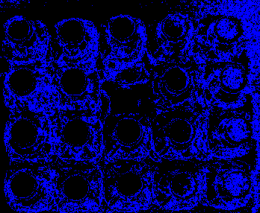
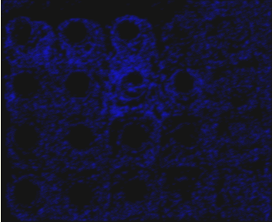
Experimental Setup
Various algorithms were tested such as utilizing a convolution mask to separate the bottle caps from the background.
Most of the attempts did not yield fruitful results.
Some of the initial outputs are displayed below.
Figure: (1)Thinning Mask (2)Thresholding (3)Gaussian Smoothing

Slide 12
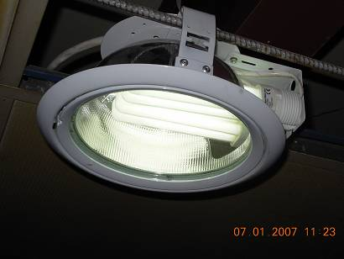
Construction
Different types of lighting were reviewed and it was found that the best type of lighting for this application is diffuse front illumination which can be obtained from a fluorescent tube with dome lighting

Slide 13
Construction
In order to position the camera in an ideal position to acquire images, a camera mount was designed and fabricated. The mount was designed so it could be easily fitted overhead the carton without interfering in any way with the packing operation. Adequate lighting (diffused and domed) was also installed without any interference
The camera mount was designed to allow minor adjustments to be easily made. As shown in the following slide, by adjusting the position of the nuts, it is possible to move the camera horizontally, and vertically as desired. It is also possible to send the angle of orientation of the lens by turning the bolt.
This flexible setup enabled easy installation of the camera and also ensured that the camera position remained constant regardless of machine vibrations.
The base plate was fabricated by welding two 50mm flat bars. The position of the holes have been calculated to ensure that the camera lens is directly overhead the center of the carton.

Slide 14
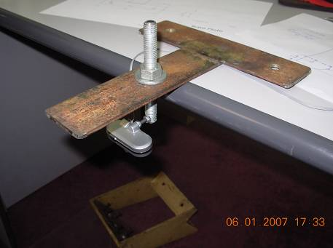
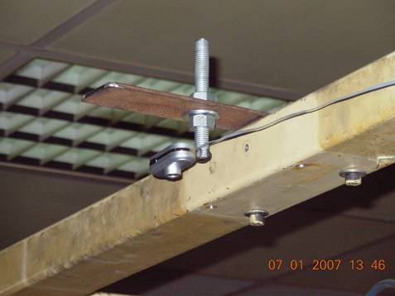
Construction

Slide 15
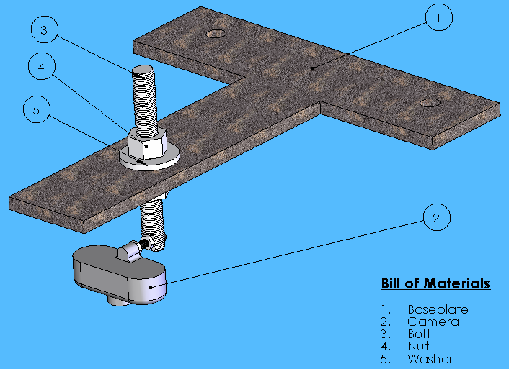
Construction

Slide 16
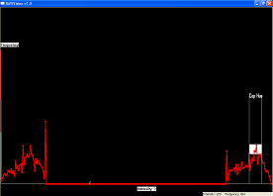
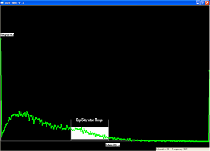
Developed Algorithm
Instead of approaching the problem with the RGB color model, an HSV color model was utilized.
Upon analyzing the following Hue and Saturation Intensity Histograms it is apparent that peaking regions marked below, correspond to values in the region of the bottle caps.

Slide 17
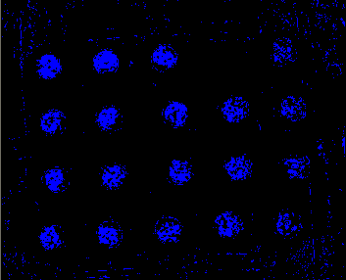
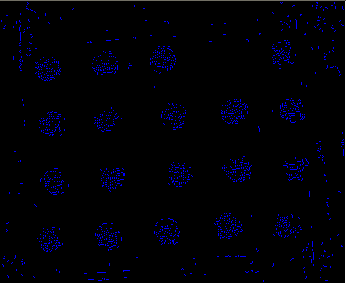
Developed Algorithm
Using a rough range of the threshold values obtained from the histogram, the image was thresholded to obtain the following image.
Then to reduce the amount of noise present in the image, it was thinned to remove solitary, unconnected pixels.

Slide 18

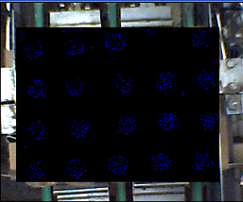
Developed Algorithm
Since there is an appreciable amount of noise in the surrounding area, a region of interest (ROI) was defined to reduce the overall noise in the image.

Slide 19
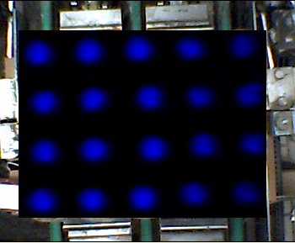
Developed Algorithm
Even though the amount of noise has been greatly reduced the output image still contains a sizeable amount of noise and more importantly is fragmented.
To increase the cohesivity of connected pixels and to identify the bottle caps and discern them from noise, the entire image was subjected to a mean filter which “blurred” the image into the following output image:

Slide 20
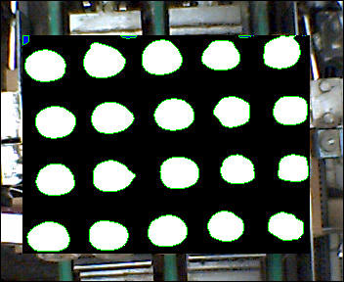
Developed Algorithm
Once the distinct BLOBS (Bnary Large OBjectS) were a identified, a contour extraction algorithm is implemented to extract the individual minimum enclosing rectangle of each blob.
By thresholding the area of each blob within the minimum enclosing rectangle it is possible to identify which blobs represent bottle caps and which is noise.

Slide 21
Conclusion
Hence, the number of bottle caps in the region of interest is counted and the total number of bottles in the image is thus ascertained.
The developed algorithm is extremely fast and can process an image on a Pentium IV in approximately 0.29 seconds been implemented and is running smoothly. Since such speed is not required an older system (Penitum II) was used where the image is processed in 2.03 seconds.
The next slide will demonstrate the robustness of this system with a video.

Slide 22
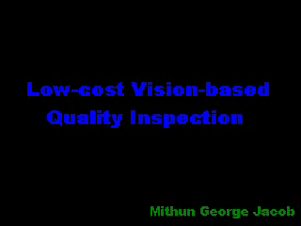

Slide 23
References
Omron Electronics LLC: Inspection Solutions for the Food & Beverage Industry, Y021-E-02, 10/04/7.5M, Omron Electronics LLC, 2004.
D. Vernon: Machine Vision, Prentice-Hall, 1991, pp 49 – 51, 86 – 89
R. Gonzalez and R. Woods: Digital Image Processing, Addison-Wesley Publishing Company, 1992, pp 414 – 428
E. Davies: Machine Vision: Theory, Algorithms and Practicalities, Academic Press, 1990, pp 42 – 44
A. Jain: Fundamental of Digital Image Processing, Prentice-Hall, 1989, Chap. 9.
Melles Griot, Lighting Fundamentals, Machine Vision Guide, Melles Griot, 2003.

