Slide 1

EI – Creating Emotionally Intelligent Experiences

Slide 2
About
Founded in 1990 as TIS (Tata Interactive Systems, India)
The division was purchased by MPS Limited in 2018 to further its growth as a global learning leader. It was then established as a separate entity known as MPS Interactive Systems Limited.
The main passion is to change the way people learn – with innovative, engaging, and high-impact learning solutions.
As a learning experience design company, they partner with customers in their Digital Transformation journey, help them deliver high-impact Learning and Performance Support solutions.

Slide 3
What they do ?
Training Delivery - Reach Diverse Learners at Speed, Scale, and Efficiency through Training Delivery Strategies i.e., Mobile learning , Personalized learning and so on.
Immersive Learning - Imagine, Experience, Connect - Unlocking Immersive Learning as a Value Driven like AR , VR , video based , story-based learning etc.
Continuous Learning - Drive Org-wide Growth Strategies and Engagement by Building a Strong Learning Culture (social , informal learning)
Training Strategies - Customized Approaches to Address Diverse Corporate Training Needs i.e., product , soft skills training , induction and onboarding

Slide 4
L&D Advisory and Consulting - Ensuring Training Investments Drive Performance Gain and Maximize Training (content and curriculum design)
Learning Technologies - Creating Transformational Learning Experiences Powered by Learning Technology (Learning portals , interactive video frameworks)
Learning Platforms - Transform your learning ecosystems with our eLearning technology and platform solutions(QuizBiz, Learning Planet

Slide 5
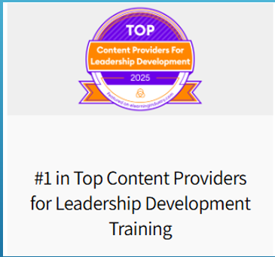
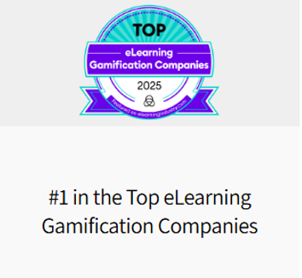
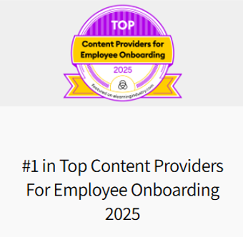
Awards

Slide 6
Technical Aspects observed !
Chat Bot(Olivia) – Fine tuned to explain about solutions and services.
Skills required –
Python
FAST APIs
Gradio/Streamlit
RAG
CrewAI
Fine Tuning
NLP
LangChain
HuggingFace Transformers

Slide 7
Observation
Optimization required -
As noticed, the bot is taking a time (> 30 sec) to respond to the user query. Reducing the latency and increasing the performance/responsiveness might there by help in solving the issue.
BUT HOW ?

Slide 8
Immersive Learning –
AR adds digital elements (like images, text, or 3D models) to your real-world view.
VR fully immerses you in a digital environment, cutting you off from the real world.
Core Skills –
Computer vision – object recognition and face tracking
3D Modelling
Tracking, Calibration and Registration
Simultaneous Localization and Mapping (SLAM) – to track surroundings

Slide 9
Thanks for your TIME

