Slide 1


DESIGN AND DEVELOPMENT OF A PROTECTION SYSTEM FOR RESCUE TEAM
BATCH -2
TEAM MEMBERS: PROJECT GUIDE:
1)ATHULYA A S (721219106007) Mr.S.MUKUNTHAN,M.Tech
2)MITHUN KUMAR N (721219106027) Assistant Professor
3)SUNDAR RAJ A (721219106052) Karpagam Institute of Technology
4)YASSHIKAA J (721219106062)

Slide 2
CONTENTS:
Abstract
Objective
Existing System
Proposed System
Literature Survey
Block Diagram
Modules in Detail
Results
Advantages
Future work
Conclusion
Reference

Slide 3
ABSTRACT:
Nowadays safety is a big challenge mainly for the rescue team.
The health of them is particularly threatened by the emission of toxic gases, lack of oxygen and other disasters.
In this project we have developed a continuous monitoring system that monitors the environmental parameters such as oxygen levels and toxic gases (methane, carbon dioxide and carbon monoxide).
It also measures the person’s heart rate. This system uses LoRa wireless technology. The parameters are continuously recorded by various sensors.
The values ​​of the sensors are continuously transmitted by radio transmitter to the remote monitoring unit placed outside the accident region and received by the receiving module (PC).
The received data is viewed through the LCD and is further uploaded to the cloud.

Slide 4
OBJECTIVE:
The objective of a smart suit for a rescue team is to enhance the safety, efficiency, and effectiveness of the rescue personnel, enabling them to respond to emergencies more effectively and potentially save lives.
To ensure safety and protection of rescue teams from hazards.
To continuously monitor the vital signs of rescue team members, including heart rate, respiration rate, and body temperature.
To monitor environmental conditions such as temperature, air quality, or presence of hazardous gases. This information can help rescue personnel assess the situation and make informed decisions to ensure their safety.
To integrate GPS or other positioning technologies to track the location of rescue team members within a rescue site.
It enables real-time information sharing, coordination, and maintaining situational awareness within the team.

Slide 5
EXISTING SYSTEM:
C – Thru Helmet
Guardian XO – Exo Skeleton
Smart Helmet

Slide 6
PROPOSED SYSTEM:
A proposed system for smart suits for rescue teams with LoRa technology using the MQ9, MAX30102, HX710B, DHT11 sensors, GPS module, and an SOS system could be designed as follows:
1. LoRa Communication: The smart suits would be equipped with LoRa communication modules to establish a wireless network among the rescue team members. LoRa technology allows for long-range communication, making it suitable for remote rescue operations.
2. MQ9 Gas Sensor: The MQ9 sensor would be integrated into the smart suit to detect harmful gases, such as carbon monoxide and methane, which could pose a risk to the rescuers' safety. It would continuously monitor the gas levels and transmit the data to a central control unit.
3. MAX30102 Heart Rate and SpO2 Sensor: The MAX30102 sensor would be used to monitor the heart rate and blood oxygen saturation levels of the rescue team members. It would provide real-time data on their physical condition, helping to identify signs of fatigue or stress.
4. HX710B Load Cell Amplifier: The HX710B sensor would be utilized to measure the weight or load carried by the rescue team members. It could provide valuable information about their physical exertion and help prevent overexertion or injury.

Slide 7
5. DHT11 Temperature and Humidity Sensor: The DHT11 sensor would monitor the temperature and humidity levels in the surrounding environment. This information is crucial for assessing the rescue conditions and ensuring the comfort and well-being of the team members.
6. GPS Module: A GPS module would be integrated into the smart suit to track the location and movements of the rescue team members. This data would enable real-time monitoring of their positions and help coordinate their efforts effectively.
7. SOS System: An SOS system would be incorporated into the smart suit to provide a quick and reliable means of communication in case of emergencies. It could include a dedicated button or sensor that, when activated, sends an immediate distress signal to the central control unit or other team members.
8. Data Processing and Visualization: The collected sensor data would be processed and analyzed by a central control unit or a dedicated software system. The processed data could be displayed on a user interface, allowing the rescue team members and command center to monitor and interpret the information in real-time.
By integrating these components into a smart suit system, rescue teams would have access to real-time data about their environment, their own physical conditions, and the ability to communicate effectively using LoRa technology. This comprehensive information would enhance the situational awareness, safety, and coordination of the rescue operations.

Slide 8
LITERATURE SURVEY:
S.No | TITLE | AUTHOR | YEAR OF PUBLISH | MERITS | DEMERITS
1. | A Smart Wearable device for securing the life of Coal Miners | Digvijay Guleria1 , Goli Dheeraj2 , Gokani Sriram3 , Komal Chadha5 | 2022 | In this system health of coal mine is monitored | This system is not applicable for other rescue teams.
2. | Smart wearables for fall detection | Xiaoqing chai, Renjie wu, Mathew pike, Hangchao Jin | 2021 | This system is used for fall detection for fire fighters. | This system is not applicable for other rescue teams.
3. | Smart monitoring using LoRa | T. Porselvi, Sai ganesh C.S. , Janaki.B, Priyadhaarshini.K, Sajitha begam | 2021 | This focusses mainly on monitoring coal mines. | This system is not applicable for other rescue teams.
4. | Intelligent helmet system | Akshunya Mishra, Saksham Malhotra, Ruchira, Pallavi choudekhar | 2018 | In this system health of coal mine is monitored. | Various systems like fall detection, pulse and oxygen system is absent.

Slide 9
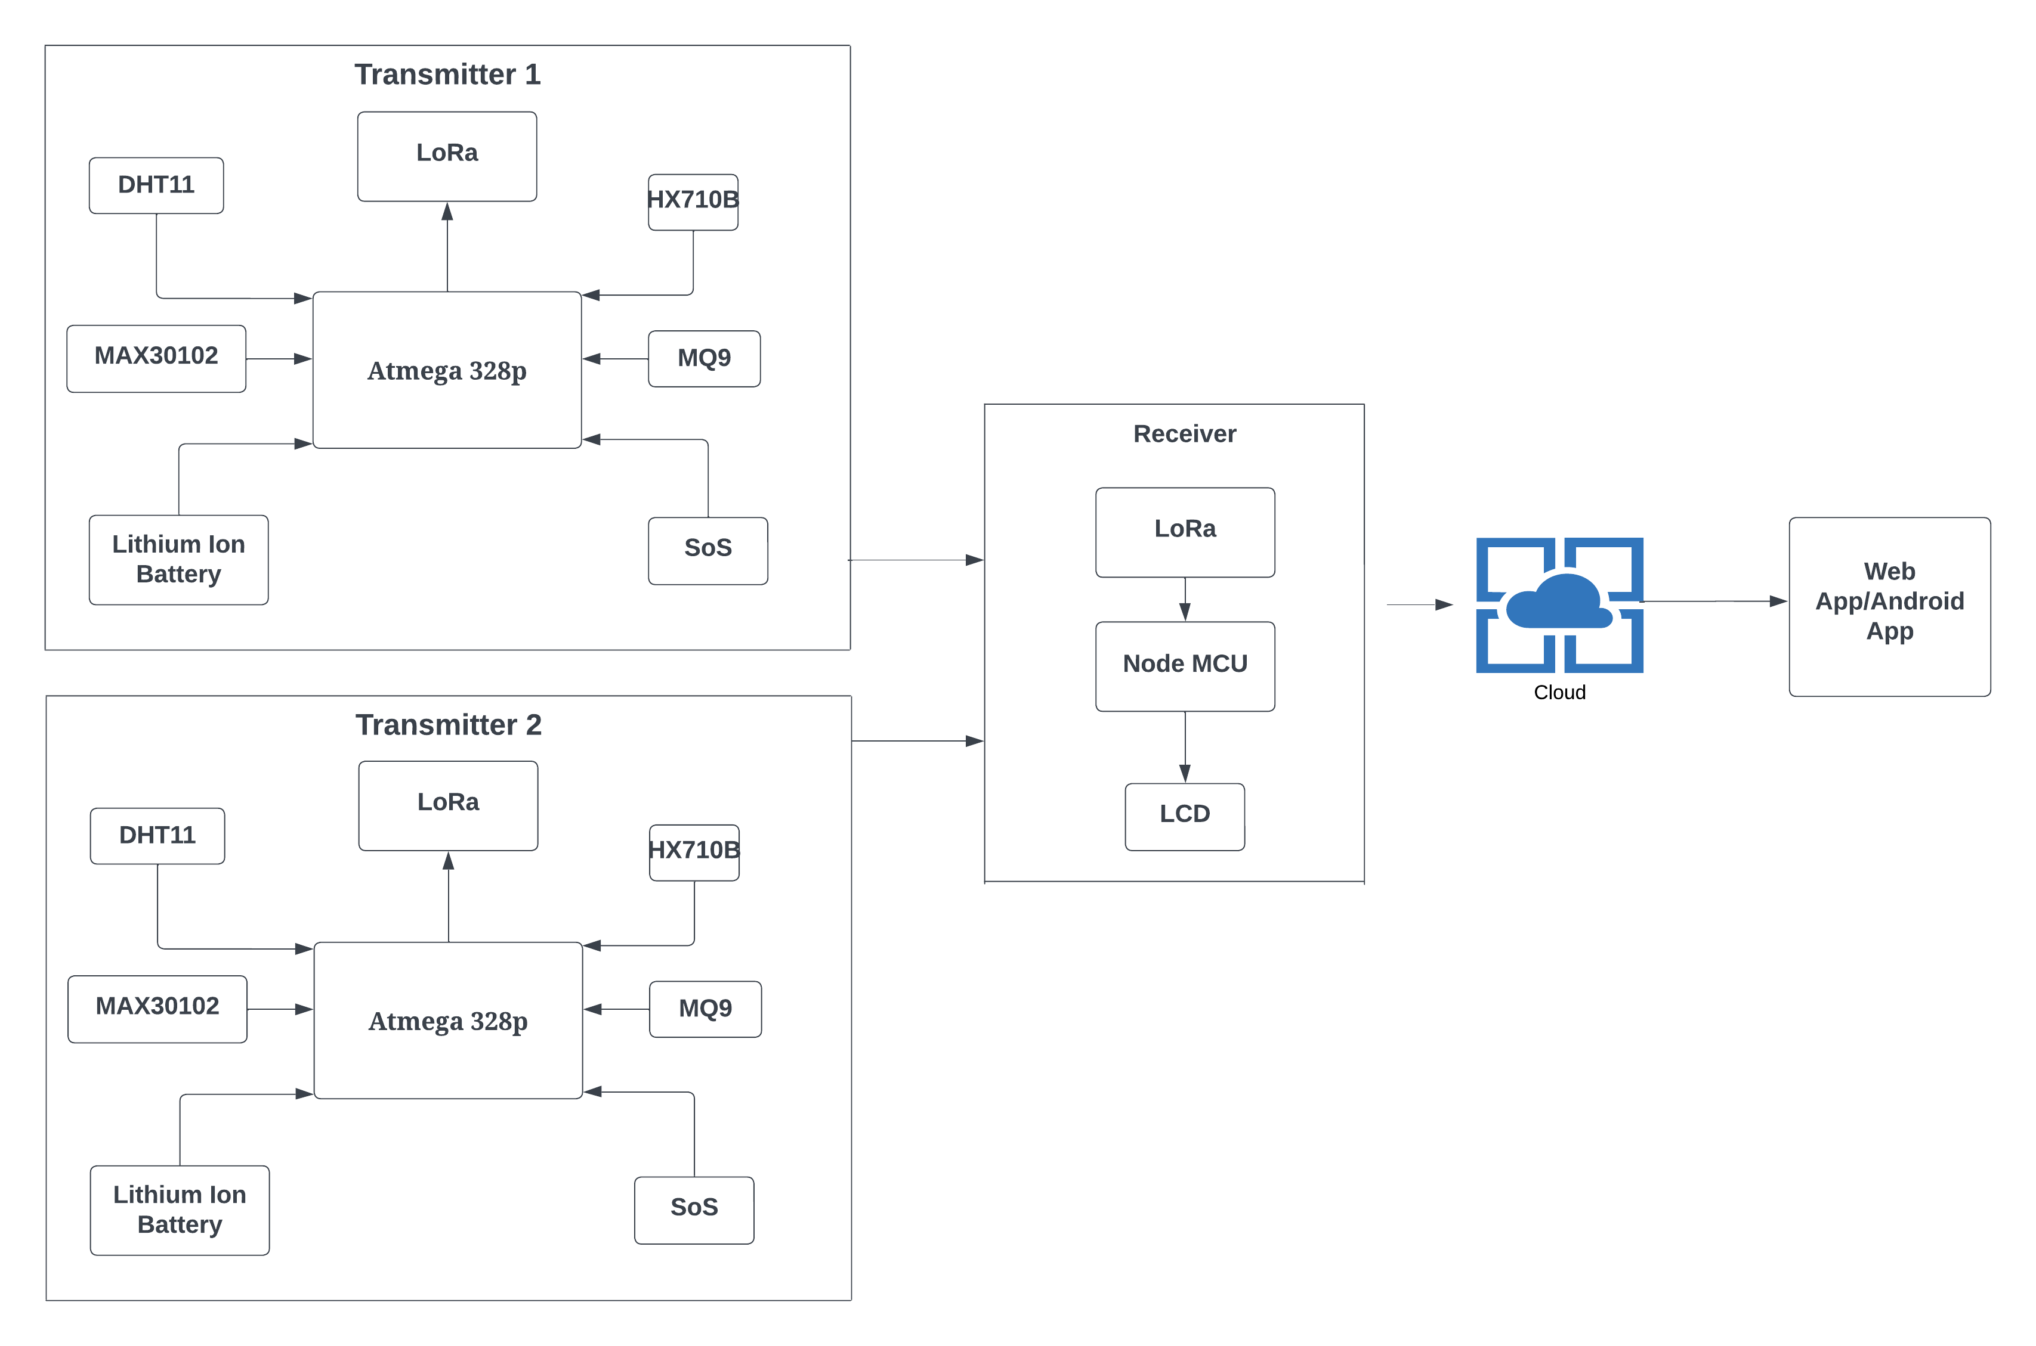
BLOCK DIAGRAM:

Slide 10
TRANSMITTER SIDE :
The Transmitter side of the Protection System for the rescue team is responsible for the safety and protection of the rescue members. As it includes various sensor modules and a LoRa module for collecting and transmitting the data wirelessly to the receiver side.
It includes various components like various sensors, a microcontroller , a LoRa module and a SOS system.
RECEIVER SIDE:
The Receiver side of the Protection System for the rescue team is responsible for receiving the data from the transmitter side, thus one could view the data.
It includes a LoRa module, Node MCU and a LCD.
The data is further uploaded to the cloud, the related person can monitor the data continuously.

Slide 11
LoRa Module :
LoRa (Long Range) modules are wireless communication modules that utilize the LoRaWAN (Low Power Wide Area Network) protocol to enable long-range, low-power communication between devices. LoRa technology is designed for IoT (Internet of Things) applications that require long-range connectivity with low power consumption. A LoRa module consists of a transceiver, which integrates both the LoRa radio and a microcontroller unit (MCU) or system-on-chip (SoC). The transceiver communicates with other LoRa devices using the Lora WAN protocol, allowing for secure and efficient data transmission over long distances.
GPS Module :
A GPS (Global Positioning System) module is a device that integrates a GPS receiver and associated components into a compact module. GPS modules enable devices to receive signals from GPS satellites and determine their precise location coordinates (latitude, longitude, and altitude) and other related information such as time and velocity.
SENSOR MODULE:
Sensors are electronic devices that detect and respond to physical stimuli or changes in the environment and convert them to electrical signals. These signals can be processed and used to provide valuable information plays an important role in IoT.

Slide 12
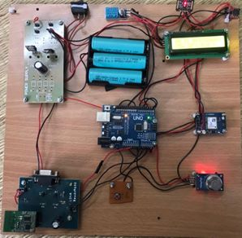
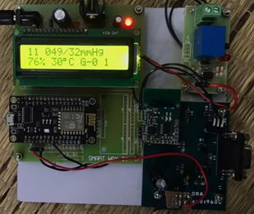
RESULTS:
TESTED HARDWARE
SENSOR NAME | MEASURED PARAMETERS | OBSERVED VALUES
HX710B | Pressure | 074/46mmHg
MQ9 | Inflammable gases | 237
MAX30102 | Pulse rate | 62
DHT11 | Humidity and temperature | 76% 30’c
TRANSMITTER
RECEIVER
RECEIVED DATA

Slide 13
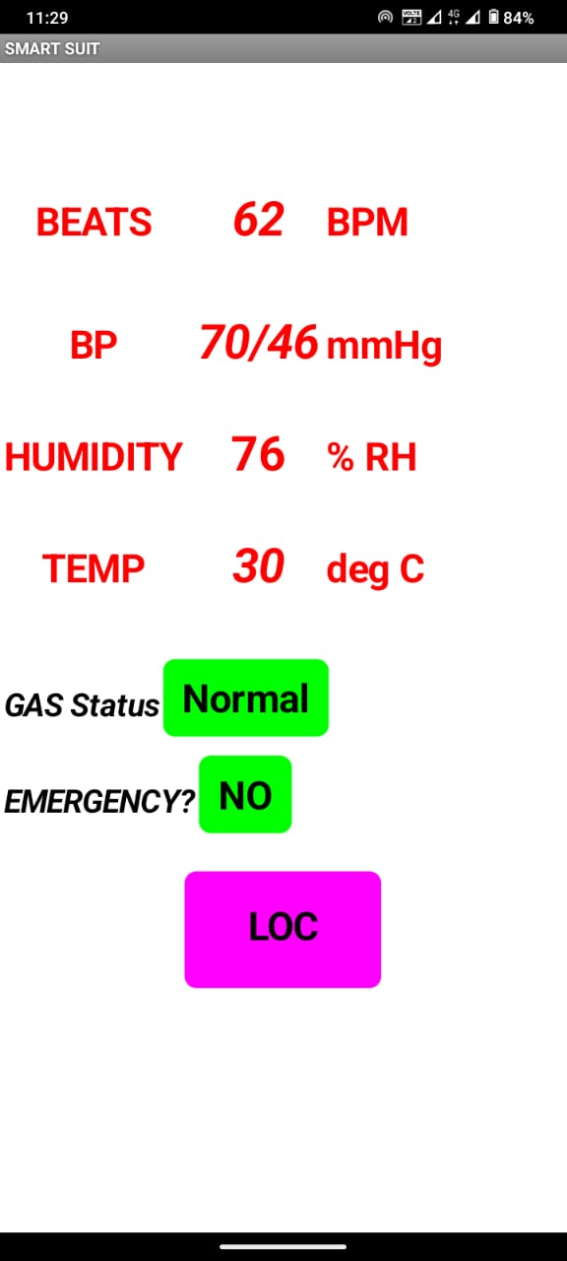
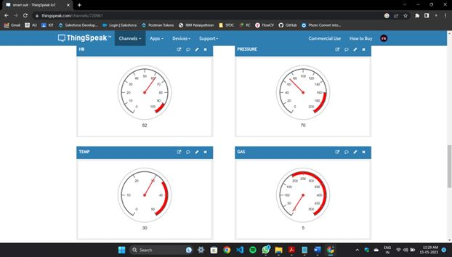
OUTPUT OBTAINED THROUGH CLOUD

Slide 14
ADVANTAGES:
Cost effective
Long Range Communication
Less manpower required
Low Power Consumption
Localization and Tracking
Real Time Data Monitoring

Slide 15
FUTURE WORK:
The future of smart suits for rescue team is likely to involve the development and integration of advanced technologies that can provide higher levels of accuracy, efficiency, and automation.

Slide 16
CONCLUSION:
According to the analysis, the existing methods are time and money consuming. The suggested solution not only resolves these issues but also increases accuracy. It is the greatest cost-effective method offered to improve the safety of the rescue team workers. It could be feasible to prevent the loss of money and valuable human lives. Also, it saves money and time.

Slide 17
REFERENCES:
[1]https://www.researchgate.net/publication/275580004_WEARABLE_TECHNOLOGIES_AND_ITS_FUTURE_APPLICATIONS
[2] Prof. Deepali Shinkar1, Saili S Garad2, Manali S Joshi3, Komal A Nimbhorkar4, Amir R Patel5“iot Based Smart Helmet for Coal Mining Tracking” Volume: 06 Issue: 12 (IRJET)
[3] https://eduzaurus.com/free-essay-samples /smartjacket-for-coal-miners/
[4] https://pdfs.semanticscholar.org/d60c/0fd4782ab327ff61625f0863cba 0e20bf67f.pdf
[5] https://shop.evilmadscientist.com/productsmenu/716
[6] https://pulsesensor.com/

Slide 18
DEMO VIDEO:
https://drive.google.com/file/d/1fqzNn09Jm4IZr-crTCiJGurW5LSdSzFs/view?usp=drivesdk

Slide 19
Thank You !

