Slide 1
Evidence words basic analysis
3/26

Slide 2
Method
There are two types of Models- Home and Alien
Home Model- Trained on Fever, Tested on Fever
Alien Model- Trained on FNC, Tested on FNC
We obtain rows that home model gets right but alien model does not
For each such row we obtain hypothesis to premise weights
We sum up the columns to get the overall global score of each evidence word
Select top 3 evidence words
We great a difference list: Key evidence words in the alien wrong classification but not in the home right classification.
In the following slides, we share the preliminary results

Slide 3
Example 1
Label-> DISAGREE
Claim→Saamy is an American film .
Evidence ->Tamil -LRB- -LSB- langpronˈtæmɪl -RSB- தமிழ் ; -LSB- t̪ɐmɨɻ -RSB- -RRB- is a Dravidian language predominantly spoken by the Tamil people of India and Sri Lanka , and also by the Tamil diaspora , Sri Lankan Moors , Burghers , Douglas , and Chindians . Saamy is a 2003 Indian Tamil action film written and directed by Hari .
Home Key Ev.→['Saamy', 'film', 'Indian’]
Alien Key Ev.→ ['film', 'by', 'by’]
Difference→ {'by'}

Slide 4
Example 2
Label-> DISAGREE
Claim →Frank Sinatra is not an actor .
Evidence →The Frank Sinatra Show is an ABC variety and drama series , starring Frank Sinatra , premiering on October 18 , 1957 , and last airing on June 27 , 1958 . The picture deals with the tribulations of three U.S. Army soldiers , played by Burt Lancaster , Montgomery Clift , and Frank Sinatra , stationed on Hawaii in the months leading up to the attack on Pearl Harbor . He appeared in various musicals such as On the Town -LRB- 1949 -RRB- , Guys and Dolls -LRB- 1955 -RRB- , High Society -LRB- 1956 -RRB- , and Pal Joey -LRB- 1957 -RRB- , winning another Golden Globe for the latter . Sinatra forged a highly successful career as a film actor . Toward the end of his career , he became associated with playing detectives , including the title character in Tony Rome -LRB- 1967 -RRB- . Francis Albert Sinatra -LRB- -LSB- sᵻˈnɑːtrə -RSB- -LSB- siˈnaːtra -RSB- ; December 12 , 1915 -- May 14 , 1998 -RRB- was an American singer , actor , and producer who was one of the most popular and influential musical artists of the 20th century . His career was reborn in 1953 with the success of From Here to Eternity , with his performance subsequently winning an Academy Award and Golden Globe Award for Best Supporting Actor . After winning an Academy Award for From Here to Eternity , he starred in The Man with the Golden Arm -LRB- 1955 -RRB- , and received critical acclaim for his performance in The Manchurian Candidate -LRB- 1962 -RRB- . On television , The Frank Sinatra Show began on ABC in 1950 , and he continued to make appearances on television throughout the 1950s and 1960s .
Home Key Ev.→['He', 'he', 'he’]
Alien Key Ev.→['was', 'was', 'was’]
Difference→ {'was'}

Slide 5
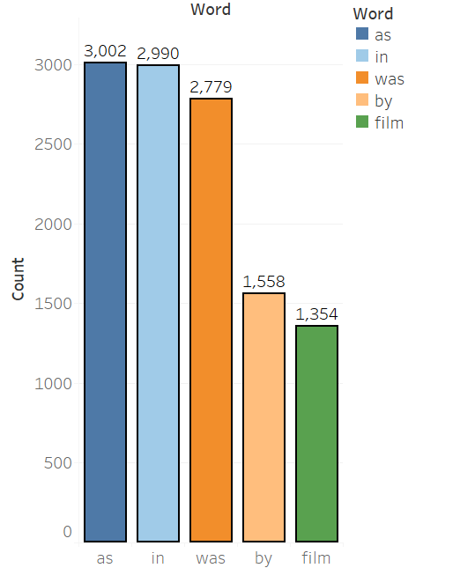
Top 5 words in Alien Wrong but not in Home right

Slide 6
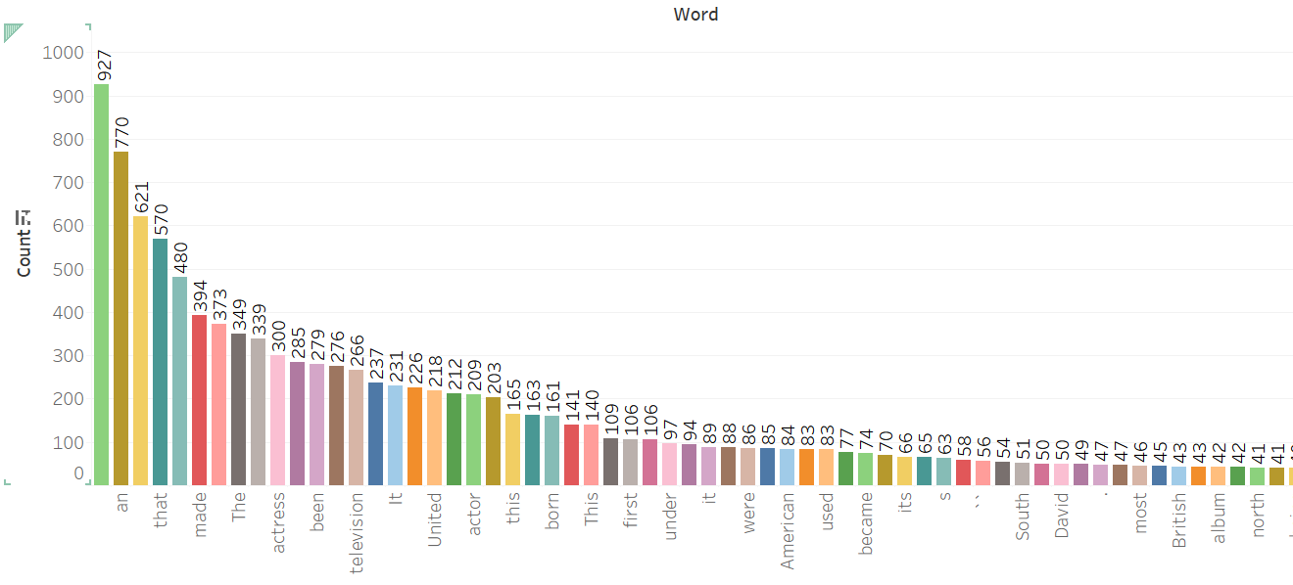

Slide 7
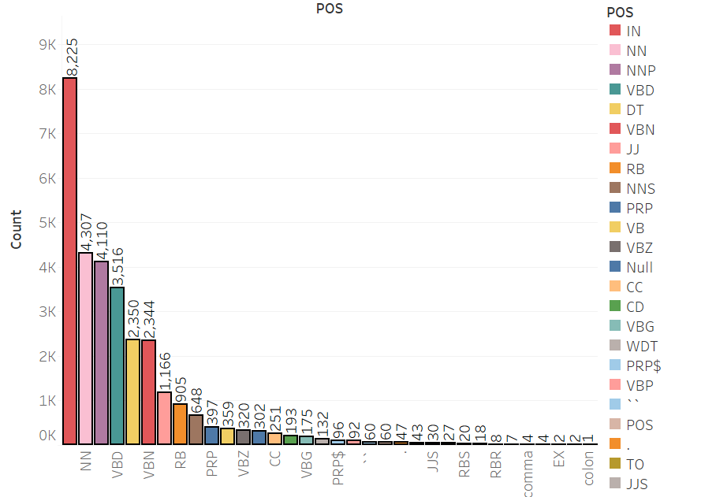
NLTK POS tags count for the list

Slide 8
Potential Issues
Self attention weights are high, this causes a lot of stop words to get inflated.
Stop words need to be removed and checked.

