Slide 1
CSC 439/539 Statistical Natural Language Processing Lecture 3: Distributional Similarity and Word Embeddings
Mihai Surdeanu
Fall 2017

Slide 2
Take-away
Distributional similarity
Word embeddings

Slide 3
Overview
”Traditional” distributional similarity
Latent semantic indexing
Word embeddings

Slide 4
Overview
”Traditional” distributional similarity
Latent semantic indexing
Word embeddings

Slide 5
Distributional hypothesis
Distributional hypothesis:
By looking at a word’s context, one can infer its meaning (Harris, 1954)
You shall know a word by the company it keeps (Firth, 1957)

Slide 6
Example
tasty tnassiorc
tnassiorc with butter
tnassiorc and coffee
greasy tnassiorc

Slide 7
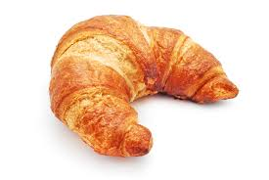
Example
tasty tnassiorc
tnassiorc with butter
tnassiorc and coffee
greasy tnassiorc

Slide 8
Co-occurrence matrix
Counts computed over a context window (say +/- 10 words) around each occurrence of a word
Context may be generated across syntactic relations as well
Example!

Slide 9
From words to vectors
We now have a context vector for each word in the vocabulary!
We can use these vectors for any similarity task, e.g., finding the top 10 most-related words (your homework 1!)
What are the advantages and disadvantages of this approach?

Slide 10
Overview
”Traditional” distributional similarity
Latent semantic indexing
Word embeddings

Slide 11


Singular value decomposition
This produces the best rank K approximation of C
Diagonal matrix with the diagonal sorted in descending order
C
U
V^{T}
K x K
K x M
N x M
N x K

Slide 12
Singular value decomposition for distributional similarity
Each column is a context word. Cells indicate how related a context word is with a semantic dimension
Each value indicates the importance of a semantic dimension
Co-occurrence matrix: each row corresponds to a different word
Each column is a distinct semantic dimension (“topic”)
C
U
V^{T}
K x K
K x M
N x M
(typically N = M)
N x K

Slide 13
Singular value decomposition for distributional similarity
This is our new distributional similarity matrix!
Each row is the vector of a word, operating over semantic dimensions!
C
U
V^{T}
K x K
K x M
N x M
(typically N = M)
N x K

Slide 14
Singular value decomposition for distributional similarity
We can use this matrix as a compression slide bar, by zero-ing out the lower ranked dimensions
C
U
V^{T}
K x K
K x M
N x M
(typically N = M)
N x K

Slide 15
The problem
The runtime of SVD is cubic in the size of the vocabulary…
Word embeddings do the same things, but much quicker (approximately linear time in the size of the vocabulary)

Slide 16
Overview
”Traditional” distributional similarity
Latent semantic indexing
Word embeddings

Slide 17
Intuition
You shall know a word by the company it keeps.
- Firth, 1957
You shall know the company by the word it keeps.
- Word2vec, skip-gram

Slide 18
Intuition
The city of Tucson is the place to vacation !
city
Tucson
P(city|Tucson) ++
P(place|Tucson) ++
…
P(dog|Tucson) - -
…
place
dog

Slide 19
Word2vec definition
(Neural) language model that predicts the surrounding words of every word
For the learning part, I prefer the name “dynamic logistic regression”

Slide 20
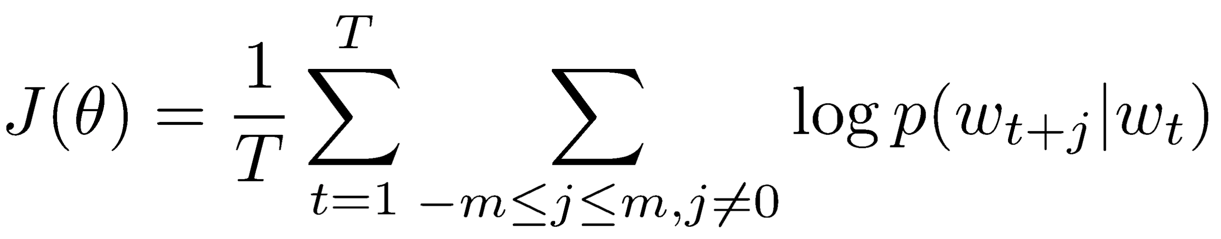
Objective function
Predict surrounding words in a window of length m (on each side), for every word
Objective: maximize the log probability of any context word given the current center:
This is similar to your objective function for LR!
But we operate over context words rather than labels
Content from Stanford’s CS224d, lecture 2

Slide 21
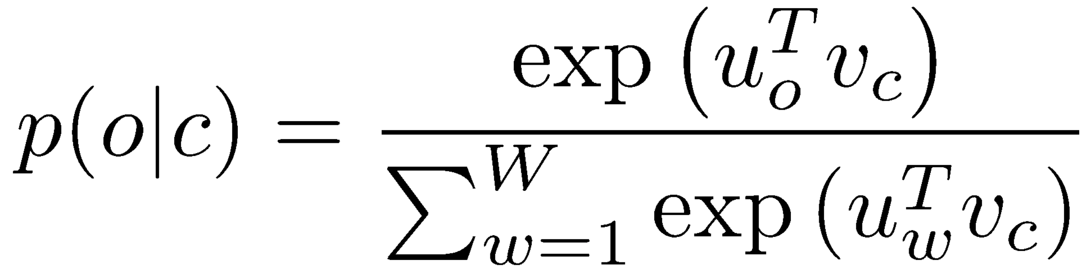
Objective function
We implement p(w_{t+j}|w_{t}) using a softmax around two vectors, a “center” vector (c) and an “outside“ vector (o):
Content from Stanford’s CS224d, lecture 2

Slide 22
Details
Thus each word gets 2 vectors: one for when the word serves as “center”, another for when it serves as “outside” context
The “center” vector is what word2vec outputs
But other research showed that v = v_{o} + v_{c} performs better in practice
The algorithm learns the weights for these vectors that maximize p(o|c) according to J
These are the values of your “features”
The algorithm dynamically learns which features are the best for this task
Hence the “dynamic” logistic regression name

Slide 23
The problem
What is the problem with this objective function? What happens with all these vectors during training?

Slide 24
The problem
What is the problem with this objective function? What happens with all these vectors during training?
So, how do we avoid this Kumbaya outcome?

Slide 25
The problem
What is the problem with this objective function? What happens with all these vectors during training?
Solution: add negative examples!

Slide 26
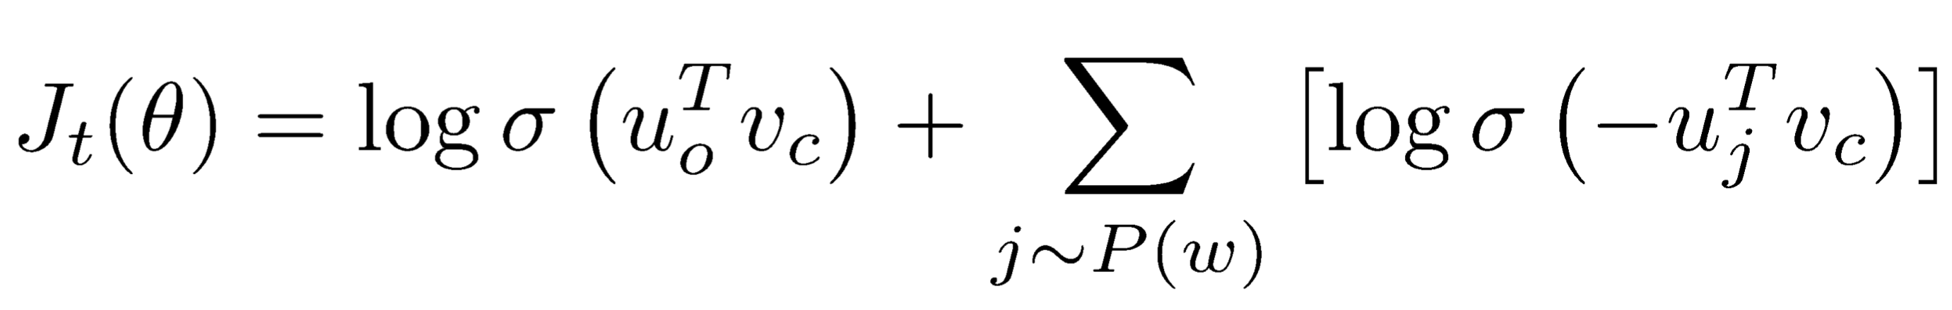
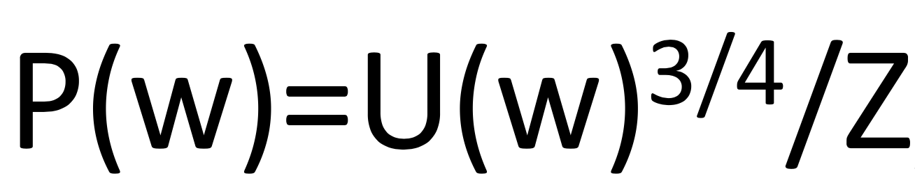
Negative examples
New objective function:
How do we pick negative examples?
Less frequent words are sampled more often
Words in the actual context are excluded
Content from Stanford’s CS224d, lecture 3

Slide 27
Variants
The model we just saw is called skip-gram
Empirically, this works well
Other possibilities: the continuous bag of words (CBOW) model
Predict the center word given its outside (context) words
Typically generates worse vectors. Why?

Slide 28
Important hyper parameters
Size of vectors
Usually between 50 and 500
Size of window around each word
Usually between 10 and 20
Number of negative examples
Usually up to 10 times more than positive ones

Slide 29
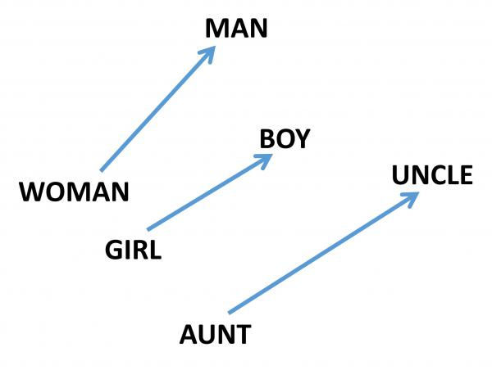
What do word embeddings learn?

Slide 30
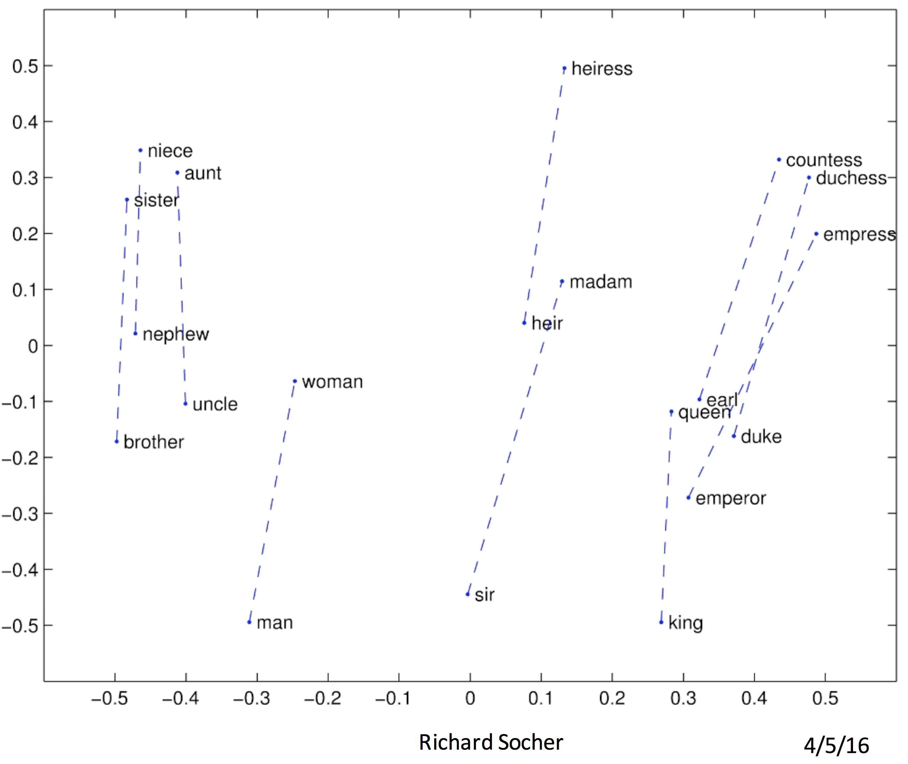
What do word embeddings learn?

Slide 31
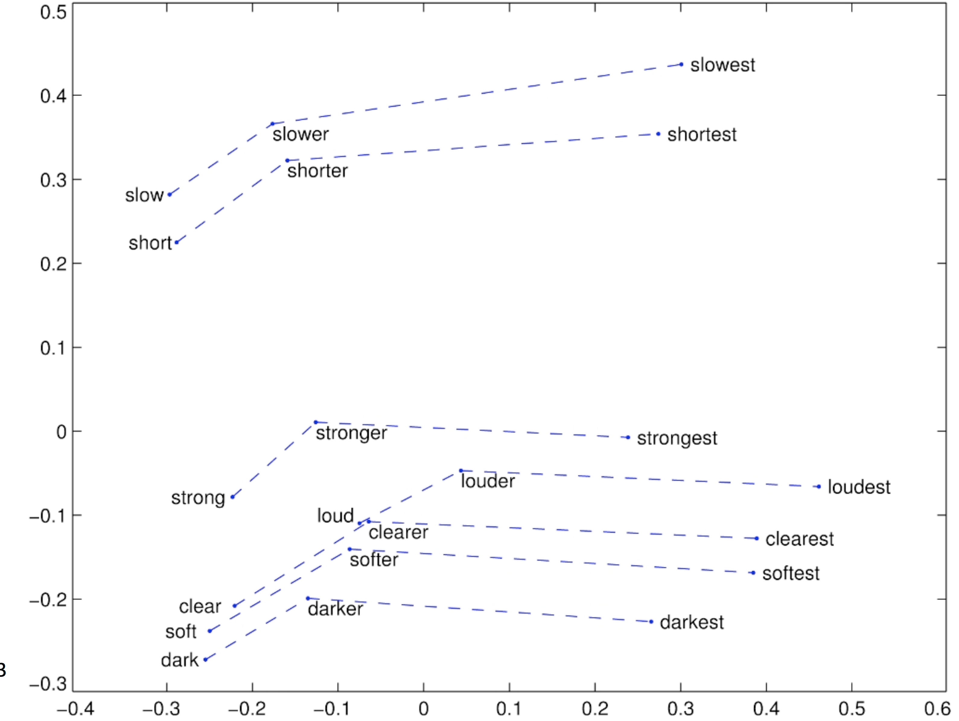
What do word embeddings learn?

Slide 33
PER
Mostly performers
Mostly politicians
PER
MISC
ORG
LOC

Slide 34
Readings
informationretrieval.org, chapter 18 (for LSI)
CS224d, lectures 2 and 3 at Stanford

Slide 35
Take-away
Distributional similarity
Word embeddings

