Slide 1
CSC 439/539 Statistical Natural Language Processing Lecture 4: Linguistic Essentials
Mihai Surdeanu
Fall 2017

Slide 2
Where we are
So far we looked at text categorization, where the data points to be classified are independent of each other
This is important, but it is only a very small slice of NLP
The rest of this course we will focus on structured learning, i.e., where the data points to be classified depend on each other

Slide 3
Take-away
We will review the most typical NLP tools: from tokenization to coreference resolution
How to use them (with NLTK)
We will cover implementation details in the remaining of this course

Slide 4
A simplified view of NLP
Applications
(Sentiment analysis, information extraction, question answering, etc.)
Linguistic Theory
(Morphology, Syntax, Semantics, etc.)
Machine Learning

Slide 5
A simplified view of NLP
Applications
(Sentiment analysis, information extraction, question answering, etc.)
NLP tools we will use in this class
Machine Learning
Linguistic Theory
(Morphology, Syntax, Semantics, etc.)

Slide 6
Typical NLP pipeline
Text
Tokenization / Sentence segmentation
Part of speech (POS) tagging
Normalization / Stemming / Lemmatization
Named entity recognition (NER)
Parsing (constituent, dependency, shallow)
Coreference resolution
Processed text

Slide 7
A run-through example
“John visited China. He enjoyed it a lot.”

Slide 8
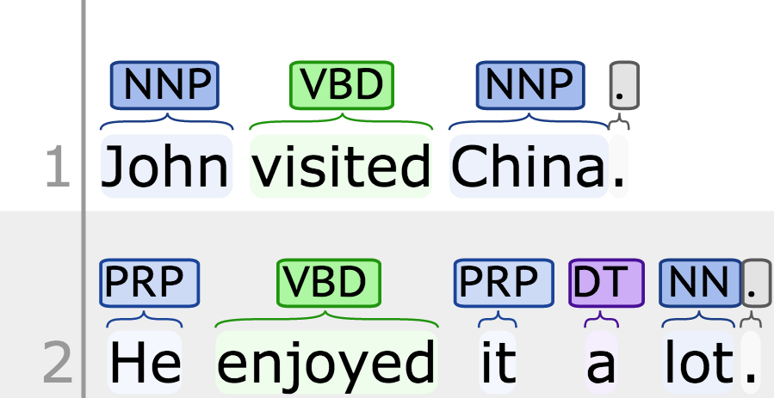
A run-through example: After tokenization, sentence segmentation, and POS tagging
“John visited China. He enjoyed it a lot.”

Slide 9
A run-through example: After lemmatization/normalization
“John visited China. He enjoyed it a lot.”
John visit China . He enjoy it a lot .

Slide 10
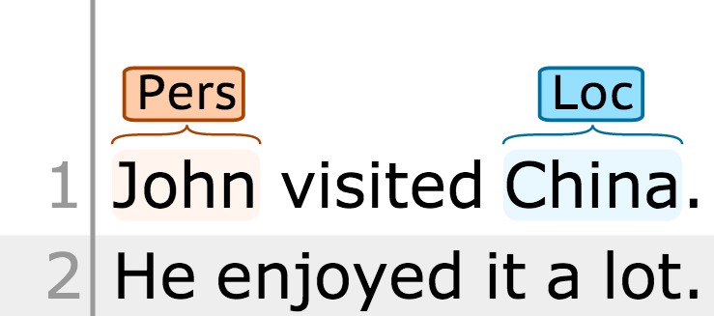
A run-through example: After NER
“John visited China. He enjoyed it a lot.”

Slide 11
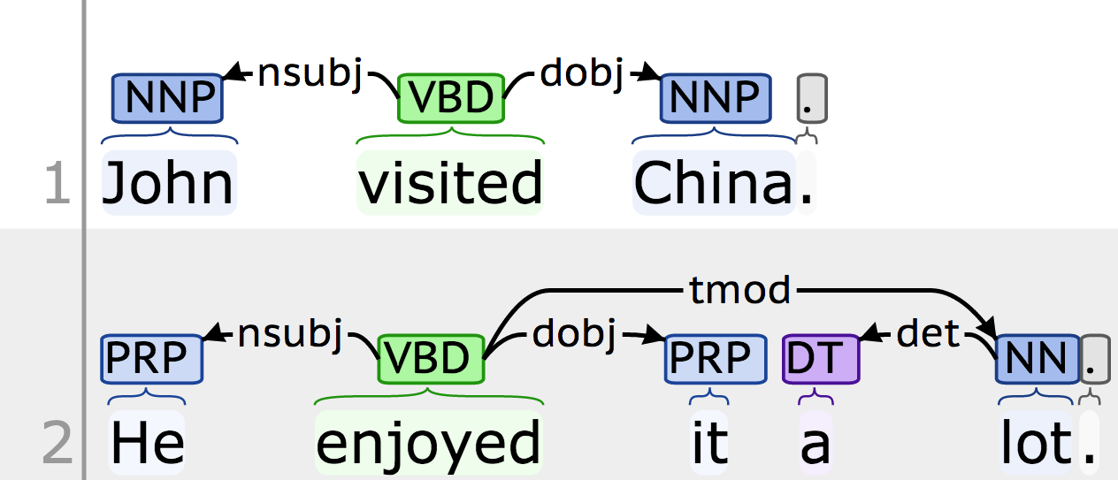
A run-through example: After dependency parsing
“John visited China. He enjoyed it a lot.”

Slide 12
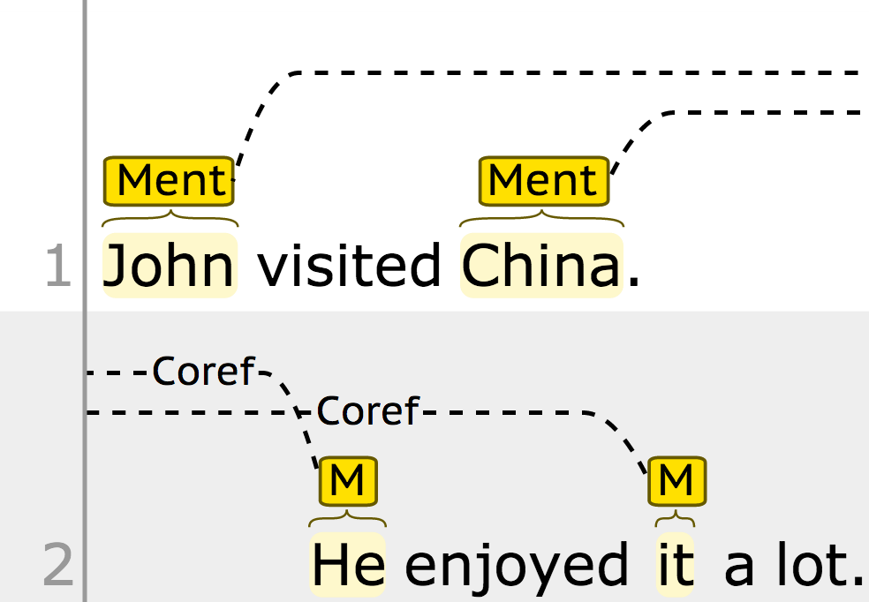
A run-through example: After coreference resolution
“John visited China. He enjoyed it a lot.”

Slide 13
Build your own visualizations
The previous example was built using Stanford’s CoreNLP
http://nlp.stanford.edu:8080/corenlp/
Our group’s visualizer
http://agathon.sista.arizona.edu:8080/odinweb/bio/enterText
Visualize constituent trees
http://www.ark.cs.cmu.edu/parseviz/

Slide 14
My favorite NLP packages
NLTK (python)
http://nltk.org/
Has everything except coreference resolution
May not have state-of-the-art implementations
Stanford’s CoreNLP (java)
http://nlp.stanford.edu/software/corenlp.shtml
Includes everything
State-of-the-art implementations
Has Python wrappers
Some components may not be the fastest or most memory efficient

Slide 15
My favorite NLP packages
OpenNLP (java)
http://opennlp.apache.org/
Includes everything
Very stable, but older algorithms…
TweetNLP (java)
http://www.ark.cs.cmu.edu/TweetNLP/
Best tools for working with tweets
Only tokenization and POS tagging

Slide 16
My favorite NLP packages
My group’s ‘processors’:
https://github.com/clulab/processors
Started as a new API for CoreNLP
Now it is bigger: includes all CoreNLP and more
Our own POS tagger and dependency parser
Discourse parser
Framework for IE development
In Scala, but easy to use from Java
spaCy.io:
https://spacy.io
Python
“Fastest in the world”
State of the art models

Slide 17
Typical NLP pipeline
Text
Tokenization / Sentence segmentation
Part of speech (POS) tagging
Normalization / Stemming / Lemmatization
Named entity recognition (NER)
Parsing (constituent, dependency, shallow)
Coreference resolution
Processed text

Slide 18
Tokenization
Segmenting running text into words and sentences.
First impulse: “Just segment around space characters.” Not so easy!
Segmenting on white spaces produces tokens such as: “cents.”, “said,”, “positive.””
Mr. Sherwood said reaction to Sea Container’s proposal has been “very positive.”
In New York Stock Exchange composite trading yesterday, Sea Containers closed
At $62.625, up 62.5 cents.

Slide 19
Tokenization issues
Many weird words
C++, C#, M*A*S*H
Emoticons: :) ;-)
Contractions
I’ll, isn’t, dog’s, etc.
You want to split these in separate words because they impact grammar.
If not split, where’s the verb in “I’m right.”?

Slide 20
Tokenization issues Hyphenation
Some are clearly single words
e-mail, co-operate, A-1-plus
Arguable cases, usually single words
non-lawyer, pro-Arab, so-called
Hyphenation often used to indicate the correct grouping of words
the once-quiet study of superconductivity
a final “take-it-or-leave-it” offer
the 26-year-old

Slide 21
Tokenization issues Whitespace not indicating a word break
Multi-part names
“New York” is different from “York”
Phrasal verbs
Make up, work out
Phone numbers
USA: (202) 555-2230
France: 33 1 34 43 32 26
Sri Lanka: (94-1) 866854

Slide 22
What is a sentence?
First impulse: “something ending with a ‘.’, ‘?’, or ‘!’”
But some periods are used in abbreviations, or to indicate both abbreviations and end of sentence.
“Mr. Smith lives in the U.S.A. He is an American citizen.”

Slide 23
What is a sentence?
When does a period indicate end of sentence, and when is it part of an abbreviation?
Two solutions:
Heuristics
Machine learning model

Slide 24
Sentence segmentation A simple algorithm
Place putative sentence boundaries after all occurrences of . ? !
Move the boundary after quotation marks, if any.
Disqualify a period boundary if:
It is preceded by a known abbreviation that does not typically occur at end of sentences, and is commonly followed by a proper name (e.g., Mr.)
It is preceded by a known abbreviation and not followed by an uppercase word.
Disqualify a boundary with ? or ! If:
It is followed by a lowercase letter (or part of known name).
Accept all other candidates as sentence boundaries.

Slide 25
Sentence segmentation A better approach
Treat it as a binary classification problem: punctuation is/is not sentence final
A variety of features can be used
Case of preceding/following words
Length of preceding/following words
Actual words preceding/following punctuation
Performance
About 90% of periods are sentence boundaries
Classifiers achieve an accuracy over 99%

Slide 26
Tokenization issues in other languages
Word segmentation in Chinese
No white spaces used
How would you tokenize “thetabledownthere”? The longest match heuristic fails on the first word.
Compound nouns in German
Lebensversicherungsgesellschaftsangestellter – life insurance company employee
It appears in English as well: “hard disk” vs. “harddisk”

Slide 27
Implementations
Tokenization is typically implemented with language-specific grammars or regular expressions compiled to finite state automata
JFlex: http://jflex.de/
Antlr: http://antlr.org/
Sentence segmentation
Heuristics following tokenization (CoreNLP, processors)
Classifier preceding tokenization (OpenNLP, NLTK)

Slide 28
NLTK example
>>> from nltk.tokenize import word_tokenize, sent_tokenize
>>> s = '''Good muffins cost $3.88\nin New York. Please buy me two of them.\n\nThanks.'''
>>> sent_tokenize(s)
['Good muffins cost $3.88\nin New York.', 'Please buy me two of them.', 'Thanks.']
>>> [word_tokenize(t) for t in sent_tokenize(s)]
[['Good', 'muffins', 'cost', '$', '3.88', 'in', 'New', 'York', '.'], ['Please', 'buy', 'me', 'two', 'of', 'them', '.'], ['Thanks', '.']]

Slide 29
Typical NLP pipeline
Text
Tokenization / Sentence segmentation
Part of speech (POS) tagging
Normalization / Stemming / Lemmatization
Named entity recognition (NER)
Parsing (constituent, dependency, shallow)
Coreference resolution
Processed text

Slide 30
POS Tagging
Process of performing automatic grammatical tagging for word categories
Part-of-speech tags aka word classes, morphological classes, or lexical tags
Implementation = sequence models
We will discuss these later in the course

Slide 31
(Mostly) English word classes
Two class types
Closed: relatively fixed membership
Open
Open classes
Nouns
Verbs
Adjectives
Adverbs

Slide 32
Open classes Nouns
Theoretically: people, places, things, etc.
But nouns are defined syntactically and morphologically
Ability to occur with determiners (a goat), to take possessives (IBM’s revenue), to have a plural (goats)
This allows other things to be labeled as nouns, e.g., verb nominalizations
Grouped into proper nouns and common nouns
Common nouns divided into
Count nouns: one goat, two goats
Mass nouns: snow, communism

Slide 33
Open classes Verbs, adjectives, adverbs
Verbs
Actions, processed
Some languages don’t have the distinction between verbs and nouns: Tongan, Riau Indonesian
Adjectives
Properties, qualities (e.g., color, age, value)
Some languages do not have adjectives: in Korean adjectives act as a subclass of verbs
Adverbs
“Semantic hodge podge” (Jurafsky and Martin, 2008)
Modifiers of verbs, other adverbs and entire verb phrases
Directional or locative (home, here, downhill), degree (extremely, very, somewhat), manner (slowly, delicately), temporal (yesterday, Monday)

Slide 34
Closed classes
Prepositions
Determiners
Pronouns
Conjunctions
Auxiliary verbs
Particles
Numerals

Slide 35
Closed classes Prepositions and particles
Prepositions
Occur before noun phrases
Semantically: spatial/temporal relations (on it, before then, on time, beside herself), other relations (written by Shakespeare)
English has fewer than 100 prepositions
Particles
Resembles a preposition but is used in combination with a verb ➔ phrasal verb (rule out, turn down)

Slide 36
Closed classes Determiners and conjunctions
Determiners
Articles: a, an, the
This, that
Conjunctions
Join two phrases, clauses, or sentences
Coordinating conjunctions
Join two elements of equal status
And, or, but
Subordinating conjunctions
Some sort of embedded status
That in “I thought that you might like some milk”

Slide 37
Closed classes Pronouns, auxiliary verbs
Pronouns
Shorthand for referring to noun phrases, entities or events
Personal pronouns: you, she, me, etc.
Possessive pronouns: my, your, his, her, etc.
Wh-pronouns: what, who, whom, whoever
Auxiliary verbs
Copula (be): connects subject with adjective or predicate nominals (he is a duck)
Do, have: for verb conjugations
Modals (can, may, must): indicator of mood

Slide 38
Closed classes Others
Interjections
Oh, ah, hey, alas, uh, um
Negatives
No, not
Politeness markers
Please, thank you
Greetings
Hello, goodbye
Existential there

Slide 39
Tagsets for English
Implementations of the above word classes, to be used by actual POS taggers
The most common one is the Penn Treebank tagset, containing 45 tags
http://web.mit.edu/6.863/www/PennTreebankTags.html
Let’s look at it. Exercise!
New kid on the block: Universal Dependencies
http://universaldependencies.org/u/pos/all.html

Slide 40
Tagset Problems
Some distinctions are quite hard for both humans and machines
Between prepositions (IN), particles (RP), and adverbs (RB):
Mrs. Shaefer never got around to joining.
All we gotta do is go around the corner.
Chateau Petrus costs around 250.

Slide 41
Tagset Problems
Some distinctions are quite hard for both humans and machines
Between prepositions (IN), particles (RP), and adverbs (RB):
Mrs. Shaefer never got around to joining.
All we gotta do is go around the corner.
Chateau Petrus costs around 250.
RP
IN
RB

Slide 42
Tagset Problems
Noun modifiers, adjectives (JJ*) or nouns (NN*)?
cotton sweater
income-tax return
the Gramm-Rudman act
Chinese cooking
Pacific waters

Slide 43
Tagset Problems
Noun modifiers, adjectives (JJ*) or nouns (NN*)?
cotton sweater
income-tax return
the Gramm-Rudman act
Chinese cooking
Pacific waters
NN
JJ
NNP
NN
NN

Slide 44
Tagset Problems
Distinguishing between past participles (VBN) and adjectives (JJ)
They were married by the Justice of the Peace yesterday.
At the time, she was already married.

Slide 45
Tagset Problems
Distinguishing between past participles (VBN) and adjectives (JJ)
They were married by the Justice of the Peace yesterday.
At the time, she was already married.
VBN
JJ

Slide 46
NLTK example
>>> import nltk
>>> text = nltk.word_tokenize("And now for something completely different")
>>> nltk.pos_tag(text)
[('And', 'CC'), ('now', 'RB'), ('for', 'IN'), ('something', 'NN'), ('completely', 'RB'), ('different', 'JJ')]

Slide 47
Practice Exercise
How is “up” tagged in these sentences?
John and Jane made up yesterday.
The AAPL stock went up 200 points today.
Up to 200 billion were wasted on war.

Slide 48
Typical NLP pipeline
Text
Tokenization / Sentence segmentation
Part of speech (POS) tagging
Normalization / Stemming / Lemmatization
Named entity recognition (NER)
Parsing (constituent, dependency, shallow)
Coreference resolution
Processed text

Slide 49
Normalization
When searching a document, a query containing “USA” should match documents containing “U.S.A.”
Implicit equivalence classes
Removing dots: “U.S.A.” ➔ ”USA”
Remove hyphens: “anti-discriminatory” ➔ “antidiscriminatory”
Explicit equivalence classes
Different spellings: “color” and “colour”
Synonyms: “car” and “automobile”
Case folding
USA ➔ usa

Slide 50
Stemming
Reduce words to a common base form
These equivalence classes are equivalent
Porter’s
Algorithm
These equival class ar equival

Slide 51
Porter’s Stemming Algorithm
5 phases of word reductions applied sequentially
sses → ss caresses → caress
ies → i ponies → poni
s → cats → cat
Rules sensitive to the measure of a word
(m > 1) ement → replacement → replac
Does not change cement!

Slide 52
Porter’s Stemming Algorithm
Pros
Very fast
Does not require POS information
Cons
Errors of commission |  | Errors of omission
organization | organ | European | Europe
doing | doe | analysis | analyzes
numerical | numerous | noise | noisy
policy | police | sparse | sparsity

Slide 53
Lemmatization
Grouping together the different inflected forms of a word so they can be analyzed as a single item.
“walk”, “walked”, “walks”, “walking” ➔ lemma:”walk”

Slide 54
Lemmatization
Implemented using lexical dictionaries such as WordNet
Pros
More accurate than stemming
Cons
Slower than stemming
May require POS tags

Slide 55
NLTK example
>>> import nltk
>>> text = nltk.word_tokenize("And now for something completely different")
>>> porter = nltk.PorterStemmer()
>>> [porter.stem(t) for t in text]
['And', 'now', 'for', 'someth', 'complet', 'differ’]
>>> wnl = nltk.WordNetLemmatizer()
>>> [wnl.lemmatize(t) for t in text]
['And', 'now', 'for', 'something', 'completely', 'different’]

Slide 56
Typical NLP pipeline
Text
Tokenization / Sentence segmentation
Part of speech (POS) tagging
Normalization / Stemming / Lemmatization
Named entity recognition (NER)
Parsing (constituent, dependency, shallow)
Coreference resolution
Processed text

Slide 57
Named entity recognition
Detection and classification of named entities in text
In reality, a good NER will identify:
Named entities
Numeric entities
Temporal expressions
Can be viewed as the first end-user NLP application.
But because many NERs are available out of the box, in this class we will consider NER as a tool to be used to construct higher-level applications.

Slide 58
Named entity types
Type | Tag | Sample categories
People | PER | Individual, fictional characters, small groups
Organization | ORG | Companies, agencies, political parties, religious groups, sports teams
Location | LOC | Physical extents, mountains, lakes, seas
Geo-political entity | GPE | Countries, states, provinces, counties
Facility | FAC | Bridges, buildings, airports
Vehicle | VEH | Planes, trains, automobiles

Slide 59
Named entity examples
Type | Example
People | Turing is often considered the father of computer science.
Organization | The IPCC said it is likely that future cyclones will be more intense.
Location | The Mt. Sanitas loop hike begins at the base of Sunshine Canyon.
Geo-political entity | Palo Alto will raise parking fees.
Facility | Drivers were advised to consider the Lincoln Tunnel.
Vehicle | The updated Mini Cooper retains its charm and agility.

Slide 60
Numeric entities
Type | Tag | Example
Money | MONEY | This laptop costs $450.
Number | NUMBER | He was the 42nd president.

Slide 61
Temporal expressions
Type | Tag | Example
Time | TIME | This class starts at 8:30am.
Date | DATE | The first lecture is on August 26, 2013.

Slide 62
Differences between NER systems
Stanford’s CoreNLP recognizes:
PERSON, LOCATION (collapsing locations and GPEs), ORGANIZATION, and MISC (other miscellaneous names, including vehicles and facilities)
MONEY, NUMBER
DATE, TIME
NLTK recognizes:
PERSON, ORGANIZATION, GPE

Slide 63
Ambiguities in NER
Name | Possible categories
Washington | Person, Location, Political Entity, Organization, Facility
Downing St. | Location, Organization
Louis Vuitton | Person, Organization, Product
Washington was born into slavery on the farm of Burroughs.
Washington went up 2 games to 1 in the four-games series.
Blair arrived in Washington for what may be his last state visit.
In June, Washington passed a primary seatbelt law.
The Washington had proved to be a leaky ship.

Slide 64
Ambiguities in NER
Name | Possible categories
Washington | Person, Location, Political Entity, Organization, Facility
Downing St. | Location, Organization
Louis Vuitton | Person, Organization, Product
Washington was born into slavery on the farm of Burroughs.
Washington went up 2 games to 1 in the four-games series.
Blair arrived in Washington for what may be his last state visit.
In June, Washington passed a primary seatbelt law.
The Washington had proved to be a leaky ship.
PER
ORG
LOC
GPE
FAC

Slide 65
NER as sequence labeling
Most entity mentions span multiple sentences
Dedicated representations
Most common: IOB
Stanford: IO
UIUC: BILOU
Beginning, Inside, Last, Outside, Unit-length
Words | Label
American | B-ORG
Airlines | I-ORG
, | O
a | O
unit | O
of | O
AMR | B-ORG
Corp. | I-ORG
, | O
immediately | O
matched | O
the | O
move | O
, | O
Tim | B-PER
Wagner | I-PER
said | O
. | O

Slide 66
Practice exercise
How is “San Francisco” tagged in these sentences (using the BIO notation)?
I would love to live in San Francisco.
San Francisco won their game yesterday.
San Francisco prohibits littering on the street.
San Francisco was a Christian saint.

Slide 67
NLTK example
>>> import nltk
>>> text = nltk.word_tokenize(“Mr. John Smith from IBM visited China on 2010-01-31.")
>>> tagged = nltk.pos_tag(text)
>>> nltk.ne_chunk(tagged)
Tree('S', [Tree('PERSON', [('Mr.', 'NNP')]), Tree('PERSON', [('John', 'NNP'), ('Smith', 'NNP')]), ('from', 'IN'), Tree('ORGANIZATION', [('IBM', 'NNP')]), ('visited', 'VBD'), Tree('GPE', [('China', 'NNP')]), ('on', 'IN'), ('2010-01-31', 'CD'), ('.', '.')])

Slide 68
Typical NLP pipeline
Text
Tokenization / Sentence segmentation
Part of speech (POS) tagging
Normalization / Stemming / Lemmatization
Named entity recognition (NER)
Parsing (constituent, dependency, shallow)
Coreference resolution
Processed text

Slide 69
Syntax representations
Syntactic parsing
The task of recognizing a sentence and assigning a syntactic structure to it.
Multiple structures possible
Constituency-based
Dependency-based
Shallow

Slide 70
Constituency-based syntax
Constituent parse tree
Ordered, rooted tree that stores the output of some grammar applied to the input sentence
Most grammars these days are Probabilistic Context Free Grammars (PCFG)

Slide 71
Constituency-based parse tree

Slide 72
Constituency-based parse tree
root node
non-terminal nodes
pre-terminal nodes
terminal nodes (leaves)

Slide 73
Structural ambiguity Attachment ambiguity
“One morning I shot an elephant in my pajamas. How he got into my pajamas I don’t know.”

Slide 74
Structural ambiguity Coordination ambiguity
“old men and women”
[old [men and women]]
[[old men] and [women]]
President Kennedy today pushed aside other White House business to devote all his time to working on the Berlin crisis address he will deliver tomorrow night to the American people over nationwide television and radio.
[nationwide [television and radio]] or [[nationwide television] and [radio]]?
Other?

Slide 75
Treebanks
Treebank = collection of parse trees examples to be given to a parser for training
The most famous one is the Penn Treebank
Contains over 45,000 annotated sentences
A de facto standard for most work in parsing

Slide 76
Most common Penn Treebank tags
Tag | Definition
S | Simple clause (sentence)
SBAR | Relative clause and subordinate clause
SBARQ | Wh-questions
SQ | Yes/no questions, clause inside SBARQ,
SINV | Sentences with subject-auxiliary inversion
ADJP | Adjective phrase
ADVP | Adverbial phrase
NP | Noun phrase
PP | Prepositional phrase
QP | Quantifier phrase (inside NP)
VP | Verb phrase
WHNP | Wh-noun phrase
WHPP | Wh-prepositional phrase

Slide 77
Most common Penn Treebank tags
Tag | Example
S | Casey threw the ball.
SBAR | The person who threw the ball.
SBARQ | Who threw the ball?
SQ | Who threw the ball? Did Casey throw the ball?
SINV | Never had I seen such a place.
ADJP | the best and brightest students
ADVP | He ran quickly.
NP | the higher prices
PP | Casey threw the ball to Jane.
QP | from 10 to 15 monkeys
VP | Casey threw the ball.
WHNP | The person who threw the ball.
WHPP | of which, by whose authority

Slide 78
All Penn Treebank tags
26 constituent tags
http://web.mit.edu/6.863/www/PennTreebankTags.html
Example!

Slide 79
Matching patterns over constituent trees
Several NLP applications can be reduced to matching certain syntactic patterns over constituent trees
Tregex and Tsurgeon
Tregex: matches patterns over trees
Tsurgeon: tree manipulation

Slide 80
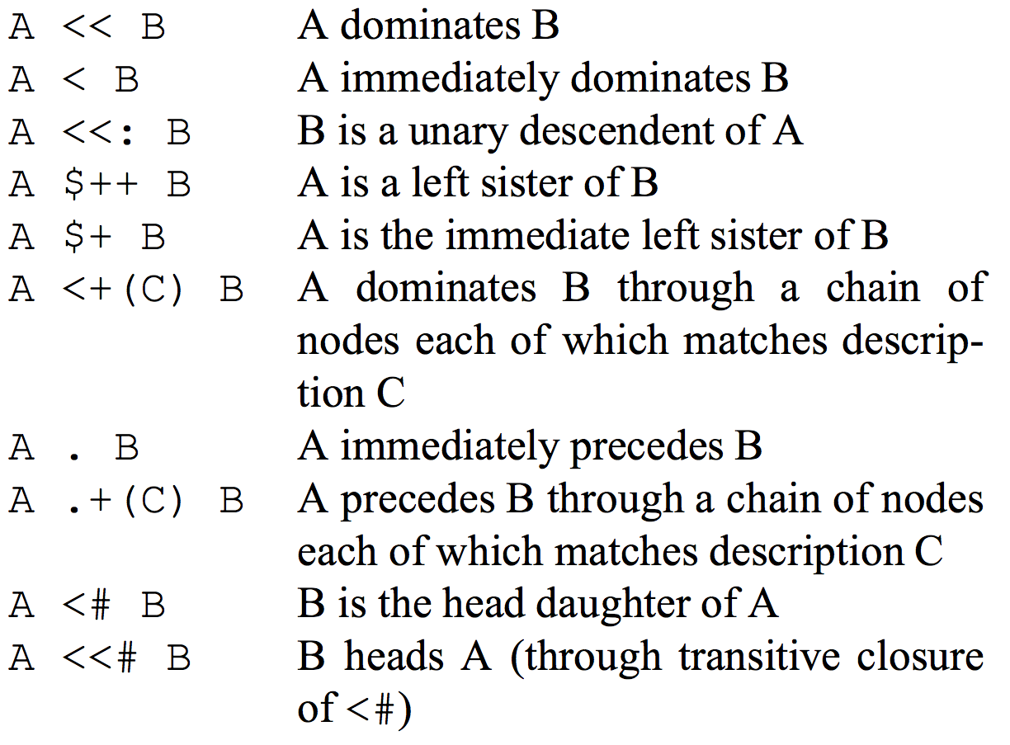
Tregex node-node relations

Slide 81
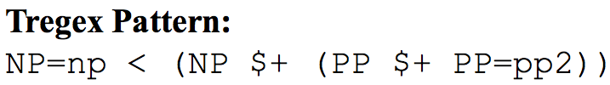
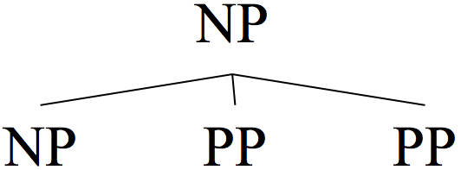
Tregex example

Slide 82
Dependency syntax
All nodes are terminal
Does not acknowledge the distinction between terminal and non-terminal nodes.
Simpler, fewer nodes (no non-terminals)
Faster to generate. Good linear-time algorithms exist.
See shift-reduce parsers such as maltparser.org
No functionality lost for many applications.

Slide 83
Generating dependencies
Most dependency representations are created from constituency-based trees by creating binary relations between constituent head words.
Head word
Most important word in a constituent
Identified using linguistic heuristics

Slide 84
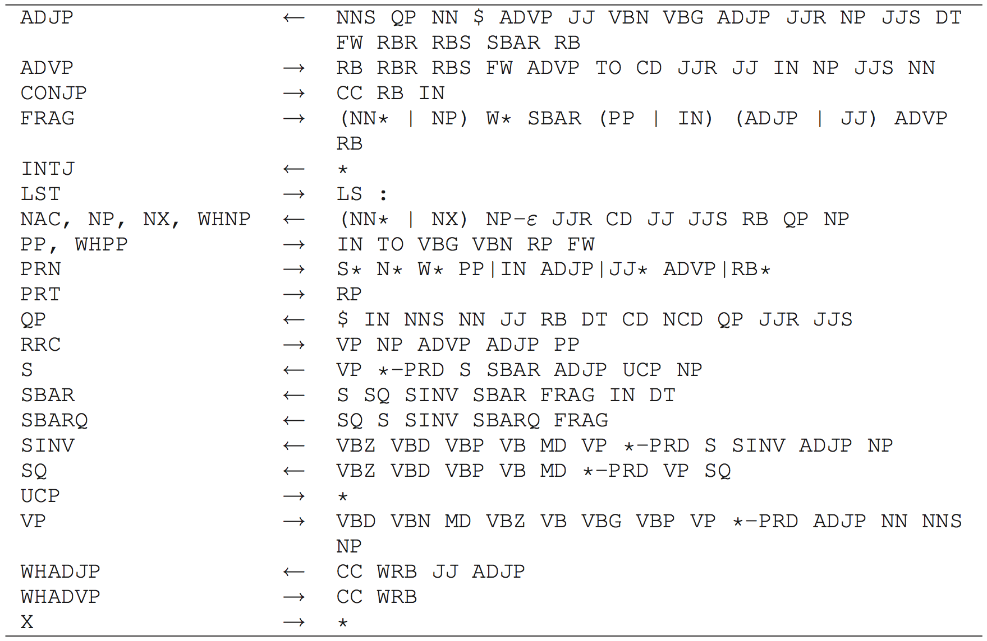
Head word identification rules

Slide 85
Converting from a constituency-based representation to dependencies
Example!

Slide 86
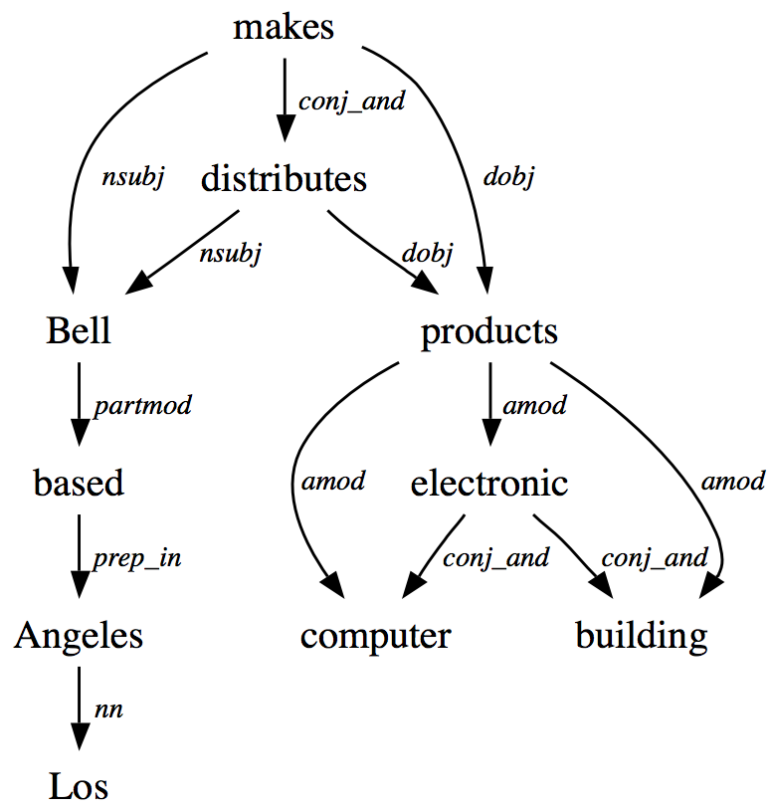
Stanford (collapsed) dependencies
Bell, based in Los Angeles, makes and distributes electronic, computer and building products.
head
governor
(for nsubj)
modifier
dependent
(for nsubj)
head
governor
(for partmod)
Graph not tree!

Slide 87
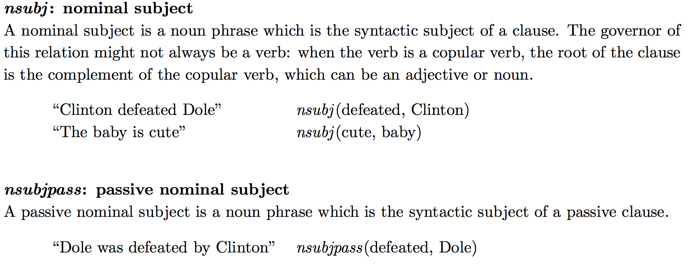
Important Stanford dependencies: nsubj and nsubjpass

Slide 88
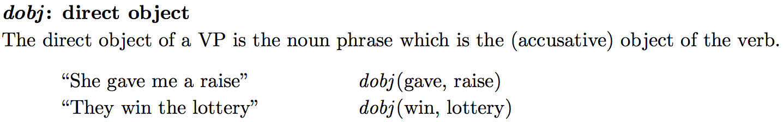
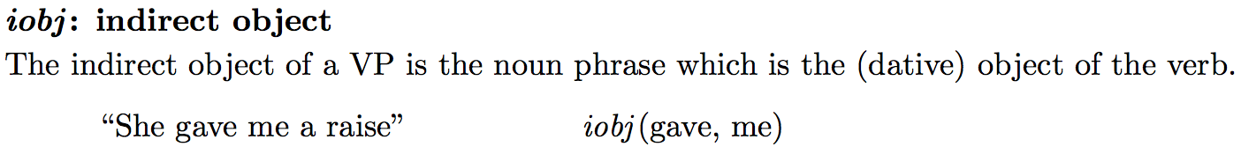
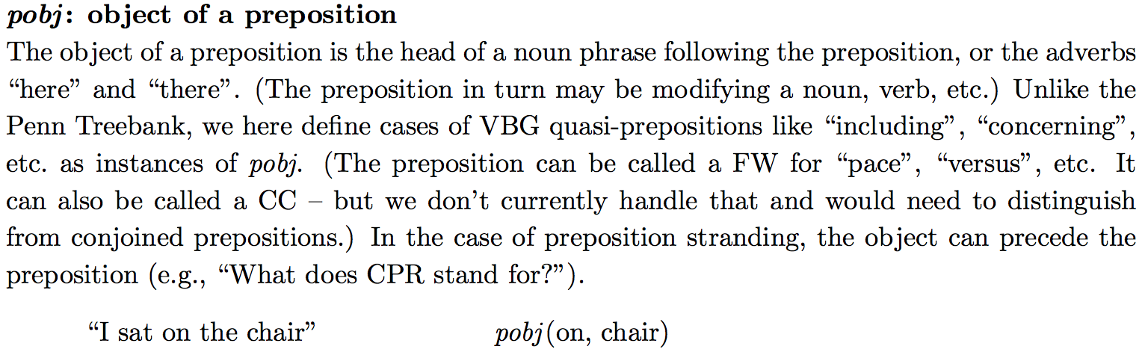
Important Stanford dependencies: dobj, iobj, pobj

Slide 89
Stanford dependencies
Approximately 53 overall
See the Stanford typed dependencies manual for details
https://nlp.stanford.edu/software/dependencies_manual.pdf
New kid on the block: universal dependencies
http://universaldependencies.org

Slide 90
Rules for ”collapsing” dependencies
http://universaldependencies.org/u/overview/enhanced-syntax.html

Slide 91
Matching patterns over dependency graphs
Often, it is more straightforward to write your own code over this simple dependency representation
For complex patterns there is Semgrex
A language similar to Tregex, but running over dependency graphs rather than constituent trees
For even more complex patterns there is Odin
https://arxiv.org/abs/1509.07513

Slide 92
Semgrex syntax: Nodes
Nodes are represented as {attr1:value1;attr2:value2;…}
Attributes are regular strings; values can be strings or regular expressions marked by “/”s
{lemma:run;pos:/VB.*/} => any verb form of the word “run”
{} is any node in the graph
{$} is any root in the graph
Descriptions can be negated with !
!{lemma:boy} => any word that isn’t “boy”
Slide by Chloe Kiddon

Slide 93
Semgrex syntax: Relations
Relationships between nodes can be specified
Relations in Semgrex have two parts: the relation symbol and the relation type: i.e. <nsubj
A <reln B : A is the dependent of a reln relation with B
A >reln B : A is the governor of a reln relation with B
A <<reln B : There is some node in a dep->gov chain from A that is the dependent of a reln relation with B
A >>reln B : There is some node in a gov>dep chain from A that is the governor of a reln relation with B
Relation types can be regular strings or regular expressions encased by “/”
Slide by Chloe Kiddon

Slide 94
Semgrex syntax: Building complex expressions
Relations can be strung together for “and”
All relations are relative to first node in string
{} >nsubj {} >dobj {}
“A node that is the governor of both an nsubj relation and a dobj relation”
& symbol is optional: {} >nsubj {} & >dobj {}
Nodes can be grouped w/ parentheses
{pos:NN} @ ({} <nsubj {})
“A noun that is aligned to a node that is the dependent of an nsubj relation ”
Not the same as {pos:NN} @ {} <nsubj {}

Slide 95
Other dependency representations CoNLL-2008 and -2009
37 syntactic dependencies
Always a tree for English!
Some parsers use these instead of the Stanford dependencies
Approximately 38 semantic dependencies (derived from semantic roles)
We probably won’t cover these in this class
See the The CoNLL-2008 Shared Task on Joint Parsing of Syntactic and Semantic Dependencies paper for details

Slide 96
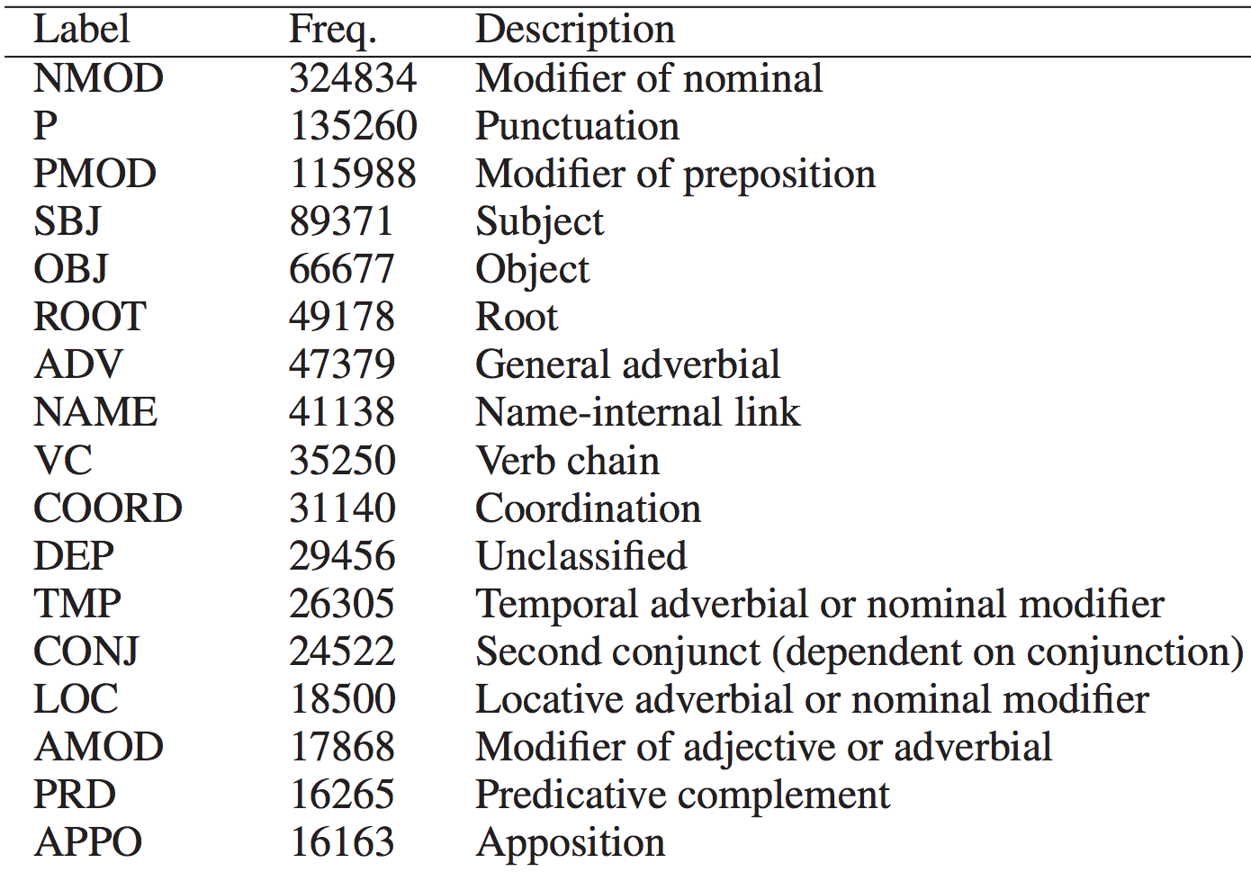
CoNLL-2008 syntactic dependencies
The key dependencies for most applications

Slide 97
Parsers with CoNLL dependencies
Malt
http://www.maltparser.org/
Very fast (O(n)), performance a couple F1 points below the state of the art
Shift-reduce algorithm
There are NLTK wrappers for it
MSTParser
http://sourceforge.net/projects/mstparser/
Not so fast (at least O(n2)) but has state of the art performance
Maximum spanning tree (MST) algorithm
Ensemble of Malt parsers
CluProcessor in https://github.com/clulab/processors
Very fast, with state of the art performance
Supports Stanford dependencies

Slide 98
Shallow syntax, or chunking
Text chunking: dividing a text in syntactically correlated sequences of words.
Chunking << dependency or constituent syntax
But it is sufficient for some applications
Can be implemented with really fast algorithms

Slide 99
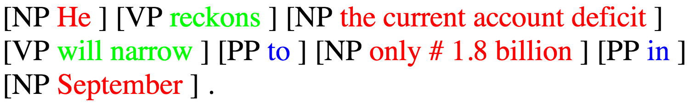
Shallow syntax example
He reckons the current account deficit will narrow to only #1.8 billion in September.
This problem reduces to sequence tagging, similarly to NER!
But the IOB (or more complex) representation is preferred here. Why?

Slide 100
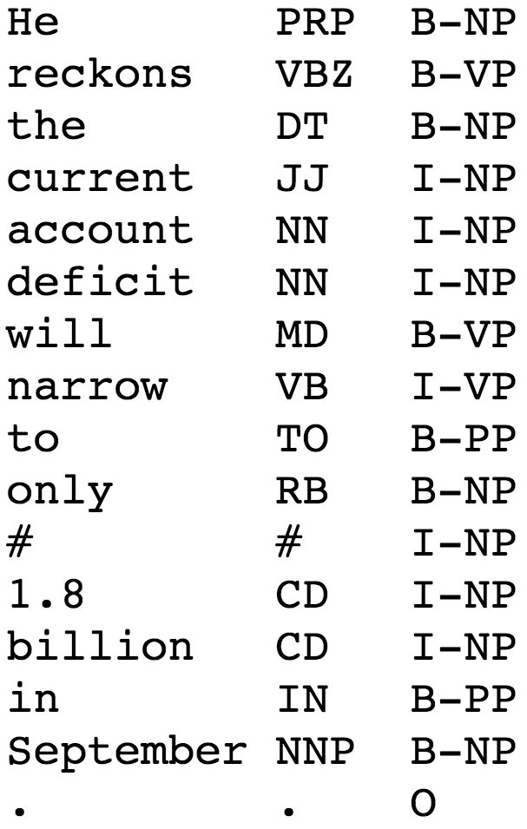
Shallow syntax example

Slide 101
Shallow syntax tools
Included in OpenNLP and processors
Not included in StanfordNLP or NLTK
But can be easily added to both. NLTK even provides nice documentation for this. See chapter 7.2 in the NLTK book.

Slide 102
Typical NLP pipeline
Text
Tokenization / Sentence segmentation
Part of speech (POS) tagging
Normalization / Stemming / Lemmatization
Named entity recognition (NER)
Parsing (constituent, dependency, shallow)
Coreference resolution
Processed text

Slide 103
Coreference resolution
Victoria Chen, Chief Financial Officer of MegaBucks Banking Corp. since 2004, saw her pay jump 20%, to $1.3 million, as the 37-year-old became the Denver-based financial services company’s president. It has been years since she came to Megabucks from rival LotsaBucks.

Slide 104
Coreference resolution
Victoria Chen, Chief Financial Officer of MegaBucks Banking Corp. since 2004, saw her pay jump 20%, to $1.3 million, as the 37-year-old became the Denver-based financial services company’s president. It has been years since she came to Megabucks from rival LotsaBucks.
Coreferring expressions: Victoria Chen, Chief Financial Officer of MegaBucks Banking Corp. since 2004, her, the 37-year-old, the Denver-based financial services company’s president
Referent: Victoria Chen

Slide 105
Coreference resolution
Victoria Chen, Chief Financial Officer of MegaBucks Banking Corp. since 2004, saw her pay jump 20%, to $1.3 million, as the 37-year-old became the Denver-based financial services company’s president. It has been years since she came to Megabucks from rival LotsaBucks.
Coreferring expressions: MegaBucks Banking Corp., the Denver-based financial services company, MegaBucks
Referent: MegaBucks Banking Corp.

Slide 106
Definition
Coreference resolution
Finding expressions that corefer, i.e., referring expressions that refer to the same entity
Subtasks
Pronominal anaphora resolution: finding the antecedent for a single pronoun
Event resolution: coreference resolution when the referring expressions point to events rather than entities

Slide 107
Types of referring expressions
Indefinite noun phrases
Mrs. Martin was so very kind as to send Mrs. Goddard a beautiful goose.
He had gone round one day to bring her some walnuts.
I saw this beautiful Ford Falcon today.
Typically evoke a representation for a new entity in the discourse

Slide 108
Types of referring expressions
Definite noun phrases
It concerns a white stallion which I have sold to an officer. But the pedigree of the white stallion was not fully established.
Refer to entities that are identifiable to the hearer. That is, they were previously mentioned in text.

Slide 109
Types of referring expressions
Pronouns
Emma smiled and chatted as cheerfully as she could.
Pronoun referents have a high degree of activation or salience in the discourse.
Pronouns usually refer to entities introduced no further than a few sentences back.
Pronouns are usually anaphoric (they appear after the referent was introduced) but can be cataphoric (the opposite).

Slide 110
Types of referring expressions
Demonstrative pronouns
I just bought a copy of Thoreau’s Walden. I had bought one five years ago. That one had been very tattered; this one was in much better condition.
This = proximal demonstrative
That = distal demonstrative (further away)

Slide 111
Types of referring expressions
Names
Miss Woodhouse certainly had not done him justice.
International Business Machines sought patent compensation from Amazon; IBM had previously sued other companies.
Names can refer to both new and old entities in the discourse.

Slide 112
Features for coreference resolution
String match
Agreement
Person, number, gender, animacy, NE class
Syntactic constructs
Appositives, predicate nominatives, etc.
Grammatical role
Subject more salient than object
Repeated mention
Billy Bones had been thinking about a glass of rum ever since the pirate ship dicked. He hobbled over to the Old Parrot bar. Jim went with him. He called for a glass of rum.
Parallelism of syntax
Selectional restrictions
John parked his car in the garage after driving it for hours.

Slide 113
Coreference resolution tools
Included in CoreNLP, processors, and OpenNLP
Not included in NLTK

Slide 114
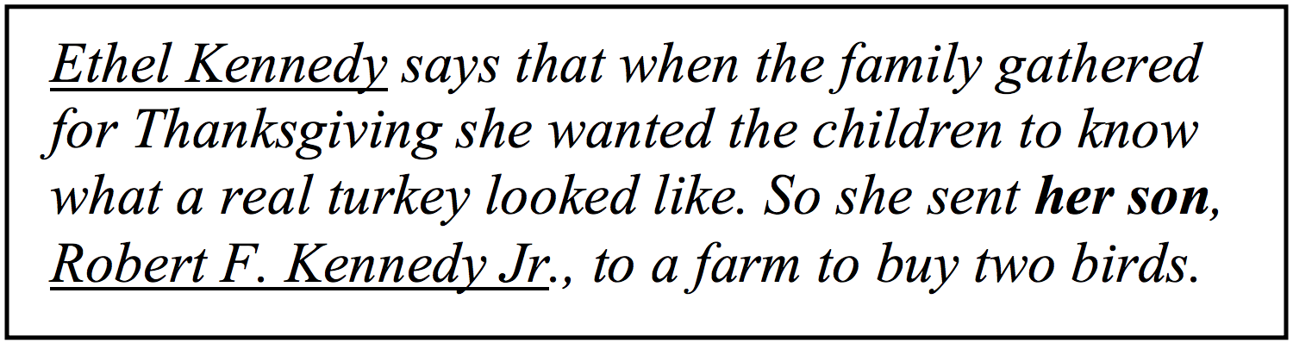
Why is coreference resolution important?
From Coreference for Learning to Extract Relations: Yes, Virginia, Coreference Matters

Slide 115
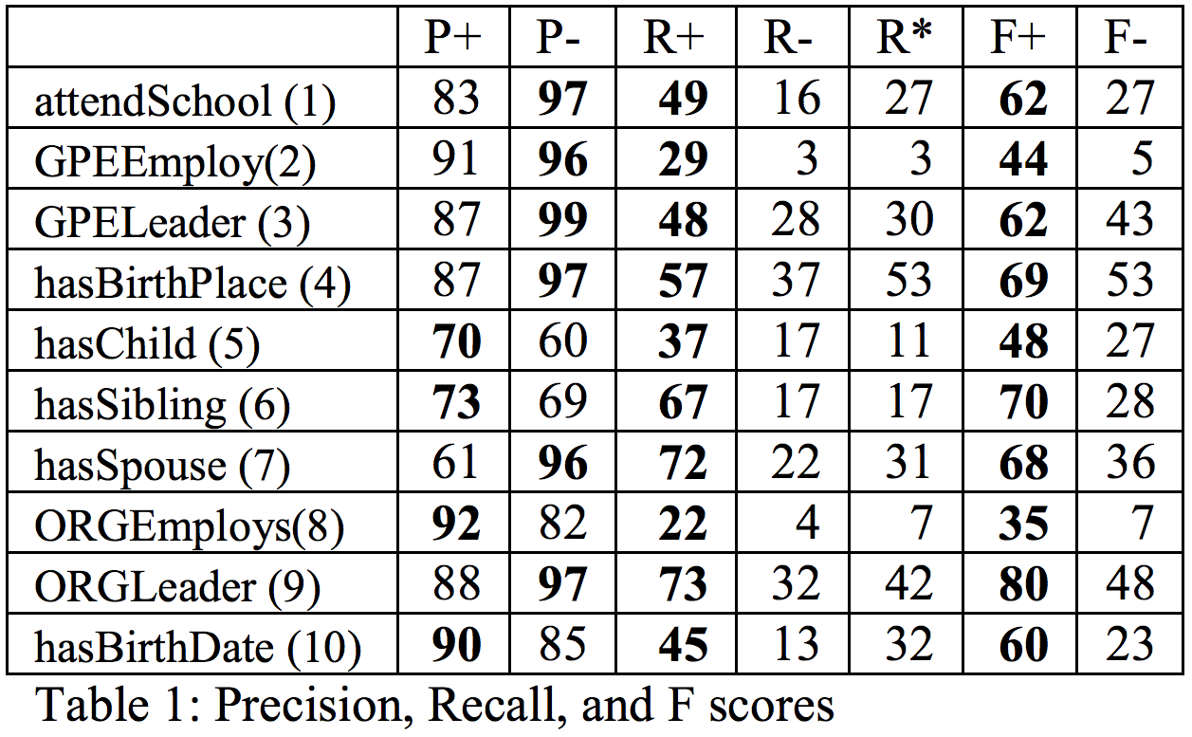
Why is coreference resolution important?
From Coreference for Learning to Extract Relations: Yes, Virginia, Coreference Matters

Slide 116
Take-away
We reviewed the most typical NLP tools: from tokenization to coreference resolution
How to use them (with NLTK)
We will cover implementation details in the remaining of this course

