Slide 1
CSC 439/539 Statistical Natural Language Processing Lecture 6: Sequence Models, (Visible) Markov Models
Mihai Surdeanu
Fall 2017

Slide 2
Take-away
Maximum entropy Markov models (MEMM)
Visible Markov models (MM) for POS tagging
Training by counting
Smoothing probabilities
Handling unknown words
Viterbi algorithm

Slide 3
Sequences in Information Extraction
Fully furnished condo in the beautiful Catalina Foothills! Equipped with everything you need - house wares, linens, full-size washer & dryer, cable and Wi-Fi. Relax on your private covered patio or take a dip in the sparkling pool! Close to fine dining and shopping, too. List price is average, please call for exact pricing and availability.
what
location
features
neighborhood
price
contact

Slide 4
Sequences Are Everywhere!
Speech recognition
Group phonemes into words
Natural language processing
Part of speech tagging
Named entity recognition
Information extraction
Question answering
Bioinformatics
Protein folding
We will use POS tagging as a use case, for its simplicity
One of the main motivations for interdisciplinarity in ML!

Slide 5
Why POS Tagging Must Model Sequences
Secretariat is expected to race tomorrow.
We want to generate all POS tags jointly given all words in the sentence!

Slide 6
Approach 0: Rule-based baseline
Assign each word a list of potential POS labels using the dictionary
Winnow down the list to a single POS label for each word using lists of hand-written disambiguation rules

Slide 7
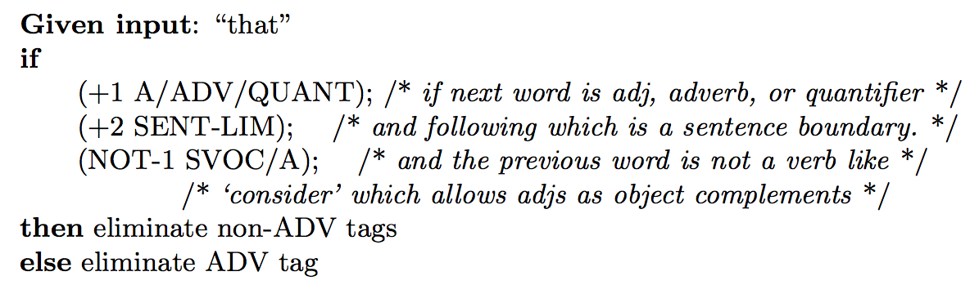
Example: adverbial-that winnow rule
You can learn these rules: see Transformation-based Learning: https://dl.acm.org/citation.cfm?id=218367
Slide by Jungyeul Park

Slide 8
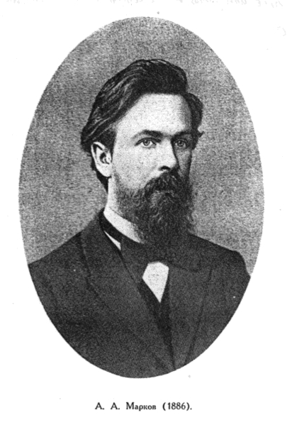
Approach 1: Maximum entropy Markov models
Maximum entropy = logistic regression
Markov models
Discovered by Andrey Markov
Limited horizon
How would you implement sequence models in the logistic regression algorithm that we know?
Let’s assume we scan the text left to right.

Slide 9
Approach 1 continued
Add the previously seen tags as features!
Use gold tags in training
Use predicted tags in testing
Other common features
Words, lemmas in a window [-k, +k]
Casing info, prefixes, suffixes of these words
Bigrams containing the current word
See also: https://github.com/clulab/processors/blob/master/main/src/main/scala/org/clulab/processors/clu/sequences/PartOfSpeechTagger.scala

Slide 10
Practice Exercise
What are the features and labels for each word in your MEMM POS classifier for the sentence:
John/NNP goes/VBZ to/TO China/NNP ./.

Slide 11
Approach 1: bidirectional MEMMs
You can stack MEMMs that traverse the text in opposite directions:
Left-to-right direction (same as before)
Right-to-left: uses the prediction(s) of the above system as features!
What is the problem with the predictions of the left-to-right model here?
Many state-of-the-art taggers use this approach: CoreNLP, processors, SVMTool

Slide 12
Approach 2
Let’s put the probability theory we covered in the previous lecture to use!
The resulting approach is called (visible) Markov model
“Visible” to distinguish it from the hidden Markov models, where the tags are unknown
Imagine implementing a POS tagger for an unstudied language without POS annotations

Slide 13
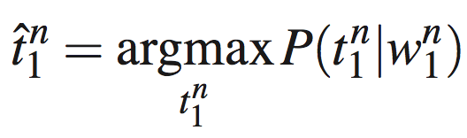
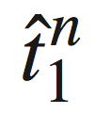
Approach 2: (Visible) Markov models
Sentence 1 contains n words
- an assignment of POS tags to this sentence
- the words in this sentence
- the estimate of optimal tag assignment
(The function argmax_{x} f(x) means “the x such that f(x) is maximized”.)

Slide 14
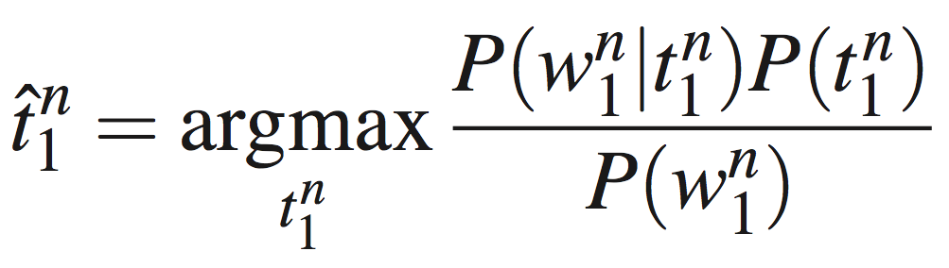
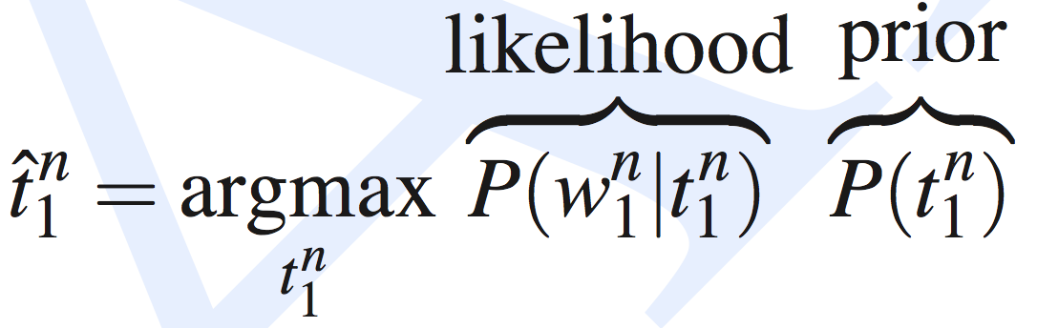
Let’s Formalize This
What’s this?
Why can we ignore that?
These two are still way too sparse!

Slide 15
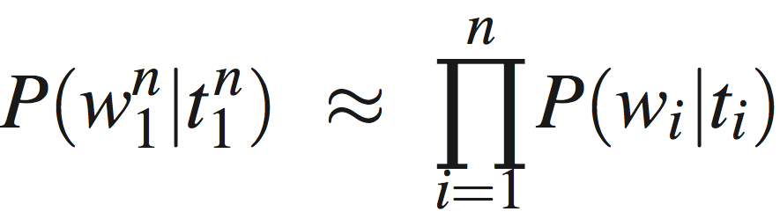
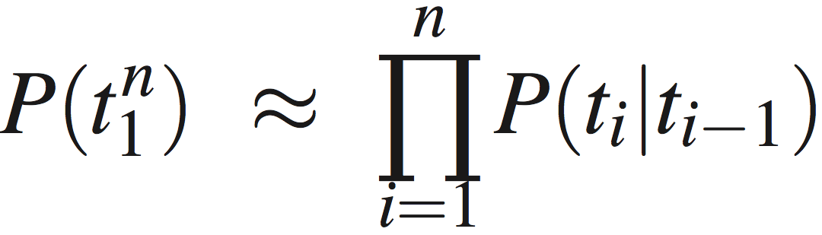
Three Approximations
Words are independent of the words around them
Words depend only on their POS tags, not on the neighboring POS tags
A tag is dependent only on the previous tag
Which rule was used to generate these?

Slide 16
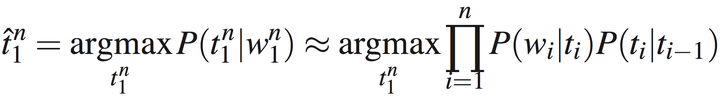
So…
Word likelihoods
Tag transition probabilities

Slide 17
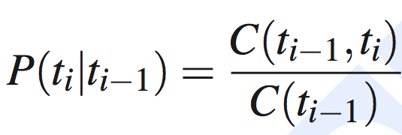
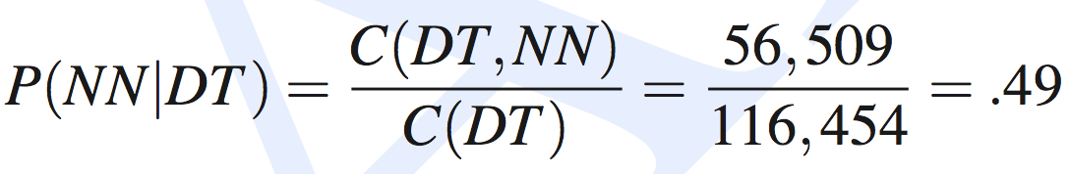
Computing Tag Transition Probabilities
In the Brown corpus (1M words)
DT occurs 116,454 times
DT is followed by NN 56,509 times

Slide 18
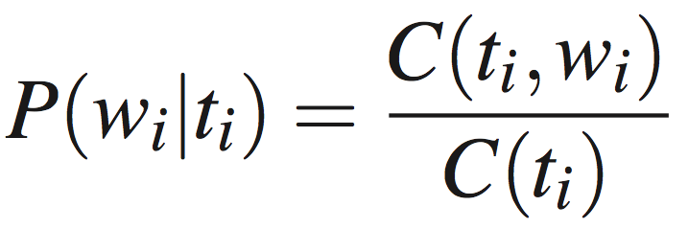
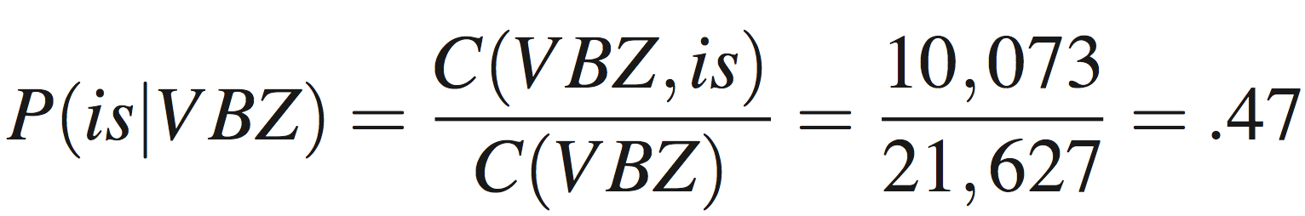
Computing Word Likelihoods
In the Brown corpus (1M words)
VBZ occurs 21,627 times
VBZ is the tag for “is” 10,073 times

Slide 19
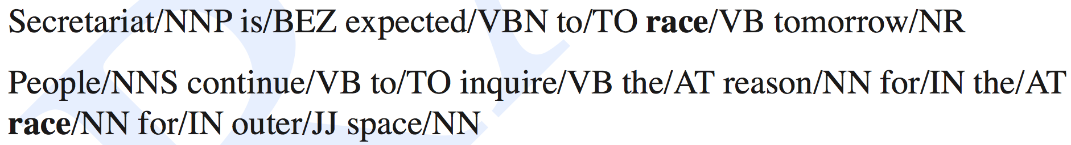
Example
“race” is ambiguous
Let’s see why VB is preferred in the first case

Slide 20
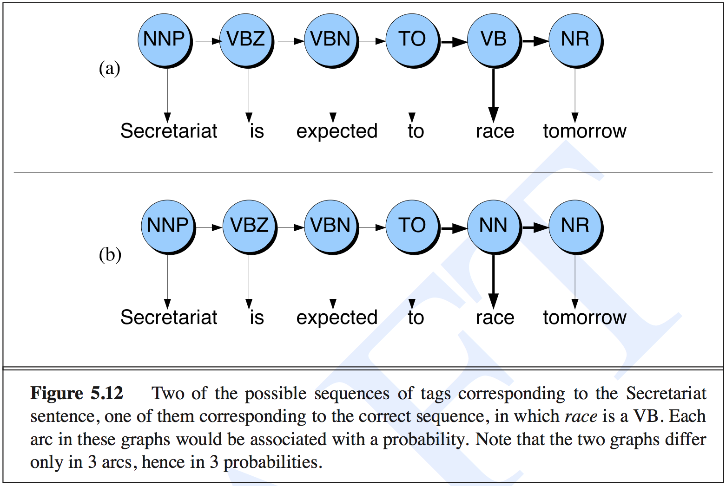
Example

Slide 21
Example
The first tag transition
P(NN|TO) = 0.00047
P(VB|TO) = .83
The word likelihood for “race”
P(race|NN) = 0.00057
P(race|VB) = 0.00012
The second tag transition
P(NR|VB) = 0.0027
P(NR|NN) = 0.0012

Slide 22
Example
P(VB|TO)P(NR|VB)P(race|VB) = 0.00000027
P(NN|TO)P(NR|NN)P(race|NN) = 0.00000000032
VB is more likely than NN, even though “race” appears more commonly as a noun!

Slide 23
Practice Exercise
You are implementing a POS tagger for Klingon. In your corpus you see the word “vjIjatlh” a total of 1,000 times, out of which 100 times it is seen with the POS tag VB. In the corpus there is a total of 10,000 words tagged as VB. What is P(vjIjatlh|VB)?

Slide 24
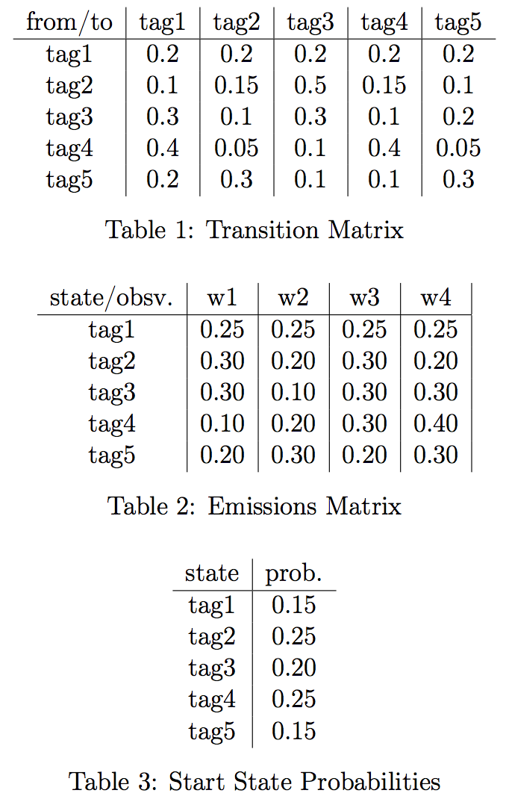
Practice Exercise (1/2)
Given the following MM, in a hypothetical language containing 5 POS tags and 4 words:

Slide 25
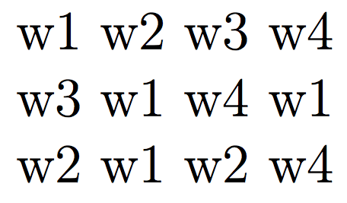
Practice Exercise (2/2)
What is the best sequence of POS tags for the sentences below, in a greedy left-to-right tagging approach using this MM? That is, in each step choose the POS tag that maximizes the current P(t_{i}|t_{i-1}).
What is the overall probability for each best sequence?

Slide 26
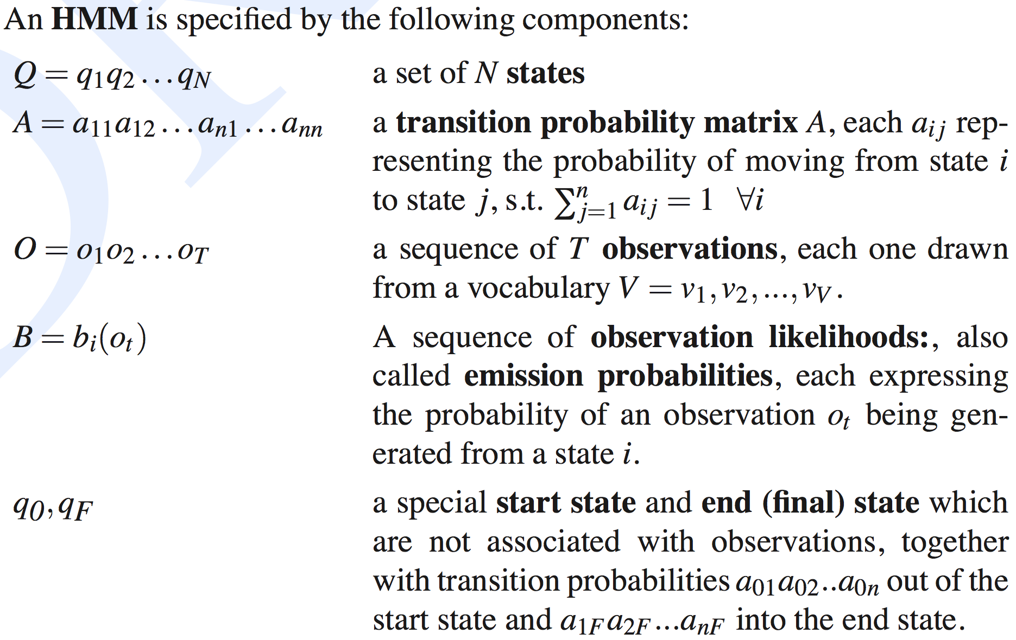
Formalization
tags = states; words = observations

Slide 27
Training/Testing an HMM
Just like with any machine learning algorithm, there are two important issues one needs to do to build an HMM:
Training:
Estimating p(t_{i}|t_{i-1}) and p(w_{i}|t_{i})
Testing (predicting):
Estimating the best sequence of tags for a sentence (or sequence or words)

Slide 28
Training: Two Types of Probabilities
A: transition probabilities
Used to compute the prior probabilities
B: observation likelihoods
Used to compute the likelihood probabilities

Slide 29
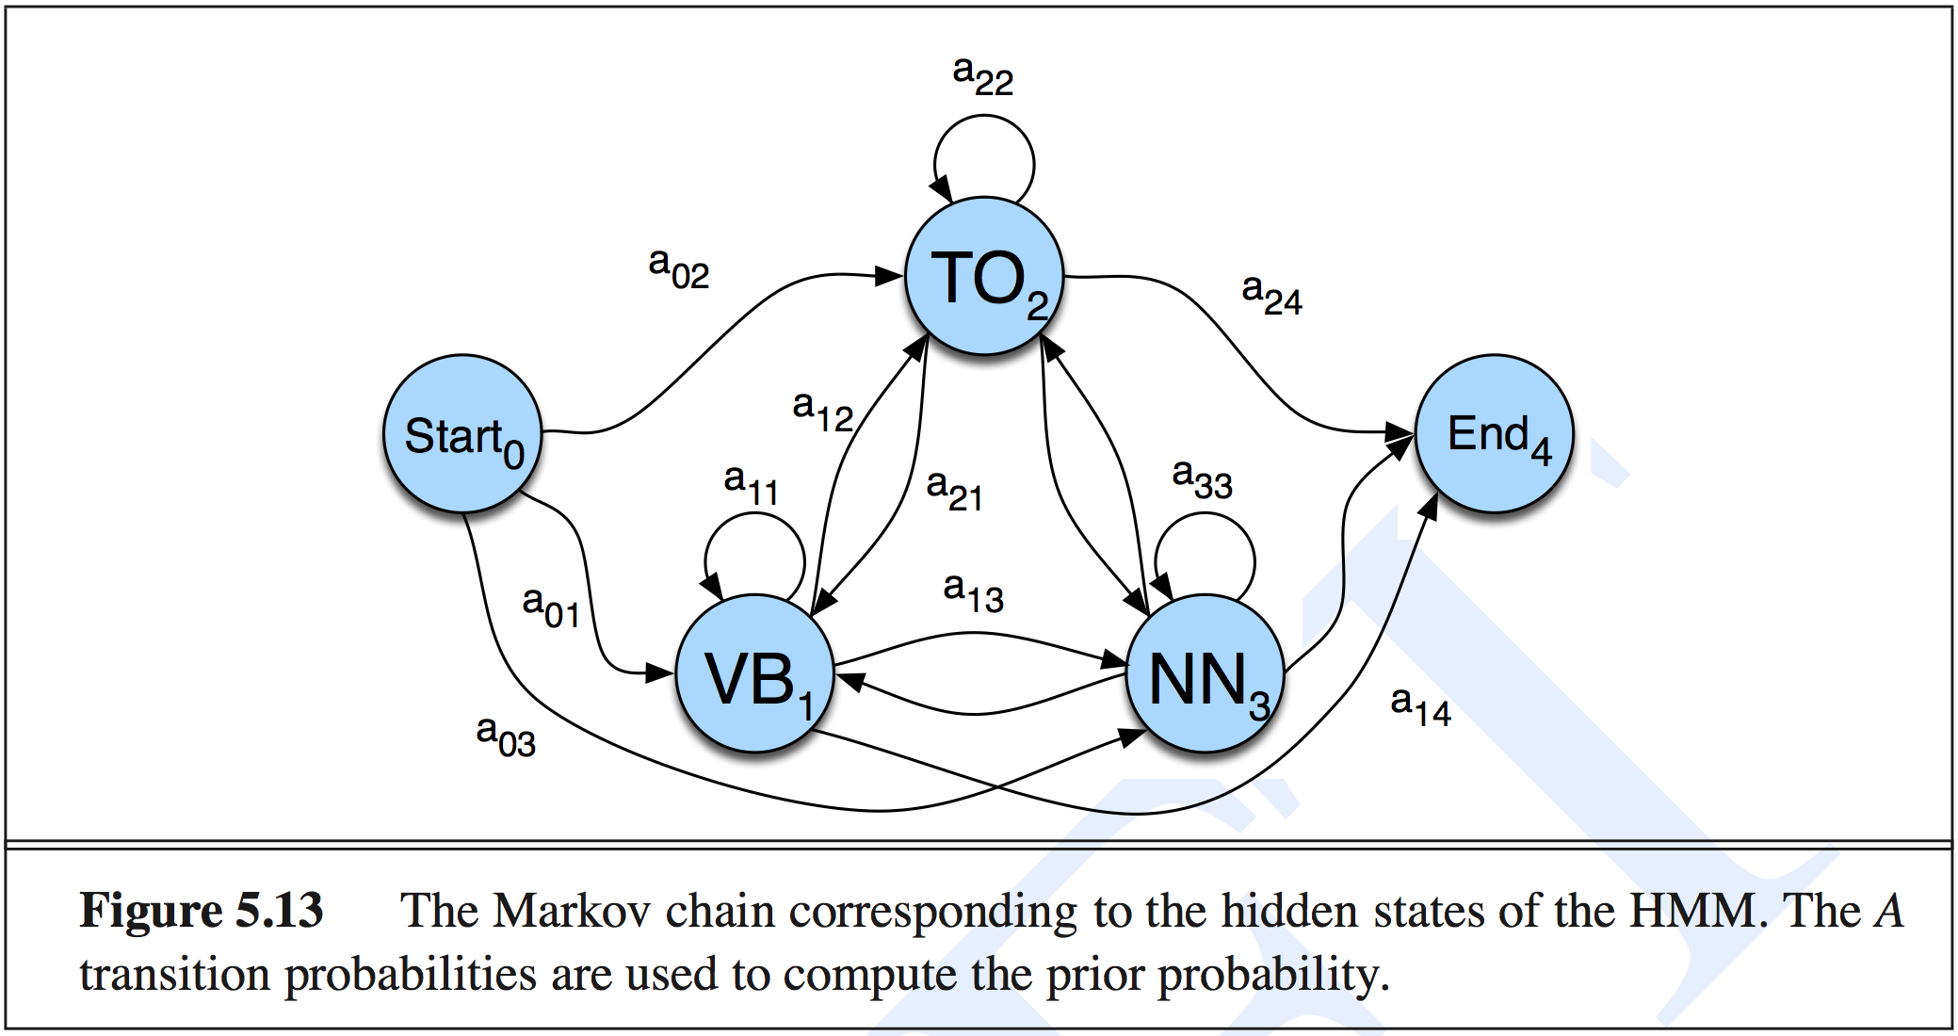
A Transition Probabilities

Slide 30
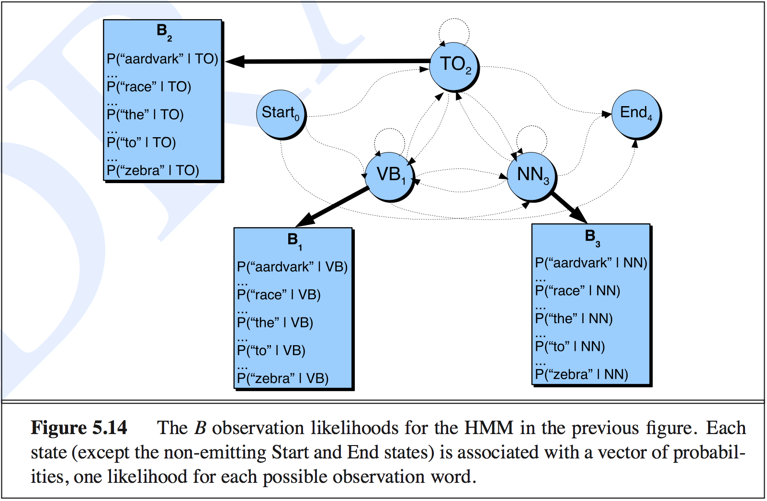
B Observation Likelihoods

Slide 31
Testing: Viterbi Algorithm
Viterbi algorithm
Computes the argmax efficiently
Example of dynamic programming
This is expensive to do…
because of this.

Slide 32

Viterbi

Slide 33
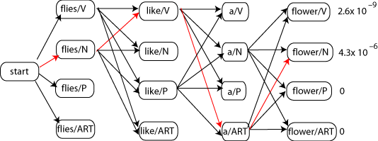
Illustration of Search Space

Slide 34
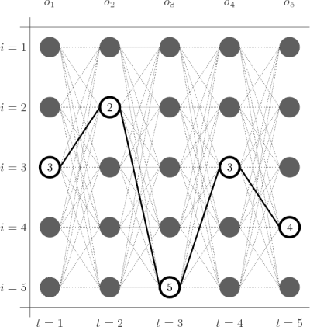
Illustration of Search Space
This is called a trellis
One row for each state (tag)
One column for each observation (word)

Slide 35
Viterbi Algorithm
Input
State (or tag) transition probabilities (A)
Observation (or word) likelihoods (B)
An observation sequence O = (o₁o₂…o_{T})
Output
Most probable state sequence Q = (q₁q₂…q_{T}) together with its probability

Slide 36
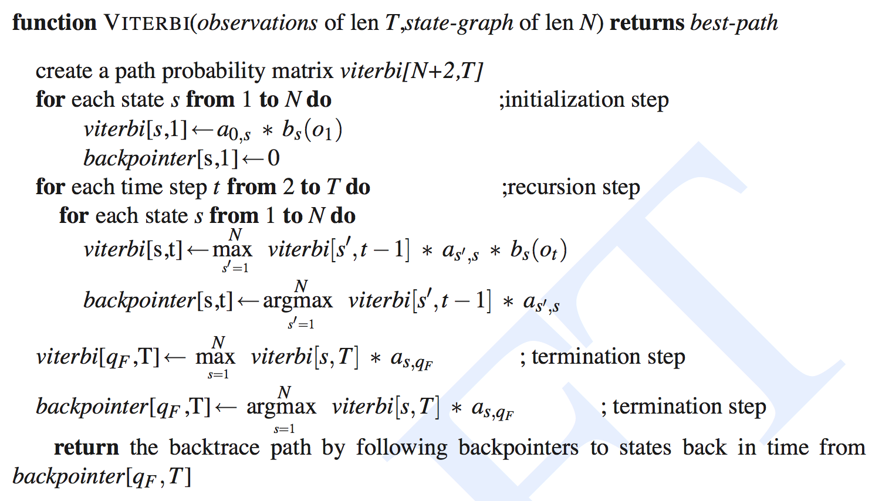
Viterbi Algorithm
Note that states 0 (virtual start) and q_{F} (virtual end) do not emit words.

Slide 37
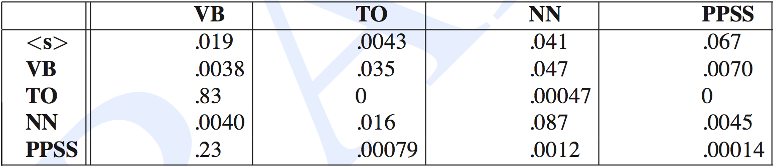
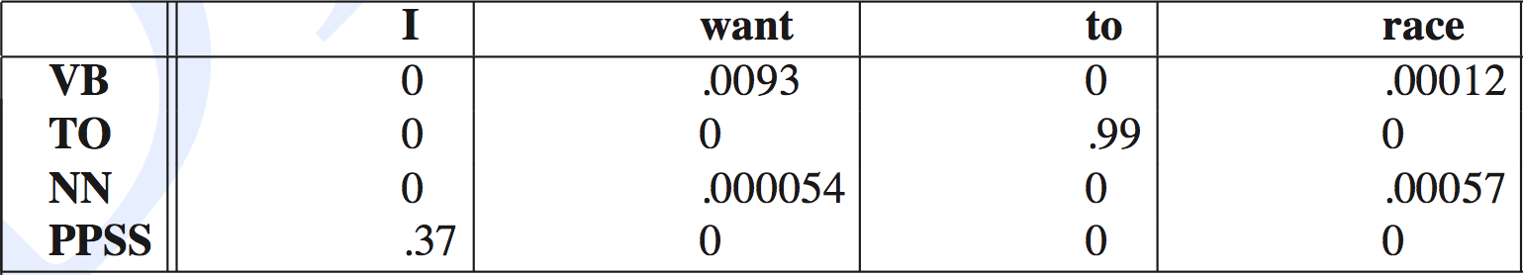
Example: A and B Matrices
A: The rows are labeled with the conditioning event, e.g., P(PPSS|VB) = .0070
B:

Slide 38
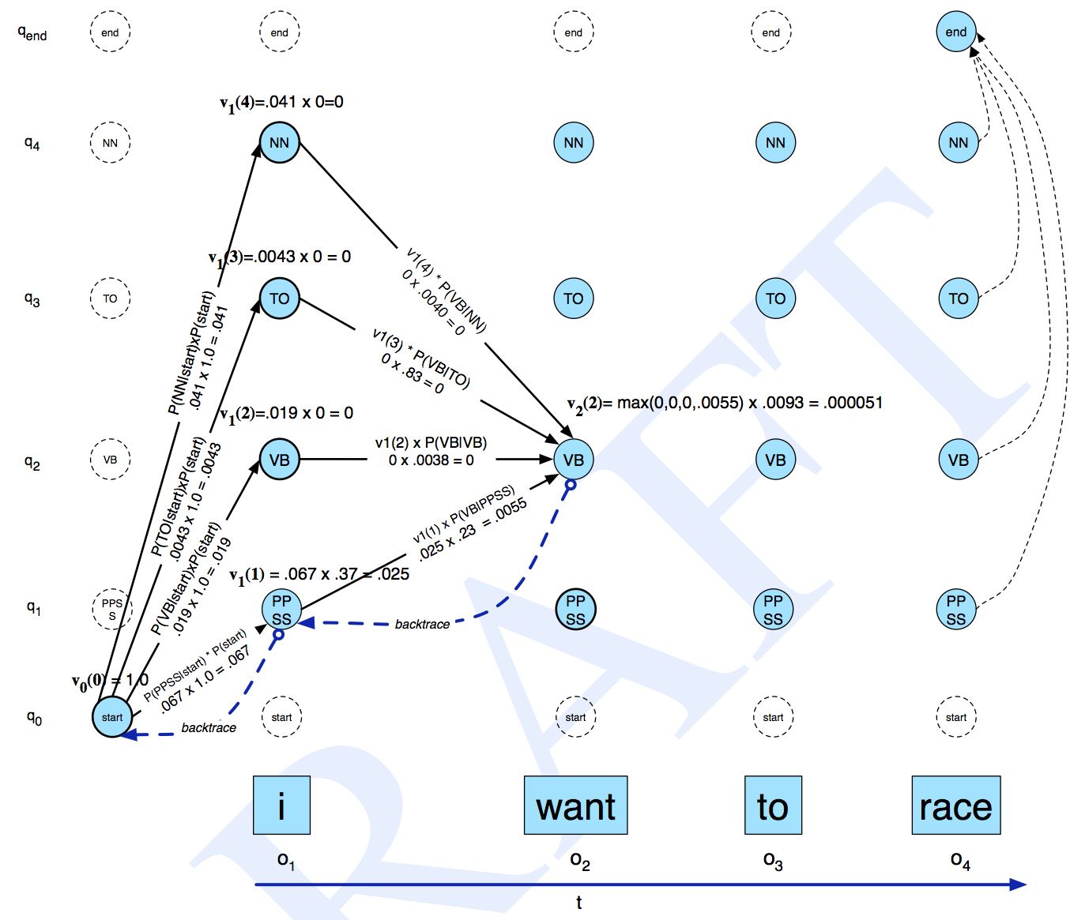
Example Trace
What’s the complexity of this algorithm?
Notes:
O(T N^2), where T is the length of the sentence, and N is the number of POS tags.

Slide 39
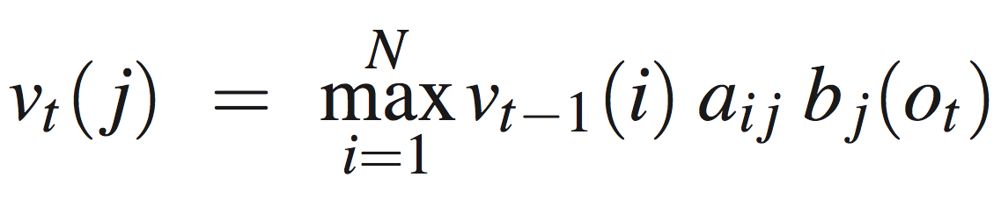
Summary of Viterbi Algorithm
v_{t-1}(i) – the previous Viterbi path probability from the previous time step t – 1 (i.e., the previous word)
a_{ij} – the transition probability from previous state q_{i} (i.e., the previous word having POS tag i) to current state q_{j} (i.e., the current word having POS tag j)
b_{j}(o_{t}) – the state observation likelihood of the observation symbol o_{t} (i.e., word at position t) given the current state j (i.e., the j POS tag)

Slide 40
Practice Exercise
What is the Viterbi path in the trellis for the MM in the previous practice exercise for each of these sequences:

Slide 41
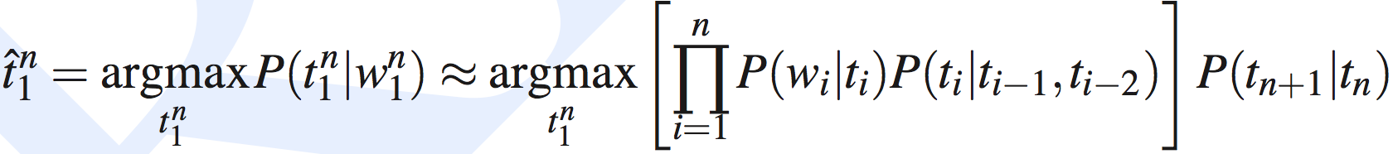
Extending the HMM Algorithm to Trigrams
This is pretty limiting for POS tagging
Let’s extend it to trigrams of tags!
This is better
t_{n+1} – end of sentence tag
We also need virtual tags, t₀ and t₋₁, to be set to the beginning of sentence value.

Slide 42
TnT
This is what the TnT (Trigrams’n’Tags) tagger does
Probably the fastest POS tagger in the world
Not the best, but pretty close (96% acc)
http://www.coli.uni-saarland.de/~thorsten/tnt/

Slide 43
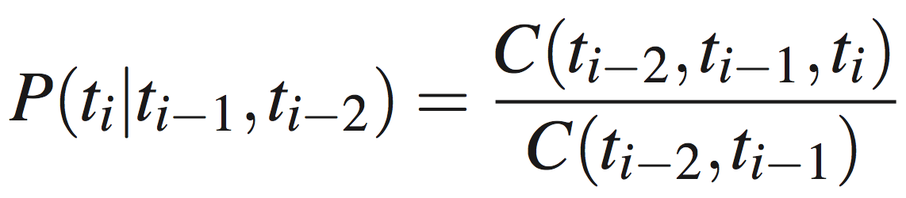
One Problem
Very
sparse!
Backoff model: linear interpolation
λ1 + λ2 + λ3 = 1, to guarantee that result is a probability.
How to set them?

Slide 44
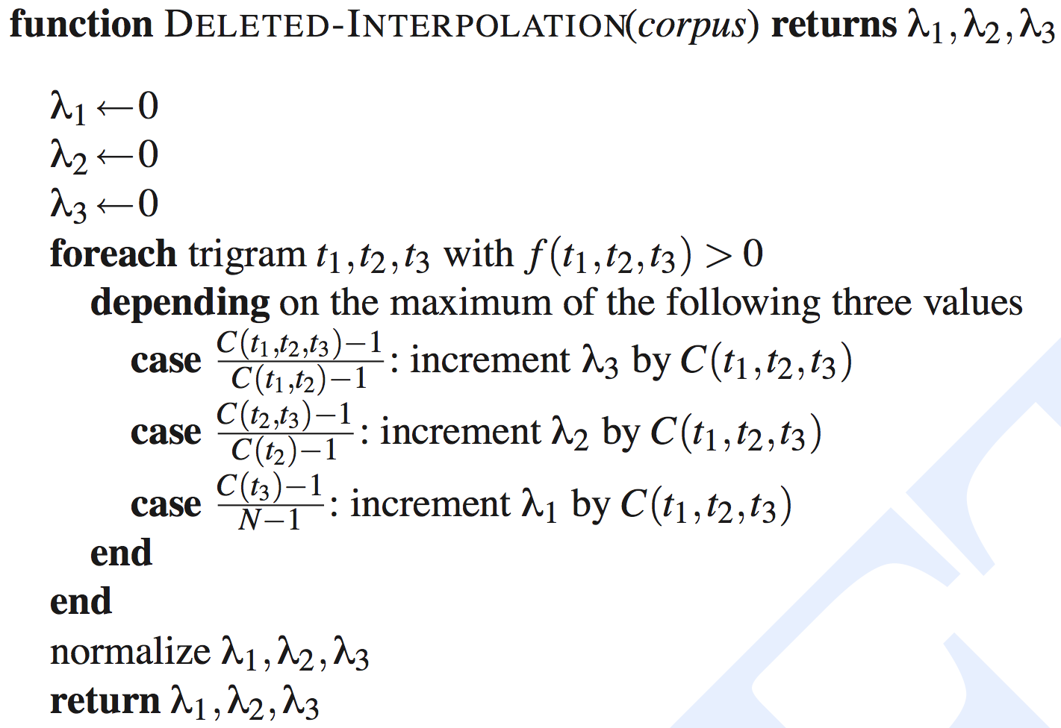
Deleted Interpolation
What is the normalization count here, to guarantee that these 3 values sum up to 1?
Notes:
N – total number of words in the corpus
When denominator is 0, result is 0
Notes:
norm = total number of trigrams in corpus

Slide 45
Other Types of Smoothing
Add one:
Where K is the number of words with POS tag t
Variant of add one (Charniak’s):
Not a proper probability distribution!

Slide 46
Practice Exercise
You are implementing a POS tagger for Klingon. In your corpus you see the word “vjIjatlh” a total of 1,000 times, out of which 100 times it is seen with the POS tag VB. In the corpus there is a total of 10,000 words tagged as VB. What is P(vjIjatlh|VB)
Using “add one” smoothing?
Using Charniak smoothing for epsilon = 0.01?

Slide 47
Another Problem for All HMMs
Work in log space to avoid underflow!

Slide 48
Yet Another Problem: Unknown Words
Solution 0 (not great): assume uniform emission probabilities (this is what “add one” smoothing does)
You can exclude closed-class POS tags such as…
This does not use any lexical information such as suffixes
Solution 1: capture lexical information:
This reduces error rate for unknown words from 40% to 20%

Slide 49
Main Disadvantage of HMMs
Hard to add features in the model
Capitalization, hyphenated, suffixes, etc.
It’s possible but every such feature must be encoded in the p(word|tag)
Redesign the model for every feature!
MEMMs avoid this limitation, but they take longer to train

Slide 50
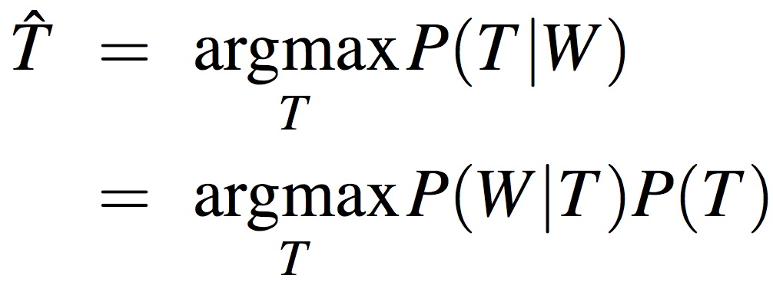
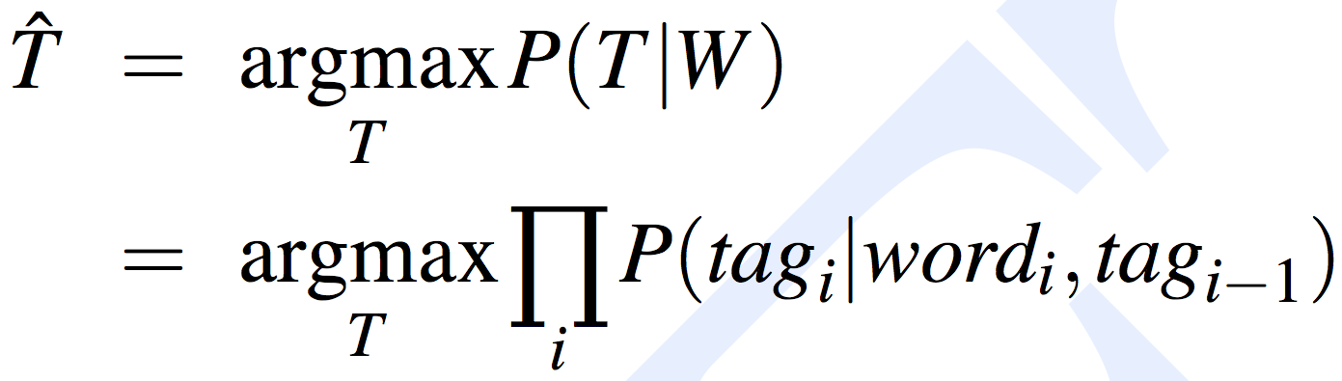
HMM vs. MEMM
(H)MM
MEMM

Slide 51
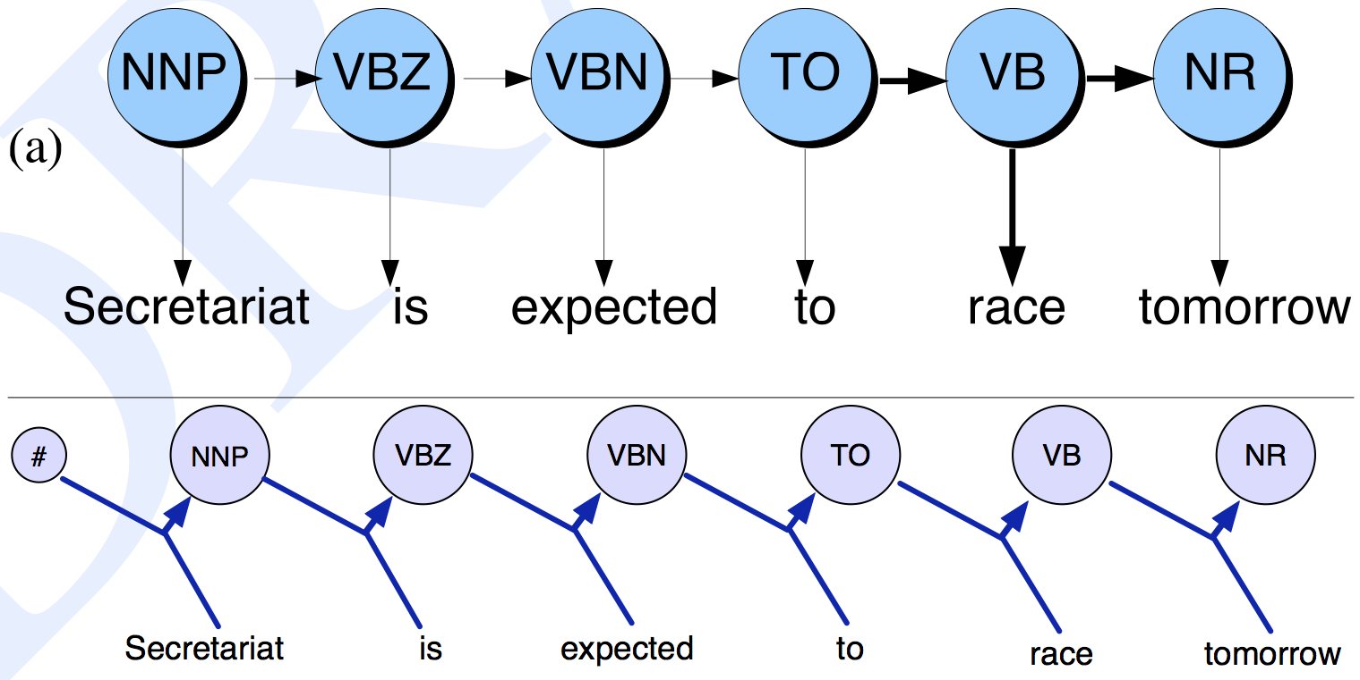
Illustration
(H)MM
MEMM

Slide 52
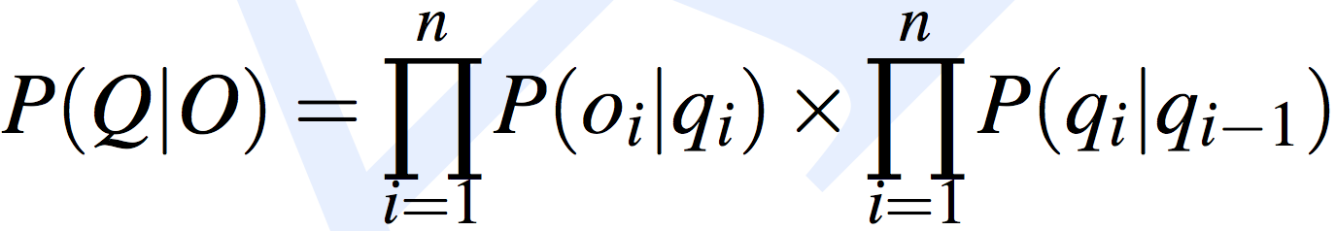
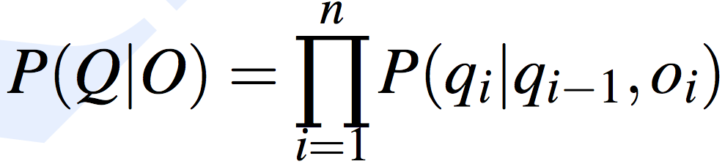
Formalization
(H)MM
MEMM

Slide 53
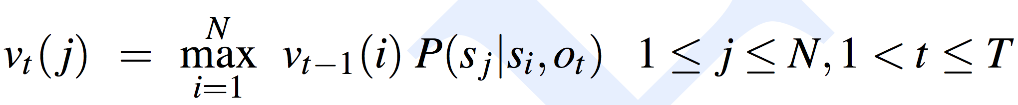
Testing (Decoding)
A slight variation of Viterbi:
(H)MM
MEMM

Slide 54
Evaluation
POS tagging accuracy = 100 x (number of correct tags) / (number of words in dataset)
Accuracy numbers currently reported for POS tagging are most often between 95% and 97%
But they are much worse for “unknown” words

Slide 55
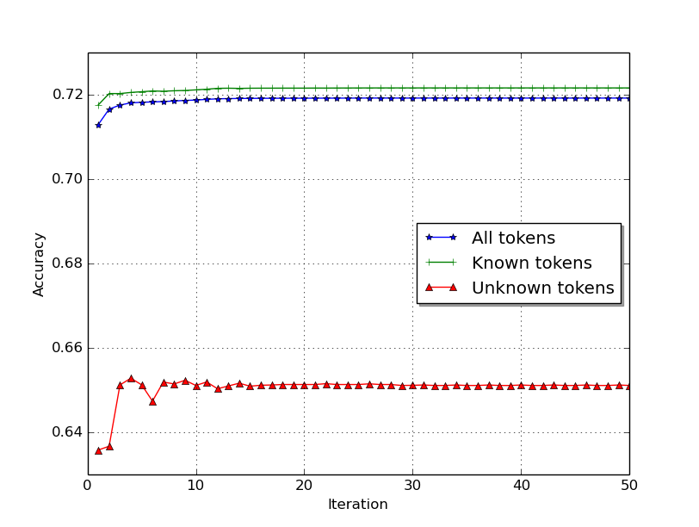
Evaluation example
Persian POS tagging results using cross-lingual projection

Slide 56
Evaluation for NER/IE
Accuracy does not work. Why?
We need precision, recall, F1:
P = TP/(TP + FP)
R = TP/(TP + FN)
F1 = 2PR/(P + R)
Micro vs. macro F1 measures
What are these?
What are the advantages/disadvantages of each?

Slide 57
Hidden Markov Models
What if you want to build a POS tagger for a language where you have no annotations?
Hidden Markov models
The states are unknown
Kinda like clustering for sequences
Not extremely useful in practice…
Skipping for now. We may revisit this idea at the end of the course, time permitting

Slide 58
Readings
FSNLP chapter 10
Optional, using MEMM for information extraction: http://cseweb.ucsd.edu/~elkan/254spring02/gidofalvi.pdf
Optional, bi-directional MEMM for POS tagging: https://nlp.stanford.edu/~manning/papers/tagging.pdf

Slide 59
Take-away
Maximum entropy Markov models (MEMM)
Visible Markov models (MM) for POS tagging
Training by counting
Smoothing probabilities
Handling unknown words
Viterbi algorithm

