Slide 1
CSC 439/539 Statistical Natural Language Processing Lecture 1: Introduction
Mihai Surdeanu
Fall 2017

Slide 2
Take-away
Why you should take this course
Admin issues
First homework due in 1 week!
What topics will be covered in this class?

Slide 3

Language is hard…

Slide 4
“Beating up” other languages
Why do we eat “pork” and “beef” but we raise “pigs” and “cows”?
What is the percentage of cognates with French in English?

Slide 5
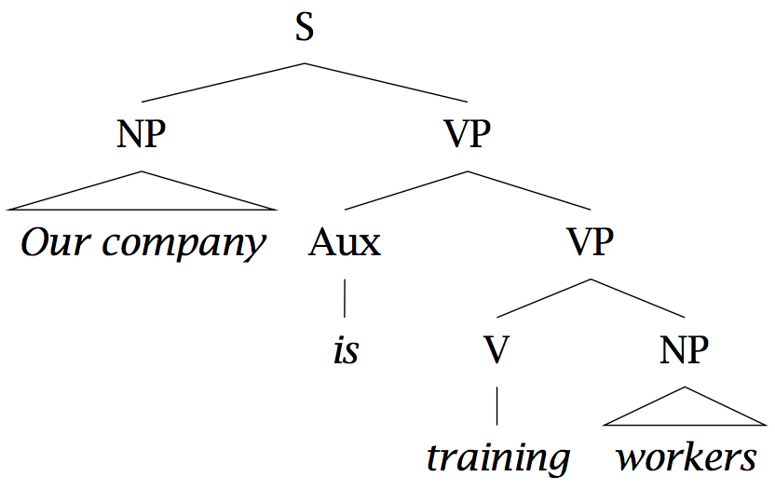
Who did what to whom?
“Our company is training workers.”
Correct: “is training” as a verb group

Slide 6
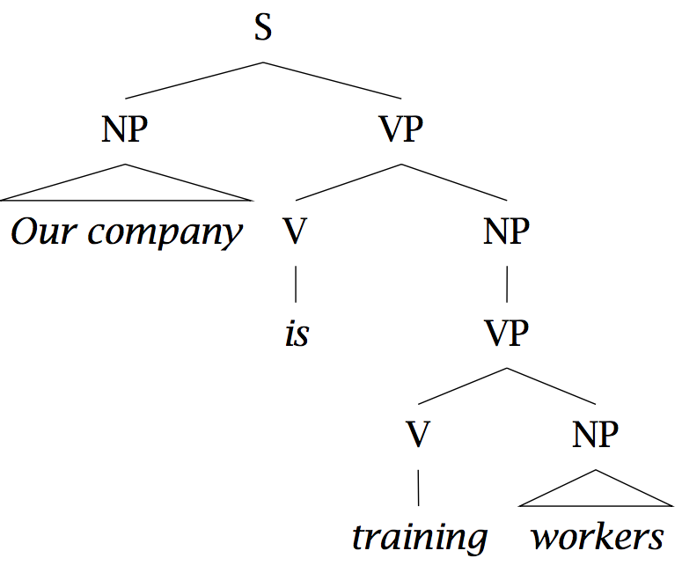
Who did what to whom?
Incorrect: “training” as gerund, as in: “Our problem is training workers.”

Slide 7
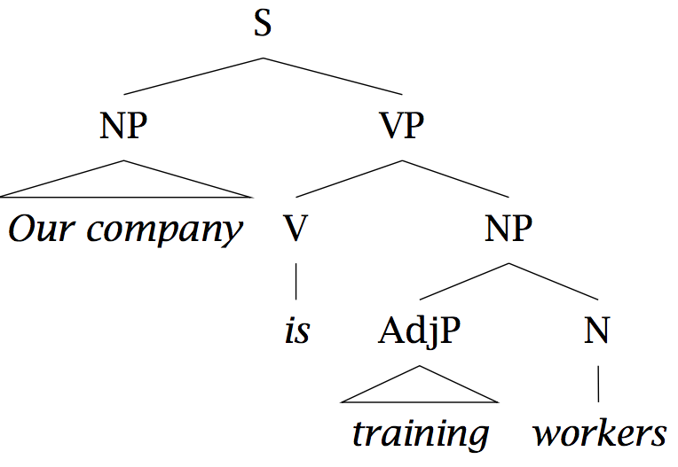
Who did what to whom?
Incorrect: “training” modifies “workers, as in: “Those are training wheels.”

Slide 8
Ambiguity and selectional preferences
I swallowed a bug while running.
What selectional preferences would you add for the verb “swallow”?
I swallowed his story, hook, line, and sinker.
The supernova swallowed the planet.

Slide 9
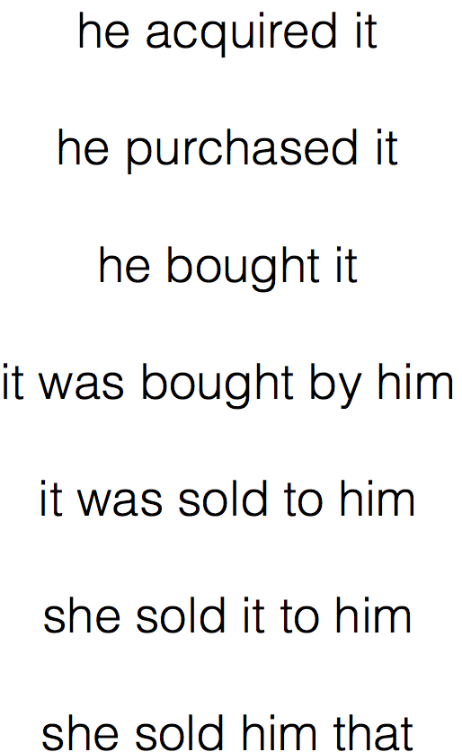
Variability
Slide by Yoav Goldberg

Slide 10

Discourse/Ellipsis/Multi-modality

Slide 11
But language understanding enables important applications

Slide 12
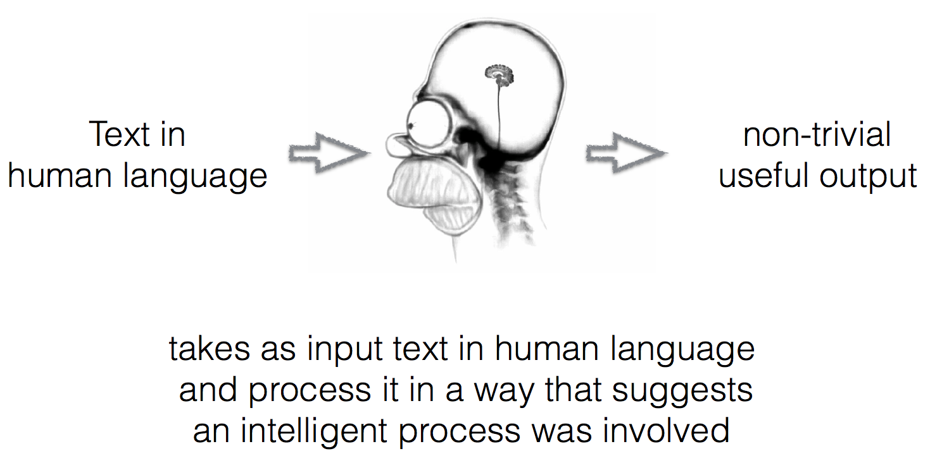
NLP in a nutshell
Slide by Yoav Goldberg

Slide 13
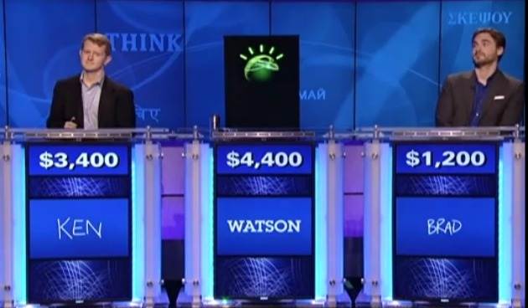
NLP Applications Question Answering

Slide 14
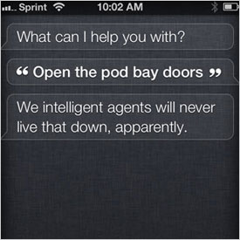
NLP Applications Question Answering

Slide 15
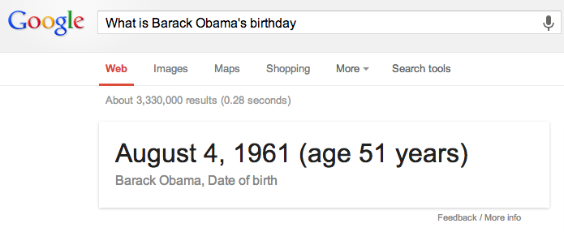
NLP Applications Question Answering

Slide 16
NLP Applications Question Answering
When athletes begin to exercise, their heart rates and respiration rates increase. At what level of organization does the human body coordinate these functions?
A: at the tissue level
B: at the organ level
C: at the system level
D: at the cellular level
Unsolved problem!
Needs inference
Very little training data

Slide 17
Machine reading/Information extraction
Human domain experts are around here
Notes:
Explain axes first!
Team 4 was the combined output of two systems: ourselves and team4b
We had the best overall performance
Team1: NaCTeM – The National Center for Text Mining, University of Manchester
Team2: USC-ISI – University of Southern California, Information Sciences Institute
Team3: IHMC – Florida Institute for Human and Machine Cognition
Team4: FRIES – Carnegie-Mellon, SRI, Arizona
Team4b: MedScan

Slide 18
Machine reading/Information extraction

Slide 19
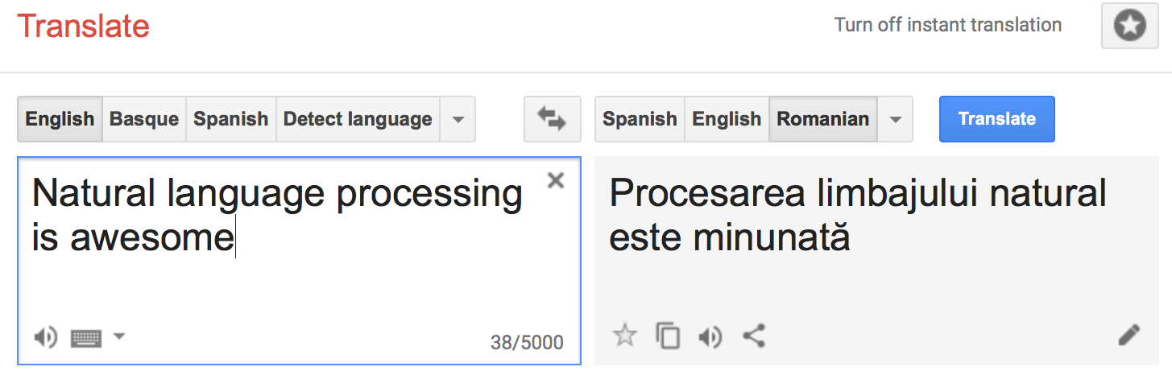
Machine translation

Slide 20
And many others…
Can you suggest a few other NLP applications?

Slide 21
Overview
Administration
First homework
Course overview

Slide 22
Instructor information
Instructor: Mihai Surdeanu
Email: msurdeanu@email.arizona.edu
Office: Gould-Simpson 746
Office hours: Tue 12:30 - 2
TAs:
Gustave (Gus) Hahn-Powell | Patricia Lee
hahnpowell@email.arizona.edu | pllee@email.arizona.edu
Office: Gould-Simpson 903 | Office: TBD
Office hours: Wed 2 - 3 | Office hours: TBD

Slide 23
Websites
Website/syllabus:
http://surdeanu.info/mihai/teaching/ling4539-fall17/index.php
But all material will be in D2L
Discussions on Piazza:
https://piazza.com/arizona/fall2017/ling439539/home

Slide 24
Prerequisites
Know how to program and have a decent understanding of data structures such as hash maps and trees. Have a basic understanding of computational linguistics:
Ling 438/538 or CSC 483/583
Ideally, Math 129 (Calc 2). However, we will cover the necessary math in class.

Slide 25
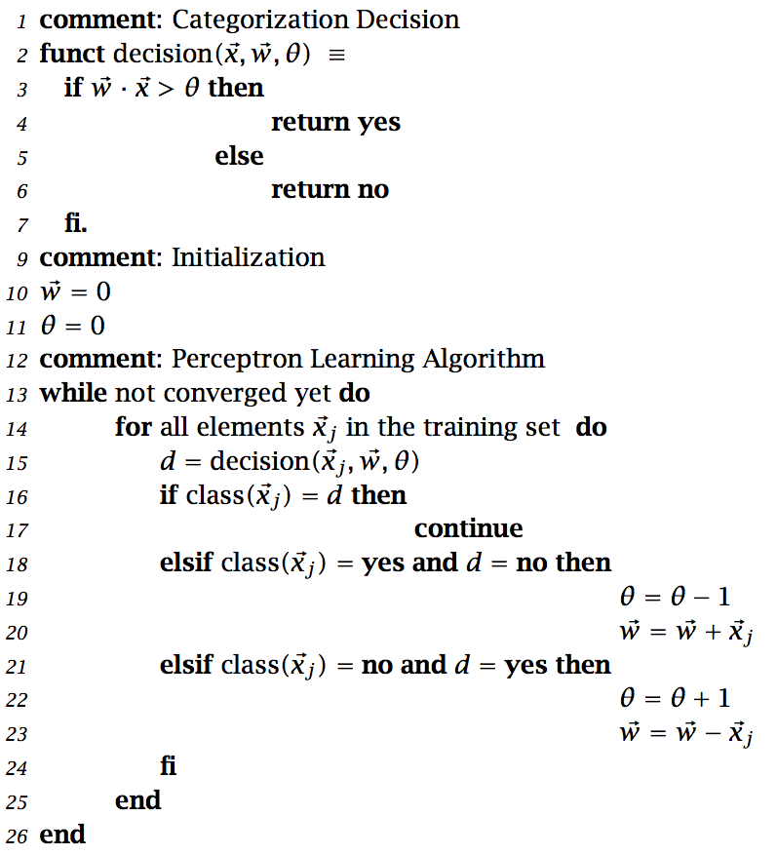
Prerequisites: does this look scary?

Slide 26
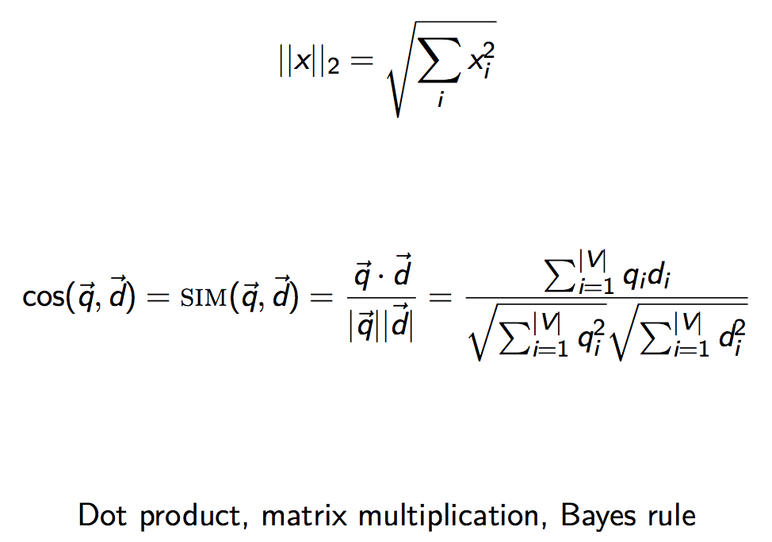
Prerequisites: does this look scary?

Slide 27
Choosing a programming language

Slide 28
The options
Python
“Official” language in this course
Java
Scala

Slide 29
Python
Pros:
Clean syntax
Popular: many NLP/ML libraries exist
Clean exception handling
Easy access to GPUs (for deep learning)
Cons:
Slow (when not on GPU)
Dynamically types
No great IDE

Slide 30
Java
Pros:
Pretty fast
Probably the most common language for serious NLP
Clean exception handling
Statically typed
Garbage collection
Several great IDEs
Cons:
Syntax too verbose
Inconsistent semantics due to enforced backwards compatibility (primitive types vs. objects, equality, etc.)

Slide 31
Scala
Pros:
Pretty fast
``Hot'' language for IR, NLP, ML, distributed computing, web development
Clean, transparent exception handling
Clean, minimalist syntax
Consistent semantics
Statically typed
Garbage collection
At least one great IDE (IntelliJ
Fully compatible with Java (use all Java libraries)
Cons:
It has some “dark corners”
Backwards compatibility not guaranteed
No deep learning library native to Scala

Slide 32
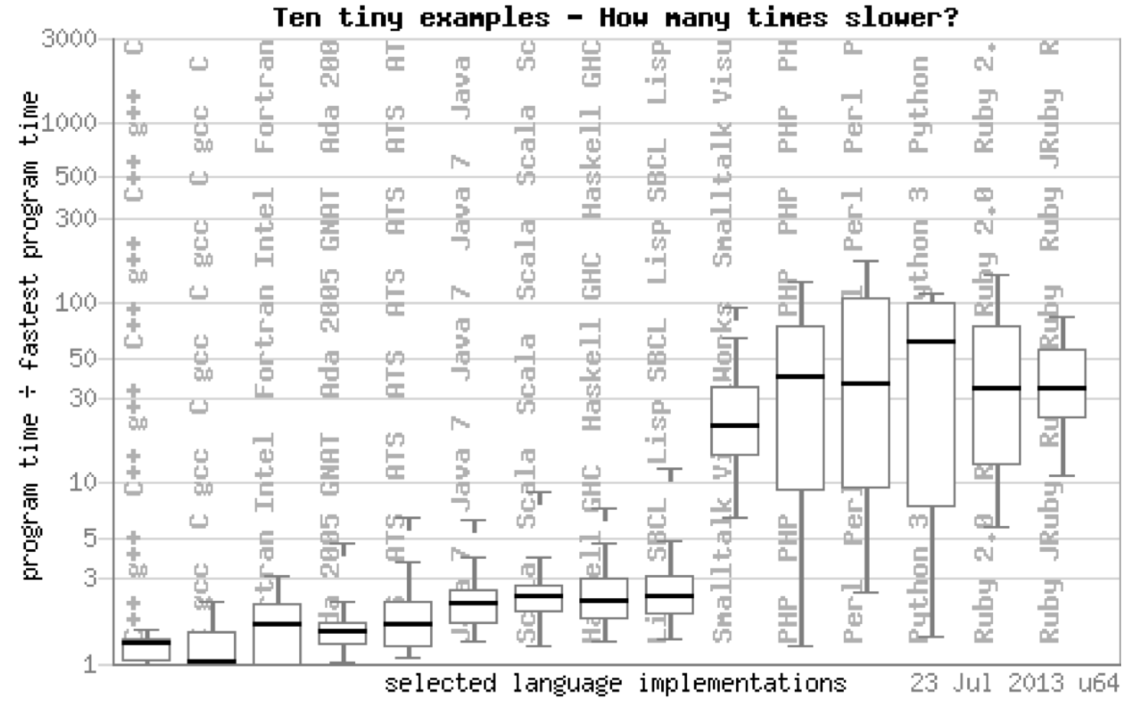
Performance comparison
More benchmarks:
http://benchmarksgame.alioth.debian.org/u64/benchmark.php?test=all&lang=all&data=u64

Slide 33

Textbook
http://nlp.stanford.edu/fsnlp
I will provide all the other additional materials.

Slide 34
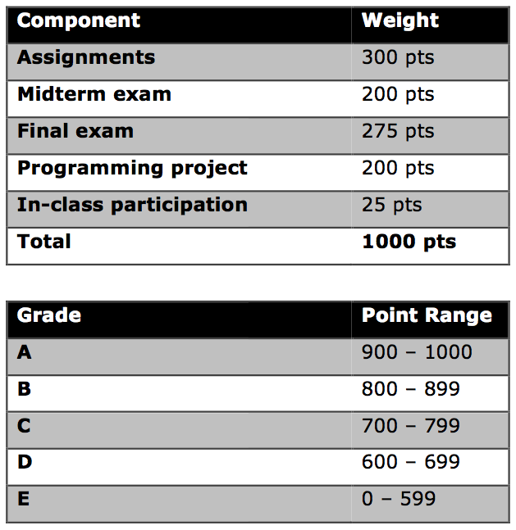
Grading

Slide 35
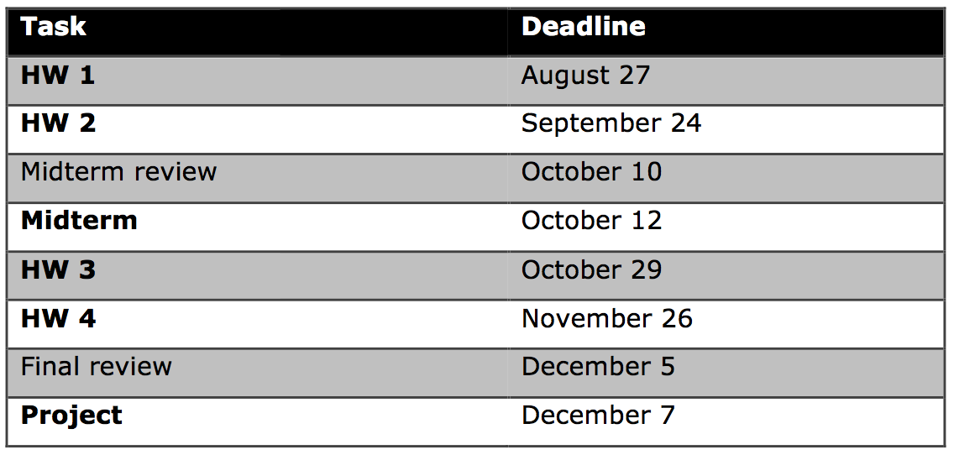
Four homeworks

Slide 36
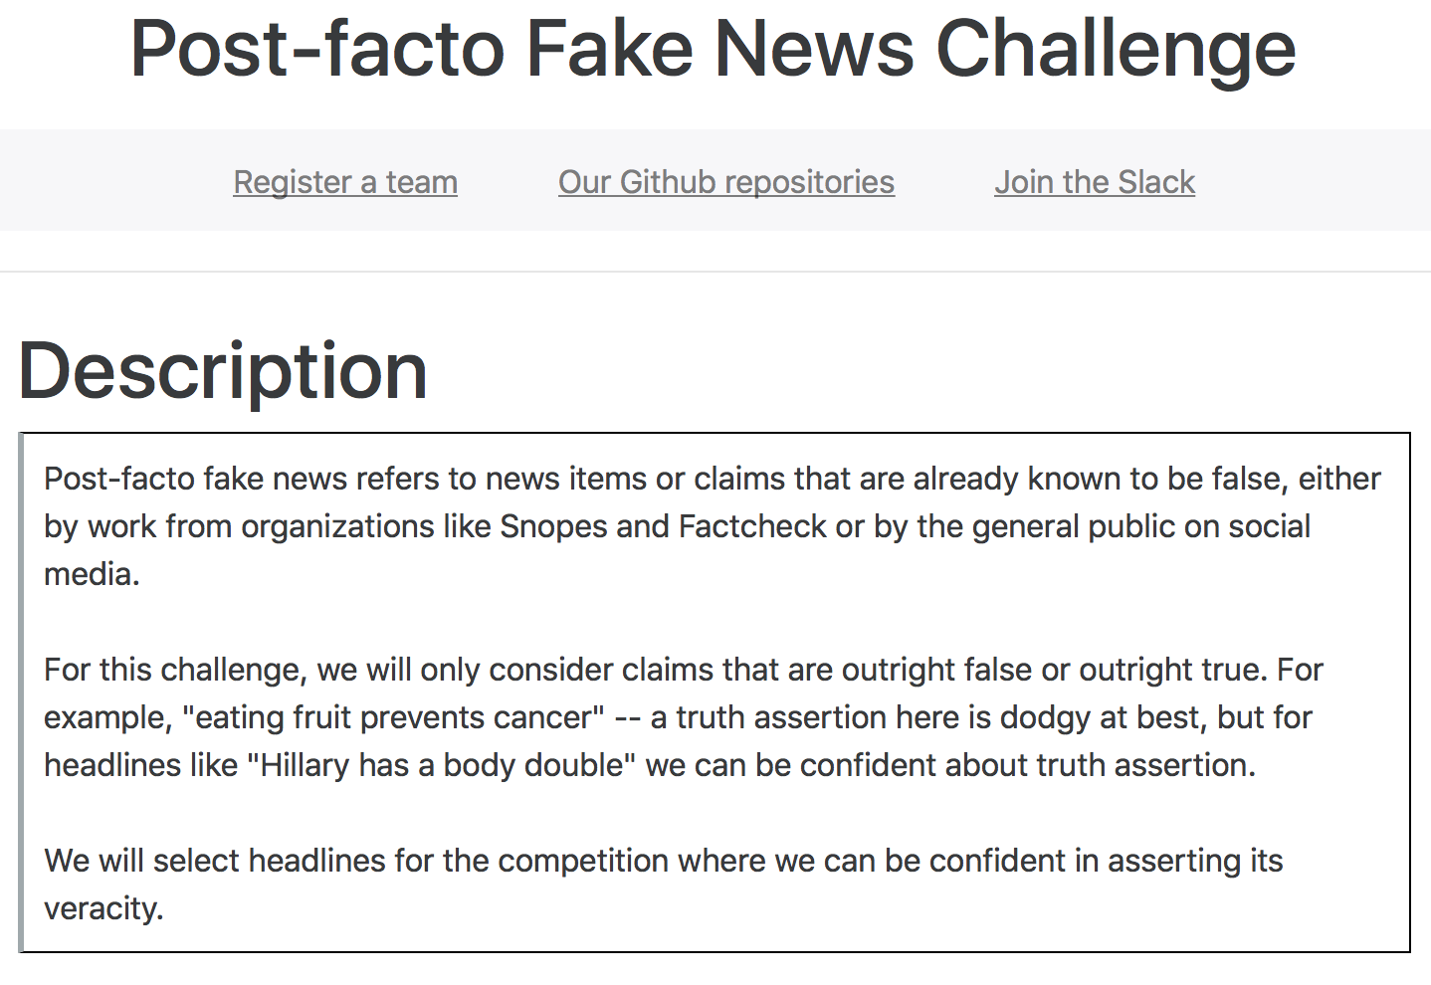
Final project
Implement a complete solution of a relevant NLP application or component.
You can choose your own, but each must be validated by the instructor.
For example:

Slide 37
Late work + attendance policy
Late work is not accepted, except in case of documented emergency approved by the instructor
Attendance is required
Students who miss class due to illness or emergency are required to bring documentation

Slide 38
Cooperation and cheating
Students are encouraged to share intellectual views and discuss freely the principles and applications of course materials. However, graded work/exercises must be the product of independent effort unless otherwise instructed.
We will use methods for plagiarism detection!
Students who violate the code of academic integrity should expect a penalty that is greater than the value of the work in question up to and including failing the course.
A record of the incident will be sent to the Dean of Students office. If you have been involved in other Code violations, the Dean of Students may impose additional sanctions.

Slide 39
Undergraduate vs. graduate requirements
This course will be co-convened. To differentiate between graduate and undergraduate students, the instructor will require graduate students to implement more complex algorithms for the programming project. Similarly, assignments and exams will have additional requirements/questions for graduate students.
The overall grading scheme will be the same between graduate and undergraduate students.

Slide 40
Overview
Administration
First homework
Course overview

Slide 41


Slide 42
First homework
Due Sunday night (8/27)!
Let’s take a look

Slide 43
Overview
Administration
First homework
Course overview

Slide 44
Part 1: Text categorization and a crash course in machine learning

Slide 45
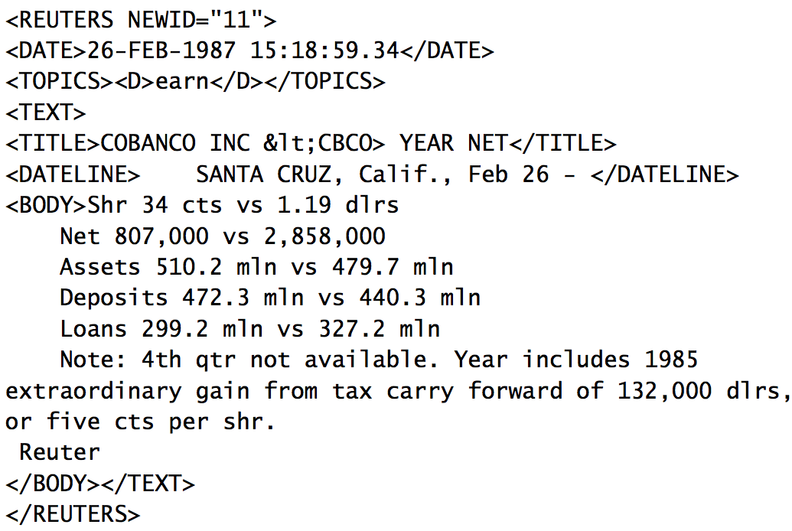
Text categorization

Slide 46
Other examples of text categorization?

Slide 47
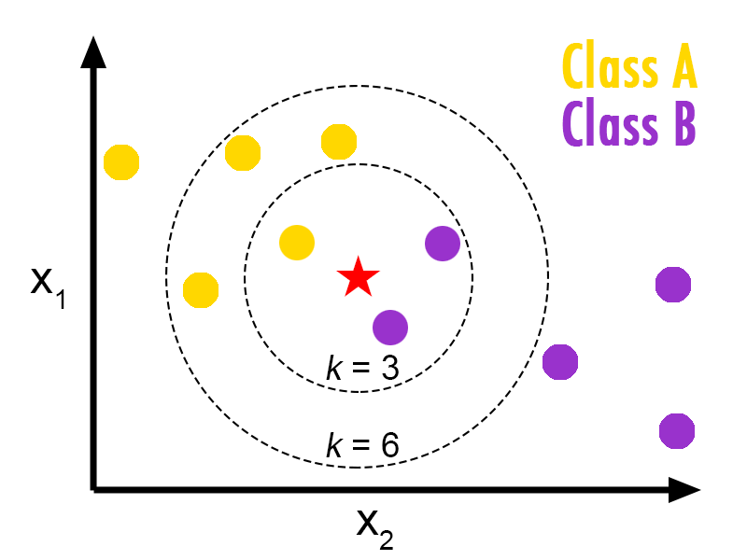
Algorithms for classification: from kNN to feed-forward neural networks

Slide 48
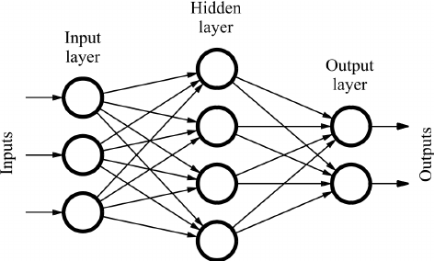
Algorithms for classification: from kNN to feed-forward neural networks

Slide 49
Part 2: Sequence models
Notes:
The previous part focuses on classification of elements independent of each other! Rare in NLP.

Slide 50
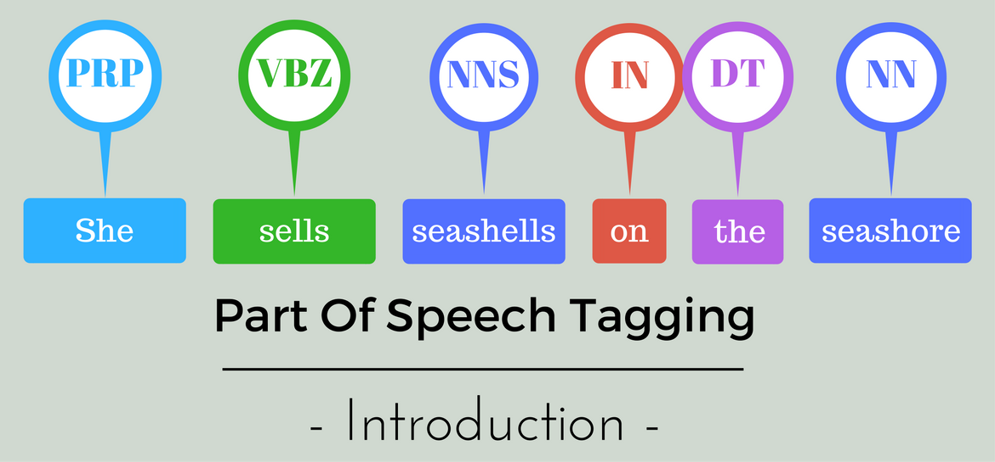
Part-of-speech tagging

Slide 51
Other examples of applications of sequence models?

Slide 52
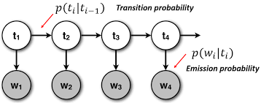
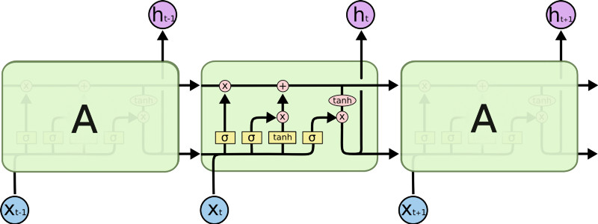
From hidden Markov models to long short-term memory models

Slide 53
Part 3: Parsing

Slide 54
Constituent parsing

Slide 55
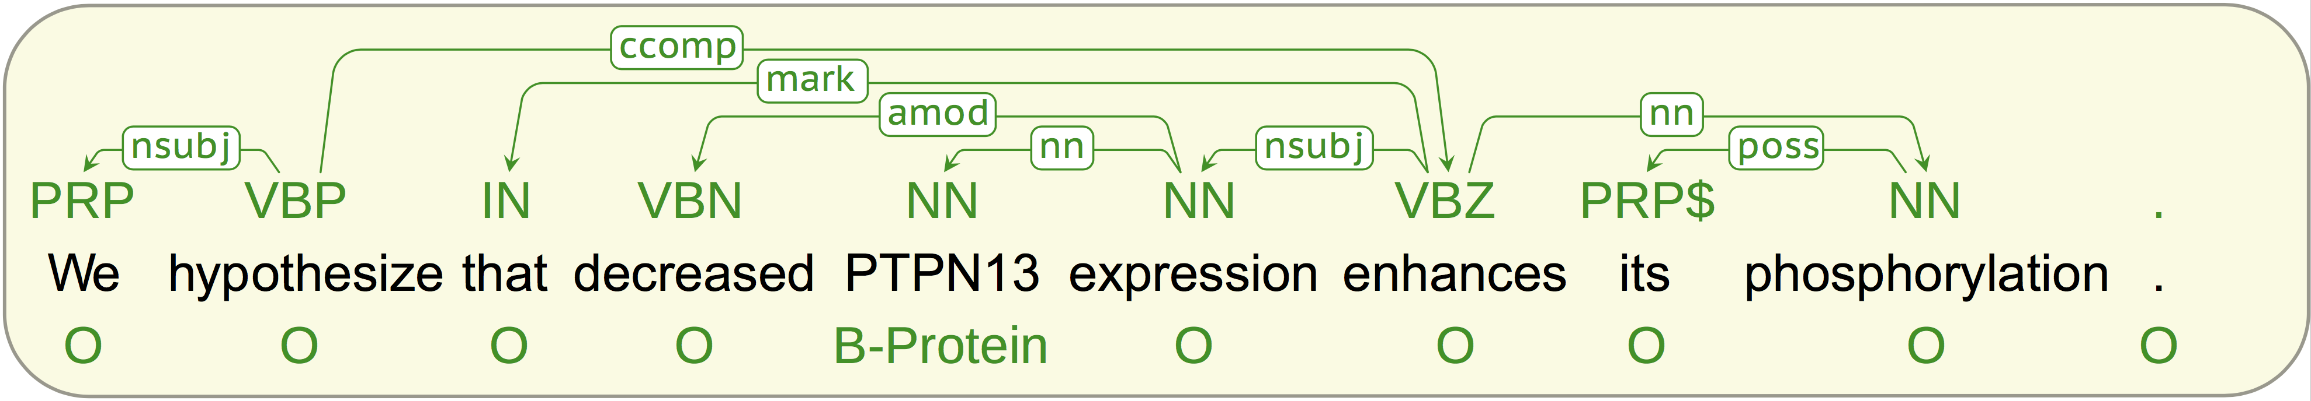
Dependency parsing

Slide 56
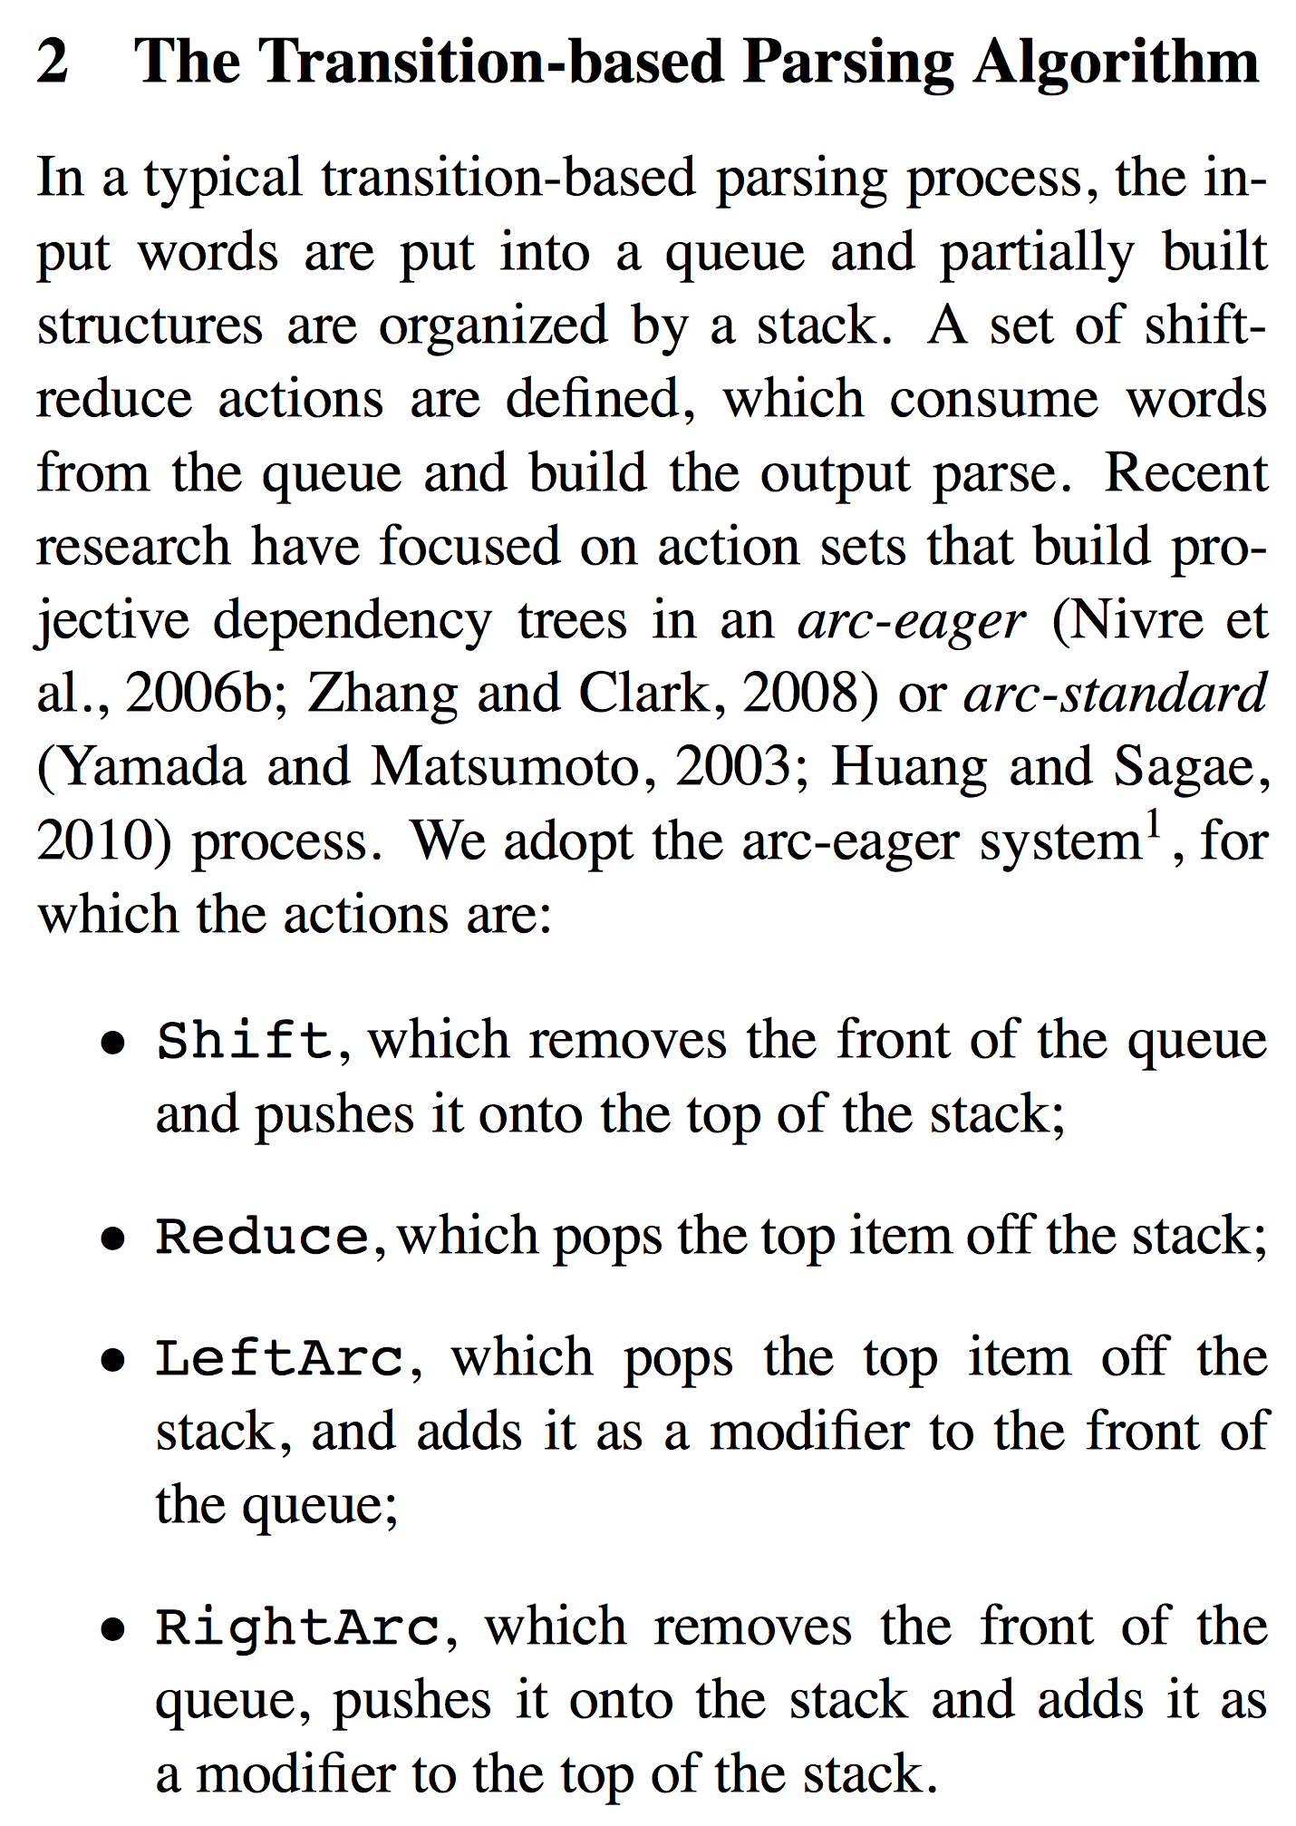
Shift-reduce parsing

Slide 57
Part 4: Alignment and machine translation

Slide 58
Machine translation

Slide 59
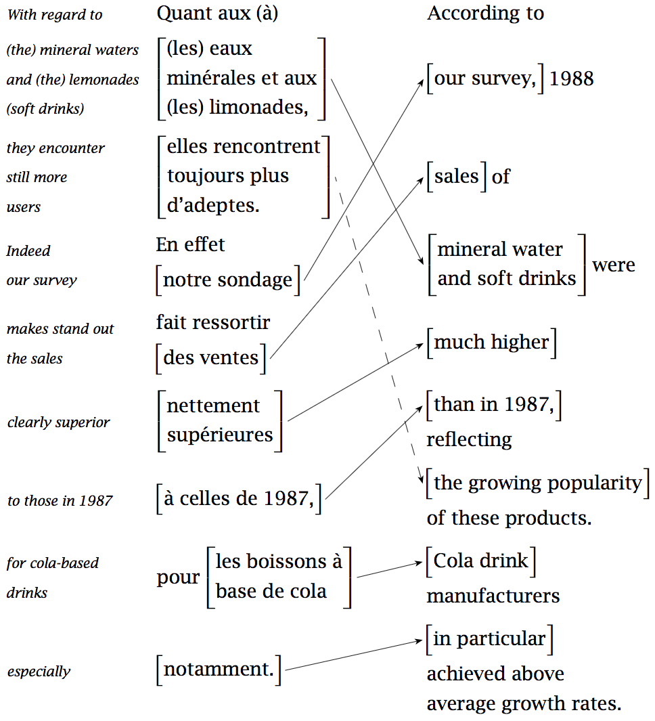
Alignment models

Slide 60
Part 5 (time permitting): Advanced techniques
Part 5 (time permitting): Advanced techniques

Slide 61
Take-away
Why you should take this course
Admin issues
First homework due in 1 week!
What topics will be covered in this class?

