Slide 1
CSC 439/539 Statistical Natural Language Processing Lecture 2b: Best Practices
Mihai Surdeanu
Fall 2017

Slide 2
Take-away
Multi-class classification
Regularization
Other decision functions for NNs
Other cost functions for NNs
Optimizers (beyond SGD)
Weight initialization
Vanishing and exploding gradients
Saturated and dead neurons
Shuffling
Learning rate
Dense vs. sparse representations

Slide 3
Multi-class classification
In general: one-vs-all, or one-vs-rest
How would you do it for the Perceptron?
Example!

Slide 4
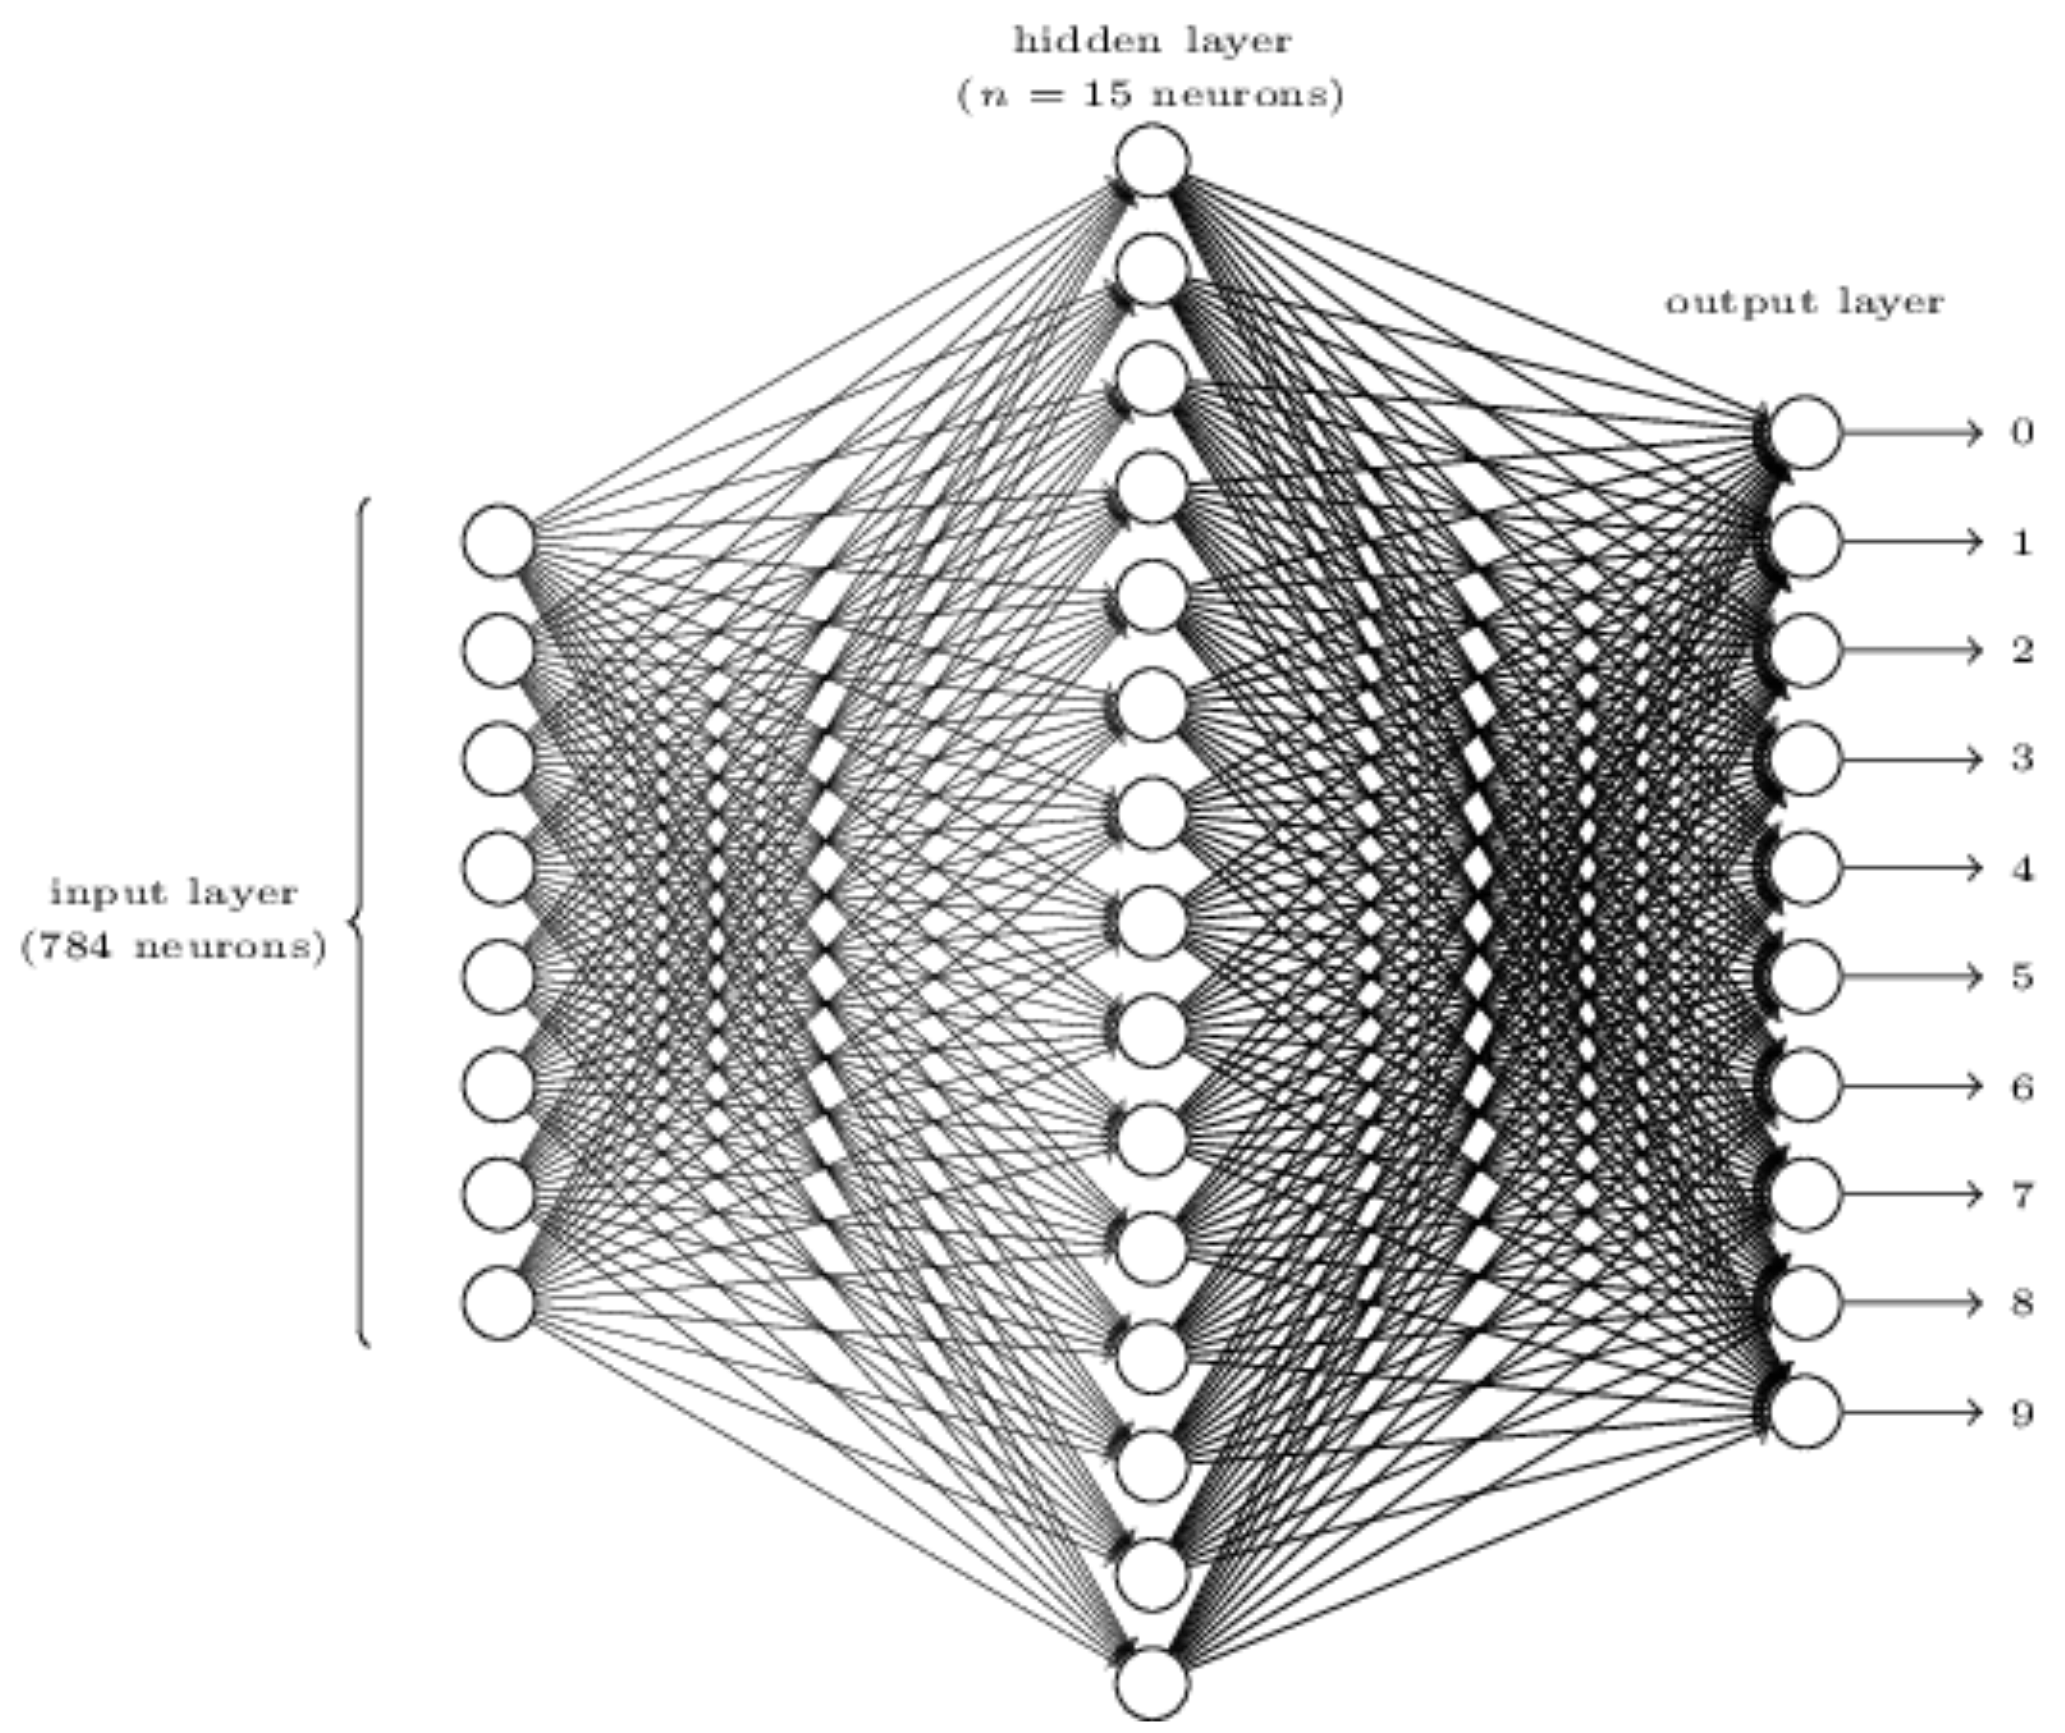
Multi-class classification for LR and NN

Slide 5
Multi-class classification for LR and NN
Softmax layer:
One output per class. Thus, one distinct vector W per class!
The scores form a probability distribution

Slide 6
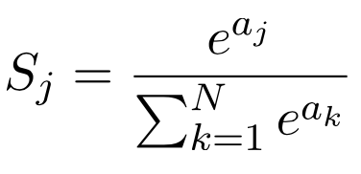
Softmax
A generalization of the sigmoid function:
Where a_{j} is the dot product of the weight vector for class j and the input vector
For a discussion of the softmax derivative, see: http://eli.thegreenplace.net/2016/the-softmax-function-and-its-derivative/
But in this course we will rely on auto-differentiation for this

Slide 7
Regularization
Regularization = feature selection
You have already seen 2 examples of regularization. What are they?
But for LR and NN, we can do this more elegantly, using the same math we’ve seen already

Slide 8
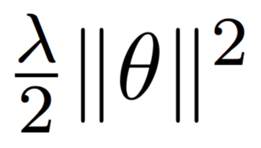


L2 and L1 Regularization
We add a new term to the cost function C:
C = YOUR_FAVORITE_COST_FUNC_TO_MINIMIZE +
What does this mean for the partial derivatives in LR?
What effect does this have on the individual weights in Theta?
L1 regularization:
C = YOUR_FAVORITE_COST_FUNC_TO_MINIMIZE +
L1 performs a more aggressive feature selection. Why?
2
1

Slide 9
Dropout
Randomly disabling (both in the forward and backward steps) a percentage of the neurons in the network, for each training example
Designed to prevent the network to rely on specific weights
A poor-man’s ensemble model (kinda similar to what?)

Slide 10
Dropout
Output layer
Hidden layer
Input layer

Slide 11
Dropout
Output layer
Hidden layer
Input layer

Slide 12
Dropout
Output layer
Hidden layer
Input layer

Slide 13
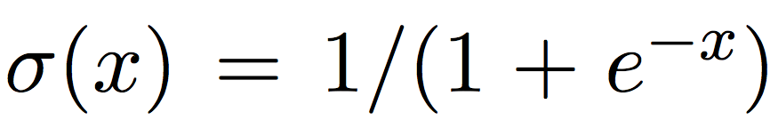
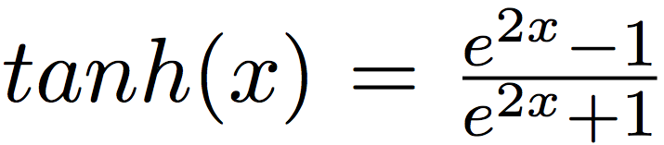
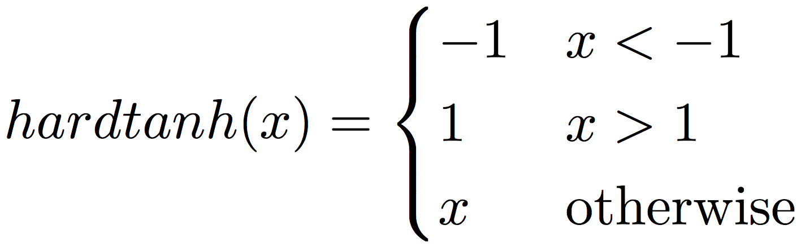
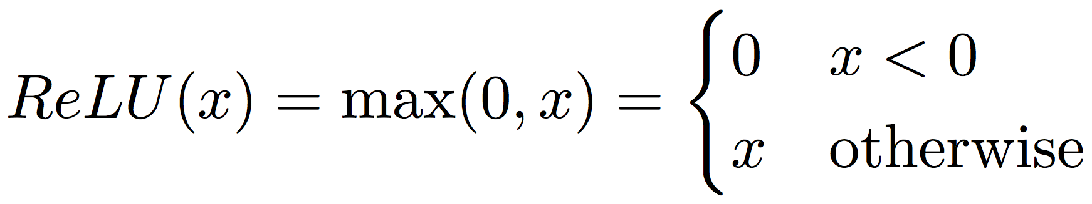
Decision functions for NNs
Sigmoid/logistic:
Hyperbolic tangent:
Hard tanh:
Rectified linear unit (ReLU):
Rule of thumb: ReLU > tanh > sigmoid

Slide 14
Other cost/loss functions for NNs
We have seen the mean squared error cost function in the previous lecture
Many others are possible. In general, a cost function computes a scalar given two vectors: the true predictions, and the network’s output on the same data
Loss values: always positive, 0 only when the network’s output is correct
Several are commonly used

Slide 15
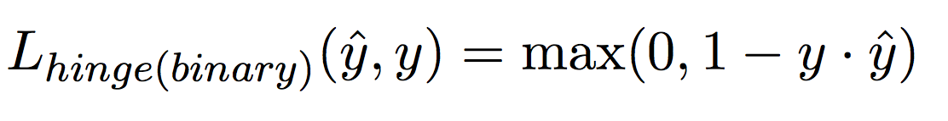
Other cost/loss functions for NNs
Hinge (binary):
Outputs must be -1 or +1 (which decision function does this?)
Hinge (multiclass):
t is the correct class, k is the highest scoring incorrect class

Slide 16
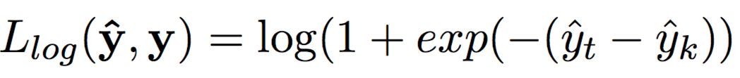
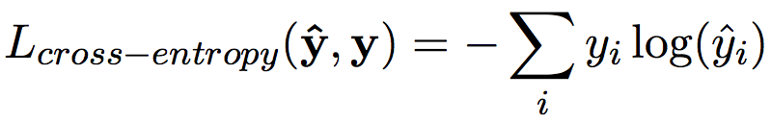
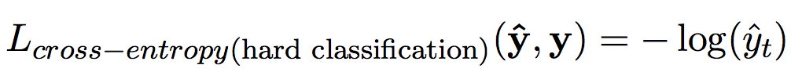
Other cost/loss functions for NNs
Log loss:
A “soft” version of the hinge loss (why?)
Categorical cross-entropy loss:
Used for multiclass tasks and when the scores are probabilities (most common for us)
For “hard” classification:

Slide 17
Cross-entropy vs. MSE
MSE’s derivative depends on the derivative of the activation, which could be very small for sigmoid
Learns slowly
Cross-entropy’s derivative depends on the error: the larger the error, the faster it learns
Learns faster where it matters
Let’s visualize this: http://neuralnetworksanddeeplearning.com/chap3.html

Slide 18
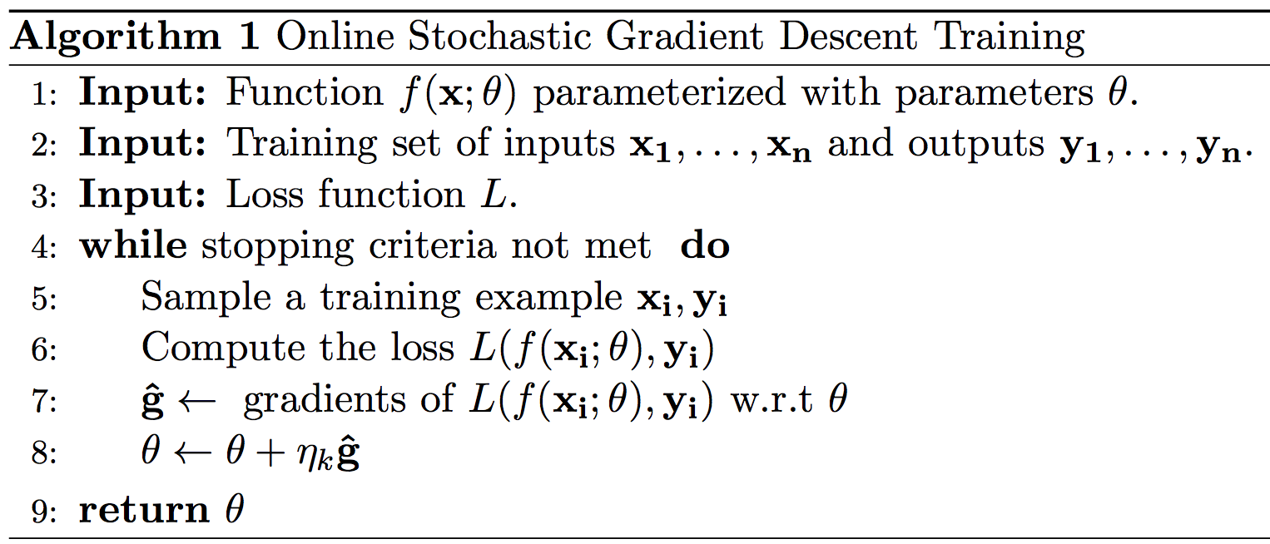
Optimizers: SGD

Slide 19
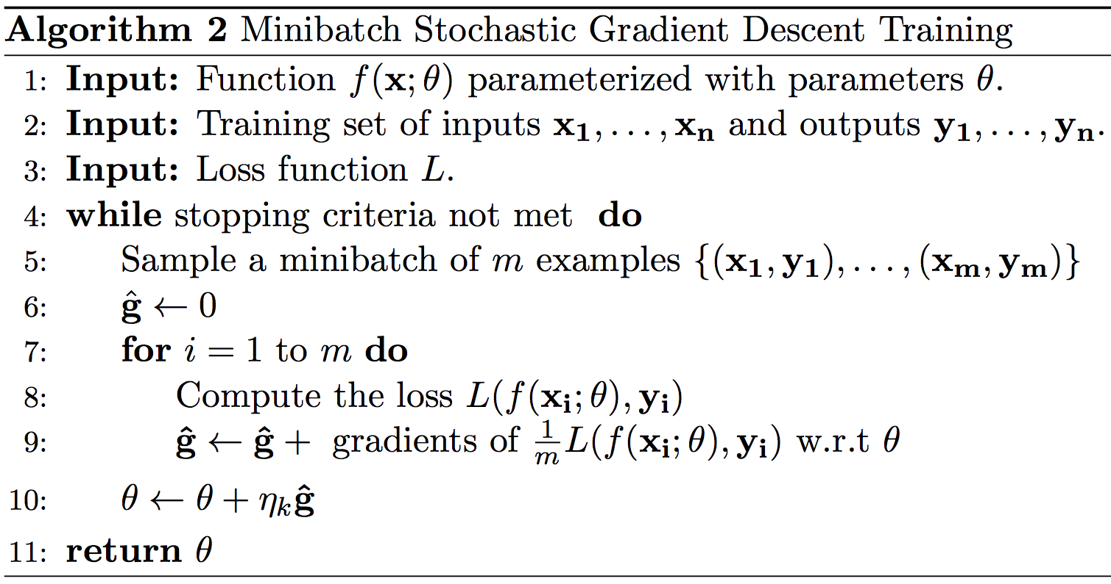
Optimizers: SGD

Slide 20
Optimizers: SGD
Easy to parallelize on a GPU!

Slide 21
Other optimizers
SGD+Momentum, Nesterov Momentum
Previous gradients are accumulated
The current update uses a combination of current gradient and previous ones

Slide 22
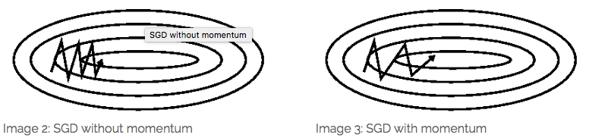
SGD with momentum
Vanilla SGD has the tendency to “Tony Hawk” it
Momentum helps accelerate SGD in the right direction (towards the local minimum)

Slide 23
Other optimizers
AdaGrad, AdaDelta, RMSProp, Adam
Use an adaptive learning rate for each minibatch, sometimes for each individual coordinate (”feature”)
AdaGrad: larger updates for infrequent and smaller updates for frequent parameters (useful for sparse data!)
Adam: momentum + individual learning rate per feature

Slide 24
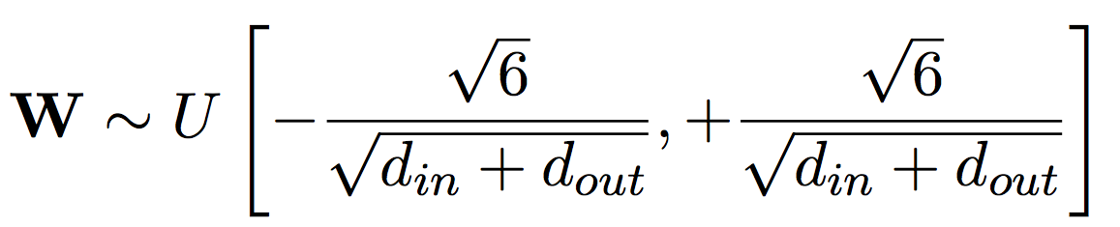
Weight initialization
Xavier initialization
Small, random weights centered around zero:

Slide 25
Vanishing and exploding gradients
Explode: gradients become exceedingly close to 1
More common in recurrent (additive) networks (we haven’t covered these yet)
Solution: gradient “clipping”, when they exceed a threshold
Vanish: gradients become exceedingly close to 0
Why is this happening?
Solution: shallower networks, step-wise training, special architectures (e.g., LSTM – coming later)

Slide 26
Saturated and dead neurons
Tanh and sigmoid can become “saturated” – values very close to 1
Why is this a problem?
ReLU activation can “die” – values of 0
Why is this a problem?
Solutions:
Change the initialization of weights
Change your features, i.e., the range of values assigned to them
Reduce learning rate

Slide 27
Shuffling
Always do it
Randomly
Curriculum learning: start with easy examples first
Why?

Slide 28
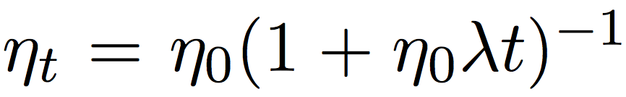
Learning rate
The learning rate is important to avoid:
“Tony Hawking” the data, or
Take a very long time to converge
Solutions:
Manual tuning: try at least 0.001, 0.01, 0.1, 1
Learning rate scheduling:
Decreases the learning rate as a function of the number of observed minibatches:

Slide 29
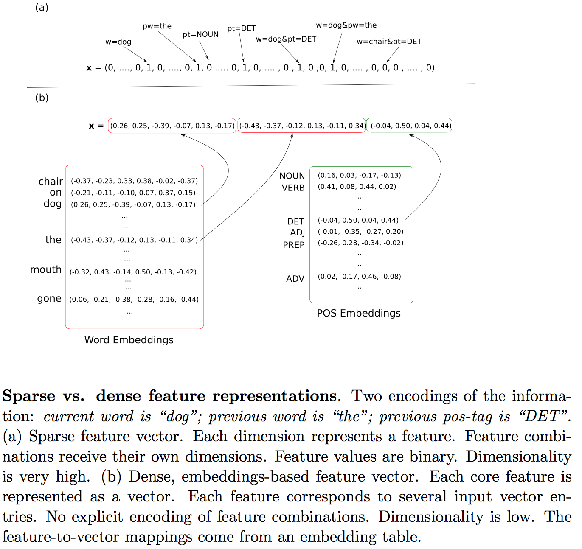
A note on dense vs. sparse representations

Slide 30
A note on dense vs. sparse representations
Coming up in the next lecture!

Slide 31
Readings
A Primer on Neural Network Models for Natural Language Processing
Up to section 6 (including) but skipping section 5 (we will cover that in lecture 3)
In D2L, or web: http://u.cs.biu.ac.il/~yogo/nnlp.pdf
Optional: for a discussion of optimizers: http://ruder.io/optimizing-gradient-descent/
Optional: for a more advanced discussion (including topics we haven’t covered yet), see: http://ruder.io/deep-learning-nlp-best-practices/?utm_campaign=Artificial%2BIntelligence%2BWeekly&utm_medium=email&utm_source=Artificial_Intelligence_Weekly_66

Slide 32
Take-away
Multi-class classification
Regularization
Other decision functions for NNs
Other cost functions for NNs
Optimizers (beyond SGD)
Weight initialization
Vanishing and exploding gradients
Saturated and dead neurons
Shuffling
Learning rate
Dense vs. sparse representations

