Slide 1
NEWS ARTICLE RECOMMENDTATION
MITHUN RAAM M – 2018103562
NAREN T P – 2018103568
SANJAY CHINNI KARTHICK V - 2018103586

Slide 2
ABSTRACT
A news article recommendation is an application used to provide similar news articles for users based on their history. This is achieved through lexical analysis; it recommends articles on various authors and categories. The project “ NEWS ARTICLE RECOMMENDTATION “ is developed in python programming language, which mainly focuses on Natural Language Processing (NLP) by recommending users the right articles at the right time. The steps involved are creating the dataset and giving it to the system and by using lexical analysis we tokenize into vector forms, and evaluate and compare each vector by Euclidean similarity and recommend news headline.

Slide 3
LITERATURE SURVEY
S.NO | Author-Publication- Year | Methodology | Advantages | Limitations
1. | News recommendation based on collaborative semantic topic models and recommendation adjustment. Yu-Shan Liao, Jun-Yi Lu, Dune-Ren Liu. 2019 | Collaborative filtering such as Matrix Factorization is a typical way to extract the implicit factors for predicting the preference ratings of users. | Matrix Factorization models ratings as the dot product between the user vector and the item vector. | Euclidean proximity gives a nice balance between being sensitive to vector direction (for vectors far enough from the origin) without being overtly biased to popular items.
2. | Personalized News Recommendation Based on Collaborative Filtering Florent Garcin, Kai Zhou, Boi Faltings. 2012 | Three approaches for personalized news recommendation: collaborative filtering at the level of news items, content-based system recommending items with similar topics, and a hybrid technique. | Personalized recommendations using collaborative filtering can be useful even for individual newspaper sites with limited amounts of data about their users. | The performance of collaborative filtering methods degrades with increasing complexity, which is most probably due to overfitting

Slide 4
S.NO | Author-Publication- Year | Methodology | Advantages | Limitations
3. | A Hybrid Geometric Approach for Measuring Similarity Level Among Documents and Document Clustering. Arash Hadrian. 2016 | Measure the similarity between documents is tousle the terms within the documents to represent them as vectors and measure the similarity among them based on the angle or Euclidean distance between each pair. | Using ED the highest similarity between two vectors happens when they are plotted in the same point in space and ED between them is 0. | -
4. | News Recommendation Systems - Accomplishments, Challenges & Future Directions. Chong feng , Muzammil khan. 2018 | The objectives of the current work are to identify and classify the challenges in news recommendation domain. | Personalized news recommendations systems, recommend news from enormous collection of news articles based use preferences. | Recommendation systems are expected to serve millions of users at a time . Items need to be recommended precisely and efficiently from a huge collection.
5. | Personalized News Recommendation Based on Consumers’ Click Behavior. Yuqi Wang, Wenqian Shang. 2015 | Consumers browse the website according to their interests, so there will be some potential association between the pages clicked by same consumers | The preferences are obtained through potential associations between news in the news browsing sequence of aconsumer. | the precision of recommendation based on traditional newsrecommendation algorithm is low because of the negativeinfluence of low association rules.

Slide 5
PROBLEM STATEMENT
News publishers have decreased disseminating news through conventional newspapers and have migrated to the use of digital means like websites and purpose-built mobile applications. It is observed that news recommendation systems can automatically process lengthy articles and identify similar articles for readers considering predefined criteria. The objectives of the current work are to identify and classify the challenges in news recommendation domain, to identify state-of-the-art approaches and classify on the application domain, to identify datasets used for evaluation and their sources, the evaluation approaches used and to highlight the challenges explicitly addressed. An important role of newspapers is to optimally inform readers, balancing between providing news that interests readers, news that provides alternate views or opinions, and news that editors believe readers have to know about.

Slide 6
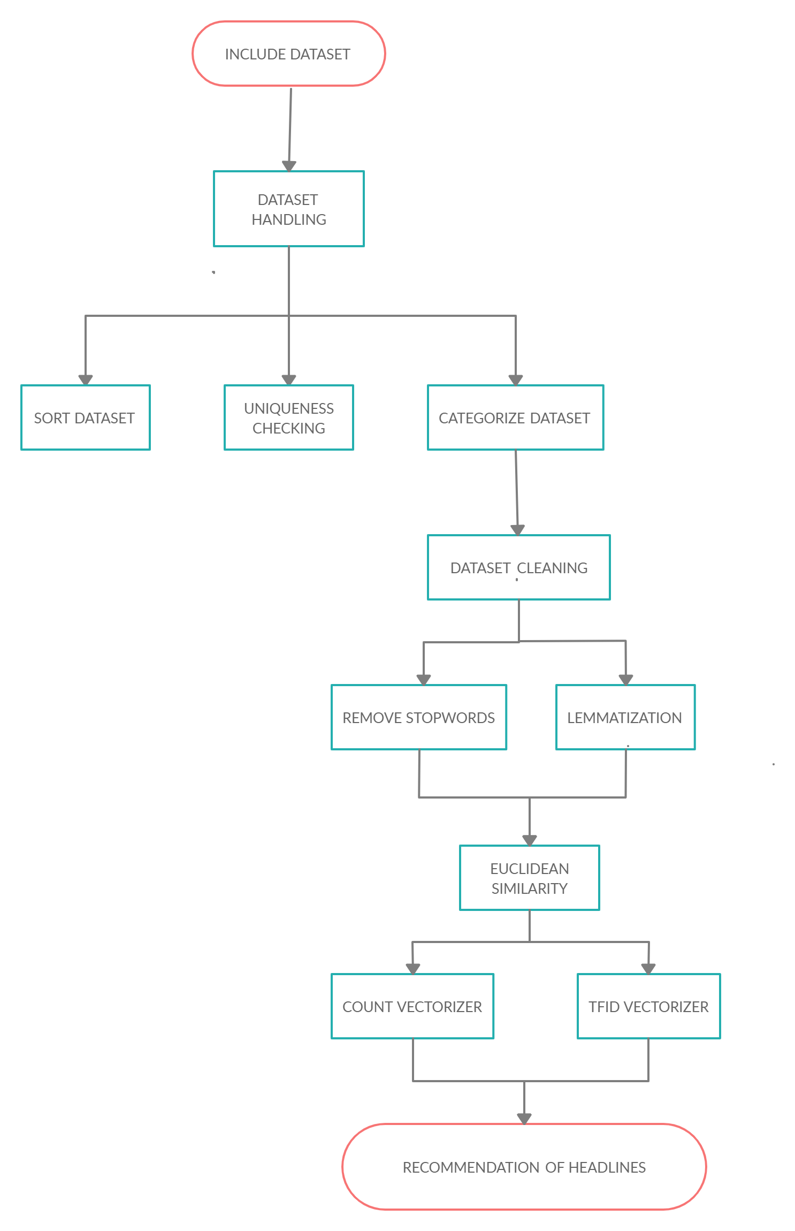
BASIC FLOW DIAGRAM
NAREN
MITHUN
SANJAY

Slide 7
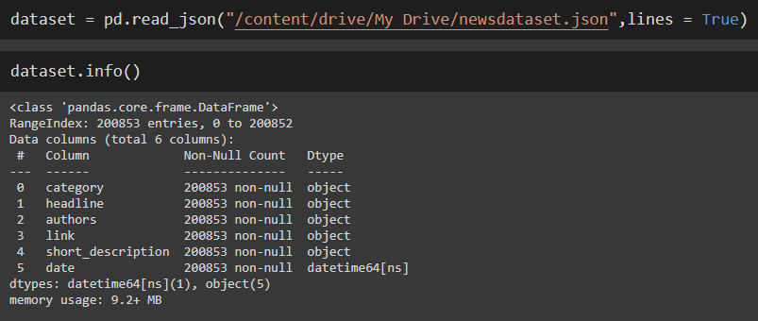
Module 1: Dataset Handling
Include Dataset
The dataset which we have used here is the BCC News Dataset.
“read_json “ function is used to include the dataset in code implementation.

Slide 8
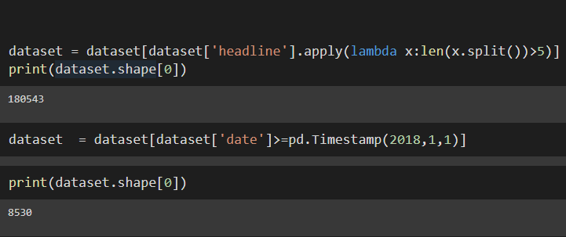
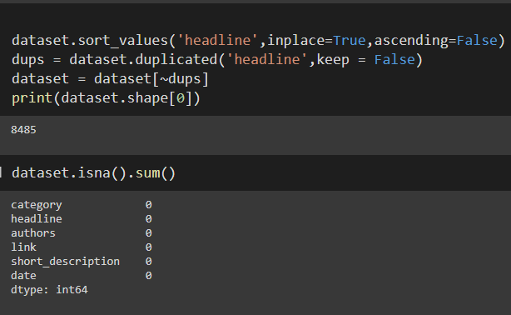
Phase 1: Sort dataset
Headlines having greater than 5 words are taken
from the dataset.
The dataset has also been sorted using
the timestamp function.
Phase 2: Uniqueness Checking
Initially, the dataset is sorted in
descending order for uniqueness
checking.
Finally, the duplicates are removed from the dataset.

Slide 9
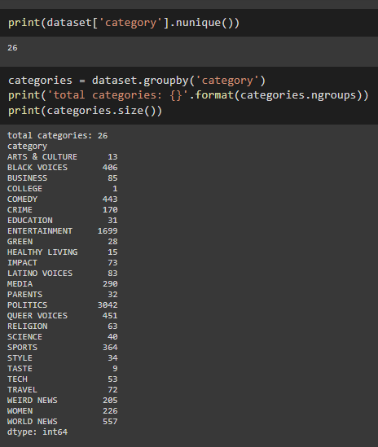
Phase 3: Categorize dataset
The number of unique categories are
displayed.
Then, the number of headlines in each
category is listed out.

Slide 10
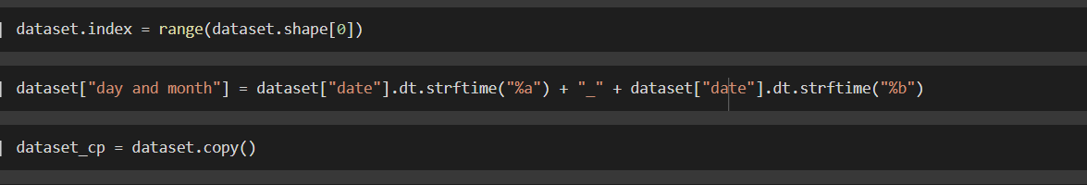
Module 2: Data Cleaning
Using strftime function we are converting
time into desired and required format.
% a – abbreviated weekday name.
%b – abbreviated month name.
The dataset is copied to another set for later use.

Slide 11
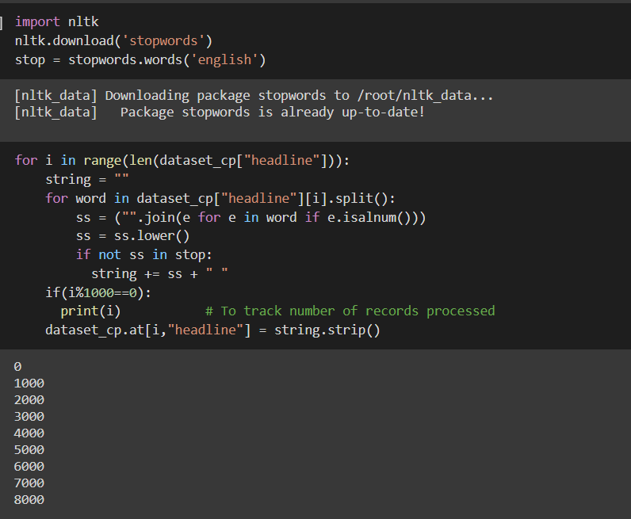
Phase 1: Removing Stopwords
First we are importing “nltk” library to download ‘stopwords’
and ‘english’.
It provides such as WordNet, along with a suite of text processing libraries for classification, tokenization, stemming, tagging, parsing, and semantic reasoning, wrappers for industrial-strength NLP libraries.
It is an amazing library to play with
natural language.
We loop through the headlines word
by word by splitting and comparing the
stopwords and removing
them.

Slide 12
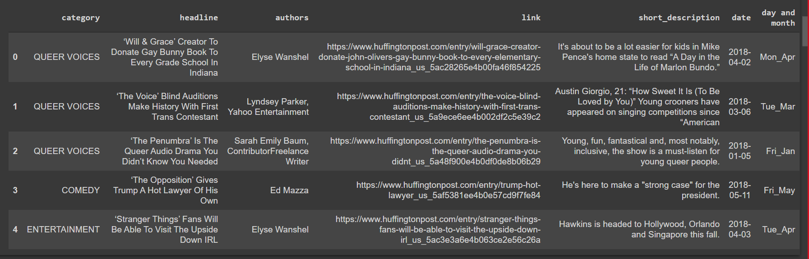
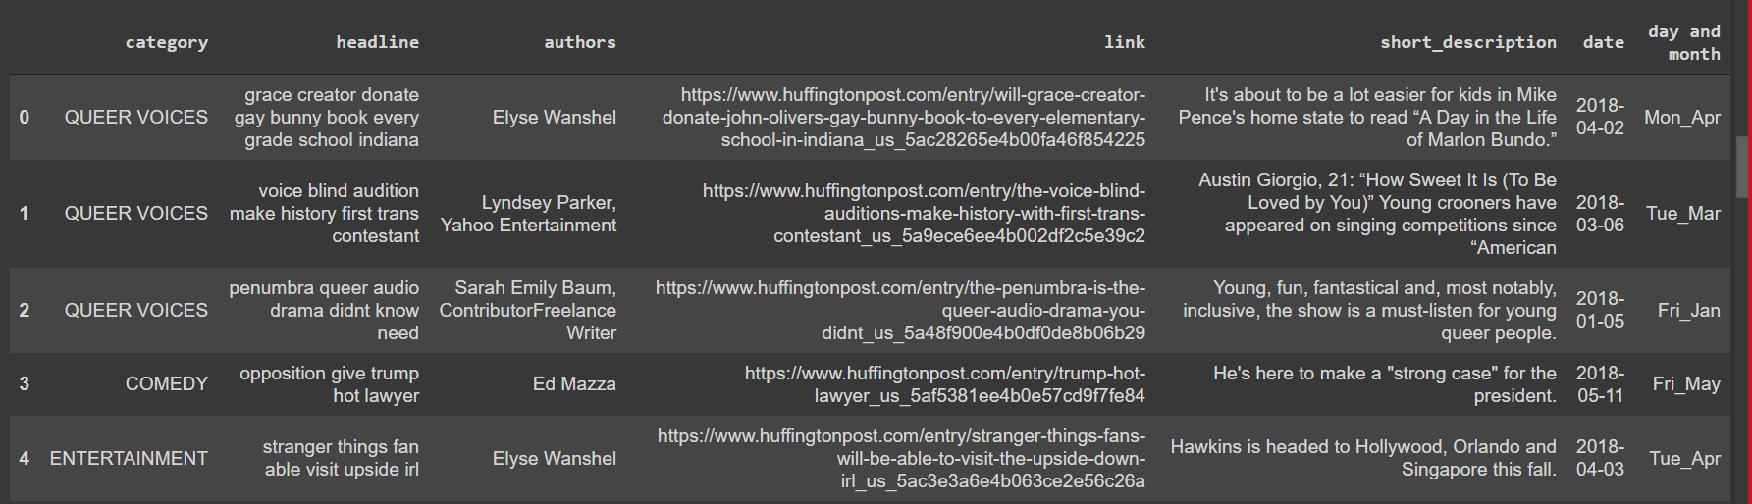

Slide 13
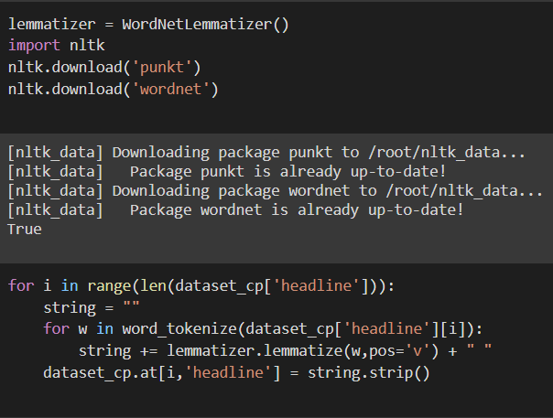
Phase 2: Lemmatization
We loop through the headlines word by word and using word_tokenize we group the different forms of word and convert into rootword.
At last, using strip function,
the leading and trailing spaces are
removed.

Slide 14
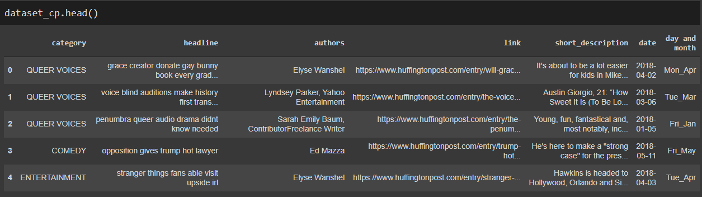
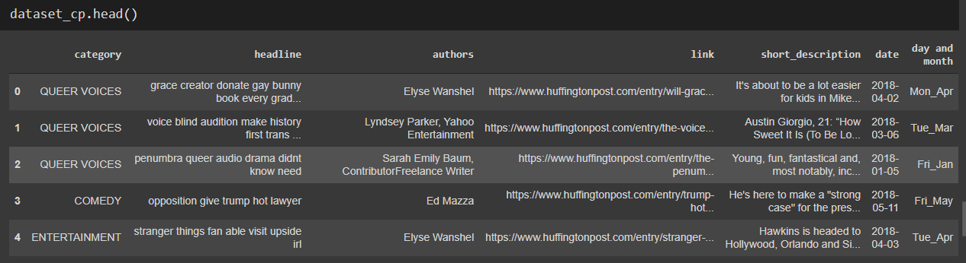

Slide 15
Module 3: Euclidean Similarity
We have used Euclidean similarity to compare two lists of numbers (i.e. vectors), and compute a single number which evaluates their similarity. Most measures were developed in the context of comparing pairs of variables across cases. In other words, the objective is to determine to what extent two variables co-vary, which is to say, the same values for the same cases have.
CountVectorizer - used to convert a collection of text documents to a vector of term/token counts. It also enables the pre-processing of text data prior to generating the vector representation.
TfidfVectorizer - Transforms text to feature vectors that can be used as input to estimator. vocabulary_ Is a dictionary that converts each token (word) to feature index in the matrix, each unique token gets a feature index.In each vector the numbers (weights) represent features tf-idf score.

Slide 16
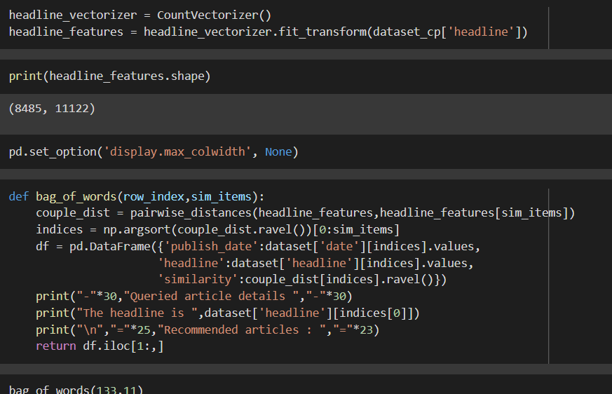
Phase 1: CountVectorizer
Count Vector is used to transform the given text into a vector form on basis of the frequency of each word occurs in the entire text.
It create a matrix in which each unique word is represented by a column of the matrix and the each text sample from
the data is the row in a matrix.

Slide 17
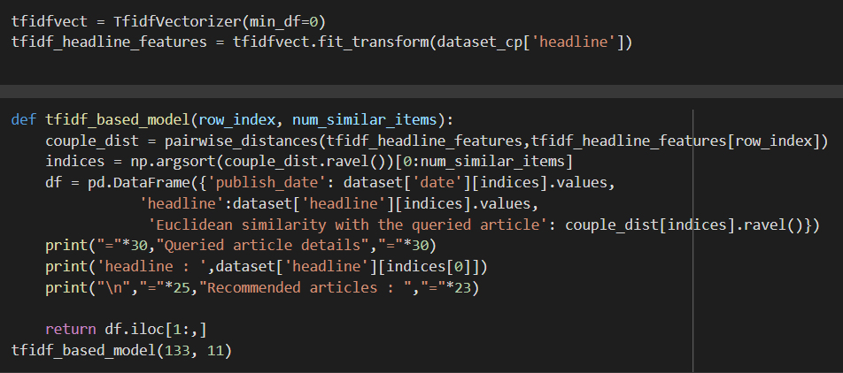
Phase 2: TfidVectorizer
TfidfVectorizer. Convert a collection of raw documents to a matrix of TF-IDF features. Equivalent to CountVectorizer followed by TfidfTransformer.
The TfidfTransformer transforms a count matrix to a normalized tf or
tf-idf representation. So although both the CountVectorizer and TfidfTransformer
(with use_idf=False)
produce term frequencies,
TfidfTransformer
is normalizing the count.

Slide 18
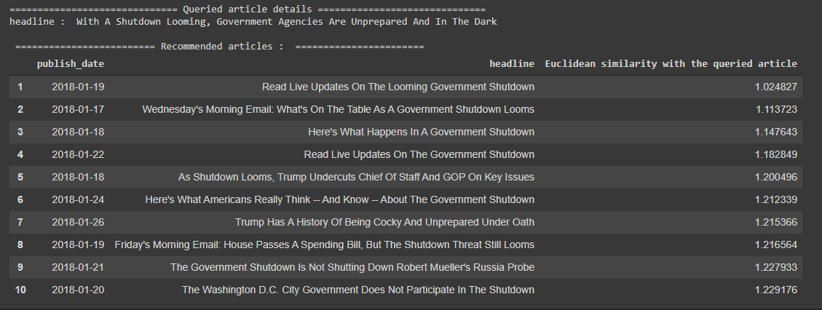
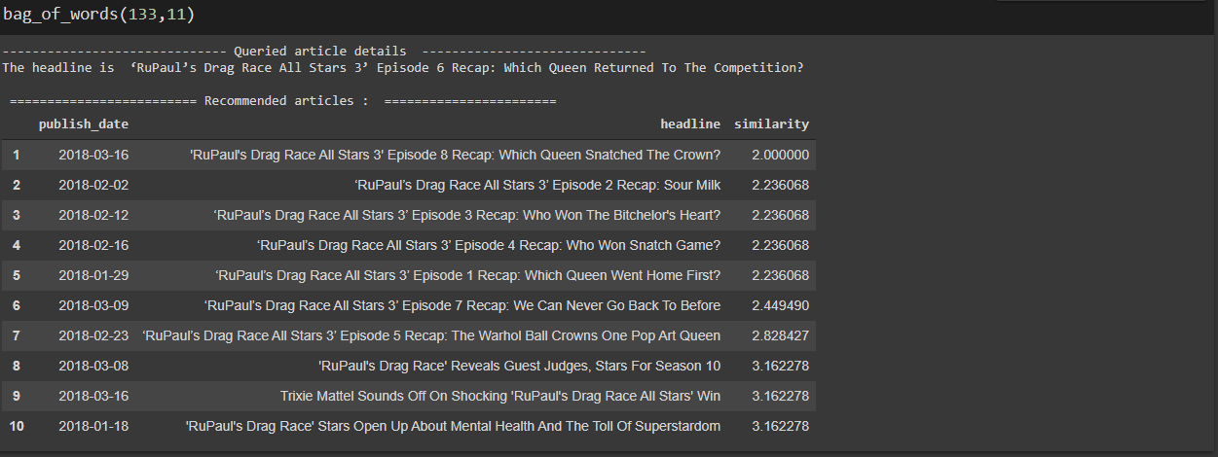
RECOMMENDATION OF HEADLINES

Slide 19
REFERENCES
Y. Liao, J. Lu and D. Liu, "News Recommendation Based on Collaborative Semantic Topic Models and Recommendation Adjustment," 2019 International Conference on Machine Learning and Cybernetics (ICMLC), Kobe, Japan, 2019, pp. 1-6, doi: 10.1109/ICMLC48188.2019.8949259.
F. Garcin, K. Zhou, B. Faltings and V. Schickel, "Personalized News Recommendation Based on Collaborative Filtering," 2012 IEEE/WIC/ACM International Conferences on Web Intelligence and Intelligent Agent Technology, Macau, 2012, pp. 437-441, doi: 10.1109/WI-IAT.2012.95.
A. Heidarian and M. J. Dinneen, "A Hybrid Geometric Approach for Measuring Similarity Level Among Documents and Document Clustering," 2016 IEEE Second International Conference on Big Data Computing Service and Applications (BigDataService), Oxford, 2016, pp. 142-151, doi: 10.1109/BigDataService.2016.14.
C. Feng, M. Khan, A. U. Rahman and A. Ahmad, "News Recommendation Systems - Accomplishments, Challenges & Future Directions," in IEEE Access, vol. 8, pp. 16702-16725, 2020, doi: 10.1109/ACCESS.2020.2967792.
Yuqi Wang and Wenqian Shang, "Personalized news recommendation based on consumers' click behavior," 2015 12th International Conference on Fuzzy Systems and Knowledge Discovery (FSKD), Zhangjiajie, 2015, pp. 634-638, doi: 10.1109/FSKD.2015.7382016.

