Slide 1

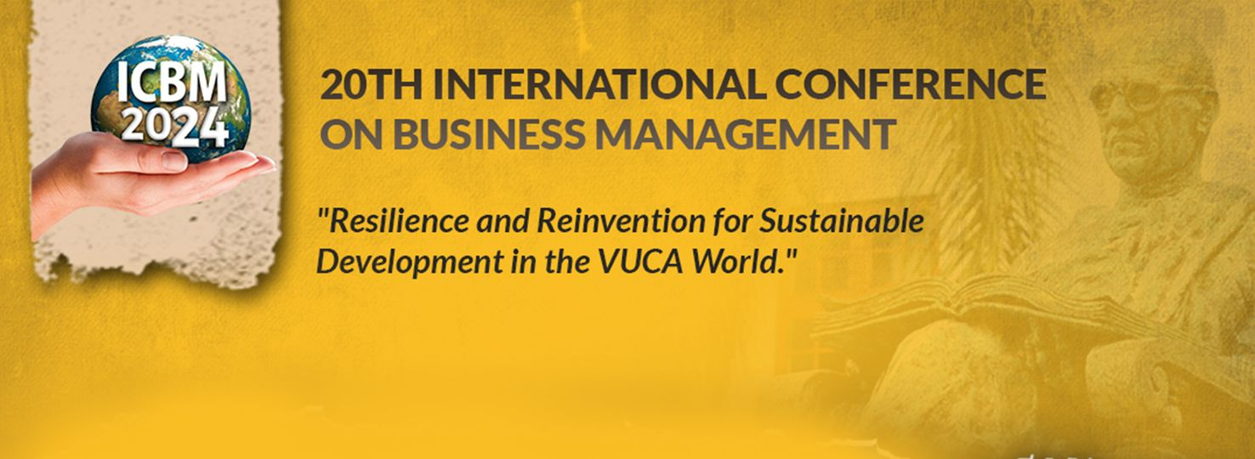
Does the Mission Drift Matters for Pro social motivation & Effort of Nascent Social Workers In Non-Governmental Organization-A Real Experiment
ICBM 2024
Paper ID: MC-11-095
Ransa, R.R.P.H. Mithursan, A. and Samaranayake, D.I.J.
Department Of Management Studies
Faculty of Management
University Of Peradeniya

Slide 2
Content
ICBM 2024
Introduction
1.1. Background of the Study
1.2. Research Problem
1.3. Research Questions
1.4. Research Objectives
Synopsis of the Literature Review
Research Methodology
Results and Discussion
Conclusion
References

Slide 3
Introduction
ICBM 2024
1.1. Background of the Study
The mission statement of an organization is a specific characteristic that defines the important functions which highlight the uniqueness and difference from the other organizations in society.
What is Mission drift?
Mission drift can be defined as process of organizational change, where an organization diverges from its main purpose of mission.
Non-profit or Non-Government Organizations [NGOs], social enterprise, hospitals, the educational bodies experienced this mission drift. (Bennett and Savani, 2011) Jaquette, 2013; Armendariz & Szafarz, 2009).
Mission drift can be identified as a noticeable movement of organizational main objectives and goals towards a new direction (Ebrahim et al., 2014; Mader & Sabro, 2019).

Slide 4
Introduction
ICBM 2024
1.2. Research Problem
According to the literature reviews, if there is a proper match between employee as well as the organization mission generated product outcomes, employee pro-social motivation and real effort in achieving the goals and objectives is highly (Carpenter & Gang, 2016; Smith, 2016). And also, it verifies that, if have mismatch between employees and organization mission generate product outcomes, employee pro-social motivation and real effort is less. Therefore, it’s worth considering that effect of mission drift of non-governmental organization on nascent social worker’s pro-social motivation and effort.

Slide 5
Introduction
ICBM 2024
1.3. Research Questions
Do nascent social workers pro-social motivated?
Whether pro-social motivation has any impact on social worker’s effort?
Do non-government organization experience a mission drift?
Do any potential mission drifts in such organization make an impact of their employee’s effort?
Do nascent social workers exert more effort if organization mission drifted?

Slide 6
Introduction
ICBM 2024
1.4. Research Objectives
Main Objective
The foremost objective of this study is to observe the impact of mission drift of an organization on its employee’s pro social motivation and effort in work.
Sub Objectives
To observe whether the nascent social workers are pro-social motivated.
To identify whether nascent social workers exert more effort in mission match situation.
To observe whether nascent social workers exert less effort in mission mismatched situation.

Slide 7
Synopsis of Literature Review
ICBM 2024
Mission Drift of NGOs | Mission drift can be identified as a noticeable movement of organizational main objectives and goals towards a new direction (Ebrahim et al., 2014; Mader & Sabro, 2019). NGO have experienced a growing shift toward the hiring of professional managers, adaption of formalizes practices. (Brest, 2012; Bromley & Meyer, 2)
Mission Match On Real Effort | Carpenter & Gong (2016) developed a model that included a framework using the standard principle-agent paradigm to examine the effect of mission matching on a worker’s productivity. (Smith, 2016) focused more on the motivational mechanism behind matching workers and missions.

Slide 8
Synopsis of Literature Review
ICBM 2024
Mission Mismatch On Real Effort | Carpenter & Gong (2016) observed that mismatched agents are less productive and relatively more responsive to financial incentives.
Prosocial Behavior On Real Effort | Pro- sociality represents good citizenship behaviors and extra-role behaviors in the workplace (Brief & Motowidlo, 1986; Baruch et al., 2004; Bolino & Grant, 2016).

Slide 9
Methodology
ICBM 2024
Research philosophy | Pragmatism
Methodological approach | Quantitative
Research approach | Deductive
Purpose of the study | Explanatory
Research strategy | Lab experiment
Data source | Primary data
Data collection method | Pre-designed app from o-tree/other development platforms
Time horizon | Cross sectional
Unit of analysis | Undergraduate who disclosed as nascent social workers
Sampling technique | Random sampling: systematic sampling

Slide 10
Methodology
ICBM 2024
Methodology
Collecting Data
Analyzing Data
Primary Data
Secondary Data
Quantitative
Lab Experiment
Population= Management Undergraduates Sample Size = 80
Four Groups Consist of 20 subjects.
(Random Sampling : Systematic Sampling)
Statistical Analysis Table & Graphs by using STATA and MS Excel
Online Article and Journal

Slide 11
Methodology
ICBM 2024
Development of Hypotheses
H 1: Mission matched situation, social workers exert more effort than mission mismatched situation.
H 2: Mission drifted situation, social workers exert less effort than mission matched situation.
H 3: Mission drifted situation, social workers exert more effort than mission mismatched situation.

Slide 12
Methodology
ICBM 2024
Conceptual Framework
Mission Mismatch
-
-
Mission Match
+
Pro social Motivation
+
Real Effort
+/-
+/-
Mission Drift
Source: Author’s preparation

Slide 13
Methodology
ICBM 2024
The experiment has included preliminary task, two Dictator games, practice Session and effort task.
Preliminary task and dictator games used for the measure of pro-sociality and practice session used for just only measured the usual effort of the employee. First effort task used for mission match situation, second effort task for the mission mismatch situation and third task used for drifted situation.
Folding pieces of paper and stuffing envelopes task used for measure the real effort of employees. (Charness et al., 2018)
B
Dictator Game 1 (Charity 1)
Dictator Game 2 (Charity 2)
Effort Task Match Mission
Effort Task Mismatch Mission
Effort Task Drifted Mission
T1
Source: Adapted, Banuri & Keefer(2016)

Slide 14
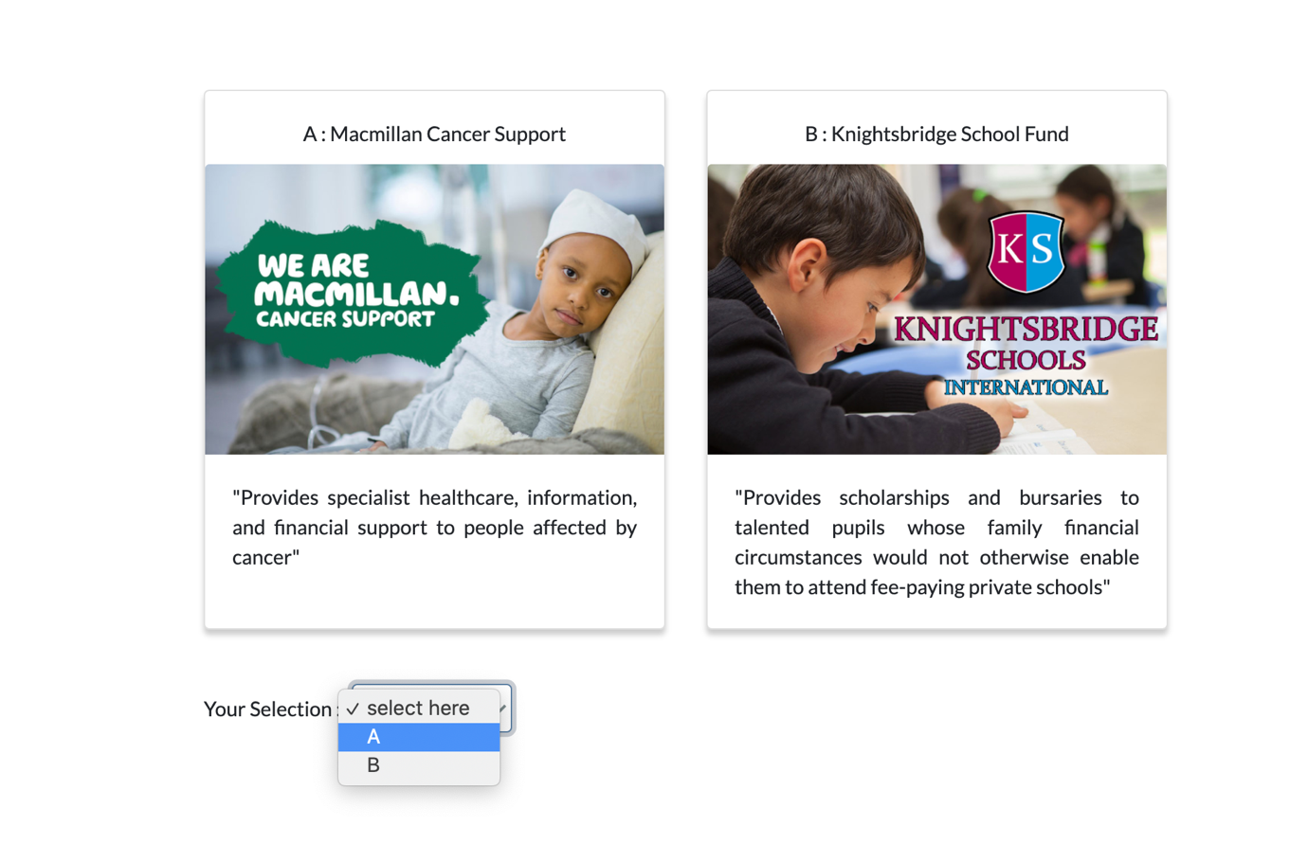
ICBM 2024
Experimental Design: Mission Matching

Slide 15
Result & Discussions
ICBM 2024
4.1. To observe whether the nascent social workers are pro-social motivated.
The mission of Sri Lanka Cancer Society is treat, cancer diagnosis, prevent and minimize the trauma of cancer patients. The Bishop’s College PPA is fee paying school and this organization support this school with donation for bursaries, price giving etc. They have selected the Sri Lanka Cancer Society as their preferred organization. Majority of the subjects have been pro-social motivated.
Most of the subjects have donated for the Sri Lanka Cancer Society than Bishop’s College Past Pupil’s Association.

Slide 16
Result & Discussions
ICBM 2024
4.2. To identify whether nascent social workers exert more effort in mission match situation.
In that situation subjects have prepared more envelops than the prepared envelops in the baseline.
In this situation their mission have matched with the organization’s pro social mission. Then, social worker’s effort have been increased in mission match situation.

Slide 17
Result & Discussions
ICBM 2024
4.3. To observe whether nascent social workers exert less effort in mission mismatched situation.
Subjects prepared less number of envelop than the baseline and mission match situation due to their mission is not match with the organization's mission.
Social workers exert less effort than the mission match situation and even baseline.

Slide 18
Result & Discussions
ICBM 2024
To observe the impact of mission drift of an organization on its employee’s pro social motivation and effort
Anchoring Effect can be identified on mission drift.
First 25 subjects have exert less effort to prepare envelope due to in that situation organization drifted their mission as earning profit in addition to given social service. Second group have exert more effort than the first group to prepare envelop because in this situation organization provide incentives for the employees though the profit that they earn.
According to that, employee have exert more effort in mission drifted situation due to the Anchoring effect on financial benefits.

Slide 19
Result & Discussions
ICBM 2024
Number of obs = 40
Prob > F = 0.0000
R-squared = 0.8373
Adj R-squared = 0.8133
Root MSE = 1.0426
Source | SS | Df | MS
Model | 190.141644 | 5 | 38.0283288
Residual | 36.9583558 | 34 | 1.08701046
Total | 227.1 | 39 | 5.82307692
TE | Coef. | Std. Err. | t | P>|t| | 95% Conf. Interval]
SLCS | .046058 | .0932135 | 0.49 | 0.624 | -.1433747 | .2354907
BCPPA | .1749221 | .078148 | 2.24 | 0.032 | .0161063 | .333738
MATCH | .9039268 | .2575634 | 3.51 | 0.001 | .380495 | 1.427359
MISMATCH | 1.293037 | .1848635 | 6.99 | 0.000 | .9173489 | 1.668725
DRIFT | .9492742 | .147812 | 6.42 | 0.000 | .648884 | 1.249664
_cons | 1.459105 | 1.184804 | 1.23 | 0.227 | -.9487053 | 3.866916
Total Effort can be measured by using pro-sociality, mission match, Mission mismatch and Mission drifted situation.
This is interpret that, how extent should increase effort by employee to obtain total effort in each situation.
Source: Author prepared using STATA

Slide 20
ICBM 2024
5. Conclusion
If organization drift their pro social mission towards profit oriented then, employees’ mission and organization mission is mismatched. That situation, worker exert less effort than in mismatch situation. But, if organization provide some incentives for employee from their profit then, workers exert more effort.
However, finally, if any non government organization want drift their mission towards profit oriented, they should provide some benefits from their profit for the employees in organization to increase the employees effort.
This study provides clear evidence on how financial compensation to the prospective employees increase their relative effort on the task assigned.
The different prosocial levels change the effort with financial motives. Example: Subjects with high prosociality (people who offered more ECUs in the dictator game) demonstrated less effort and subjects with low prosociality (people who offered less ECUs in the dictator game) demonstrated high effort when the charity offer financial compensation

Slide 21
ICBM 2024
6. References
Banuri, S. & Keefer, P. (2012). Pro-social behavior where we least expect it? The selection and socialization of intrinsically-motivated government (tax!) officials. World Bank Working Paper, Development Economics Research Group, World Bank, Washington, DC.
Buchbinder, E., Eisikovits, Z. and Karnieli-Miller, O., 2004. Social workers’ perceptions of the balance between the psychological and the social. Social Service Review, 78(4), pp.531-552.
Carpenter, J. & Gong, E. (2016). Motivating Agents: How Much Does the Mission Matter? Journal of Labor Economics, 34(1), 211-236.
Charness, G., Gneezy, U. and Henderson, A., 2018. Experimental methods: Measuring effort in economics experiments. Journal of Economic Behavior & Organization, 149, pp.74-87.
Lipsky, M. and Smith, S.R., 1989. Nonprofit organizations, government, and the welfare state. Political science quarterly, 104(4), pp.625-648.
Samaranayake, D.I.J. and Banuri, S., 2020. Impact of the organizational Mission Drift on Its Employees Effort. In Peradeniya International Economics Research Symposium (Vol. 8, pp. 114-121).
Walz, T. and Groze, V., 1991. The mission of social work revisited: An agenda for the 1990s. Social Work, 36(6), pp.500-504.

Slide 22
End…
Let’s the forum is open for Q and A session

