Slide 1

FaceFilter APP
MITIN SHARMA

Slide 2
INTRODUCTION: This is a simple application, wherein, webcam capture live image and detect face of the person and put filters like snapchat application.
The main objective of this application is to learn deep learning concepts.

Slide 3
HOW IT WORKS? This is a python based application
To implement face detection, python application uses openCV library.
Haar feature based cascade classifiers to learn machine about human faces

Slide 4
Algorithm: The algorithm needs a lot of positive images (images of faces) and negative images (images without faces) to train the classifier.
Then we need to extract features from it
They are just like our convolutional kernel

Slide 5
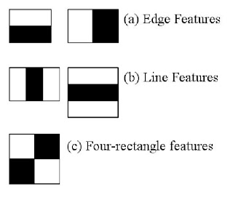
Each feature is a single value obtained by subtracting sum of pixels under white rectangle from sum of pixels under black rectangle

Slide 6
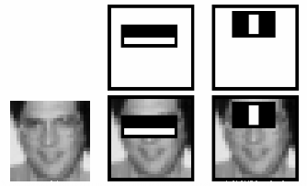
To simplify calculations of sum of pixels we use integral images.
how large may be the number of pixels, to an operation involving just four pixels

Slide 7
Top row shows two good features.
The first feature selected seems to focus on the property that the region of the eyes is often darker than the region of the nose and cheeks.
The second feature selected relies on the property that the eyes are darker than the bridge of the nose.

Slide 8
OpenCV: OpenCV comes with a trainer as well as detector. If you want to train your own classifier for any object like car, planes etc. you can use OpenCV to create one.
OpenCV already contains many pre-trained classifiers for face, eyes, smile etc.
Those XML files are stored in opencv/data/haarcascades/ folder.

Slide 9
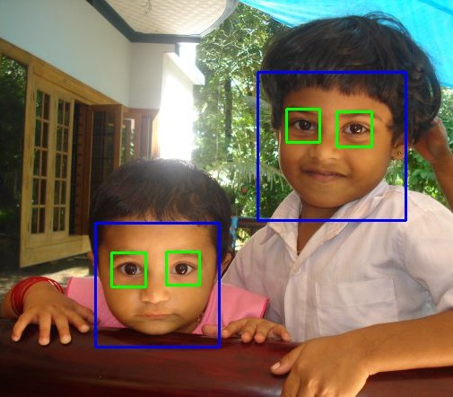

Slide 10
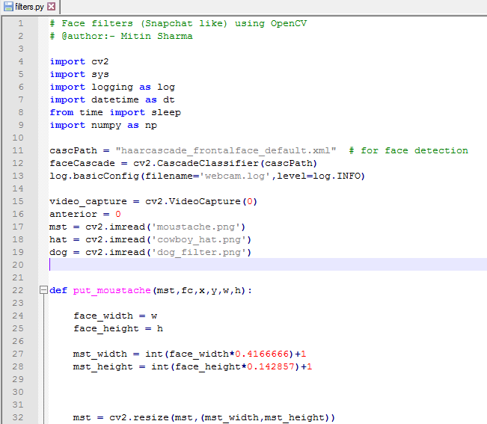
Code:

Slide 11
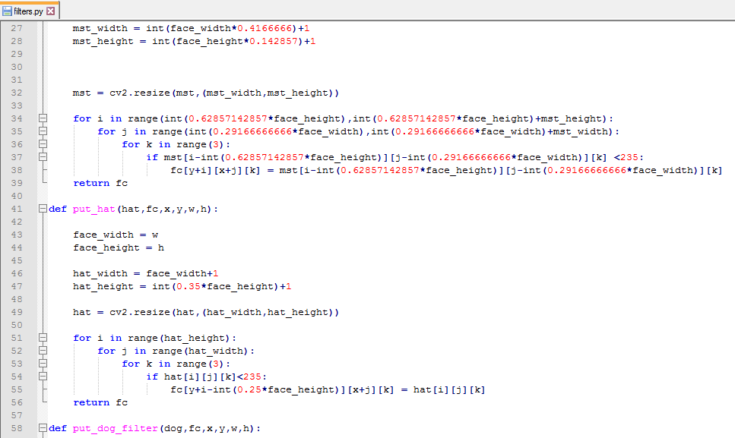

Slide 12
SCREENS:

Slide 13
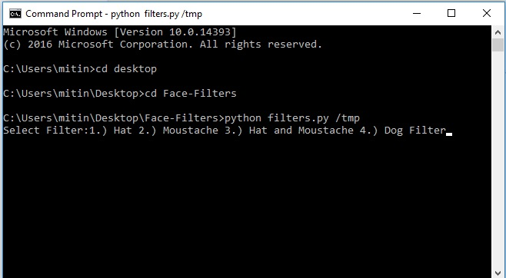
HOME SCREEN:-

Slide 14
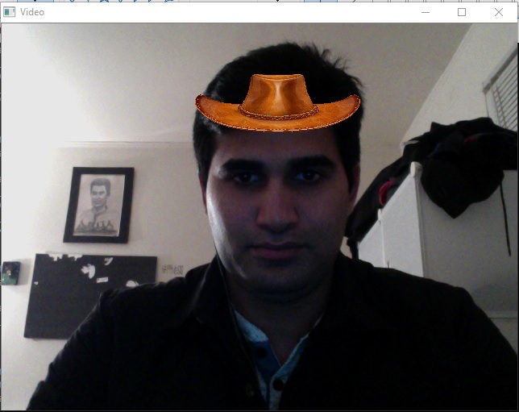
Hat Filter:-

Slide 15
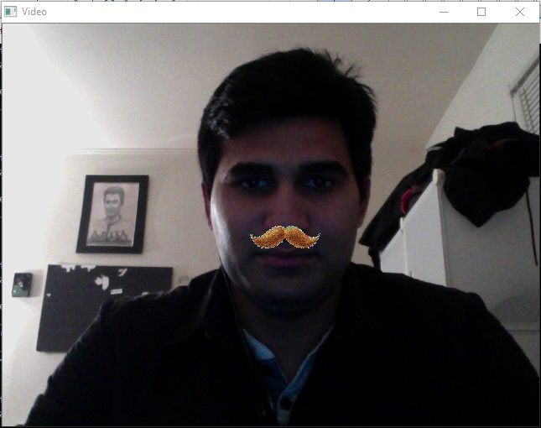
Moustache Filter:-

Slide 16
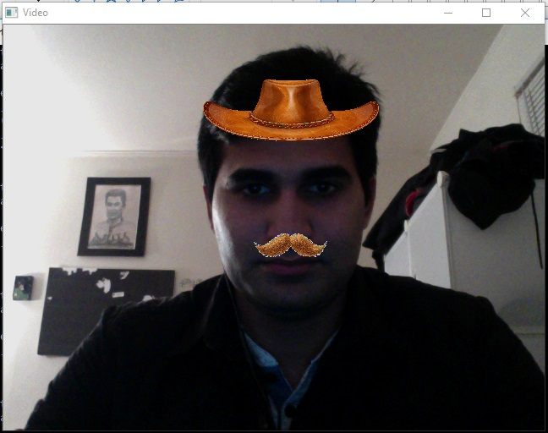
Hat and Moustache Filter:-

Slide 17
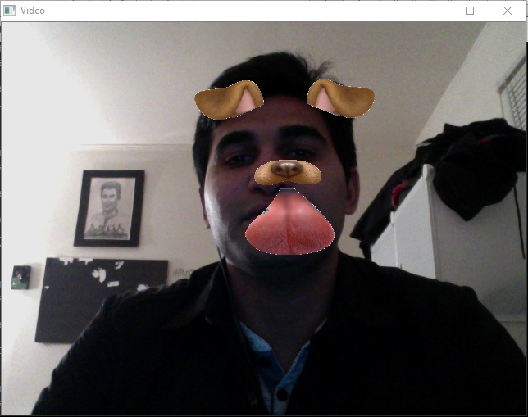
Dog Filter:-

Slide 18
THANK YOU

