Slide 1
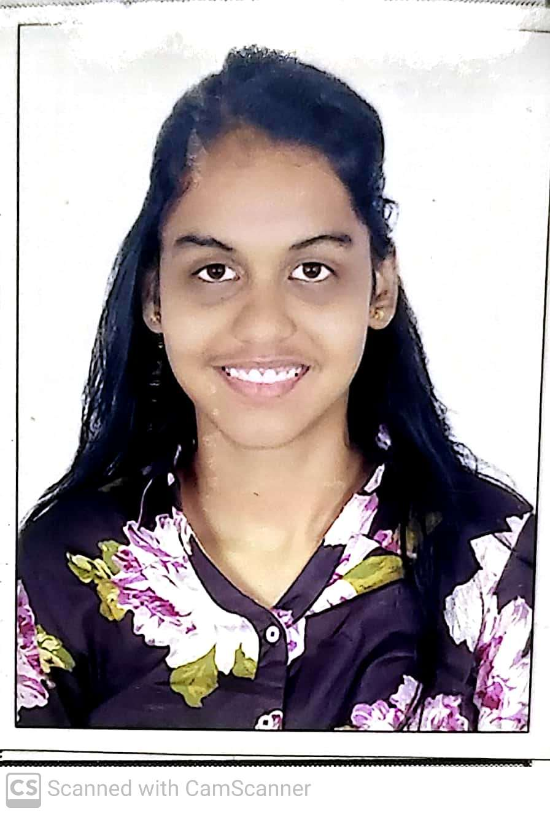



Mitali Jadhaw
Analyst/Software Engineer
Bachelor of Engineering
Electronics & Telecomm : 2017-2021
Skills
Mumbai
Java 8 /J2EE | Java Basics, OOPS, Generics, Collections, Arrays, Loops, Lambda Exp, Stream API Junit, Mockito, Servlets
Spring core | IOC & Dependency Injection, Autowire
Spring REST | REST controllers, Implementation of GET, POST, PUT & DELETE, Bean Validation & Exception Handling, Testing Services, Controller & Repository layer
Spring Data JPA | Implement DAO layer using spring Data repositories, Transaction Management
Spring Boot Microservices | Spring Boot Starters, annotations, Messaging Service, Sync/Async communication
Spring Cloud | Eureka, Netflix Hystrix, Netflix Zuul & Config server
React | Components, Hooks, Event handling, Redux, Reducers
Database | MongoDB Atlas
UI Tech | HTML5,CSS3,Javascript,ES6, Typescript
UI Tech | HTML 5 & CSS 3,JavaScript, ES6 & TypeScript Reusable templates, Optimized UI Designed
Tools | Git, Postman, Maven, IDE
Add On skills | Communications, Team management. Peer learning, Leadership
xxxxxxxxxxx@capgemini.com
91 xxxxxxxxxxxx
A4
Mongo, React and Spring developer
Hands on experience in developing microservices using Spring Boot, Spring Security, Spring Cloud API Gateway, Eureka Server
Good Knowledge of Spring MVCB and Spring REST
Proficient React developer with working knowledge on ReactJS(Hooks, redux)
Proficient in developing webpages using HTML5, CSS3, Object Oriented Javascript,ES6,JSON, XML. Good knowledge of DOM and DOM functions
Knowledge of creating documentation with Swagger and unit testing using JUnit and Mockito to ensure quality
E-Flight Reservation System
Completed end to end case study of Flight Reservation System along with JWT authentication, Payment gateway using Stripe, Spring microservices, responsive UI and Reactjs used for user interface and MongoDB Atlas for database management
Check out my work on GitHub & Video Profile

