Slide 1
E212: Properties of Elementary Particles
Bence Mitlasóczki, Benoît Scholtes
26-27 February
Supervisor: Stephan Duell

Slide 2
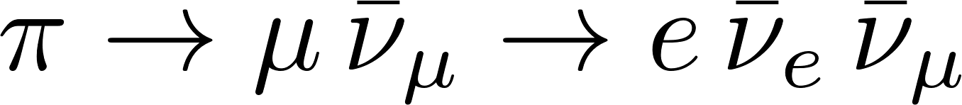
Introduction: the bubble chamber, our tasks
Magnification
Analyzing events: cross section, pion multiplicity
Finding events
Strange particle event candidates
Notes:
First we are going to talk about the bubble chamber, then
Magnification: to get the real distances for momentum (curvature) and other distance measurements
Then we will talk about how we analyzed the events like counting incoming proton number, elastic/inelastic scattering numbers to get cross section values
Then,
Finally, we looked for neutral particle decays and tried connecting them to a primary inelastic vertex

Slide 3
The bubble chamber
Liquid hydrogen
Piston
Ionization: bubble seeds
Photographs
Notes:
First talk about how the bubble chamber works: it is filled with liquid hydrogen, just below boiling point. At the moment of recording, a piston causes expansion, pressure drop, the boiling temperature drops below the hydrogen temperature. In the resulting metastable medium, ionization provides seeds for bubbles to form. Letting the created bubbles expand for about 10 ms, becoming 0.01-0.1 mm in size. The chamber is then photographed in three angles, the piston compresses the hydrogen again, the bubbles disappear. One cycle takes 100 ms.

Slide 4
The CERN 2 m bubble chamber
Beam: 24 GeV/c protons
Liquid hydrogen target
3 cameras: spatial reconstruction
Notes:
If this is a valid new slide: talk about the specifics of the bubble chamber, like 40 million pictures were taken and distributed worldwide, helped finding new particles (see cern website on bubble chambers: http://hst-archive.web.cern.ch/archiv/HST2005/bubble_chambers/BCwebsite/index.htm). Then turn the topic to our task: we used the special table available since 1977 (fpseul.pdf) to view the projected pictures. Continue with the magnification.

Slide 5
The experiment
Determine magnification
Measure cross-section
Most probable inelastic process
Average pion multiplicity: two methods
Pion to muon to electron decay: theory vs experiment
Find strange particle pair: V0
Notes:
The lab description says our tasks are:
Determine magnification of course
Count primary vertices and incoming protons to determine cross-sections: the total and the estimated elastic
By counting the number of particles created, determine which number happens the most often
The average pi0 created: we can use two methods, one is the mysterious pion multiplicity, the other one is the pair production
The muon resulting from pi+- decaying at rest into a muon-neutrino pair has a theoretically calculated momentum: we need to find a candidate by looking for the remarkable track, then investigate if the pion decayed at rest (give reason why we expect it), the length of the muon track and from this the momentum. Did we measure the electron curvature?
Find two V0 vertices, analyze them using conservation laws (baryon, lepton numbers, charge, momentum, energy), conclude what V0 could be.

Slide 6
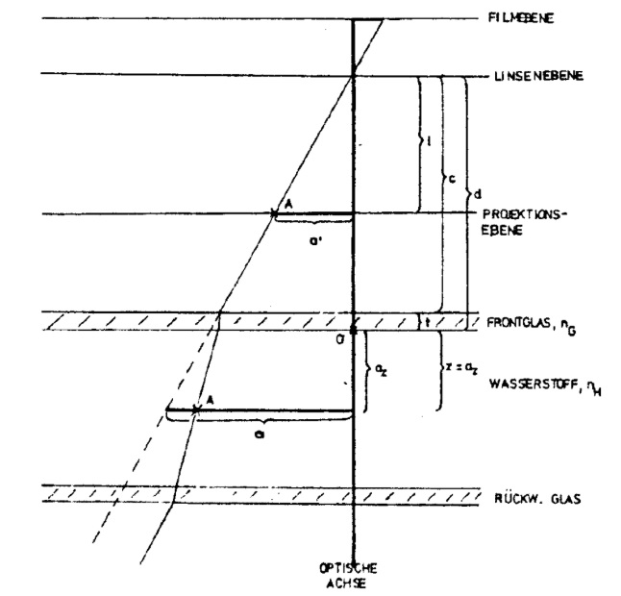
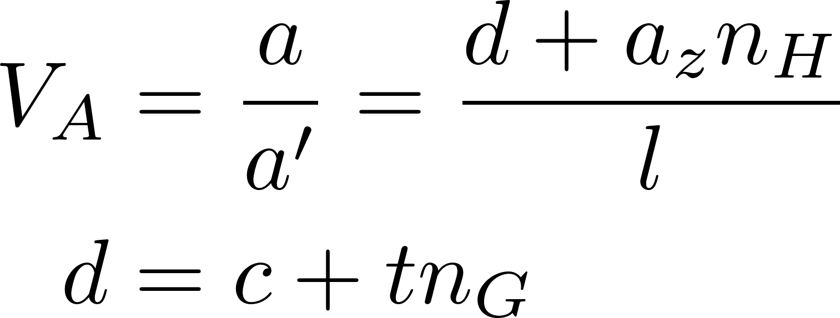
Magnification
Notes:
Possibly highlight a, a’, aZ
Talk about the beam passing through perpendicular to the image plane and to the optical axis as well, running through point A in depth a_z.

Slide 7
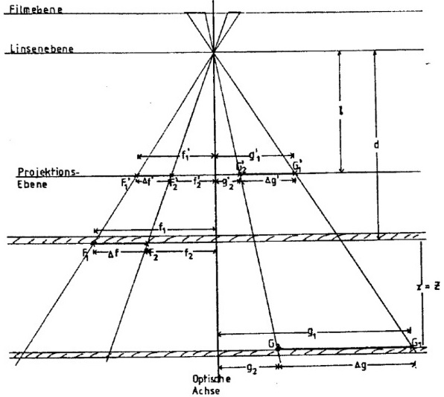
Magnification
F1, F2: front glass
F1’, F2’: pictures of F1, F2
G1, G2: back glass (z = Z)
G1’, G2’: pictures of G1, G2
Notes:
What remains: derivation of the magnification, depending on how much time we have, just mention the end result with the assumption of beam at half depth

Slide 8
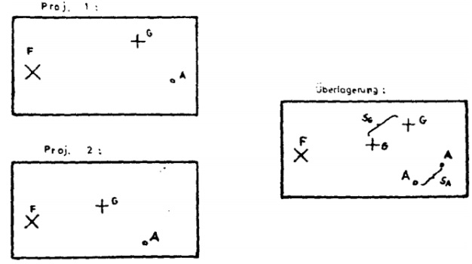
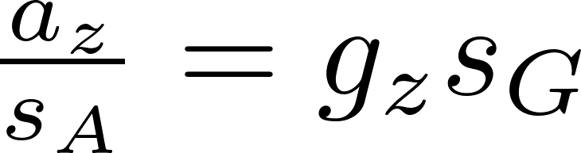
Stereo-shift method
Purpose: depth distribution
F: front glass
G: back glass
Notes:
We can use the reference points to measure the proton beam depth; az is this depth, gz is the chamber depth
TODO: are sG and sA the magnificated values (e.g. Do we use the magnification factor)? What about gz value?

Slide 9
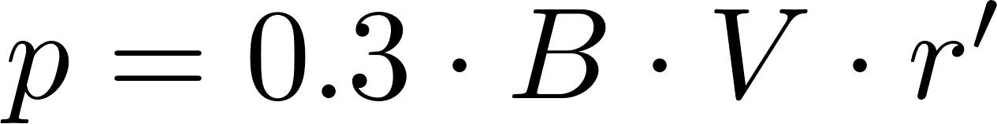
Momentum, charge
Magnetic field
Charge conservation
Notes:
Once we get to deal with the interactions, we need momenta and charge. The easiest method is to use the curve samples we were provided.
TODO: check B value (in Gauss?), maybe some words about derivation, errors in measurement (i.e. We had as much as 500 cm when the radius was large, or something similar).
Talk about conservation laws here: proton + proton = +2 charge, while momentum: 24 GeV + 0. Possibly mention baryon and lepton number conservation here as well

Slide 10
Cross-section
Notes:
L is the distance in reality, e.g. After accounting for magnification

Slide 11
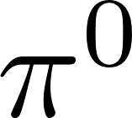
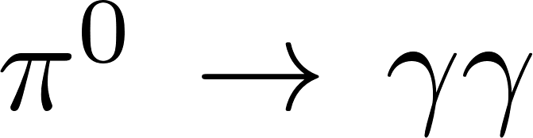
production
From average charged multiplicity
Notes:
Talk a bit about pair production counting and charge multiplicity -> pi0 multiplicity

Slide 12
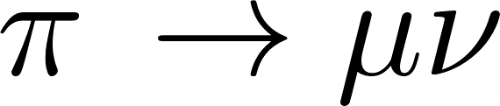
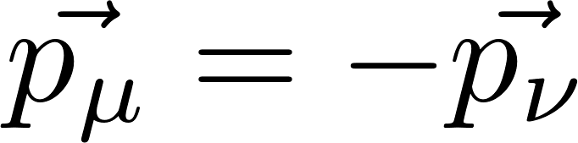
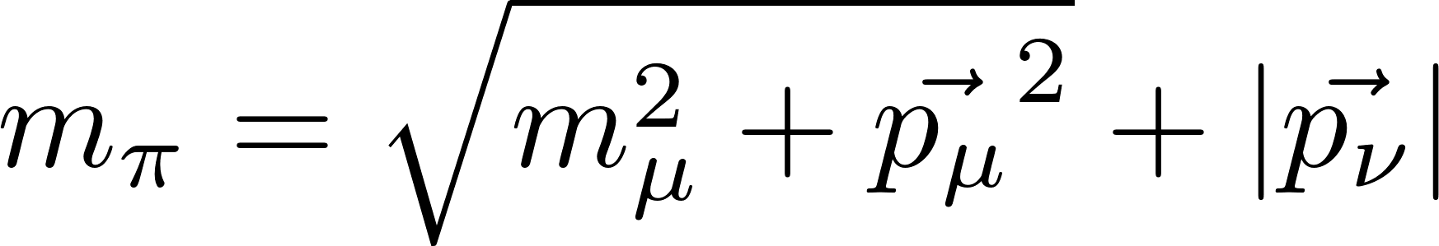
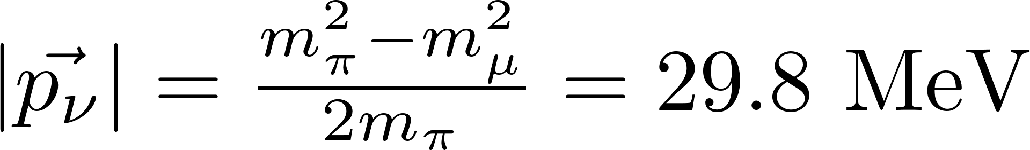
Neutrino momentum in
Pion at rest:
Energy conservation:
Notes:
The derivation holds for CMS but we want to find an event where it decays at rest

Slide 13
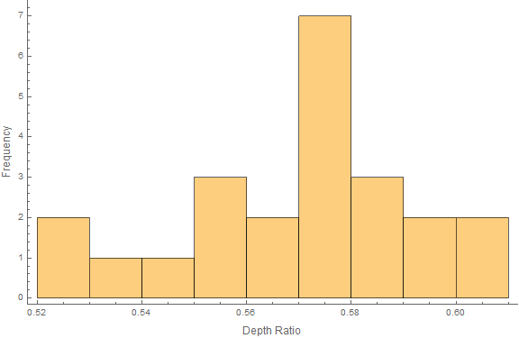

Results
Magnification: F21, F22; G41, G42
$V_{A}=0.852±0.003$
23 stereo-shift measurements
Mean: $\frac{s_{A}}{s_{B}}=0.570±0.021$
Assumption: 0.5!
Notes:
Pythagorean formula: separation is lf=23.9951 cm, lg = 32.1905 cm; measured: 28.2 pm 0.1, 37.7 pm 0.1 cm.
We did not consider the error the deviation from 0.5 depth caused, we should have.

Slide 14
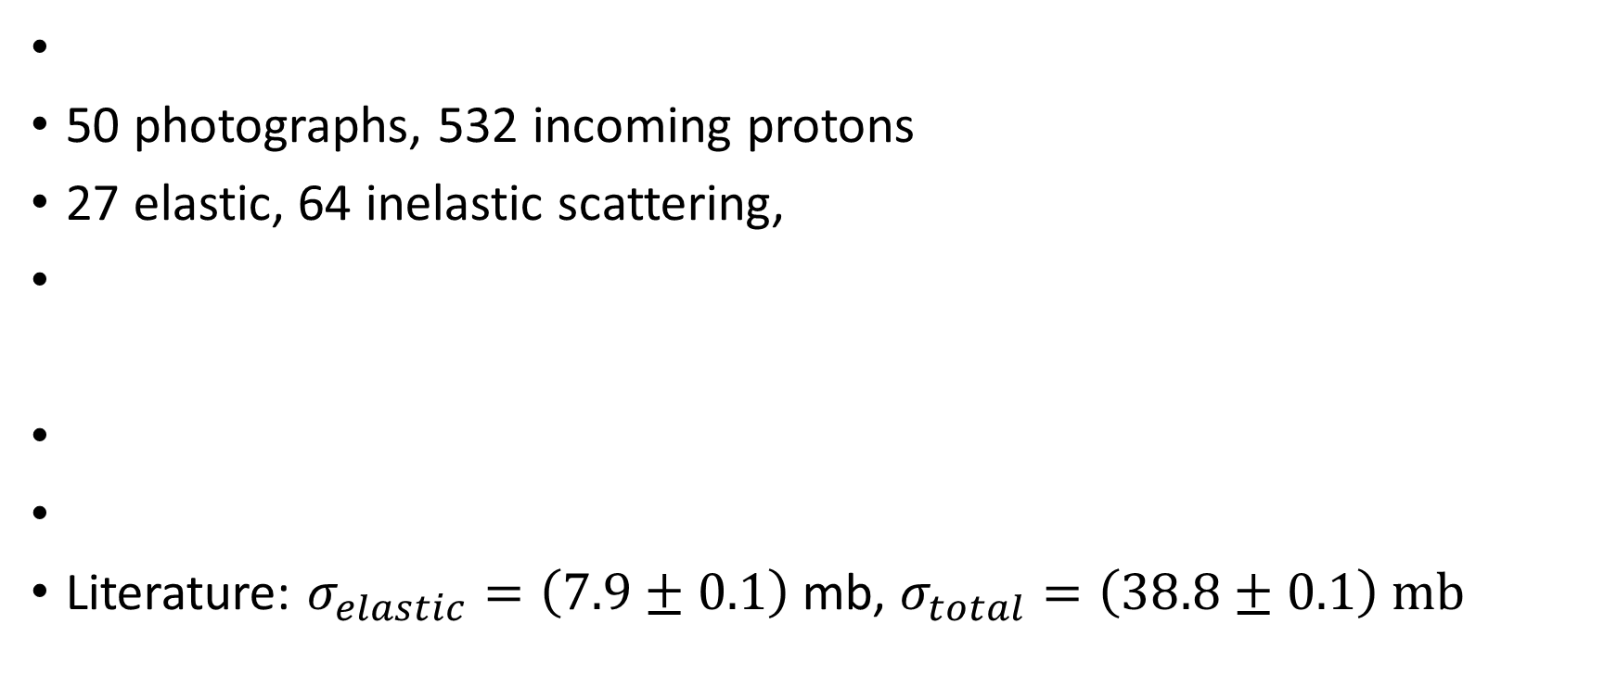
Cross-section
50 photographs, 532 incoming protons
27 elastic, 64 inelastic scattering,
Literature: $σ_{elastic}=\left(7.9±0.1\right)$ mb, $σ_{total}=\left(38.8±0.1\right) mb$
Notes:
L is the distance in reality, e.g. After accounting for magnification
Expected cross sections:

Slide 15
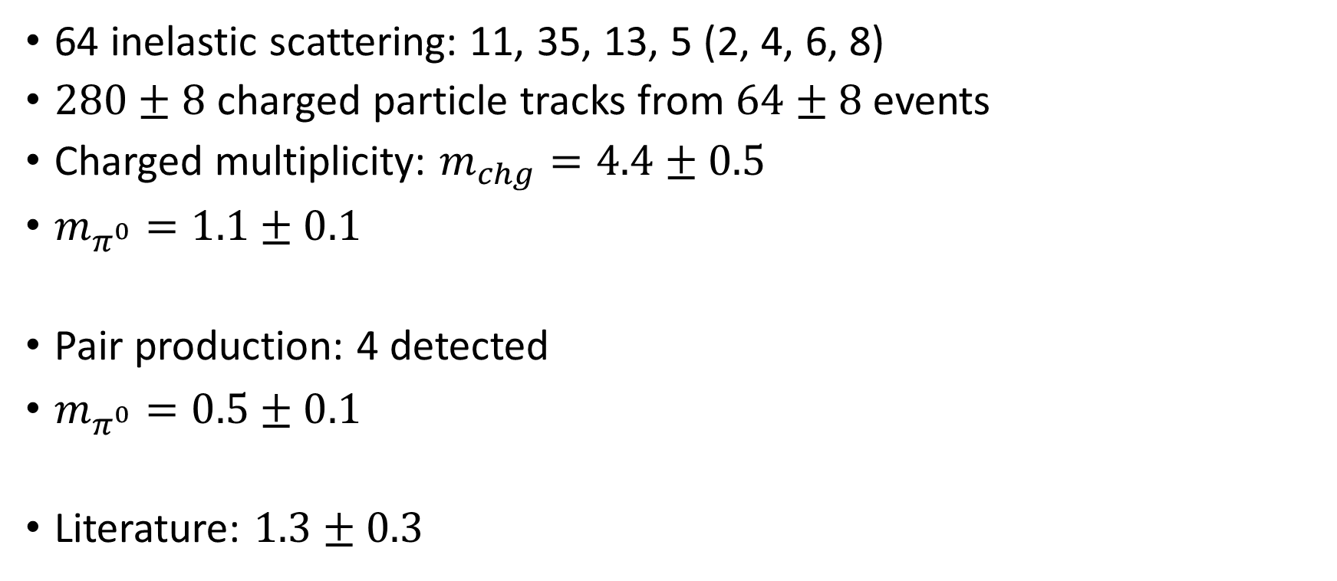
Pion multiplicity
64 inelastic scattering: 11, 35, 13, 5 (2, 4, 6, 8)
$280±8$ charged particle tracks from $64±8$ events
Charged multiplicity: $m_{chg}=4.4±0.5$
$m_{π^{0}}=1.1±0.1$
Pair production: 4 detected
$m_{π^{0}}=0.5±0.1$
Literature: $1.3±0.3$
Notes:
4.375 pm 0.513 charged multiplicity
1.094 pm 0.13 neutral multiplicity
0.5026 pm 0.0589

Slide 16
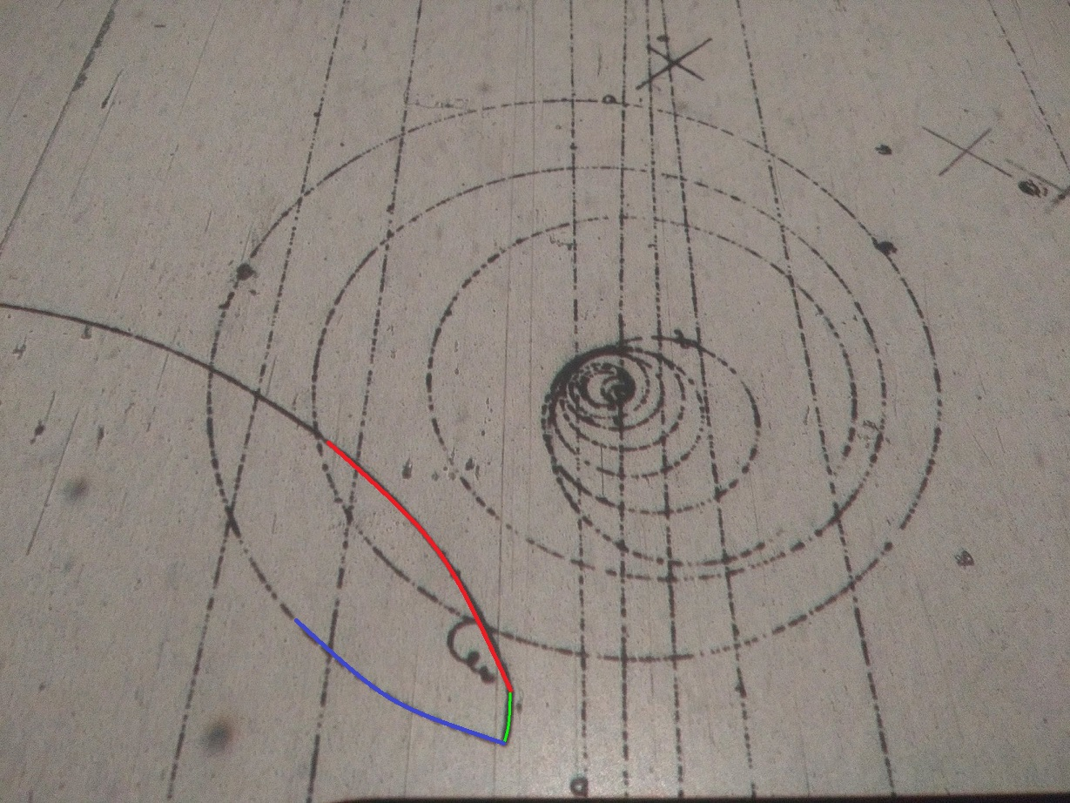
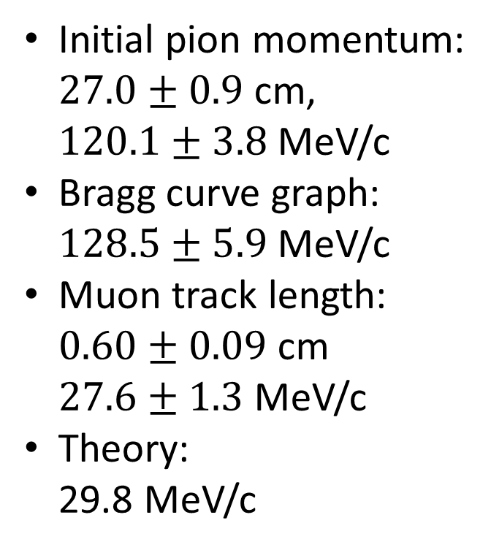
Neutrino momentum
Initial pion momentum: $27.0±0.9$ cm, $120.1±3.8$ MeV/c
Bragg curve graph: $128.5±5.9$ MeV/c
Muon track length: $0.60±0.09$ cm $27.6±1.3$ MeV/c
Theory: 29.8 MeV/c

Slide 17
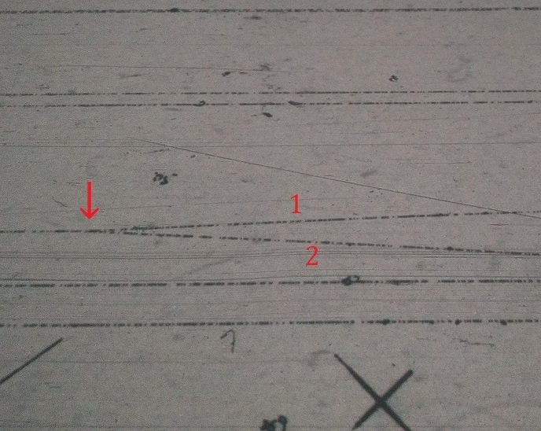
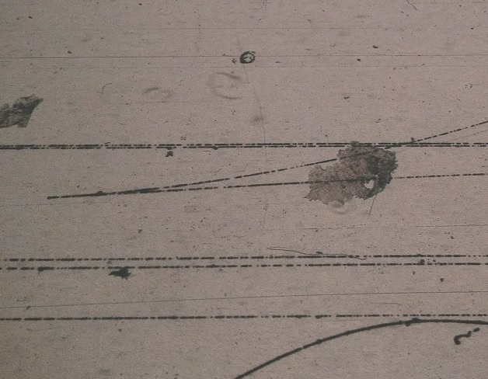
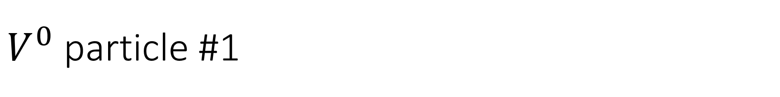
$V^{0}$ particle #1

Slide 18
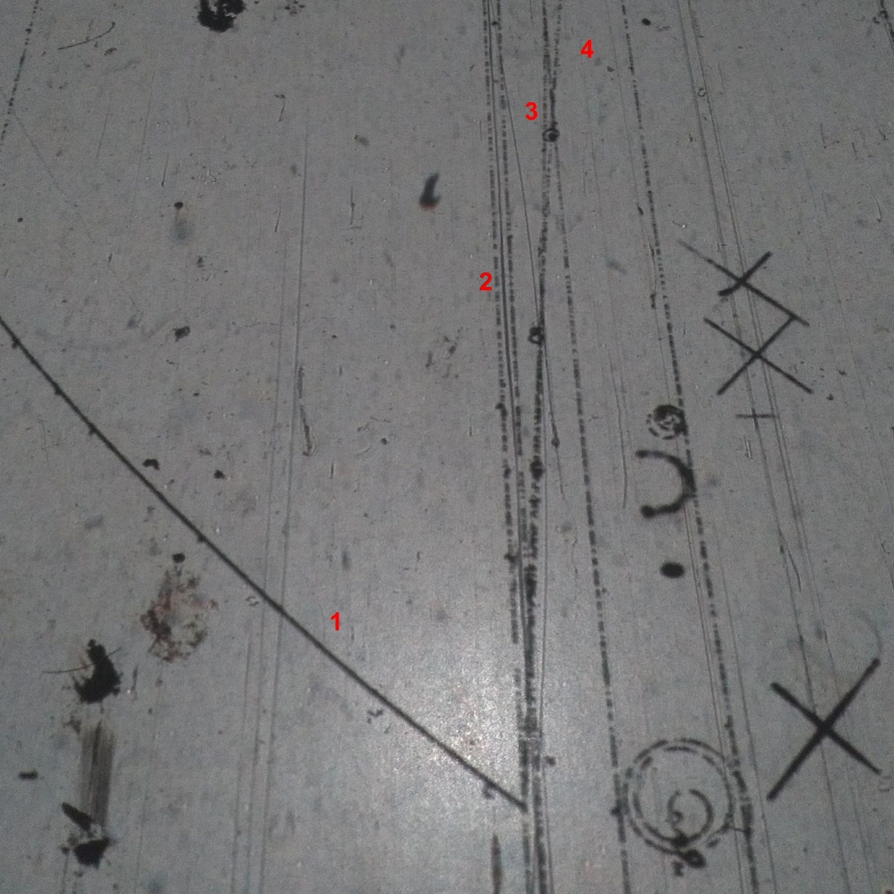
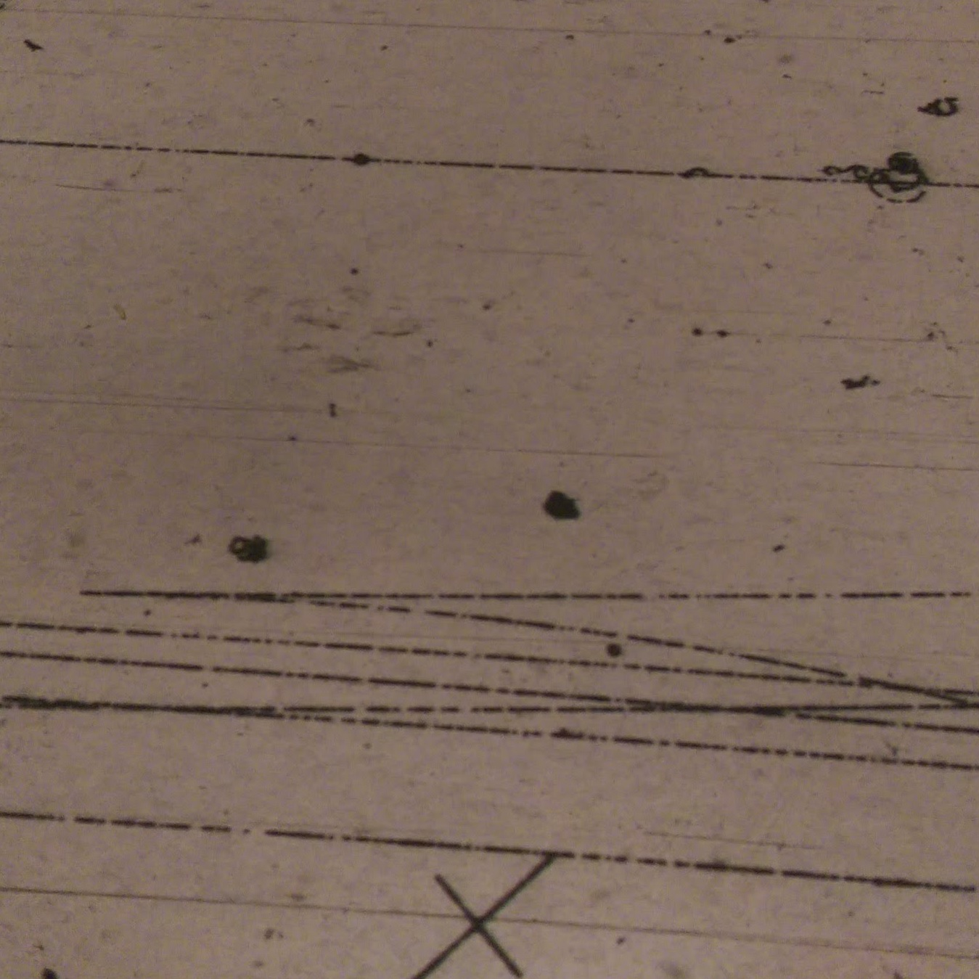
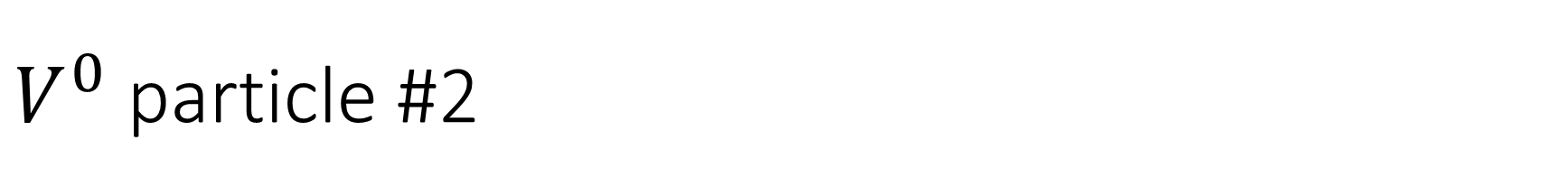
$V^{0}$ particle #2

