Slide 1
E212: Properties of Elementary Particles
Bence Mitlasóczki, Benoît Scholtes
26-27 February
Supervisor: Stephan Duell

Slide 2
Contents
Introduction and Motivation
Theory
Standard Model, Hadrons, and Multiplets
Bubble chamber and conservation laws
Procedure
Results
Conclusion

Slide 3
Introduction and Motivation
Bubble chambers were used to discover weak neutral currents at CERN in 1973 which led to the discovery of the Z boson.
Bubble chambers use superheated liquid in a chamber with a magnetic field to track and identify charged particles
Particle collisions in the chamber can then be identified and analysed, such that new particles can be discovered
50 bubble chamber photographs from the CERN proton-synchrotron in 1971 were analysed

Slide 4
Aims
The aims of this experiment were:
Determine the elastic and total cross-section of the proton-proton collisions
Calculate the charge multiplicity and neutral pion multiplicity
Find and verify a pi-mu-e decay
Analyse two strange neutral particle decays and identify the particles

Slide 5
Theory: The Standard Model (SM)
Comprises of our current best understanding of particle physics
Explained the observed fundamental particles, fundamental forces, and how these interact with each other
Further explains how these form atoms
SM does not include gravity, though it is too weak to affect particle interactions and ignored

Slide 6
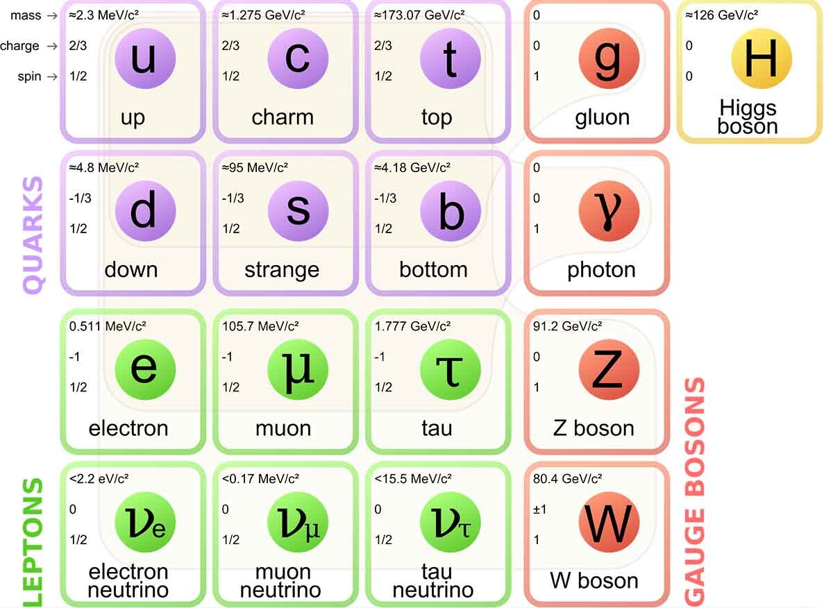
Fermions and Bosons in the SM

Slide 7
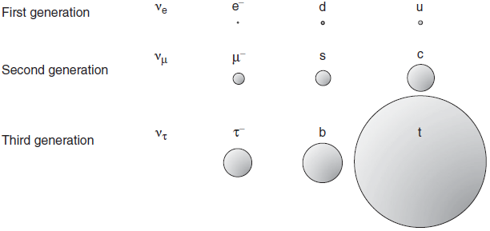
Relative Masses of Matter Particles

Slide 8
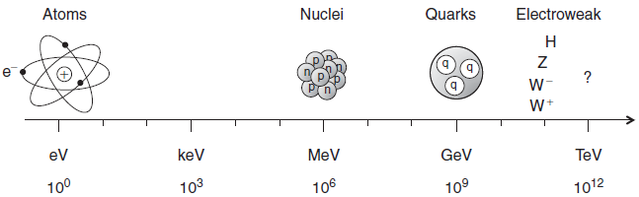
Probing Higher Masses and Smaller Scales
Need higher energies to probe smaller length scales and higher masses

Slide 9
Fundamental Forces
Photon: mediates electromagnetic force, couples to electric charge
Gluons: mediate strong force, couple to colour charge
W, Z bosons: mediate weak interaction, couples to all matter particles
Higgs boson: generates mass of all massive particles

Slide 10
Hadrons and the Strong Force
Colour confinement: colour charge cannot be freely observed
Instead, composite colourless particles are formed: Hadrons/Mesons
Hadrons have 3 quarks/anti-quarks (e.g. red, blue, green)
Mesons have 1 quark, 1 anti-quark (e.g. red, anti-red)
These are the main possibilities to achieve colourlessness
They are both bound by the 8 gluons
Protons (uud) and neutrons (udd) are both hadrons
Exotic hadrons have been theorised too (pentaquarks, tetraquarks)

Slide 11
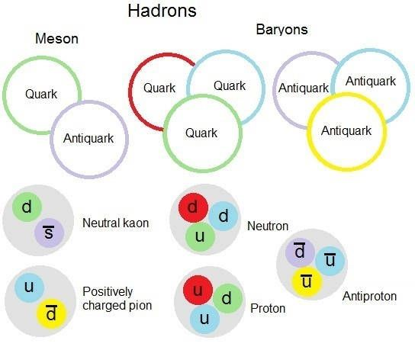
Hadrons

Slide 12
Multiplets
Hadrons form multiplets under a group theoretic treatment of QCD
Group theory predicts the possibilities of particles from achieving colourlessness from the quarks in the SM
Multiplets are formed from similar composite quarks
The following multiplet is composed of mesons made up of u, d, and s quarks (and their anti-quarks)
Strangeness (conserved quantum number) is defined as the:
S = # anti-strange quarks - # strange quarks

Slide 13
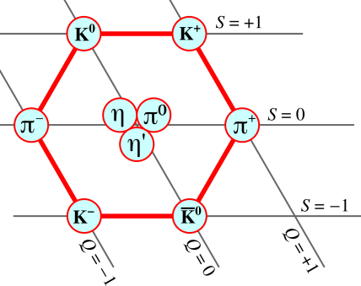
Light Pseudoscalar Meson Nonet

Slide 14
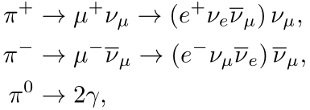
Pion Decay Modes
The main pion decay modes are:
In our experiment, the pi-minus instead scatters with the protons in the bubble chamber to produce a pi-zero and neutron
Thus, only the pi-plus decays were observed and analysed

Slide 15
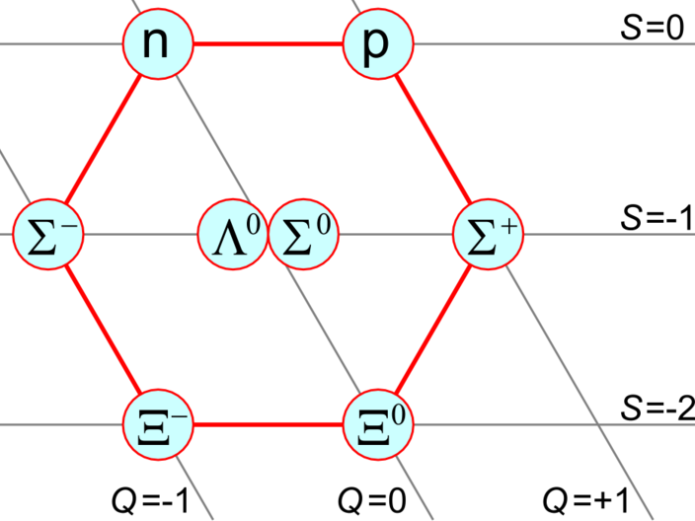
Light Baryon Octet

Slide 16
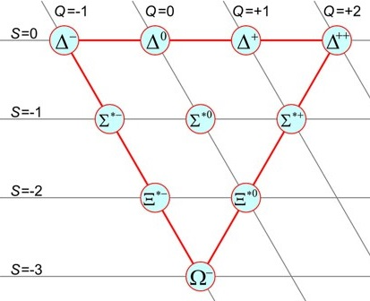
Light Baryon Decuplet

Slide 17
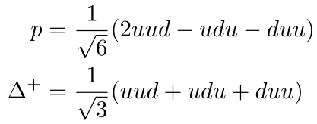
Proton and Delta-Plus
Both composed of two up quarks, one down quark
Linear combination of quarks differ however, giving different quark wavefunctions:
As a result, Lambda-plus is heavier: m = 1232 MeV (proton: 938 MeV)
Decays to pi-zero + proton, or pi-plus + neutron
This particle is often produced in these bubble chamber experiments

Slide 18
Kinematics and Conservation Laws
In order to analyse particle physics experiments and find new particles, the following laws are used:
Energy and momentum conservation, such that masses of unidentified particles can be calculated
Conservation of:
Electric charge
Angular momentum
Baryon number
Lepton number
Strangeness (violated in the weak interaction)

Slide 19
Bubble Chamber
Used to photograph particle collisions such that particles can be tracked
Can then identify particles and allow for new particle discoveries
Large container filled with a liquid superheated to a metastable state (over the boiling temperature but not yet boiled)
Disturbances, such as moving charged particles, then cause local ionisation of the liquid which form expanding bubbles
These ionisation tracks of bubbles are then photographed
A magnetic field is used to determine the charge and velocities of particles from their track arc radii and deflections

Slide 20
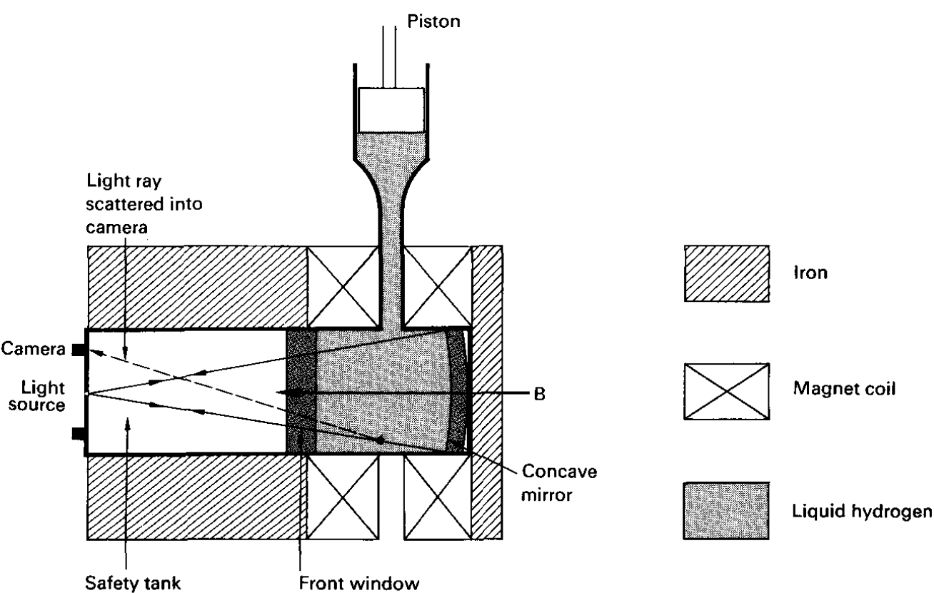
Bubble Chamber

Slide 21
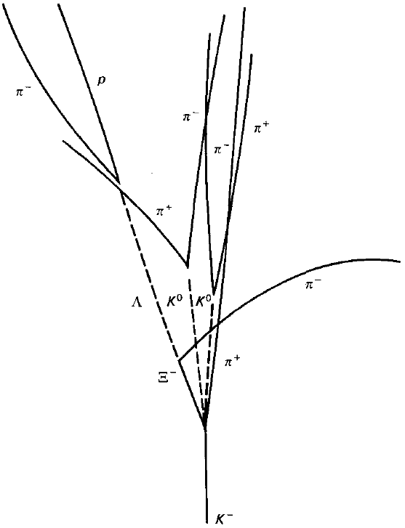
Bubble Chamber Photograph Example

Slide 22
The CERN 2m Bubble Chamber
Directed beams of protons of 24 GeV/c into the bubble chamber
Liquid used was liquid hydrogen
3 cameras used for spatial reconstruction of particle tracks
In this experiment, only tracks approximately in the same plane (<18%) were analysed
Notes:
If this is a valid new slide: talk about the specifics of the bubble chamber, like 40 million pictures were taken and distributed worldwide, helped finding new particles (see cern website on bubble chambers: http://hst-archive.web.cern.ch/archiv/HST2005/bubble_chambers/BCwebsite/index.htm). Then turn the topic to our task: we used the special table available since 1977 (fpseul.pdf) to view the projected pictures. Continue with the magnification.

Slide 24
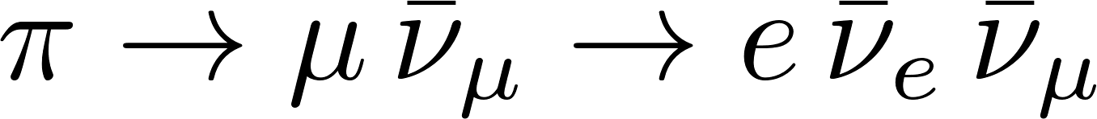
Introduction: the bubble chamber, our tasks
Magnification
Analyzing events: cross section, pion multiplicity
Finding events
Strange particle event candidates
Notes:
First we are going to talk about the bubble chamber, then
Magnification: to get the real distances for momentum (curvature) and other distance measurements
Then we will talk about how we analyzed the events like counting incoming proton number, elastic/inelastic scattering numbers to get cross section values
Then,
Finally, we looked for neutral particle decays and tried connecting them to a primary inelastic vertex

Slide 25
The Procedure
Determine the magnification of photographs
Measure cross-section of proton-proton collisions
Most probable inelastic process
Average pion multiplicity: two methods
Pion to muon to electron decay: theory vs experiment
Find strange particle pair: V0
Notes:
The lab description says our tasks are:
Determine magnification of course
Count primary vertices and incoming protons to determine cross-sections: the total and the estimated elastic
By counting the number of particles created, determine which number happens the most often
The average pi0 created: we can use two methods, one is the mysterious pion multiplicity, the other one is the pair production
The muon resulting from pi+- decaying at rest into a muon-neutrino pair has a theoretically calculated momentum: we need to find a candidate by looking for the remarkable track, then investigate if the pion decayed at rest (give reason why we expect it), the length of the muon track and from this the momentum. Did we measure the electron curvature?
Find two V0 vertices, analyze them using conservation laws (baryon, lepton numbers, charge, momentum, energy), conclude what V0 could be.

Slide 26
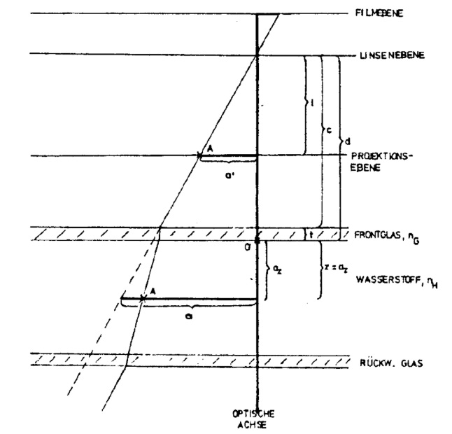
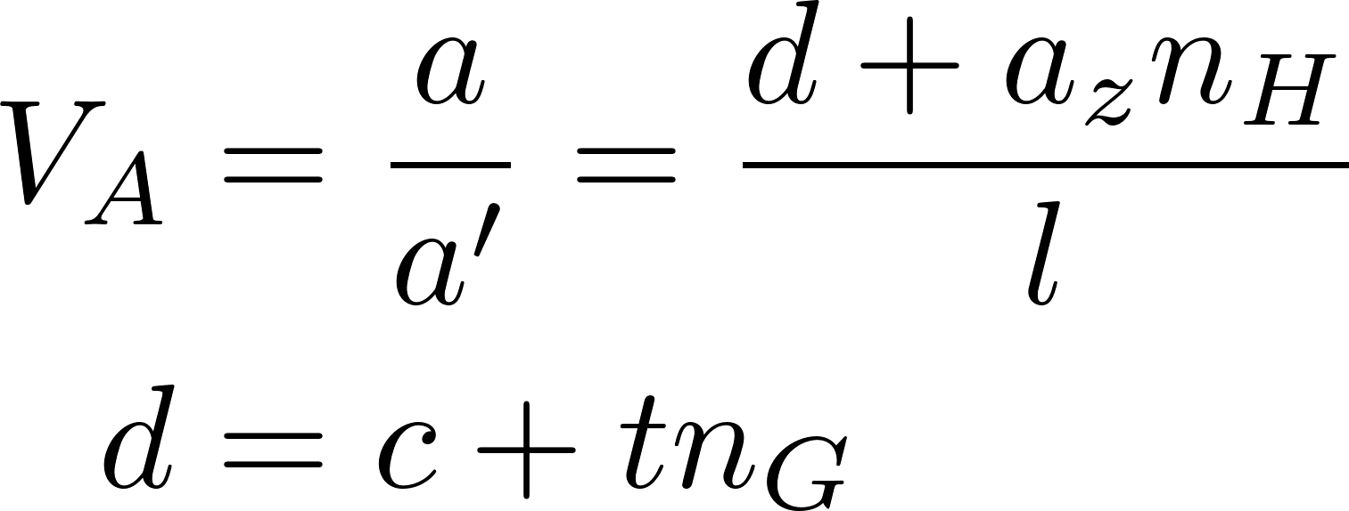
Magnification
Notes:
Possibly highlight a, a’, aZ
Talk about the beam passing through perpendicular to the image plane and to the optical axis as well, running through point A in depth a_z.

Slide 27
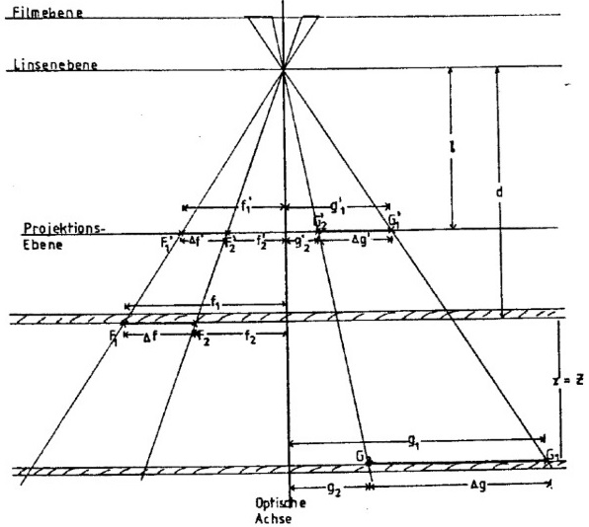
Magnification
F1, F2: front glass
F1’, F2’: pictures of F1, F2
G1, G2: back glass (z = Z)
G1’, G2’: pictures of G1, G2
Notes:
What remains: derivation of the magnification, depending on how much time we have, just mention the end result with the assumption of beam at half depth

Slide 28
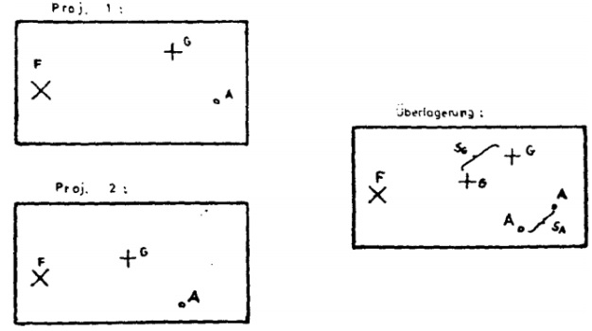
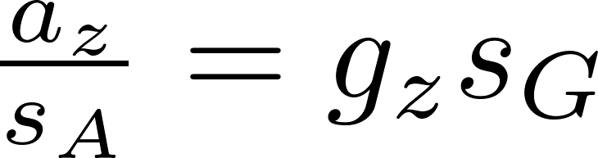
Stereo-shift method
Purpose: depth distribution
F: front glass
G: back glass
Notes:
We can use the reference points to measure the proton beam depth; az is this depth, gz is the chamber depth
TODO: are sG and sA the magnificated values (e.g. Do we use the magnification factor)? What about gz value?

Slide 29
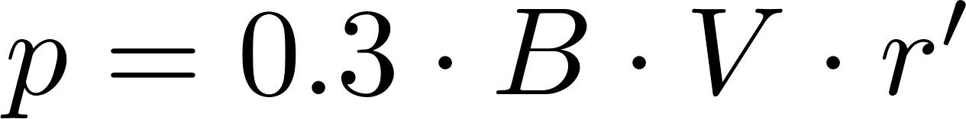
Momentum, charge
Magnetic field
Charge conservation
Notes:
Once we get to deal with the interactions, we need momenta and charge. The easiest method is to use the curve samples we were provided.
TODO: check B value (in Gauss?), maybe some words about derivation, errors in measurement (i.e. We had as much as 500 cm when the radius was large, or something similar).
Talk about conservation laws here: proton + proton = +2 charge, while momentum: 24 GeV + 0. Possibly mention baryon and lepton number conservation here as well

Slide 30
Cross-section
Notes:
L is the distance in reality, e.g. After accounting for magnification

Slide 31
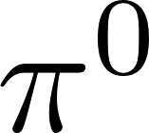
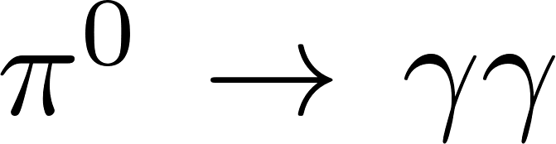
production
From average charged multiplicity
Notes:
Talk a bit about pair production counting and charge multiplicity -> pi0 multiplicity

Slide 32
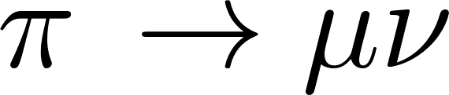
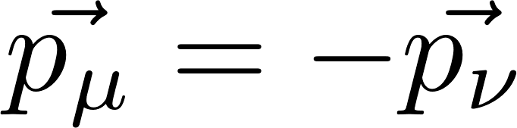
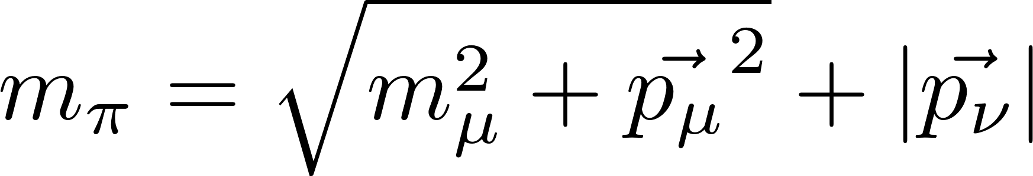
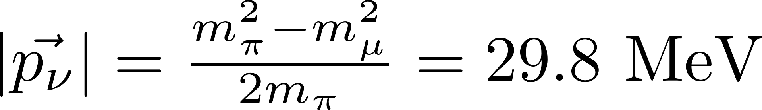
Neutrino momentum in
Pion at rest:
Energy conservation:
Notes:
The derivation holds for CMS but we want to find an event where it decays at rest

Slide 33
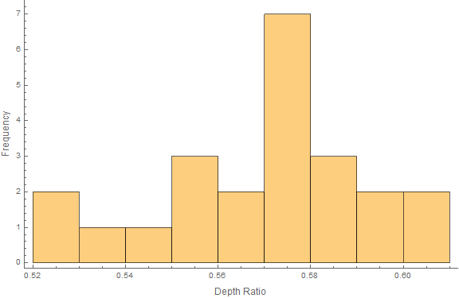

Results
Magnification: F21, F22; G41, G42
$V_{A}=0.852±0.003$
23 stereo-shift measurements
Mean: $\frac{s_{A}}{s_{B}}=0.570±0.021$
Assumption: 0.5!
Notes:
Pythagorean formula: separation is lf=23.9951 cm, lg = 32.1905 cm; measured: 28.2 pm 0.1, 37.7 pm 0.1 cm.
We did not consider the error the deviation from 0.5 depth caused, we should have.

Slide 34
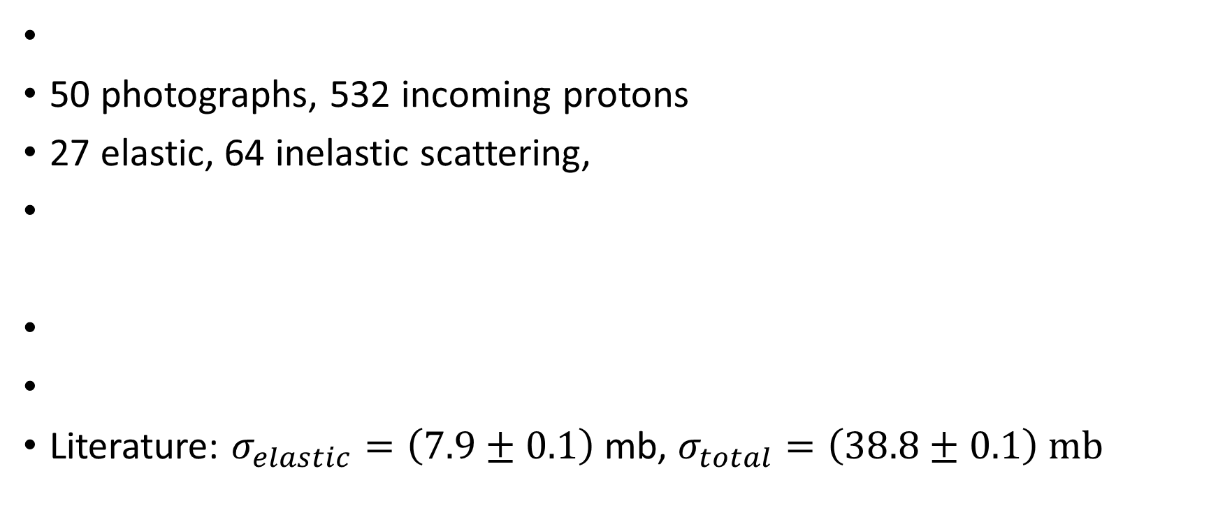
Cross-section
50 photographs, 532 incoming protons
27 elastic, 64 inelastic scattering,
Literature: $σ_{elastic}=\left(7.9±0.1\right)$ mb, $σ_{total}=\left(38.8±0.1\right) mb$
Notes:
L is the distance in reality, e.g. After accounting for magnification
Expected cross sections:

Slide 35
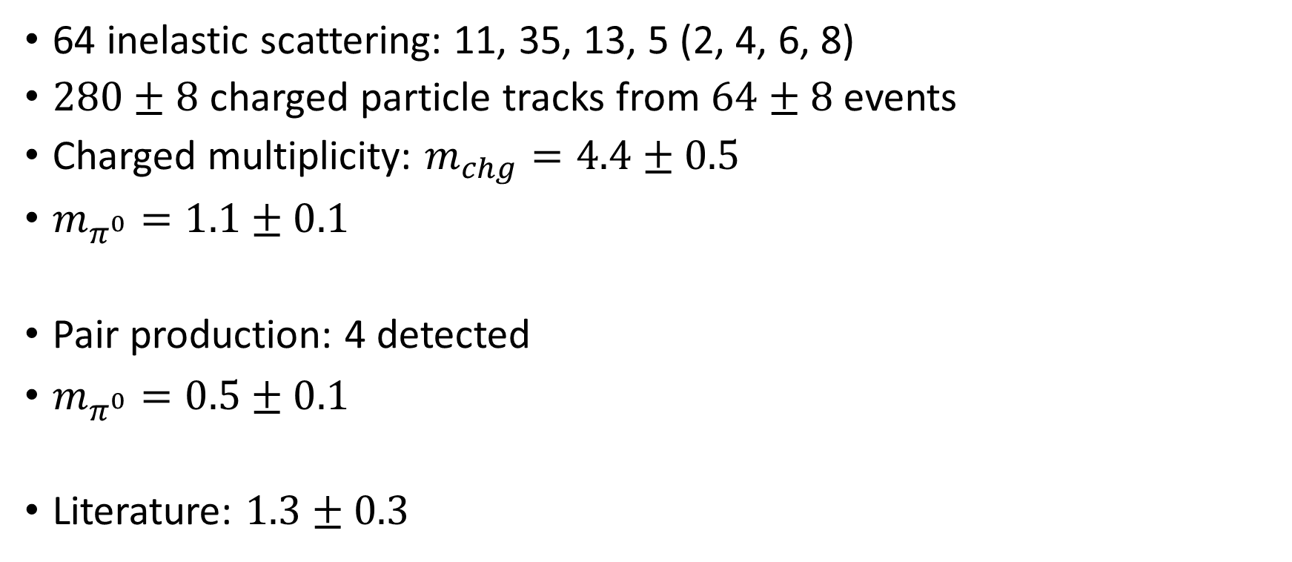
Pion multiplicity
64 inelastic scattering: 11, 35, 13, 5 (2, 4, 6, 8)
$280±8$ charged particle tracks from $64±8$ events
Charged multiplicity: $m_{chg}=4.4±0.5$
$m_{π^{0}}=1.1±0.1$
Pair production: 4 detected
$m_{π^{0}}=0.5±0.1$
Literature: $1.3±0.3$
Notes:
4.375 pm 0.513 charged multiplicity
1.094 pm 0.13 neutral multiplicity
0.5026 pm 0.0589

Slide 36
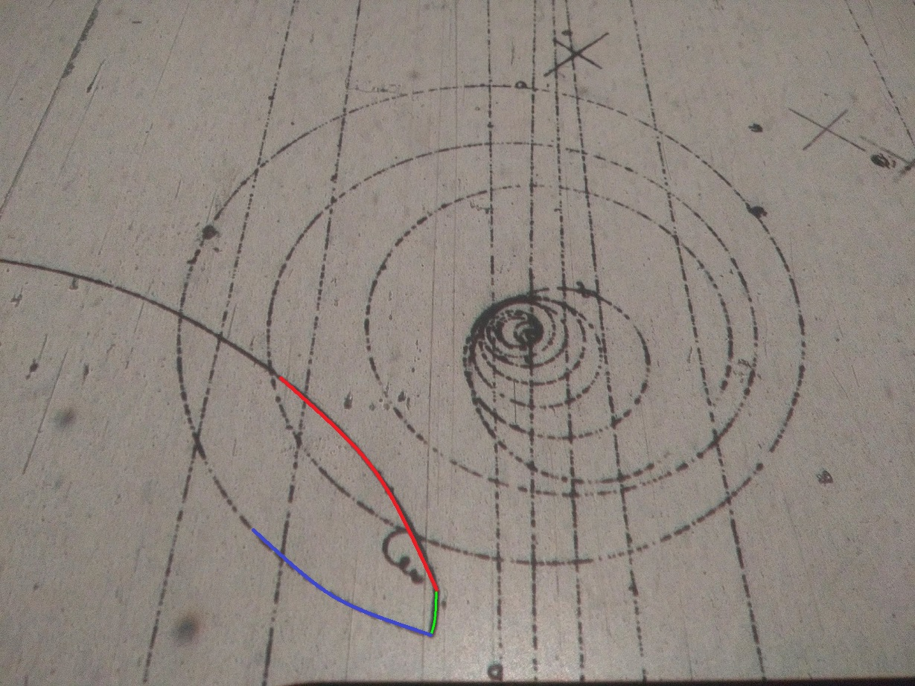
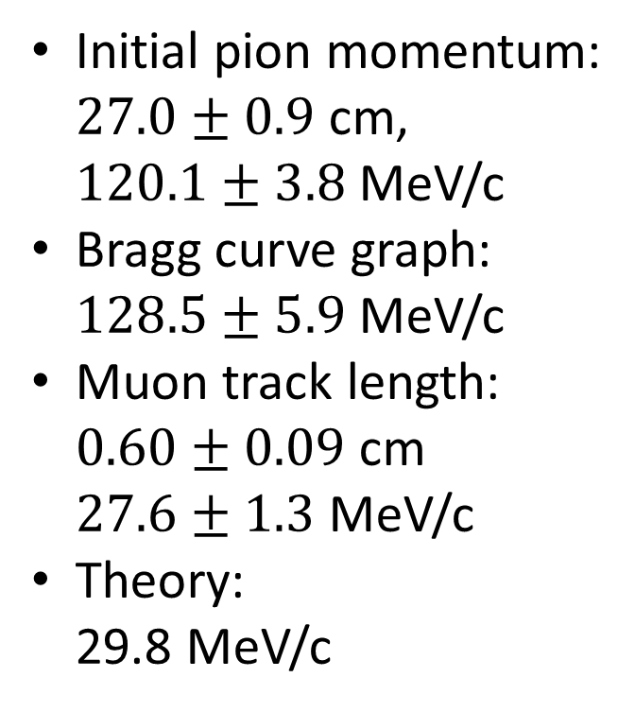
Neutrino momentum
Initial pion momentum: $27.0±0.9$ cm, $120.1±3.8$ MeV/c
Bragg curve graph: $128.5±5.9$ MeV/c
Muon track length: $0.60±0.09$ cm $27.6±1.3$ MeV/c
Theory: 29.8 MeV/c

Slide 37
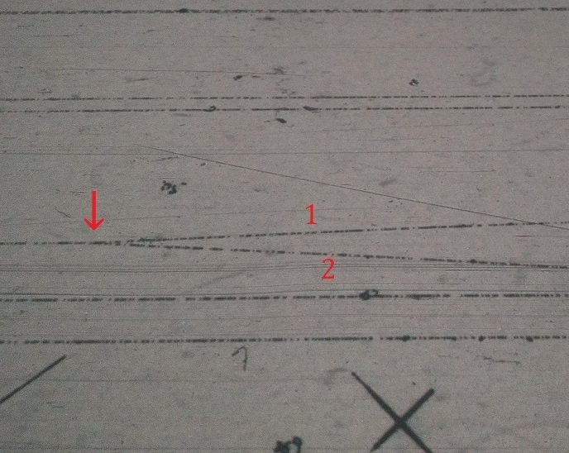
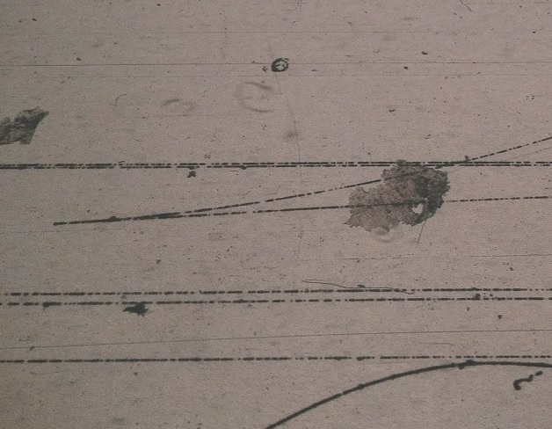
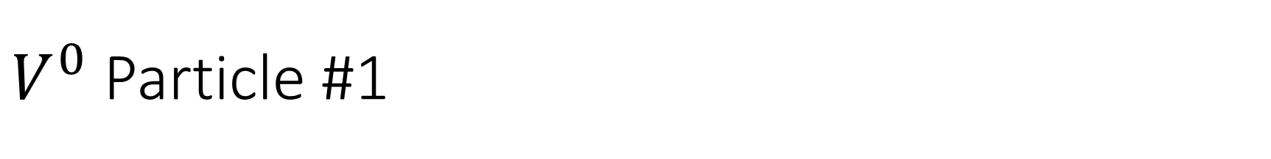
$V^{0}$ Particle #1

Slide 38
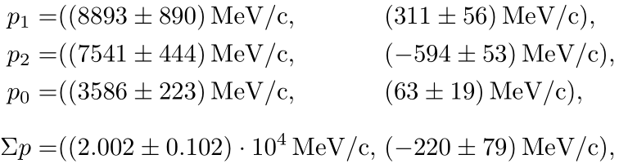
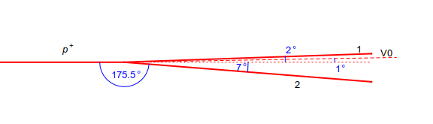
Diagram of Collision with Radii
Radii: particle 1 has (2000 ± 200) cm; particle 2 has (1700 ± 100) cm
Momenta:

Slide 39
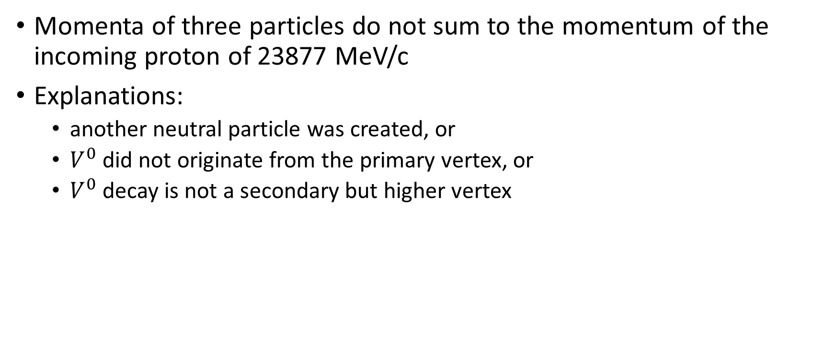
Problem
Momenta of three particles do not sum to the momentum of the incoming proton of 23877 MeV/c
Explanations:
another neutral particle was created, or
$V^{0}$ did not originate from the primary vertex, or
$V^{0}$ decay is not a secondary but higher vertex

Slide 40
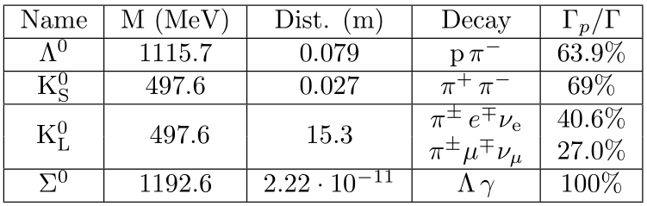
Possible Neutral Particles Not Detected

Slide 41
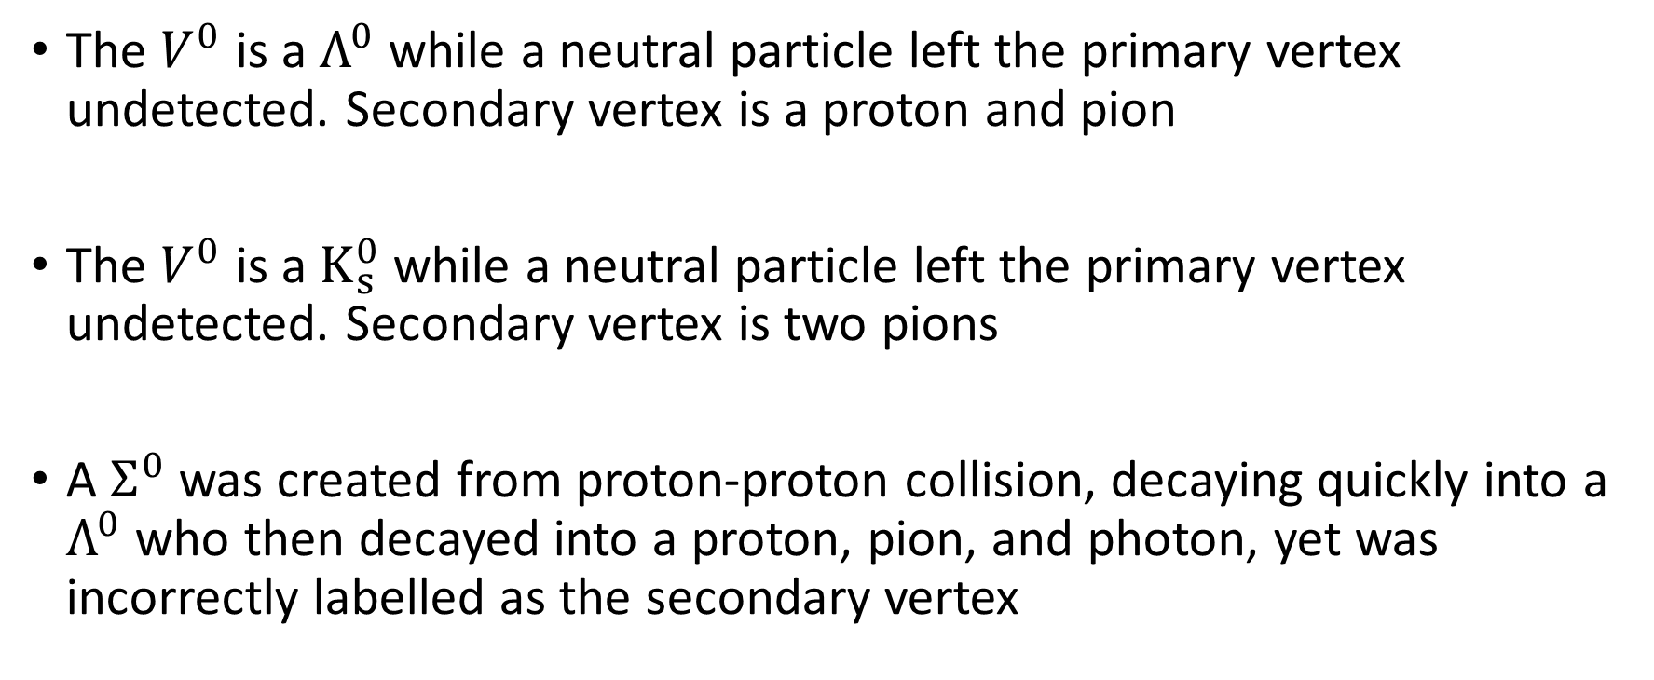
Possible Solutions
The $V^{0}$ is a $Λ^{0}$ while a neutral particle left the primary vertex undetected. Secondary vertex is a proton and pion
The $V^{0}$ is a $K_{s}^{0}$ while a neutral particle left the primary vertex undetected. Secondary vertex is two pions
A $Σ^{0}$ was created from proton-proton collision, decaying quickly into a $Λ^{0}$ who then decayed into a proton, pion, and photon, yet was incorrectly labelled as the secondary vertex

Slide 44
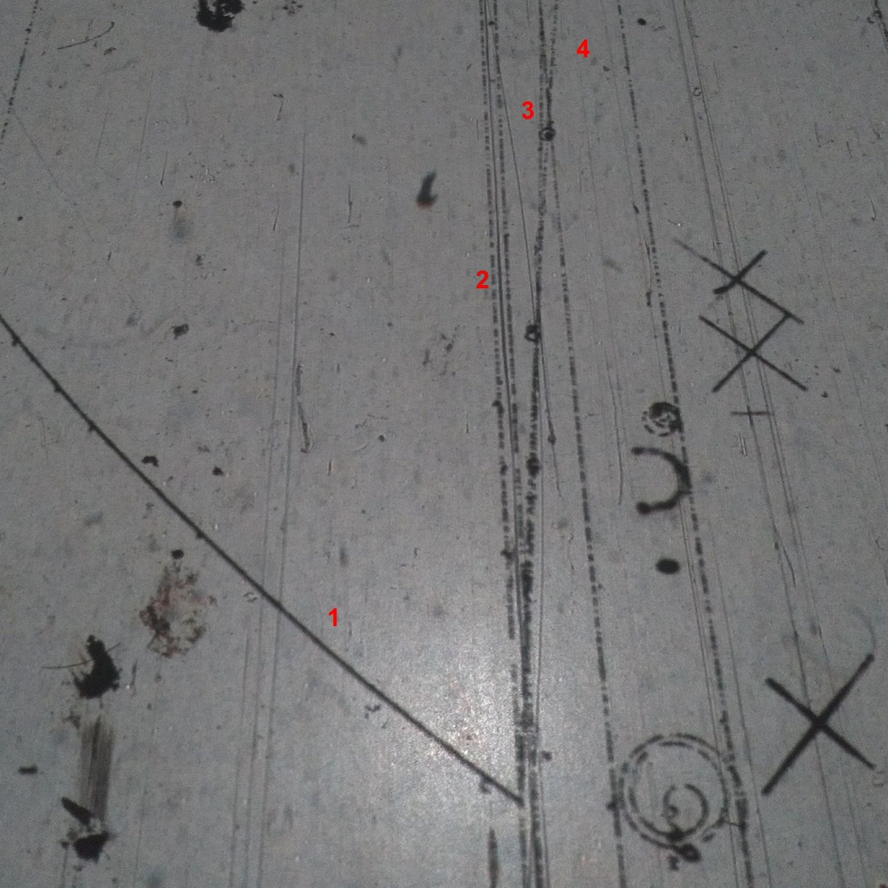
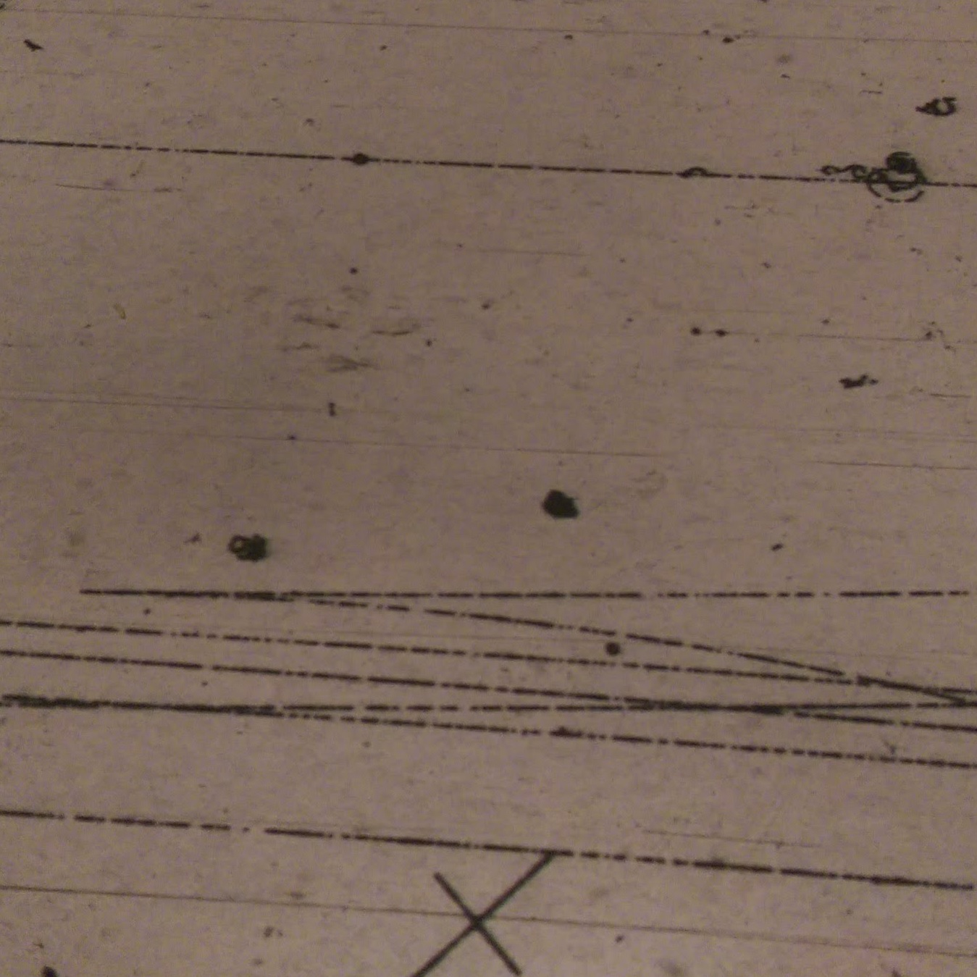
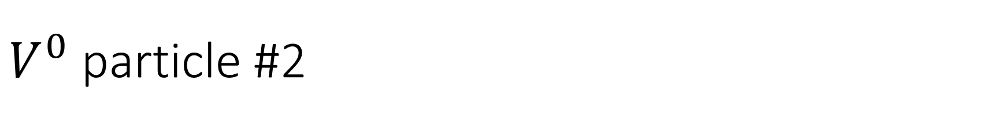
$V^{0}$ particle #2

Slide 45
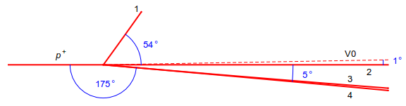
Diagram of Collision

Slide 46

Missing Momentum
The missing momentum was calculated at (38.7 ± 22) GeV, which is within the uncertainty of the $V^{0}$ momentum.
Can conclude that a $Λ^{0}$ or${ K}^{0}$ was created at the first vertex

Slide 47
Conclusion

Slide 48
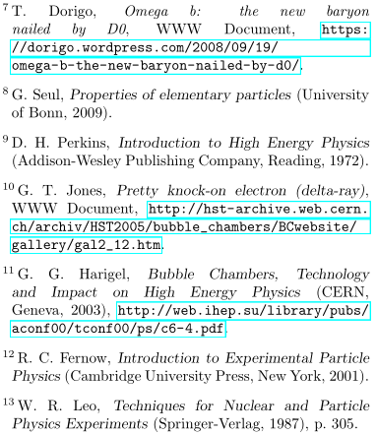
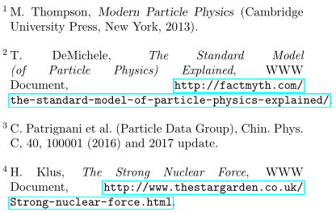
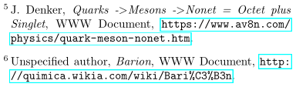
References

