Slide 1
E212: Properties of Elementary Particles
Bence Mitlasóczki, Benoît Scholtes
26-27 February
Supervisor: Stephan Duell

Slide 2
Contents
Introduction and Motivation
Theory
Standard Model, Hadrons, and Multiplets
Bubble chamber and conservation laws
Procedure
Magnification, stereo-shift, multiplicities, cross-sections
Results
Cross-sections, multiplicities, pi-mu-e decay, two strange particles
Conclusion

Slide 3
Introduction and Motivation
Bubble chambers were used to discover weak neutral currents at CERN in 1973 which led to the discovery of the Z boson.
Also discovered the Omega-minus in 1964
Bubble chambers use superheated liquid in a chamber with a magnetic field to track and identify charged particles
Particle collisions in the chamber can then be identified and analysed, such that new particles can be discovered
50 bubble chamber photographs from the CERN proton-synchrotron in 1971 were analysed

Slide 4
Aims
The aims of this experiment were:
Determine the elastic and total cross-section of the proton-proton collisions
Calculate the charge multiplicity and neutral pion multiplicity
Find and verify a pi-mu-e decay
Analyse two strange neutral particle decays and identify the particles

Slide 5
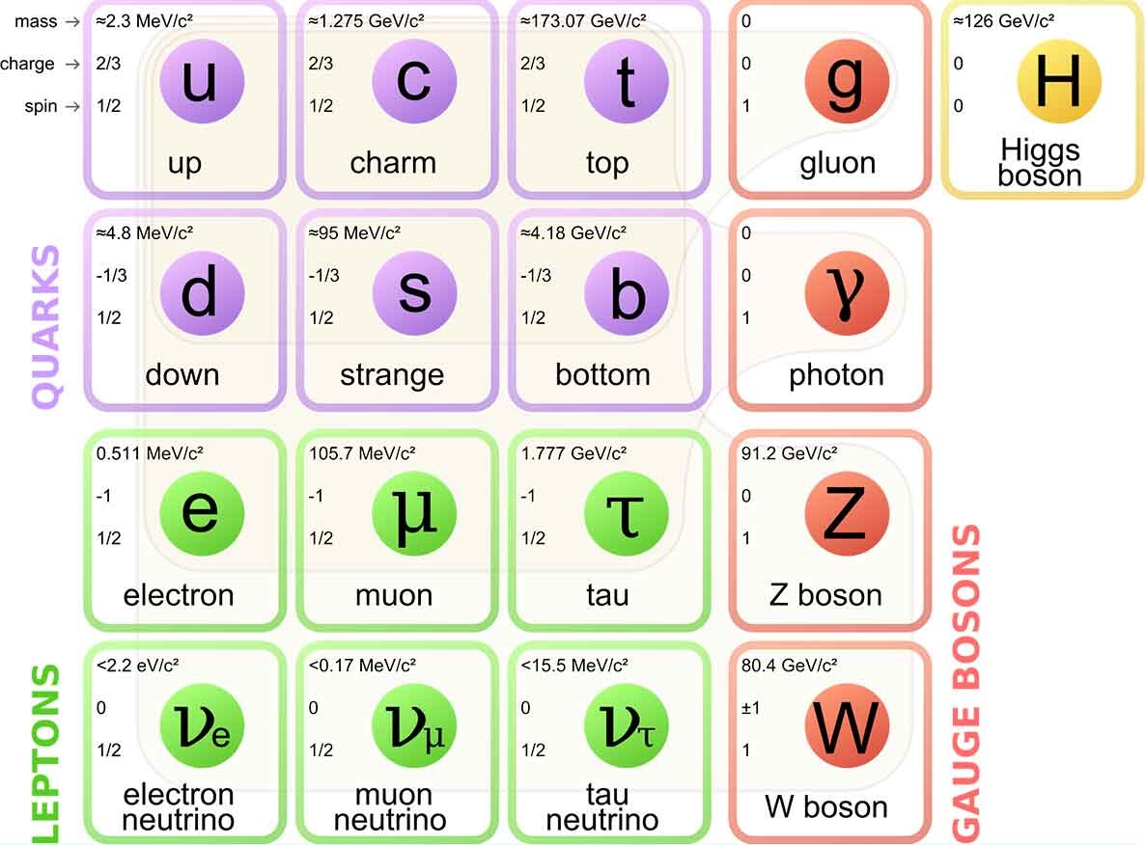
Theory: The Standard Model (SM)

Slide 6
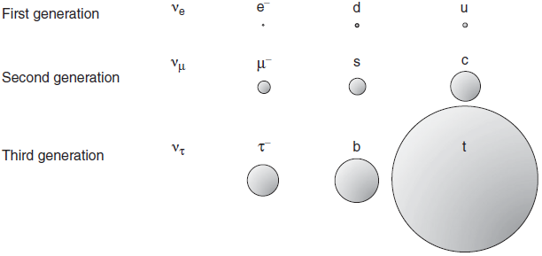
Relative Masses of Matter Particles

Slide 7
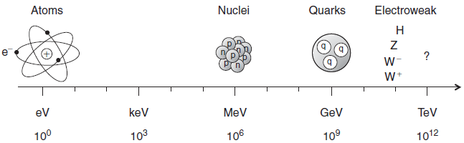
Probing Higher Masses and Smaller Scales
Need higher energies to probe smaller length scales and higher masses

Slide 8
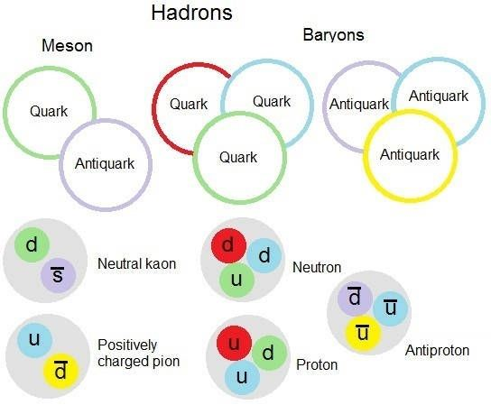
Hadrons

Slide 9
Multiplets
Hadrons form multiplets under a group theoretic treatment of QCD
Group theory predicts the possibilities of particles from achieving colourlessness from the quarks in the SM
Multiplets are formed from similar quarks and quantum numbers, such as spin
The following multiplet is composed of mesons made up of u, d, and s quarks (and their anti-quarks)
Strangeness (conserved quantum number) is defined as the:
S = # anti-strange quarks - # strange quarks

Slide 10
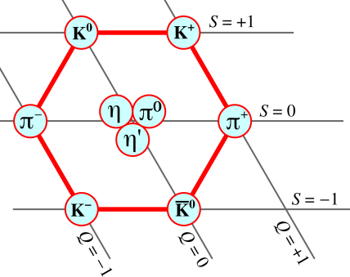
Light Pseudoscalar Meson Nonet

Slide 11
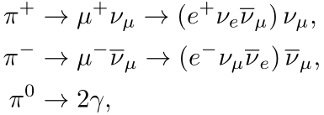
Pion Decay Modes
The main pion decay modes are:
In our experiment, the pi-minus instead scatters with the protons in the bubble chamber to produce a pi-zero and neutron
Thus, only the pi-plus decays were observed and analysed

Slide 12
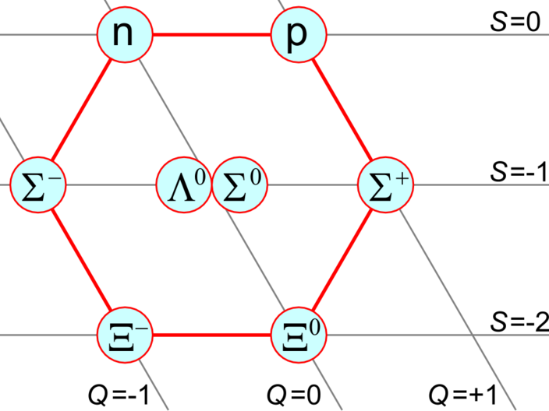
Light Baryon Octet

Slide 13
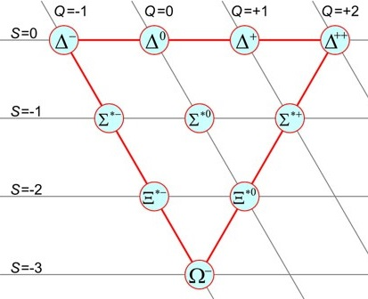
Light Baryon Decuplet

Slide 14
Kinematics and Conservation Laws
In order to analyse particle physics experiments and find new particles, the following laws are used:
Energy and momentum conservation, such that masses of unidentified particles can be calculated
Conservation of:
Electric charge
Angular momentum
Baryon number
Lepton number
Strangeness (violated in the weak interaction)

Slide 15
Bubble Chamber
Used to photograph particle collisions
Can then identify particles and allow for new particle discoveries
Large container filled with a superheated liquid
Disturbances then cause local ionisation of the liquid which form expanding bubbles
These ionisation tracks of bubbles are then photographed
A magnetic field is used to determine the charge and velocities of particles

Slide 16
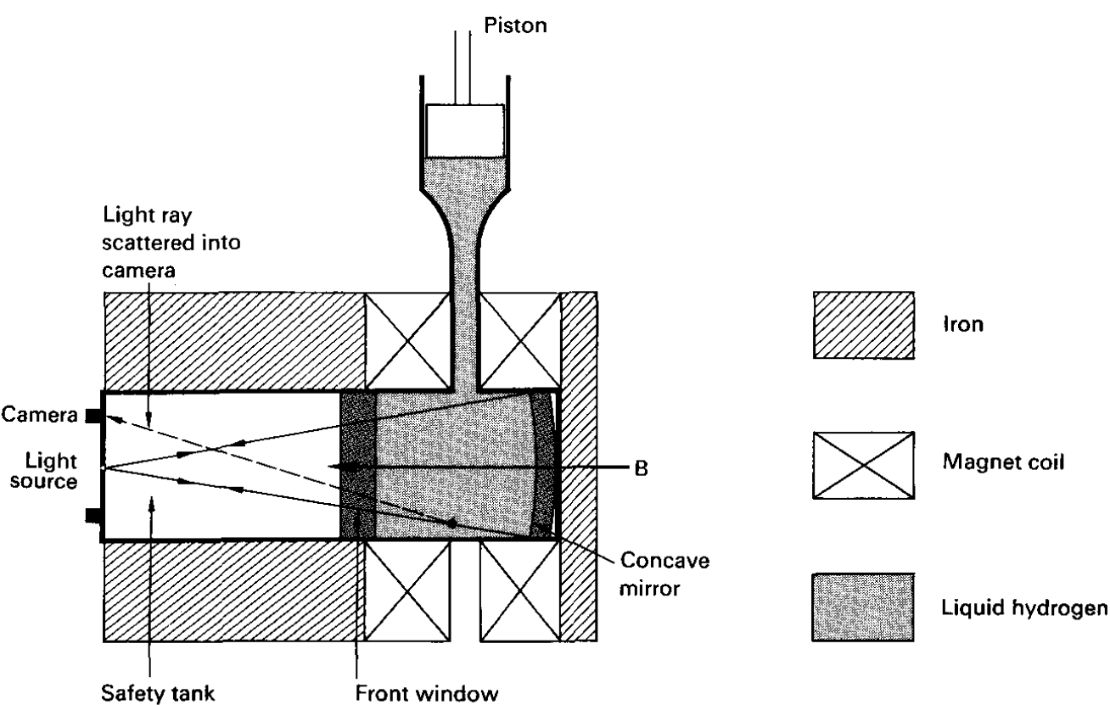
Bubble Chamber

Slide 17
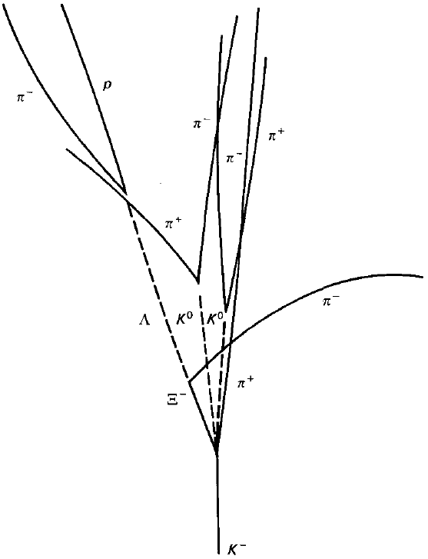
Bubble Chamber Photograph Example

Slide 18
The CERN 2m Bubble Chamber
Directed beams of protons of 24 GeV/c into the bubble chamber
Liquid used was liquid hydrogen
3 cameras used for spatial reconstruction of particle tracks
In this experiment, only tracks approximately in the same plane (<18%) were analysed
Notes:
If this is a valid new slide: talk about the specifics of the bubble chamber, like 40 million pictures were taken and distributed worldwide, helped finding new particles (see cern website on bubble chambers: http://hst-archive.web.cern.ch/archiv/HST2005/bubble_chambers/BCwebsite/index.htm). Then turn the topic to our task: we used the special table available since 1977 (fpseul.pdf) to view the projected pictures. Continue with the magnification.

Slide 19
The Procedure
Determine the magnification of photographs
Measure cross-section of proton-proton collisions
Most probable inelastic process
Average pion multiplicity: two methods
Pion to muon to electron decay: theory vs experiment
Find strange particle pair: V0
Notes:
The lab description says our tasks are:
Determine magnification of course
Count primary vertices and incoming protons to determine cross-sections: the total and the estimated elastic
By counting the number of particles created, determine which number happens the most often
The average pi0 created: we can use two methods, one is the mysterious pion multiplicity, the other one is the pair production
The muon resulting from pi+- decaying at rest into a muon-neutrino pair has a theoretically calculated momentum: we need to find a candidate by looking for the remarkable track, then investigate if the pion decayed at rest (give reason why we expect it), the length of the muon track and from this the momentum. Did we measure the electron curvature?
Find two V0 vertices, analyze them using conservation laws (baryon, lepton numbers, charge, momentum, energy), conclude what V0 could be.

Slide 20
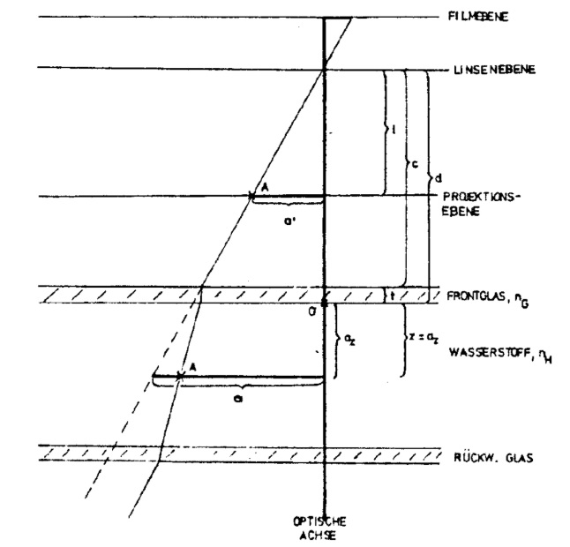
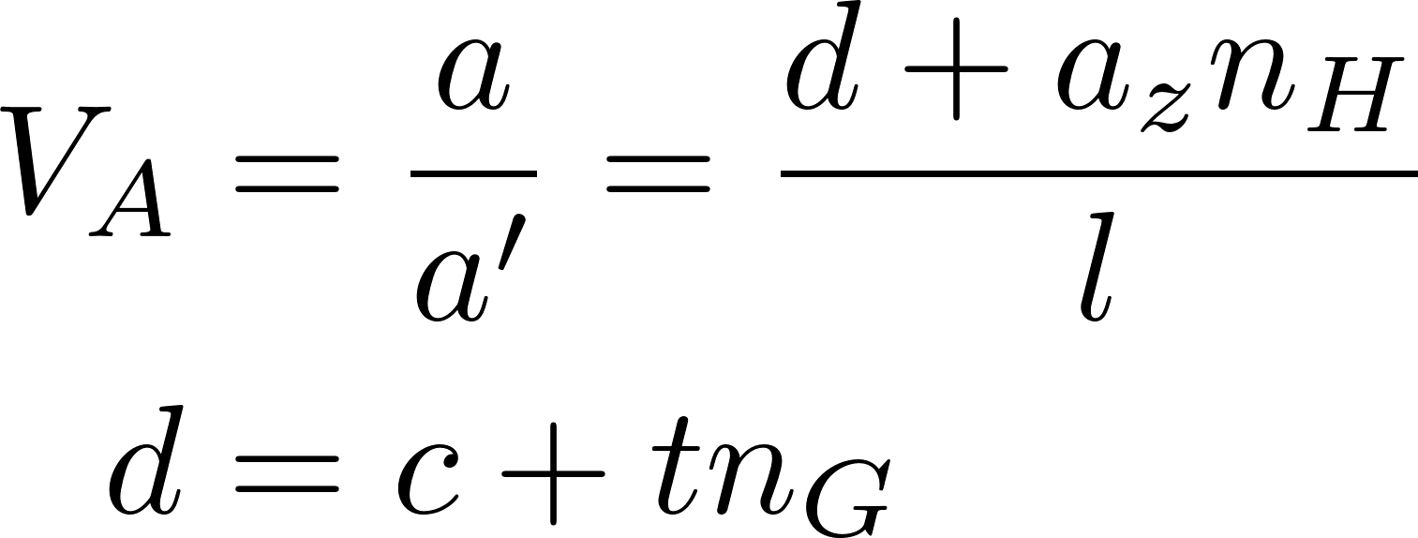
Magnification
Notes:
Possibly highlight a, a’, aZ
Talk about the beam passing through perpendicular to the image plane and to the optical axis as well, running through point A in depth a_z.

Slide 21
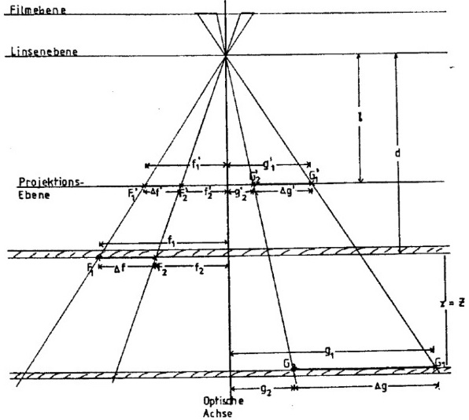
Magnification
F1, F2: front glass
F1’, F2’: pictures of F1, F2
G1, G2: back glass (z = Z)
G1’, G2’: pictures of G1, G2
Notes:
What remains: derivation of the magnification, depending on how much time we have, just mention the end result with the assumption of beam at half depth

Slide 22
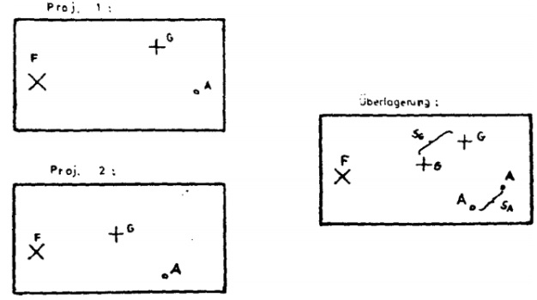
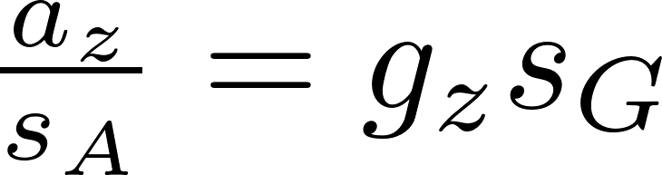
Stereo-shift method
Purpose: depth distribution
F: front glass
G: back glass
Notes:
We can use the reference points to measure the proton beam depth; az is this depth, gz is the chamber depth
TODO: are sG and sA the magnificated values (e.g. Do we use the magnification factor)? What about gz value?

Slide 23
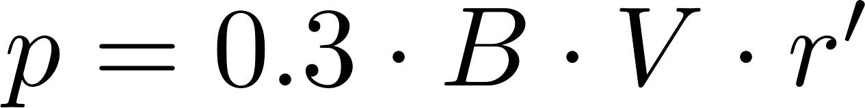
Momentum, charge
Magnetic field
Charge conservation
Notes:
Once we get to deal with the interactions, we need momenta and charge. The easiest method is to use the curve samples we were provided.
TODO: check B value (in Gauss?), maybe some words about derivation, errors in measurement (i.e. We had as much as 500 cm when the radius was large, or something similar).
Talk about conservation laws here: proton + proton = +2 charge, while momentum: 24 GeV + 0. Possibly mention baryon and lepton number conservation here as well

Slide 24
Cross-section
Notes:
L is the distance in reality, e.g. After accounting for magnification

Slide 25
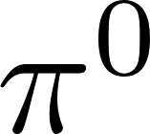
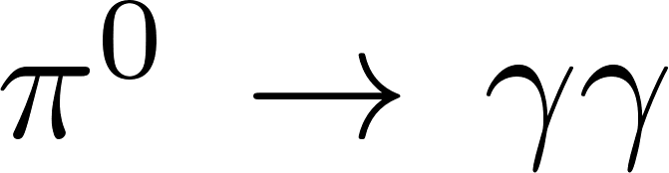
production
From average charged multiplicity
Notes:
Talk a bit about pair production counting and charge multiplicity -> pi0 multiplicity

Slide 26
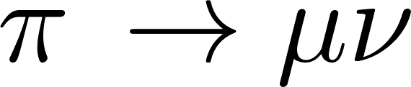
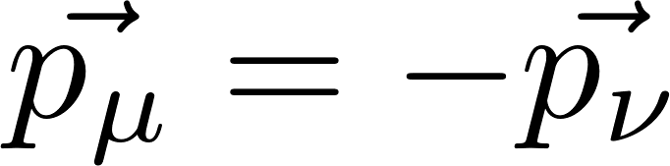
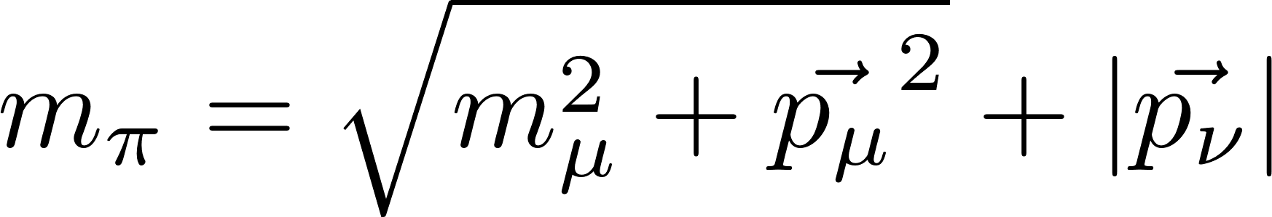
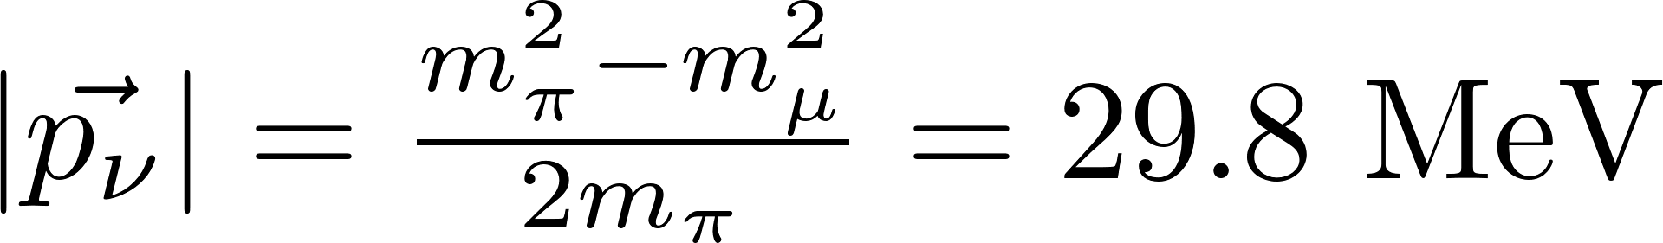
Neutrino momentum in
Pion at rest:
Energy conservation:
Notes:
The derivation holds for CMS but we want to find an event where it decays at rest

Slide 27
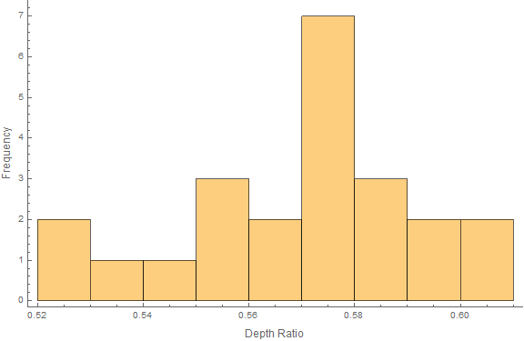

Results
Magnification: F21, F22; G41, G42
$V_{A}=0.852±0.003$
23 stereo-shift measurements
Mean: $\frac{s_{A}}{s_{B}}=0.570±0.021$
Assumption: 0.5!
Notes:
Pythagorean formula: separation is lf=23.9951 cm, lg = 32.1905 cm; measured: 28.2 pm 0.1, 37.7 pm 0.1 cm.
We did not consider the error the deviation from 0.5 depth caused, we should have.

Slide 28
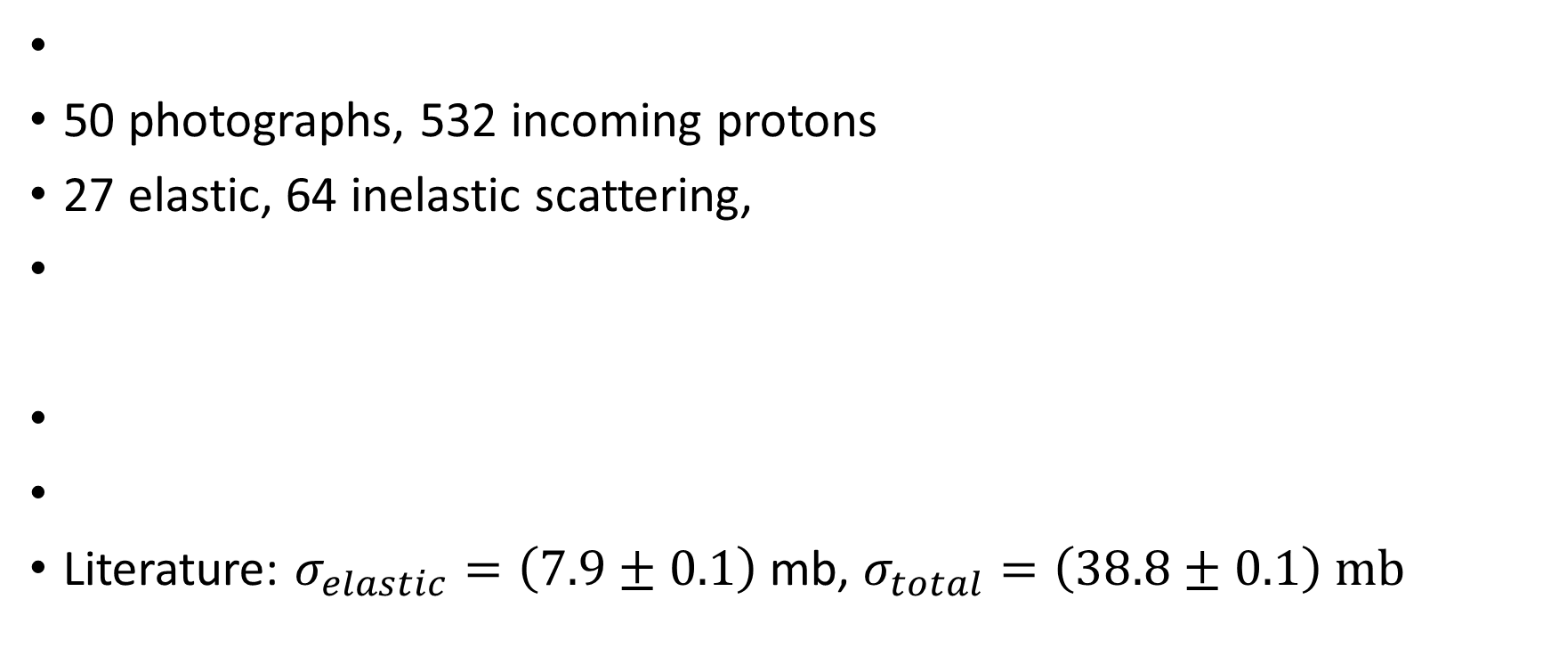
Cross-section
50 photographs, 532 incoming protons
27 elastic, 64 inelastic scattering,
Literature: $σ_{elastic}=\left(7.9±0.1\right)$ mb, $σ_{total}=\left(38.8±0.1\right) mb$
Notes:
L is the distance in reality, e.g. After accounting for magnification
Expected cross sections:

Slide 29
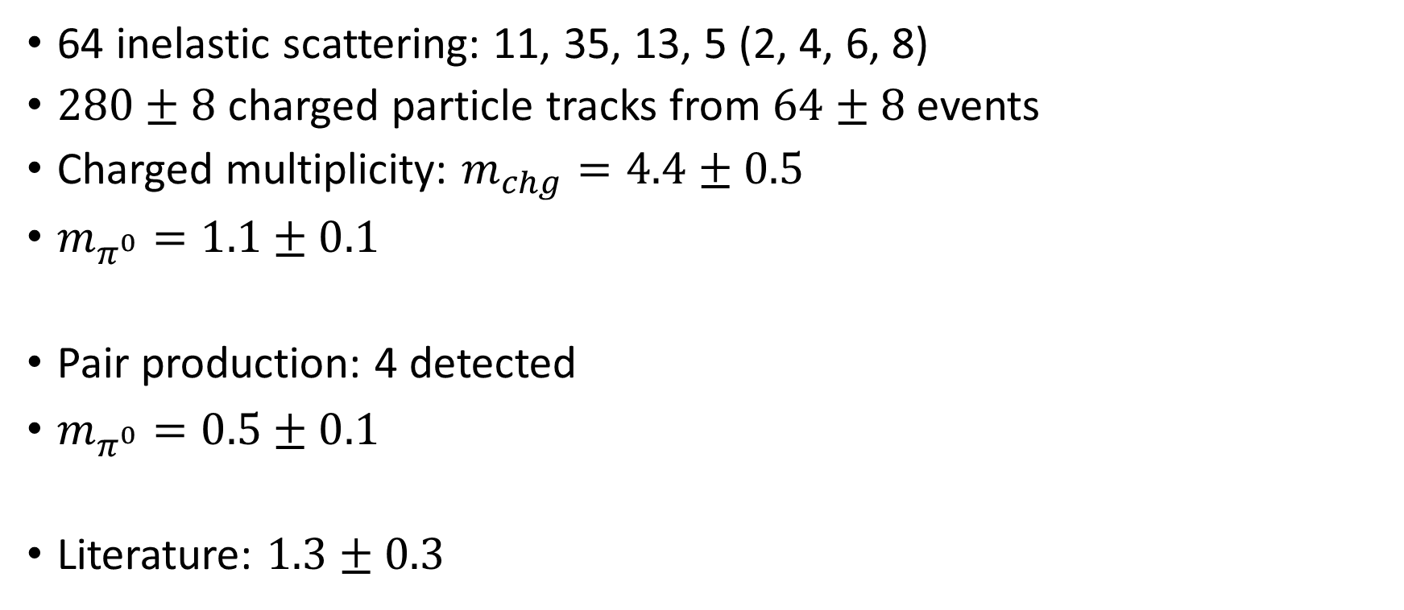
Pion multiplicity
64 inelastic scattering: 11, 35, 13, 5 (2, 4, 6, 8)
$280±8$ charged particle tracks from $64±8$ events
Charged multiplicity: $m_{chg}=4.4±0.5$
$m_{π^{0}}=1.1±0.1$
Pair production: 4 detected
$m_{π^{0}}=0.5±0.1$
Literature: $1.3±0.3$
Notes:
4.375 pm 0.513 charged multiplicity
1.094 pm 0.13 neutral multiplicity
0.5026 pm 0.0589

Slide 30
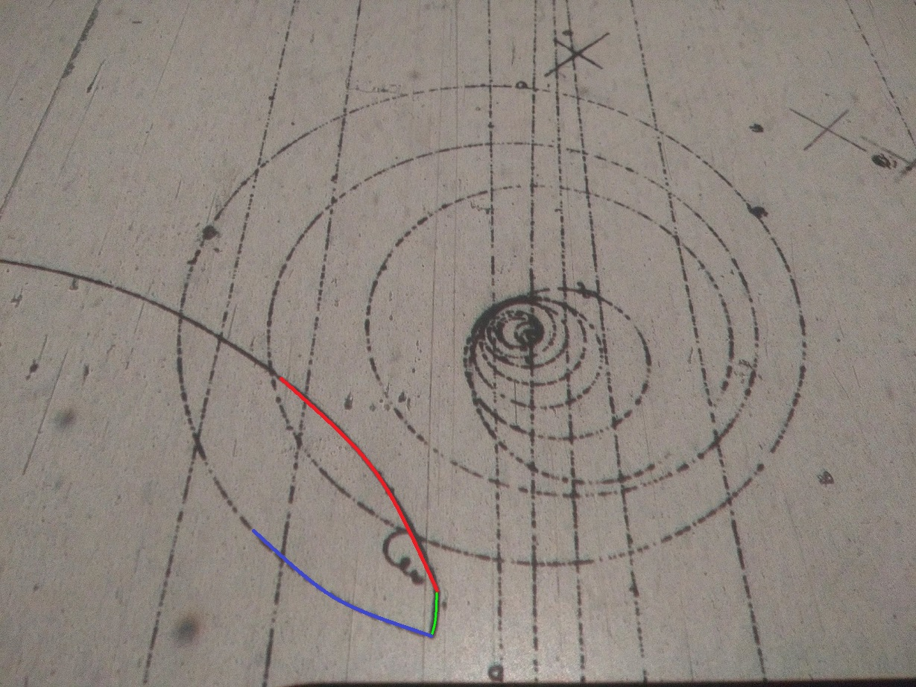
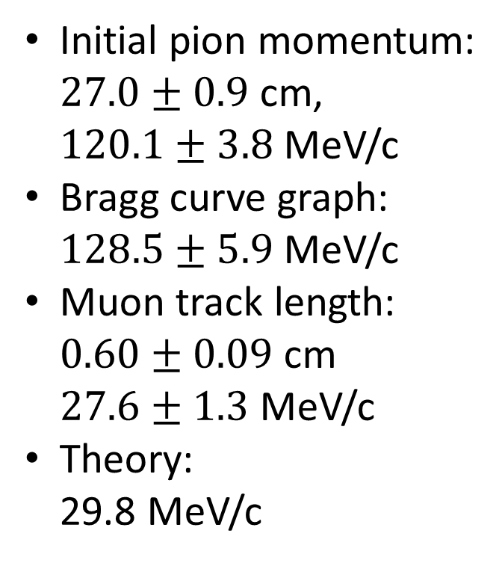
Neutrino momentum
Initial pion momentum: $27.0±0.9$ cm, $120.1±3.8$ MeV/c
Bragg curve graph: $128.5±5.9$ MeV/c
Muon track length: $0.60±0.09$ cm $27.6±1.3$ MeV/c
Theory: 29.8 MeV/c

Slide 31
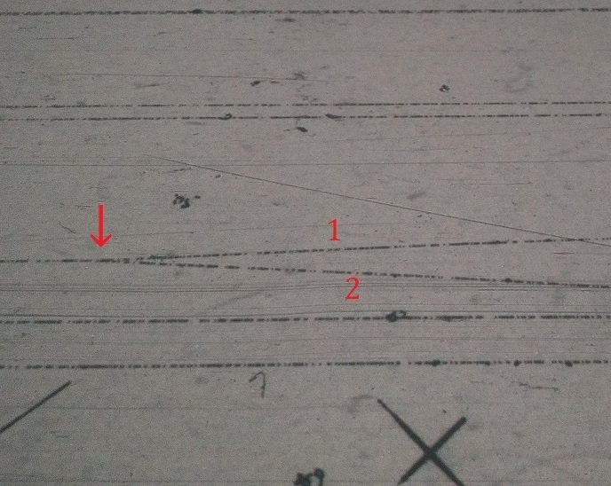
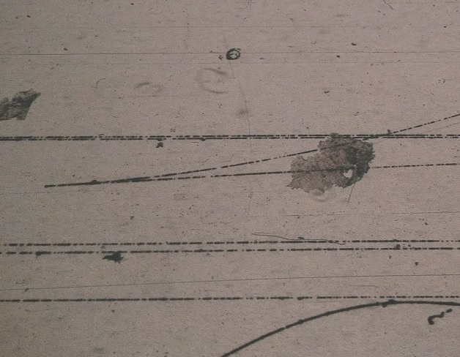
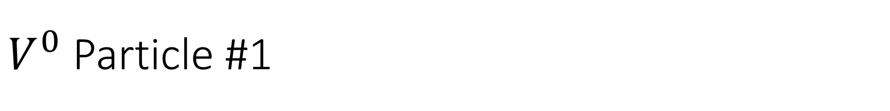
$V^{0}$ Particle #1

Slide 32
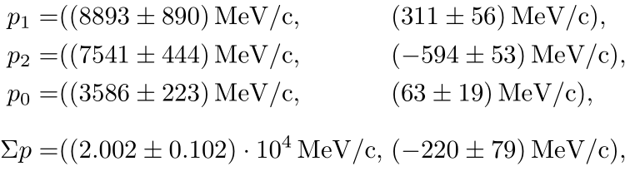
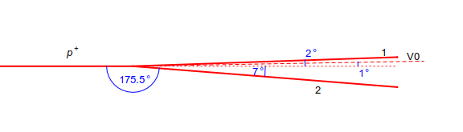
Diagram of Collision with Radii
Radii: particle 1 has (2000 ± 200) cm; particle 2 has (1700 ± 100) cm
Momenta:

Slide 33
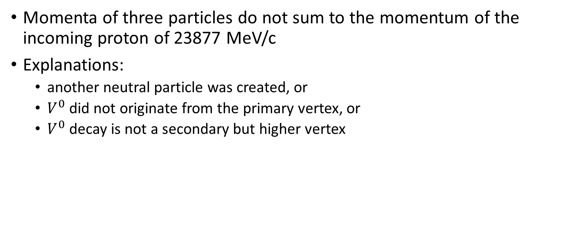
Problem
Momenta of three particles do not sum to the momentum of the incoming proton of 23877 MeV/c
Explanations:
another neutral particle was created, or
$V^{0}$ did not originate from the primary vertex, or
$V^{0}$ decay is not a secondary but higher vertex

Slide 34
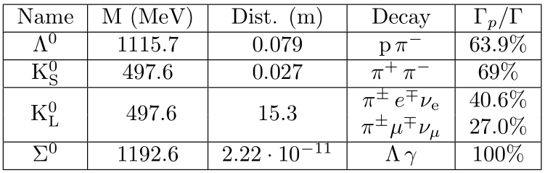
Possible Neutral Particles Not Detected

Slide 35
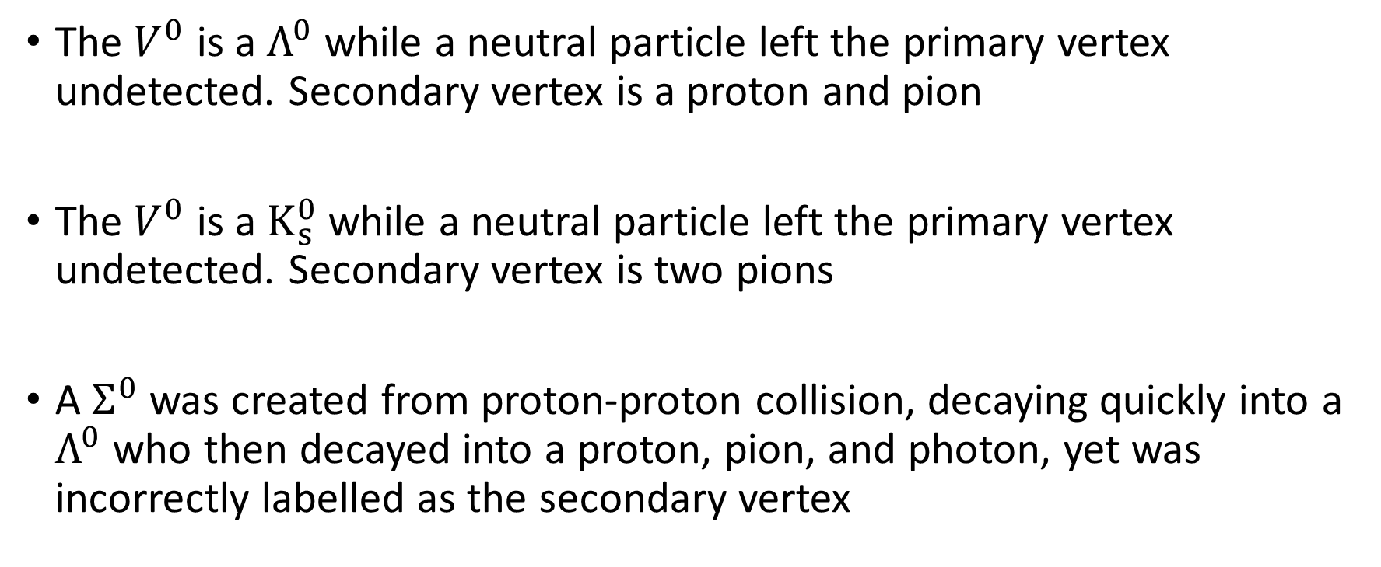
Possible Solutions
The $V^{0}$ is a $Λ^{0}$ while a neutral particle left the primary vertex undetected. Secondary vertex is a proton and pion
The $V^{0}$ is a $K_{s}^{0}$ while a neutral particle left the primary vertex undetected. Secondary vertex is two pions
A $Σ^{0}$ was created from proton-proton collision, decaying quickly into a $Λ^{0}$ who then decayed into a proton, pion, and photon, yet was incorrectly labelled as the secondary vertex

Slide 36
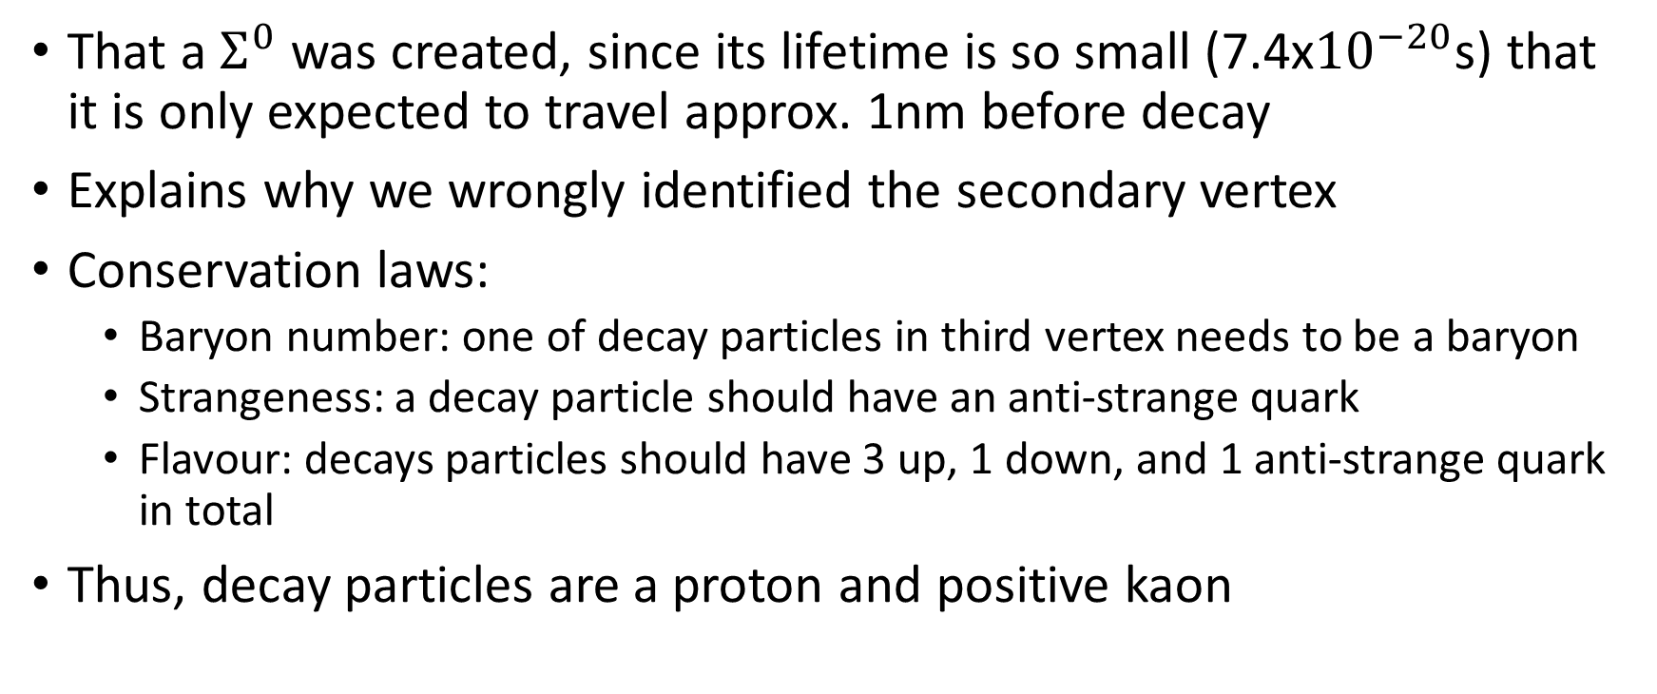
Best Solution
That a $Σ^{0}$ was created, since its lifetime is so small (7.4x${10}^{−20}$s) that it is only expected to travel approx. 1nm before decay
Explains why we wrongly identified the secondary vertex
Conservation laws:
Baryon number: one of decay particles in third vertex needs to be a baryon
Strangeness: a decay particle should have an anti-strange quark
Flavour: decays particles should have 3 up, 1 down, and 1 anti-strange quark in total
Thus, decay particles are a proton and positive kaon

Slide 37

Ultimate Interaction Identification

Slide 39
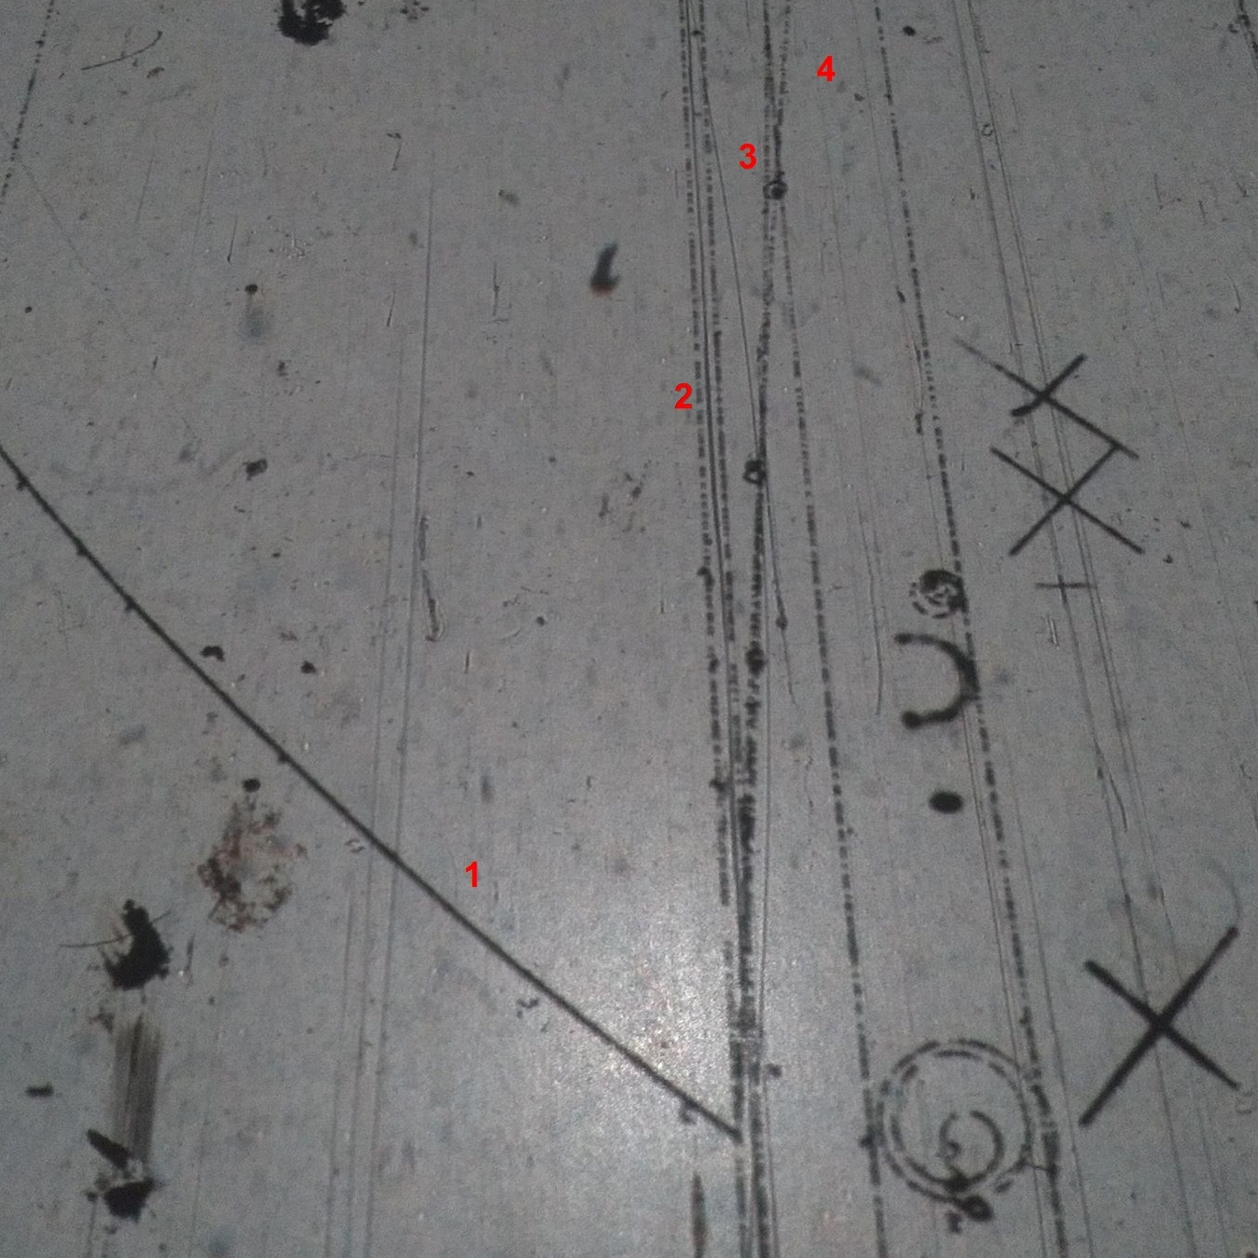
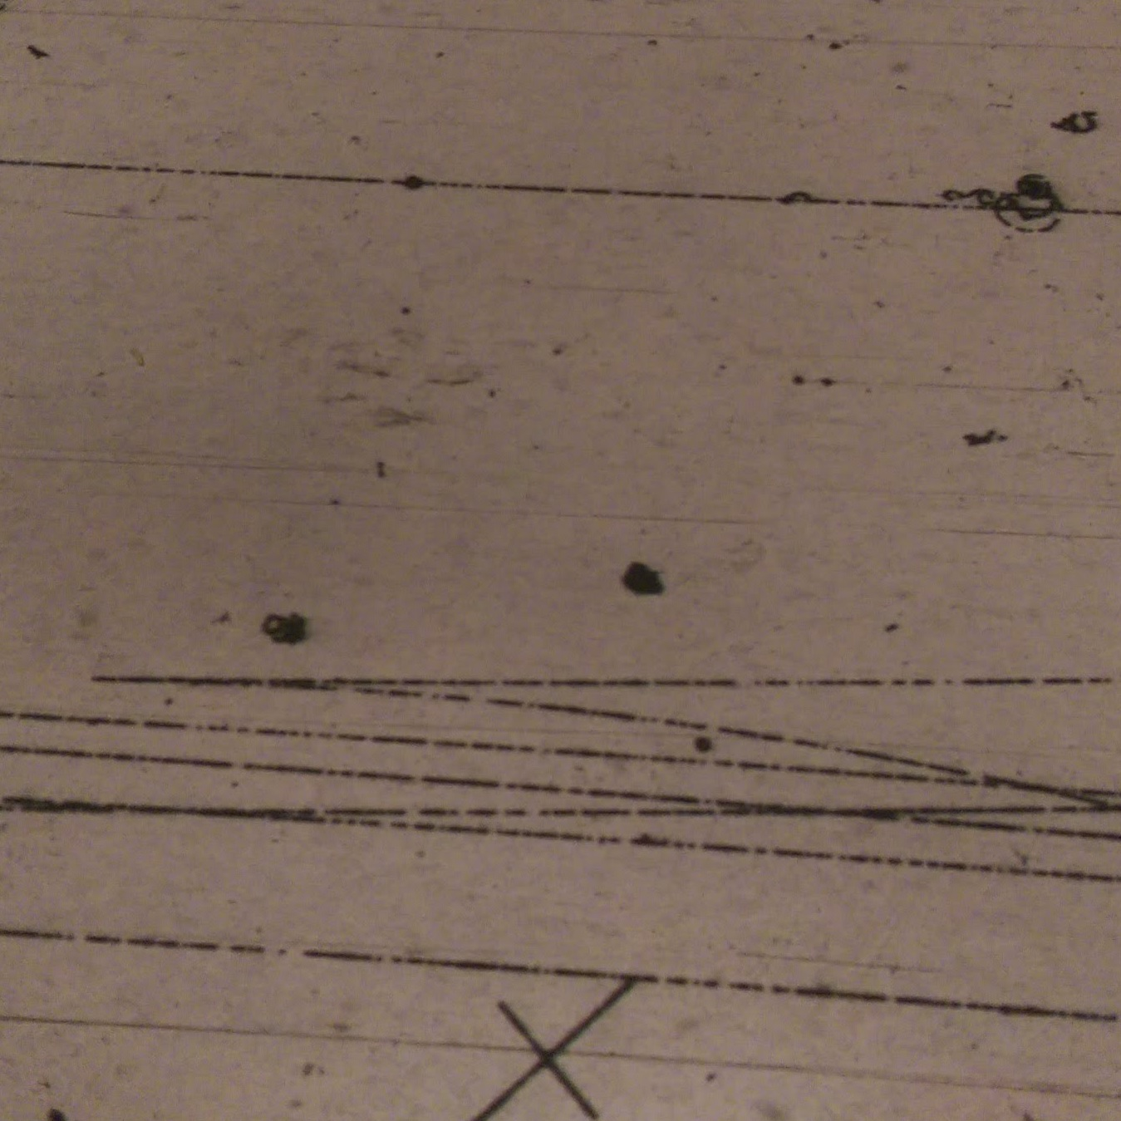
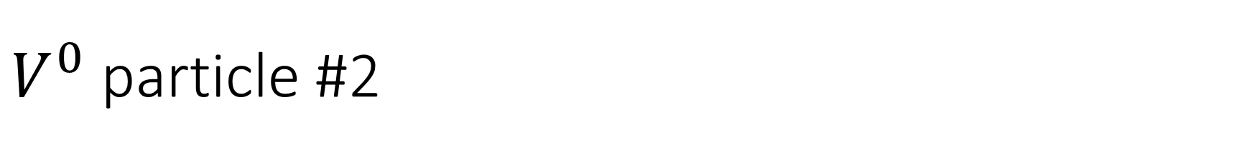
$V^{0}$ particle #2

Slide 40
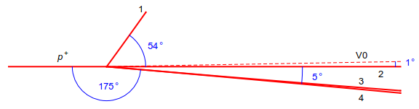
Diagram of Collision

Slide 41

Missing Momentum
The missing momentum was calculated at (38.7 ± 22) GeV, which is within the uncertainty of the $V^{0}$ momentum.
Can conclude that a $Λ^{0}$ or${ K}^{0}$ was created at the first vertex

Slide 42
Conclusion

Slide 43
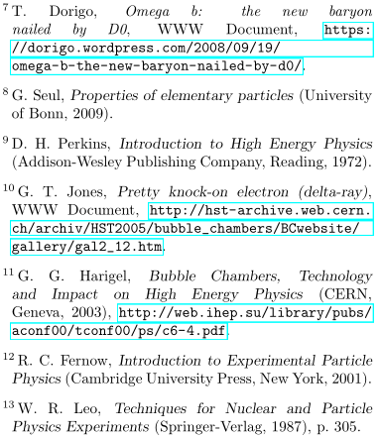
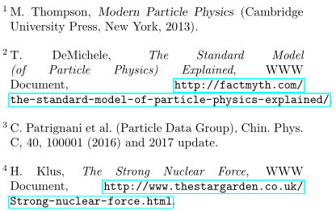
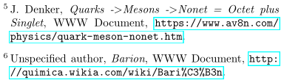
References

