Slide 1
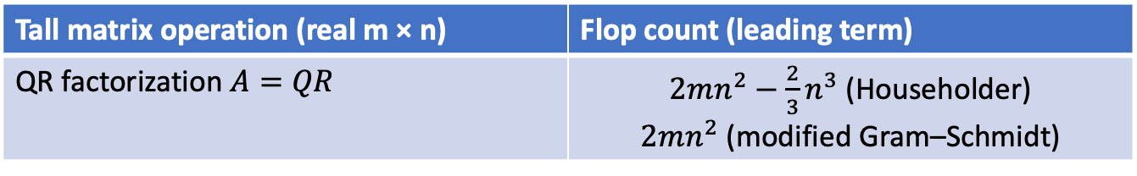
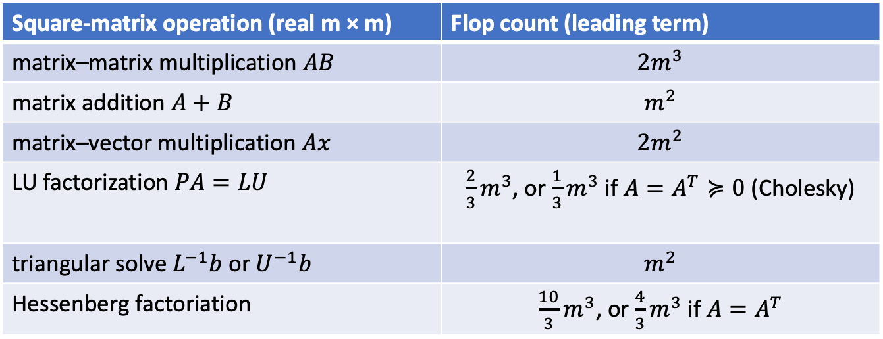
Flop counts for dense linear-algebra operations
= floating-point operations (real ±, ×)
Square-matrix operation (real m × m) | Flop count (leading term)
matrix–matrix multiplication $AB$ | $$2m^{3}$$
matrix addition $A+B$ | $$m^{2}$$
matrix–vector multiplication $Ax$ | $$2m^{2}$$
LU factorization $PA=LU$ | $\frac{2}{3}m^{3}$, or $\frac{1}{3}m^{3}$ if $A=A^{T}≽0$ (Cholesky)
triangular solve $L^{−1}b$ or $U^{−1}b$ | $$m^{2}$$
Hessenberg factoriation | $\frac{10}{3}m^{3}$, or $\frac{4}{3}m^{3}$ if $A=A^{T}$
Tall matrix operation (real m × n) | Flop count (leading term)
QR factorization $A=QR$ | $2mn^{2}−\frac{2}{3}n^{3}$ (Householder) $2mn^{2}$ (modified Gram–Schmidt)
Implicit assumption: Dense-matrix calculations are dominated by flops (compute-bound). True?

