Slide 1
GPU Acceleration
adapted from slides by Rabab Alomairy & Evelyne Ringoot
(Alan Edelman)

Slide 2
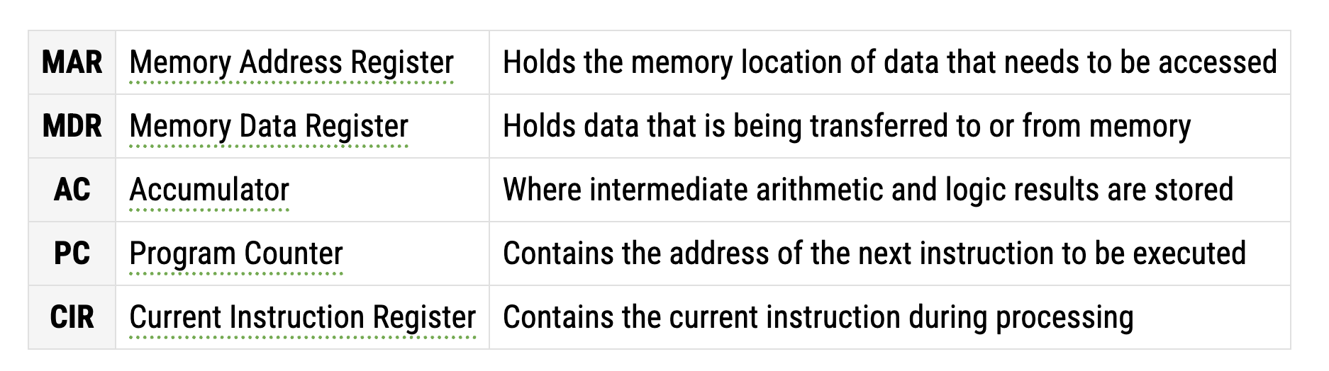
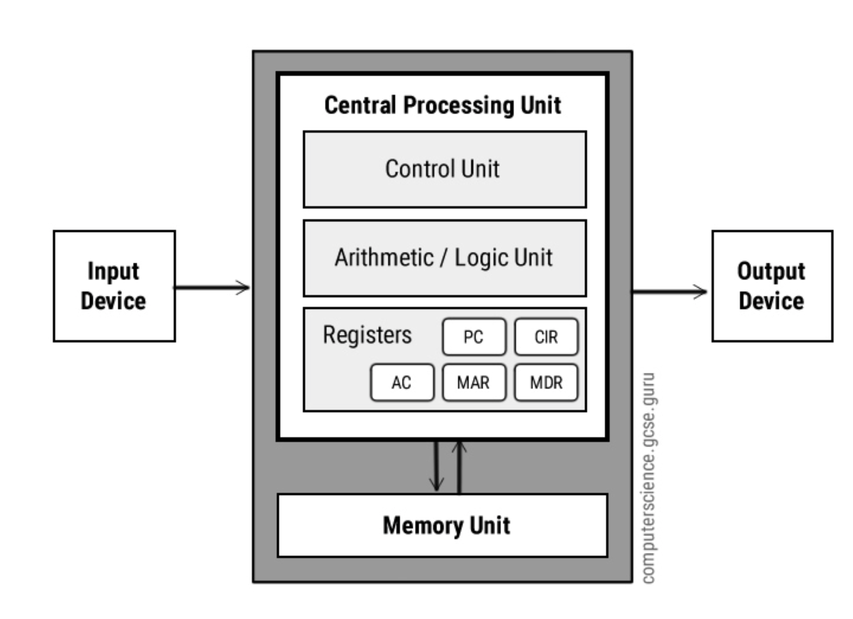
Typical old fashioned CPU (central processing unit)
Key Point : Data and Computation are not
in the same physical hardware locations.
Theoretical courses count operations, but
execution time depends on much more.

Slide 3
Typical old fashioned CPU (central processing unit)
I have a big matrix, where is it in this
diagram?
MOSTLY not in the CPU

Slide 4
Typical old fashioned CPU (central processing unit)
I have a big matrix, where is it in this
diagram?
MOSTLY not in the CPU
but a few elements may be in registers
and the rest in memory (but…)

Slide 5
Typical old fashioned CPU (central processing unit)
I have a large Julia (etc) program,
where is that?
not in the CPU
It gets compiled down to machine
Instructions in the memory unit
also mostly not in the CPU
but one instruction is in a register

Slide 6

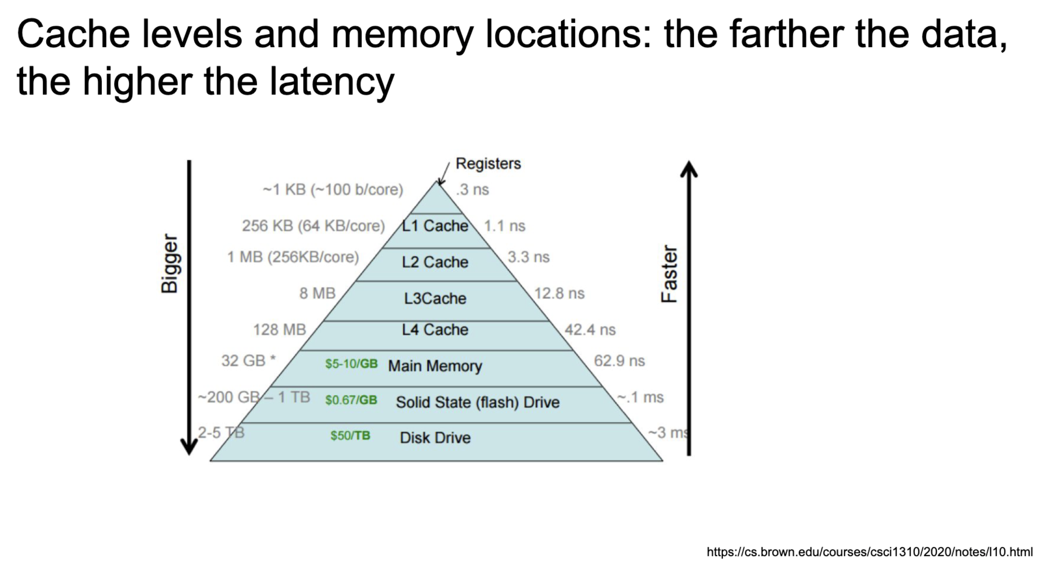
Modern Memory is hierarchical
Too simplified
Faster memory is more
expensive.
The pyramid is dictated by
performance vs economics.

Slide 7
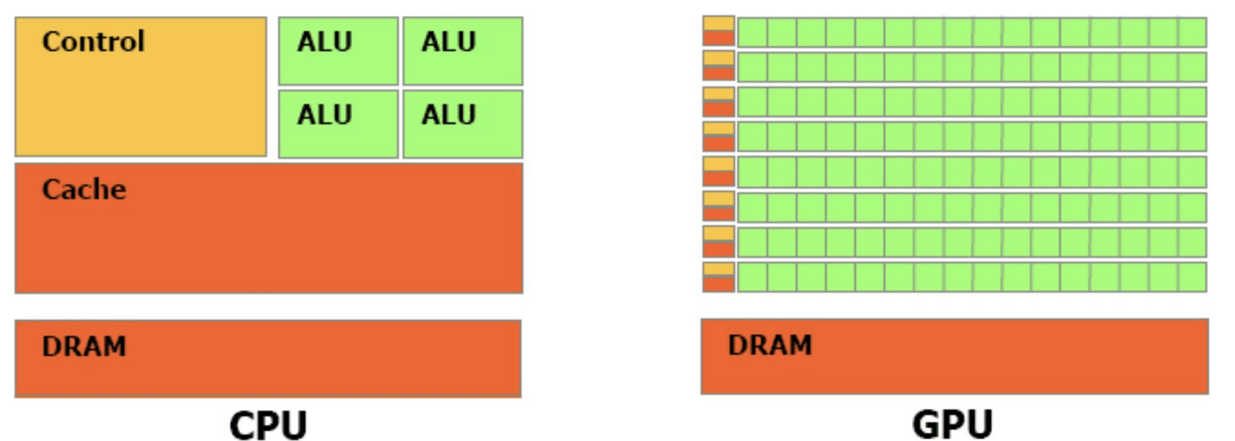
These days a single core has a lot of parallelism!
Multiple ALUs

Slide 8
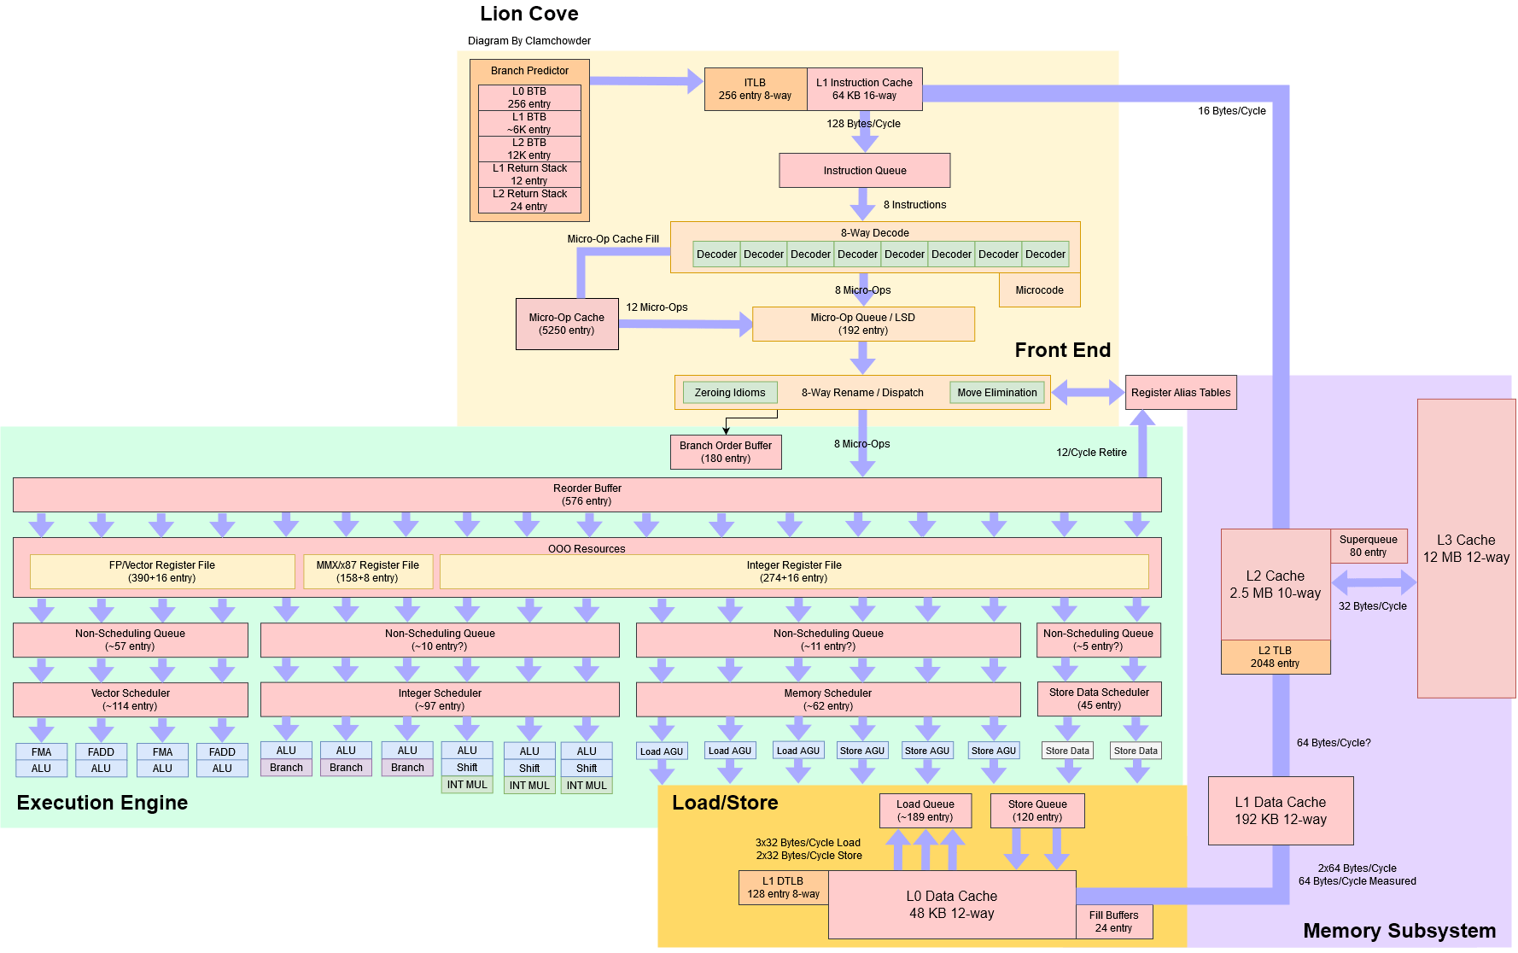
These days a single core has a lot of parallelism!
https://chipsandcheese.com/p/lion-cove-intels-p-core-roars

Slide 9

Lion Cove
https://cdrdv2-public.intel.com/824430/2024_Intel_Tech%20Tour%20TW_Next%20Gen%20P-core%20The%20Lion%20Cove%20Architecture-4.pdf
for lion cove marketing

Slide 10

What is the GPU (graphics processing unit) difference
Make each core dead simple, and make up for it with massive quantity.

Slide 11
What is the GPU (graphics processing unit) difference
Make each core dead simple, and make up for it with massive quantity.
and have multiple cores act in lockstep

Slide 12
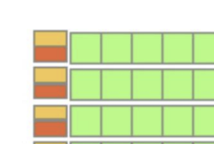
What to call each of these processing elements?
NVIDIA Cuda Core
AMD Stream Processor
Apple Not publicly named?
The good news is you probably don’t need to remember these names.

Slide 13
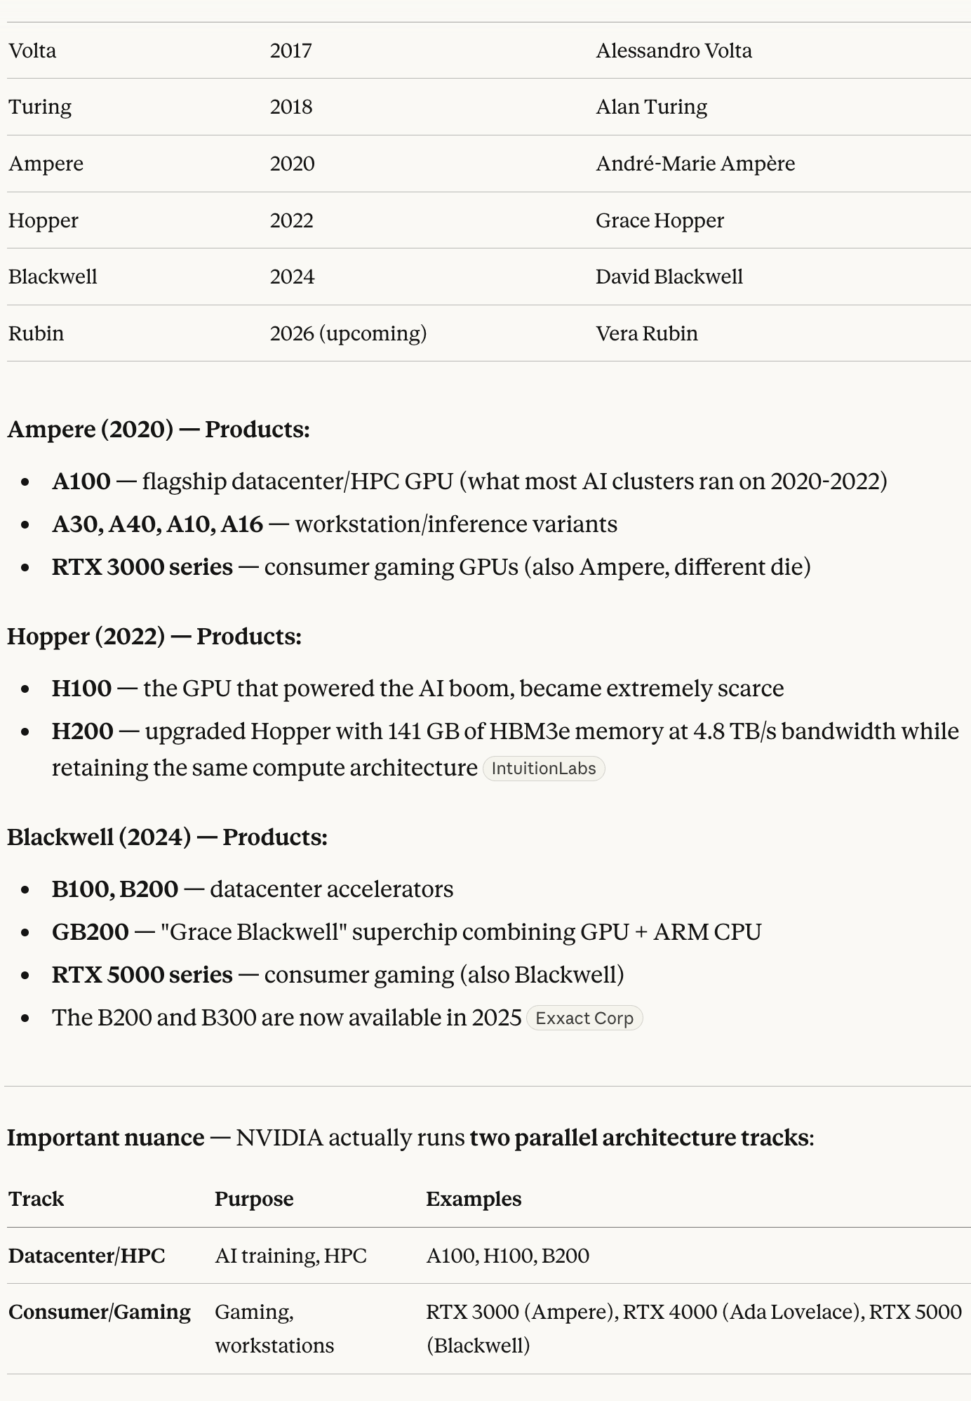
NVIDIA architectures and products
https://en.wikipedia.org/wiki/List_of_eponyms_of_Nvidia_GPU_microarchitectures
claude:

Slide 14
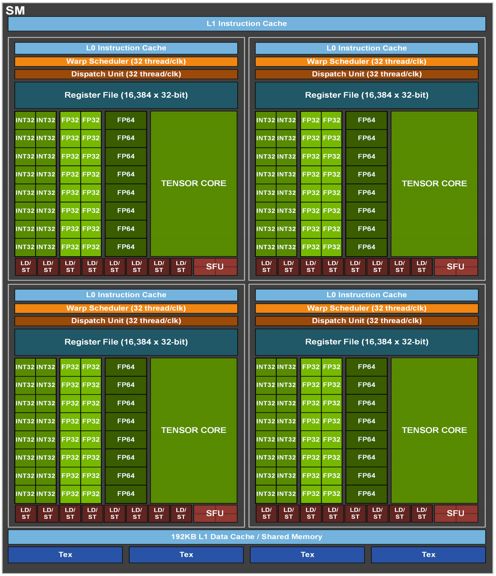
An Ampere Streaming Multiprocessor
4 Supartition
Each Subpartition
16 Int32 cores
16 FP32 cores
8 FP64 cores
1 tensor Cores – matmul accumulator
In each cycle cores operate in lock step scheduled by the warp scheduler
A warp scheduler schedules 32 threads

Slide 15
Wait if there are 16 FP32s and 32 threads in a warp, how does that work out?
It takes two cycles for a thread to complete so it pipelines:
wash 1
dry 1, wash 2
fold 1, dry 2
fold 2
all this x 16 parallel

Slide 16
An Ampere Streaming Multiprocessor
Notice the shared memory in the SM at the bottom (& the L1 instruction cache)
the SM is one self contained parallel computing unit
juggles many warps to hide latency

Slide 17
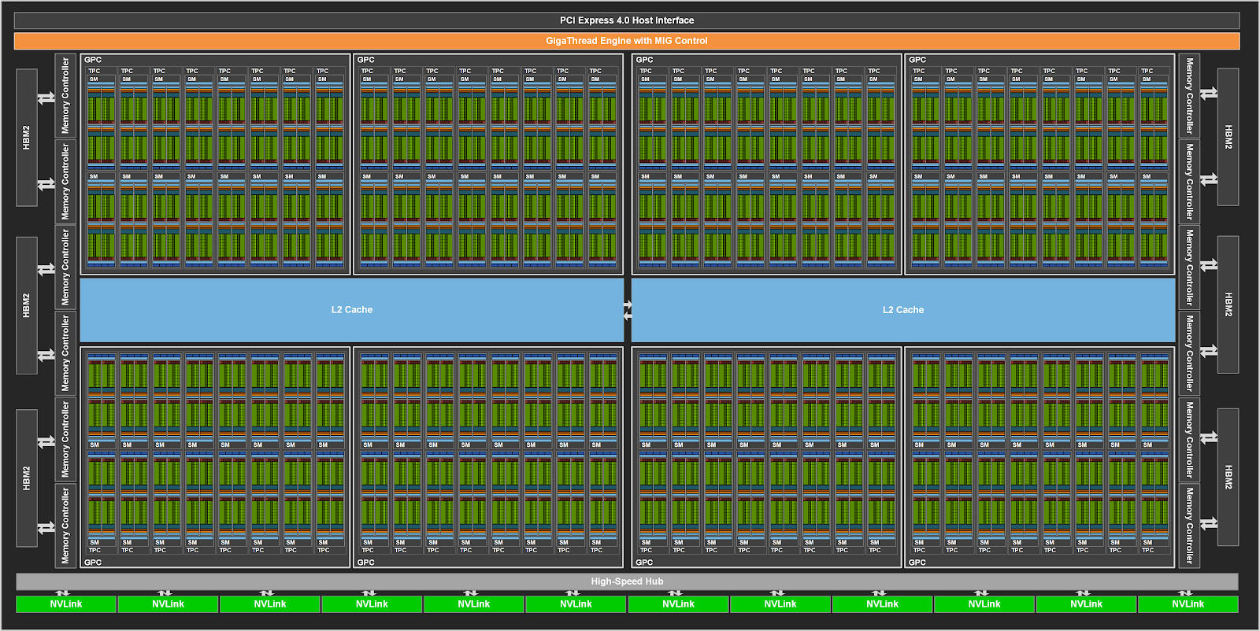
Overview of NVIDIA Ampere GPU Architecture
Transistor Count: 54.2 billion
Die Area: 826 mm²
Architecture: Ampere
Memory: Up to 80 GB HBM2e
Peak FP64 Performance: ~19.5 TFLOP/s (A100 80GB SXM)
Interconnect: NVLink (up to 600 GB/s), PCIe Gen4
128 SMs per full GPU

Slide 18
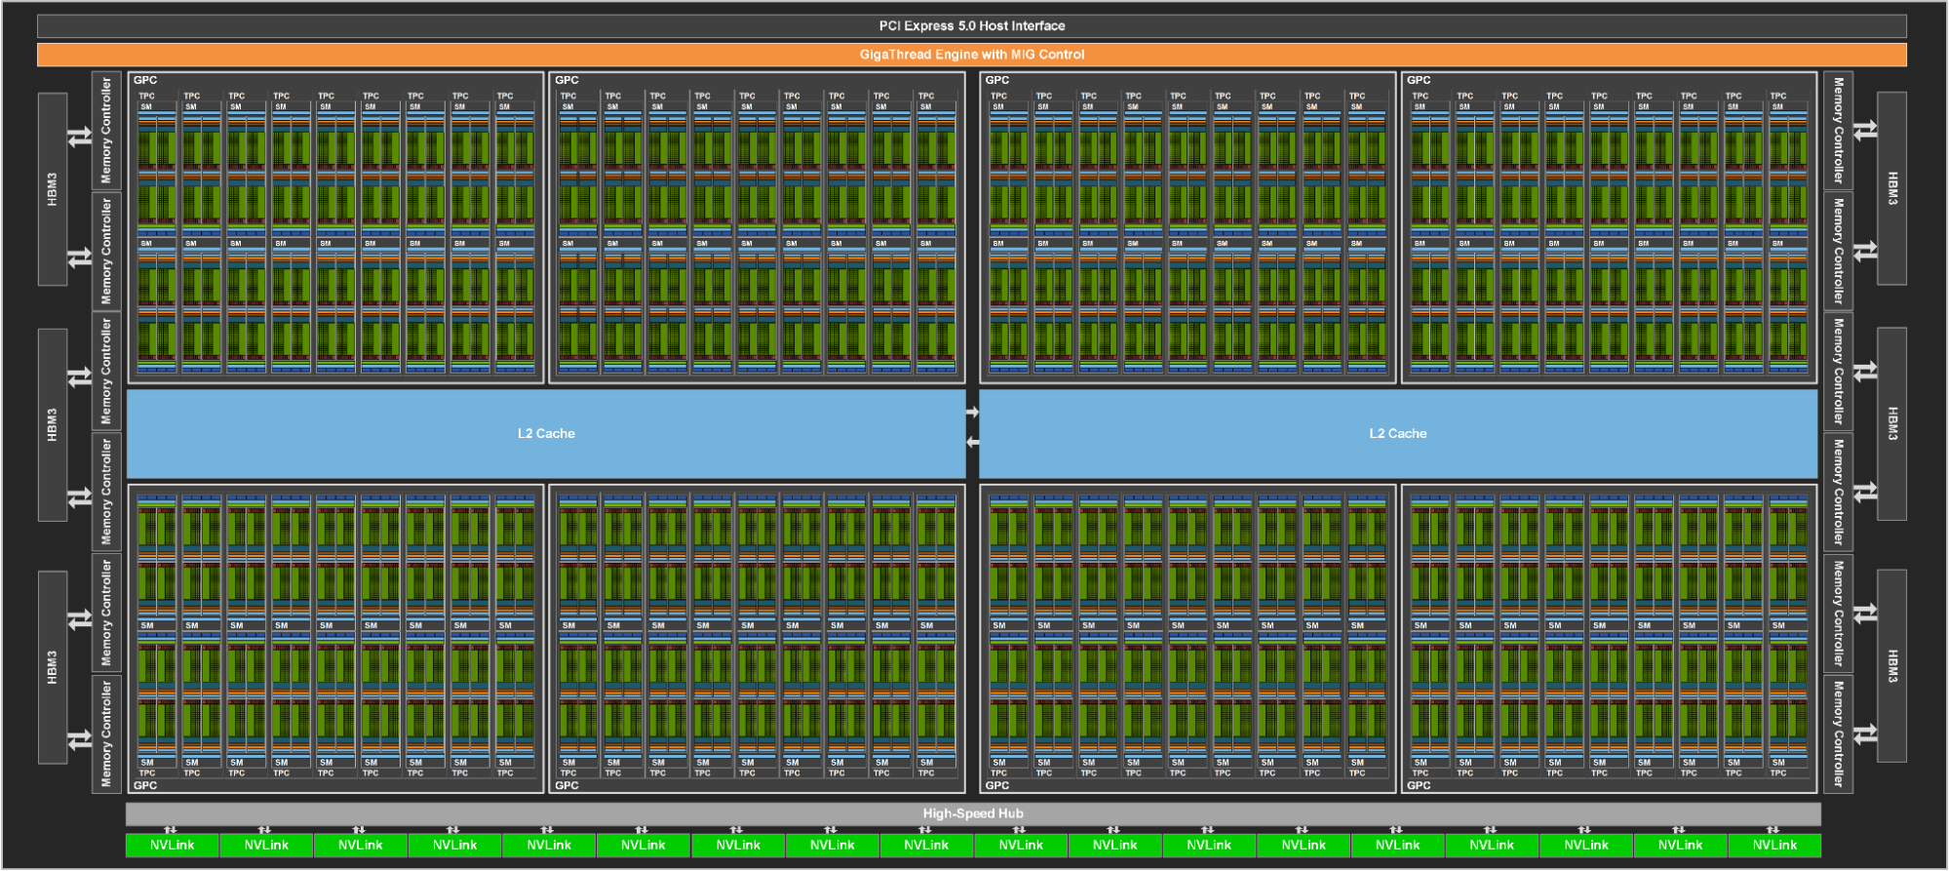
Overview of NVIDIA HOPPER GPU Architecture
Transistor Count: 80 billion
Die Area: 814 mm²
Architecture: Hopper
Memory: Up to 96 GB HBM2e
Peak FP64 Performance: ~34 TFLOP/s (H100 96GB SXM)
Interconnect: NVLink (up to 900 GB/s), PCIe Gen4
132 SMs per full GPU

Slide 19
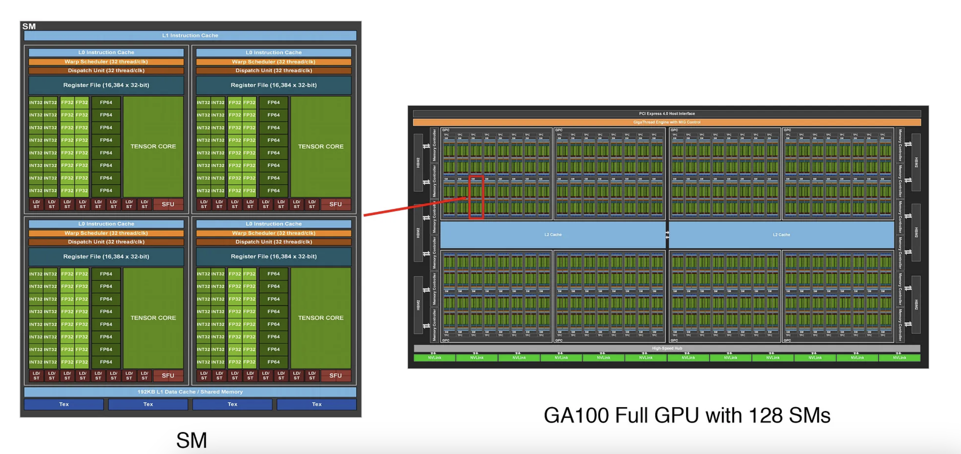
Streaming multiprocessor (SM)

Slide 20
Streaming multiprocessor (SM)
SM contains four processing blocks that share an L1 cache for data caching.
Each processing block has a Warp scheduler
16 INT32 CUDA cores
16 FP32 CUDA cores
8 FP64 CUDA cores
8 Load/Store cores
Tensor core for matrix multiplication
16K 32-bit register file.
The maximum number of thread blocks per SM is 32.

Slide 21
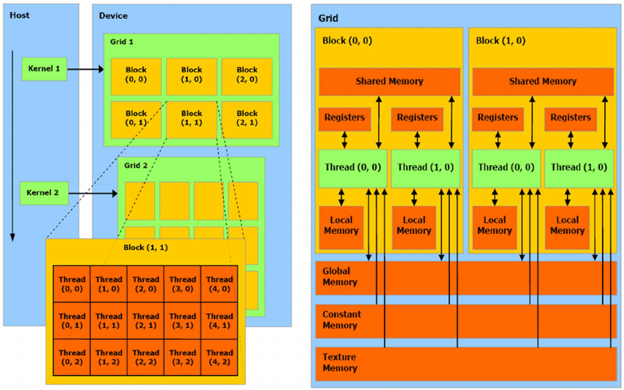
How to program a GPU
Single-Instruction-Multiple-Threads (SIMT).
SIMT allows GPUs to execute the same instruction across multiple threads
Perspective is a thread
Threads grouped into blocks
Blocks grouped into grids
Threads within block can access shared memory and synchronize
GPUs are designed to maximize throughput.
Transferring data from the CPU to the GPU can be a bottleneck

Slide 22
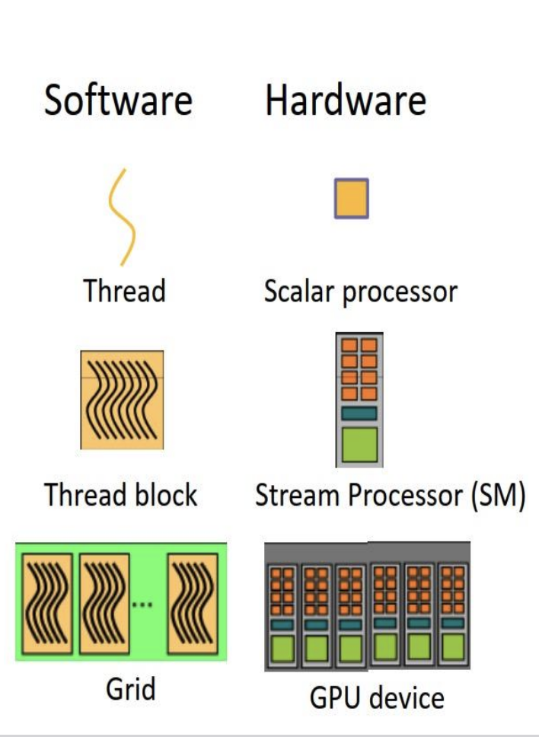
Mapping Software to Hardware
Thread: Smallest unit of execution, executes a kernel function.
Scalar Processor (core): Executes one thread. Multiple cores live inside an SM.
Thread Block: Group of threads executed on a single SM. Threads in a block can share memory and synchronize.
SM (Streaming Multiprocessor): Executes thread blocks. Contains cores, Tensor Cores, registers, shared memory, etc.
Grid: Collection of thread blocks. Can span across multiple SMs.
GPU Device: The full hardware accelerator; includes many SMs and memory hierarchies (L2 cache, global memory, etc.).

Slide 23
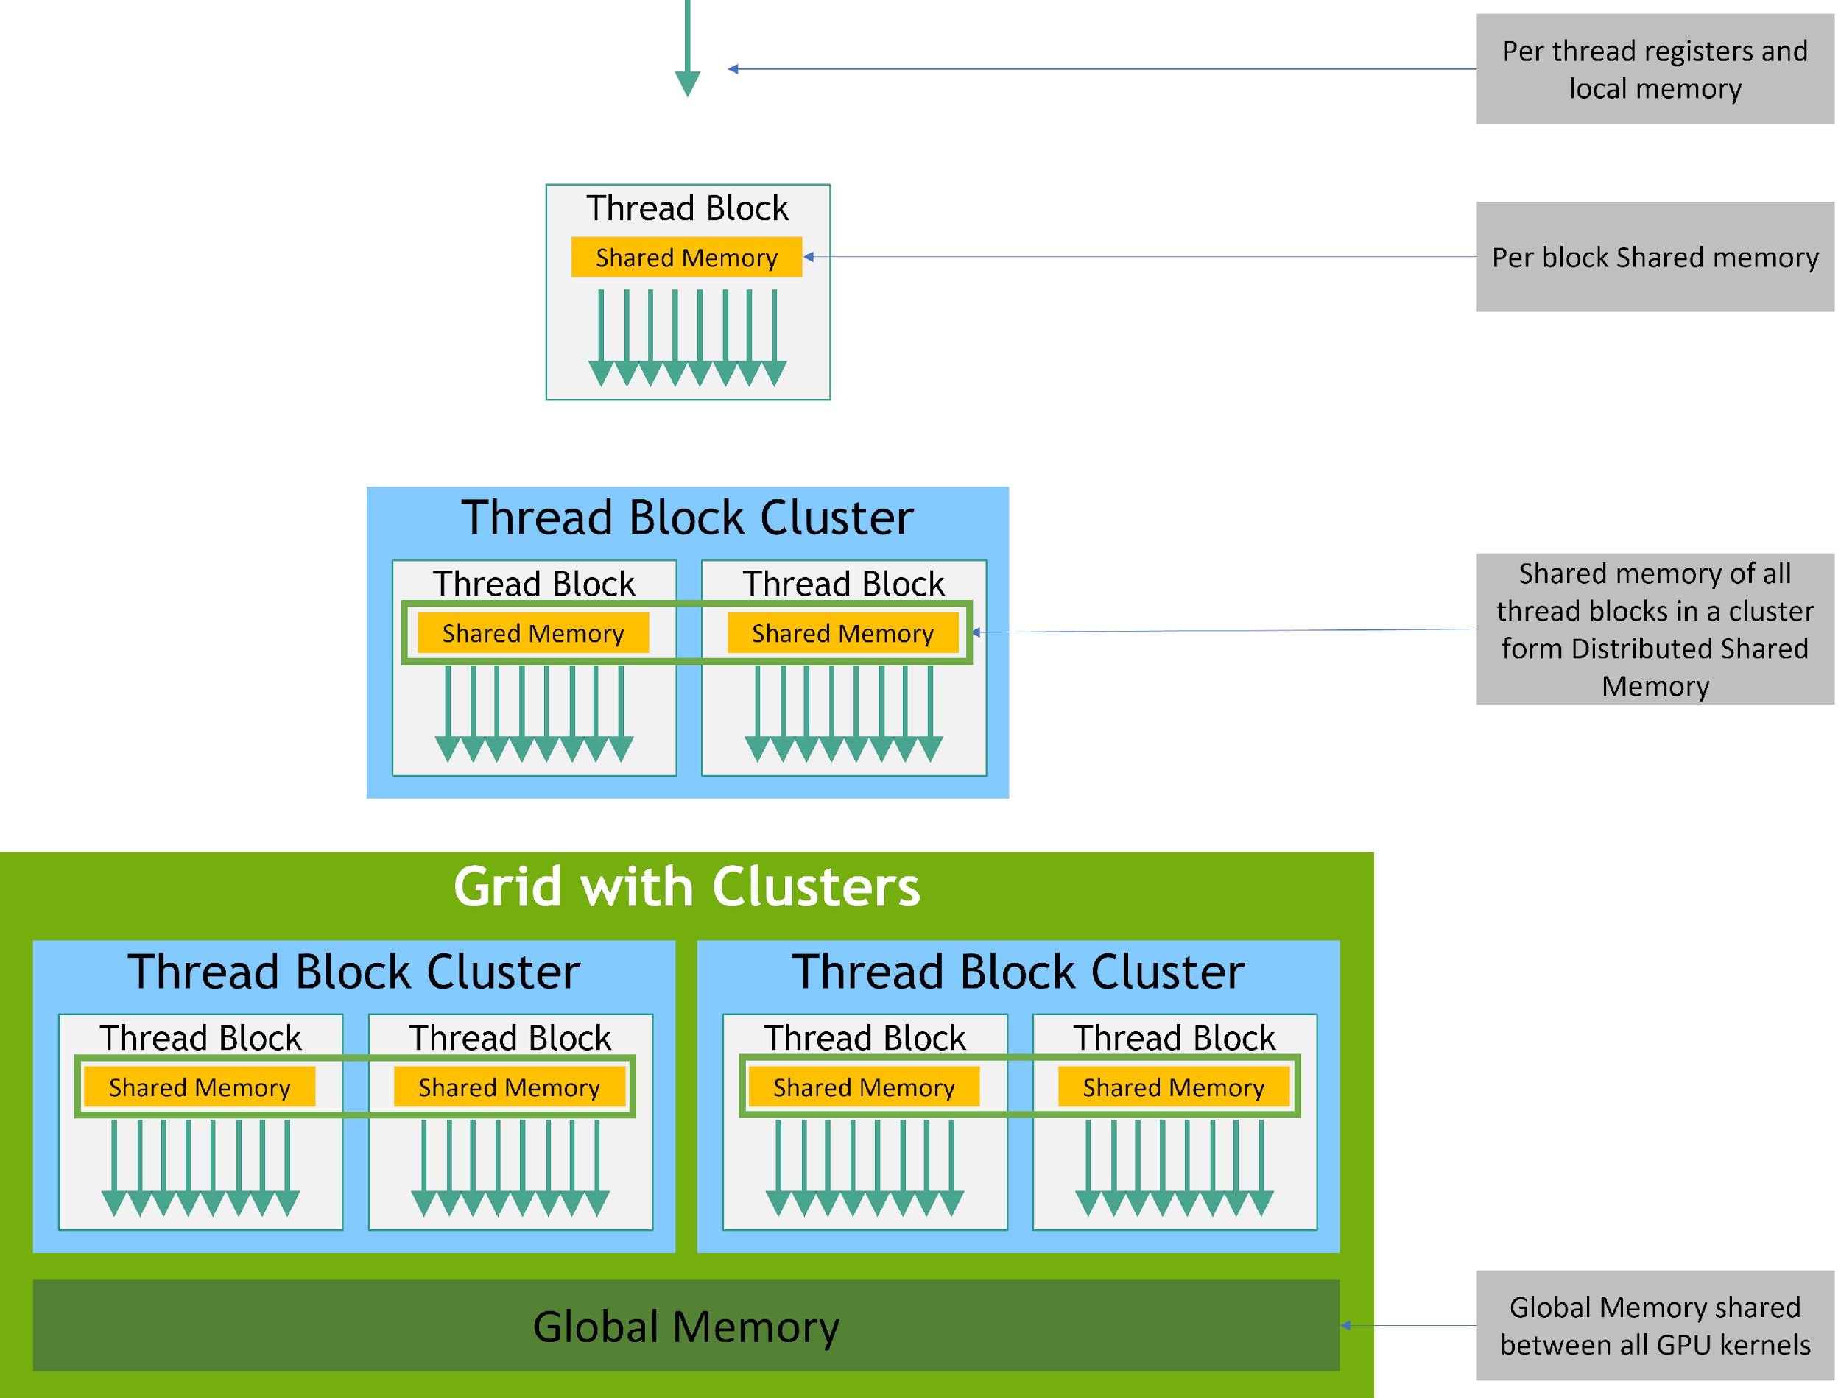
Memory Hierarchy
Each thread has private local memory.
Each thread block has shared memory visible to all threads of the block and with the same lifetime as the block.
Thread blocks in a thread block cluster can perform read, write, and atomics operations on each other’s shared memory.
All threads have access to the same global memory.

Slide 24
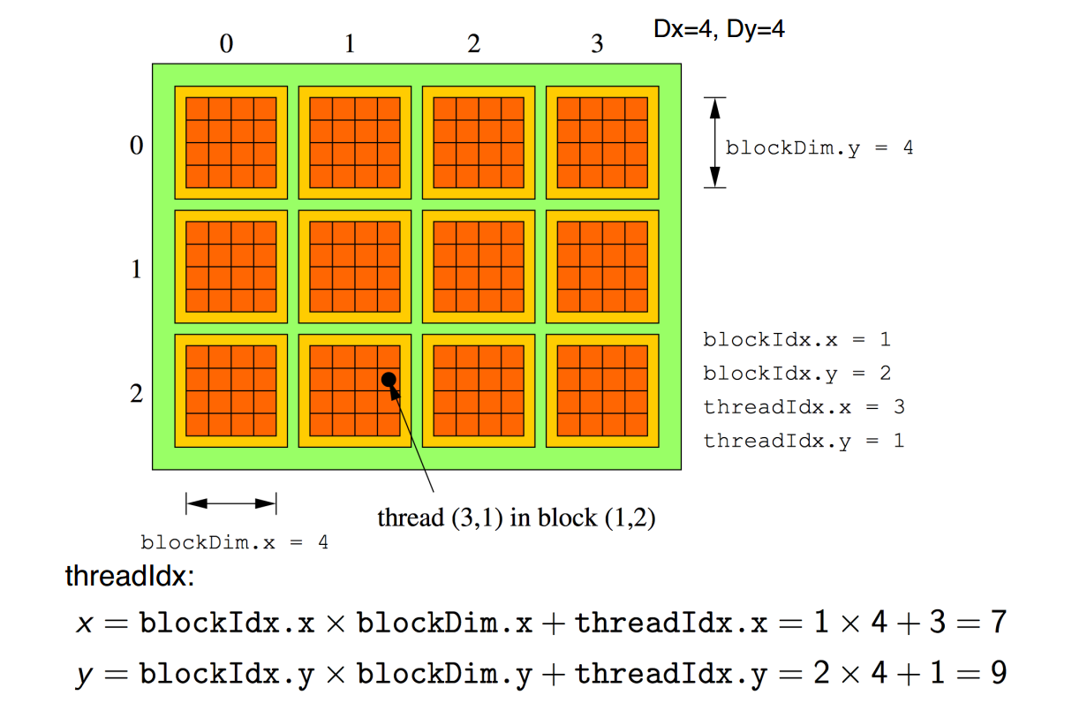
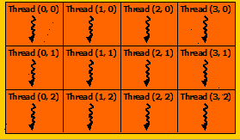
SIMT Programming model
Grid
x
Block
y
Global thread ID: the position of the thread within block (threadIdx) , the position of the block within the grid (blockIdx), and block dimension (blockDim)

Slide 25
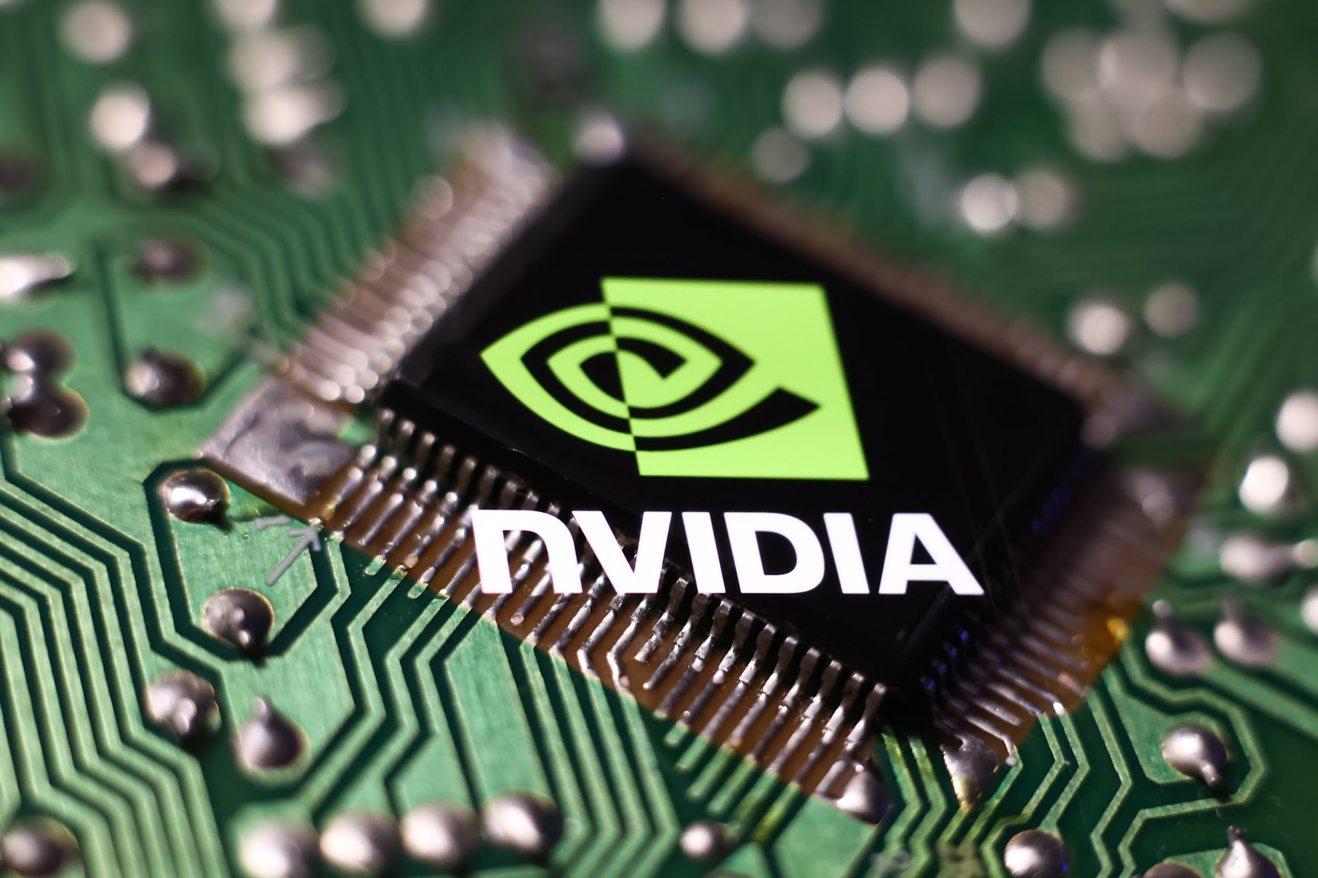
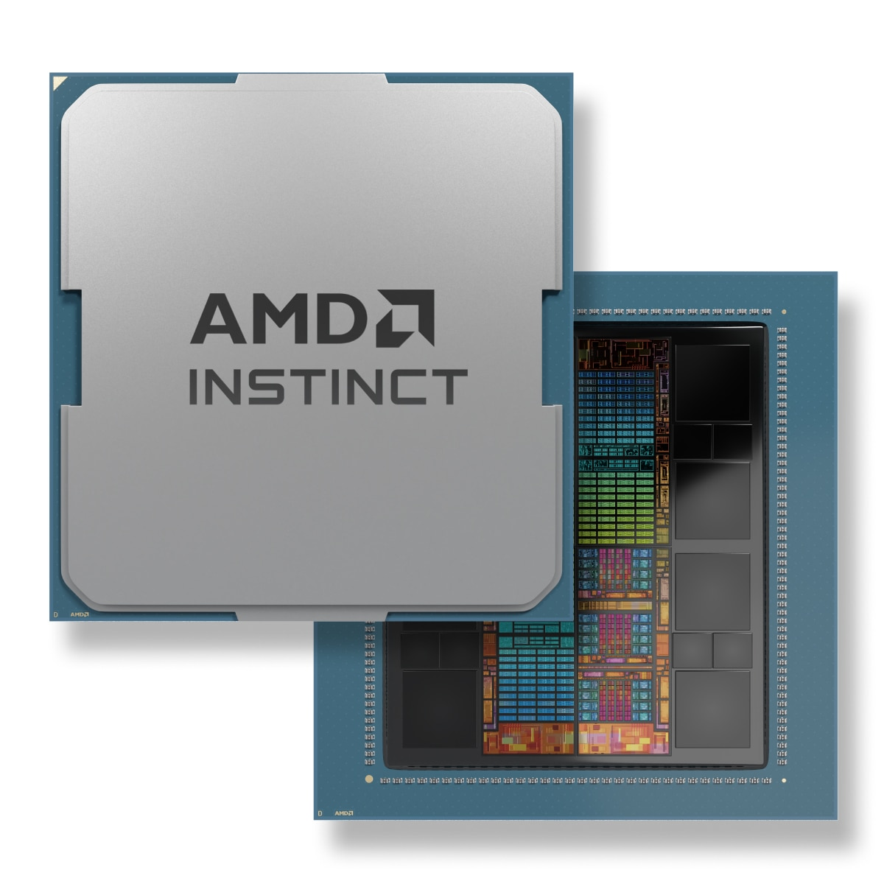
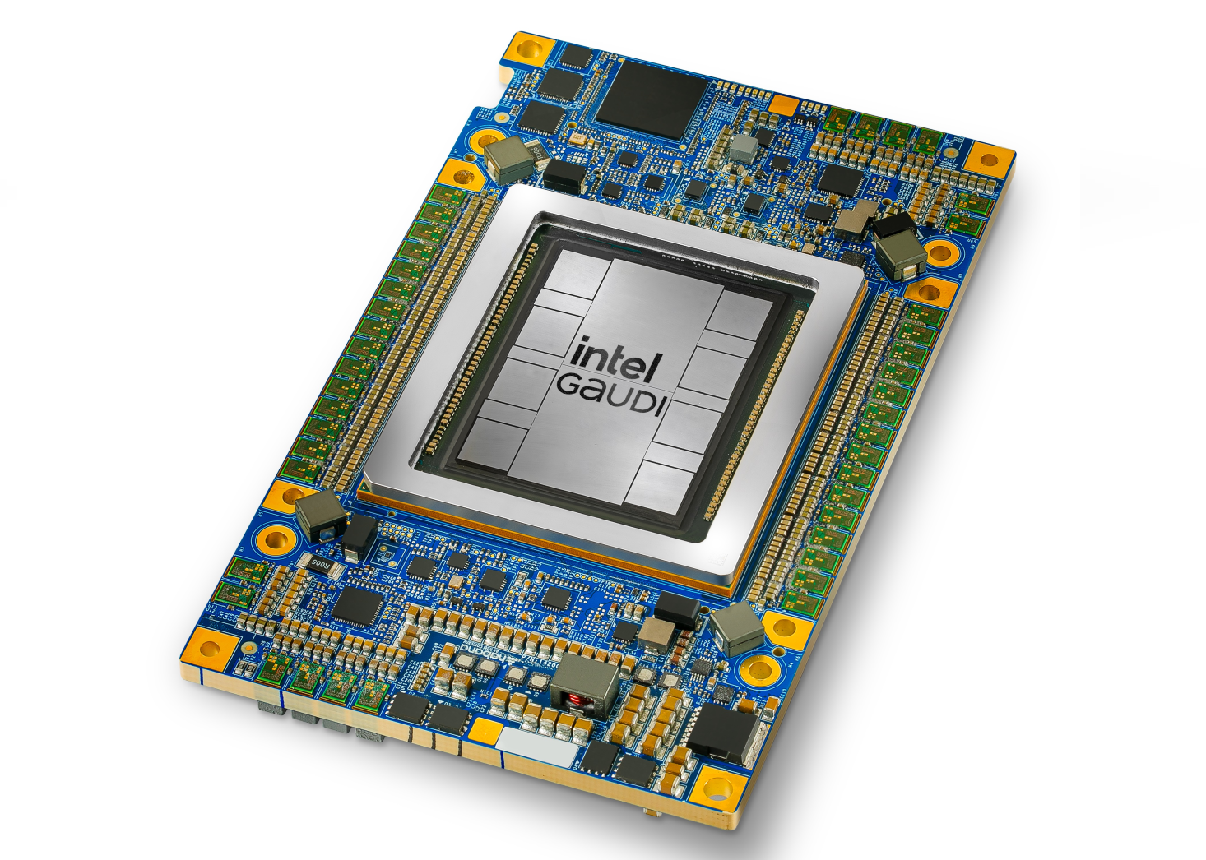

Existing GPUs and their Software
Hardware | NVIDIA | AMD | Intel | Apple
Software | CUDA | ROCm | OneAPI | Metal

Slide 26
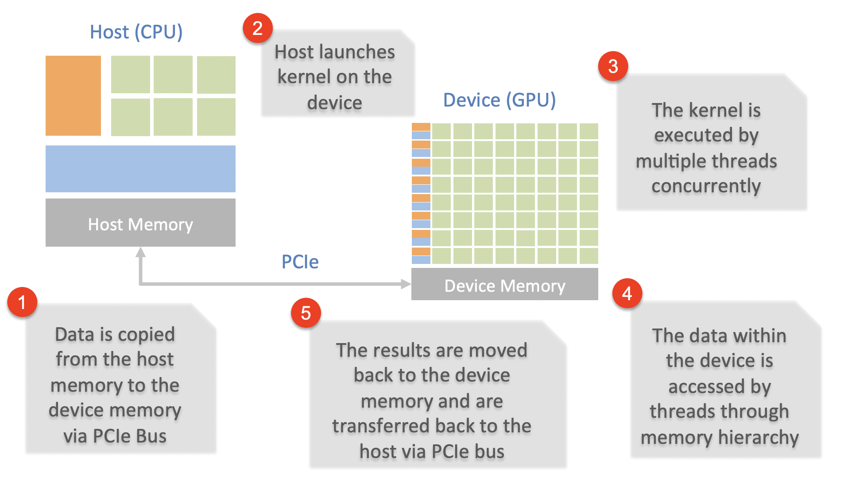
Typical Execution Dataflow

Slide 27
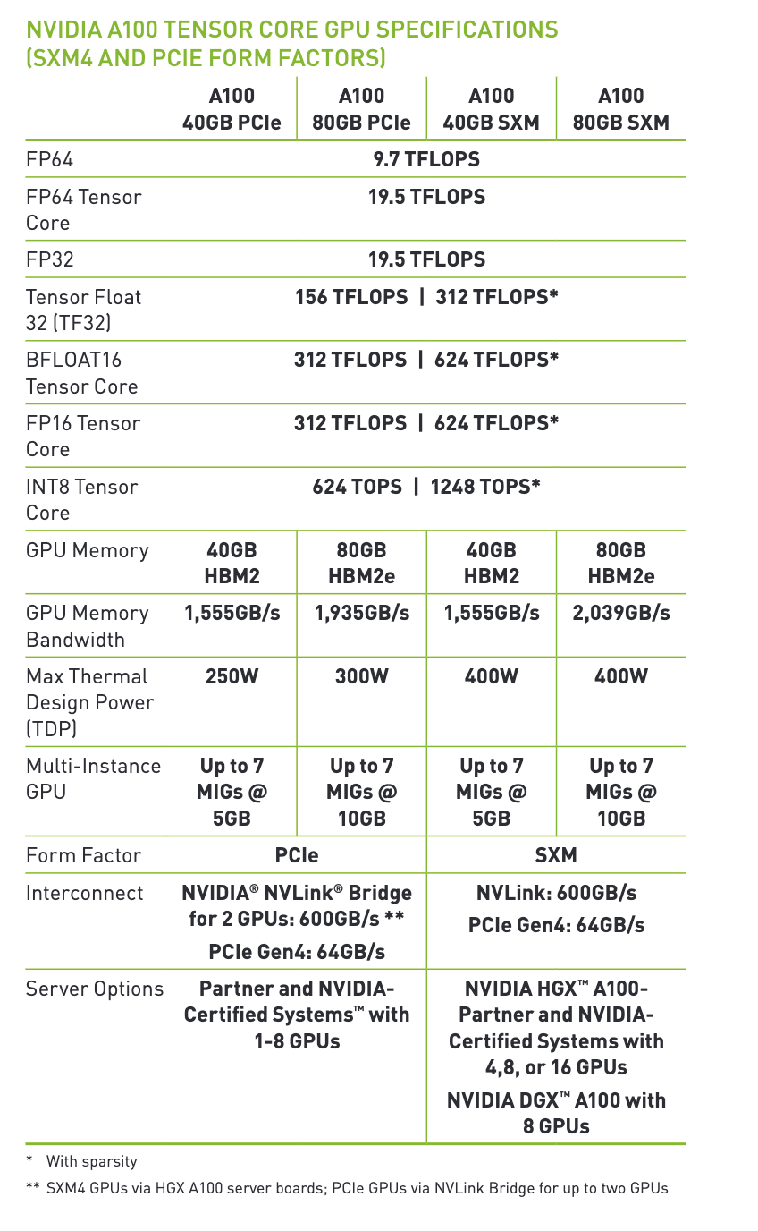
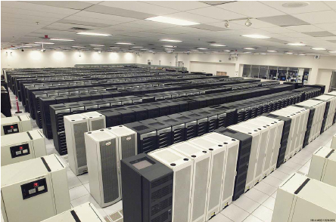
NVIDIA Ampere A100
An NVIDIA A100 GPU
It has 40 MB L2 cache, which helps reduce latency
It supports up to 80 GB of HBM2 memory with a maximum memory bandwidth of 2039 GB/s , essential for handling large data and reducing data transfer.
It contains in total 6912 FP32/INT32 CUDA cores and 3456 FP64 CUDA cores
NVIDIA H100: offers up to 30 TFLOPs of FP64 performance, which is over 3x the FP64 performance of the A100
GB200 Grace Blackwell Superchip: Provides 90 TFLOPS of FP64 performance
ASCI White supercomputer
Lawrence Livermore National Laboratory
Top #1 in 2007, 7.9 TFLOPS

Slide 28

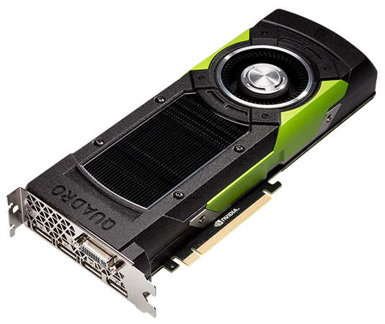
NVIDIA CUDA: CUDA.jl
AMD ROCm: AMDGPU.jl
Intel oneAPI: oneAPI.jl
Performance portability layer: KernelAbstractions.jl
Notes:
Several back-ends with similar structure: API package, kernel package, array package.
oneAPI has them all merged into a single package.
Focus on CUDA stack: most mature.

Slide 29



Installation
pkg> add CUDA julia> using CUDA
julia> CUDA.version() Downloading artifact: CUDA10.2 Downloading artifact: CUDNN+CUDA10.2 Downloading artifact: CUTENSOR+CUDA10.2 v"10.2.89"
julia> CUDA.functional() true
Automatic installation of CUDA
lazily, on first use
unless the environment contains JULIA_CUDA_USE_BINARYBUILDER=false
No need for Requires.jl
Container-friendly
Notes:
Trivial installation, nowadays. Only requires NVIDIA driver.

Slide 30
Array programming
julia> CuArray{Float32,2}(undef, 2, 2) 2×2 CuArray{Float32,2}: 0.0 0.0 0.0 0.0
julia> similar(a) 1×3 CuArray{Int64,2}: 0 0 0
julia> a = CuArray([1 2 3]) 1×3 CuArray{Int64,2}: 1 2 3
julia> b = Array(a) 1×3 Array{Int64,2}: 1 2 3
Goal: API compatibility with Base.Array
Notes:
Start your GPU application with: the CuArray type

Slide 31
Array programming
julia> CUDA.ones(2) 2-element CuArray{Float32,1}: 1.0 1.0
julia> CUDA.zeros(Float32, 2) 2-element CuArray{Float32,1}: 0.0 0.0
julia> CUDA.fill(42, (3,4)) 3×4 CuArray{Int64,2}: 42 42 42 42 42 42 42 42 42 42 42 42
julia> rand(2, 2) 2×2 CuArray{Float32,2}: 0.73055 0.843176 0.939997 0.61159
Goal: API compatibility with Base.Array
Notes:
Convenience constructors

Slide 32
Array programming
julia> a = CuArray{Float32}(undef, (2,2));
CURAND julia> rand!(a) 2×2 CuArray{Float32,2}: 0.73055 0.843176 0.939997 0.61159
CUBLAS julia> a * a 2×2 CuArray{Float32,2}: 1.32629 1.13166 1.26161 1.16663
CUSOLVER julia> LinearAlgebra.qr!(a) CuQR{Float32,CuArray{Float32,2}} with factors Q and R: Float32[-0.613648 -0.78958; -0.78958 0.613648] Float32[-1.1905 -1.00031; 0.0 -0.290454]
CUFFT julia> CUFFT.plan_fft(a) * a 2-element CuArray{Complex{Float32},1}: -1.99196+0.0im 0.589576+0.0im -2.38968+0.0im -0.969958+0.0im
CUDNN julia> softmax(real(ans)) 2×2 CuArray{Float32,2}: 0.15712 0.32963 0.84288 0.67037
CUSPARSE julia> sparse(a) 2×2 CuSparseMatrixCSR{Float32,Int32} with 4 stored entries: [1, 1] = -1.1905 [2, 1] = 0.489313 [1, 2] = -1.00031 [2, 2] = -0.290454
Notes:
When possible, we reuse NVIDIA’s libraries for performance.

Slide 33
Array programming
julia> a = CuArray([1 2 3]) julia> b = CuArray([4 5 6])
julia> map(a) do x x + 1 end 1×3 CuArray{Int64,2}: 2 3 4
julia> a .+ 2b 1×3 CuArray{Int64,2}: 9 12 15
julia> reduce(+, a) 6
julia> accumulate(+, b; dims=2) 1×3 CuArray{Int64,2}: 4 9 15
julia> findfirst(isequal(2), a) CartesianIndex(1, 2)
Powerful array language: obviates need for custom kernels
makes it possible to write generic code
Notes:
Real power comes from higher-order array expressions

Slide 34
Vector Addition Example
CPU code
GPU (CUDA) kernel
vector_size = 1024
a = rand(1:4, vector_size)
b = rand(1:4, vector_size)
c = zeros(Int, vector_size)
function vadd(c, a, b)
Thread.@threads for i in 1:vector_size
c[i] = a[i] + b[i]
end
return
end
da = CuArray(a)
db = CuArray(b)
dc = CUDA.zeros(Int, size(a))
function vadd(c, a, b)
i = threadIdx().x
c[i] = a[i] + b[i]
return
end
@cuda threads=length(a) vadd(dc, da, db)
Notice: only local index
Any Ideas what is the limitation here?

Slide 35
Enhanced GPU Vector Addition
threadIdx().x + (blockIdx().x - 1) * blockDim().x = 3 + (3-1) * 256 = 515
Gets the global index of the thread in a multidimensional grid
gridDim().x = 2048
threadIdx().x
threadIdx().x
threadIdx().x
threadIdx().x
1 | 2 | 3 | … | 256
1 | 2 | 3 | … | 256
1 | 2 | 3 | … | 256
…
1 | 2 | 3 | … | 256
blockIdx().x = 1
blockIdx().x = 2
blockIdx().x = 3
blockIdx().x = 2048
da = CuArray(a)
db = CuArray(b)
dc = CUDA.zeros(Int, size(a))
function vadd(c, a, b)
i = threadIdx().x + (blockIdx().x - 1) * blockDim().x
c[i] = a[i] + b[i]
return
end
@cuda threads=1024 blocks=cld(length(da),1024) vadd(dc, da, db)

Slide 36
Notebook:
https://github.com/Rabab53/mit-parallel-computing-course/blob/main/Introduction_to_julia_gpu/gpu_introduction.ipynb
Notes:
https://drive.google.com/file/d/1v8hCrhw5bow8VaPwvDCxGejAcTkopnkX/view?usp=sharing

