Slide 1
Random Matrix Approach to Linear Control Systems
Charlotte Kiang
May 16, 2012

Slide 2
About me
My name is Charlotte Kiang, and I am a junior at Wellesley College, majoring in math and computer science with a focus on engineering applications.

Slide 3
What I hope to accomplish today
Show the equivalence between a single jump linear control system and a random walk on a self-similar graph whose vertices are the visible points of the plane. (Result first published by Tamás Kalmár-Nagy in Proceedings of the 46th IEEE Congress on Decision and Control.)
Talk a bit about the implications of this result.

Slide 4
A (very brief) introduction to Control Theory
- Mathematical control theory is the area of applied mathematics that deals with the principles underlying the design and analysis of control systems.
Control systems, themselves, are broadly defined as systems whose functions are to influence an object’s behavior in order to achieve a desired goal.
Two main “branches” of control theory research concern optimization and uncertainty. The problem I will be discussing today mainly concerns optimization.

Slide 5
Our General Problem
The problem that we are looking into today concerns a networked control system, meaning its inputs come from an external source in its environment.
Problems that concern networked control systems occur in real-time, so our system must receive input and process it as quickly as possible.
Some examples of these control systems that we see in everyday life:
Robotics
Aircrafts and spacecrafts (avionics and autopilots)
Cars
Vehicular control systems are extremely sensitive to delays, so we must find the most efficient way to communicate with our network. Since our signals occur at random time intervals, networks often experience traffic that delay reception. We can use random matrix theory to help build a framework for analysis of these systems.

Slide 6
On to the math…
To deal with the problem of traffic, we must consider each signal’s arrival time. Since arrival times are uncertain, the best we can do is to characterize them according to a probability distribution.
The underlying probability distributions for control systems are often very complicated, but we can gain insight by focusing on a simple but characteristic problem of its class. One such model is the so-called-random Fibonacci sequence.
By exploring patterns that arise in linear control systems with random time delays, we can find an equivalence with the random Fibonnaci recurrence. We can exploit this symmetry to propose a modified recurrence rule for the system.

Slide 7
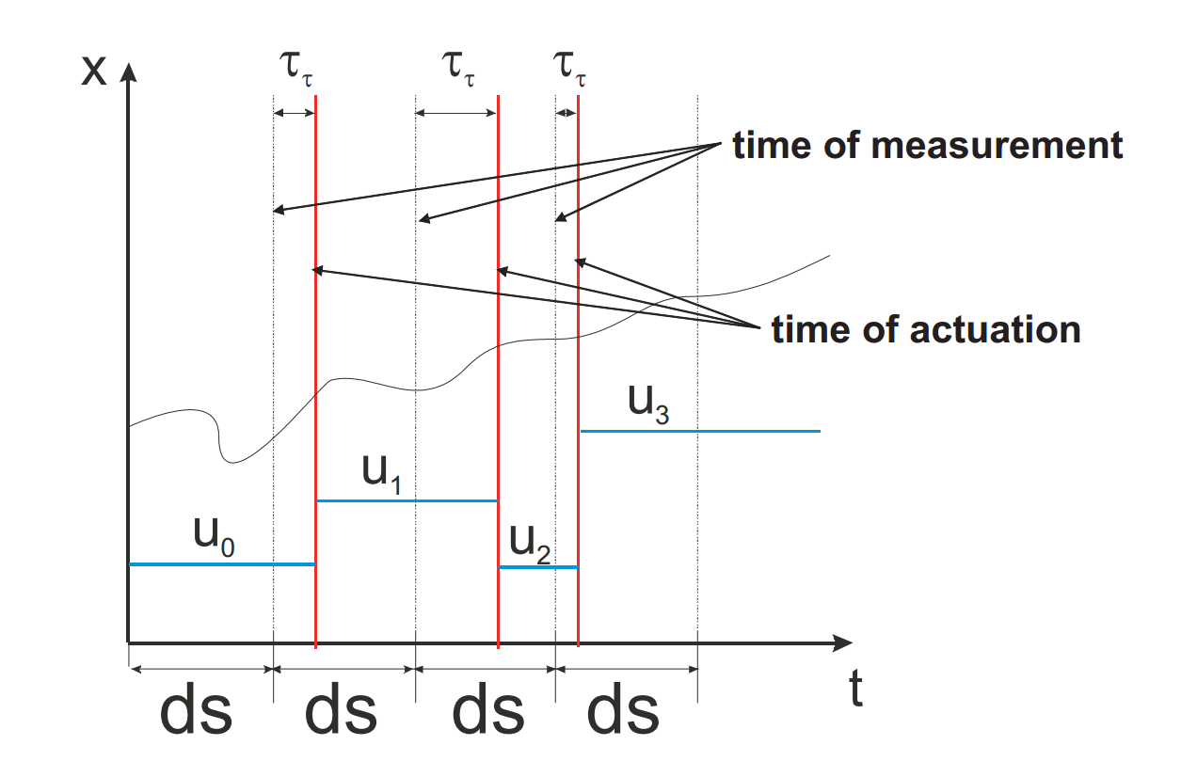
Graph of a control system with random actuation time delays

Slide 8
Our claim
We claim that linear control systems with random time delay follow a jump linear pattern. Thus, we must show why this pattern arises naturally in these systems.

Slide 9
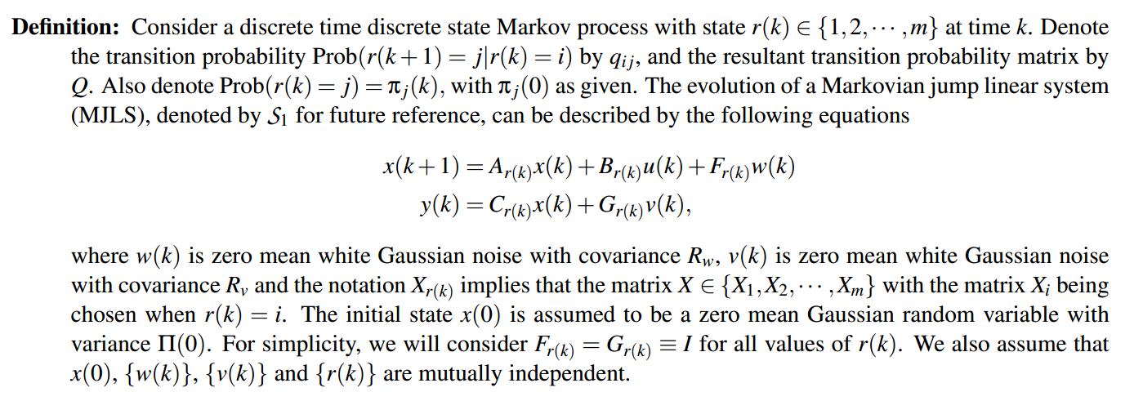
Definition of a linear jump system
A linear jump system is a discrete linear time system with randomly jumping parameters that can be described using a finite state Markov chain. (For the purposes of this presentation, that’s all you need to understand right now, but a formal definition is below.)

Slide 10
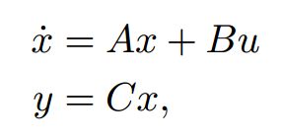
Linear Jumps, Pt. 1
We consider a basic model of a linear control system with random actuator delays due to communication over a network. The structure of the control system takes the usual form
where the state evolves continuously. We assume that our control signal is proportional to our output. Our sampling time ds (as seen on our earlier graph) specifies the time instants s_{i} = ids.
Our terms of interest here are x(t) (overall state at given time), and u (our control input).

Slide 11
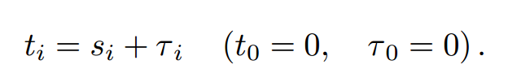

Linear Jumps, Pt. 2
We want our actuation times to be the same as our sampling times, but this only occurs in an ideal model. Due to network delays, these instead become
Note that we are assuming here that (That is, our delay in actuation is less than our sampling time interval.)
(This is a highly simplified model, but the observed patterns are still useful.)

Slide 12
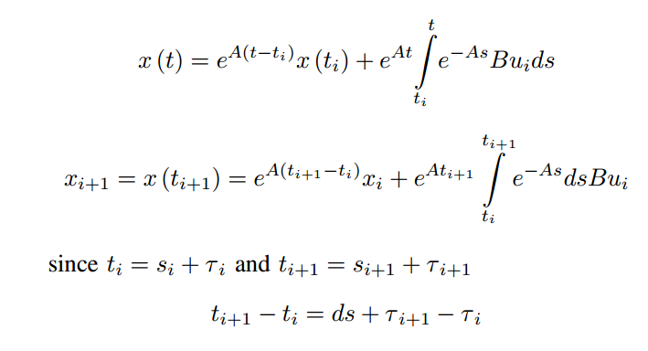
Linear Jumps, Pt. 3
Now we derive a mapping between values of the state and control input for consecutive actuation times. On [t_{i}, t_{i+1}], we can solve for x = Ax + Bu:

Slide 13
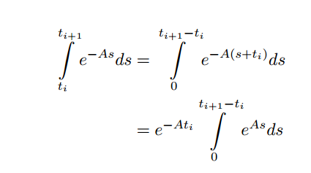
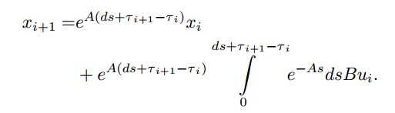
Linear Jumps, Pt. 4
Also,
And,

Slide 14
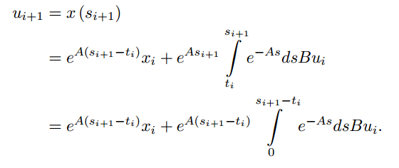
Linear Jumps, Pt. 5
We have assumed state-feedback control, so:

Slide 15
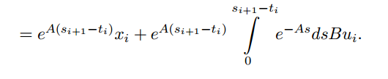

Linear Jumps, Pt. 6
(from previous slide)
From our earlier definitions, we also have
So if we substitute this in, we get:

Slide 16
Linear Jumps, Pt. 7
With these two results,
and
we can build our mapping.

Slide 17
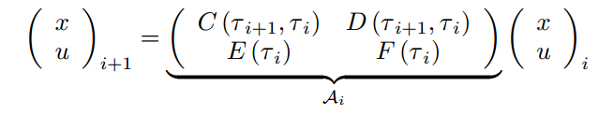
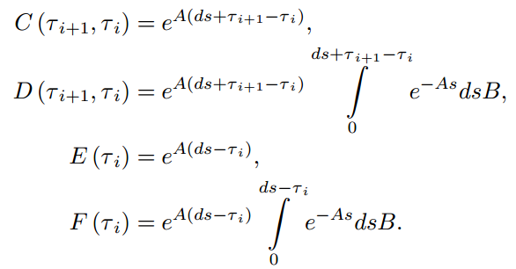
Linear Jumps, Pt. 8
Our mapping:
where

Slide 18


Linear Jumps, Pt. 9
As we can see, this model is a gives a recursive relationship between our state and control input at any given time.
We can generalize this further for any time n, by saying that the nth element of the sequence
can be written as

Slide 19
Linear Jumps, Pt. 10.
Therefore, the stability of our system (our rate of convergence/divergence) will be determined by the growth/decay of the associated infinite random matrix product. (Note that each term should be dependent on the previous one.)
To account for this dependence, we can describe the distribution of these matrices over an associated Markov chain.
This system is otherwise known as a linear jump system.

Slide 20
What to do with this
Using these results alone, we can run some Monte-Carlo Simulations to obtain information about the stability of a system, but our goal today is to understand the underlying principles that govern this class of problems.
As such, we now return to one of the simplest linear jump systems: the Fibonacci sequence.

Slide 21




Fibonacci: INtro
One of the simplest linear jump systems is a variant of the well-known Fibonacci series. The one we will look at is a second-order random recurrence relation, also known as the Fibonacci recurrence.
That is,
can be written as the two-dimensional map
where our coefficient matrix D_{n} at time n is chosen randomly as either A or B with probability ½, where

Slide 22
Results from Fibonacci
Recall that our original goal was to exploit the symmetry between our linear control system equation and this Fibonacci one to build a new recurrence relation. To do so, we must uncover the geometric structure induced by the Fibonacci series.

Slide 23
Lyapunov Exponents
To relate our Fibonacci series to control systems, we must look at their Lyapunov exponents. A Lyapunov exponent of a dynamical system (such as the networked control system we are considering) is a quantity that characterizes the rate of separation of two infinitesimally small trajectories.
Quantitatively, two trajectories in phase space (i.e. possible states) with initial separation diverge at a rate given by:
where is the Lyapunov exponent.
For us, this is useful in characterizing state vs control – similar to what we did earlier.

Slide 24
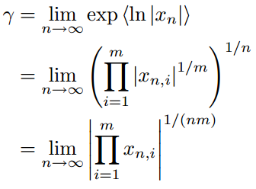
Lyapunov Exponents and Fibonacci
The Lyapunov exponent for the Fibonacci series can also be expressed as a path average, by considering all possible values for |x_{n}|.
We can see that
where the geometric mean is taken over all the m possible paths of length n.

Slide 25
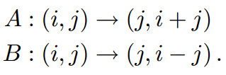

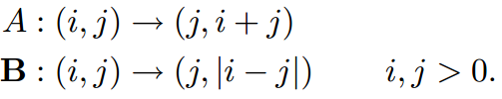
FIBONACCI PATHS, PT. 1
To characterize all possible paths, we must investigate their geometrical structure. Consider the following two transformations, which both map lattice points to lattice points (i.e., points with integer coordinates):
We will now modify this recurrence slightly to act only on the first quadrant of integer lattice . Our modified maps are:

Slide 26
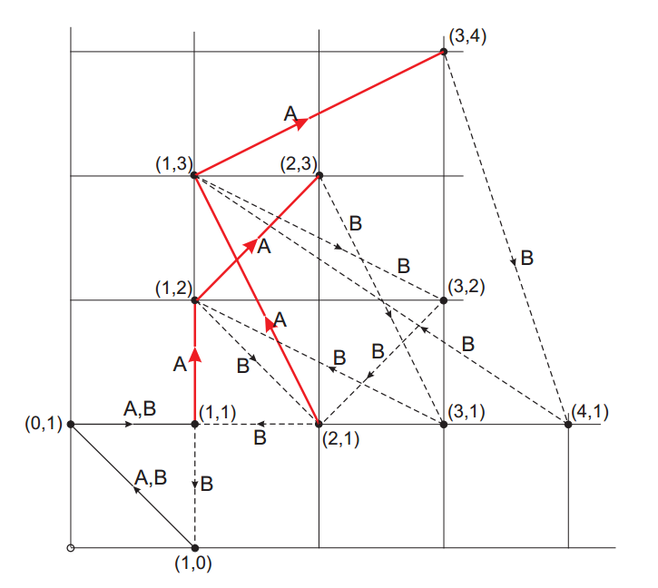
FIBONACCI PATHS, PT. 2
The Random Fibonacci Maps on the First Quadrant
The figure to the left depicts our result of repeated applications of our modified A and B beginning with (1,1), just as the Fibonacci sequence does.
An interesting consequence of this is that the coordinates of points that can be reached from (1,1) are relative primes (though I have not had a chance to prove this).
More importantly, this figure is a directed graph called the Fibonacci graph.

Slide 27
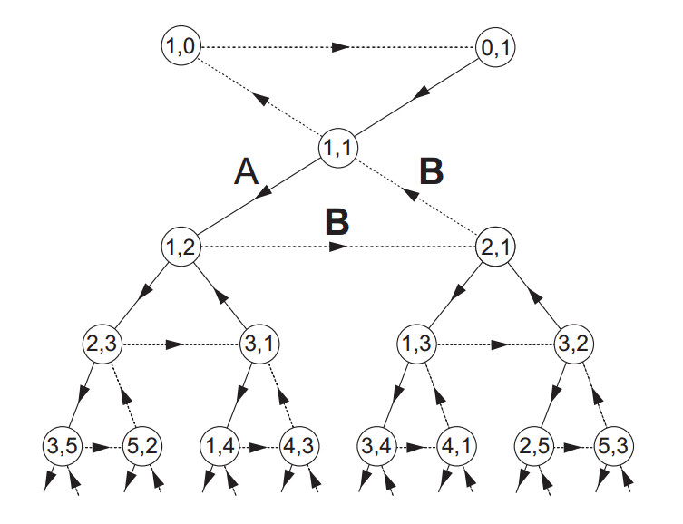
Topology of the Fibonacci Graph
Fibonacci Graph (Coordinates are all same as last slide’s graph)
The graph to the left can be obtained by “unfolding” our previous graph (all values are the same).

Slide 28
Topology of the Fibonacci Graph, pt. 2
Fibonacci Graph
A point with integer points (i, j) is called visible if gcd(i, j) = 1. We say that a point is reachable from another lattice point (i, j) if there exist a sequence of transformations (using our modified A and B that we used to construct our graph) that takes (i, j) to (k, l). Then (i, j) is reachable from (1, 1) iff (i, j) is visible. (This is equivalent to saying all nodes of this graph are relatively prime, as we mentioned before.)
Consequently, every visible point is reachable from every visible point.

Slide 29
Topology of the Fibonacci Graph, pt. 3
Fibonacci Graph
Given the previous statements, it follows that all points on this graph have an “address” that consists of the series of transformations that take (i, j) to (1, 1).
But really, this is equivalent to the mathematical statement that we proved earlier:

Slide 30
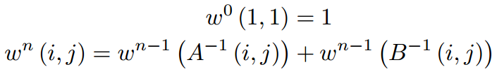
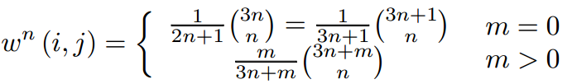
Consequences of this symmetry
Now that we have drawn this parallel with the Fibonacci graph, we can say a lot more about linear control systems.
For instance, a random walk on the Fibonacci graph is a diffusion process, so we can calculate the probability of arriving at a point (i, j) after n applications of A or B. Let w^{n}(i, j) denote the probability of arriving to (i, j) in the nth step. The following recursion
denotes those probabilities. Then,
where m is the distance of point (i, j) from (1, 1).

Slide 31

Consequences of this symmetry, Pt. 2
Using some hypergeometric functions, we can obtain a closed form expression for w^{n}(i, j):
By obtaining expressions for the diffusion coefficient, the rate of the divergence for the random walk can be categorized.

Slide 32
What else?
The previous result is just one among many mathematical possibilities that exist now that we have established symmetry between a random walk on the Fibonacci graph and linear control systems. If we can model our problem using this graph, this strongly suggests that graph theory, statistical physics, combinatorics and even number theory have applications in control theory.

Slide 33

Control Theory Demonstration

Slide 34
REFERENCES
Czornik, Adam and Swierniak, Adrzej. “On direct controllability of discrete time jump linear systems.” http://mbi.osu.edu/publications/reports/techreport_08.pdf. Accessed April 15, 2012.
Gupta, Vijay and Murray, Richard M. “Lecture Summary: Markov Linear Jump Systems.” (http://www.eeci-institute.eu/pdf/M010/Lecture_mjls.pdf) European Embedded Control Institute. Accessed May 5, 2012.
Kalmár-Nagy, Tamás. “Random Matrix Theory Approach to Linear Control Systems with Network-Induced Delays.” Proceedings of the 46th IEEE Conference on Decision and Control, Dec 12-14 2007: 5210-5214. Accessed online.
Sontag, Eduardo. Mathematical Control Theory: Deterministic Finite Dimensional Systems. Second Edition, Springer, New York, 1998.

