Slide 1

Largest singular values of extremely large bidiagonal matrices in Julia
Project 18.338
Evelyne Ringoot, Fall 2022

Slide 2
Largest singular values of extremely large bidiagonal matrices in Julia
K-th largest singular value of bidiagonal matrices can be obtained using a truncated version of the matrix
1
2
The Limit distribution of largest singular value value is the Tracy-Widom law
3
Impact on design of random SVD algorithms
Notes:
Last time: goals reason

Slide 3
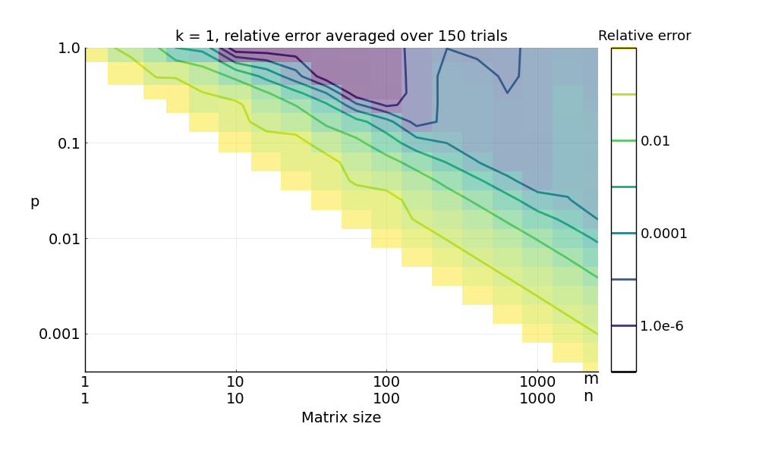
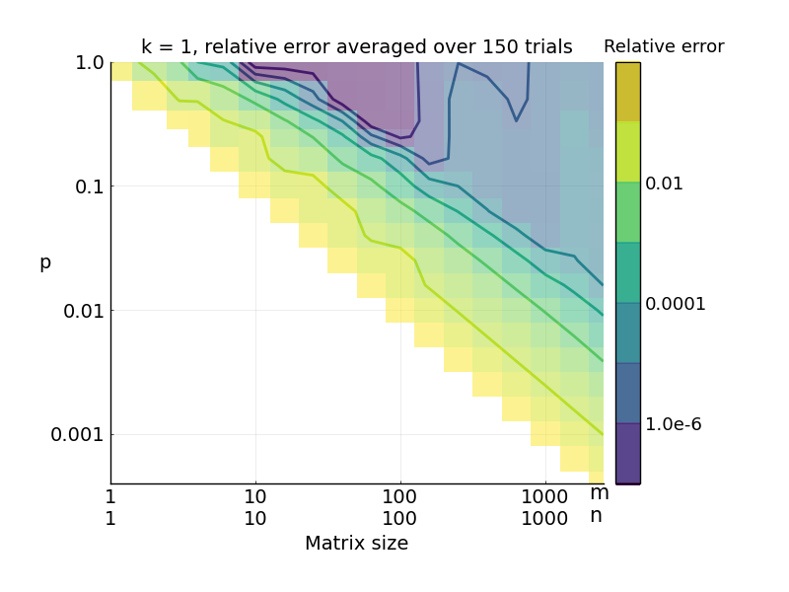
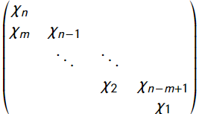

Accuracy of estimating singular values by using a portion of the bidiagonal matrix can be estimated by log-log regression
1
Bidiagonal matrix
=lower bidiagonal reduction of Gaussian matrix
Method: Monte-Carlo simulations
Generate bidiagonal matrices of various sizes (M,N) and calculate their k-th singular value
Use portion p of rows and columns to obtain an estimate of k-th singular value and the corresponding relative accuracy
Calculate the log-log relationship that estimated which portion p of the matrix is required for an accuracy>1e-3
Verify the relation hold for higher n: confirmed for n=m=10 000 p= 0,4% (n=40)
$$p ≈6.4⋅n^{−4/5}$$
Notes:
-explain p=1

Slide 4
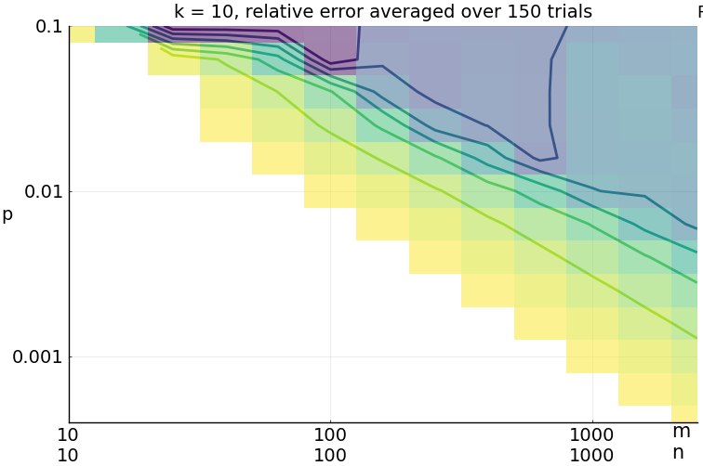
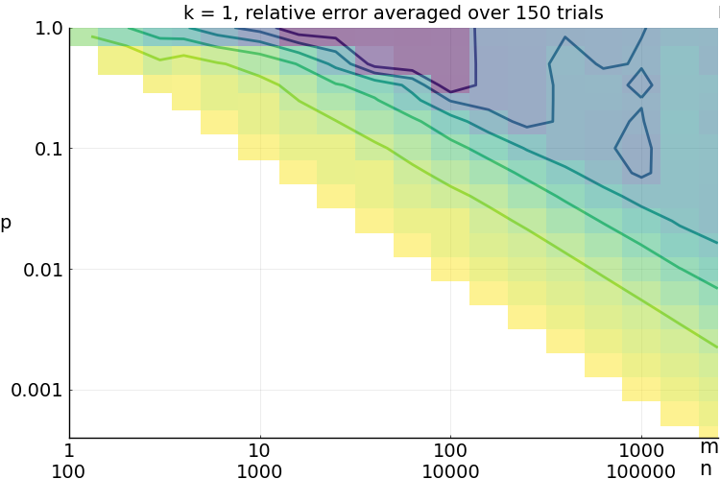
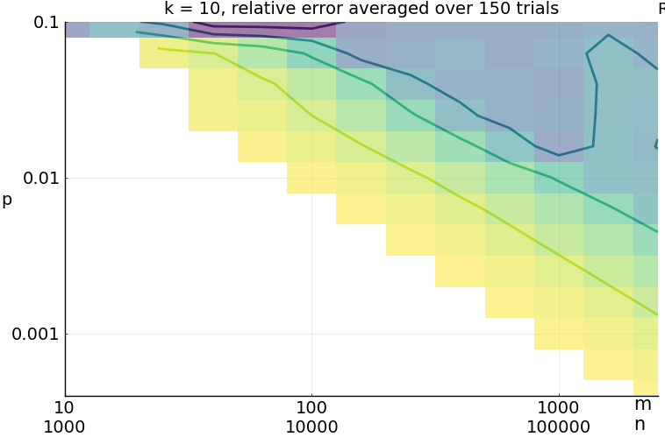




Relative low sensitivity of the accuracy of approximate singular values to parameters k and m/n ratio
1
$k=$1
$k=$10
Variation of parameter k of the k-th largest singular value:
Similar accuracy can be observed. Any conclusions for the first singular value extend to the k-th singular value in the area of relatively low error (as such by extension k<<n)
Variation of m/n ratio, size of the matrix prior to bidiagonal reduction:
Similar but slightly lower accuracy can be observed. For higher m/n ratios, the lower bidiagonal will dominate in magnitude
$$\frac{m}{n}=1$$
$$\frac{m}{n}=100$$

Slide 5
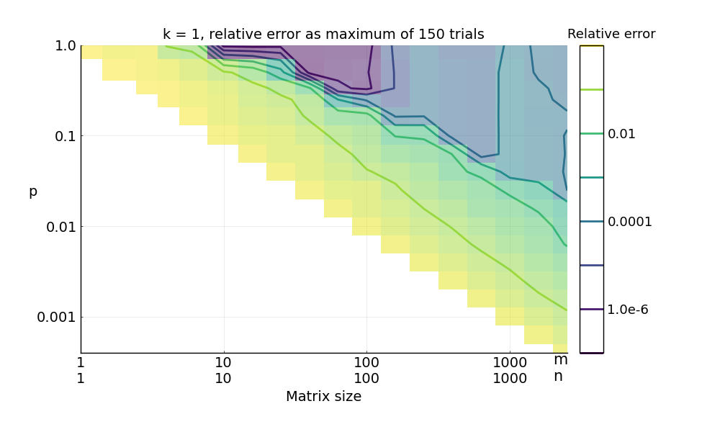
Approximation is accurate for averages, not necessarily for single values
1
The maximum error increases with matrix size and does not follow the same trend
The singular value estimate obtained by considering a truncated part of the matrix is always a lower bound
This estimation method is inappropriate to use to obtain a ‘certain’ estimate for one specific matrix. Rather, it will estimate well values where multiple matrices need to be considered and averaged

Slide 6
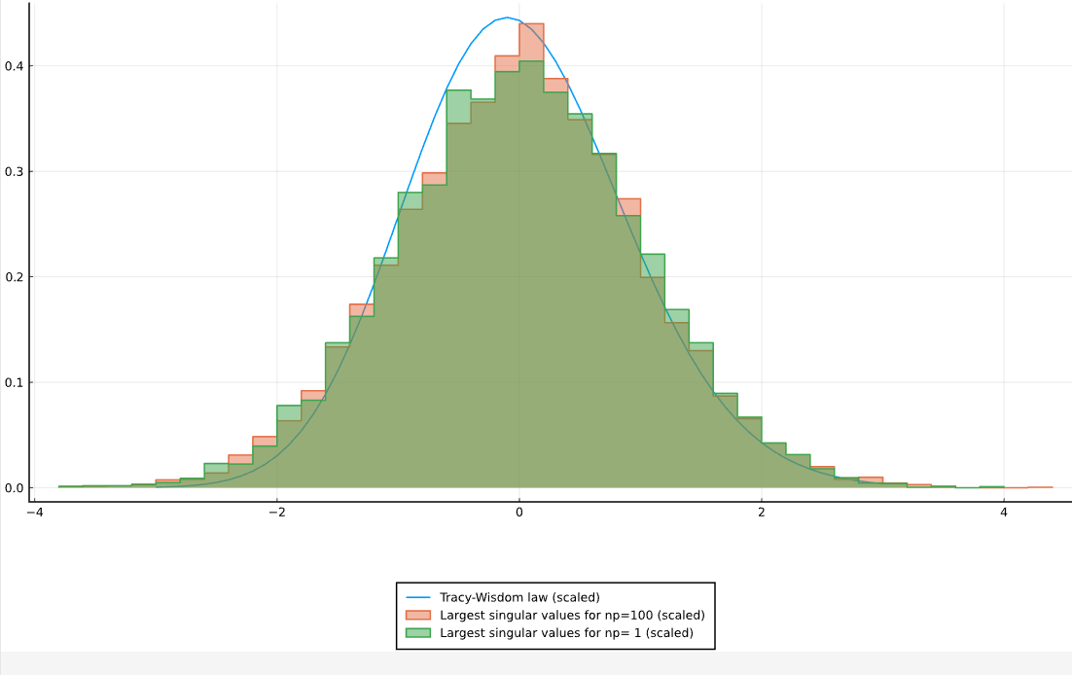
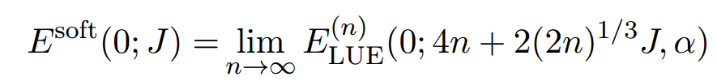
Limit distribution of largest singular value approaches Tracy-Widom soft edge law
2
Accuracy for extremely large matrices unfeasible
examine distribution
Method: 1000 Monte-carlo trials
For n= 1 million np= 100
Follows Tracy-Widom soft-edge law after scaling:
Open questions
Scaling of Tracy-Widom law
Distribution can be examined, but not accuracy sufficient?
Singular values follow law, at large n: var<<mean theoretical estimate can be devised
Notes:
Notice np=1

Slide 7
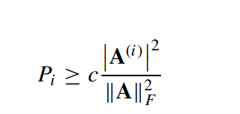
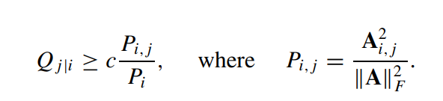
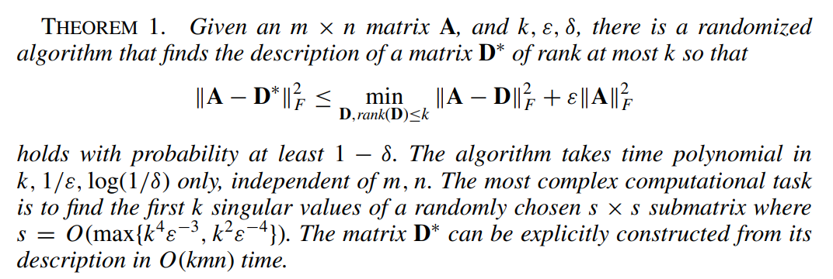
Impact on random SVD algorithms for low-rank approximations
3
State of the art
Future
Research for optimal sampling techniques, e.g.
Based on Frobenius norm [Frieze, e.a., 2004]
Select rows so that
Select columns so that:
Then
Adaptive sampling [Deshpande, e.a., 2006]
Volume-based sampling [Deshpande, e.a., 2006]
Linear-time algorithm O(MN) [Har-Peled, e.a., 2006]
Recently extended to GPUs
Random SVD for GPUs [Foster, e.a., 2011]
CUDA implementation [Struski e.a., 2021]
Open project goals:
Verify the Frobenius norm sampling on a real-world examples of matrices in physical problems
Understand the CUDA RSVD algorithm in more detail
Open research questions:
Best sampling technique for GPU (including accruacy and speed)
Potential for improvements on the CUDA-implementation
Notes:
MIT folks

Slide 8
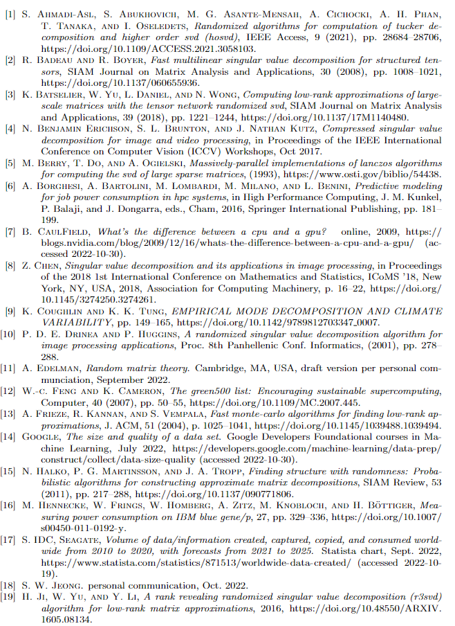
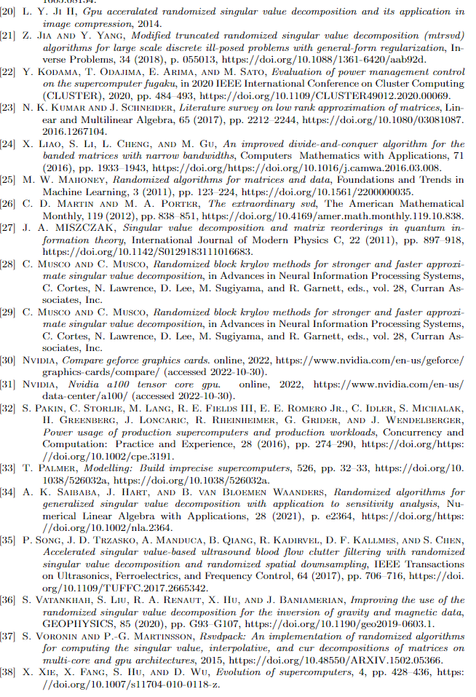
References

