Slide 1
Tail Bounds on the Smallest Singular Value
Shyam Narayanan
18.338 Final Presentation

Slide 2
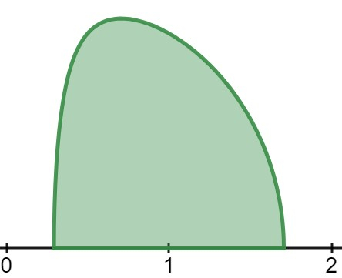
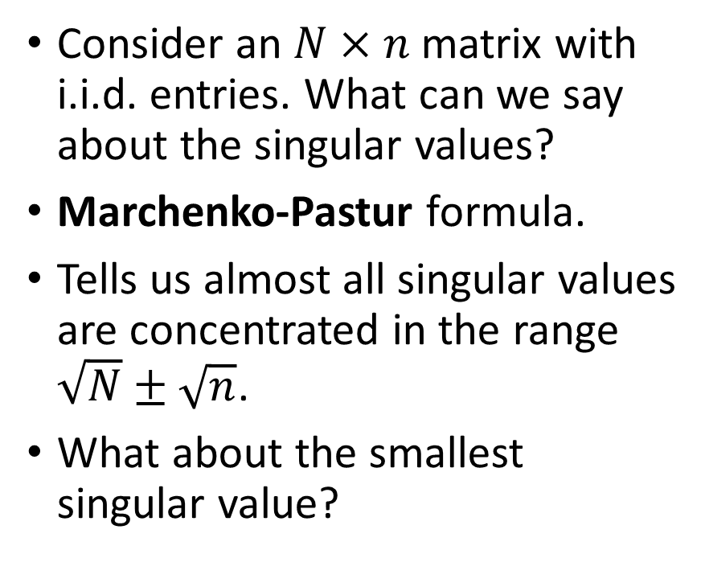
Singular Values of a Random Matrix
Consider an $N×n$ matrix with i.i.d. entries. What can we say about the singular values?
Marchenko-Pastur formula.
Tells us almost all singular values are concentrated in the range $\sqrt{N}±\sqrt{n}$.
What about the smallest singular value?

Slide 3
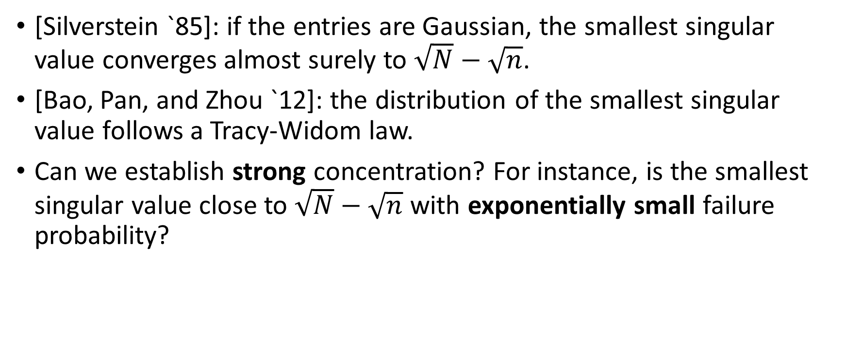
The smallest singular value
[Silverstein `85]: if the entries are Gaussian, the smallest singular value converges almost surely to $\sqrt{N}−\sqrt{n}$.
[Bao, Pan, and Zhou `12]: the distribution of the smallest singular value follows a Tracy-Widom law.
Can we establish strong concentration? For instance, is the smallest singular value close to $\sqrt{N}−\sqrt{n}$ with exponentially small failure probability?

Slide 4
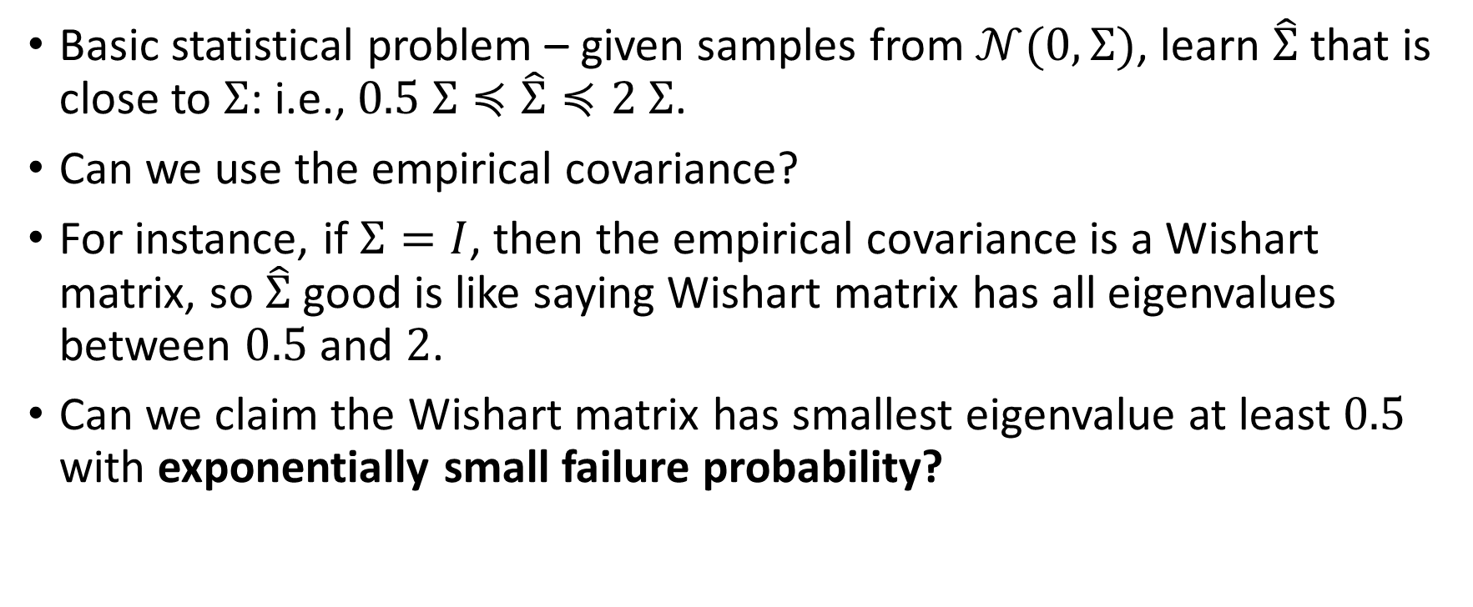
Motivation from (high-confidence) Statistics
Basic statistical problem – given samples from $𝒩(0, Σ)$, learn $\hat{Σ}$ that is close to $Σ$: i.e., $0.5 Σ≼\hat{Σ}≼2 Σ$.
Can we use the empirical covariance?
For instance, if $Σ=I$, then the empirical covariance is a Wishart matrix, so $\hat{Σ}$ good is like saying Wishart matrix has all eigenvalues between $0.5$ and $2$.
Can we claim the Wishart matrix has smallest eigenvalue at least $0.5$ with exponentially small failure probability?

Slide 5
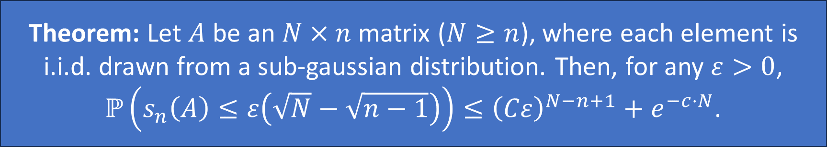

Main Result
Rudelson and Vershynin (2009).
For $N=1.1n$, smallest singular value is at least $0.001 \sqrt{n}$ with $e^{−cn}$ failure probability.
For $N=n+\sqrt{n}$, smallest singular value is at least $0.001$ with $e^{−c\sqrt{n}}$ failure probability.
Theorem: Let $A$ be an $N×n$ matrix ($N≥n$), where each element is i.i.d. drawn from a sub-gaussian distribution. Then, for any $ε>0$,
$ℙ\left(s_{n}\left(A\right)≤ε\left(\sqrt{N}−\sqrt{n−1}\right)\right)≤{\left(Cε\right)}^{N−n+1}+e^{−c⋅N}$.

Slide 6
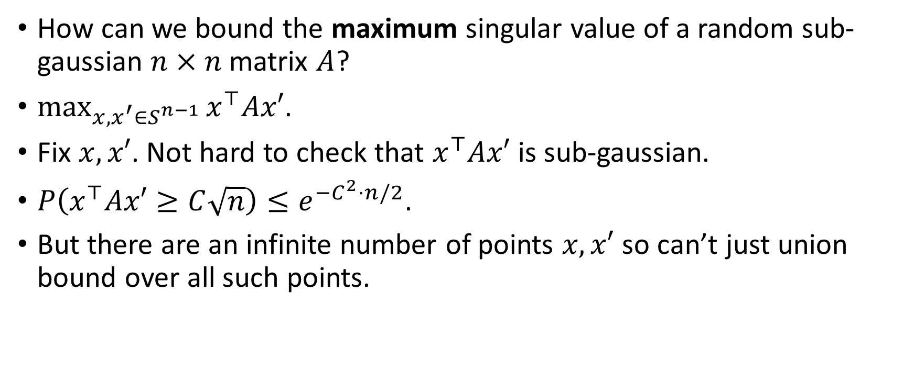
Prelude: bounding the largest singular value
How can we bound the maximum singular value of a random sub-gaussian $n×n$ matrix $A$?
$\max_{x,x^{′}∈S^{n−1}}{x^{⊤}Ax′}$.
Fix $x, x′$. Not hard to check that $x^{⊤}Ax′$ is sub-gaussian.
$P\left(x^{⊤}Ax′≥C\sqrt{n}\right)≤e^{−C^{2}⋅n/2}$.
But there are an infinite number of points $x,x′$ so can’t just union bound over all such points.

Slide 7
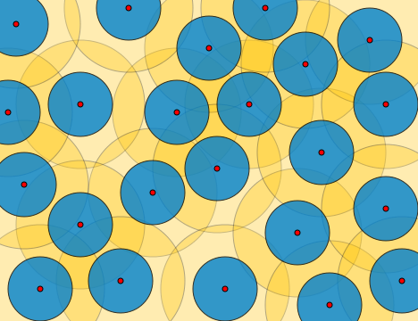
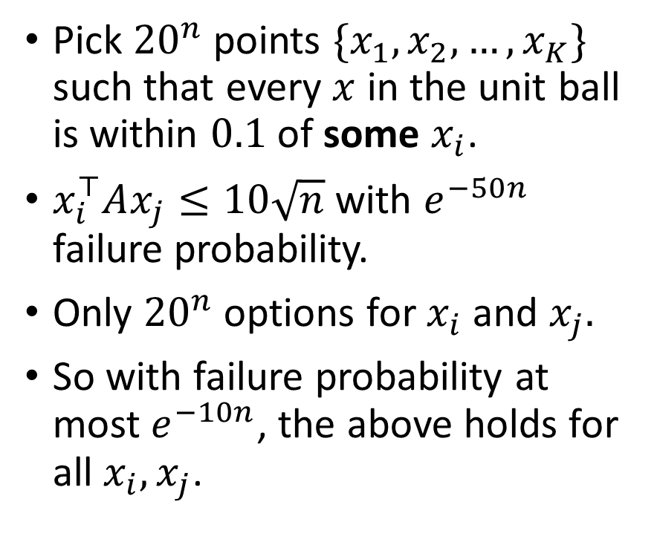

Main trick: $ε$-net.
Pick ${20}^{n}$ points $\{x_{1},x_{2},…, x_{K}\}$ such that every $x$ in the unit ball is within $0.1$ of some $x_{i}$.
$x_{i}^{⊤}Ax_{j}≤10\sqrt{n}$ with $e^{−50n}$ failure probability.
Only ${20}^{n}$ options for $x_{i}$ and $x_{j}.$
So with failure probability at most $e^{−10n}$, the above holds for all $x_{i}, x_{j}$.
David Eppstein. https://en.m.wikipedia.org/wiki/File:Metric_epsilon-net.svg

Slide 8
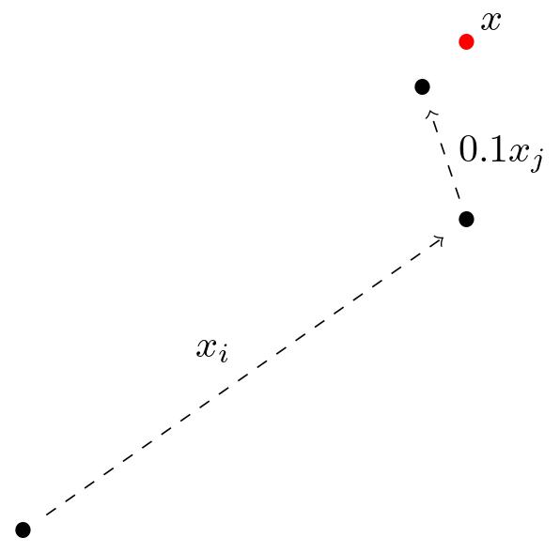
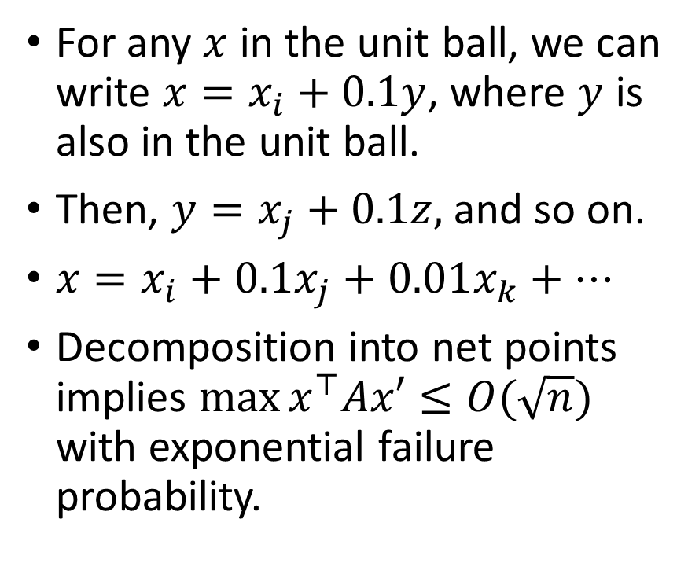
Telescoping sum
For any $x$ in the unit ball, we can write $x=x_{i}+0.1y$, where $y$ is also in the unit ball.
Then, $y=x_{j}+0.1z,$ and so on.
$x=x_{i}+0.1x_{j}+0.01x_{k}+⋯$
Decomposition into net points implies $\max{x^{⊤}Ax′}≤O(\sqrt{n})$ with exponential failure probability.

Slide 9
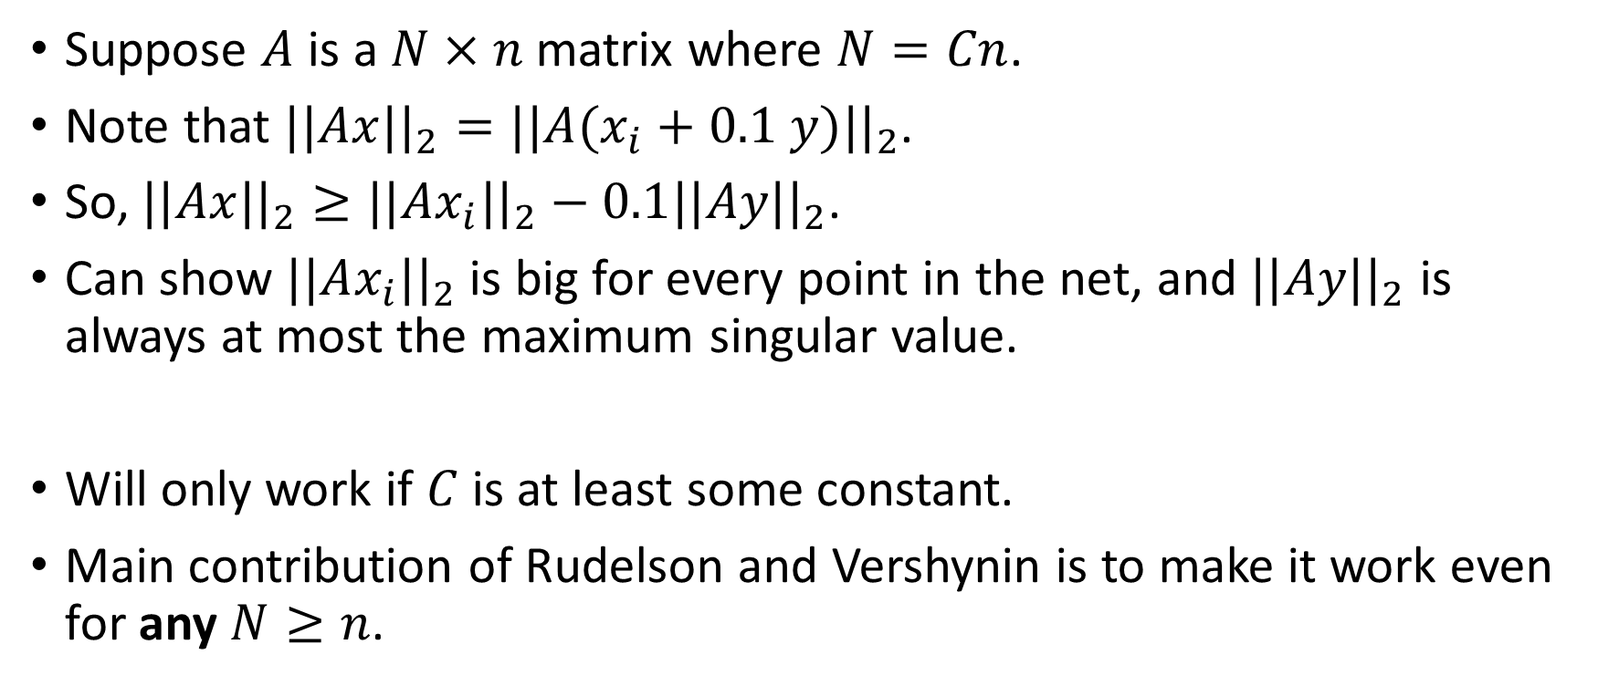
Smallest singular value for tall matrices
Suppose $A$ is a $N×n$ matrix where $N=Cn$.
Note that $||Ax||_{2}=||A(x_{i}+0.1 y)||_{2}$.
So, $||Ax||_{2}≥||Ax_{i}||_{2}−0.1||Ay||_{2}$.
Can show $||Ax_{i}||_{2}$ is big for every point in the net, and $||Ay||_{2}$ is always at most the maximum singular value.
Will only work if $C$ is at least some constant.
Main contribution of Rudelson and Vershynin is to make it work even for any $N≥n$.

Slide 10
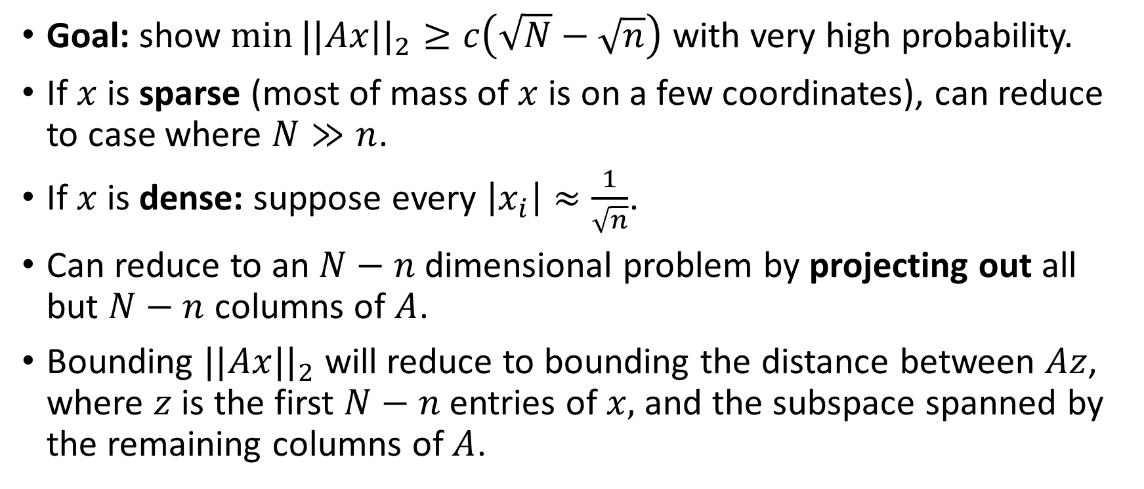
Overview
Goal: show $\min{||Ax||_{2}}≥c\left(\sqrt{N}−\sqrt{n}\right)$ with very high probability.
If $x$ is sparse (most of mass of $x$ is on a few coordinates), can reduce to case where $N≫n$.
If $x$ is dense: suppose every $\left|x_{i}\right|≈\frac{1}{\sqrt{n}}$.
Can reduce to an $N−n$ dimensional problem by projecting out all but $N−n$ columns of $A$.
Bounding $||Ax||_{2}$ will reduce to bounding the distance between $Az$, where $z$ is the first $N−n$ entries of $x,$ and the subspace spanned by the remaining columns of $A$.

Slide 11
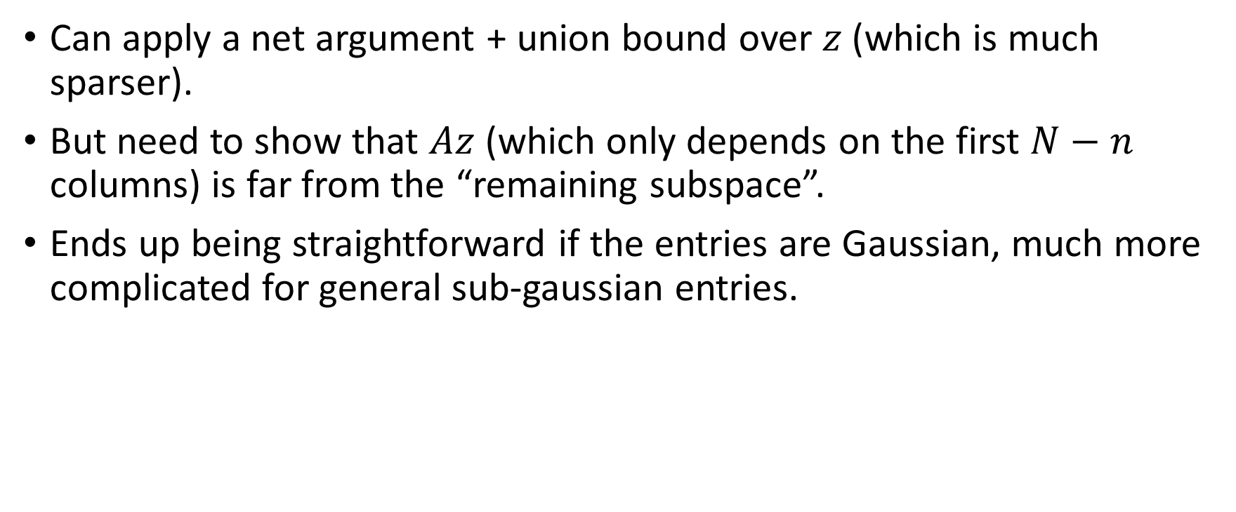
Smaller Union Bound
Can apply a net argument + union bound over $z$ (which is much sparser).
But need to show that $Az$ (which only depends on the first $N−n$ columns) is far from the “remaining subspace”.
Ends up being straightforward if the entries are Gaussian, much more complicated for general sub-gaussian entries.

Slide 12
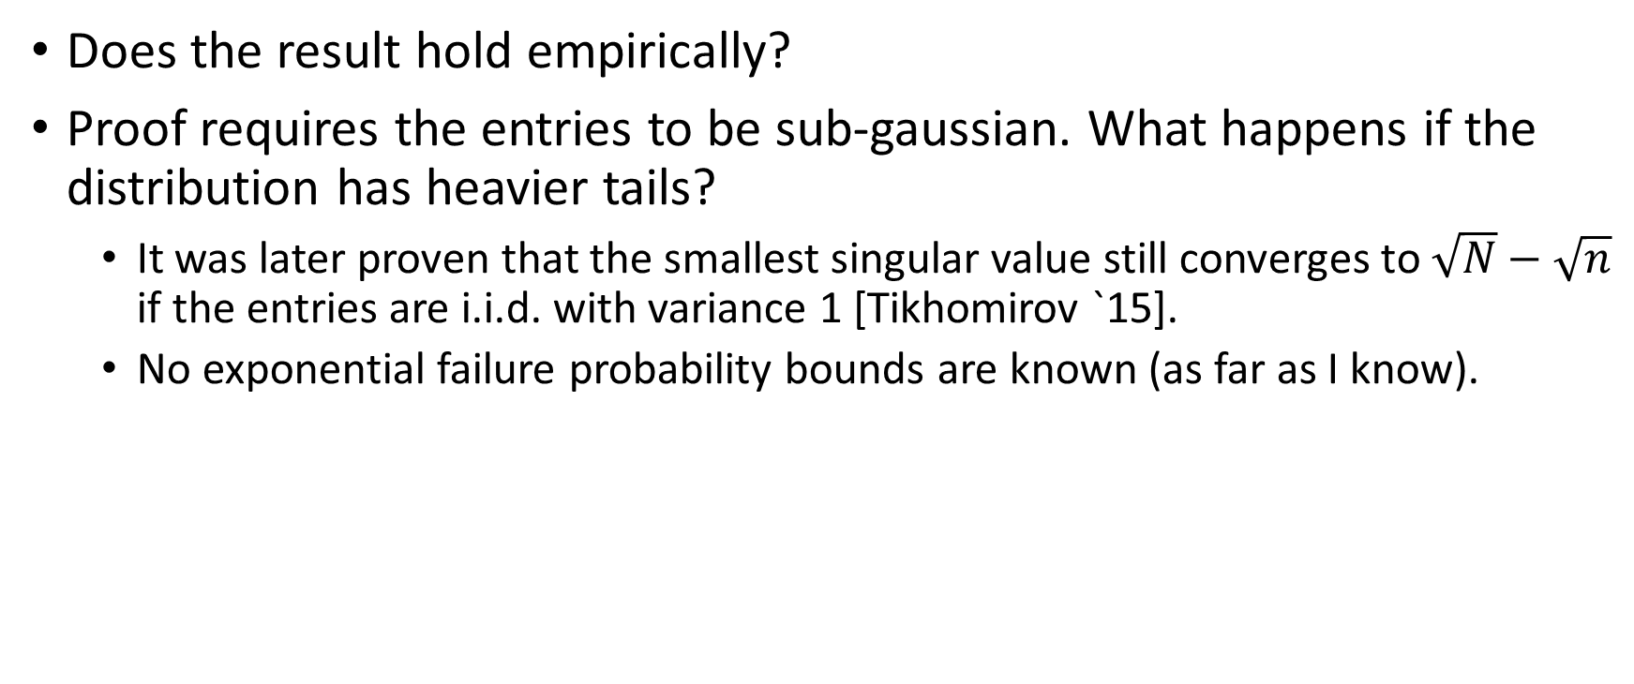
Simulations
Does the result hold empirically?
Proof requires the entries to be sub-gaussian. What happens if the distribution has heavier tails?
It was later proven that the smallest singular value still converges to $\sqrt{N}−\sqrt{n}$ if the entries are i.i.d. with variance 1 [Tikhomirov `15].
No exponential failure probability bounds are known (as far as I know).

Slide 13
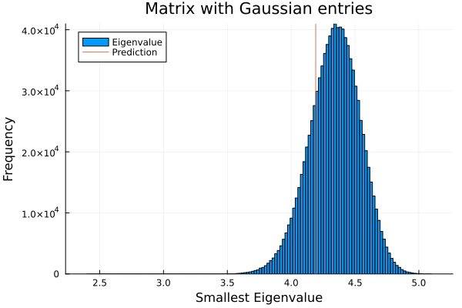
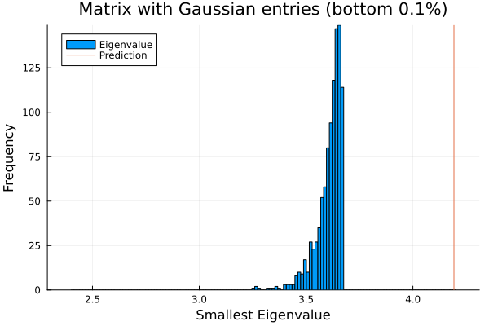
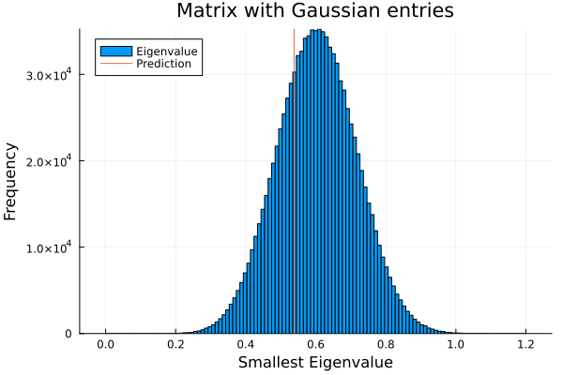
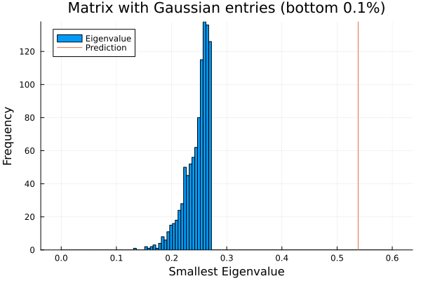


Gaussian entries
$$N=200,n=100$$
$$N=110,n=100$$

Slide 14
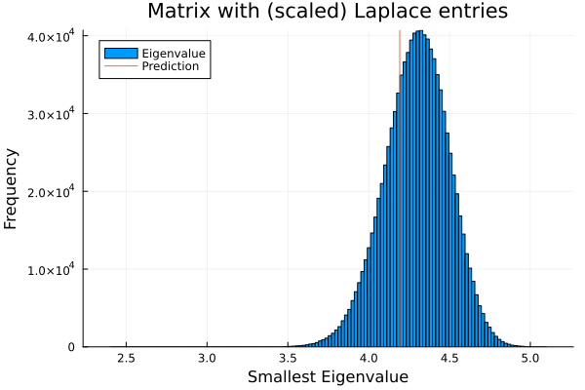
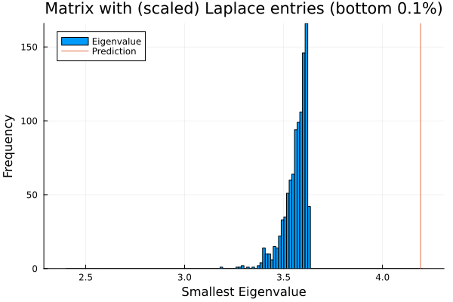
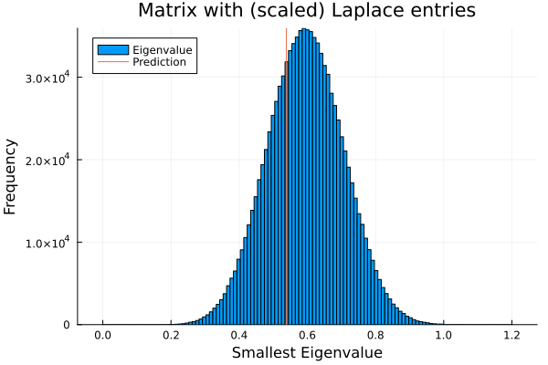
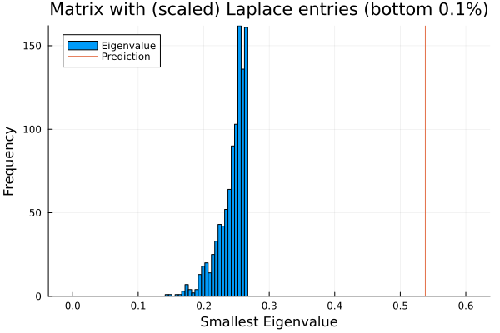
Laplace entries
$$N=200,n=100$$
$$N=110,n=100$$

Slide 15
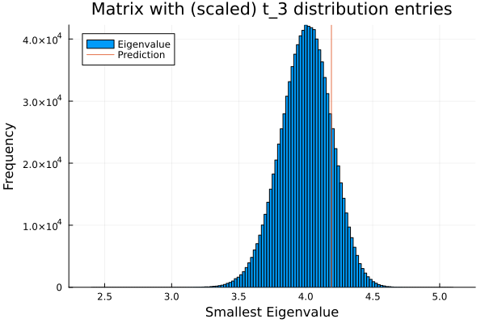
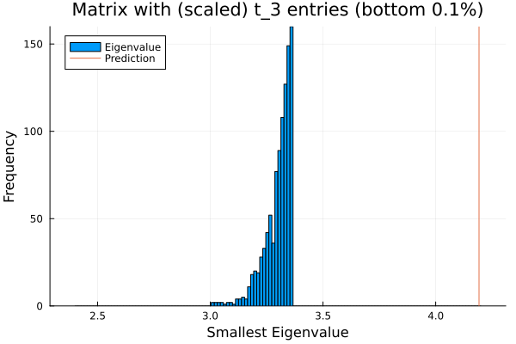
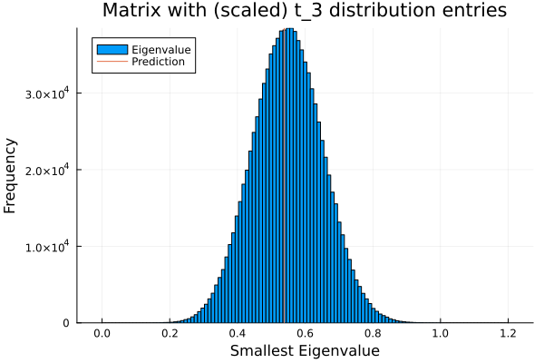
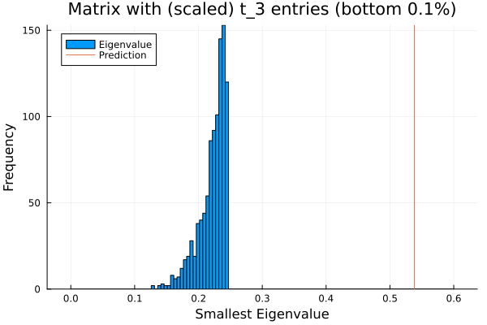
Student t-distribution entries
$$N=200,n=100$$
$$N=110,n=100$$

Slide 16
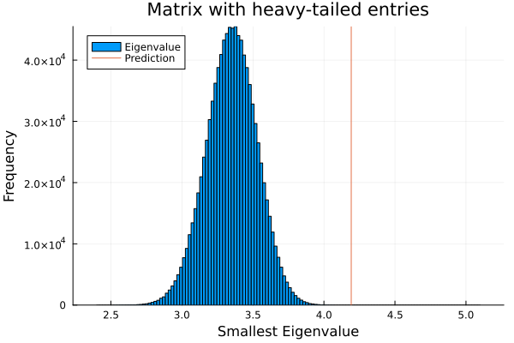
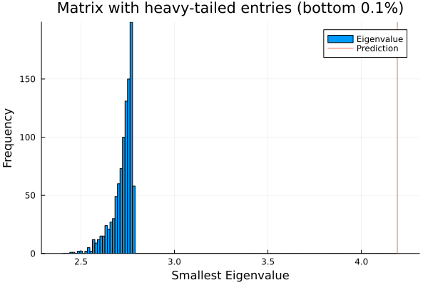
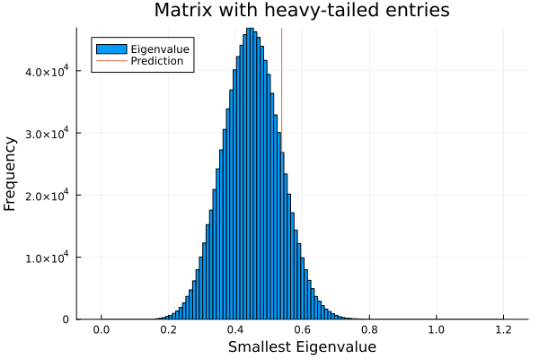
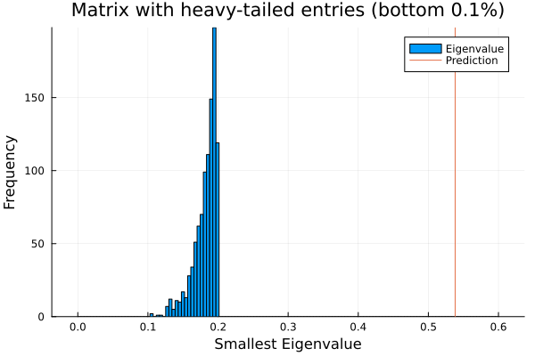
Skew + heavy-tailed entries
$$N=200,n=100$$
$$N=110,n=100$$

Slide 17
Thanks for listening!

