Slide 1
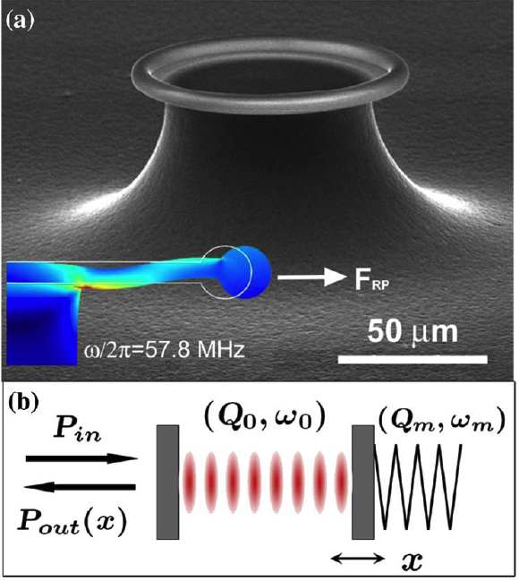
Understanding Resonant Systems
• Option 1: Simulate the whole thing exactly
— many powerful numerical tools
— limited insight into a single system
— can be difficult, especially for
weak effects (nonlinearities, etc.)
• Option 2: Solve each component separately,
couple with explicit perturbative method
(one kind of “coupled-mode” theory)
[ Schliesser et al.,
PRL 97, 243905 (2006) ]
• Option 3: abstract the geometry into its most generic form
…write down the most general possible equations
…constrain by fundamental laws (conservation of energy)
…solve for universal behaviors of a whole class of devices
… characterized via specific parameters from option 2

Slide 2
“Temporal coupled-mode theory”
Generic form developed by Haus, Louisell, & others in 1960s & early 1970s, many variations…
  Haus, Waves & Fields in Optoelectronics (1984)
  Very general description/derivation: Suh, Wang, & Fan (2004)
  Reviewed in our Photonic Crystals: Molding the Flow of Light, 2nd ed., ab-initio.mit.edu/book
Equations are generic ⇒ reappear in many forms in many systems, rederived in many ways (e.g. Breit–Wigner scattering theory)
  full generality is not always apparent
(modern name coined by S. Fan @ Stanford)

Slide 3
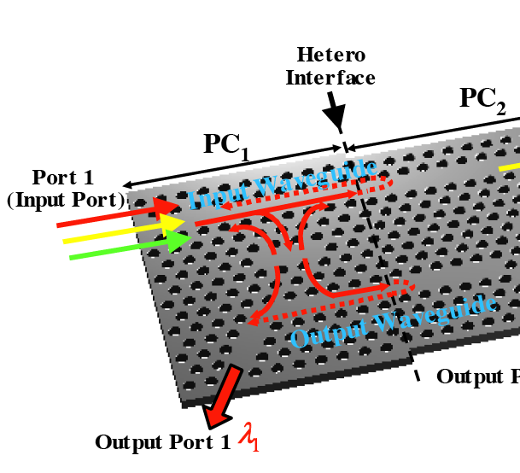
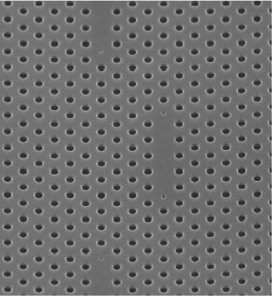
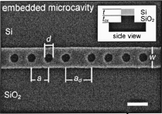
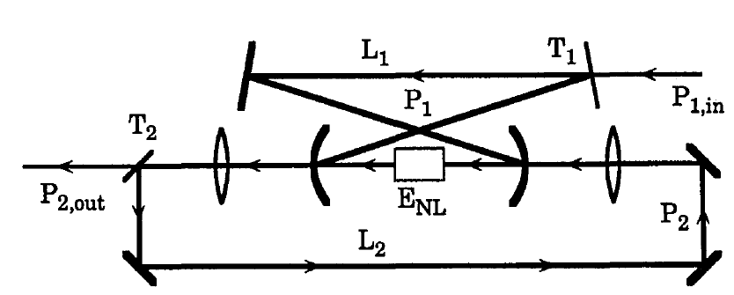
TCMT example: a linear filter
[ C.-W. Wong,
APL 84, 1242 (2004). ]
[ Notomi et al. (2005). ]
[ Takano et al. (2006) ]
= abstractly:
two single-mode i/o ports
+ one resonance
420 nm
port 1
port 2
resonant cavity
frequency ω₀, lifetime τ
[ Ou & Kimble (1993) ]

Slide 4
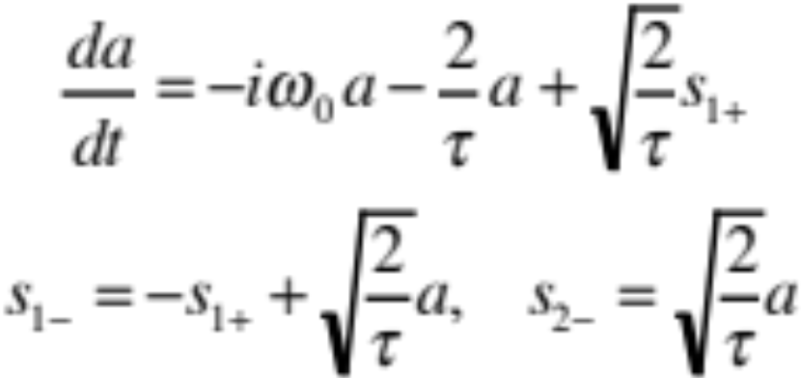
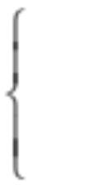
Temporal Coupled-Mode Theory for a linear filter
s₁₊
input
a
output
s_{1–}
s_{2–}
resonant cavity
frequency ω₀, lifetime τ
|s|² = power
|a|² = energy
assumes only:
• exponential decay
(strong confinement)
• linearity
• conservation of energy
• time-reversal symmetry
can be
relaxed

Slide 5
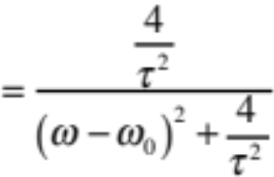
Temporal Coupled-Mode Theory for a linear filter
s₁₊
input
a
output
s_{1–}
s_{2–}
resonant cavity
frequency ω₀, lifetime τ
|s|² = flux
|a|² = energy
1
T = Lorentzian filter
transmission T
= |_x0008_ s_{2–} |² / |_x0008_ s₁₊ |²
ω
ω₀

Slide 6
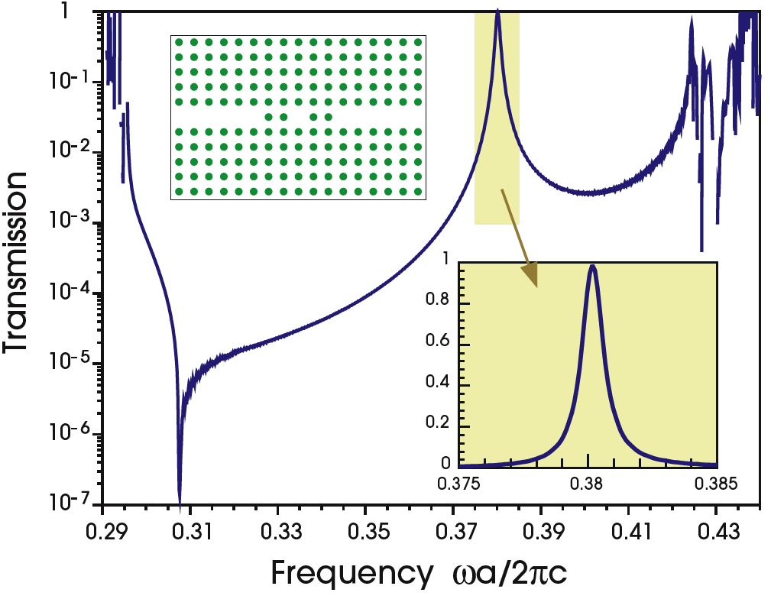
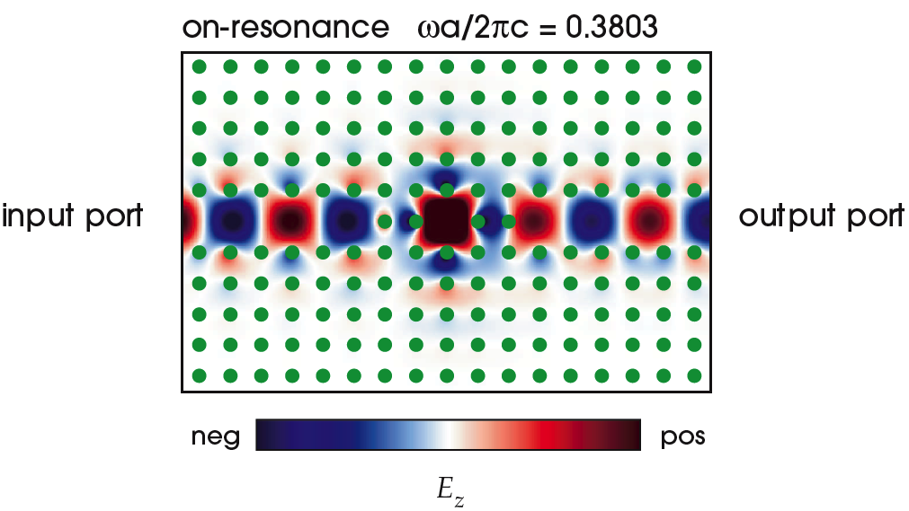
Resonant Filter Example
Lorentzian peak, as predicted.
An apparent miracle:
~ 100% transmission
at the resonant frequency
cavity decays to input/output with equal rates
– At resonance, reflected wave
destructively interferes
with backwards-decay from cavity
& the two exactly cancel.

Slide 7
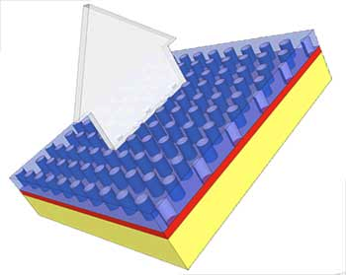
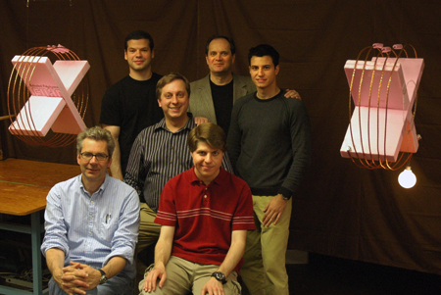
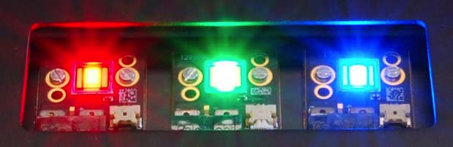
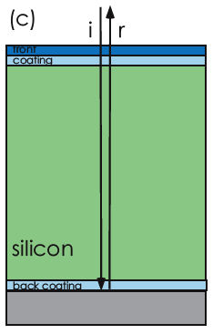
Some interesting resonant transmission processes
input
power
Resonant
LED emission
luminus.com
output
power
~ 40% eff.
(narrow-band)
resonant
absorption in
a thin-film
photovoltaic
Wireless resonant power transfer
[ M. Soljacic, MIT (2007) ]
witricity.com
[ e.g. Ghebrebrhan (2009) ]

Slide 8

Another interesting example: Channel-Drop Filters
waveguide 1
Perfect channel-dropping if:
Two resonant modes with:
• even and odd symmetry
• equal frequency (degenerate)
• equal decay rates
Coupler
waveguide 2
(mirror plane)
[ S. Fan et al., Phys. Rev. Lett. 80, 960 (1998) ]

Slide 9
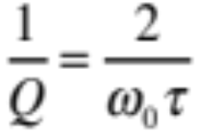
Dimensionless Losses: Q
Q = ω₀τ / 2
quality factor Q = # optical periods for energy to decay by exp(–2π)
energy ~ exp(–ω₀t/Q) = exp(–2t/τ)
in frequency domain: 1/Q = bandwidth
1
T = Lorentzian filter
from temporal
coupled-mode theory:
FWHM
ω
…quality factor Q
ω₀

Slide 10

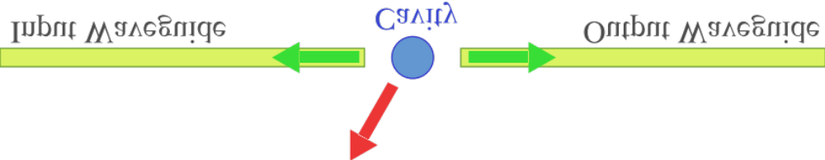

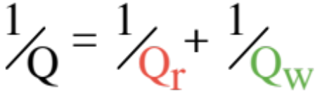
More than one Q…
A simple model device (filters, bends, …):
losses
(radiation/absorption)
We want: Q_{r} >> Q_{w}
TCMT ⇒
Q = lifetime/period
= frequency/bandwidth
1 – transmission ~ 2Q / Q_{r}
worst case: high-Q (narrow-band) cavities

Slide 11
Nonlinearities + Microcavities?
weak effects
∆n < 1%
very intense fields
& sensitive to small changes
A simple idea:
for the same input power, nonlinear effects
are stronger in a microcavity
That’s not all!
nonlinearities + microcavities
= qualitatively new phenomena

Slide 12
Nonlinear Optics
Kerr nonlinearities χ⁽³⁾: (polarization ~ E³)
• Self-Phase Modulation (SPM)
= change in refractive index(ω) ~ |E(ω)|²
• Cross-Phase Modulation (XPM)
= change in refractive index(ω) ~ |E(ω ₂) |²
• Third-Harmonic Generation (THG) & down-conversion (FWM)
= ω → 3ω, and back
• etc…
ω
ω
ω
3ω
ω
ω
ω
Second-order nonlinearities χ⁽²⁾: (polarization ~ E²)
• Second-Harmonic Generation (SHG) & down-conversion
= ω → 2ω, and back
• Difference-Frequency Generation (DFG) = ω₁, ω₂ → ω₁−ω₂
• etc…

Slide 13
Nonlinearities + Microcavities?
weak effects
∆n < 1%
very intense fields
& sensitive to small changes
A simple idea:
for the same input power, nonlinear effects
are stronger in a microcavity
That’s not all!
nonlinearities + microcavities
= qualitatively new phenomena
let’s start with a well-known example from 1970’s…

Slide 14
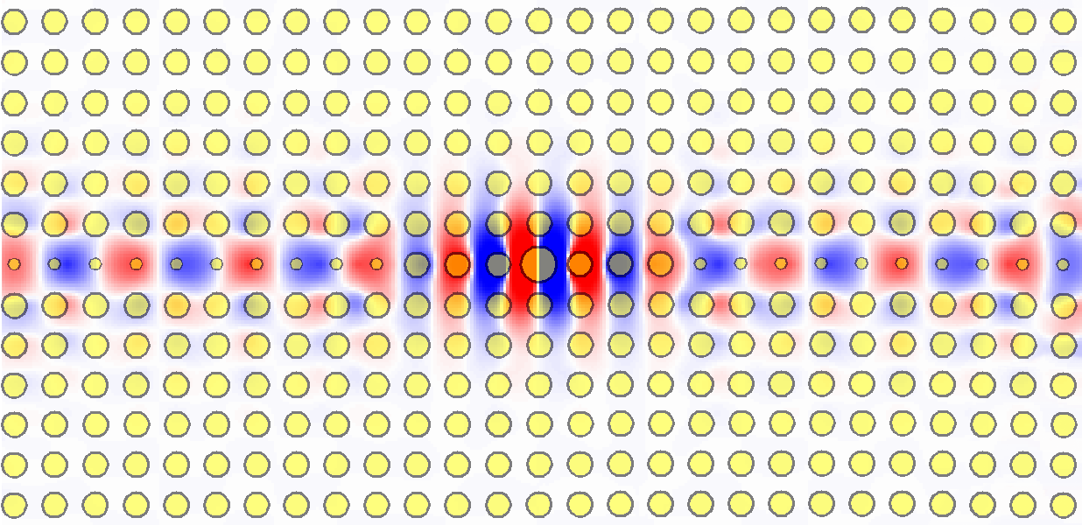
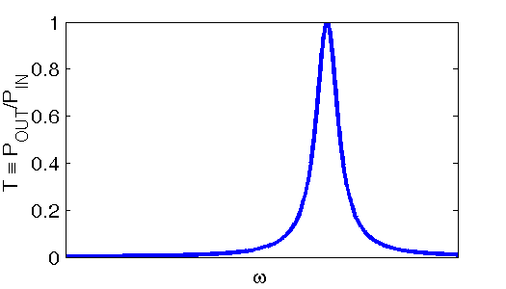
A Simple Linear Filter
in
out
Linear response:
Lorenzian Transmisson

Slide 15
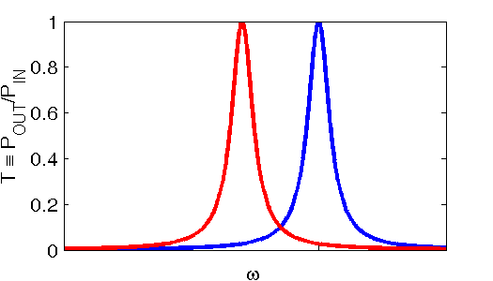
Filter + Kerr Nonlinearity?
in
out
Kerr nonlinearity:
∆n ~ |E|²
Linear response:
Lorenzian Transmisson
shifted peak?
+ nonlinear
index shift
= ω shift

Slide 16
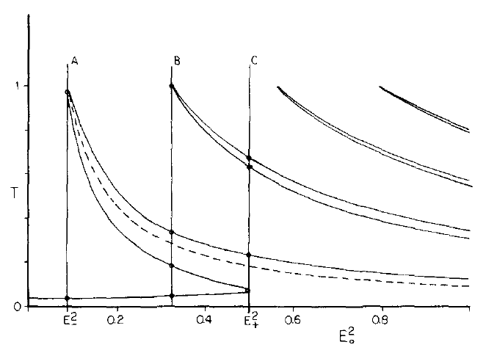
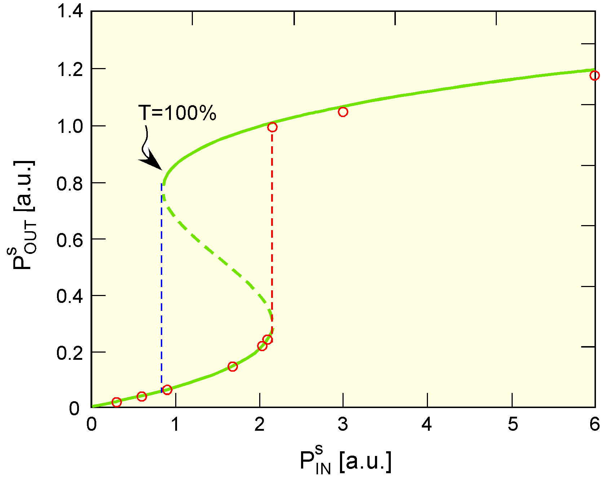
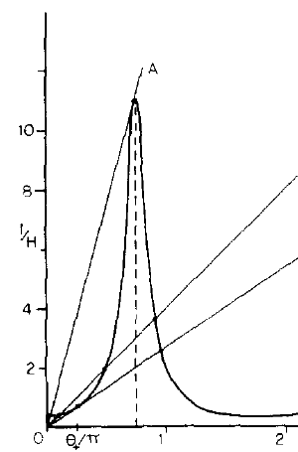
Optical Bistability
[ Felber and Marburger., Appl. Phys. Lett. 28, 731 (1978). ]
Logic gates, switching,
rectifiers, amplifiers,
isolators, …
stable
unstable
[ Soljacic et al.,
PRE Rapid. Comm. 66, 055601 (2002). ]
stable
Bistable (hysteresis) response
(& even multistable for multimode cavity)
Power threshold ~ V/Q²
(in cavity with V ~ (λ/2)³,
for Si and telecom bandwidth
power ~ mW)

Slide 17
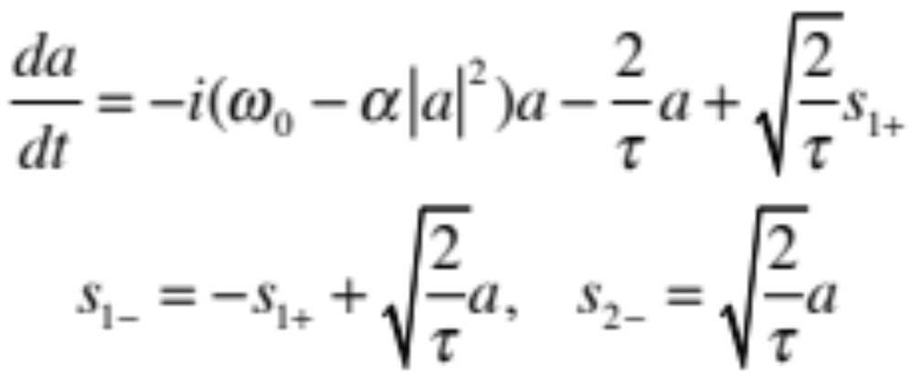
TCMT for Bistability
[ Soljacic et al., PRE Rapid. Comm. 66, 055601 (2002). ]
input
a
output
s₁₊
s_{2–}
resonant cavity
frequency ω₀, lifetime τ,
SPM coefficient α ~ χ⁽³⁾
(from perturbation theory)
|s|² = power
|a|² = energy
gives cubic equation
for transmission
… bistable curve

Slide 18
Accuracy of Coupled-Mode Theory
[ Soljacic et al., PRE Rapid. Comm. 66, 055601 (2002). ]
semi-analytical
numerical

Slide 19
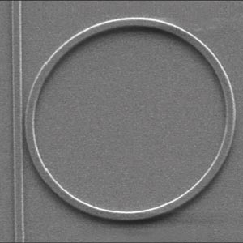
Optical Bistability in Practice
[ Xu & Lipson, 2005 ]
[ Notomi et al. (2005). ]
10µm
420 nm
Q ~ 30,000
V ~ 10 optimum
Power threshold ~ 40 µW
Q ~ 10,000
V ~ 300 optimum
Power threshold ~ 10 mW

Slide 20
THG in Doubly-Resonant Cavities
[ publications from our group: H. Hashemi (2008) & A. Rodriguez (2007) ]
Q₁
cavity
ω₁
ω₃=3ω₁
χ⁽³⁾
input/output channel
Q₃
Not easy to make at micro-scale
— must precisely tune ω₃ / ω₁
— materials must be ok at ω₁ and 3ω₁
But … what if we could do it?
… what are the consequences?
e.g. ring resonator
with proper geometry

Slide 21
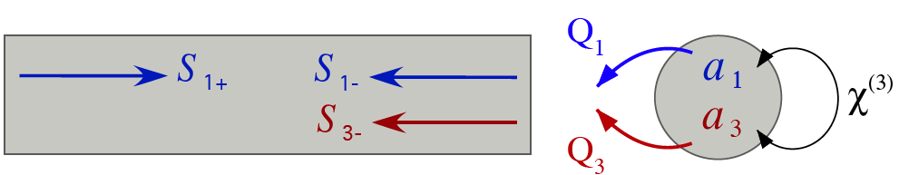
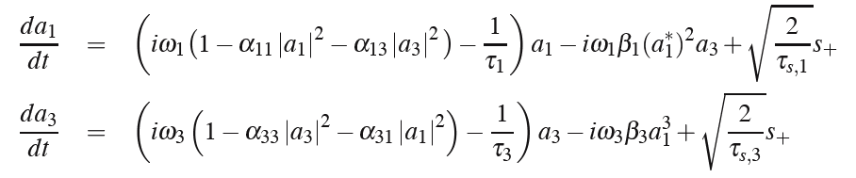
Coupled-mode Theory for THG
third harmonic generation
down-
conversion
SPM
XPM
SPM
XPM
THG
[ Rodriguez et al. (2007) ]

Slide 22
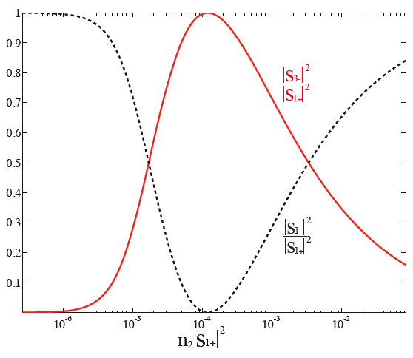
α=0: Critical Power for Efficient THG
third-harmonic generation in doubly-resonant χ⁽³⁾ (Kerr) cavity
THG
P_{crit} ~ V/Q²
~ mW for Si,
telecom bandwidth
& λ-scale cavity
THG conversion efficiency
reflection
at ω₁
[ Rodriguez
et al. (2007) ]
input power P_{in} at ω₁

Slide 23
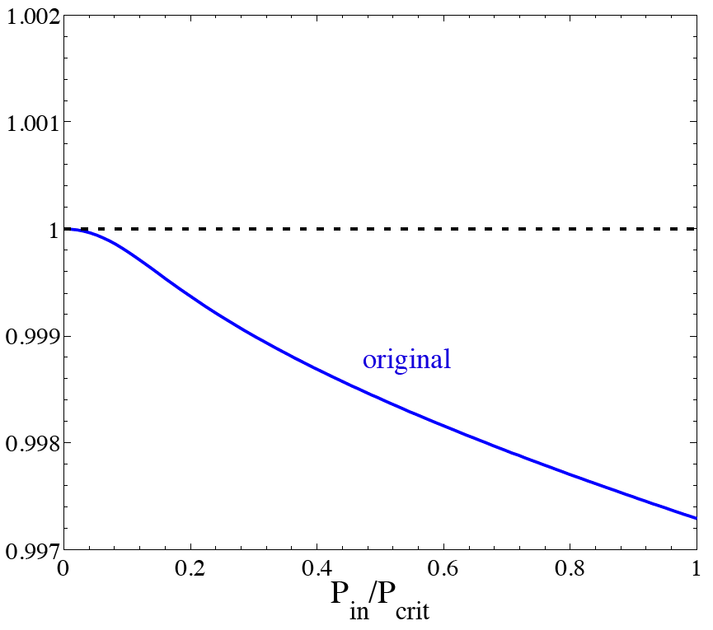
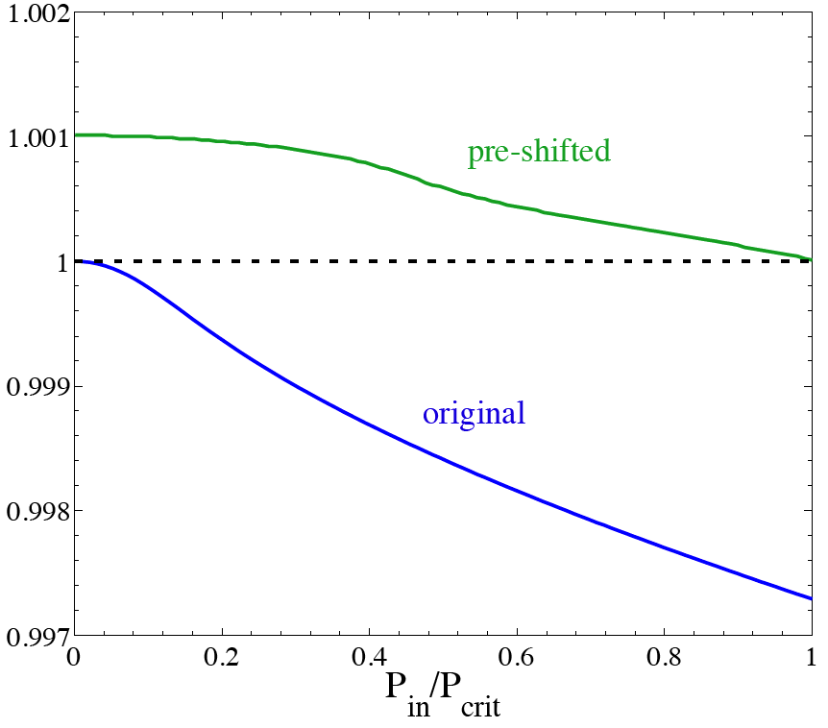
Detuning for Kerr THG
[ Hashemi et al (2008) ]
because of SPM/XPM,
the input power
changes resonant ω
…
compensate by
pre-shifting resonance
so that at P_{in} = P_{crit}
we have ω₃= 3 ω₁
ω_{cav} / ω_{in}

Slide 24
Stability and Dynamics? brief review
Steady state-solution: a₁ oscillating at ω₁, a₃ at ω₃
— rewrite equations in terms of A₁ = a₁ e^{iω1t}
A₃ = a₃ e^{iω3t}
then steady state = A₁, A₃ constant = fixed-point
A₁
stable
unstable
fixed point
fixed point
A₃
cartoon phase space (A₁, A₃ are actually complex)

Slide 25
for simplicity, assume SPM = XPM coefficients: α₁₁ = α₃₃ = α₁₃ = α₃₁ = α

Slide 26
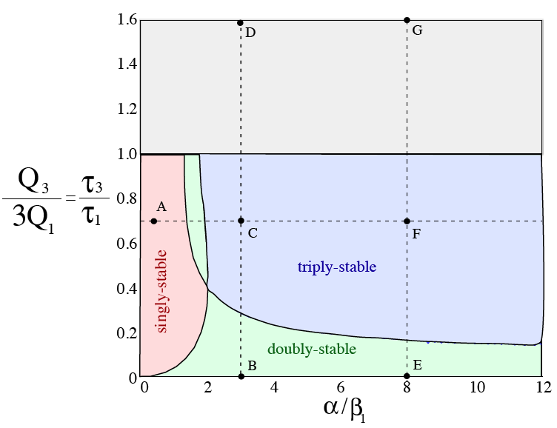
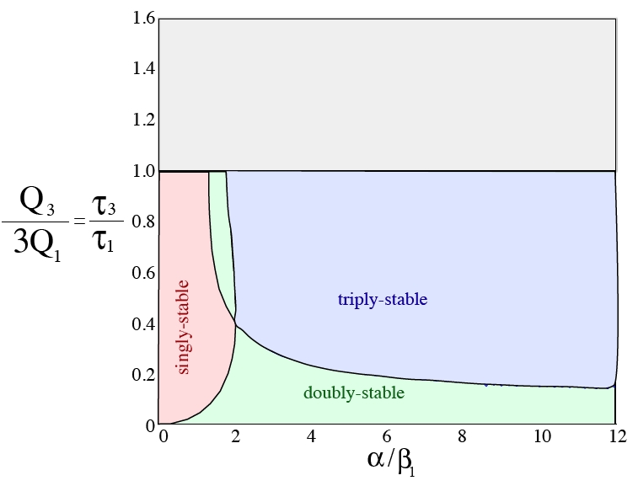
THG Stability Phase Diagram
[ Hashemi et al (2008) ]
unstable 100%-efficiency —
lower-efficiency stable solutions
SPM+XPM / THG

Slide 27
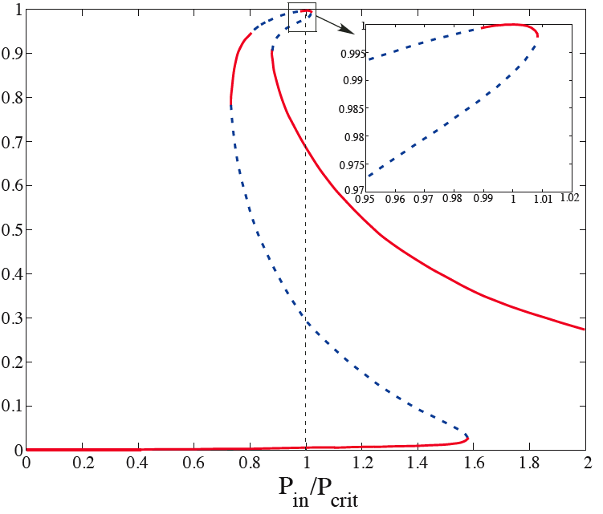
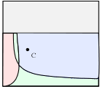
Bifurcation with Input Power
THG efficiency
[ Hashemi et al
(2008) ]

Slide 28
Limit Cycles
Steady state-solution: a₁ oscillating at ω₁, a₃ at ω₃
— rewrite equations in terms of A₁ = a₁ e^{iω1t}
A₃ = a₃ e^{iω3t}
then steady state = A₁, A₃ constant = fixed-point
A₁
unstable
fixed point
stable
fixed point
limit cycle
= stable oscillating solution
A₃
cartoon phase space (A₁, A₃ are actually complex)

Slide 29
Stability Phase Diagram
[ Hashemi et al (2008) ]
unstable 100%-efficiency —
lower-efficiency stable solutions
+ limit cycles

Slide 30
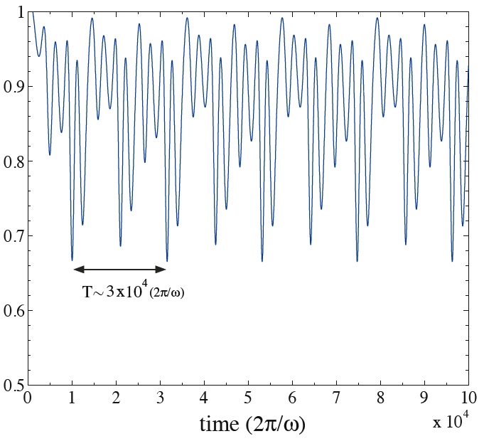
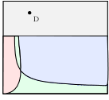
An Optical Kerr-THG Oscillator
[ analogous to self-pulsing in SHG; Drummond (1980) ]
[ Hashemi et al
(2008) ]
THG efficiency

