Slide 1

Red

Slide 2
Talking About:
The Color
What it Represents
How it Effects us
Variations

Slide 3

Red
1 of 3 Primary Colors
Powerful Color
Grabs attention
Pulse
Basic

Slide 4
Red
Positive:
Love
Energy
Strength
Physical Courage
Excitement
Negative:
Anger
Defiance
Aggression
Danger

Slide 5
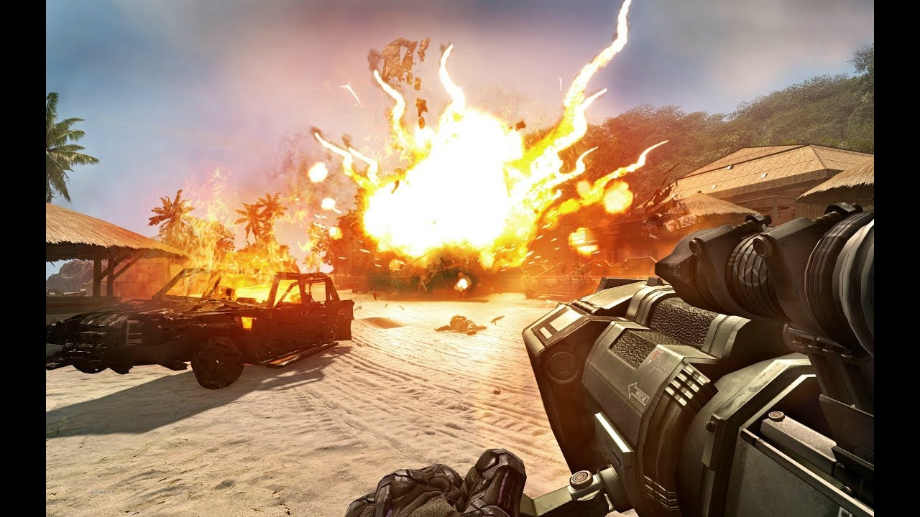
What it Represents
Energy:
Boosts physical energy levels, increase heart rate and blood pressure
Action:
Fast moving and promotes a need for quick action and movement

Slide 6
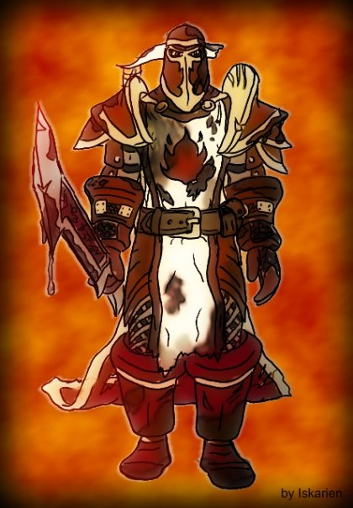
What it Represents
Desire:
Relates to the physical desire in all forms (Sexual, Lust)
Passion:
Relates to a passionate belief in an issue or situation. Can be love-hate or anger.

Slide 7
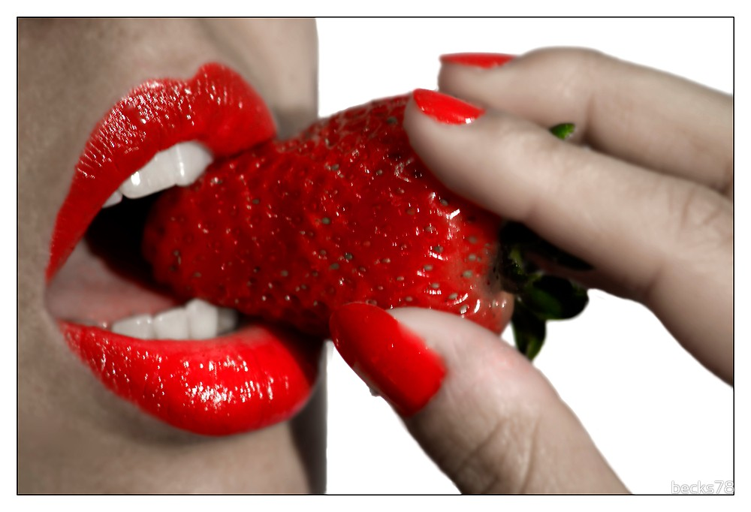
How it Effects us
Stimulating:
In a physical sense, it can be sexual or physical appetite. Red stimulates our deepest passions. Some can be courage, love, hatred, revenge ….

Slide 8
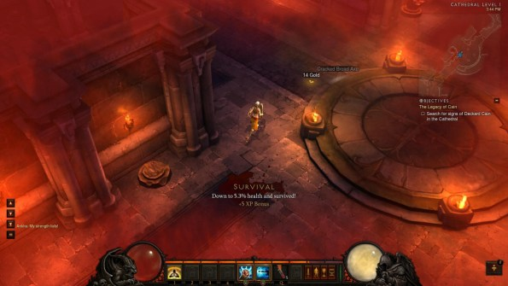
How it effects us
Exciting and Motivating:
Excites us in our very emotions, inspires a call to action
Attention-Getting:
Forces us to take notice, alerting of danger. Universal color of danger

Slide 9
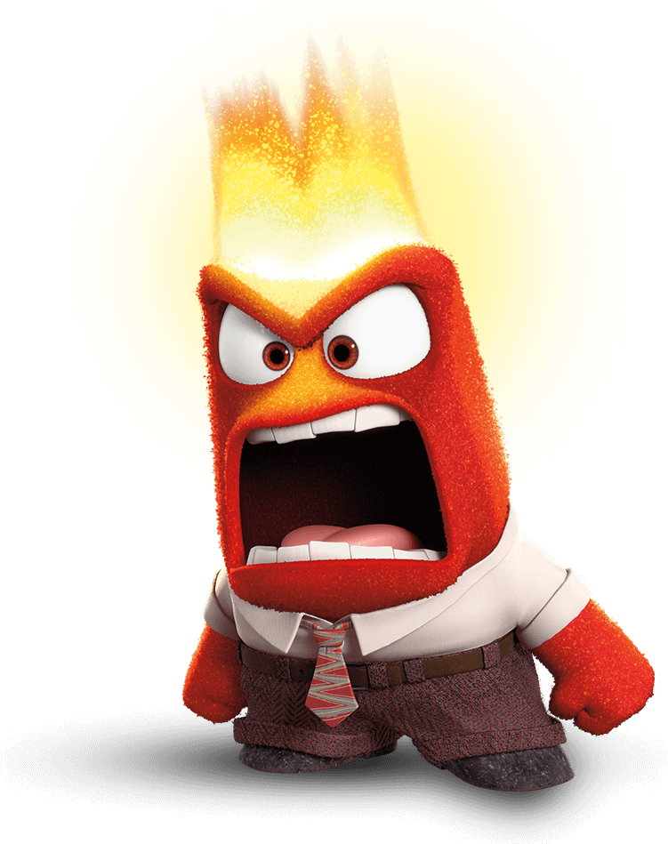
How it Effects us
Assertive and Aggressive:
When a lot of red is introduced, such as car color, it has a way of making individuals more aggressive and prone to hostile behavior.

Slide 10


Variations
Maroon:
Dark Bluish Red, references control and more thoughtful action
Scarlet:
Little mix of Orange. Enthusiastic and optimistic.

Slide 11


Variations
Crimson:
Little Blue, Determined to success without upsetting anyone. More sensuality than sexuality
Burgundy:
Dark Purplish Red, more sophisticated and serious. Control and power, determined ambition.

