Slide 1
Vitis High Level Synthesis (HLS)
Eng. Amr Alaa
Eng. Mamdouh Ellamei Prof. Mohamed Abd El-Ghany

Slide 2
Why HLS?
Vitis HLS allows the user to easily create complex FPGA-based algorithms using C/C++ code.
It supports complex data types (floating-points, fixed-points,…) and math functions (sine, arctan, sqrt,…).
It also supports AXI4-Stream to easily exchange data with other IPs.

Slide 3
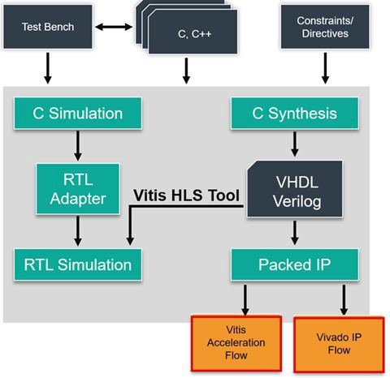
Vitis HLS Development Flow
Architect the algorithm based on the Design Principles
(C-Simulation) Verify the C/C++ Code with the C/C++ testbench
(C-Synthesis) Generate the RTL using HLS
(Co-Simulation) Verify the kernel generated with C++ outputs
(Analyze) Review the HLS synthesis reports and co-simulation reports, analyze
Re-run previous steps until performance goals are met.

Slide 4
Port protocol (Interface Synthesis)
ap_none: No protocol. The interface is a data port.
ap_stable:No protocol. The interface is a data port. Vivado HLS assumes the data port is always stable after reset, which allows internal optimizations to remove unnecessary registers.
ap_ovld: Implements the output data port with an associated reading or writing.
valid
port to indicate when the data is valid for
IMPORTANT!: Vivado HLS implements the input argument or the input half of any read/write arguments with mode ap_none.
ap_vld: Implements the data port with an associated writing.
valid
port to indicate when the data is valid for reading or
ap_ack: Implements the data port with an associated was read or written.
acknowledge
port to acknowledge that the data
ap_hs: Implements the data port with associated
valid
and
acknowledge
ports to provide a two-way
handshake to indicate when the data is valid for reading and writing and to acknowledge that the data
was read or written.

Slide 5
ap_none
void example(char x){
Example function block
#pragma HLS interface ap_none port=x;
X (8:0)
}

Slide 6
ap_vld
void example(char x){
X_o (8:0)
#pragma HLS interface ap_vld port=x;
Example function block
 | X_o_ap_vld
}
X_i (8:0)
X_i_ap_vld

Slide 7
ap_hs
void example(char x){
Example function block
#pragma HLS interface ap_hs port=x;
X_i (8:0)
}
X_ap_ack
X_ap_vld

Slide 8
Port protocol (Cont’d)
ap_bus
ap_fifo
ap_memory
axis
m_axi
s_axilite

Slide 9
Function block protocol (Interface Synthesis)
ap_ctrl_none: no control signals for function (Combinational logic) For Sequential Logic and Pipelined logic:
ap_ctrl_hs:
ap_ctrl_chain:

Slide 10
ap_ctrl_hs
ap_done
Used with Vivado IP to concatenate multiple blocks.
ap_start
Example function block
 | ap_ready
ap_done: When the design has completed operation.
ap_idle: Indicates if the design is idle.
ap_idle
ap_ready: When the block is ready to accept new inputs.
ap_start: when the block can start processing data.

Slide 11
Datatypes
ap_uint<N>: ap_uint allows the use of arbitrary number of bits (N) for an integer variable.
ap_int<N>: This is the signed version of ap_uint. It represents arbitrary precision signed integers.
ap_fixed: This is a data type for fixed-point arithmetic. It allows you to specify the total number of bits as well as the number of integer bits.
float: If you need to represent real numbers, you can use the float data type. However, keep in mind that floating-point arithmetic can be more resource-intensive than integer or fixed-point arithmetic.
Structures: You can define your own data types using structures. For example, you could create a structure that contains multiple ap_uint fields.
Arrays: If you need to work with multiple ap_uint values at once, you can use an array

Slide 12
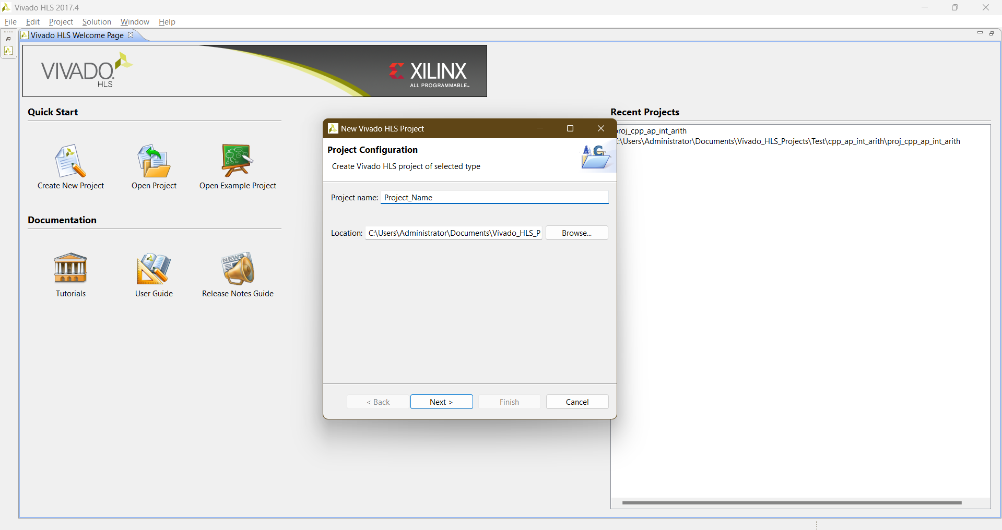
Creating a new project

Slide 13


Slide 14
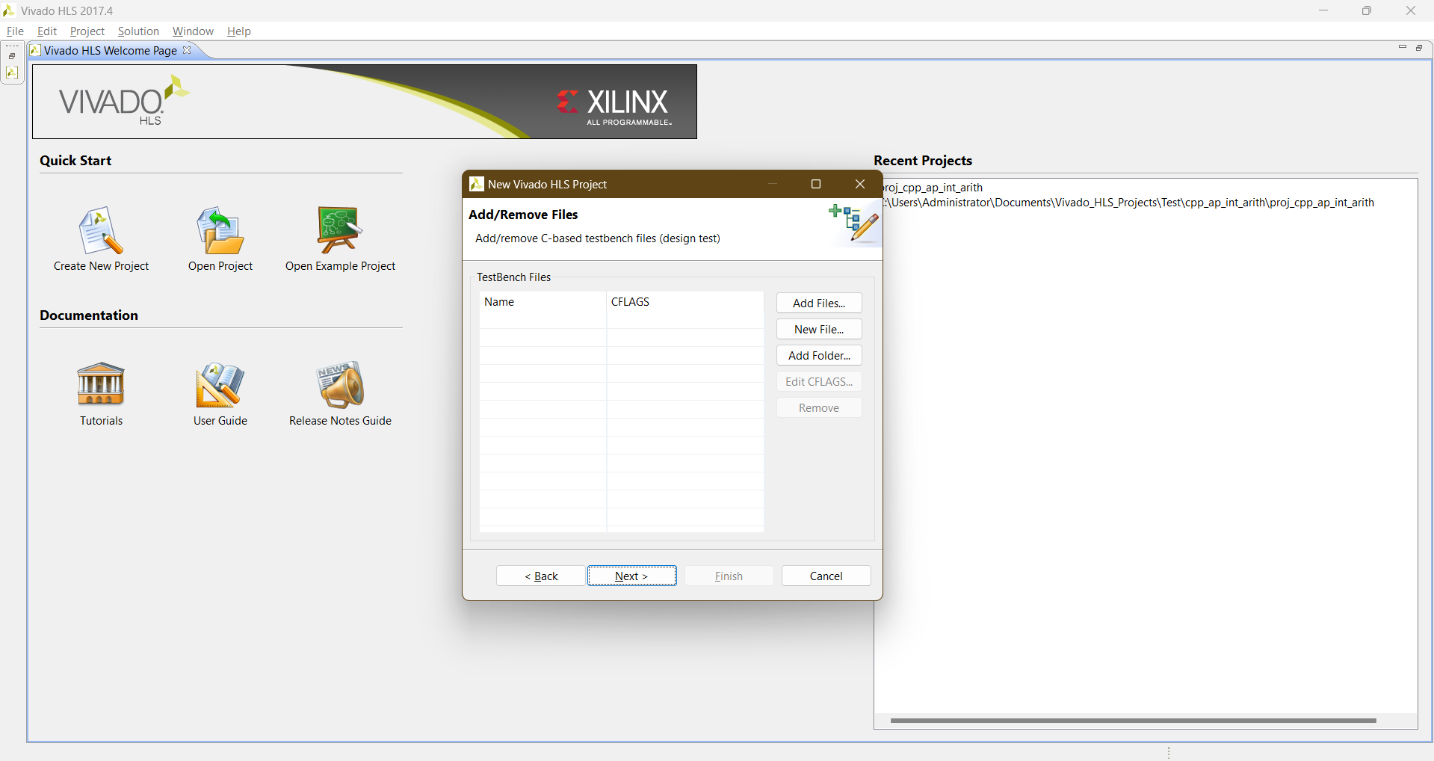

Slide 15
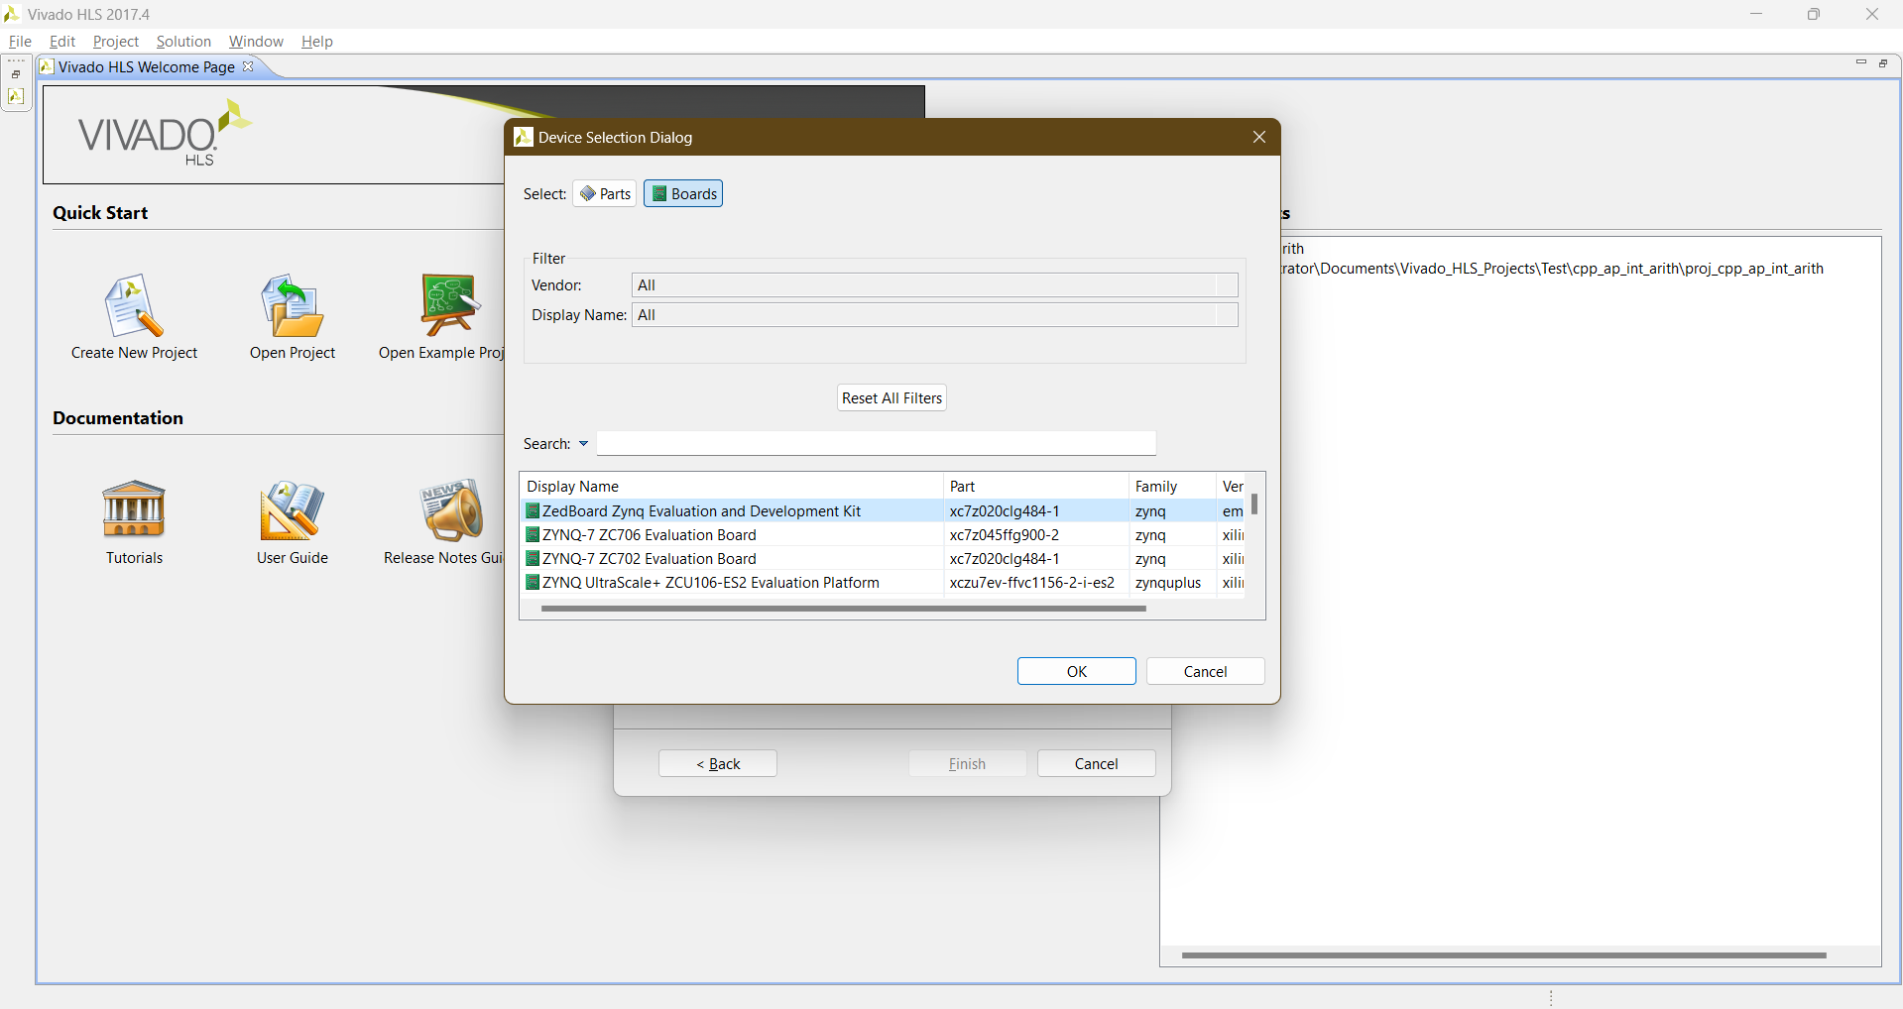

Slide 16
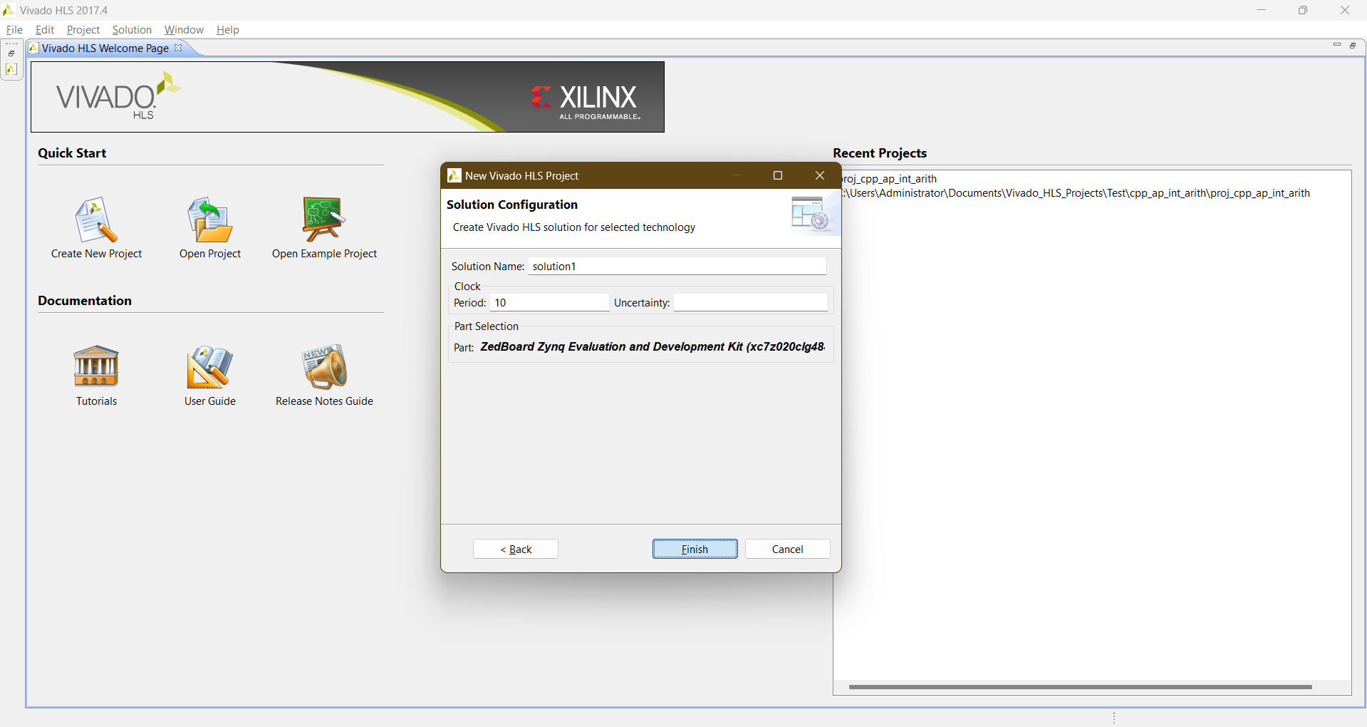

Slide 17
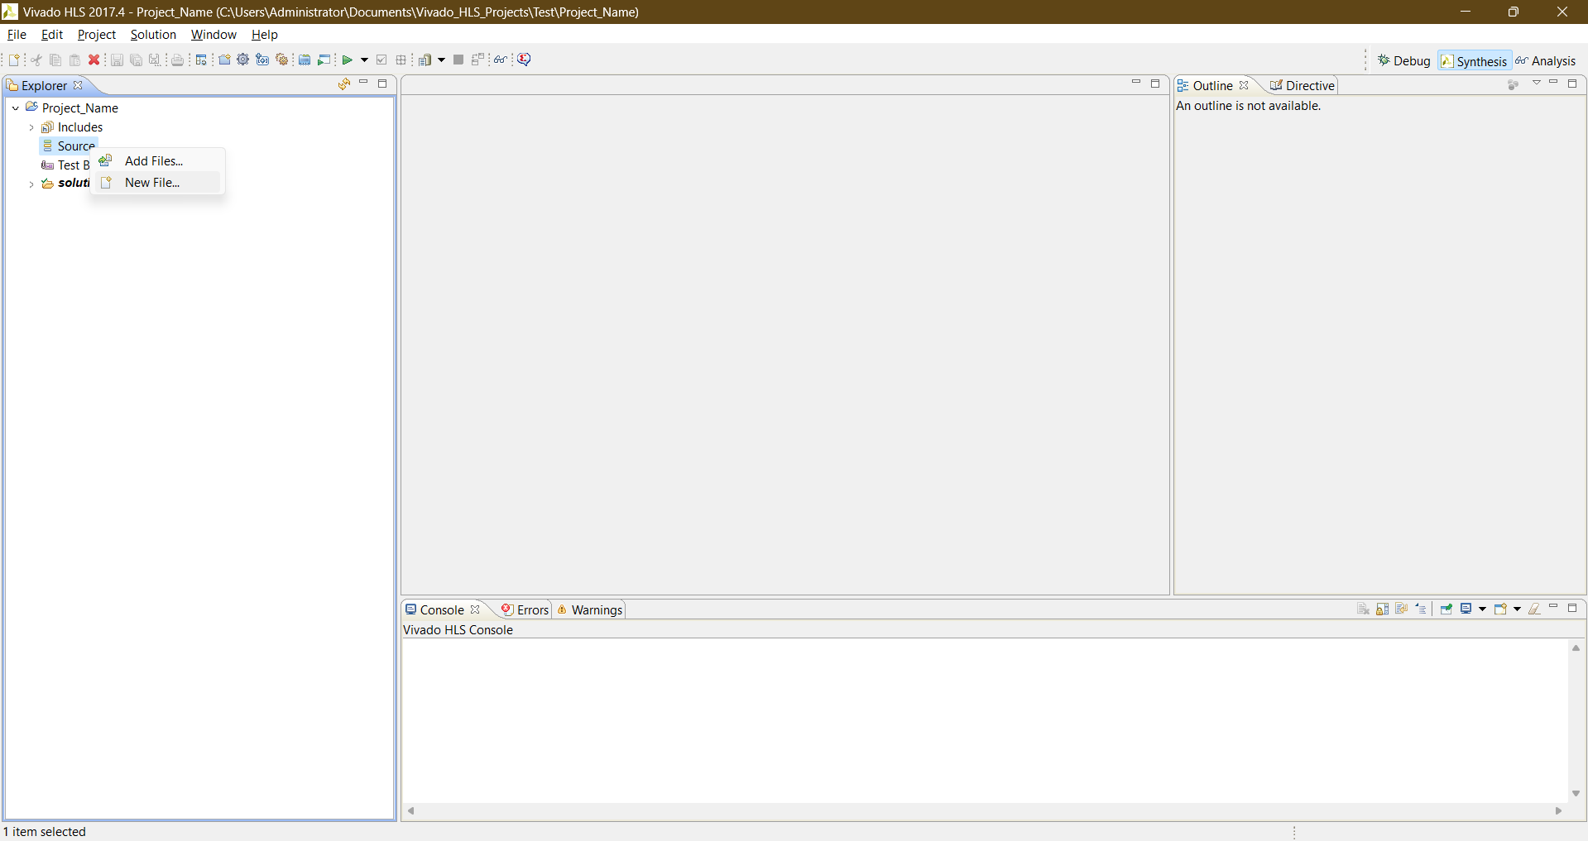

Slide 18
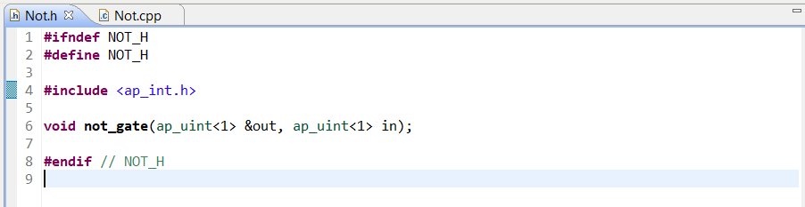
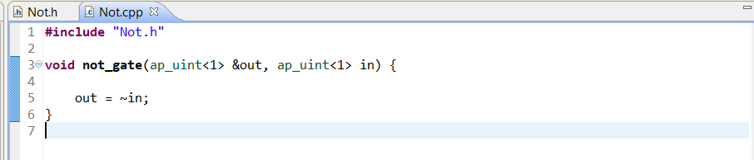

Slide 19
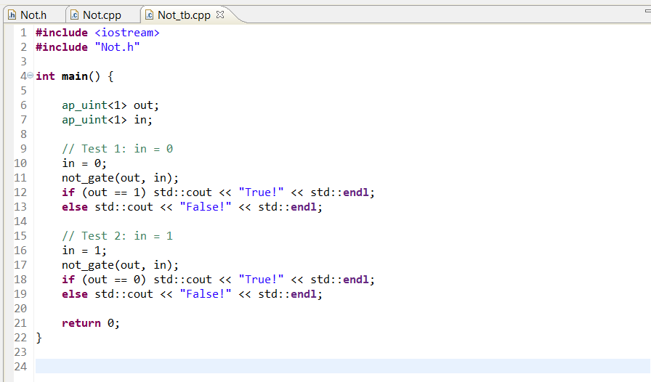
How to write a test bench

Slide 20
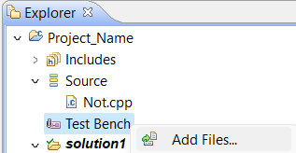
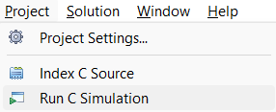
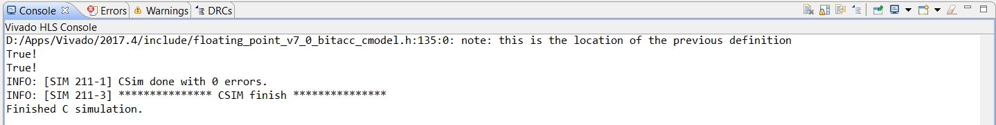
How to run a test bench

Slide 21

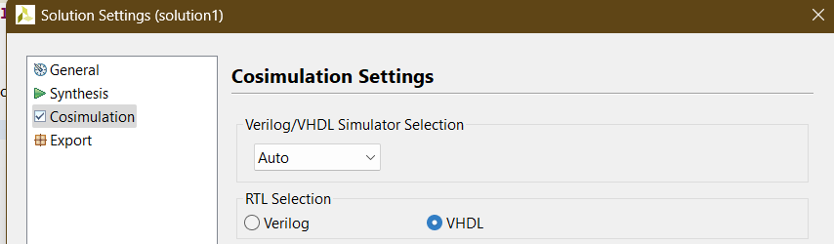
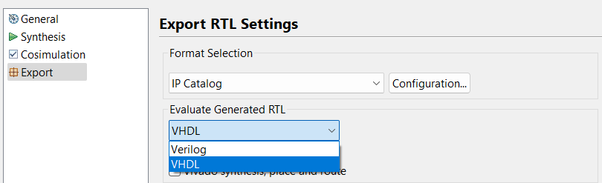

Slide 22

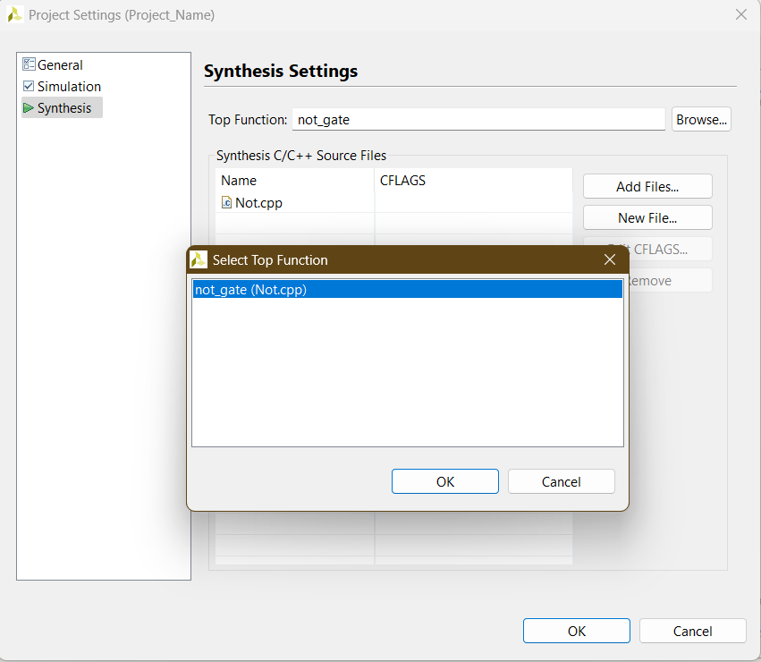


Slide 23
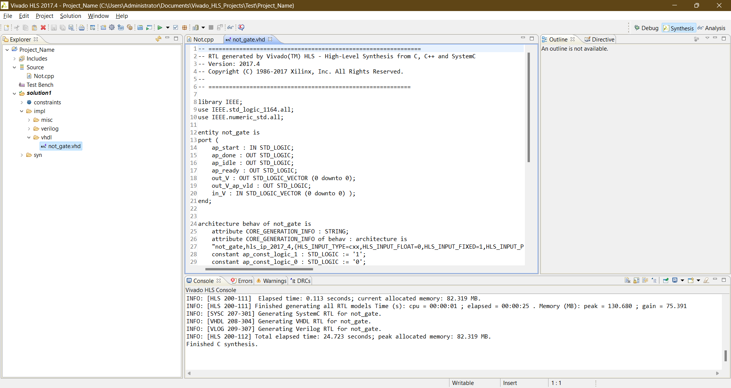

Slide 24
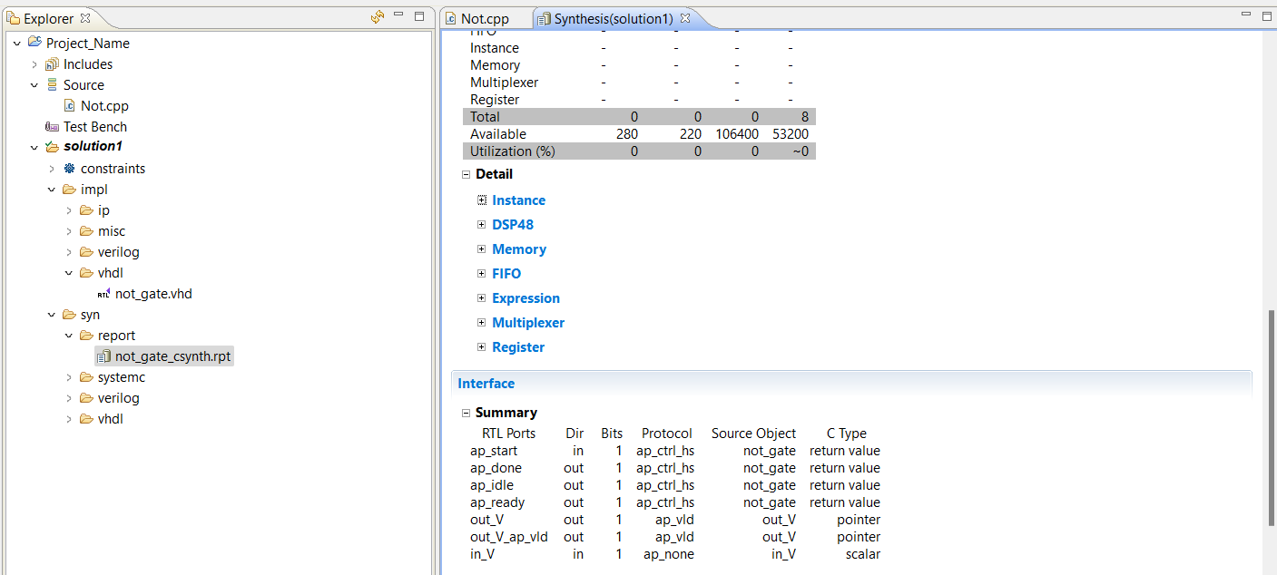
Synthesis Report

Slide 25
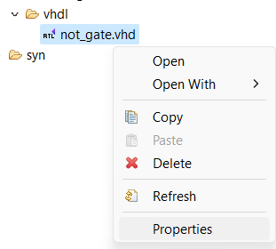
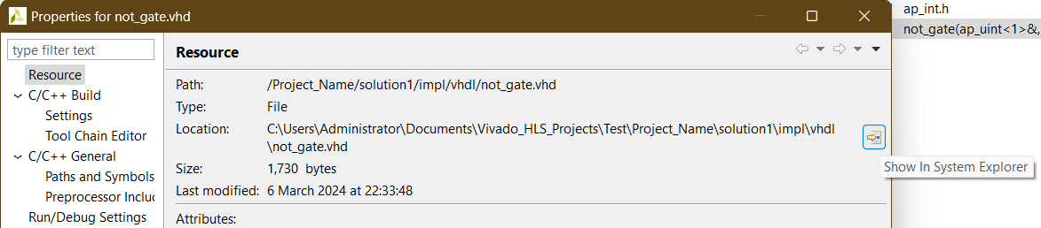
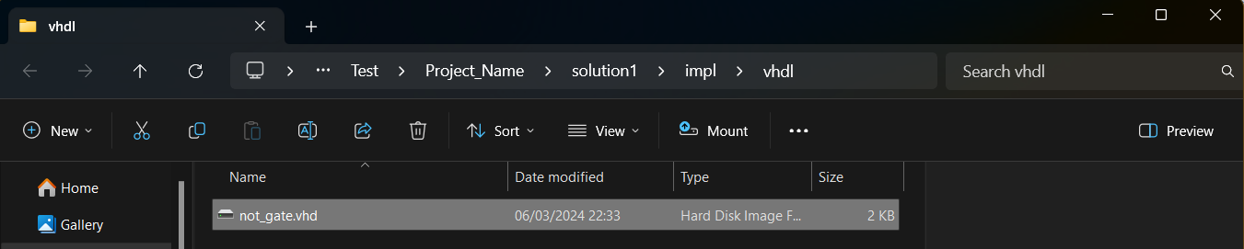
Add the .vhd file to your existing project in Vivado:

Slide 26
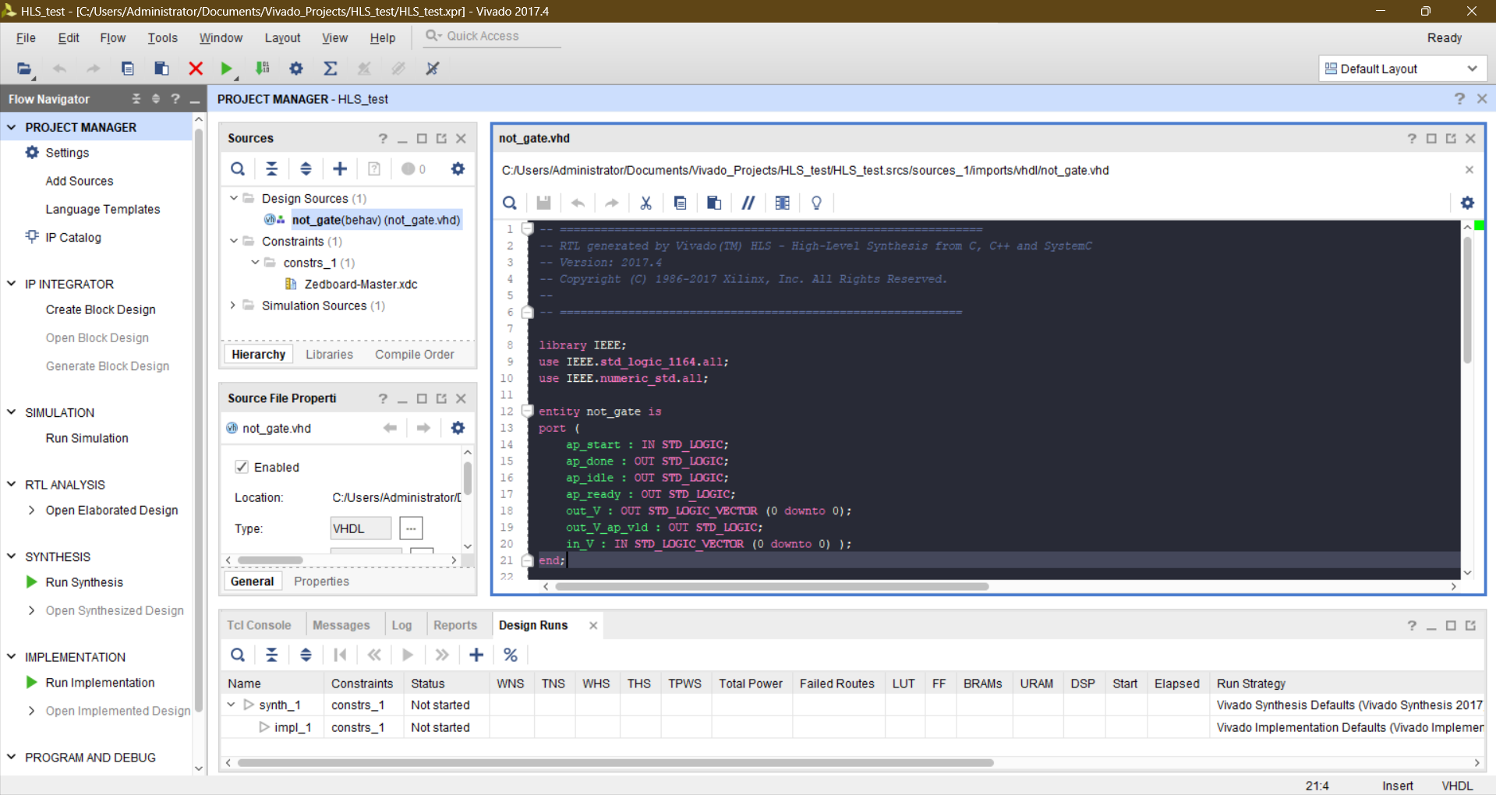

Slide 27
Task
Design a 4-bit adder, multiplier, & divider in C++, then use HLS to synthesize into RTL.

