Slide 1
Winter Clothing
by Ana Jaklenec + Pat Allen
January 5, 2010
MITOC Winter School 2010

Slide 2
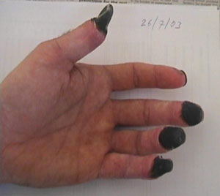
Why Is Clothing an Issue?
Lopped off fingers are relatively minor on the spectrum of quality-of-life reducing deformities
You TOO can get some, right here in the Northeast!

Slide 3
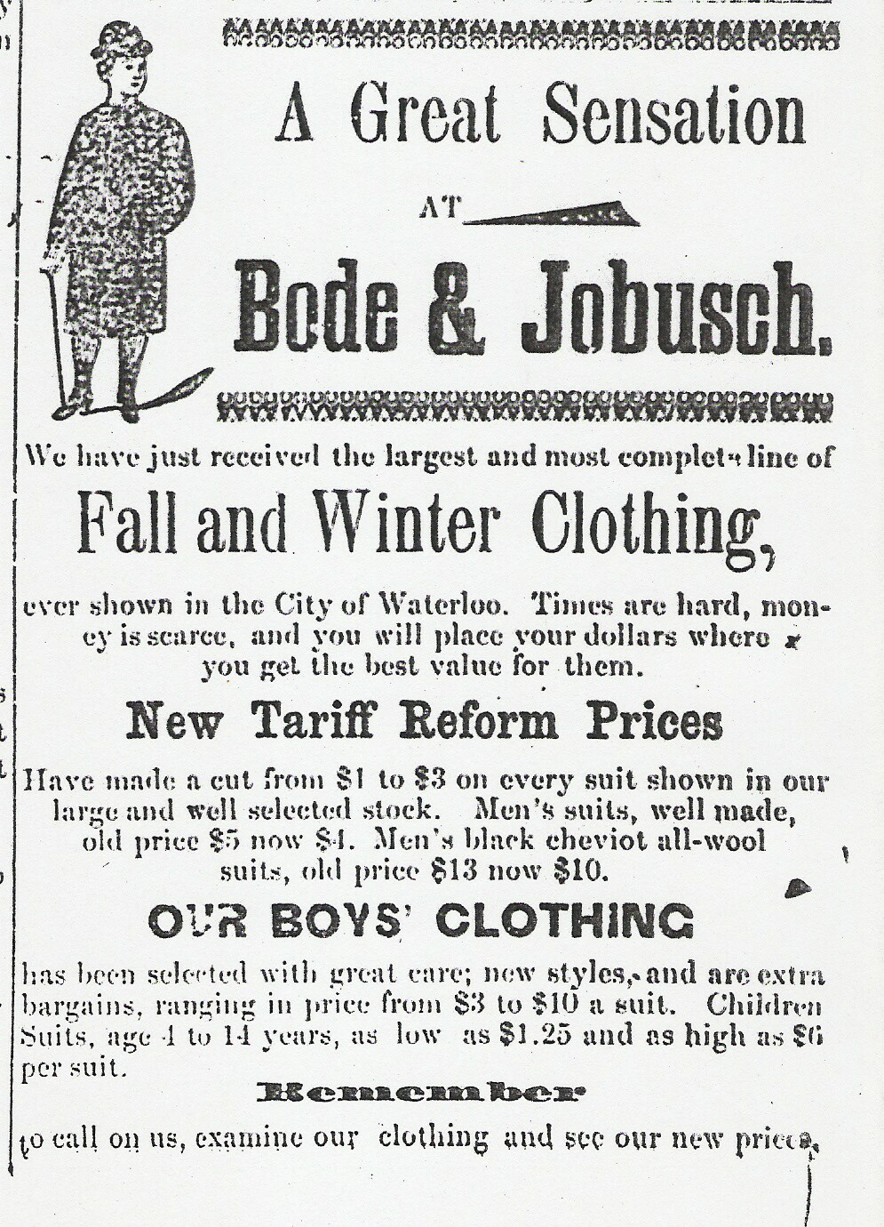
Why clothing is tricky
Weather conditions will change throughout the day
  Temperature
  Precipitation
  Wind
Your activity level will change throughout the day
  Moving Hard
  Moving Easy
  Resting
  Sleeping

Slide 4
Your Clothing Must…
Keep trapped warm air next to you
Protect you from wind and precipitation
Keep you as dry as possible (wicking)
Be a flexible layering system
Keep you warm even when wet

Slide 5
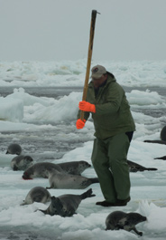
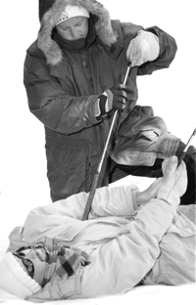
Cotton Kills
Absorbs water like a sponge
Water is slow to evaporate
Fibers shrink when wet; ability to trap air and thus insulate is lost
Poor wind protection

Slide 6
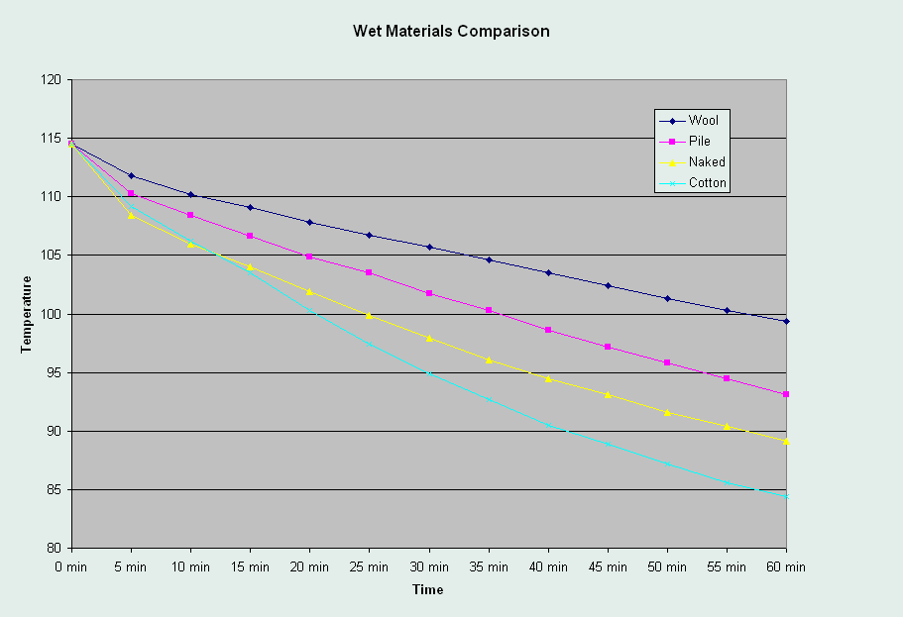
Cotton Kills (Part II)
Wet Materials Comparison
wool
fleece
naked
cotton
Steve Howard, LANL

Slide 7
Clothing must be Versatile!
Dress like an onion
YOU
Wicking
Layer
Warm
Insulating
Layer
Shell
Layer
Cold

Slide 8
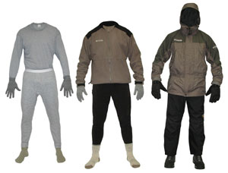
Shell Layer: Wind and/or Water Barrier
Components
Goggles
Jacket
Gloves/Mittens
Pants/Bibs
Gaiters
Boots
Materials
Nylon (Wind)
Coated nylon (Water)
Gore-Tex and related fabrics

Slide 9
Insulating Layer: Think volume
Components
Hat + Balaclava
Jacket or Sweater
Gloves/Mittens
Pants
Socks
Materials
Fleece
  light, water resistant, medium bulk
Wool
  bulky, scratchy, water resistant, heavy
Down
  light, compressible, NOT water-resistant
Synthetic Fill

Slide 10
Wicking Layer: Moves moisture away from skin
Components
T-Shirt
Liner Gloves
Pants/Tights
Liner Socks
Materials
Silk
Polypropylene (Cool-Max, Capilene)
Polyester
Spandex, Lycra
more expensive = less smelly...

Slide 11
Effectively Using your Clothing
Maintain warm skin temperature
  Remove layers if sweating!
  Add layers if freezing!
Anticipate condition changes
  Add layers before a windy section
  Remove layers before going up a hill
Use zippers and vents to create intermediate levels of warmth
Bring extra insulating layers in case!

Slide 12
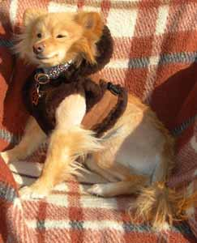
$$$$$
MITOC doesn’t rent clothing
Get items that fit well and will last
MITOC webpage has links for finding gear on a budget
More on this later in the Cheap Gear presentation

Slide 13
Credits
Previous revisions from Polly Anikeeva, Dan Walker, Paulina Varshavskaya, Luke Sosnowsky.

Slide 14
?

