Slide 1

Basic Non-Clothing Gear
Patrick Allen
MITOC Winter School 2009
From previous slides by Rob Jagnow, Mike Whitson, et al.

Slide 2
Gear Gear Gear…
Day trip essentials
    (overnight gear to be covered later)
Group gear
Fancy things to put on your wish list
Electronics and batteries in the winter
But first…discussion of a popular buzzword

Slide 3
Fast and Light?
In winter: a smaller margin of error than summer
On Winter School group trips, we will be conservative, which means:
Heavy and Slow… but Safe!
Save weight with lightweight (but winter-proof) clothing and gear, but don’t leave things out.
  Some alpinists may decide to take risks and not carry essential items to save weight and travel faster - we will not be doing this.
What and how much gear to take depends on the trip
  difficulty of terrain, remoteness, conditions...

Slide 4
The “10” backcountry essentials
0. Attitude and knowledge!
Food
Water
Clothing
Shelter
Fire
Light
Navigation
Signaling
Tools
First Aid
And now, the lightning tour…

Slide 5
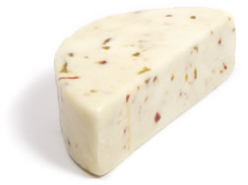
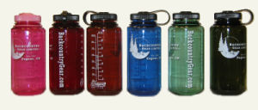
Food and Water
Extra food
  plan for more than you’ll need
  leave the diet at home!
Water - at least 2 liters
  In winter, a wide mouth Nalgene is vastly preferable
    Can pour in boiling liquids
    Carry upside down, in insulator (or extra sock)
    CamelBak hoses will freeze.
cheese = safety equipment

Slide 6
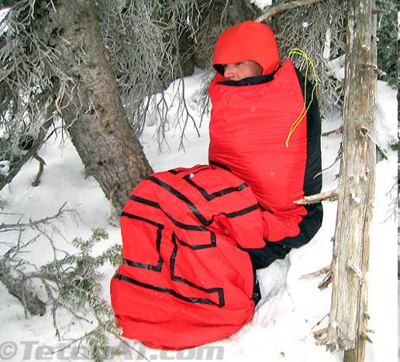
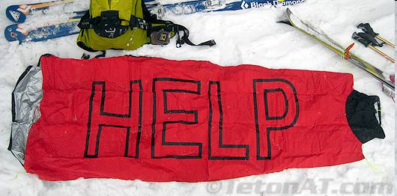
Clothing and Shelter
Bottom line: pack to survive a night out
  Warm insulating clothes, even if you’ll be exercising all day—what if you get hurt?
Emergency shelter, even for day trips
  Mostly included in group gear, but consider space blanket or even spare garbage bags as light and useful

Slide 7
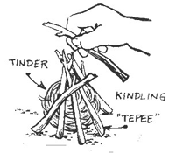
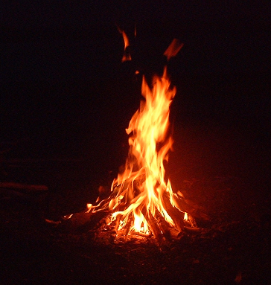
Fire
Fire starter
  Vaseline cotton balls + magnesium block, flint sparker…everything fits in a film canister!
Weatherproof matches
  Butane lighters are convenient, but need to be kept dry, and are poor in super cold
www.thecookinginn.com
www.alaskancampfire.com

Slide 8
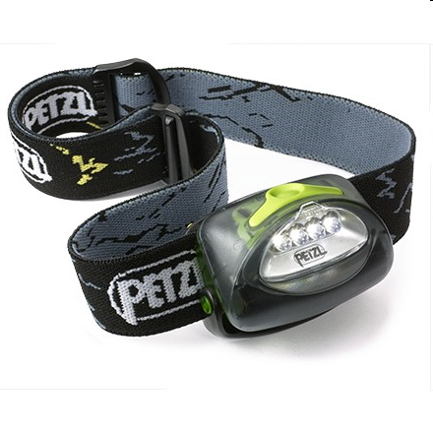
Light
Flashlights—impractical for hiking;
Headlamps are your friend!
LED: very long-lasting (2 AA = ~80 hours)
  Cost $10-$30; $18 for good quality with a power regulator from MITOC)
  write your name on it!

Slide 9
Navigation
Map
  each person carries one in a waterproof bag. This is provided for you, or you’re told where to print it from.
  water-resistant WMNF maps available from MITOC
  Other resources: www.topozone.com,
  www.terraserver-usa.com
Compass
  $10 compass is plenty
GPS? We’ll discuss this.
Knowledge of how to use these tools!

Slide 10
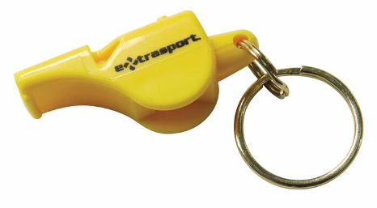
Signaling
Whistle (plastic! Get from MITOC)
  wear in a visible and accessible place
  3 blasts = SOS
Signal mirrors can be cheap and useful.
  3 flashes = SOS
  good for shaving, too
Cell phones, radios, etc.
  Can be carried, and can be very useful, but should not be relied on. Make sure you can work with a low-tech backup!

Slide 11
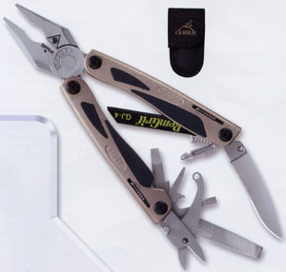
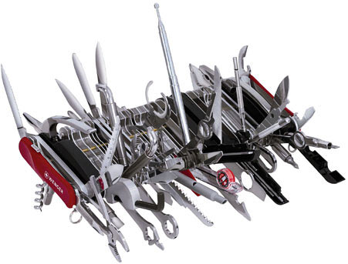
Tools
(and personal gear)
Knife (smaller, folding)
  $10 Target is okay
  Swiss Army, Leatherman / Gerber is awesome
Toilet paper, hand sanitizer
Sunglasses and sunscreen

Slide 12
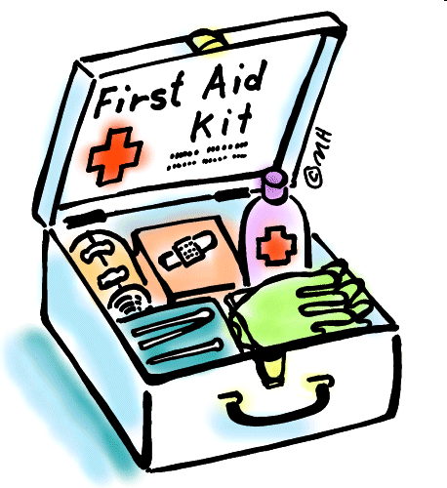
First Aid
All trips will carry a MITOC first aid kit.
You might also consider:
Vitamin “I” – Ibuprofen (Advil, etc.)
Personal meds (consider what happens when frozen!)
Blister treatment
If you have any relevant medical conditions, make sure your trip leaders know!

Slide 13
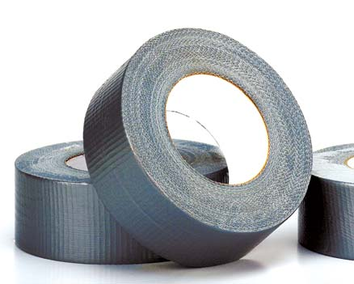
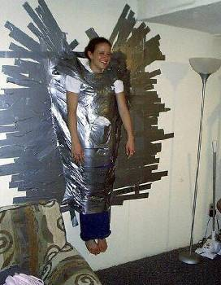
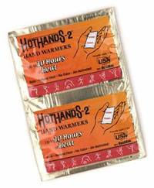
Handy Nonessentials
Duct Tape!
  Handy, wrap around water bottle or hiking poles
Spare straps, parachute cord (MITOC sells!)
Cell phones or 2-way radios (nice, but don’t rely)
Iodine, other water treatment
Chemical handwarmers
Thermometer

Slide 14
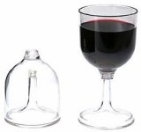

More Handy Nonessentials
Hiking poles with snow baskets (telescopic)
  FlickLocks (cam-action) better than twist locks
  Black Diamond Traverse is good value
GPS (don’t depend on it alone!)
Binoculars
Camera
Altimeter / heart rate monitor
Lexan margarita glasses with little umbrellas

Slide 15
If you bring a cell phone…
Carry it close to your body
Carry an ear piece
  If it’s very cold, a charged cell phone will last ~30 seconds if used next to the ear
  Ear piece allows you to keep phone (and hands!) warm
  May also allow you to hear better

Slide 16
MITOC Requirements
MITOC requires all WS participants to carry the following specific items on all trips:
  Map (photocopy provided by leader is sufficient)
  Compass
  Whistle
  Headlamp
However, if these are the only things you bring, we will laugh… and leave you in Boston.

Slide 17
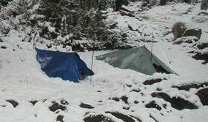
Group gear
Emergency shelter
  Depending on objective: mountaineering tent, tarp tent, tarp, bivy sack
Sleeping bag and pad
Stove with pot
Group first aid / repair kit
Group gear is distributed by leaders among trip participants
www.bushwalking.org

Slide 18
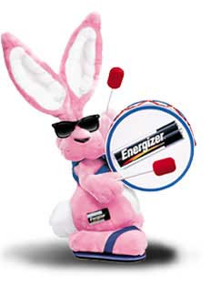
Batteries
Batteries perform VERY POORLY in the cold
Carry close to your body
  For cameras & other gadgets, take batteries out
  Put chemical handwarmer in camera bag
Rewarm & get extra life
Replace often (use new batteries)

Slide 19
Batteries
Not all batteries perform the same
Lithium ion batteries are superior in winter
  Energizer E² Lithium
  Last 3-5 times longer than alkaline in cold temps.
  40% lighter than Alkaline.
  More expensive ($9 to $13/four AA) but 23% cheaper per unit of usable energy than Alkaline at -20C
Alkaline and NiMH batteries fine for day trips

Slide 20
Battery Comparison
Lower Operating Range
Shelf Life
Discharge
Type
Lifespan
At -5F
NiCad or NiMH | 3.5 years | 20F |  | 25%
Alkaline | 10+ years | 0F |  | 40%
Silver Oxide (watch) | 10+ years | 0F |  | 50%
Lithium or Lithium ion | 10+ years | -40F |  | 80%
SOURCE: http://www.climber.org/gear/batteries.html

Slide 21
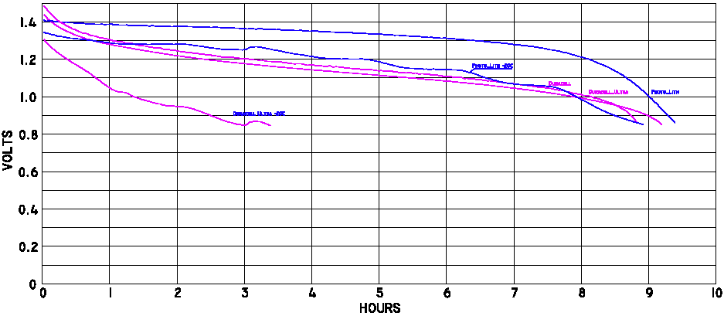
Batteries and Temperature
Proto Lithium -20 °C
Proto Lithium
+20 °C
Voltage [V]
Duracell Ultra -20 °C
Duracell Ultra
+20 °C
Time [Hr]
Source: http://www.climber.org/gear/batteries.html

Slide 22
ALWAYS CARRY SPARE BATTERIES
(in the right size)
(keep them warm, too)

Slide 23
Activity-Specific Gear
Hiking
  Snowshoes, poles, crampons, ice axe
Skiing
  Skis, ski boots, ski poles, climbing skins, wax, binding repair stuff
Ice climbing/mountaineering
  Harness, ice tools, rope, snow/ice protection, eye protection, helmet
More on all this later….

