Slide 1
Winter Gear on the Cheap
Ana Jaklenec
January 5, 2010
MITOC Winter School 2010

Slide 2
Objective
Get you ready for Winter School trips
  MITOC Rents:
    Technical Gear
    Backpacks
    Boots
  You need to have your own:
    Clothing (shell, insulating and wicking layers)
    Accessories (hats, gloves, goggles, gaiters, etc.)

Slide 3
Introduction
If you haven’t noticed, outdoor brands are expensive!
  Patagonia (aka, Pata-gucci), Arc’Teryx, Mountain Hardwear
  Even REI, EMS!
But our loans/stipends/fellowships are running low! Whatever do we do?

Slide 4
Have no Fear!
There are many ways to get stuff way below retail, including:
  Finding cheap places and killer sales
  Learning how to shop non-outdoor stores for effective substitutes
  Learn how to leech off of friends
  Buy stuff from MITOC very close to cost
  Learn how to make your own gear
Sales – if you wait they will come!

Slide 5
What you need
    Shell (wind + water proof)
      Gore-tex jacket with hood – coated nylon rain jacket
      Gore-tex double zipper pants – coated nylon rain pants
      Mitten/glove shell – coatred nylon
      Gaiters – duck tape
    Insulating
      Sweater – fleece, wool
      Down jacket – 2nd fleece or wool sweater (larger)
      Pants – fleece pjs or gym pants
      Gloves – wool, fleece
      Hat/balaclava – polyester, fleece, wool
      Socks – wool (COTTON KILLS)
    Wicking
      Top + pants – thermals (smartwool, techwick, etc.)
      Sock liners – nylon, polypropylene (helps prevent blisters)

Slide 6
Outdoor Places to get stuff cheap
Boston Area Stores:
  EMS (www.ems.com)
    Look at returns/clearance items
    Good coupons
    Student discount (15% OFF non-sale items)
  REI (www.rei.com)
    Killer sales (like garage sales)
    Returns in the basement
  Hilton’s Tent City (www.hiltonstentcity.com)
    Bins of fleece items
    MITOC discount

Slide 7
Other Places to get stuff cheap
Regional Stores:
  LL Bean Factory Outlet (Burlington, MA; Freeport, ME; Concord, NH)
  IME Basement Consignment Shop - N. Conway, NH
  Ragged Mountain - Intervale, NH downstairs (consignment shop and prototypes, really cheap)
  Kittery Trading Post, Kittery, ME (near 16 on way to Intervale)

Slide 8
Online Places to Get stuff Cheap
Online Stores:
  Steep and Cheap (www.steepandcheap.com)
    One item at a time; RSS feeds, highly addictive.
    Alternative: www.sacattack.com (more data, for the addicted)
  Sierra Trading Post (www.sierratradingpost.com)
  REI-outlet (www.rei-outlet.com)
  Campmor (www.campmor.com)
  TelemarkSki (www.telemarkski.com)
  Al’s Ski Barn (www.untracked.com)
  Mountain Equipment Coop (www.mec.ca)
    Watch the exchange rate

Slide 9
Non-Technical Stores with good stuff
Garment District (by the pound!)
City Sports
Old Navy
Filene’s Basement
Target
K-Mart
Marshalls, TJ Maxx
…
Think fleece, gloves,
hats, and nylon stuff!

Slide 10
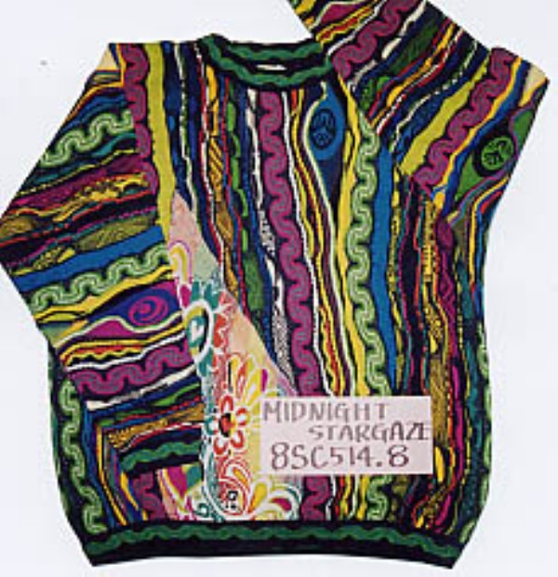
Don’t forget Thrift Stores!
Salvation Army
Goodwill
Wool: Great for layers.
Bright funky colors are good!
Wool plaid shirts rock!

Slide 11
Borrow Gear!
Many people in MITOC have extra gear!
  Email mitoc-gear@mit.edu
  People might sell older gear
Many people in your dorm/living group probably have stuff
  Wool sweaters
  Nylon wind pants
  Funky hats

Slide 12
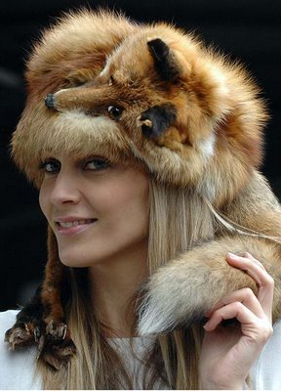
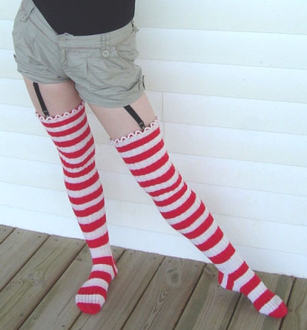
Make your own Gear
Not as hard as you think. Much cheaper!
Fleece mittens and balaclavas are easy to sew, < $10. You can buy outdoor materials from Ragged Mountain or online!
MITOC has a sewing machine you can use!
Repair your own gear
Take up knitting!

Slide 13
Pattern and Materials
justmakeit.com/patterns/index.html
www.seattlefabrics.com/
www.owfinc.com/
www.specialtyoutdoors.com/tips/project.asp
www.sundroptextiles.com/
www.maldenmillsstore.com
http://www.thegreenpepper.com/
www.raggedmountain.com (tons of patterns in basement)
www.peak.org/~ce/

Slide 14
MITOC used gear sale!
This Wednesday (Jan 6th, 2010)
MITOC office (W20-461)
7:30-8:30pm
checks or cash only!
sellers: drop gear off at 7pm

Slide 15
?

