Slide 1
Lecture 19: Discounting and Climate Change Policy - Chapter 10: Discounting - Chapter 11: Climate change policy
GEOS210-500 Fall 2016
Notes:
<!--slidoc-defaults --pace=1 -->

Slide 2
Before the Flood
Did the movie’s portrayal change your opinion about any issue? If yes, which issue(s)?
Answer: text

Slide 3
Growth
Which curve will eventually grow faster than all the others?
A.. Y = ax + b
B.. Y = x<sup>5</sup>
C.. Y = 2<sup>x</sup>
D.. Y = ax + b + x<sup>50</sup>
Answer: C
Respond using one of two ways:
- Text 40404: d geos210 answer explanation
- Open <https://geos210.slidoc.org/interact> and send answer explanation
Notes:
Notes:
<div>
<b>HTML</b>
</div>

Slide 4
Exponential growth
Do exponential growth processes go on forever?
A.. Yes, and it is catastrophic \(e^{\alpha x}\)
B.. Yes, this is the problem of the end game
C.. No, the mathematical exponential function levels out at some value.
D.. No, a limiting process stops the increase
Answer: D

Slide 5
The “suspects”
Continental drift
The sun
The Earth’s orbit
Internal variability
Greenhouse gases

Slide 6
Instant vs. delayed gratification: Powerball Jackpot
Jackpot for Sat., Nov 12, 2016 is $258,000,000
Which option would you take:
A.. Annuity: 30 average annual payments of $8,600,000
B.. Lump sum: $170,700,000
Explain why
Answer: choice; explain
Notes:
Powerball jackpot analysis: https://www.usamega.com/powerball-jackpot.asp

Slide 7
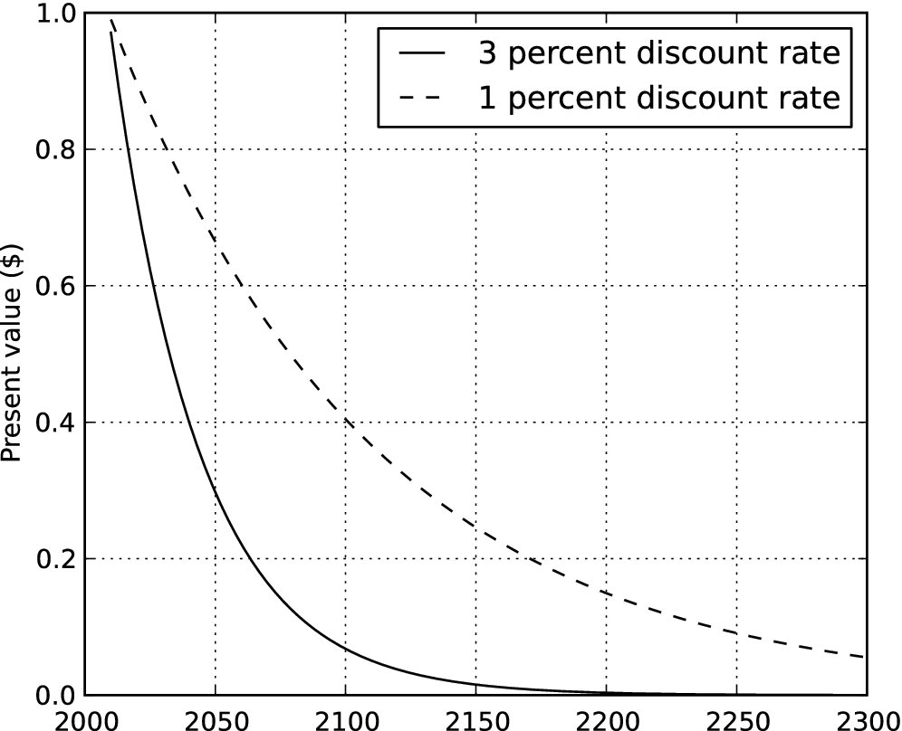
Present value of $1 in climate damages
Answer: text

Slide 8
Present value of $1 in climate damages
![image1](‘height=400‘)
Answer: text

Slide 9
Present value of $1 in climate damages
Notes:
![image1](temimage)
Answer: text

Slide 10
Present value of $1 in climate damages

Slide 11
Last slide

