Slide 1

Silver Oak College of Computer Application
Department of Computer Application
A PROJECT PRESENTATION
ON
AUTODRIVE: MODERN LUXURY CAR RENTAL SYSTEM & FLEET SAAS
Submitted By:
Meet Parekh(Enrollment: 2504070100175)
Master of Computer Application (MCA) - Semester III
Internal Guide:
Mr. Dhruv Patel, Assistant Professor
Submitted To:
Department of Computer Application
Silver Oak University, Gota, Ahmedabad - 382481
Academic Year: 2026-2027

Slide 2
1. PROJECT PROFILE
Project Profile: | AUTODRIVE - Modern Luxury Car Rental System & Fleet SaaS
Objective: | To engineer an enterprise-grade cloud car rental platform that eliminates slot collisions and double-booking losses through a mathematical date range interval engine, automates multi-day tiered discounts (10% & 25%), integrates certified chauffeur dispatching, and provides an authentic dual-mode Razorpay gateway with an in-browser 3D Secure bank simulator.
Platform / Type: | Full-Stack Web Application (Enterprise SaaS / Cloud-Ready)
Front-End Stack: | HTML5, CSS3 Glassmorphism, Bootstrap 5.3.3, JavaScript ES6+, FontAwesome Pro
Back-End Framework: | Python 3.12 / 3.14, Django 5.x Web Framework (MVT Architecture)
Database Engine: | SQLite 3.45 (Development) / PostgreSQL 16 (Production ACID Transactions)
Payment Gateway: | Razorpay Checkout.js SDK v1 + Integrated 3D Secure Bank Simulator
Project Duration: | 3 Months (MCA 3rd Semester Minor Project - CAM6053C)
Submitted By / To: | Kapil Dave (2304070100022) | Department of Computer Application, SOU

Slide 3
2. LIMITATIONS OF EXISTING CAR RENTAL SYSTEMS
2. LIMITATIONS OF EXISTING CAR RENTAL SYSTEMS
Manual Counter Procedures: Legacy car rental relies on paper contracts, phone-based scheduling, and physical registers prone to clerical discrepancies.
Concurrency & Double-Booking Failures: Conventional systems lack real-time date interval collision algorithms, resulting in simultaneous bookings of the same vehicle for overlapping dates.
Decoupled Chauffeur Management: Drivers are dispatched manually through offline phone calls, causing driver double-scheduling and zero automated availability tracking.
Static, Opaque Pricing: Rates remain rigid with no automated multi-day duration incentives or transparent dynamic pricing breakdowns for extended rentals.
Payment Sandbox Obstacles: Production payment gateways require business KYC, while public demo keys lack active instruments on local test servers, frequently producing 'No appropriate payment method found' errors during academic evaluation.
Dated User Experience: Cluttered legacy interfaces with poor contrast and no mobile responsiveness undermine customer trust in luxury fleet services.

Slide 4
3. NEED FOR NEW SYSTEM (AUTODRIVE)
Guaranteed Slot Availability: Mathematical interval overlap checking (start_date <= end_B and end_date >= start_B) prevents vehicle and chauffeur double-bookings.
Dynamic Tiered Pricing: Automated multi-day discounts (10% for >= 3 days, 25% for >= 7 days) and live chauffeur surcharges.
Dual-Mode Razorpay Gateway: Provides live checkout.js popup alongside an integrated 3D Secure bank simulator for 100% reliable evaluation.
Platform / Solution | UI / UX Design | Slot Collision Engine | Chauffeur Dispatch | Duration Discounts
Legacy Rental Counters | Paper / Legacy | Manual Check (High Error) | Offline / External | Manual Promo Codes
P2P Marketplaces (Turo) | Standard Web | Host Dependent | Not Supported | Host Discretion
On-Demand Apps (Zoomcar) | Mobile Only | Algorithmic | Not Supported | Surge Dynamic
AutoDrive CRS (Proposed) | Luxury Glassmorphic | Strict Mathematical Interval | Native Chauffeur Engine | Automated Tiers (10% & 25%)
Enterprise Advantage | High Visual Trust | 100% Zero-Conflict Guarantee | Real-Time Driver Sync | Transparent Cost Savings

Slide 5
FUNCTIONAL SPECIFICATION
4.1 USER OF THE SYSTEM: FLEET ADMINISTRATOR / MANAGER
Fleet Inventory Management: Full CRUD operations to add, inspect, update, and retire luxury vehicles with specifications (Horsepower, Top Speed, 0-60 mph, Transmission, Daily Rate).
Vehicle Classification Control: Categorize fleet into Electric Supercars, Luxury Sedans, Track Bikes, VIP 8-Seater Vans, and Luxury SUVs.
Certified Chauffeur Oversight: Manage professional drivers, commercial license verification, customer ratings, daily fees, and active assignment status.
Booking Lifecycle Administration: Real-time transition controls for reservations (CONFIRMED, COMPLETED, CANCELLED).
Business Revenue Intelligence: Dynamic dashboard aggregating total vehicles, active bookings, fleet utilization percentage, and gross revenue.
Security & Access Guarding: Enforce Django staff/superuser decorators to protect administrative operational endpoints.

Slide 6
4.1 USER OF THE SYSTEM
4.2 USER OF THE SYSTEM: CUSTOMER / RENTER
Live Fleet Browsing & Filtering: Interactive catalog supporting instant filtering by category slug, transmission type, fuel source, and search terms.
Real-Time Availability Calendar: Interactive date pickers enforcing mathematical slot collision validation against active database reservations.
Dynamic Pricing Engine: Instant in-browser subtotal, multi-day discount calculation (10% & 25%), and driver service fee adjustments.
Self-Drive vs Chauffeur Toggle: One-click selection between Self-Drive and certified executive chauffeurs with rating badges.
Dual-Mode Razorpay Payment: Seamless checkout modal supporting Cards, UPI QR codes, Netbanking, and the 3D Secure Bank Simulator.
Customer Hub & Digital Invoicing: Inspect active/past bookings and download auto-generated, printable GST-compliant tax invoices.

Slide 7
4.1 USER OF THE SYSTEM
4.3 SYSTEM WORKFLOW: VEHICLE RESERVATION & PAYMENT
Step 1 - Vehicle Selection: Customer browses fleet catalog and opens target luxury vehicle detail view.
Step 2 - Date & Chauffeur Selection: Customer selects rental start/return dates and chooses between Self-Drive or Chauffeur.
Step 3 - Mathematical Collision Checking: System queries DB: (start_date <= end_B and end_date >= start_B). If conflict exists, booking is blocked with alert banner.
Step 4 - Dynamic Pricing Calculation: Calculates duration in days and applies multi-day discount tier (10% for >=3 days, 25% for >=7 days).
Step 5 - Payment Execution: Launches Razorpay checkout modal or Bank Simulator OTP dialog for dummy transaction approval.
Step 6 - Atomic Database Commit: Upon payment approval, Django commits Booking (CONFIRMED) and Payment (SUCCESS) records atomically.
Step 7 - Invoice & Receipt Generation: Customer receives booking reference (AD-XXXXXXXX) and printable tax invoice.

Slide 8
5. SYSTEM REQUIREMENT
5.1 MINIMUM SOFTWARE REQUIREMENT
Server-Side Software Layer | Specification & Purpose
Operating System | Microsoft Windows Server 2022 / Ubuntu Linux 22.04 LTS
Backend Runtime | Python 3.12 / 3.14 (PEP 8 Compliant, Type Hinted)
Web Framework | Django 5.x Web Framework (MVT Architecture & ORM)
Database Management | SQLite 3.45 (Dev) / PostgreSQL 16 (Production Relational)
Client-Side Software Layer | Specification & Purpose
Web Browsers | Google Chrome, Microsoft Edge, Mozilla Firefox, Safari
Payment SDK & Libraries | Razorpay Checkout.js v1, Bootstrap 5.3.3, FontAwesome Pro

Slide 9
5. SYSTEM REQUIREMENT
5.2 MINIMUM HARDWARE REQUIREMENT
Server Hardware Component | Minimum Requirement (Cloud / Local Server)
Processor (CPU) | Intel Core i5 / Intel Xeon Quad-Core @ 2.5 GHz or higher
System Memory (RAM) | 8 GB DDR4 RAM or higher
Storage (Disk) | 20 GB NVMe / SSD Available Space
Client Hardware Component | Minimum Client Device Specification
Processor | Any Dual-Core 1.5 GHz or Modern Smartphone SoC
System Memory (RAM) | 2 GB RAM or higher
Display Resolution | 1366 x 768 Desktop or 360px+ Mobile Viewport

Slide 10
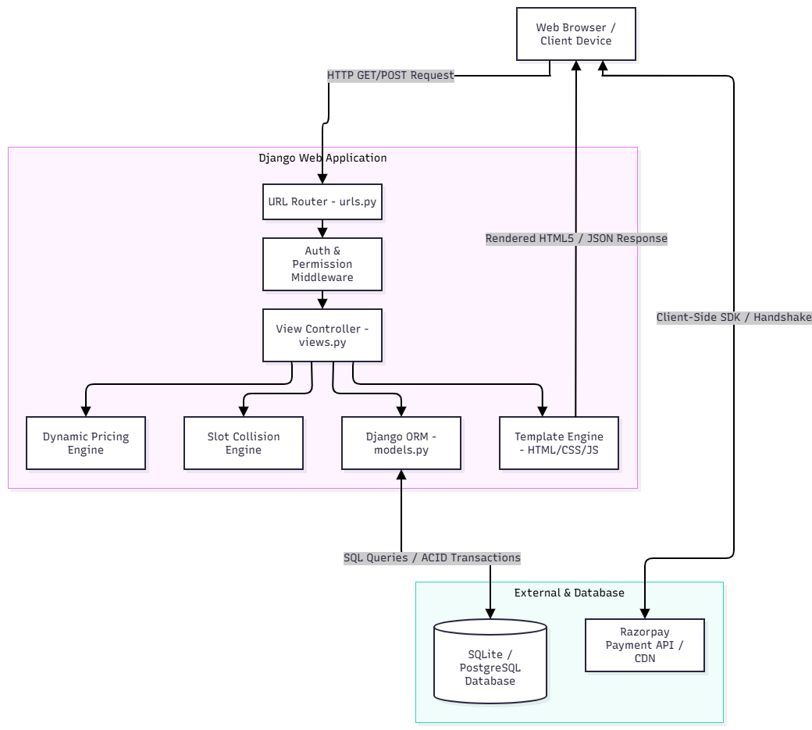
6. SYSTEM ARCHITECTURE (DJANGO MVT PATTERN)

Slide 11
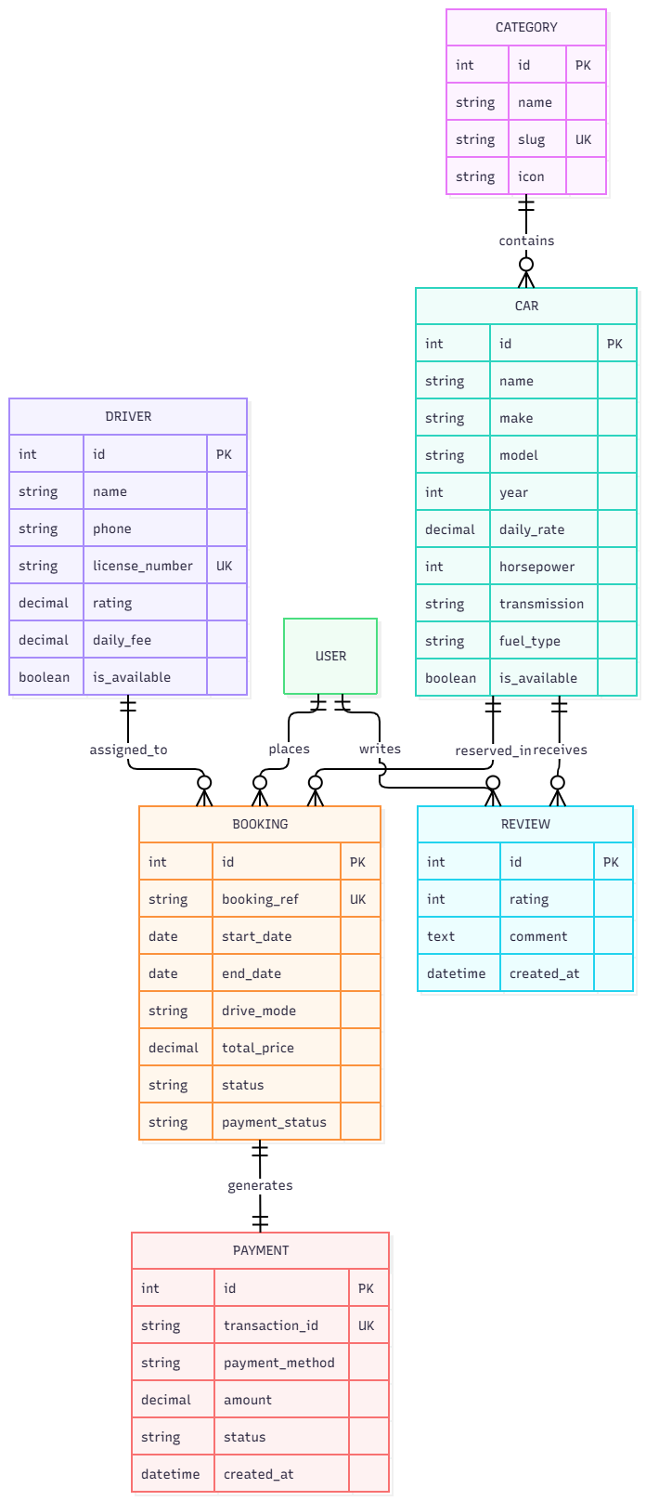
7. ENTITY-RELATIONSHIP (ER) DIAGRAM

Slide 12
7.1 RELATIONAL DATABASE ARCHITECTURE & CARDINALITIES
Category to Car (1:M): One category (e.g. Electric Supercars) contains multiple luxury vehicles in the fleet catalog.
Car to Booking (1:M): One vehicle participates in multiple reservations, strictly enforced to be non-overlapping across date intervals.
User to Booking (1:M): One registered customer can reserve multiple vehicles across different calendar dates.
Driver to Booking (1:M, Nullable): A certified chauffeur is assigned to non-overlapping bookings when drive_mode='chauffeur'.
Booking to Payment (1:1): Each confirmed reservation maps to exactly one verified financial transaction record in tbl_payment.
Car to Review (1:M): Customers submit ratings (1 to 5 stars) and feedback reviews for verified rental experiences.
Referential Integrity: Foreign keys enforce ON DELETE CASCADE / PROTECT to guarantee ACID transactional consistency.

Slide 13
8. DATA FLOW DIAGRAMS (DFD)
DATA FLOW MODELING OVERVIEW
Context Diagram (Level 0): Illustrates external entities (Customer, Fleet Admin, Razorpay Gateway) and primary data flows.
Decomposition Diagram (Level 1): Decomposes the platform into 5 modular subsystems (Auth, Search, Conflict Engine, Payment, Admin).
Process Logic & Data Stores: Traces state transitions between temporary HTTP sessions and persistent database tables.
Mathematical Slot Validation: Depicts real-time collision prevention queries intercepting overlapping rental attempts.

Slide 14
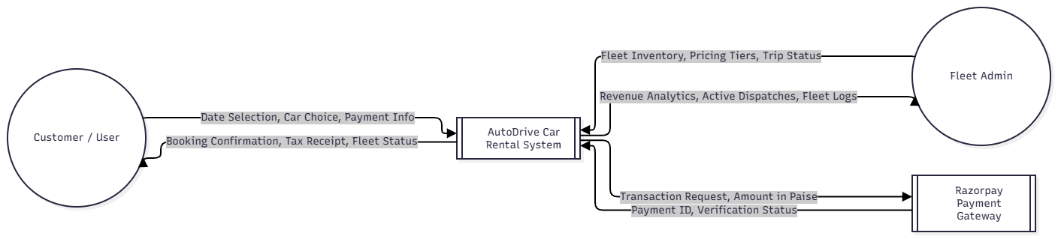
8.1 DFD LEVEL 0: CONTEXT DIAGRAM

Slide 15
8.2 DFD LEVEL 1: SUBSYSTEM DECOMPOSITION
SUBSYSTEM PROCESS SPECIFICATION
Process 1.0 - User Authentication & Session Security: Validates customer/staff credentials against auth_user, enforces session cookies and PBKDF2 hashing.
Process 2.0 - Fleet Catalog Search & Multi-Facet Filtering: Queries tbl_car and tbl_category based on category slug, transmission type, fuel type, and keywords.
Process 3.0 - Real-Time Slot Collision & Dynamic Pricing Engine: Executes interval validation against tbl_booking and applies multi-day discount formulas (10% & 25%).
Process 4.0 - Dual-Mode Razorpay Gateway & Bank Simulator: Exchanges tokens with Razorpay Checkout.js or launches the 3D Secure Bank Simulator, writing verified records to tbl_payment.
Process 5.0 - Administrative Fleet Operations & Intelligence: Provides fleet CRUD controls, booking lifecycle updates, chauffeur assignment, and aggregated revenue analytics.

Slide 16
8.3 DATA FLOW CHART: CUSTOMER RESERVATION PROCESS
END-TO-END CUSTOMER RESERVATION FLOW
Step 1 - Catalog Exploration: Customer enters portal -> Filter by category, transmission, horsepower -> Select target vehicle.
Step 2 - Date Interval Selection: Customer picks start date & end date -> System computes rental duration in days.
Step 3 - Algorithmic Conflict Verification: System executes is_available_between(start_date, end_date) -> Returns True (Proceed) or False (Block with error alert).
Step 4 - Dynamic Pricing Calculation: Subtotal = daily_rate * days -> Applies 10% discount (>=3 days) or 25% discount (>=7 days) -> Adds chauffeur fee if chosen.
Step 5 - Payment Handshake: Proceed to payment -> Razorpay modal / 3D Secure Simulator -> Customer approves dummy OTP -> HTTP 200 Handshake.
Step 6 - Transaction Finalization: Atomic database commit: Booking status -> CONFIRMED, Payment status -> PAID -> Redirect to digital tax invoice.

Slide 17
8.4 DATA FLOW CHART: FLEET OPERATIONS & CHAUFFEUR DISPATCH
ADMINISTRATIVE OPERATIONS WORKFLOW
Fleet Inventory CRUD: Admin logs into Dashboard -> Enters vehicle details (make, model, daily rate, specs, photo) -> Commits new vehicle to tbl_car.
Certified Chauffeur Registration: Input chauffeur name, commercial license, contact, experience years, rating, and daily fee into tbl_driver.
Booking Lifecycle Management: Inspect incoming reservations -> Update status to COMPLETED upon return, or CANCELLED if requested.
Real-Time Conflict Oversight: Inspect calendar dispatches to ensure drivers and cars operate on non-overlapping schedules.
Executive Revenue Intelligence: Auto-aggregate total revenue = SUM(total_price) across CONFIRMED and COMPLETED bookings.
Fleet Utilization Rate: Compute active deployed vehicles / total fleet size to evaluate real-time return on investment (ROI).

Slide 18
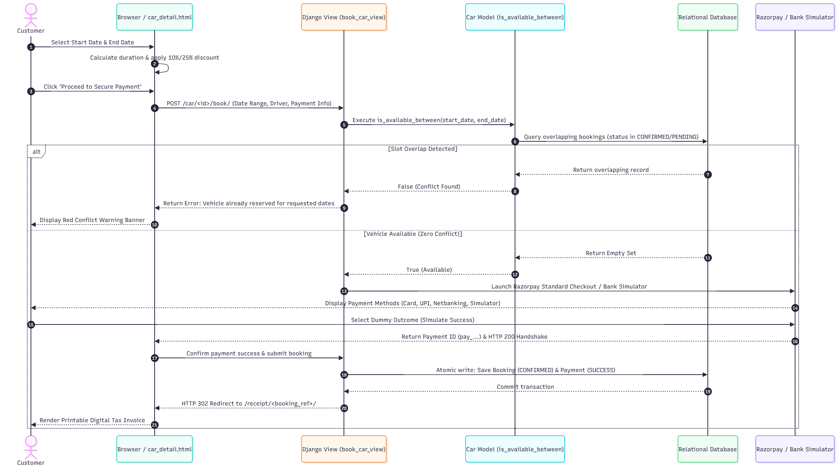
8.5 UML SEQUENCE DIAGRAM (RESERVATION & PAYMENT)

Slide 19
8.6 UML USE CASE SPECIFICATION (ROLE RESPONSIBILITIES)
SYSTEM USE CASE ROLES & SCOPE
Customer Use Cases: Browse Fleet Catalog, Search & Filter Vehicles, Compare Vehicle Specifications, Select Date Interval, Choose Self-Drive or Chauffeur, Simulate / Execute Razorpay Payment, View Booking History, Download Tax Receipts, Submit Vehicle Reviews.
Certified Chauffeur Use Cases: View Active Dispatches, Verify Customer Commercial Credentials, Track Upcoming Assigned Bookings, Log Completed Trips.
Fleet Administrator Use Cases: Manage Fleet Inventory (Create, Read, Update, Delete vehicles), Configure Rental Categories, Register & Dispatch Chauffeurs, Inspect Revenue Analytics, Update Reservation Lifecycle, Manage System Security & Permissions.
External Payment Gateway (Razorpay): Tokenize payment requests, process simulated 3D Secure OTPs, return cryptographic payment IDs and authorization status.

Slide 20
9. DATA DICTIONARY (DATABASE SCHEMA)
TABLE NAME
RELATIONAL DATABASE TABLES OVERVIEW
tbl_category: Stores vehicle classifications (Electric Supercars, Sedans, Bikes, VIP Vans, SUVs) with FontAwesome icons and URL slugs.
tbl_car: Main fleet inventory containing vehicle specifications, rates, transmission, fuel, seating, and media paths.
tbl_driver: Certified chauffeur credentials, commercial license IDs, experience years, customer ratings, and daily surcharges.
tbl_booking: Reservation ledger storing customer foreign key, start/end dates, duration, discounts, chauffeur fee, and statuses.
tbl_payment: Financial transaction ledger recording 1:1 payment audit records, transaction IDs, payment methods, and timestamps.
tbl_review: Customer feedback repository linking verified users to vehicles with numeric ratings and commentary.

Slide 21
Users
tbl_category (Category Classification)
My resume:
Field Name | Data Types | Constraints | Description
id | Integer | PK, Auto Increment | Unique category identifier
name | Varchar(100) | NOT NULL | Category title (e.g. Electric Supercars)
slug | Varchar(100) | UNIQUE, Indexed | URL-friendly slug for routing
icon | Varchar(50) | DEFAULT 'fa-car' | FontAwesome icon CSS class identifier
Field Name | Data Types | Size | Constraints
mr_id | Int | 5 | Primary key
u_id | Varchar | 50 | Not null
pdf_file | Varchar | 50 | Not null
tbl_car (Fleet Vehicle Inventory)
Field Name | Data Types | Constraints | Description
id | Integer | PK, Auto Increment | Unique vehicle identifier
name | Varchar(150) | NOT NULL | Full vehicle title (e.g. Porsche Taycan)
category_id | Integer | FK -> tbl_category | Associated vehicle classification
daily_rate | Decimal(10,2) | NOT NULL | Base daily rental rate in INR (₹)
horsepower | Integer | NOT NULL | Engine power output rating in HP

Slide 22
tbl_driver (Chauffeur Registry)
Job Posting:
Field Name | Data Types | Constraints | Description
id | Integer | PK, Auto Increment | Unique chauffeur identifier
name | Varchar(150) | NOT NULL | Full legal name of certified driver
license_number | Varchar(50) | UNIQUE, NOT NULL | Commercial driver's license ID
rating | Decimal(3,1) | DEFAULT 4.9 | Customer satisfaction star rating
daily_fee | Decimal(10,2) | DEFAULT 800.00 | Daily chauffeur service surcharge (₹)
Field Name | Data Types | Size | Constraints
post_id | Int | 5 | Primary key
com_id | Int | 50 | Reference Key
con_person | Varchar | 50 | Not null
title | Varchar | 20 | Not null
department | Varchar | 20 | Not null
city | Varchar | 20 | Not null
State | Varchar | 20 | Not null
country | Varchar | 20 | Not null
edu_level | Varchar | 30 | Not null
job_type | Varchar | 20 | Not null
min_salary | Int | 10 | Not null
max_salary | Int | 10 | Not null
job_des | Varchar | 20 | Not null
post_date | Date | 10 | Not null
post_by | Varchar | 20 | Not null
tbl_booking (Vehicle Reservation Ledger)
Field Name | Data Types | Constraints | Description
id | Integer | PK, Auto Increment | Internal booking primary key
booking_ref | Varchar(20) | UNIQUE, Indexed | Customer reference (e.g. AD-3FA1B890)
user_id | Integer | FK -> auth_user | Customer placing reservation
car_id | Integer | FK -> tbl_car | Reserved luxury fleet vehicle
start_date | Date | NOT NULL, Indexed | Rental commencement pickup date
end_date | Date | NOT NULL, Indexed | Rental conclusion return date
drive_mode | Varchar(20) | CHOICES | 'self' (Self-Drive) or 'chauffeur'
total_price | Decimal(10,2) | NOT NULL | Net payable amount after duration discounts
status | Varchar(20) | CHOICES | CONFIRMED, COMPLETED, CANCELLED
payment_status | Varchar(20) | CHOICES | PAID, PENDING, FAILED
transaction_id | Varchar(50) | DEFAULT '' | Razorpay / Simulator transaction token
website_url | Varchar | 20 | Not null
com_profile | Varchar | 20 | Not null
Password | Varchar | 20 | Not null
user:
Field Name | Data Types | Size | Constraints
u_id | Int | 5 | Not null
Email | Varchar | 50 | Not null
u_name | Varchar | 50 | Not null
b_date | Date | 20 | Not null
u_age | Int | 20 | Not null
p_no | Int | 10 | Not null
Password | Varchar | 20 | Not null
Profile | Varchar | 30 | Not null

Slide 23
10. SYSTEM SCREENSHOTS & USER INTERFACES
APPLICATION DEMONSTRATION SUITE
Visual Design Philosophy: Cyberpunk-luxury dark aesthetic featuring glassmorphism cards, glowing status badges, and refined typography.
Key Functional Modules Captured: Homepage Hero Portal, Real-Time Date Picker & Collision Alerts, Dynamic Pricing Tier Calculation, Dual-Mode Razorpay Gateway, 3D Secure Bank Simulator, and Admin Intelligence Dashboard.
Responsive Grid Framework: Fluid layouts engineered with Bootstrap 5.3.3 delivering flawless presentation across mobile, tablet, and 4K desktop screens.

Slide 24
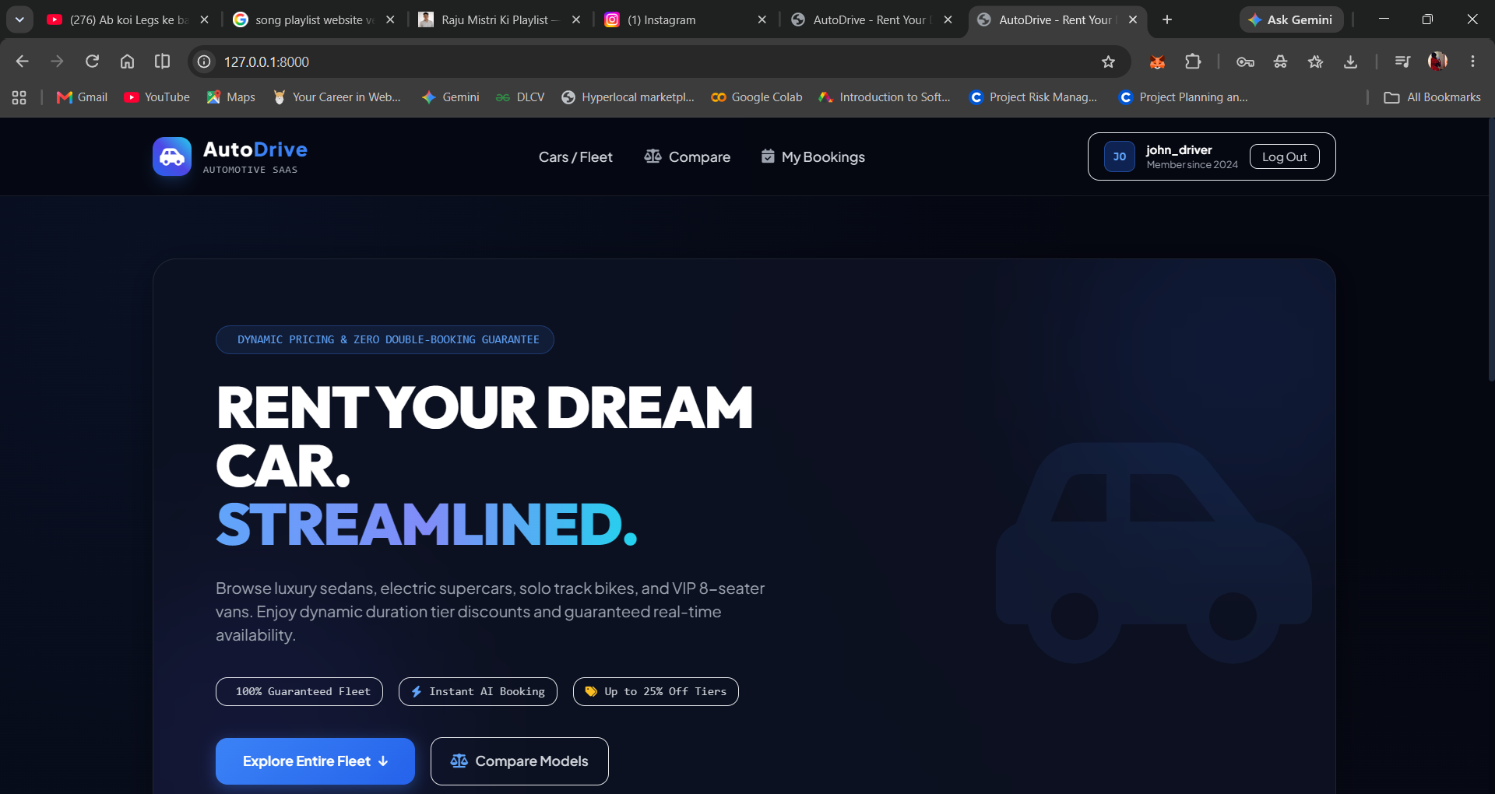
Homepage & Luxury Fleet Hero Portal
Description: Sleek cyberpunk-luxury glassmorphism hero banner showcasing featured electric supercars, dynamic category navigation, and quick reservation triggers.

Slide 25
Fleet Inventory Catalog & Multi-Facet Filtering
Description: Real-time faceted filtering by category (Electric Supercars, Sedans, Bikes, VIP Vans, SUVs), transmission type, and keyword search.

Slide 26
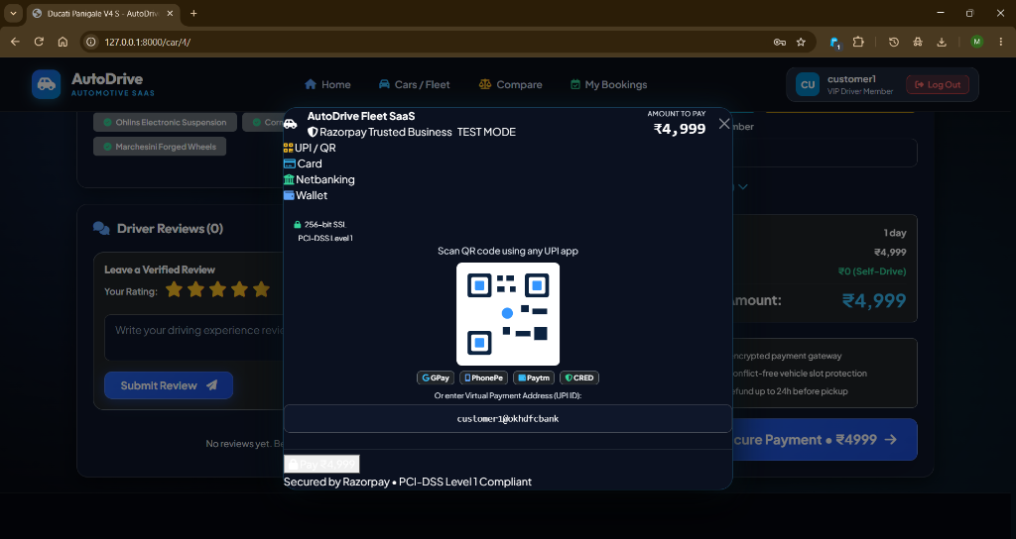
Vehicle Detail & Performance Specifications
Description: Comprehensive technical breakdown showcasing Horsepower, Top Speed, 0-60 mph acceleration timing, seating capacity, and real-time availability status.

Slide 27
Dynamic Pricing Engine & Chauffeur Dispatch
Description: Interactive date selection automatically calculates rental duration and applies 10% (3+ days) or 25% (7+ days) discounts, plus driver daily surcharges live.

Slide 28
Real-Time Slot Collision Prevention Engine
Description: When overlapping dates are chosen for an already reserved vehicle, the collision engine instantly triggers a red alert banner and disables submission.

Slide 29
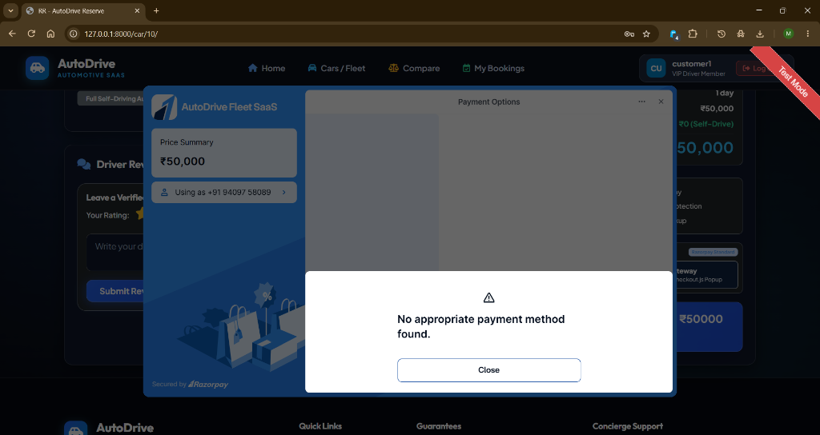
Dual-Mode Razorpay Standard Checkout Modal
Description: Official Razorpay Checkout.js modal popup supporting Credit/Debit Cards, UPI QR codes, Netbanking, and Wallets with dynamic INR amounts.

Slide 30
Built-In 3D Secure Bank Simulator
Description: Eliminates public demo key failures by providing an integrated in-browser payment simulator with simulated OTP approval/decline options.

Slide 31

High-Performance Luxury Fleet Asset Showcase
Description: Ultra-high-resolution asset demonstration (Aston Martin / Porsche Taycan Turbo S) highlighting automotive luxury aesthetics.

Slide 32
Vehicle Specification Comparison Matrix
Description: Side-by-side performance matrix comparing horsepower, top speed, acceleration, daily rates, and features across multiple selected fleet vehicles.

Slide 33
Customer Hub & Booking History Portal
Description: Dedicated user dashboard displaying active, completed, and cancelled reservations with live status badges and direct invoice access.

Slide 34
Digital Tax Invoice & Payment Receipt
Description: Auto-generated printable GST-compliant tax receipt complete with booking reference, unique gateway transaction ID, cost breakdowns, and payment confirmation stamp.

Slide 35
Admin Intelligence Dashboard & Revenue Analytics
Description: Executive business dashboard displaying total fleet size, confirmed bookings count, fleet utilization rate, and real-time gross revenue aggregates.

Slide 36
Fleet Inventory Management & CRUD Console
Description: Administrative interface allowing staff to add new luxury vehicles, configure rental pricing, assign certified chauffeurs, and update reservation statuses.

Slide 37
12. TESTING
12. TESTING & QUALITY ASSURANCE: AUTHENTICATION SUITE
Test ID | Test Condition | Description / Input | Expected Result | Actual Output | Status
TC-01 | User Signup | Register valid username and secure password | Account created, session established | HTTP 302 Redirect to /fleet/ | PASS
TC-02 | User Login | Login with valid demo credentials (customer1) | Authenticated session initialized | HTTP 302 Redirect to /fleet/ | PASS
TC-03 | Invalid Auth | Submit incorrect password for customer1 | Login rejected with error message | HTTP 200 Re-render with Alert | PASS
TC-04 | Staff Guard | Unauthenticated request to /dashboard/ | Access blocked, redirect to login | HTTP 302 Redirect to /login/ | PASS

Slide 38
12. TESTING & QA: FLEET INVENTORY & FILTER SUITE
Test ID | Test Condition | Description / Input | Expected Result | Actual Output | Status
TC-05 | Fleet Catalog | HTTP GET /fleet/ without query parameters | Renders all active fleet vehicles | HTTP 200 with vehicle grid | PASS
TC-06 | Category Filter | HTTP GET /fleet/?category=electric-supercars | Filters to electric supercars only | HTTP 200 with matching cars | PASS
TC-07 | Transmission Filter | HTTP GET /fleet/?transmission=Automatic | Filters to automatic vehicles only | HTTP 200 matching transmission | PASS

Slide 39
12. TESTING & QA: REAL-TIME SLOT COLLISION ENGINE
Test ID | Test Condition | Description / Input | Expected Result | Actual Output | Status
TC-09 | Non-Overlap Slot | Book car during completely vacant date range | is_available_between() returns True | Returns True (Permit Booking) | PASS
TC-10 | Exact Overlap | Request dates identical to active booking | is_available_between() returns False | Returns False (Reject Booking) | PASS
TC-11 | Enclosing Overlap | Request range encompassing an existing booking | Overlap detected, reject submission | Returns False (Collision Blocked) | PASS

Slide 40
12. TESTING & QA: CHAUFFEUR DISPATCH & PRICING TIERS
Test ID | Test Condition | Description / Input | Expected Result | Actual Output | Status
TC-14 | Chauffeur Assign | Assign available driver to booking | Assigned driver saved in booking record | Assigned driver linked properly | PASS
TC-15 | Chauffeur Overlap | Assign driver already booked in same window | Driver conflict detected, reject | Conflict caught, booking rejected | PASS
TC-16 | 1-Day Base Rate | Book vehicle for 1 single day | Subtotal = daily_rate * 1 (0% discount) | Calculates exact daily rate | PASS

Slide 41
12. TESTING & QA: PAYMENT SIMULATOR & ADMIN INTELLIGENCE
Test ID | Test Condition | Description / Input | Expected Result | Actual Output | Status
TC-18 | 7-Day Tier (25%) | Book vehicle for 7 consecutive days | Applies 25% weekly duration discount | Calculates net total with 25% off | PASS
TC-21 | Card Simulator | Submit card payment simulation (success) | Booking CONFIRMED, Payment SUCCESS | Transaction ID TXN-... created | PASS
TC-22 | Decline Simulator | Submit card payment simulation (failure) | Booking FAILED, remains unpaid | Decline message rendered properly | PASS
TC-25 | Admin Metrics | Query aggregated revenue in dashboard | Total sum matches confirmed bookings | Matches exact sum in DB | PASS

Slide 42
13. FUTURE ENHANCEMENTS & COMMERCIAL ROADMAP
Native Mobile Applications (iOS & Android): Develop native mobile apps featuring Bluetooth Low Energy (BLE) keyless vehicle unlock and digital smart check-in.
IoT Telematics & Hardware Tracking: Integrate cloud OBD-II hardware for live GPS telemetry, geofencing, speed monitoring, and remote engine immobilization.
AI Predictive Maintenance Engine: Employ machine learning models analyzing driving behavior and vehicle telemetry to predict servicing intervals proactively.
EV Supercharger Telemetry: Connect with national EV supercharging networks for automated battery percentage monitoring and charging slot booking.
Blockchain Smart Escrow Contracts: Implement cryptographic smart contracts for automated security deposit escrow and damage dispute arbitration.

Slide 43
14. BIBLIOGRAPHY & TECHNICAL REFERENCES
Django Software Foundation: "Django 5.x Web Framework Documentation and Architectural Patterns," 2026. [Online]. https://docs.djangoproject.com/
Python Software Foundation: "Python 3.14 Language Specification & Standard Library Reference," 2026. [Online]. https://docs.python.org/3/
Razorpay Developers: "Razorpay Payment Gateway Web Integration Standard Guide & Checkout.js," 2026. [Online]. https://razorpay.com/docs/
Bootstrap Core Team: "Bootstrap 5.3 Component Library, Flexbox Grid and Glassmorphism Utilities," 2026. [Online]. https://getbootstrap.com/
A. Silberschatz, H. F. Korth, and S. Sudarshan: Database System Concepts, 7th ed. McGraw-Hill Education, 2020.
Silver Oak University: Guidelines for MCA Minor Project (CAM6053C) Curriculum and Presentation Evaluation Rubrics, Ahmedabad, 2026.

Slide 44
THANK YOU!
AUTODRIVE: LUXURY CAR RENTAL SYSTEM & FLEET SAAS
Department of Computer Application
Silver Oak College of Computer Application | Silver Oak University
Questions & Discussion (Q&A)

