Slide 1
UNFCCC – NAI SOFTWARE
Sector: Agriculture
Practical Aspects and Exercises
CGE
Greenhouse Gas Inventory Hands-on Training Workshop
Notes:
CGE = Consultative Group of Experts on National Communications from Parties not included in Annex I to the Convention
NAI Parties = Parties not included in Annex I to the Convention

Slide 2
CONTENT
  Details on use of the UNFCCC – NAI Software to calculate and report GHG emissions in the Industrial Processes sector.
  Practical exercises (to be solved by the participants after the presentation).

Slide 3
BACKGROUND
  The decision trees in the IPCC good practice guidance are used to choose a good practice method that suits national circumstances.
  The UNFCCC-NAI Software contains, basically, the methods of lesser complexity that countries can use to prepare their inventories.
  However, in principle, the software can be used to report the estimated emissions independently of the complexity of method used (Tier 2, 3, etc).

Slide 4
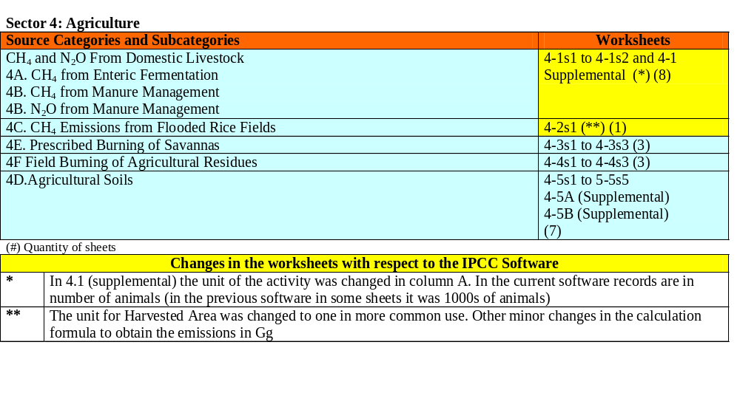
SECTOR: AGRICULTURE

Slide 5
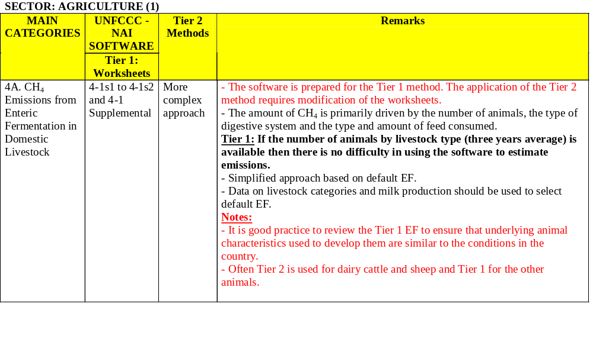
SECTOR: AGRICULTURE
CH₄ Emissions from Domestic Livestock
Enteric Fermentation (1)
Notes:
EF = emission factor

Slide 6
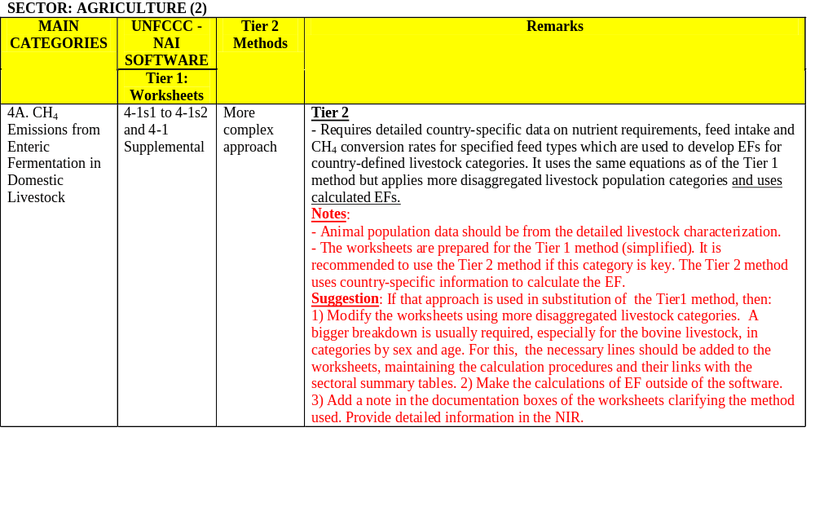
SECTOR: AGRICULTURE
CH₄ Emissions from Domestic Livestock
Enteric Fermentation (2)
Notes:
EF = emission factor
NIR = national inventory report

Slide 7
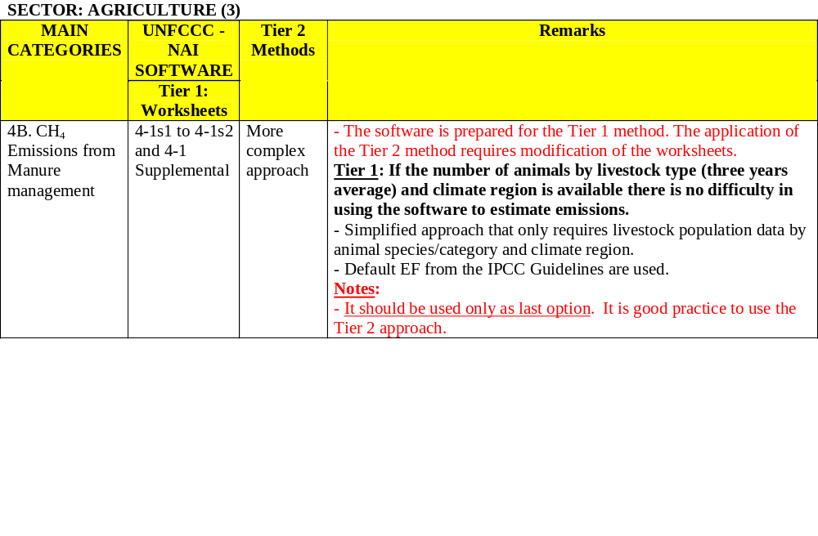
SECTOR: AGRICULTURE
CH₄ Emissions from Domestic Livestock
Manure Management (1)
Notes:
IPCC Guidelines = Revised 1996 IPCC Guidelines for National Greenhouse Gas Inventories

Slide 8
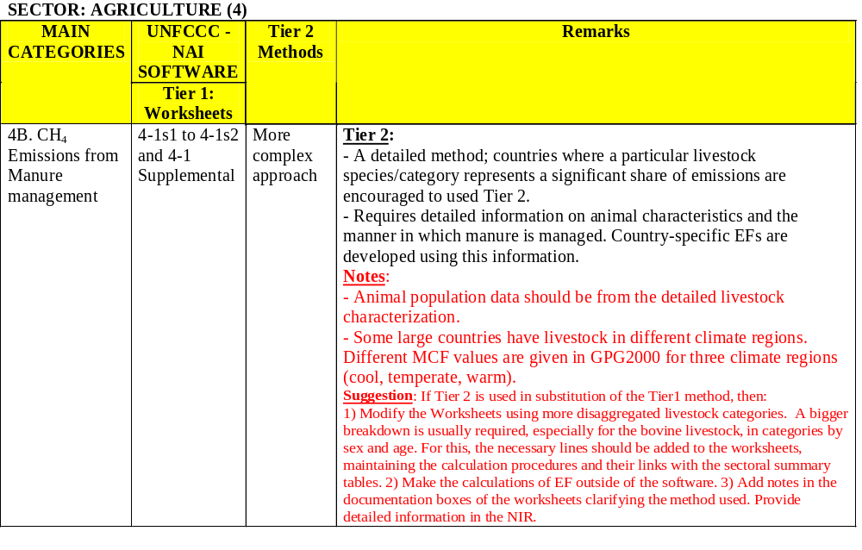
SECTOR: AGRICULTURE
CH₄ Emissions from Domestic Livestock
Manure Management (2)
Notes:
MCF = methane conversion factor
GPG2000 = Good Practice Guidance and Uncertainty Management in National Greenhouse Gas Inventories

Slide 9
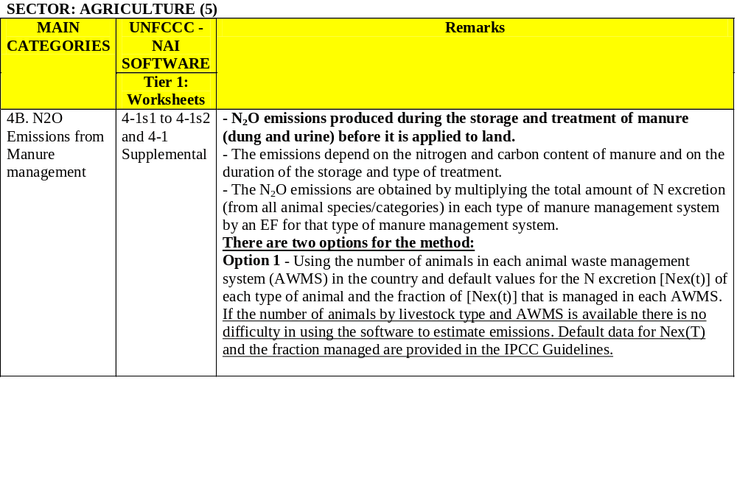
SECTOR: AGRICULTURE
N₂O Emissions from Domestic Livestock. Manure Management (1)
Notes:
IPCC Guidelines = Revised 1996 IPCC Guidelines for National Greenhouse Gas Inventories

Slide 10
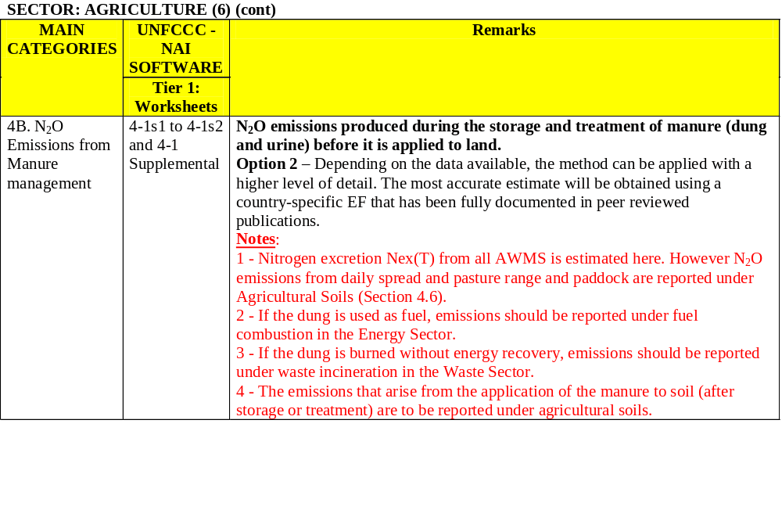
SECTOR: AGRICULTURE
N₂O Emissions from Domestic Livestock. Manure Management (2)

Slide 11
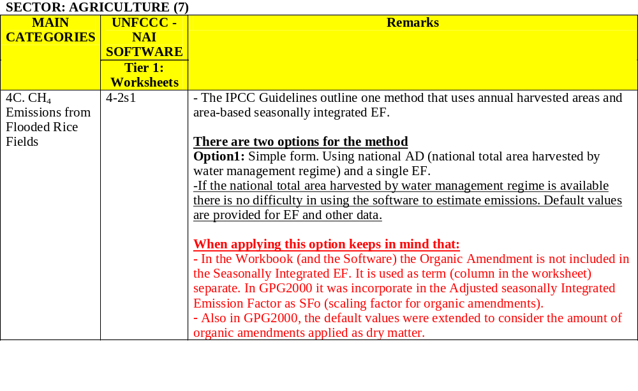
SECTOR: AGRICULTURE
CH₄ Emissions from Rice Cultivation (1)
Notes:
AD = activity data

Slide 12
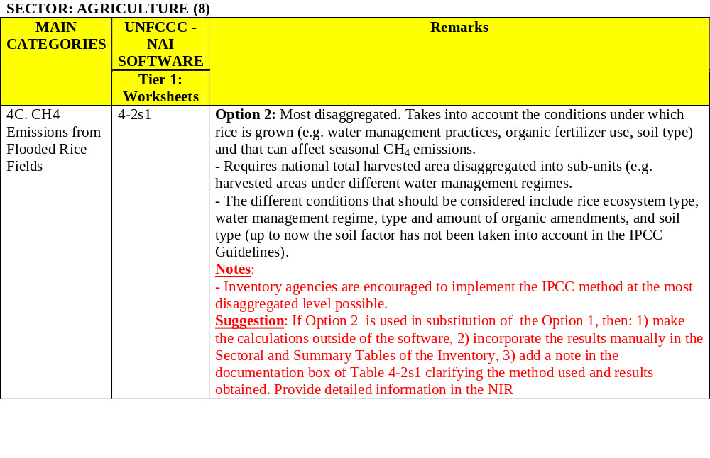
SECTOR: AGRICULTURE
CH₄ Emissions from Rice Cultivation (2)

Slide 13
SECTOR: AGRICULTURE
Exercise 4.1: CH₄ Emissions from Rice Cultivation (I)
Country A: Year: 2000. Worksheet 4-2s1
Data
According to data submitted by the Ministry of Agriculture, 400,000 ha of intermittently flooded paddy fields (single aeration) and 50,000 ha of upland rice were cultivated in the year. Compost was used as amendment. Actual data on soil types subject to composting are not available. The default CH₄ EF for continuously flooded rice without organic fertilizer = 20 g/m²
Cultivated area (ha) | Cropping seasons | Water management regime | Amount of compost applied (t/ha)
400 000 | 2 | Intermittently flooded (single aeration) | 6
50 000 | 1 | Upland rice | 3

Slide 14
SECTOR: AGRICULTURE
Exercise 4.1: CH₄ Emissions from Rice Cultivation (II)
Tasks
Using the UNFCCC - NAI Software:
Calculate CH₄ emissions.
Verify the emissions report in the Sectoral and Summary Tables.
Fill Table 8A (Overview Table) for the self evaluation of quality and completeness.
Print the worksheet used, the Sectoral Summary Table and the Overview Table (8A).

Slide 15
SECTOR: AGRICULTURE
Exercise 4.1: CH₄ Emissions from Rice Cultivation (III)
Steps
Open the software and select in the Agriculture sector Worksheet 4-2s1 CH₄ Emissions from Flooded Rice Fields.
Enter in column A the harvested area by water management regime (in 1000 ha). The harvested area is given by the cultivated area times the number of cropping seasons. Area cultivated under upland (or dry conditions) is excluded from calculations.
Enter the scaling factor for CH₄ emissions in column B. Default value = 0.5 (relative to EF for continuously flooded fields).

Slide 16
SECTOR: AGRICULTURE
Exercise 4.1: CH₄ Emissions from Rice Cultivation (IV)
Steps
Enter a correction factor (scaling factor) for organic amendment in column C = 1.5 (when fermented organic amendments are used, divide the amount applied by six and select the scaling factor in Table 4.21 GPG2000).
Enter in D the Seasonally Integrated CH₄ EF for continuously flooded rice without organic amendment = 20g/m².
In column E the software calculates CH₄ emissions (Gg).

Slide 17
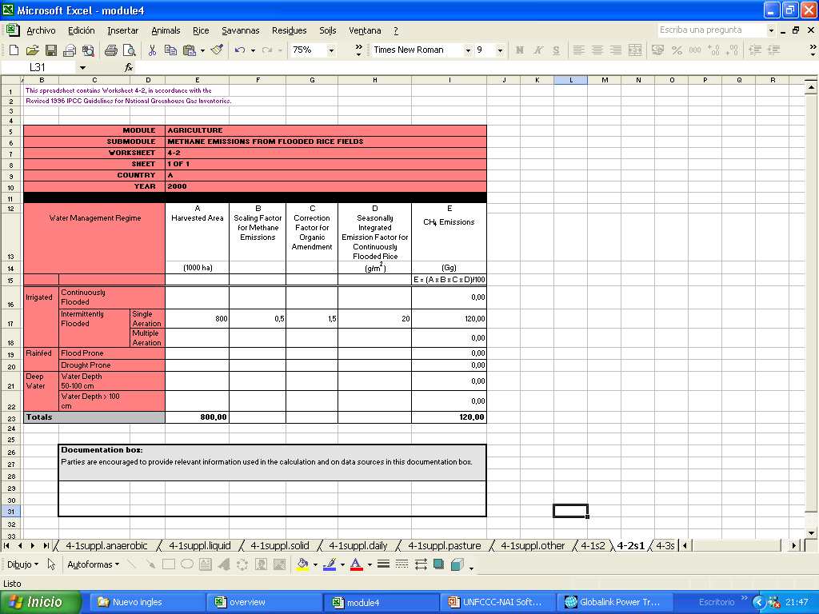
CH4 EMISSIONS FROM RICE CULTIVATION

Slide 18
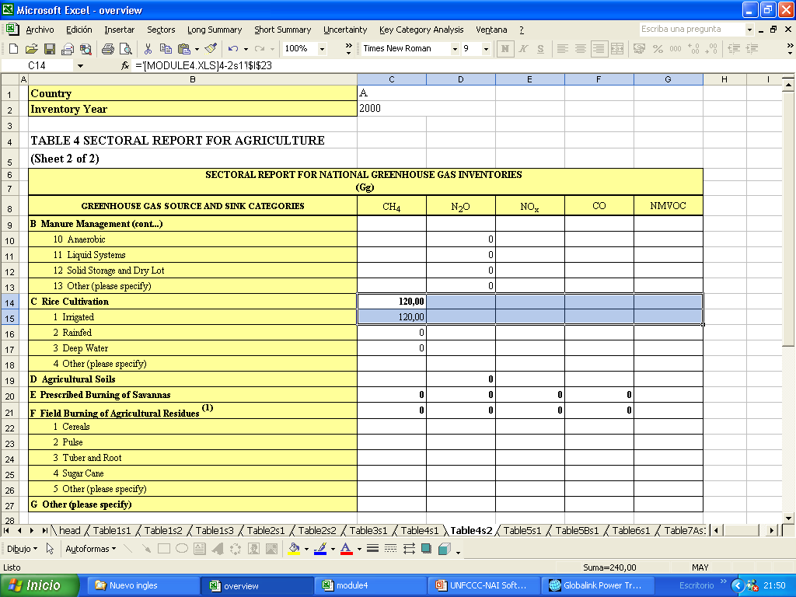
CH4 EMISSIONS FROM RICE CULTIVATION IN THE SECTORAL TABLE FOR AGRICULTURE

Slide 19
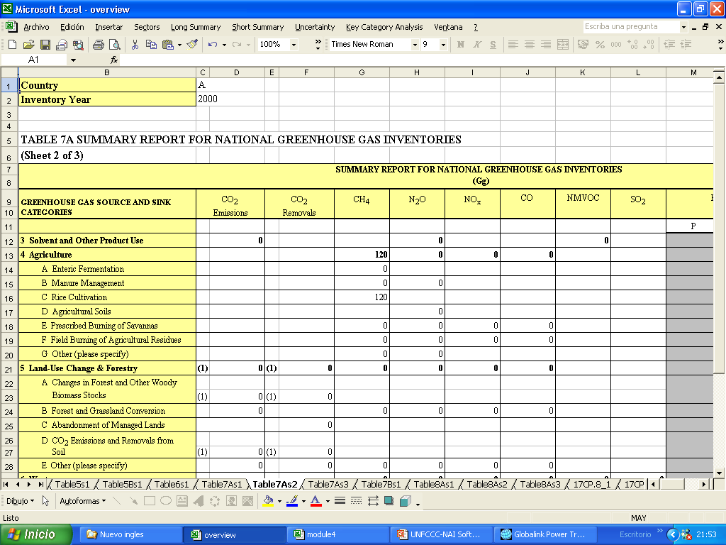
CH4 EMISSIONS FROMN RICE CULTIVATION IN THE SUMMARY REPORT TABLE

Slide 20
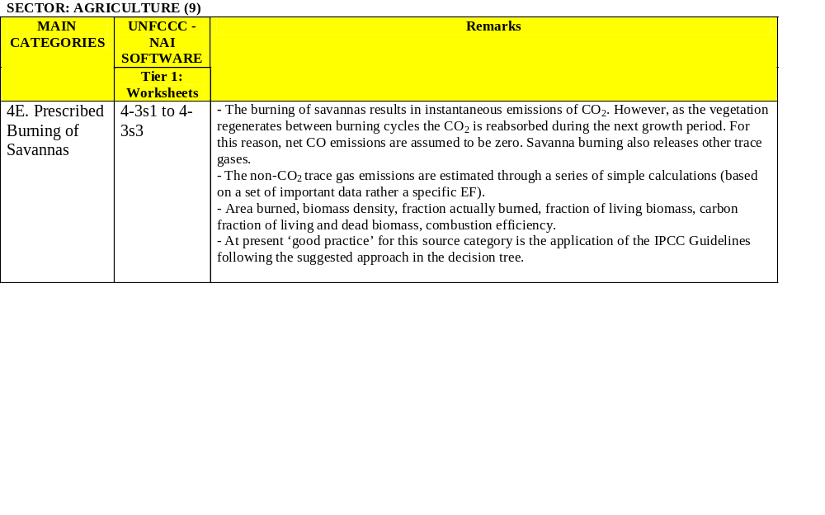
SECTOR: AGRICULTURE
Prescribed Burning of Savannas

Slide 21
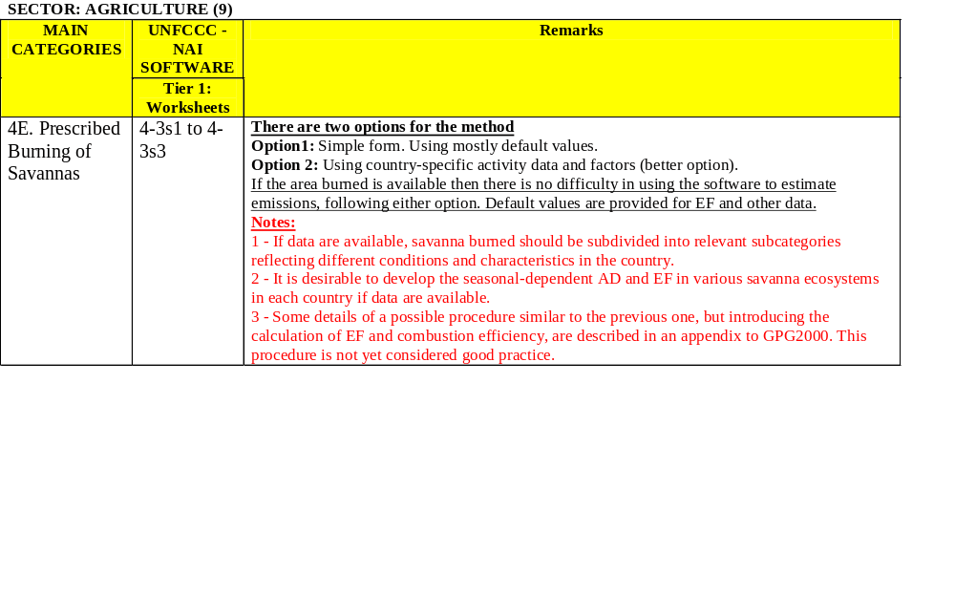
SECTOR: AGRICULTURE
Prescribed Burning of Savannas

Slide 22
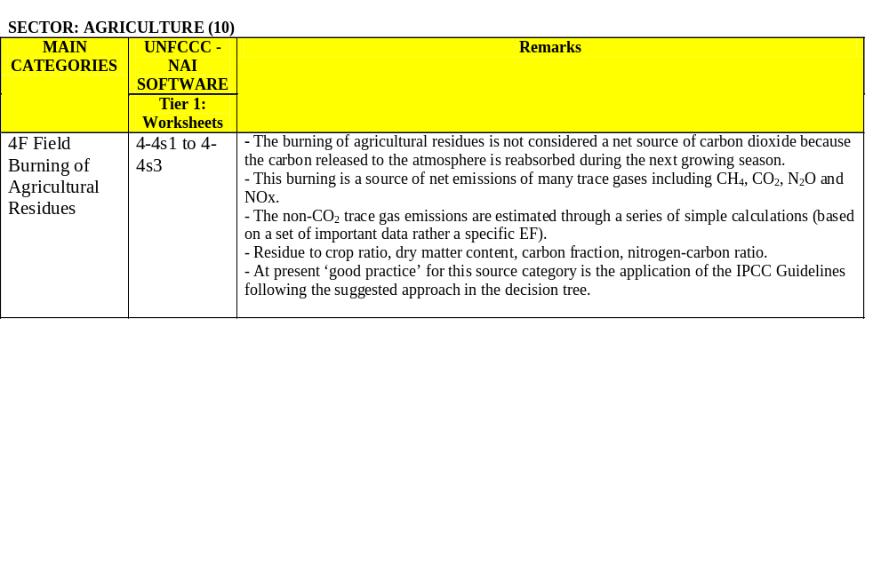
SECTOR: AGRICULTURE
Field Burning of Agricultural Residues

Slide 23
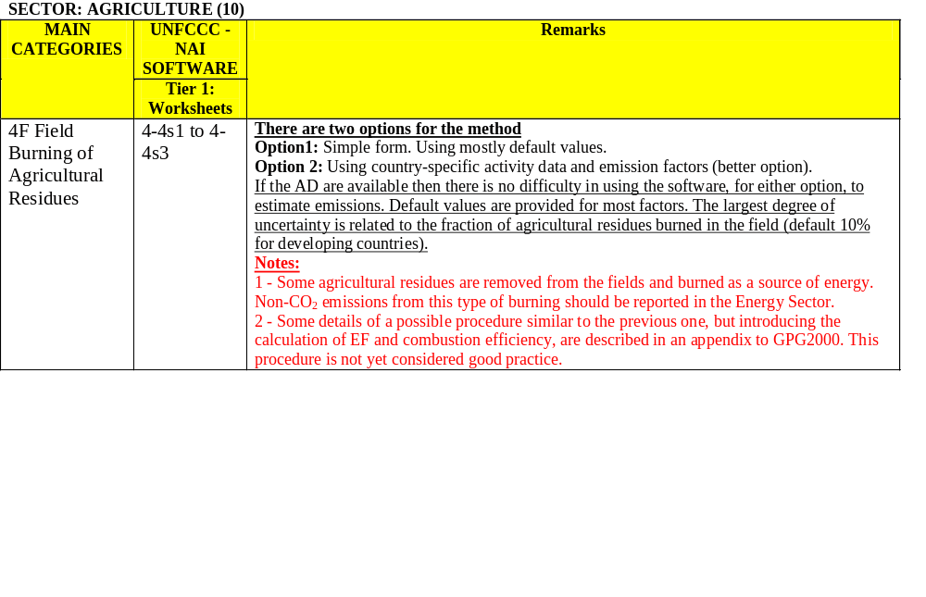
SECTOR: AGRICULTURE
Field Burning of Agricultural Residues

Slide 24
SECTOR: AGRICULTURE
Exercise 4.2: Field Burning of Agricultural Residues (I)
Country A: Year: 2000. Worksheet 4-2s1
Data
The Ministry of Agriculture has provided information on annual production and other data relating to locally important crops. It has also specified the crops whose residues are burned in the field (maize, soybeans and rice). Data on actual values for the rate of oxidation are not available.
Crop | Annual Production 1000 tonne | Residue to crop ratio | Proportion burned in fields | Dry matter fraction | Carbon fraction | Nitrogen-Carbon ratio
Maize | 450 | 1 | 0,10 | 0.4 | 0.4709 | 0.02
Soybeans | 350 | 2.1 | 0,07 | 0.87 | 0.45 | 0.05
Rice | 2000 | 1,4 | 0.08 | 0.85 | 0.4144 | 0.014

Slide 25
SECTOR: AGRICULTURE
Exercise 4.2: Field Burning of Agricultural Residues (II)
Tasks
Using the UNFCCC - NAI Software:
Calculate non-CO₂ emissions.
Verify the emissions reported in the Sectoral and Summary Tables.
Fills Table 8A (Overview Table) for the self evaluation of quality and completeness.
Print the worksheet used, the Sectoral Summary Table and the Overview Table (8A).

Slide 26
SECTOR: AGRICULTURE
Exercise 4.4: Field Burning of Agricultural Residues (III)
Steps
Open the software and select in the Agriculture sector Worksheet 4-4 Field Burning of Agricultural Residues.
For each type of crop enter annual production in Gg in
column A.
Enter in column B the residue to crop ratio for each crop type.
The software calculates in column C the quantity of residue.
Enter in column D the dry matter fraction for each crop type.
The software calculates in column E the quantity of dry residue.

Slide 27
SECTOR: AGRICULTURE
Exercise 4.2: Field Burning of Agricultural Residues (IV)
Steps
Enter in column F the fraction burned in fields for each crop type.
Enter in column G the fraction oxidized for each crop (default value 0.90).
The software calculates in column H the total biomass burned.
Enter in column I the carbon fraction for each residue. The software calculates in column J the total carbon released.

Slide 28
SECTOR: AGRICULTURE
Exercise 4.2: Field Burning of Agricultural Residues (V)
Steps
Enter Nitrogen-Carbon ratio in column K for each crop. The software calculates in column L the total nitrogen released.
Enter emission ratios in column M (CH₄=0.005; CO=0.,06, N₂O=0.007, NOx=0.121).
The software makes the rest of the calculations to obtain the emissions of non-CO₂ gases.

Slide 29
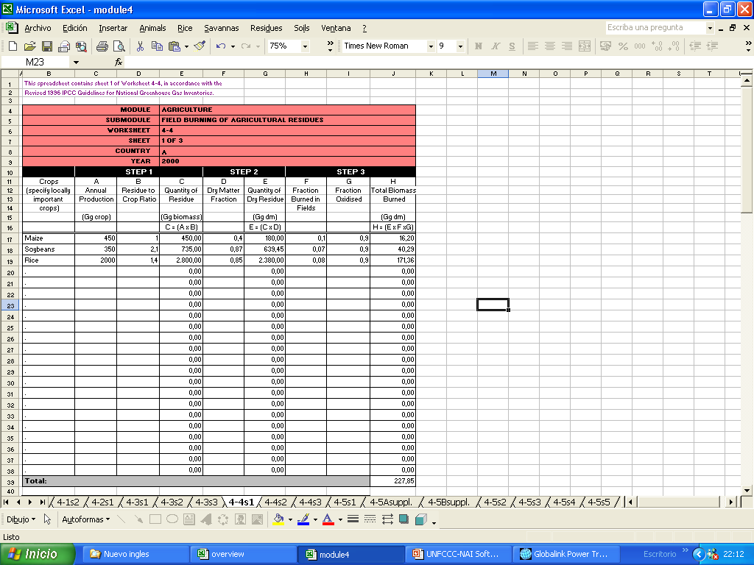
BIOMASS BURNED

Slide 30
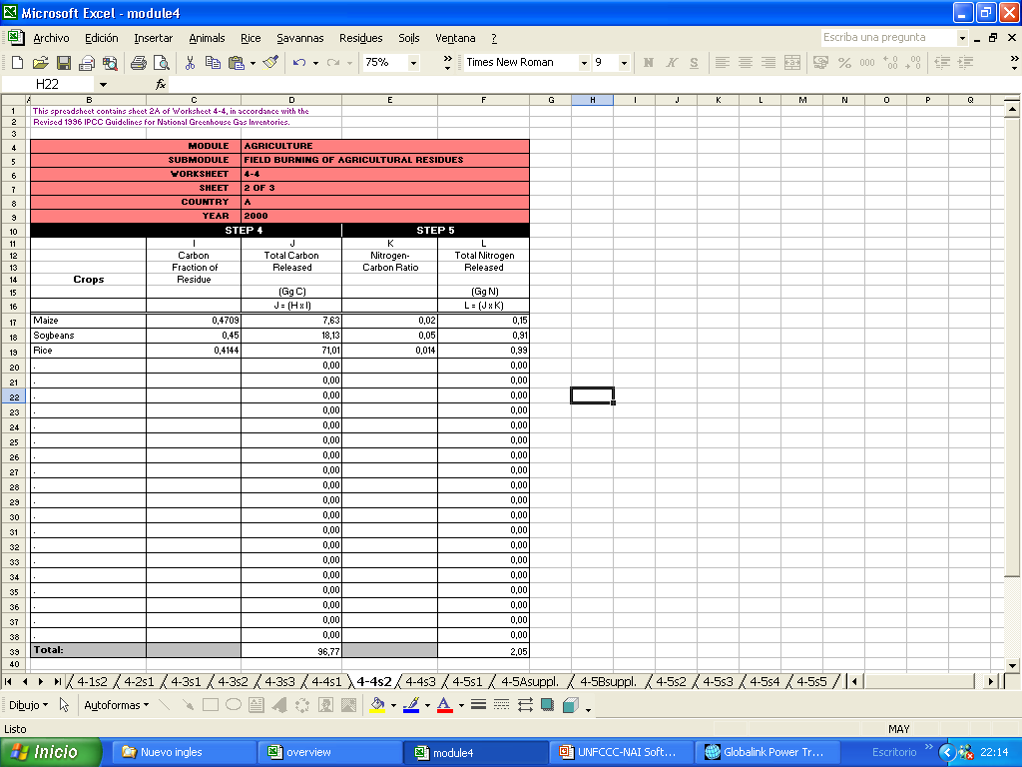
CARBON AND NITROGEN RELEASED

Slide 31
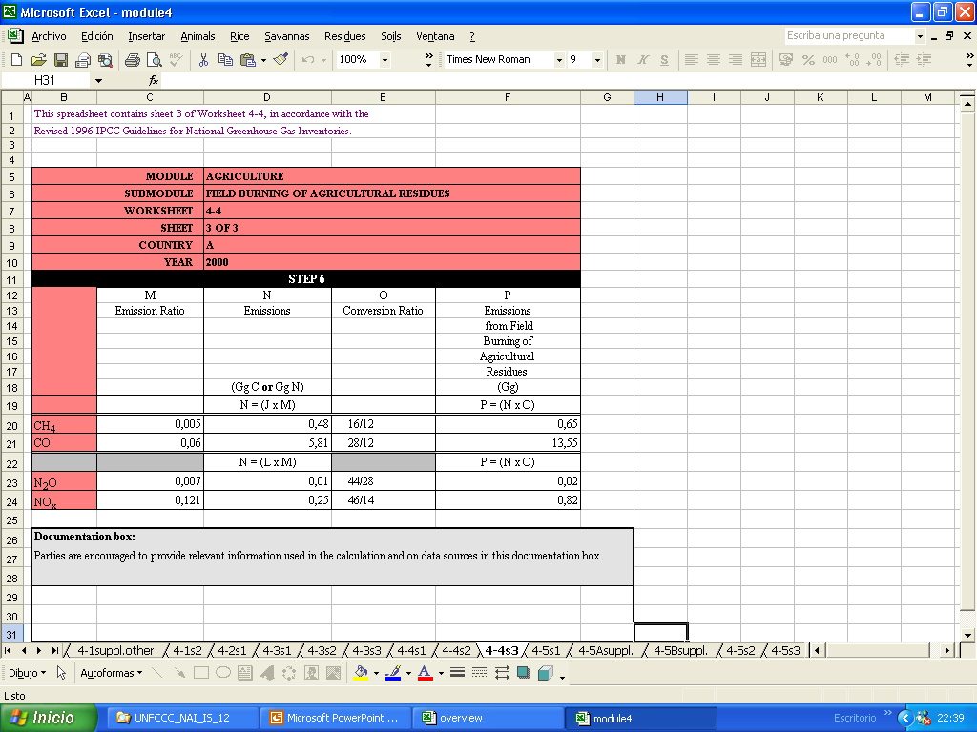
NON CO2 EMISSIONS FROM FIEL BURNING OF AGRICULTURA RESIDUES
EMISSIONS FROM FIEL BURNING OF AGRICULTURAL RESIDUES

Slide 32
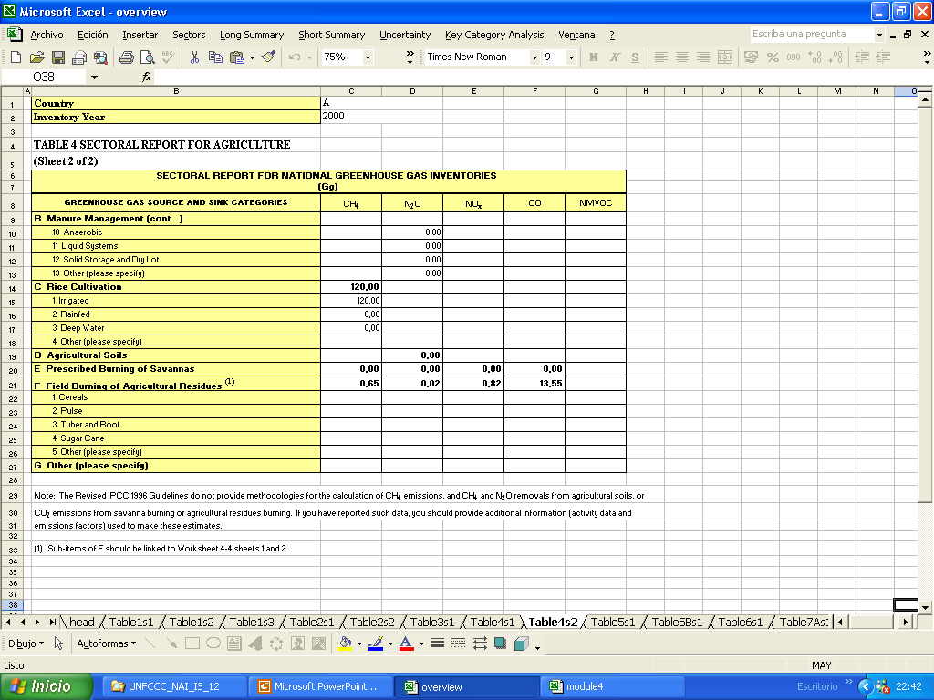
NON-CO2 EMISSIONS FROM FIELD BURNING OF AGRICULTURAL RESIDUES IN THE SECTORAL REPORT TABLE FOR AGRICULTURE

Slide 33
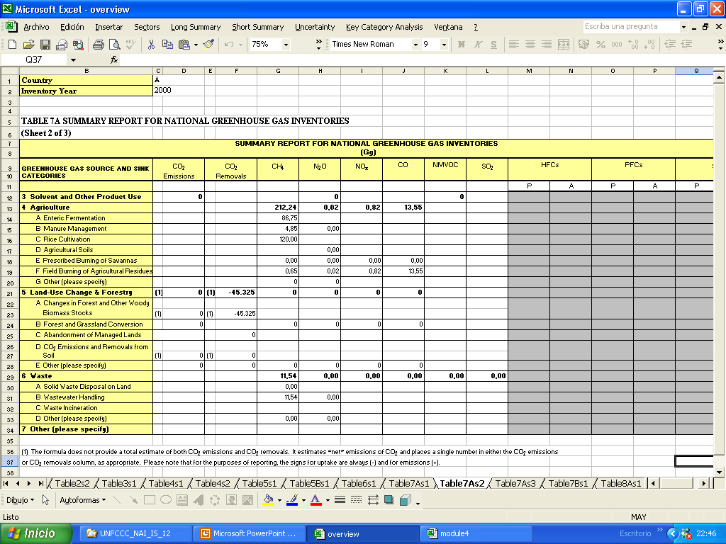
NON-CO2 EMISSIONS FROM FIELD BURNING OF AGRICULTURAL RESIDUES IN THE SUMMARY REPORT TABLE

Slide 34
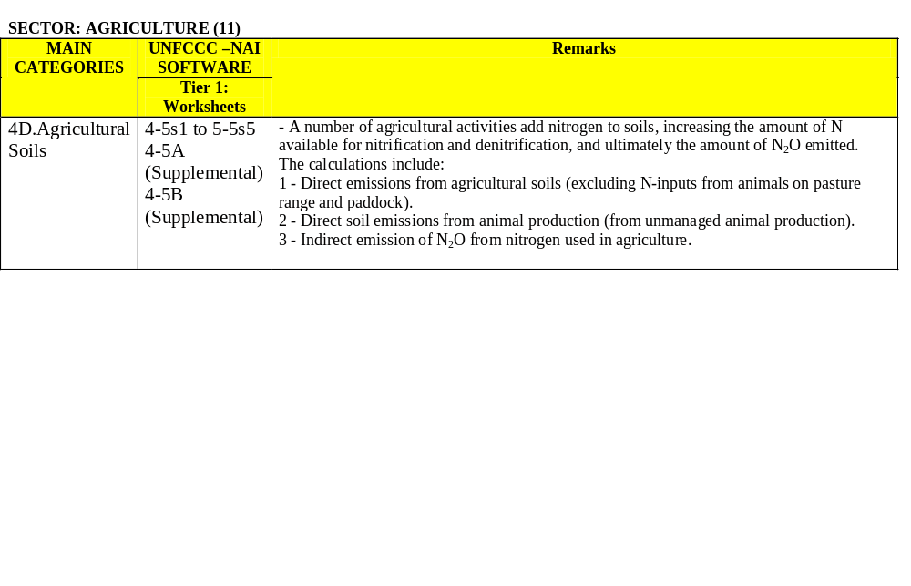
SECTOR: AGRICULTURE
Agricultural Soils

Slide 35
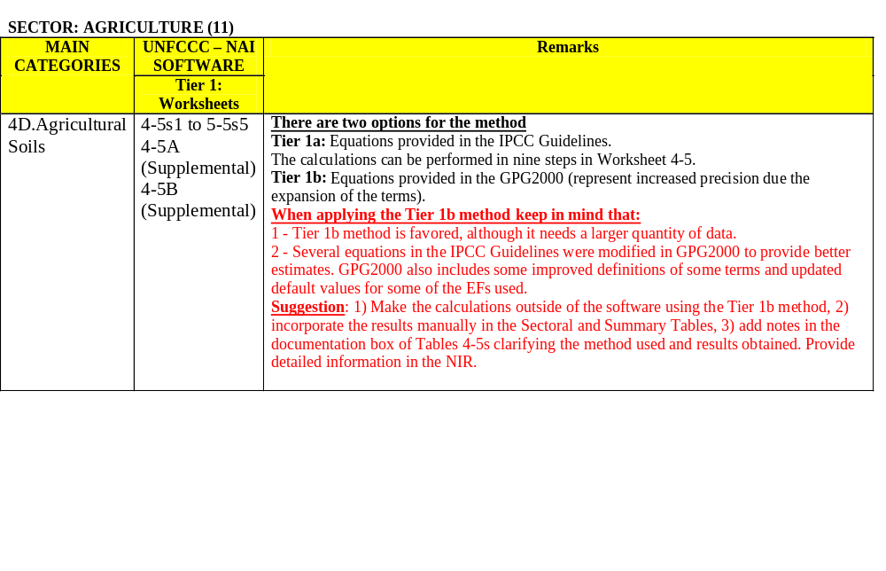
SECTOR: AGRICULTURE
Agricultural Soils

Slide 36
SECTOR: AGRICULTURE
Exercise on Self Evaluation 1: CH₄ from Enteric Fermentation and Manure Management in Domestic Livestock (I)
Country A: Year: 2000.
Data
The National Statistics Office has provided data on the domestic livestock population in the country for the year 2000. Also, from data provided by the University of Agricultural Sciences, the GHG Inventory Team has determined some emission factors that better represent the conditions and circumstances of the country.
Determine the CH₄ emissions from enteric fermentation and manure management using the UNFCCC-NAI software.
Verify in the Sectoral Report Table and the Summary Table of the Inventory the results obtained.

Slide 37
SECTOR: AGRICULTURE
Exercise on Self Evaluation 1: CH₄ from Enteric Fermentation and Manure Management in Domestic Livestock (II)
COUNTRY A: YEAR 2000. LIVESTOCK POPULATION AND EMISSION FACTORS
LIVESTOCK | POPULATION (1000s) | EF Enteric Fermentation (kg/head/yr) | EF Manure Management (kg/head/yr)
Cows (1) | 500 | 49.5 | 1.024
Cows | 600 | 45.76 | 0.868
Veal | 400 | 3.087 | 0.015
Bulls | 108 | 41.96 | 0.621
Oxen | 300 | 51.38 | 0.624
Sheep | 900 | 4.163 | 0.167
Goats | 200 | 5.035 | 0.181
Horses | 400 | 18 | 2.18
Swine | 1500 | 0.937 | 1.425
Poultry | 15500 |  | 0.023

Slide 38
SECTOR: AGRICULTURE
Exercise on Self Evaluation 1: CH₄ from Enteric Fermentation and Manure Management in Domestic Livestock (III)
RESULTS
CH₄ emissions from Enteric Fermentation | 86.75 Gg CH4
CH₄ emissions from Manure Management | 4.85 Gg CH4
Total CH₄ emissions from Domestic Livestock | 91.6 Gg CH4

Slide 39
Thank you

