Slide 1



SMART INDIA HACKATHON 2025
TITLE PAGE
Problem Statement ID – 25102
Problem Statement Title - AI-based drop-out prediction and counseling
Theme - Smart Automation
PS Category- Software
Team ID-
Team Name - TasselTurners

Slide 2
AI-based drop-out prediction and counseling system
TasselTurners
Proposed Solution
that is capable of:
Unified dashboard : Attendance + Scores + Fee data
Risk detection engine : Color-coded early alerts
Role-based dashboards : Admin, Mentor, Faculty, Student
Smart notifications : Alerts to mentors & guardians
How It Addresses The Problem:
Detects issues weeks before final exams.
Helps mentors counsel students before disengagement.
Easy to deploy in public institutes (low-cost, no heavy infra).
Innovation & Uniqueness
Combines simple rule-based color coding + ML prediction (transparent logic).
Plug-and-play: Works with Excel/CSV uploads, no complex setup.
Counseling recommendation engine – suggests tailored actions (extra classes, financial aid).

Slide 3
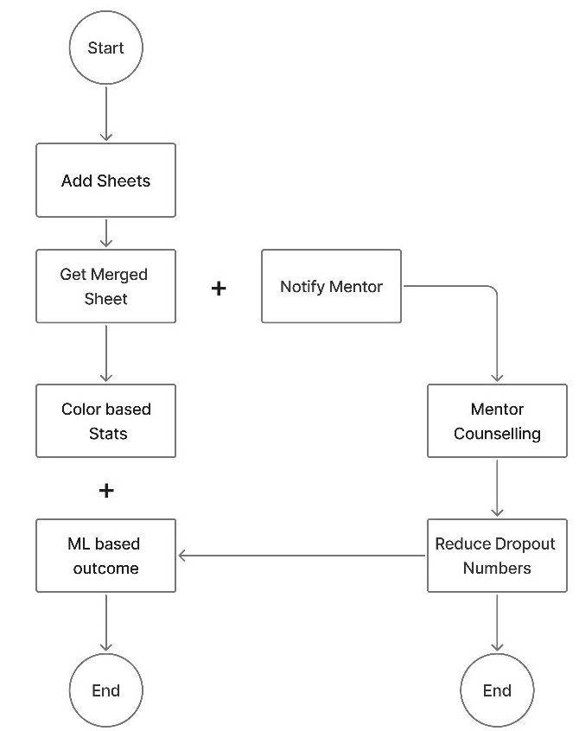
TECHNICAL APPROACH
TasselTurners
Technologies to be used:
Frontend : React.js , Tailwind CSS , Recharts
Backend : Node.js + Express , Python(flask)
ML Engine : Pandas, Scikit-learn
Database : PostgreSQL (SQL DB)
Notifications : smtplib, python(email)
File Handling : Pandas
Methodology:
Excel Upload → Backend API → Risk Engine → Database → Dashboards (Admin/Mentor/Faculty/Student) → Notifications→ Counseling → Resolution

Slide 4
FEASIBILITY AND VIABILITY
TasselTurners
Feasibility:
Uses existing institute spreadsheets → no extra cost.
Scalable across multiple departments/colleges.
Web-based & Simple UI → minimal training for faculty/mentors
Potential Challenges & Risk:
Data Quality(incomplete or inconsistent records).
Resistance from teachers unused digital dashboard.
Privacy concerns of students.
Strategies to Overcome:
Automated data cleaning.
Simple user interface with tooltips.
Role based access control for privacy.

Slide 5
IMPACT AND BENEFITS
TasselTurners
Impact on Target Audience:
🎓 Students: Support before disengagement → better academic success.
👨‍🏫 Mentors/Faculty: Clear insights, Early alerts = proactive counseling.
🏫 Colleges/Admins : Higher retention rates, improved reputation, data-driven decisions
👨‍👩‍👧 Parents : Early involvement will reduce dropout surprises.
Benefits:
🧑‍🤝‍🧑 Social: Reduces student stress
💰 Economic: Saves institutional resources and reputation which boosted by the pass percentage & Affordable solution
Educational : Data-driven mentoring, transparent process
🌱 Environmental: A centralized system that reduces manual record-keeping.
“One flag resolved = One future saved.”
A Student flagged for 55% attendance
Mentor Counselled
Risk resolved

Slide 6
RESEARCH AND REFERENCES
TasselTurners
Std IX to X Dropout data:- https://www.pib.gov.in/PressReleasePage.aspx?PRID=2161543
Higher Secondary School Retention Rate:- https://shorturl.at/THloH
College Dropout Data:- https://shorturl.at/qLQsy

