Slide 1
SecureLink
Production-grade encrypted messaging and attack detection platform

Slide 2
Snowflake / UNC5537
The June 2024 customer data theft campaign showed how stolen credentials and missing MFA can lead to cloud data theft and extortion.

Slide 3
What Failed
Stolen credentials, missing MFA, weak network allow lists, stale secrets, and limited anomaly detection created avoidable exposure.

Slide 4
Cryptography
AES-GCM, SHA-256, HMAC, RSA-PSS signatures, Diffie-Hellman, and JWT authentication.

Slide 5
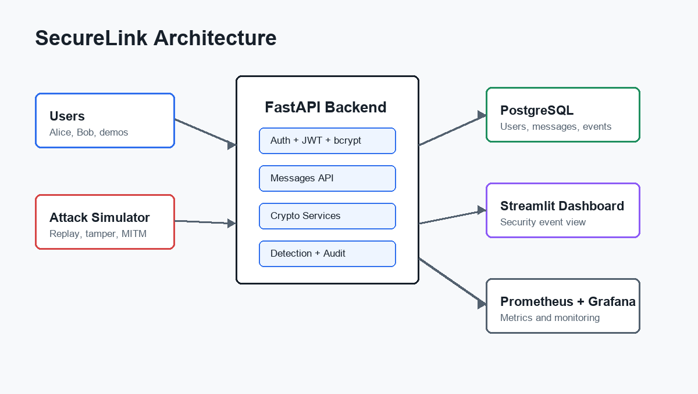
Architecture
FastAPI, PostgreSQL, Streamlit, Prometheus, Grafana, Redis, and Caddy TLS.

Slide 6
Message Flow
JWT auth, DH-derived session key, AES-GCM encryption, HMAC, RSA signature, verification before decrypt.

Slide 7
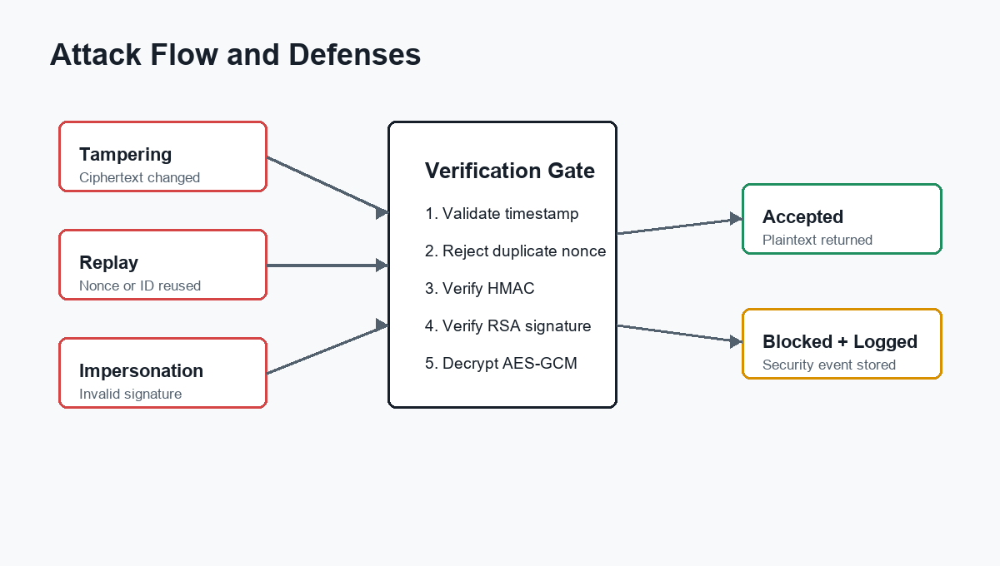
Attack Simulations
Replay, tampering, invalid signature, MITM, and brute-force login attempts are blocked or logged.

Slide 8
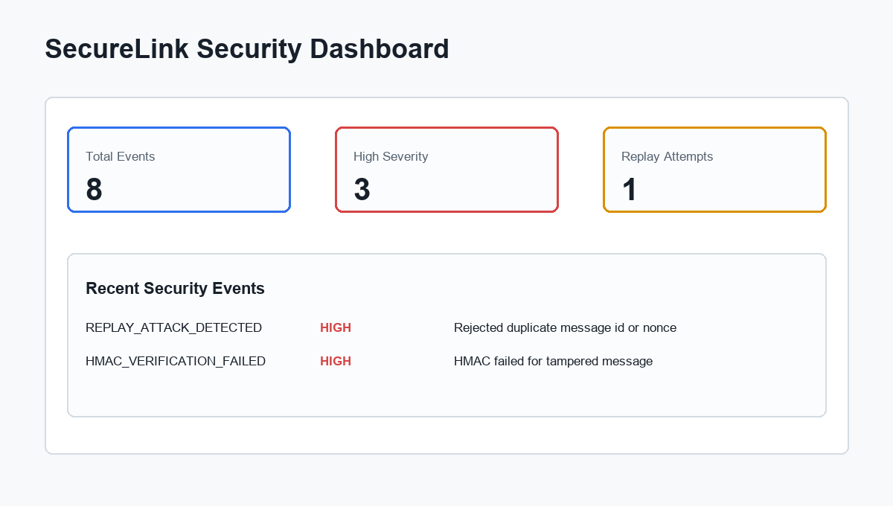
Monitoring
Security events appear in Streamlit; API metrics are exported to Prometheus and Grafana.

Slide 9
Recommendations
Use TLS, rate limiting, key rotation, audit logging, least privilege, and continuous monitoring.

Slide 10
Conclusion
SecureLink demonstrates layered cryptographic controls and intrusion-detection style visibility.

