Slide 1
Climate Change: Earth Surface Temperature Data
Team 13
Mitra Buggaveeti
Deeksha Reddy Ganta
Sai Kiran Reddy Bokka
Lahari Prathapagiri
Lakshmi Prasanna Adeboyena

Slide 2
Contents
Introduction to dataset
Business Problem or Opportunity
Working
Visualization
Results
Future work

Slide 3
Introduction to dataset
The Berkeley Earth Surface Temperature (BEST) dataset contains global surface temperature measurements starting from 1750 to the present day.
It includes monthly and annual average temperature readings for land and ocean locations, as well as estimates of uncertainties in the measurements.
The data is derived from a combination of sources including weather stations, ships, buoys, and satellite measurements.
The dataset is intended for use in research and analysis related to climate change, global warming, and related fields.
It contains over 8 million temperature readings and can be downloaded from the Kaggle website.

Slide 4
Business Problem or Opportunity
The chosen dataset can be used to address various business problems and opportunities such as:
Climate change research:
The dataset can be used to identify long-term trends in temperature and investigate the impact of climate change different regions around the world.
Sustainable development:
Businesses can use this dataset to inform sustainable development strategies, particularly for businesses operating in industries that are high emitters of greenhouse gases.
Risk assessment:
Businesses can identify regions at risk for extreme weather events and develop contingency plans.

Slide 5
Working
We have visualize the dataset by using data visualization libraries such as Matplotlib and Seaborn to create visualizations of the data and the models.
This helps to better understand the patterns and relationships in the data and to communicate the results of the analysis to others.

Slide 6
Visualization
We have visualize the dataset based on certain factors like
Temperature Variation in Charlotte from 1900 until 2000
Yearly charlotte temperatures
Monthly Avg Temperatures in Charlotte vs NYC'
Temperature Distribution by Decade in Charlotte
Yearly Temperatures in Charlotte
Linear regression model

Slide 7
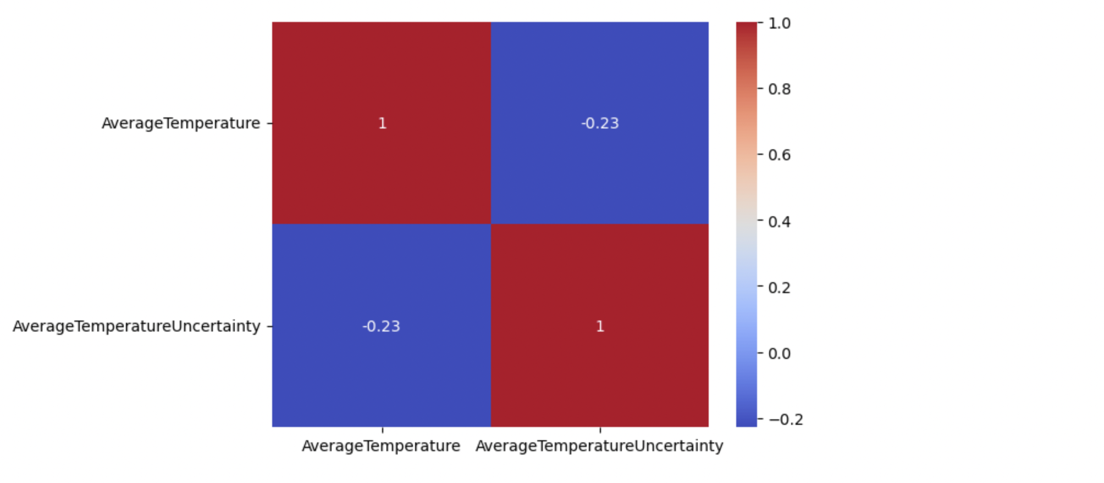
Results

Slide 8
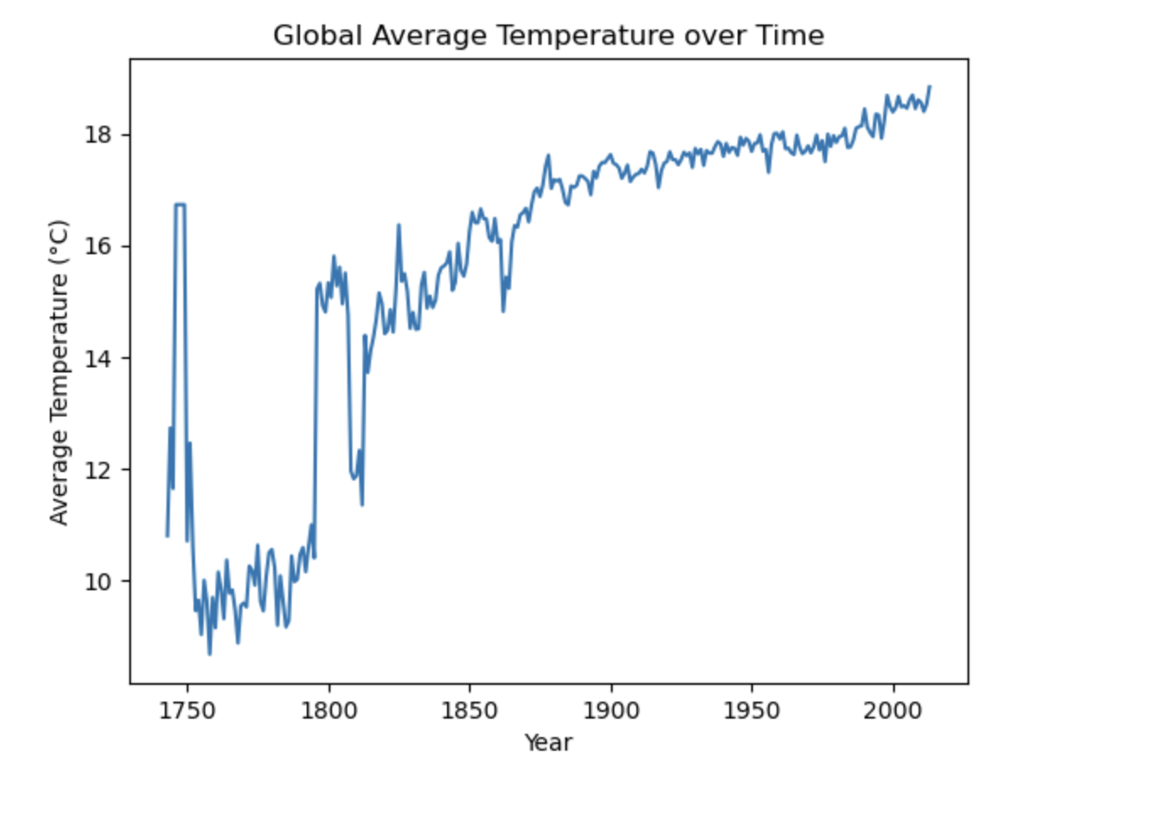
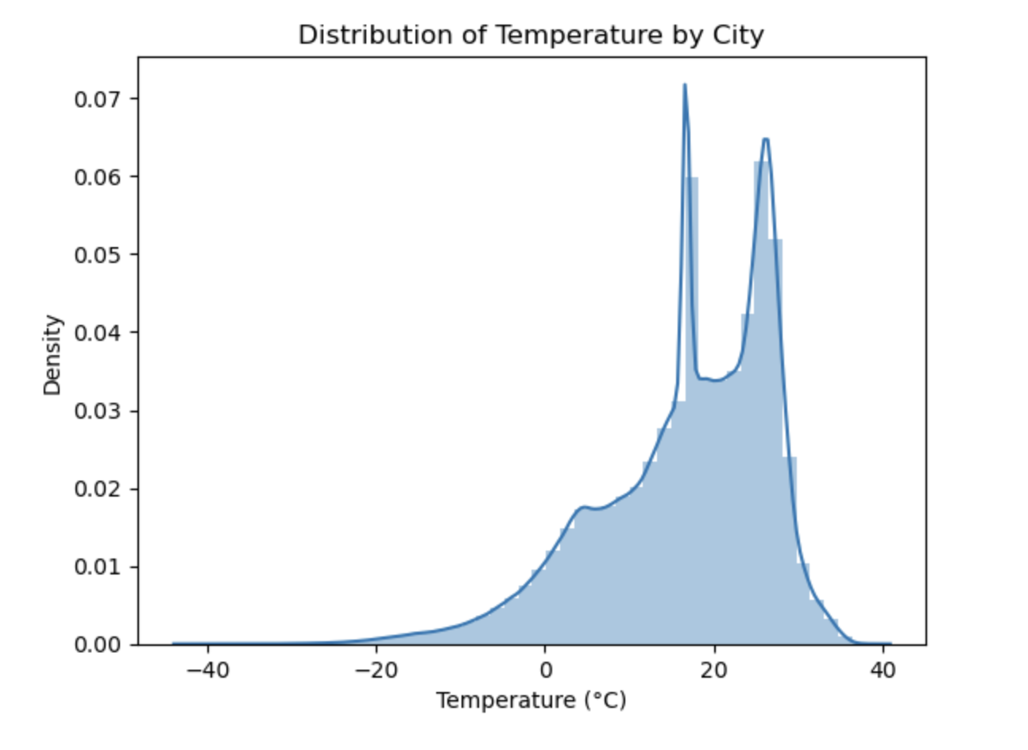

Slide 9
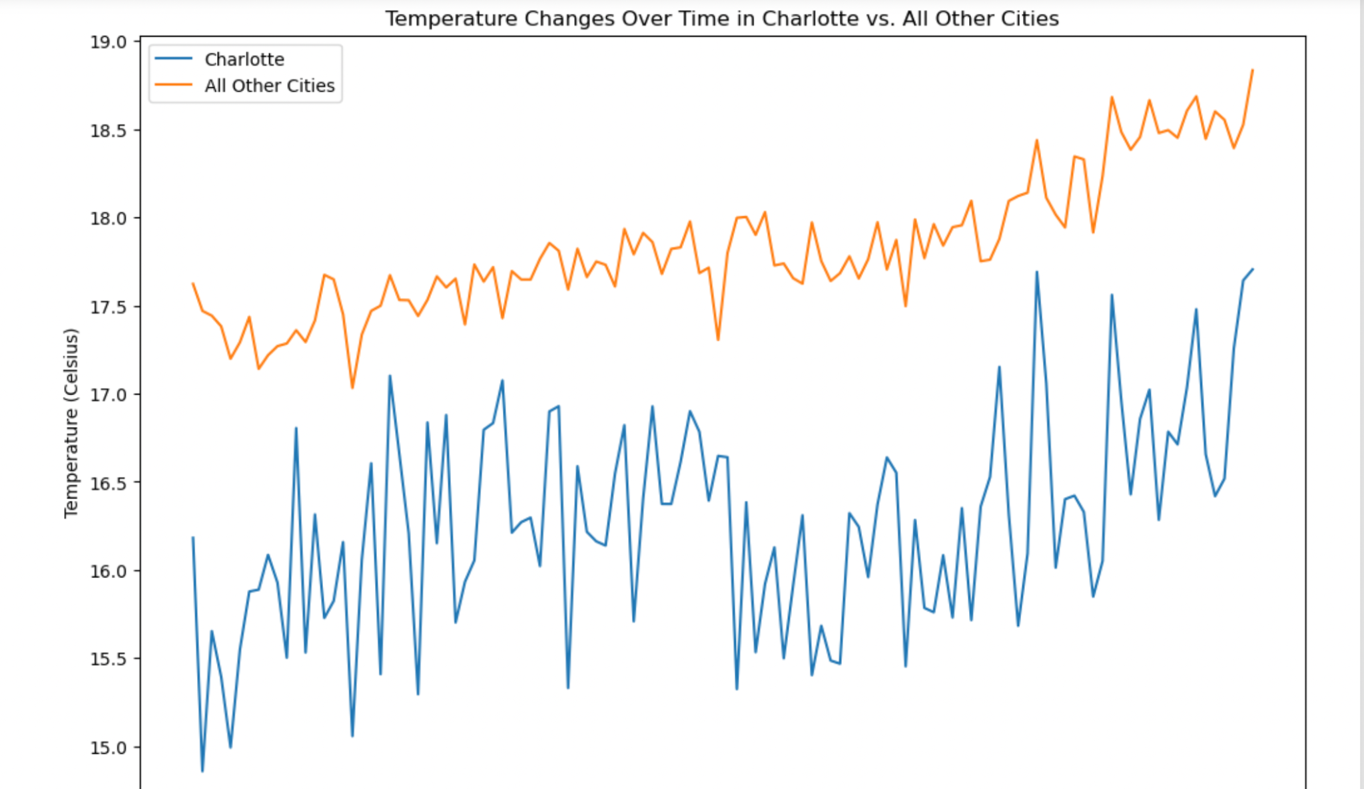
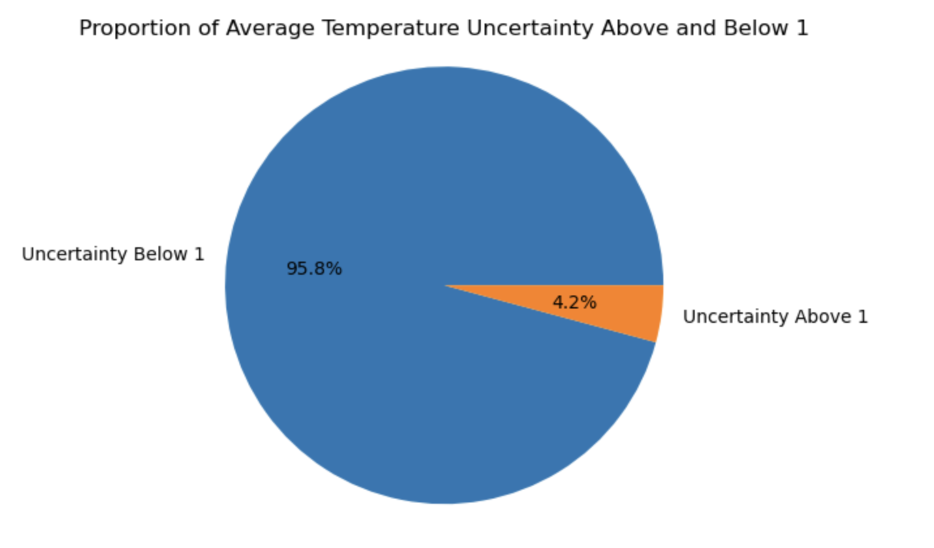

Slide 10
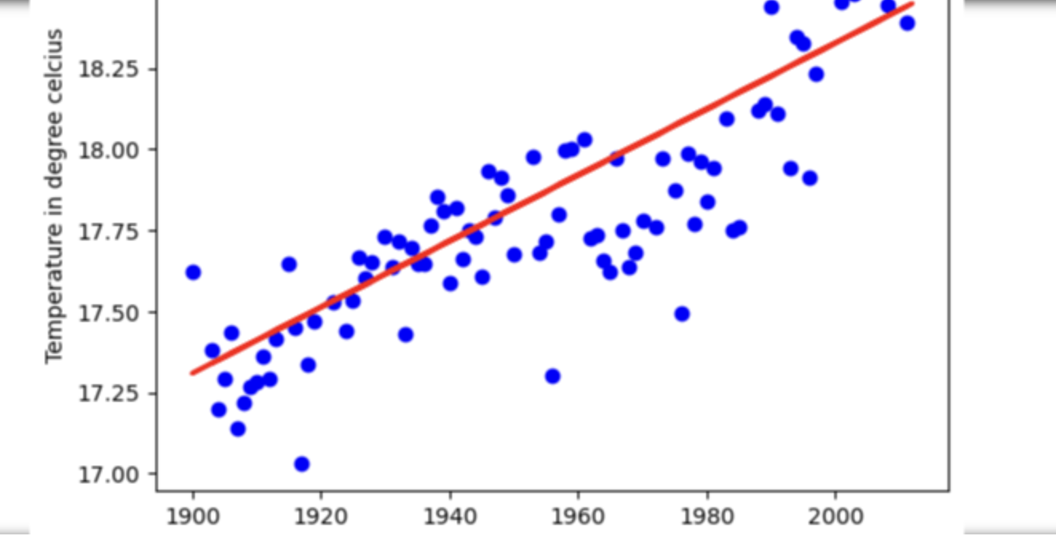
Linear Regression Model

Slide 11
Future Work
Using the visualizations and advancements we made to the set, we can predict the temperature values for the next few months (October, and November)

Slide 12
DataSet links & References
DataSet - https://www.kaggle.com/datasets/berkeleyearth/climate-change-earth-surface-temperature-data
Berkeley Earth data:
https://berkeleyearth.org/data/
Github link:
https://github.com/mitrabuggaveeti/BDA_Project_13

Slide 13
THANK YOU

