Slide 1
MODEL BUILDING
SRIRAM VADREVU
RUDRAMOORTHY
HARI KRISHNA JARABANI
Roshini DRAKSHAPALLY
MITRA BUGGAVEETI

Slide 2
MODELS USED
Convolution Neural Network
Linear Regression Model
K Nearest Neighbour Model
Decision Tree Model

Slide 3
ABOUT THE DATASET
The Dataset used in the model building is Fashion MNIST Dataset from Kaggle.
It consists of a training set of 60,000 examples and a test set of 10,000 examples.
Every image is 28 pixels in height and 20 pixels in width, which is total of 784 pixels in total. Each pixel is associated with a pixel value which ranges from 0 to 255.
Each image is to be classified by referring them to label numbers ranging from 0 to 9. Each label has its own value such as, T-shirt, Trouser, Dress, Sneaker etc.

Slide 4
LOADING AND Cleaning THE DATA
In first step, we imported the libraries that are to be used.
Loaded the train and test csv file in the local folder.
Normalized the pixel value for better results.

Slide 5
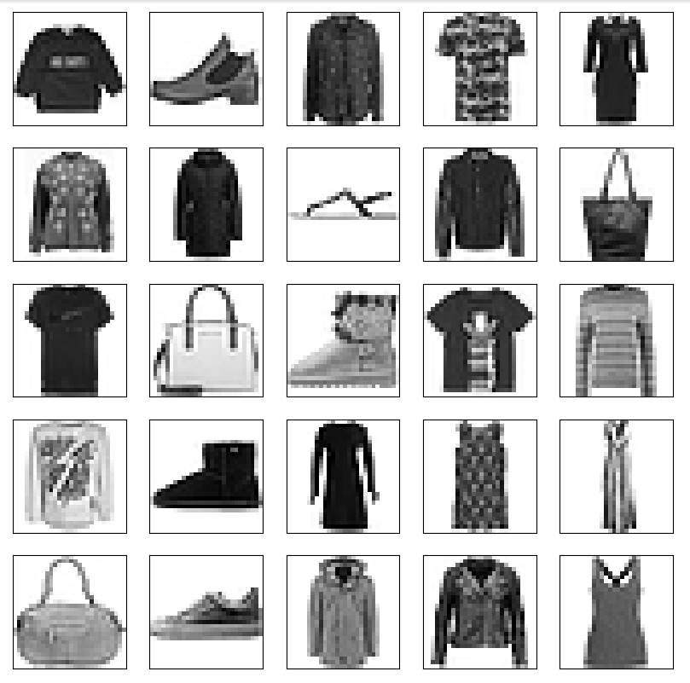

Slide 6
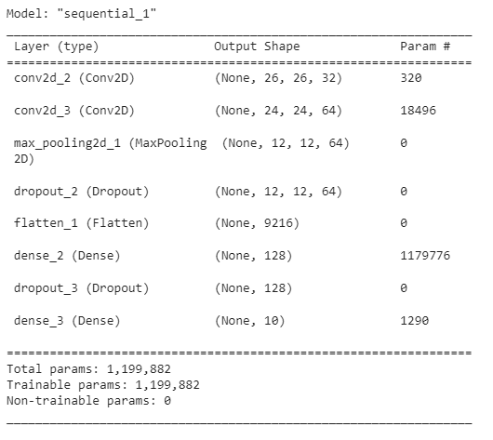
Convolution neural network
Final model summary
Created a CNN model using Conv, MaxPooling, Dropout and Dense layers.
Compiled, Trained and evaluated the model by calculating the Accuracy Score.
Performed for 10 epochs for better accuracy.

Slide 7
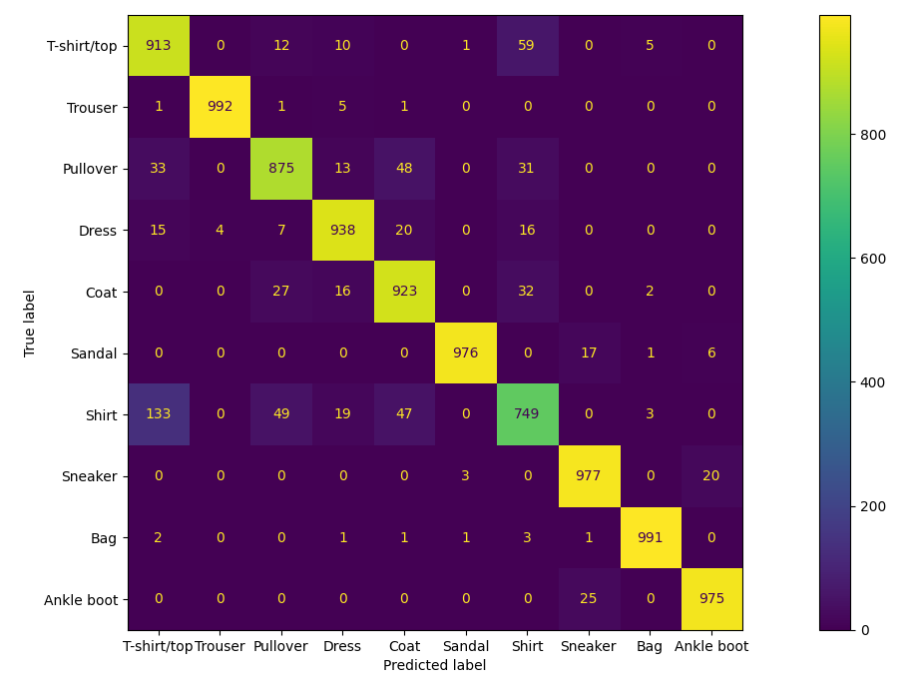
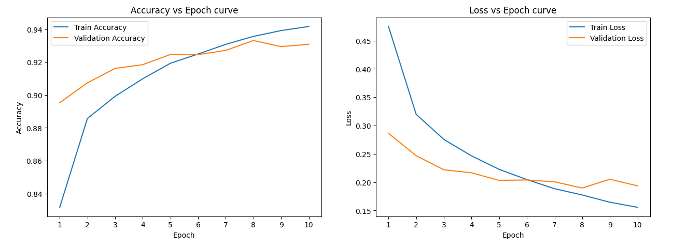
CONFUSION MATRIX

Slide 8
LINEAR REGRESSION MODEL
The MNIST Fashion dataset is better suited for classification than regression, hence linear regression is not a good fit.
A supervised learning process called linear regression models the relationship between a dependent variable and one or more independent variables and seeks the best-fitting linear function for the data.

Slide 9
K-NEAREST NEIGHBOUR MODEL
The MNIST Fashion dataset is a classification problem, hence K-Nearest Neighbors (KNN), a form of supervised learning method, is a good fit.
KNN is a non-parametric algorithm that functions by locating the k closest training instances in the feature space and uses their labels to predict the label of a new sample.

Slide 10
Decision tree model
A decision tree model is a type of machine learning algorithm that builds a tree-like model of decisions and their possible consequences.
The decision tree model can be trained on a subset of the MNIST Fashion dataset, and the performance of the model can be evaluated using metrics such as accuracy, precision, and recall.
The accuracy of the model indicates the percentage of correct predictions, while the precision and recall measure the model's ability to correctly identify positive and negative samples, respectively.

Slide 11
TABLE OF EVALUATION
Models | Accuracy Score | loss | MSE | MAE | R sQUARE
CNN | 93.09% | 0.1936 | - | - | -
LINEAR REGRESSION | 32.28% | - | 1.9638 | 1.0140 | 0.7619
KNN MODEL | 85.61% | - | 1.9864 | 0.4742 | 0.75922
DECISION TREE MODEL | 79.84% | - | 2.6799 | 0.6455 | 0.67516

Slide 12
EVALUATION OF MODELS
Evaluation of a model can be done in many ways. We may use Accuracy Score, Loss, Confusion Matrix, Mean Squared Error Value, Absolute Squared Error Value or R-score for evaluation.
CNN can be evaluated using Confusion matrix as it is a Classification model, whereas the other three models can be evaluated by Mean Squared Error Value, Absolute Squared Error Value or R-score.
By comparing the Accuracy Scores, CNN has highest accuracy value and it is the most efficient model for MNIST Fashion Dataset.

Slide 13
THANK YOU

