Slide 1
PARKING MANAGEMENT SYSTEM
BUGGAVEETI MITRA (16BD1A052L) BANDARU SANDEEP (16BD1A0522) CHAITANYA POHNERKAR (16BD1A052P) ASHOK KUMAR BANOTH (16BD1A0524)

Slide 2
INTRODUCTION
Parking Management system is a web-based application to the facilitate parking for customers. In this system, customer can register in the application and get user id and password. Administrator will manage all the events adding, deleting and updating the slots. Existing system is very difficult to manage and it is a time-consuming process. More manual work is needed. In order to overcome all these problems, the project is developed from manual procedure to automate.

Slide 3
PURPOSE AND SCOPE
Parking management system is used to manage all the activity related to parking. The traditional parking system is highly dependent on manual work. The search for a parking space is also a tedious task.
Failing which will force the person to move on to the next parking space with no guarantee of finding a free space either. This process can be highly simplified by providing an automated system.
This system is applicable to any place that has a parking facility. For example parking in places like malls, cinema theatres, stadiums etc.

Slide 4

TECHNOLOGIES
Server Side
Front End
React JS
HTML,CSS
Back End
Node JS
Mongo DB
Client Side
Internet Browser

Slide 5
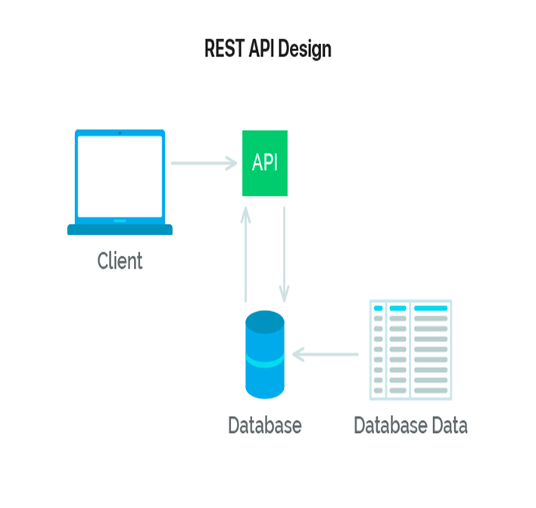
REST API
REST stands for REpresentational State Transfer
An API can be considered “RESTful” if it has the following features (not a complete list just the main ones):
Client–server – The client handles the front end the server handles the backend and can both be replaced independently of each other.
Stateless – No client data is stored on the server between requests and session state is stored on the client.
Cacheable – Clients can cache response (just like browsers caching static elements of a web page) to improve performance.

Slide 6
FUNCTIONAL REQUIREMENTS
User Registration
User Login
User Profile
Selecting & Booking Parking Slot
Active Bookings
Admin panel
Log out

Slide 7
NON-FUNCTIONAL REQUIREMENTS
Should be available for installation on computer.
Crashing of application should not occur.
Response time for each query sent by the user should be minimum.
Application should be updated properly.

Slide 8
LITERATURE SURVEY
In today’s world parking lots have become redundant and needs lot of manpower to handle and maintain it. These parking lots are not user friendly and do not provide data regarding availability of free spaces.
Many researchers have contributed to this issue and formalised with various methods to better optimise the parking lot to serve the needs.As the involvement of technology in everyday life has been increasing day by day, providing online solutions to parking is no surprise. User can pre-book his parking slot in any desired parking just by using an online parking system.

Slide 9
USE CASE DIAGRAM
A cornerstone part of the system is the functional requirements that the system fulfils. Use Case diagrams are used to analyze the system’s high-level requirements.
These requirements are expressed through different use cases.
A use case diagram is a dynamic or behavior diagram in UML. Use case diagrams model the functionality of a system using actors and use cases. Use cases are a set of actions, services, and functions that the system needs to perform.

Slide 10
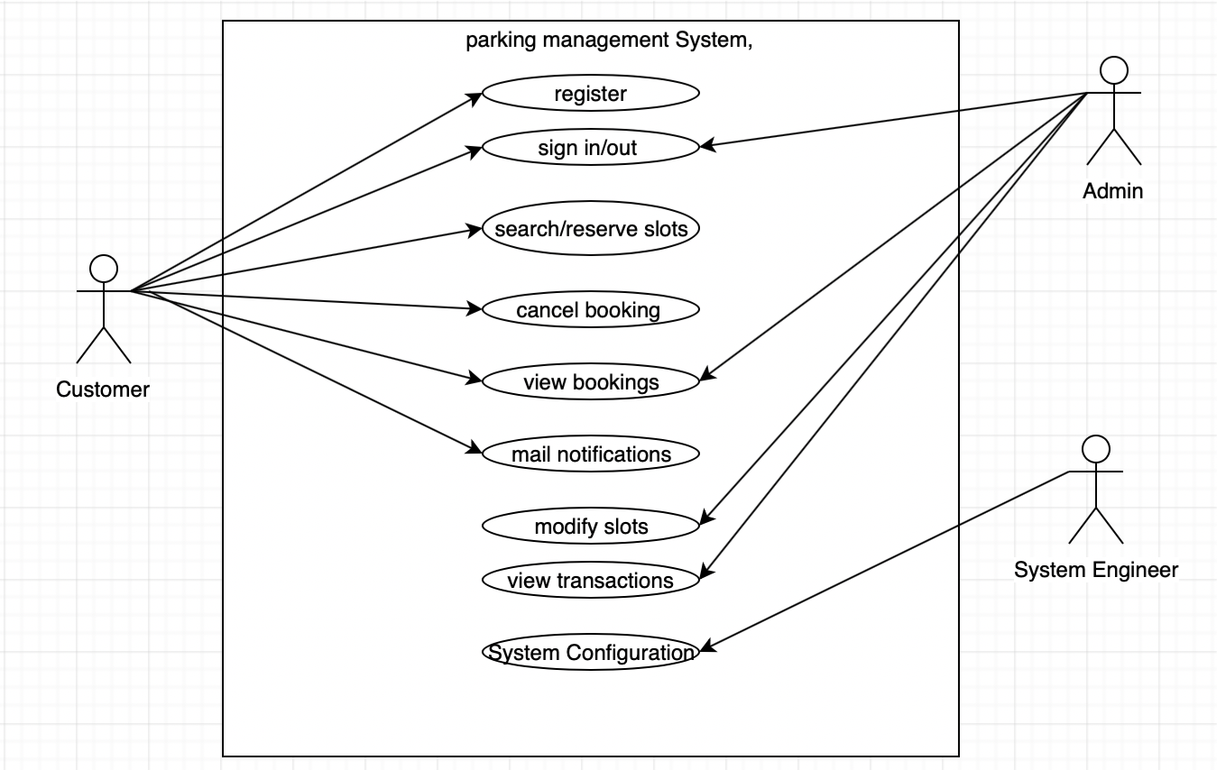
USE CASE DIAGRAM FOR PARKING MANAGEMENT SYSTEM

Slide 11
CLASS DIAGRAM
Class UML diagram is the most common diagram type for software documentation.
Class diagrams contain classes, alongside with their attributes (also referred to as data fields) and their behaviour (also referred to as member functions).
More specifically, each class has 3 fields: the class name at the top, the class attributes right below the name, the class operations/ behaviour at the bottom.

Slide 12
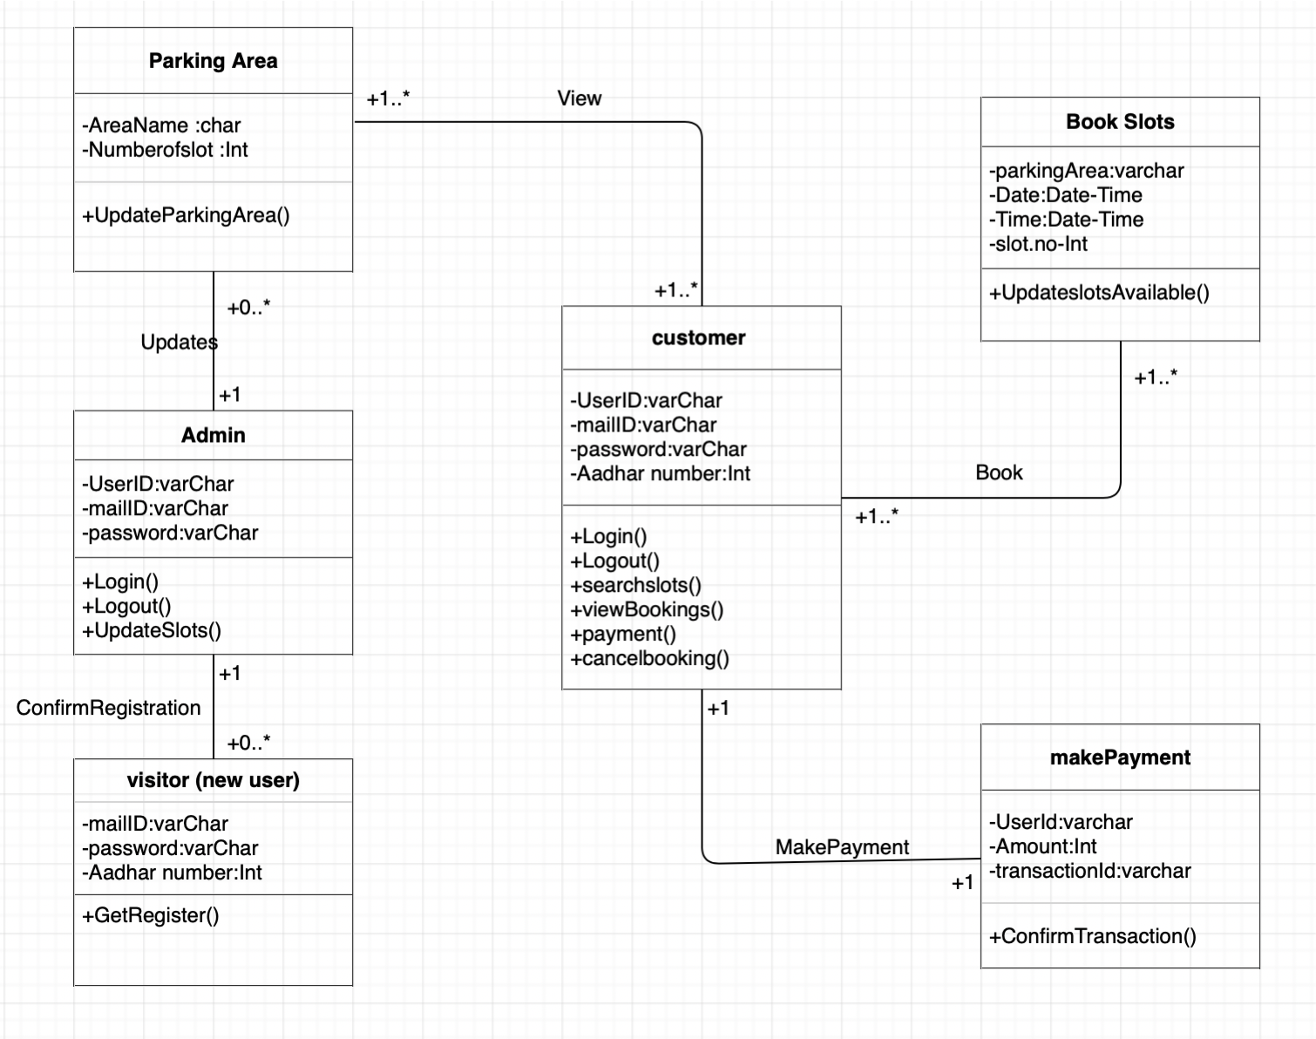
CLASS DIAGRAM FOR PARKING MANAGEMENT SYSTEM

Slide 13
ACTIVITY DIAGRAM
Activity diagram is another important diagram in UML to describe the dynamic aspects of the system.
Activity diagram is basically a flowchart to represent the flow from one activity to another activity. The activity can be described as an operation of the system.
The control flow is drawn from one operation to another. This flow can be sequential, branched, or concurrent.

Slide 14
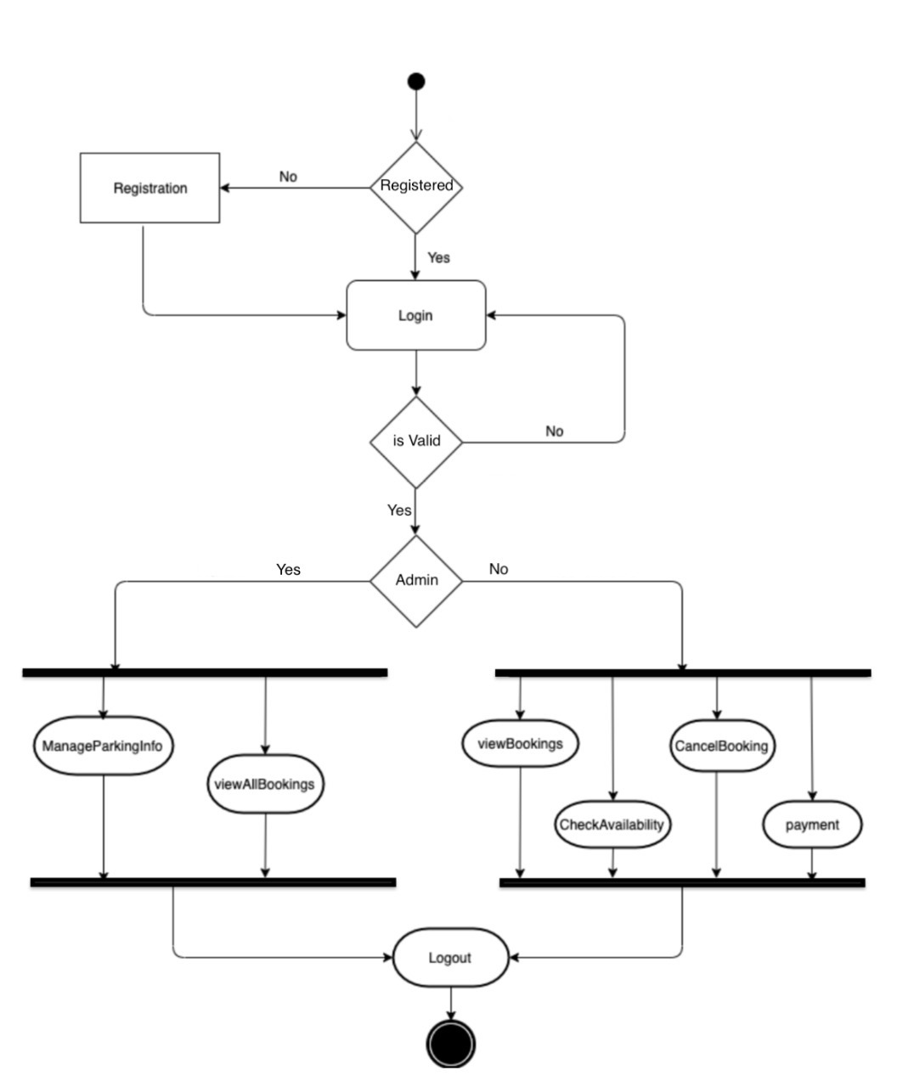
ACTIVITY DIAGRAM FOR PARKING MANAGEMENT SYSTEM

Slide 15
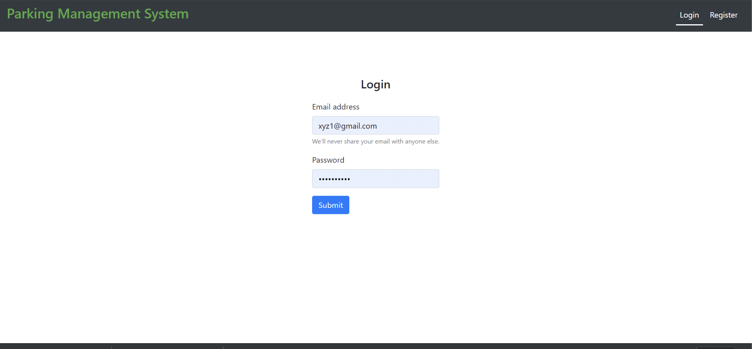
IMPLEMENTATION
User Login:

Slide 16
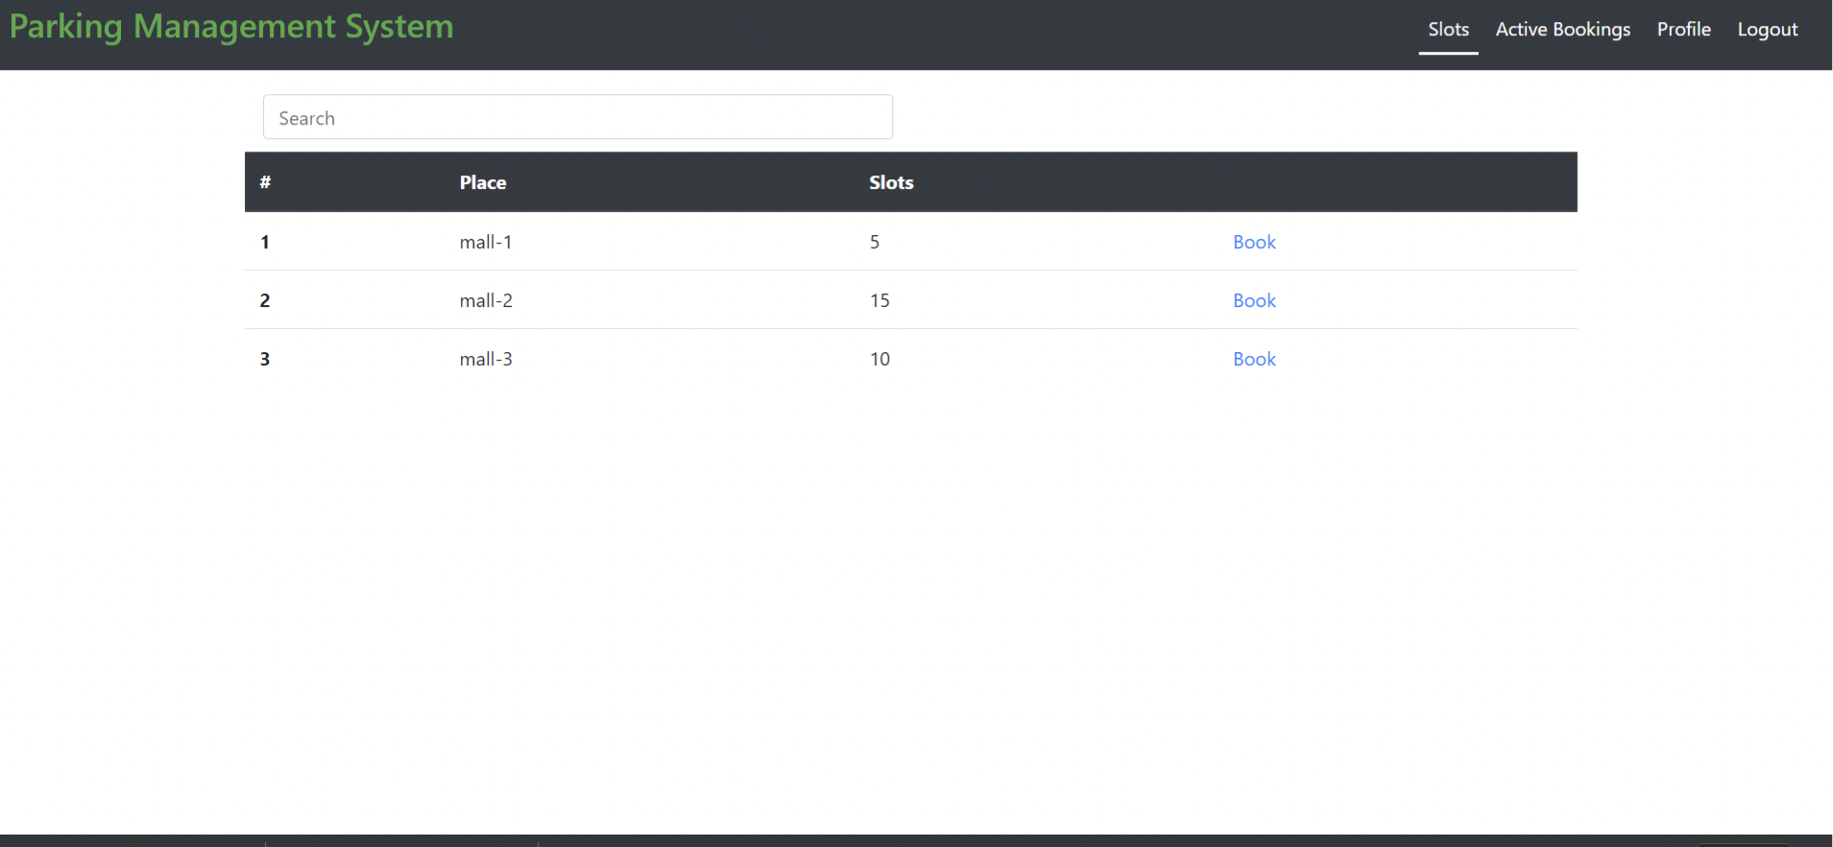
Parking slots Search page:

Slide 17
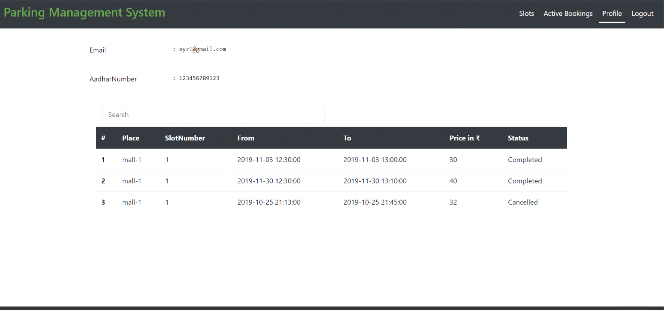
Profile and Previous booking history page

Slide 18
ADVANTAGES
• It is highly feasible for extremely small sites that are unable to accommodate a conventional ramped parking structure.
• There is high parking efficiency (i.e. sf/space and cf/space).
• There is no need for driving while looking for an available space.
• Emissions are greatly brought down and reduced.
• The patrons wait for their car in a highly controlled environment.
• There is a minimal staff requirement if it is used by known parkers.

Slide 19
LIMITATIONS
• There is a greater construction cost per space (For new exclusive parking slots)
• It may be a bit confusing for unfamiliar users.
• It is not recommended for high peak hour volume facilities.
• There is an uncertain building department review and approval process.
• It requires a maintenance contract with the supplier.
• There is a minimal staff requirement if it is used by known parkers.

Slide 20
FUTURE ENHANCEMENTS FOR THIS SYSTEM
Refund upon cancellation.
Email integration for ‘forgot password’ feature.
Validation of Aadhar Card.
A system to check if parking slot is emptied before/after allocated time expires.

Slide 21
CONCLUSION
The systems proposed helps us effectively in reserving as well as eliminates the need for searching of a parking space in parking lot. This project is implemented for satisfying the different needs of drivers and service providers, which is based on real-time parking information, also helps to manage the problem faced by drivers on day to day basis.

Slide 22
REFERENCES
https://nodejs.org/en/docs/
https://www.mongodb.com/
https://reactjs.org/
https://redux.js.org/

Slide 23
THANK YOU

