Slide 1
BMI/Harmony: Experimental Protocol
July 27, 2022

Slide 2
High-Level Explanation
Characterize the Start and Stop Motor Imagery with and without Harmony.

Slide 3
Procedure Outline
Measure for robot
Fit EEG Cap and EOG electrodes
EOG Calibration (90 sec)
20 trials without Harmony (6 min)
20 trials with Harmony (6 min)

Slide 4
Visual Interface

Slide 5
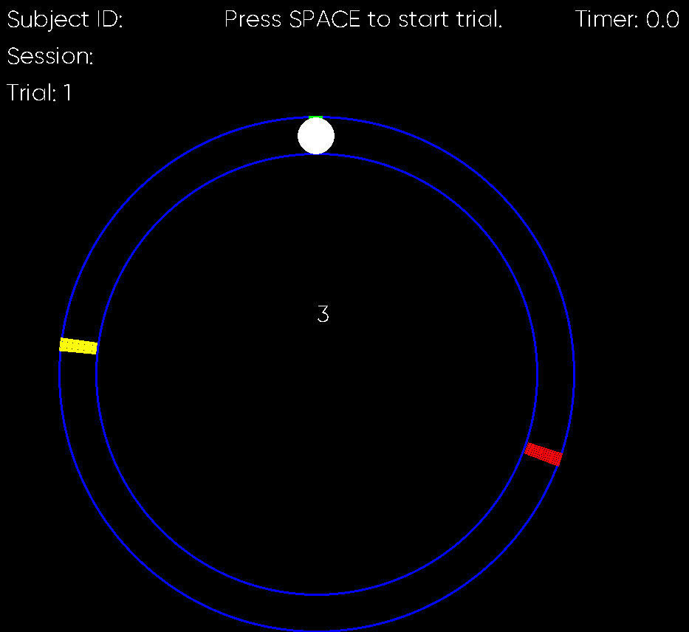
Fixation (3 sec)
Begin MI (2-4 sec)
20 trials
Rest (7 sec)
End MI (6-8 sec)

