Slide 1
Abstract
Abstract
Introduction
Modules
Architecture Model
Software/Hardware Requirements
Screenshots
Conclusion
Future Enhancement
References
The stock market prediction has been a classical yet, it’s impossible to predict a stock price correctly most of the time. So, the question arises, if humans can estimate and consider all factors to predict a movement or a future value of a stock, why can’t machines? Or, rephrasing, how can we make machines predict the value for a stock?
A stock price may depend on several factors operating in the current world and stock market such as physical factors, physiological, rational and irrational behavior, etc.

Slide 2
Abstract
Abstract
Introduction
Modules
Architecture Model
Software/Hardware Requirements
Screenshots
Conclusion
Future Enhancement
References
There are two common approaches to pick a stock, the first is fundamental analysis and the second is technical analysis.
Both fundamental analysis and technical analysis can be used to determine if an investment in a stock is attractive or not and to further forecast the future trends of stocks.
We think if we can manage to bring these two analysis and with one more analysis i.e., Sentiment analysis into effect, we can make our predictor a bit more effective for using in trading predictions through LSTM networks.

Slide 3
Abstract
Introduction
Modules
Architecture Model
Software/Hardware Requirements
Screenshots
Conclusion
Future Enhancement
References
Abstract
Introduction
Existing System
Proposed System
Software requirements
Architecture Model
Modules
UML Diagrams/ER Diagrams/Flow Charts
References
Introduction
Stock price prediction?
Its aims is to determine the future movement of the stock value of a financial exchange.
We can use Machine learning via text mining innovation methods to successfully predict the stock market changes.
Stock analysis?
It refers to the method that an investor or trader uses to evaluate and investigate a particular trading instrument, investment sector, or the stock market.
Stock analysis is also called equity analysis or market analysis.

Slide 4
Abstract
Introduction
Modules
Architecture Model
Software/Hardware Requirements
Screenshots
Conclusion
Future Enhancement
References
Abstract
Introduction
Existing System
Proposed System
Software requirements
Architecture Model
Modules
UML Diagrams/ER Diagrams/Flow Charts
References
Introduction
Investors or traders make buying or selling decisions based on stock analysis information.
Fundamental Analysis:
This analysis follows on impact and correlation of stock prices of other companies, past performances, records, profits, and debts of the company.
It also uses Different key ratios to determine the financial health and understand the true value of a company’s stock. Such as Earnings per share (EPS), Price to Earnings ratio (P/E), Price to Earnings to Growth ratio (PEG), Return on Equity (ROE) etc.

Slide 5
Abstract
Introduction
Modules
Architecture Model
Software/Hardware Requirements
Screenshots
Conclusion
Future Enhancement
References
Abstract
Introduction
Existing System
Proposed System
Software requirements
Architecture Model
Modules
UML Diagrams/ER Diagrams/Flow Charts
References
Introduction
Technical Analysis:
This method involves in reading the charts and using statistical figures to identify the trends in the stock market.
This method include the patterns like Bullish candlestick pattern, Bearish candlestick pattern, Continuation Pattern, etc. And, Indicators like Leading, Lagging, etc.
Sentiment analysis:
It is the process of detecting positive or negative sentiment in text.

Slide 6
Abstract
Introduction
Modules
Architecture Model
Software/Hardware Requirements
Screenshots
Conclusion
Future Enhancement
References
Abstract
Introduction
Existing System
Proposed System
Software requirements
Architecture Model
Modules
UML Diagrams/ER Diagrams/Flow Charts
References
Introduction
It’s often used by businesses to detect sentiment in social data, gauge brand reputation, and understand customers.
Sentiment analysis models focus on polarity (positive, negative, neutral) but also on feelings and emotions (angry, happy, sad, etc.), urgency (urgent, not urgent) and even intentions (interested, not interested).

Slide 7
Abstract
Introduction
Modules
Architecture Model
Software/Hardware Requirements
Screenshots
Conclusion
Future Enhancement
References
Abstract
Introduction
Existing System
Proposed System
Software requirements
Architecture Model
Modules
UML Diagrams/ER Diagrams/Flow Charts
References
Existing System
LITERATURE SURVEY like Historical Data Analysis, Multi-Source Multiple Instance Learning, Support Vector Machines (SVM) and Independent Component Analysis (ICA) are used for Stock Market Prediction.
It doesn't exploit data pre-processing techniques to remove inconsistency and incompleteness of the data.
The existing system does not perform well when there is a change in the operating environment.
Here reported that existing system highly predictive values, by selecting an appropriate time period for their experiment to obtain highly predictive scores.

Slide 8
Abstract
Introduction
Modules
Architecture Model
Software/Hardware Requirements
Screenshots
Conclusion
Future Enhancement
References
Abstract
Introduction
Existing System
Proposed System
Software requirements
Architecture Model
Modules
UML Diagrams/ER Diagrams/Flow Charts
References
Existing System
The impact of the financial ratios and technical analysis on stock price forecasting using random forests, The use of AI and human-made awareness frameworks to predict stock costs is growing example.
A constantly increasing no.of experts spend their time every day considering ways to deal with techniques that can further improve the precision of the stock conjecture model.
As a result of galactic no.of decisions available, there can be ‘n’ no.of ways on the most capable strategy to envision the expense of stock, anyway all techniques

Slide 9
Abstract
Introduction
Modules
Architecture Model
Software/Hardware Requirements
Screenshots
Conclusion
Future Enhancement
References
Abstract
Introduction
Existing System
Proposed System
Software requirements
Architecture Model
Modules
UML Diagrams/ER Diagrams/Flow Charts
References
Existing System
don’t work a comparable way.
The yield changes for each methodology whether or not comparative educational file is being applied.
In the alluded to paper the stock worth gauge has been finished by utilizing the self-confident timberland figuring is being used to betoken the expense of the stock utilizing fiscal extents structure the perspective quarter.
This is a single technique for optically crusading the circumstance by advancing toward it utilizing an insightful model, utilizing the capricious boondocks to anticipate the future expense of stock from data.

Slide 10
Abstract
Introduction
Modules
Architecture Model
Software/Hardware Requirements
Screenshots
Conclusion
Future Enhancement
References
Abstract
Introduction
Existing System
Proposed System
Software requirements
Architecture Model
Modules
UML Diagrams/ER Diagrams/Flow Charts
References
Existing System
Disadvantages of Existing System:
In statistical analysis data pre-processing techniques on data are does not used. Which exploits inconsistency and incompleteness in data.
In alternative approach, it does not consider long-term trading strategies as it fails to take the entire history of trends into account; furthermore, there is no provision for outlier detection.
In using GA (Genetic Algorithms), we fail to capture correlation between stock prices in the form of long-term temporal dependencies.
The major issue with using simple ANNs for stock prediction is the phenomenon of exploding / vanishing gradient, where the weights of a large network either become too large or too small (respectively), drastically slowing their convergence to the optimal value.

Slide 11
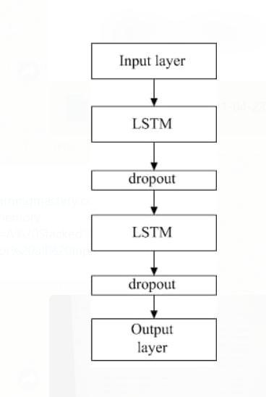
Abstract
Introduction
Modules
Architecture Model
Software/Hardware Requirements
Screenshots
Conclusion
Future Enhancement
References
Abstract
Introduction
Existing System
Proposed System
Software requirements
Architecture Model
Modules
UML Diagrams/ER Diagrams/Flow Charts
References
Proposed System

Slide 12
Abstract
Introduction
Modules
Architecture Model
Software/Hardware Requirements
Screenshots
Conclusion
Future Enhancement
References
Abstract
Introduction
Existing System
Proposed System
Software requirements
Architecture Model
Modules
UML Diagrams/ER Diagrams/Flow Charts
References
Proposed System
Accuracy plays an important role in stock market prediction. Although many algorithms are available for this purpose, selecting the most accurate one continues to be the fundamental task in getting the best results.
In order to achieve this, we proposed model that can analyzes the past study & present data and, gives an idea in order of creating methodologies to select stocks.
Our proposed model overcomes the lack of implementation of financial analysis methods.
This project aims to perform fundamental analysis, technical analysis and sentiment analysis to make our predictor a bit more effective and get information about the intrinsic values of the companies as well as the right entry and exit prices for investing in stocks, followed by an LSTM network to predict the future values.

Slide 13
Abstract
Introduction
Modules
Architecture Model
Software/Hardware Requirements
Screenshots
Conclusion
Future Enhancement
References
Abstract
Introduction
Existing System
Proposed System
Software requirements
Architecture Model
Modules
UML Diagrams/ER Diagrams/Flow Charts
References
Proposed System
This project aims to perform fundamental analysis, technical analysis and sentiment analysis to make our predictor a bit more effective and get information about the intrinsic values of the companies as well as the right entry and exit prices for investing in stocks, followed by an LSTM network to predict the future values.
The typical LSTM unit consists of a cell, an info door, an entrance door and a door with a view.
The cell collects values over discretionary time intervals, and the three inputs manage the progress of data into and out of the cell.

Slide 14
Abstract
Introduction
Modules
Architecture Model
Software/Hardware Requirements
Screenshots
Conclusion
Future Enhancement
References
Abstract
Introduction
Existing System
Proposed System
Software requirements
Architecture Model
Modules
UML Diagrams/ER Diagrams/Flow Charts
References
Proposed System
Advantages of Proposed System:
Forget gate: the forget gate decides when specific portions of the cell state are to be replaced with more recent information. It outputs values close to 1 for parts of the cell state that should be retained, and zero for values that should be neglected.
Input gate: based on the input (i.e., previous output o(t-1), input x(t), and previous cell state c(t-1)), this section of the network learns the conditions under which any information should be stored (or updated) in the cell state.
Output gate: depending on the input and cell state, this portion decides what information is propagated forward (i.e., output o(t) and cell state c(t)) to the next node in the network.

Slide 15
Modules
Abstract
Introduction
Modules
Architecture Model
Software/Hardware Requirements
Screenshots
Conclusion
Future Enhancement
References
There are 3 modules in prediction of stock price:
Data Preprocessing
Analysis module
Predictor module
Data Preprocessing:
Stock data is collected and pre-processed according to the requirements.
Analysis module:
Fundamental and Technical analysis are applied to the pre-processed data

Slide 16
Modules
Abstract
Introduction
Modules
Architecture Model
Software/Hardware Requirements
Screenshots
Conclusion
Future Enhancement
References
Predictor module:
Stock price prediction can be done using Machine Learning (Classification and Regression) Algorithms.
But the data collected in stock prediction is huge. To handle to the data, we are using Deep Learning algorithm(LSTM Network).
In order to get best accuracy sentimental analysis is applied to the LSTM model.

Slide 17
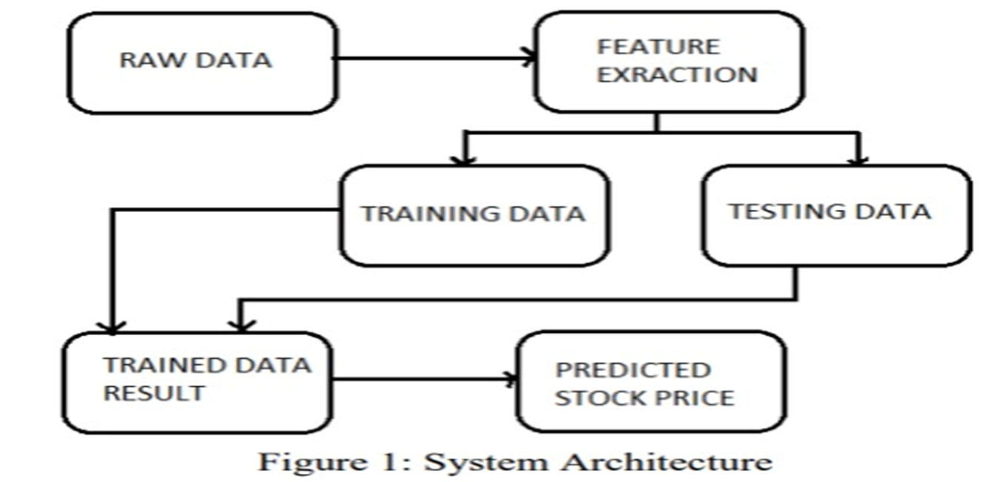
Architectural Model
Abstract
Introduction
Modules
Architecture Model
Software/Hardware Requirements
Screenshots
Conclusion
Future Enhancement
References

Slide 18
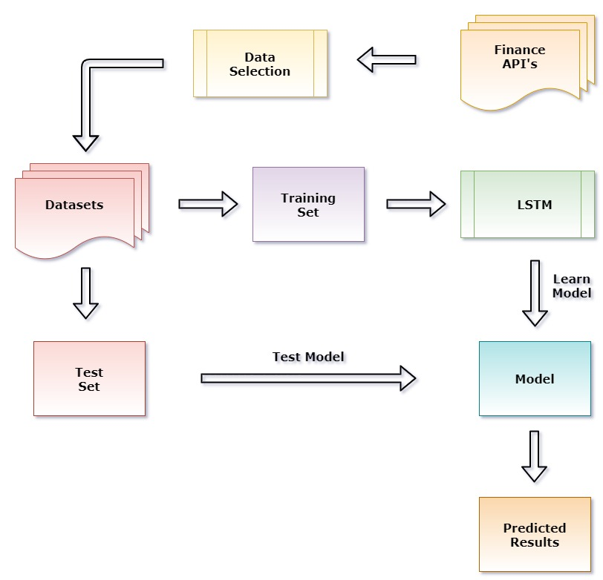
Architectural Model
Abstract
Introduction
Modules
Architecture Model
Software/Hardware Requirements
Screenshots
Conclusion
Future Enhancement
References

Slide 19
Introduction
Existing System
Proposed System
Software Requirements
References
Abstract
Introduction
Modules
Architecture Model
UML / Data Flow/ Flow Chart
Screenshots
Conclusion
Future Enhancement
References
UML / Data Flow/ Flow Chart
Algorithm
Step 1: Start
Step 2: Collecting Stock data of a company
Step 3: Perform pre-processing on collected stock data
Step 4: Apply Fundamental and Technical analysis on pre-processed data
Step 5: Train the LSTM model with data from step 4. In order to get best accuracy apply sentimental analysis.
Step 6: Stop

Slide 20
Raw data
Model into time series
Processed data
LSTM
Prediction Results
Visualization

Slide 21
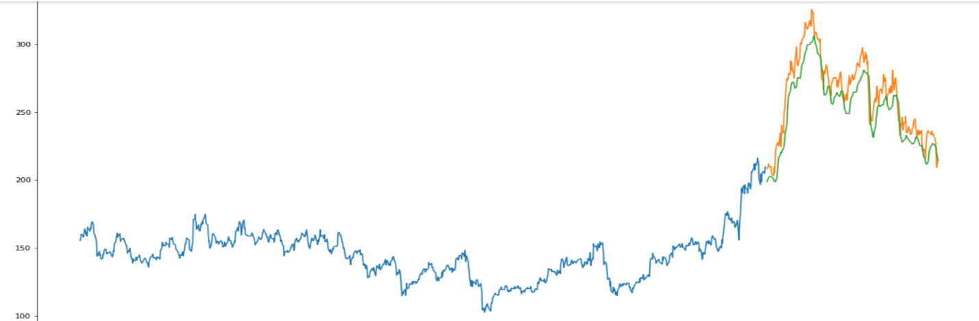
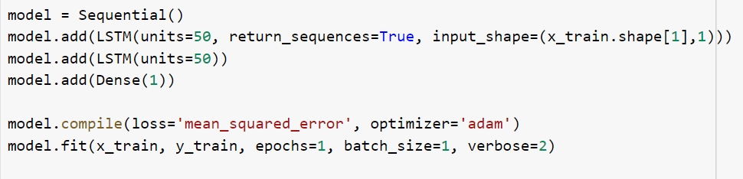
Screenshots & Test Cases
Abstract
Introduction
Modules
Architecture Model
Software/Hardware Requirements
Screenshots & Test Cases
Conclusion
Future Enhancement
References

Slide 22
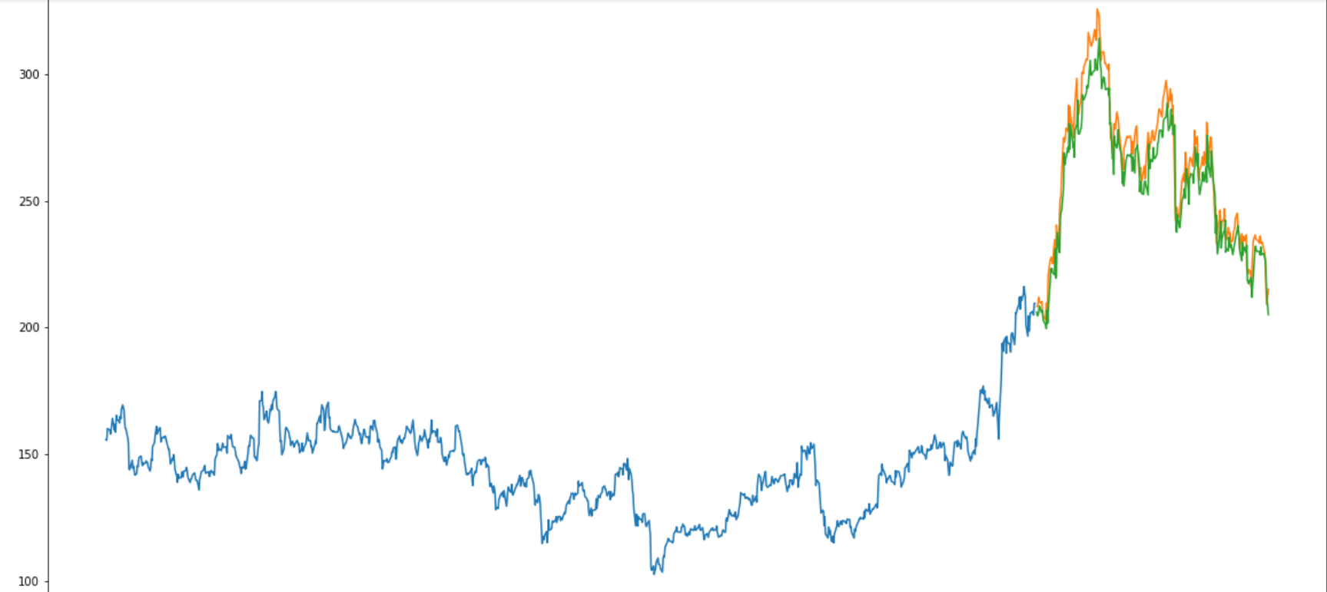
LSTM with FA and TA

Slide 23
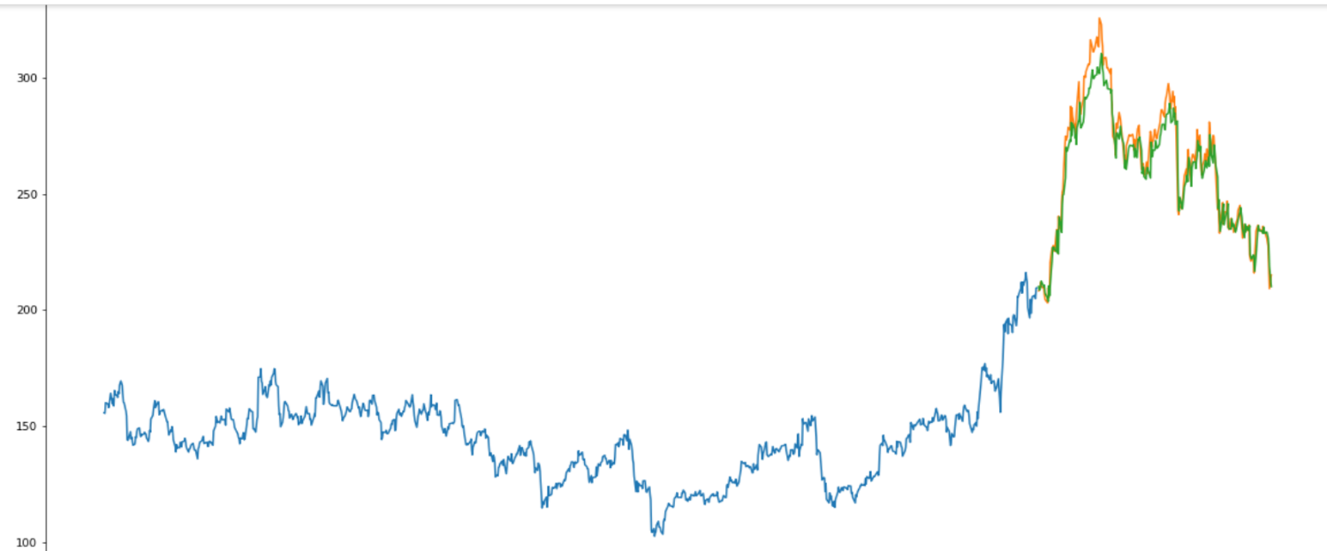
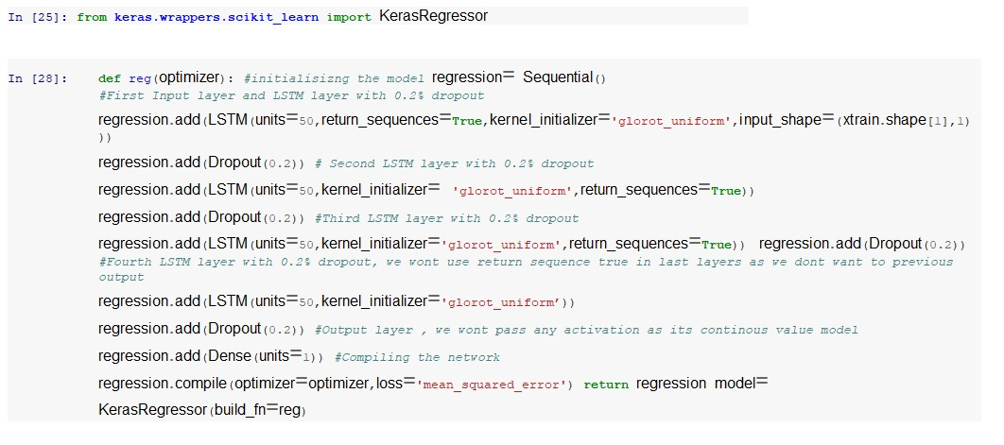
LSTM with FA,TA and Sentimental Analysis

Slide 24
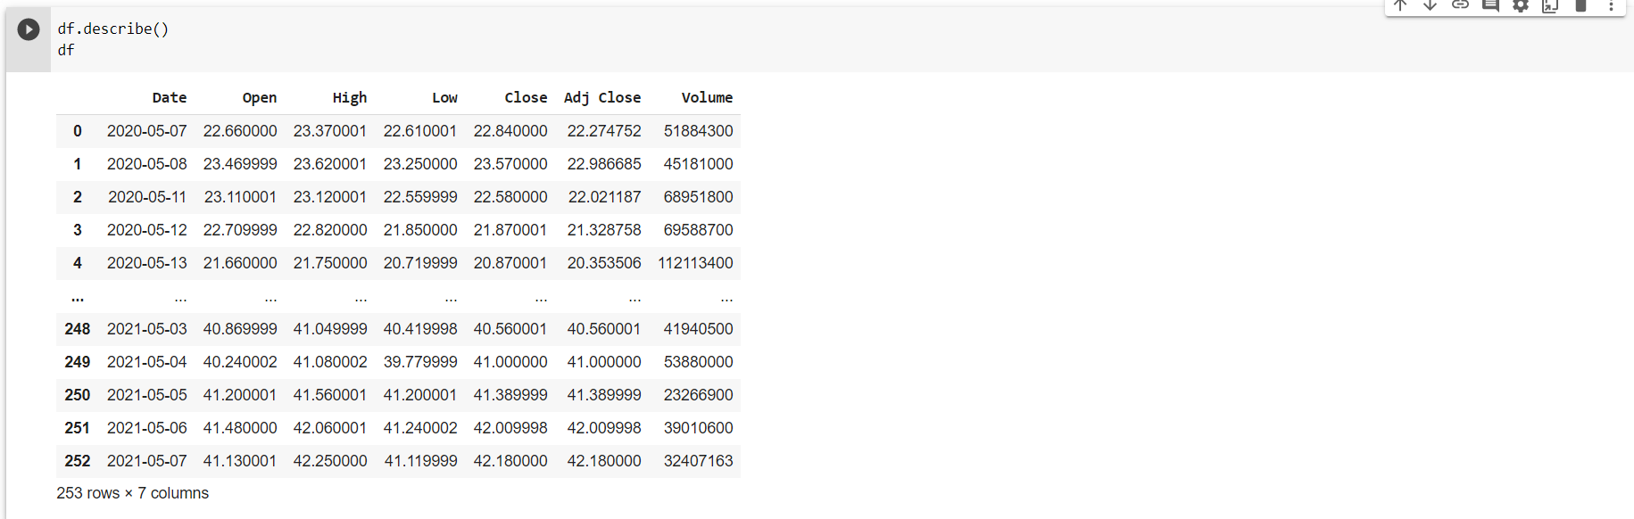

Slide 25
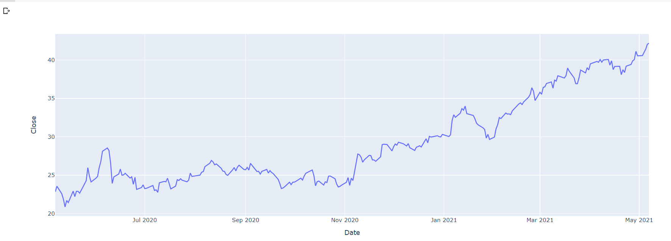

Slide 26
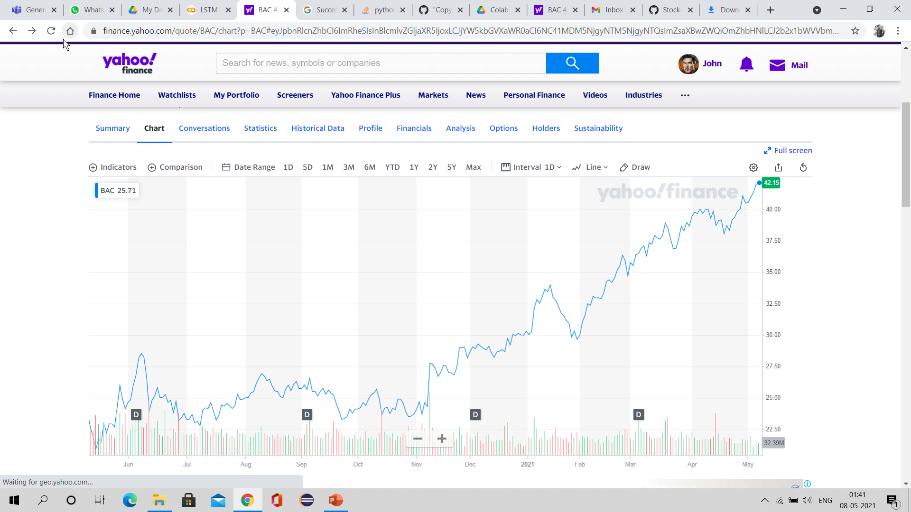

Slide 27
Model | Root Mean Square Error(rmse)
LSTM | 11.49446193
LSTM with FA and TA | 2.772259608962642
LSTM with FA,TA and Sentimental analysis | 0.938146

Slide 28
Conclusion
Abstract
Introduction
Modules
Architecture Model
Software/Hardware Requirements
Screenshots
Conclusion
Future Enhancement
References
In this case study, We learnt how to handle and process time series data and build deep learning models with production perspective.
Stock Price time series is considered as the most challenging time series and we are able to predict the TataGlobal Data and Bank of American Corporation with high accuracy.

Slide 29
Future Enhancement
Abstract
Introduction
Modules
Architecture Model
Software/Hardware Requirements
Screenshots
Conclusion
Future Enhancement
References
Collect news data for more years to have more data points.
Deep Learning Models work very well with large data. Since we have limited stock price data. To do a more extensive stock analysis, we can take hourly stock price data instead of daily stock price data to increase the data points. This shall improve the accuracy.
Play more with the LSTM architecture and hyperparameters to improve the model accuracy.

Slide 30
Introduction
Existing System
Proposed System
Software requirements
References
Abstract
Introduction
Modules
Architecture Model
Software/Hardware Requirements
Screenshots
Conclusion
Future Enhancement
References
References
[1]. Sohangir S, Wang D, Pomeranets A, Khoshgoftaar TM. Big data: Deep learning for financial sentiment analysis. Journal of Big Data. 2018.
[2]. Martin V. Predicting the French stock market using social media analysis. In: 2013 8th International Workshop on Semantic and Social Media Adaptation and Personalization. IEEE; 2013.
[3]. Khatri SK, Srivastava A. Using sentimental analysis in prediction of stock market investment. In: 2016 5th International Conference on Reliability, Infocom Technologies and Optimization (Trends and Future Directions) (ICRITO). IEEE; 2016.
[4] Shared S, Bagavathi Sivakumar P, Anantha Narayanan V, ” The Smart Bus for a Smart City - A real-time implementation”, 2016 IEEE International Conference on Advanced
Networks and Telecommunications Systems (ANTS).
2/1

Slide 31
Introduction
Existing System
Proposed System
Software requirements
References
Abstract
Introduction
Modules
Architecture Model
Software/Hardware Requirements
Screenshots
Conclusion
Future Enhancement
References
References
5] Ajay Shingare, Ankita Pendole, Nikita Chaudhari and Parikshit Deshpande, Prof. Samadhan Sonavane,” GPS Supported City Bus Tracking & Smart Ticketing System”,2015 International Conference on Green Computing and Internet of Things
(ICGCIoT).
2/1

Slide 32
Q and A?
?

