Slide 1
Android Application Development
Project Title: FitNess - Physical Fitness And Mental
Health App
Section : ‘J’
Students Name : Sneha Jayaraman - PES1201802825
H M Thrupthi - PES1201801987
K M Mitravinda - PES1201801872

Slide 2
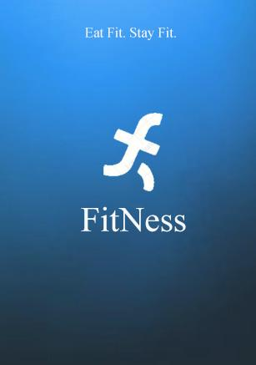

Slide 3
Abstract
Sedentary lifestyle that we lead in today’s world has imposed a lot of serious health complications in our lives.
Moreover, we also hear people say that technological advancement has brought a huge change in today’s lifestyle.
Diet and exercise are the main factors that have a significant impact on a person’s fitness, health and lifestyle.
Good nutritional habits, appropriate physical and mental exercises and positive thoughts are very much needed for one’s overall well being.
Thus, FitNEss provides useful tools to monitor the above mentioned practices and implement the same.

Slide 4
Problem Statement
To build an app that provides the users with useful tools and facilities to aid in the enhancement of their nutritional habits, physical health and mental well being.
FitNEss also aims to provide all the facilities in a way that is not only easy to use and navigate but also efficient and user friendly.

Slide 5
Existing or similar applications of your app that created.
There are many android applications dealing with fitness and health as it has become the need of the hour to maintain our health due to exponential increase in pollution, consumption of junk food and chaotic mental balance with loss of patience.
We see that all 3 of physical fitness, right nutrition and mental well being are needed for one’s overall wellbeing.
Some of the apps dealing with the above are:
Google Fit (Physical fitness app)
Runtastic (Running app)
Glo (Yoga app)
Pocket Yoga (Yoga app)
Headspace (Meditation app)
The above mentioned apps aim to aid the user and increase the quality of their experience in their target fields of health.

Slide 6
Explanation of the application created
FitNEss aims to aid the user with the combination of good nutrition, right physical and mental practices and appropriate thoughts.
The following are the tools and facilities provided to the user.
Nutrition and Calorie Tracker and Recorder
Workout Regimes for Physical Fitness
Yoga Practices for Physical and Mental Well Being
Meditation Practices for Good Mental Health
Positive Thought Practices for Maintenance of Mental Balance
Inspirational Video for the day

Slide 7
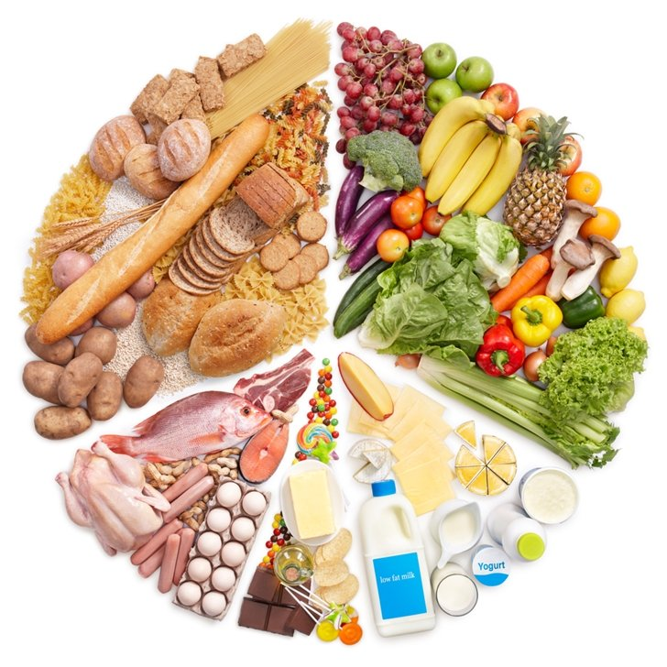
Explanation of the application created
Nutrition and Calorie Tracker and Recorder:
As we all know, the food that we eat majorly affects our physical health and influences the functioning of the whole body.
Thus it becomes important to track, record
and monitor the amount of food we eat, the
calories it contains and it’s nutritional aspects.
FitNEss makes this job easier by providing the
user with a facility which gives
information about a particular food item
such as the number of calories it contains per
serving.
FitNEss uses the Nutritionix database containing almost all major food items along with their nutritional information.

Slide 8

Explanation of the application created
This greatly benefits the users as they can easily search for the food item they consumed or want to consume by typing its name and get all the required information related to it.
The users can also set a goal for the number of calories they aim to consume.
Every time the user consumes a food item, they can add it to the food diary which helps to record it. The number of calories of the food item is then subtracted from the user’s calorie goal to show the number of calories remaining from their goal.
Once the calorie limit is reached, the same is indicated to the user.
This way, the user can stay cautious of the food they consume and also track and record it.

Slide 9

Explanation of the application created
2) Workout Regimes for Physical Fitness:
Exercise and physical fitness play a major role in keeping our body fit, functional and healthy.
Appropriate workout regimes must be followed to ensure the same.
FitNEss helps the user by providing
appropriate set of exercises for
targeted parts of the body like:
abs, arm, leg, chest, shoulder and
back.
There are different categories of
workouts with many sets exercises
which the user can practice in
the comfort of their homes.
Each workout set has a specific period of time and each exercise has a timer which helps the user to practice strictly.
The user also gets to use the step counter to track and record the number of steps taken by them over the entire day.

Slide 10
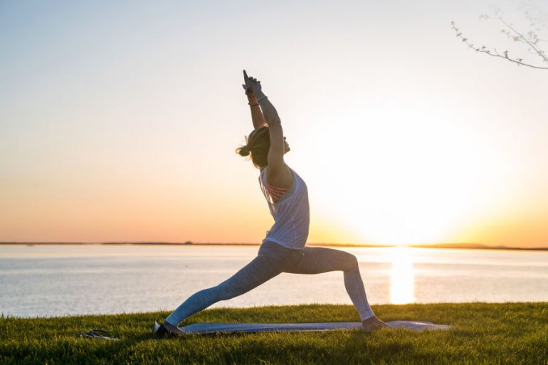
Explanation of the application created
3) Yoga Practices for Physical and Mental Well Being:
Practicing yoga is another way to maintain not only one’s physical fitness but also their mental health.
Different yoga postures can be
practiced to achieve the same.
FitNEss provides the user with
various yoga postures which
can be practiced at the
comfort of their homes.
Each yoga posture is timed
with the help of a timer.
This helps the user in their
strict practice and also yields
better results.

Slide 11
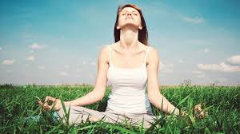
Explanation of the application created
4) Meditation Practices for Good Mental Health:
One’s mental health is equally important to their physical fitness in determining their overall well being.
Meditation as we all know, is one of the best and most widely used technique to control and maintain one’s mental health.
Practice of meditation also needs
a good and appropriate supporting
soundtrack to help complete the
meditation without any disturbances
and efficiently.
FitNEss provides the user with
different types of supporting
soundtracks to help the user meditate
peacefully.

Slide 12

Explanation of the application created
5) Positive Thought Practices for Maintenance of Mental Balance:
The influence of thoughts generated in our minds on our mental health though underrated, is quite significant.
Thus it becomes important to generate positive thoughts and visualizations in our minds.
FitNEss provides the users with various
categories of positive thoughts in the
form of short stories and quotes
in the form of pictures.
This can help the users to practice and
develop positive thinkings and
visualizations.

Slide 13
Innovation in the application
There are many apps available which aim to provide facilities to the users in targeted fields of healthcare like workout, yoga, meditation, step count, calorie count, nutritional value of food items etc.
We see that all of the above mentioned factors are equally important in building and maintaining one’s overall well being.
Thus FitNEss aims to combine the benefits of the above mentioned practices in providing the right facilities to maintain one’s health targeted for all age groups.
FitNEss helps in finding the right balance between good nutritional habits, regular workouts, meditations and right
thought practices to help enhance the quality of one’s lifestyle.

Slide 14
Lessons learnt from the project
We realised the need for good communication while working as a team.
We got an opportunity to read and explore more about health, nutrition and fitness which is of great need for everyone nowadays.
We got a chance to use our creativity in designing the app and share our ideas to choose the most suitable one.
Technically, we learnt how to use different layouts in Android ,integrate our project with firebase and also work with the firebase database.

Slide 15
Thank You

