Slide 1
CS 6220 Data Mining Techniques
Team Project presentation
Mitresh Pandya
Tirth Patel

Slide 2
Introduction
Questions to address
Why we chose this?
What is the motivation behind it?
Why is this interesting?

Slide 3
What we used
Boston crime dataset that is released by the government here. https://data.boston.gov/dataset/crime-incident-reports-august-2015-to-date-source-new-system
Boston Housing Dataset that we extracted from the housing price evaluation dataset: https://data.boston.gov/dataset/property-assessment

Slide 4
Crime data
Why we chose this dataset?
For crime records we needed to get some authentic source for the dataset and so we chose to explore the government sites and this seems to be an authentic source with data getting updated everyday.
Although we are just taking the dataset from June 2015 to June 2019 for the purpose of this project.

Slide 5
Housing Data
Why we choose this dataset?
First we wanted an authentic dataset so that we can get actual and real-life example to work on.
We found many datasets but we wanted to establish a connection between the two datasets and so it was crucial to find a dataset that will have some common parameter.
There were two such variables we thought to connect: one was the district variable or to use zip code from the housing dataset.
So, the best parameter to connect seemed to be zip code as the districts were based on the police stations and it is possible that more than one zip codes fall under one district.

Slide 6
Solution/Method

Slide 7
Data Preprocessing
The crime dataset we got was mostly complete but it needed some pre processing

Slide 8
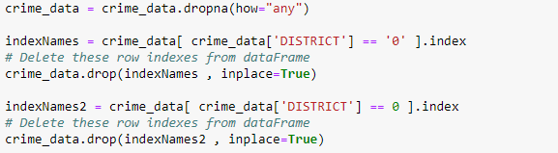
Removing data with no importance
There are several rows in the dataset which contains no street, no district, no location etc.
This step is taken to take care of that.

Slide 9
Format the Occurrence dates
The occurrence dates were in the format of “MM-DD-YYYY HH:MM”. But for the model to work well it was needed for the dates to be in the format of “YYYY-MM-DD”.
The code snippet shown here does that.

Slide 10
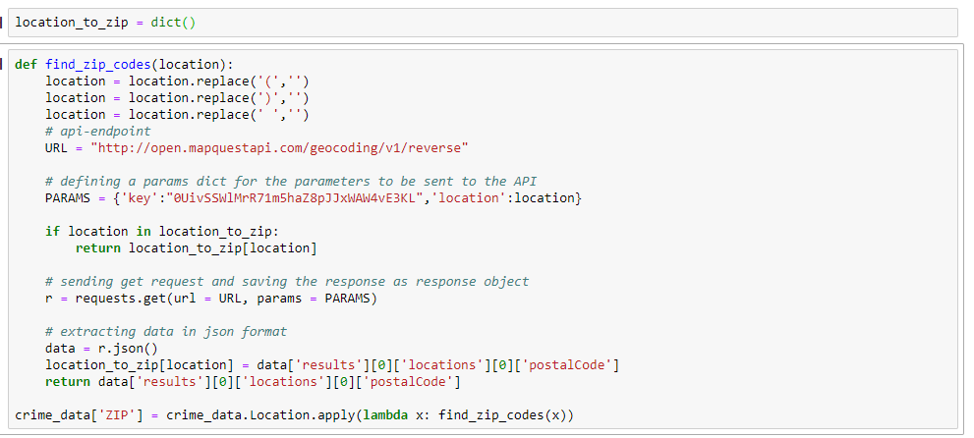
FIND THE zip codes

Slide 11
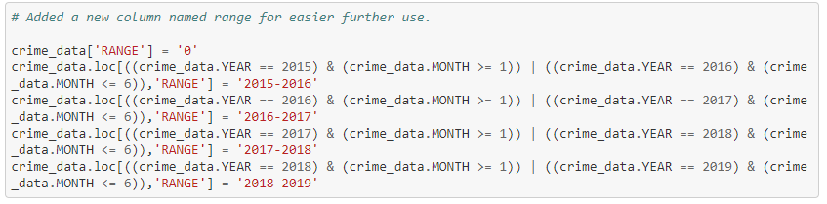
Adding range column
Data was from June instead of January in 2015. Same goes for 2019.
Need of keeping the range for more accurate results.
Hence, made a range for entire dataset starting from June 2015 and so on.
Later on exported it in a CSV and used it rather than running this code snippet every time.

Slide 12
Data and experiment

Slide 13
Crimes we mainly focused on

Slide 14
Why only part one?
What is part one anyways?
Why did we choose to focus only on part one type crimes?
What is the importance of that?

Slide 15
Evaluation and results

Slide 16
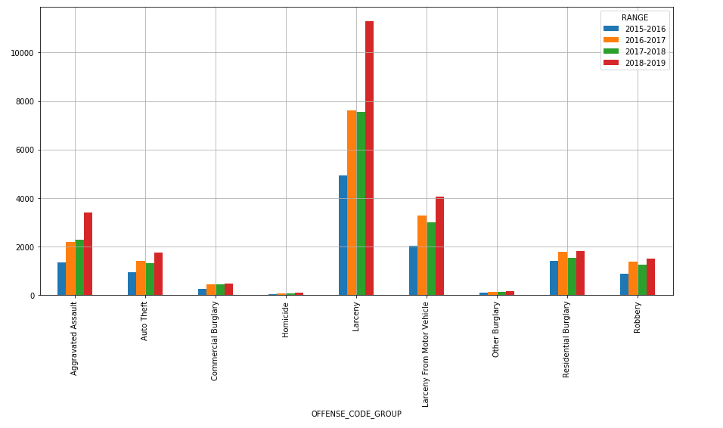
Interesting statistics of crime data
Part one crime statistics.

Slide 17
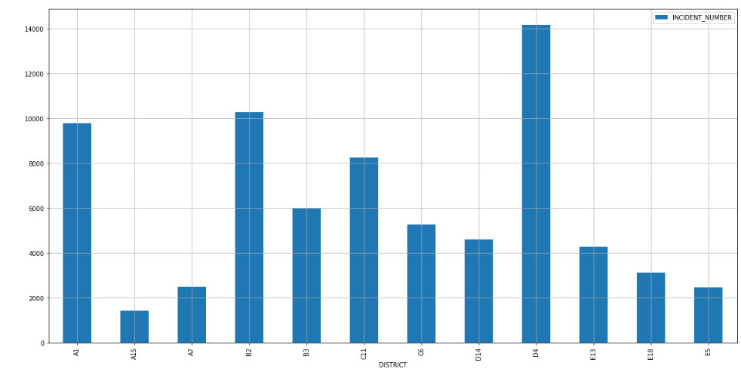
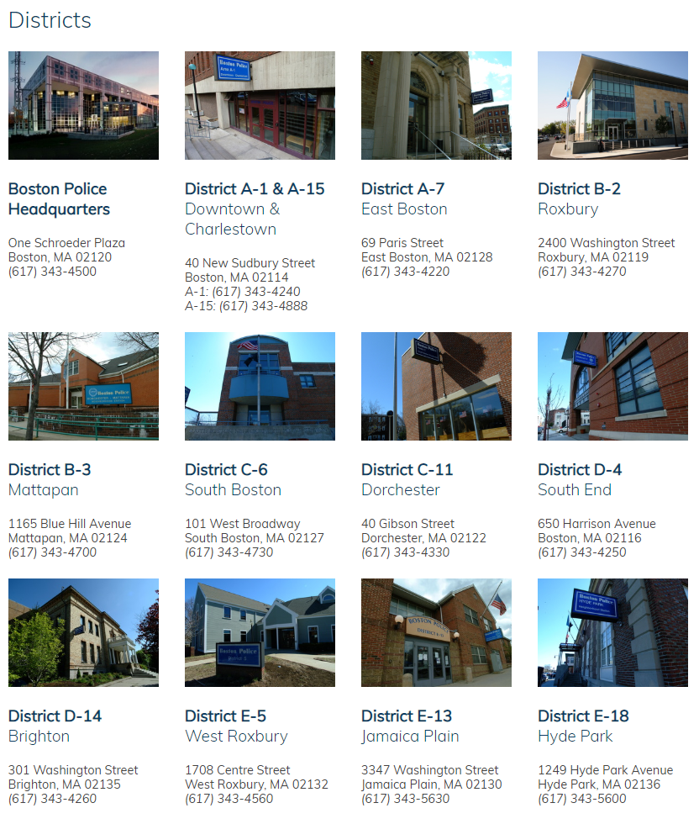
Data according to districts.

Slide 18
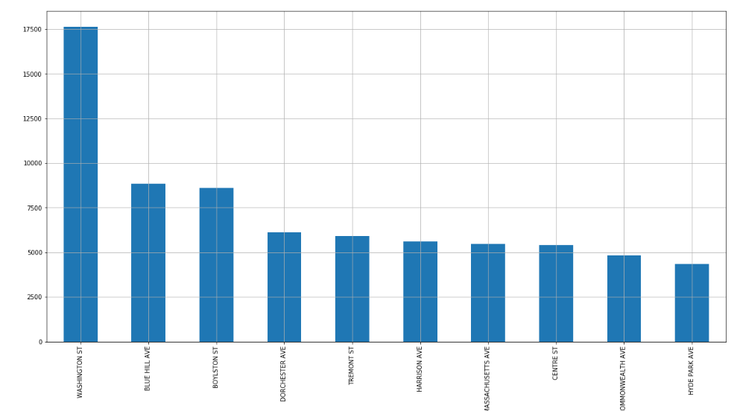
Top 10 unsafe streets.

Slide 19
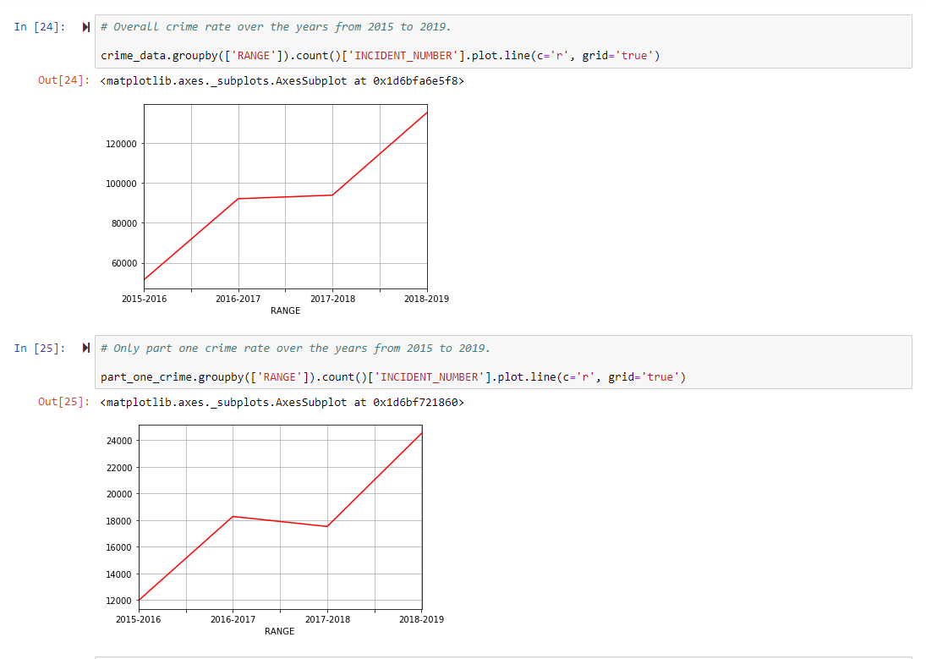
Trend of crime over the years.

Slide 20
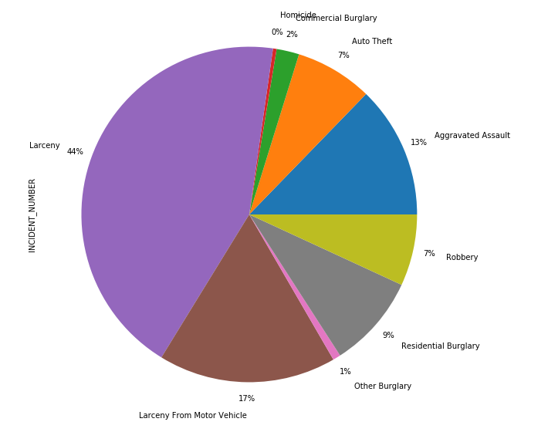
Part one crime distribution among itself.

Slide 21
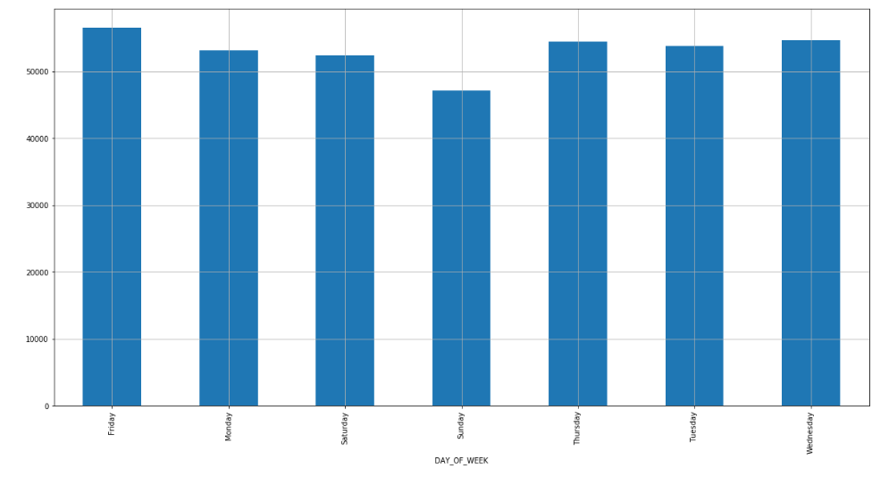
Crimes on which day of the week?

Slide 22
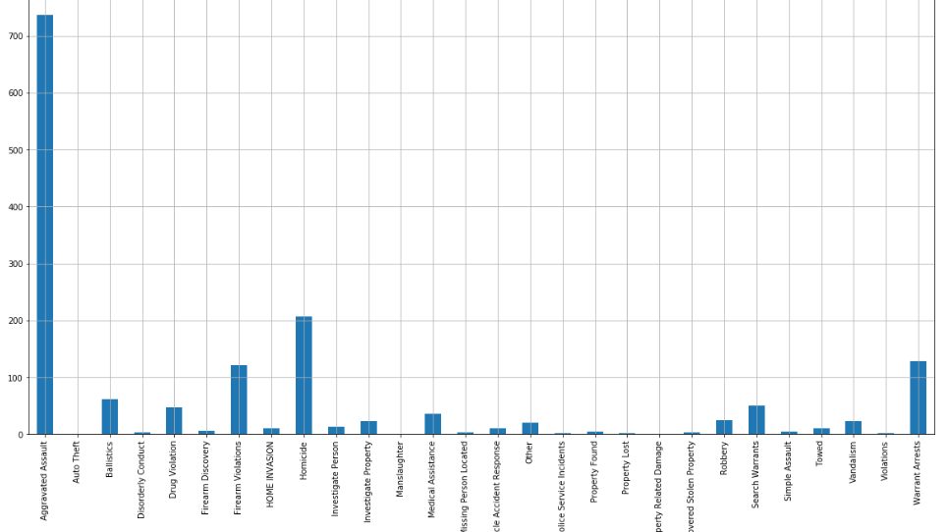
Shooting involved?

Slide 23
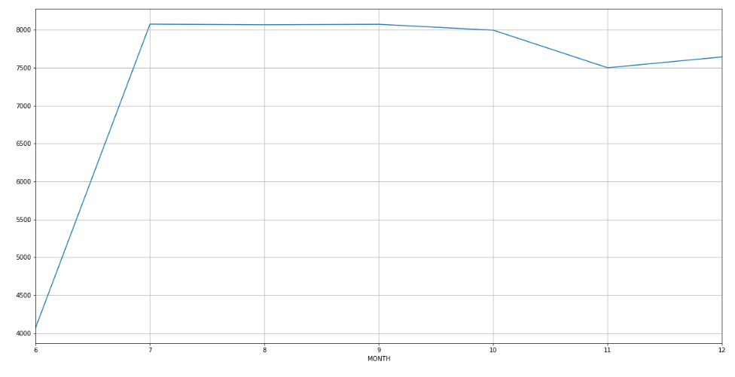
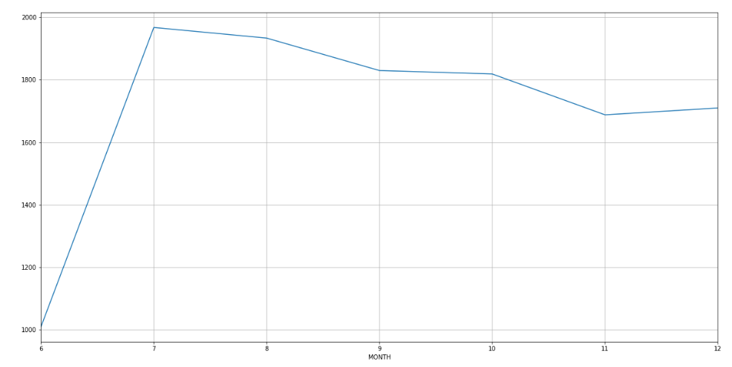
Overall crime vs Part one crime in a year 2015
Overall crime
Part one crime

Slide 24
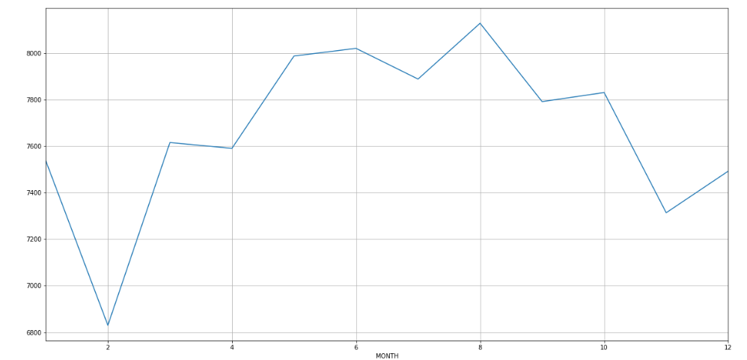
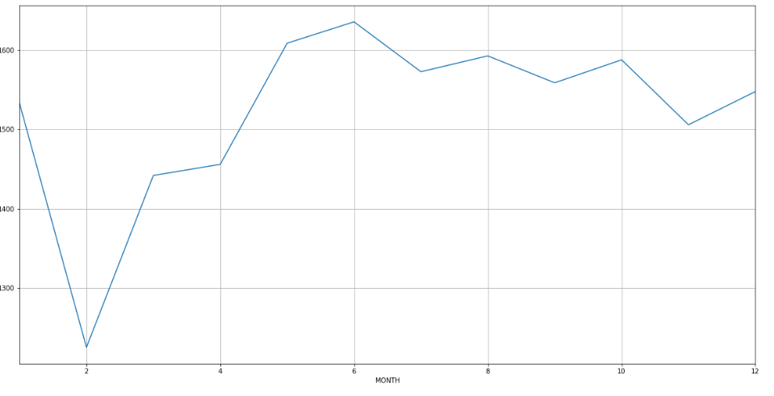
Overall crime vs Part one crime in a year 2016
Overall crime
Part one crime

Slide 25
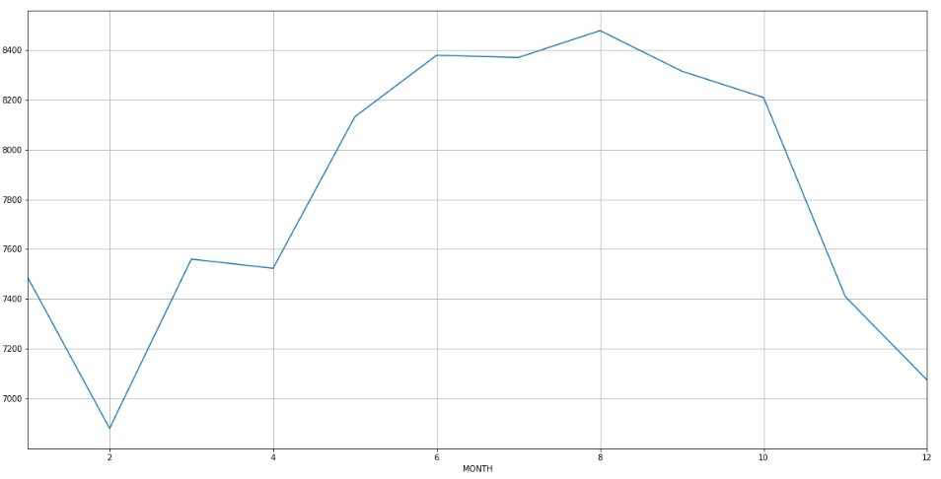
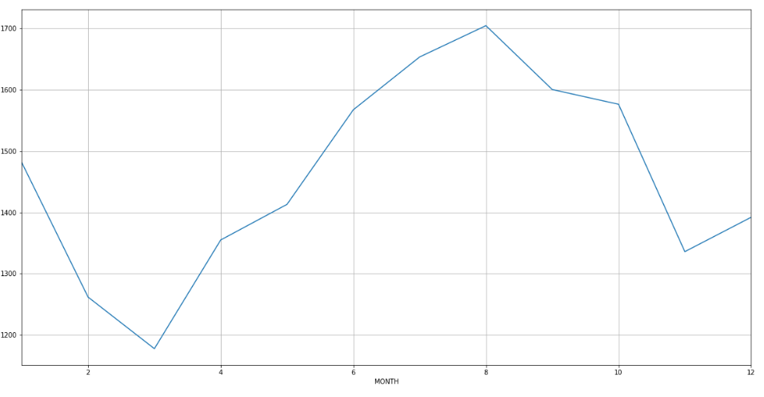
Overall crime vs Part one crime in a year 2017
Overall crime
Part one crime

Slide 26
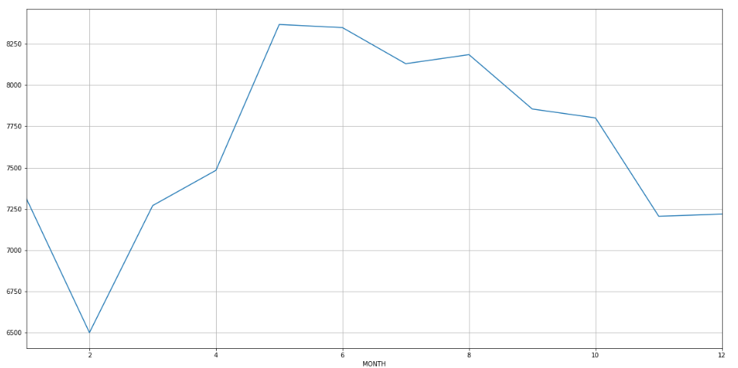
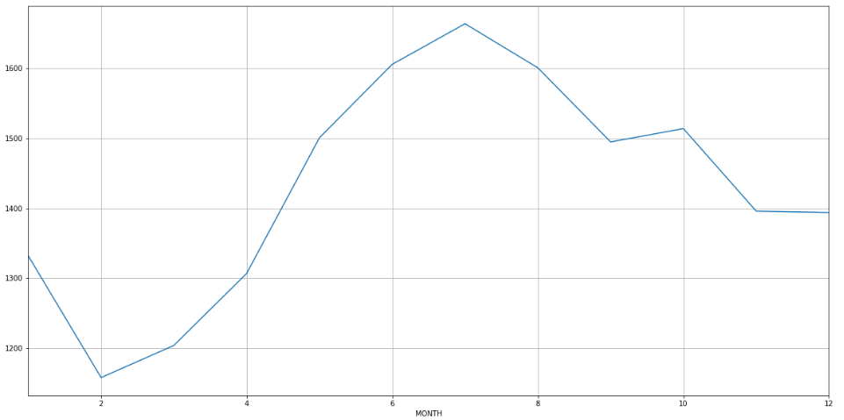
Overall crime vs Part one crime in a year 2018
Overall crime
Part one crime

Slide 27
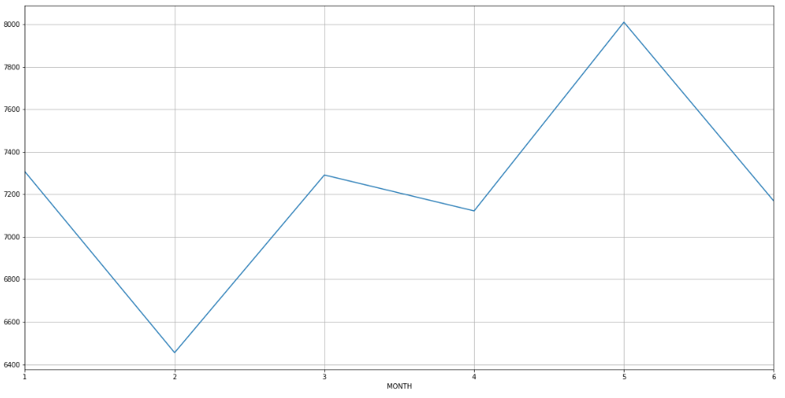
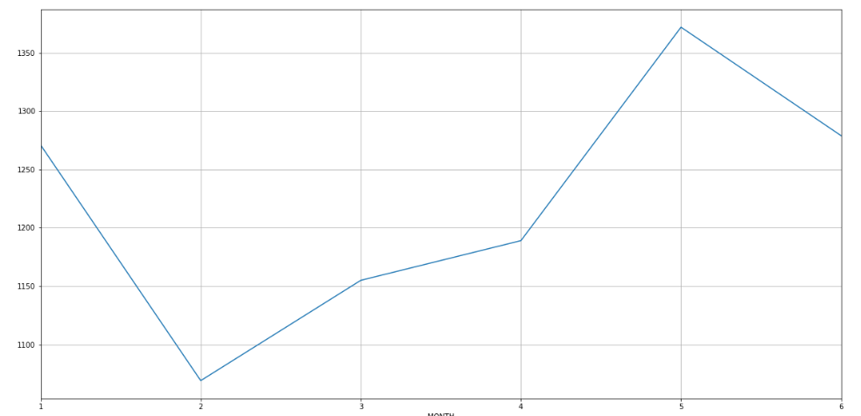
Overall crime vs Part one crime in a year 2019
Overall crime
Part one crime

Slide 28
Time Series Analysis

Slide 29
Time Series Analysis
It would be an interesting problem if we would be able to predict the trends of crime rates in regions.
Based on the predictions if we can observe probable decrease in crime in a region, we can say that there might be chances of increase in price.
Which might be a good investment opportunity.

Slide 30
Why time series prediction?
The Data as per most of the analysis seems to be a bit seasonal and might follow a sort of trend.
So we want to check how dependent the value of crime is on time.
Based on this assumption, we thought to implement a Time Series model for its prediction.

Slide 31
ARIMA model
We used Auto Regressor Integrated Moving Average model for the task.
What is ARIMA model?
AR:
Lets imagine we have a function x such that:
x(t) = alpha * x(t – 1) + error (t)
This equation is AR(1), which means that the instance is solely dependent on the previous value, alpha is a co-efficient we use to minimize the error.
MA:
So if the function looks something like:
x(t) = beta * error(t-1) + error (t)
This is a Moving Average Model with beta coefficient and x as function of previous error and current error.
I:
Integrated here means a differencing term.

Slide 32
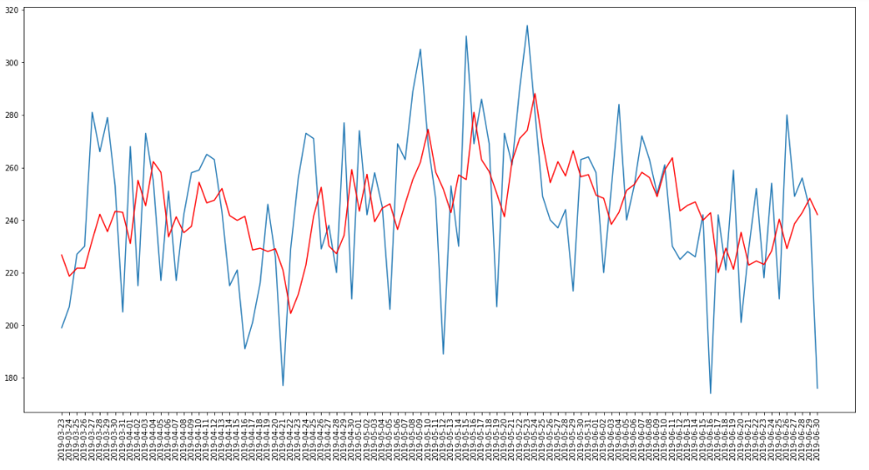
Training and Testing
Here we train the model with about three to four years of data and then we predict its performance.
The y-axis is crime rate and x-axis is the date.
The trend is seemed to be followed here, not overfitting the curve to an extent.
We used RMS error as measure for the task.

