Slide 1
CS 6220 Data Mining Techniques
Team Project presentation
Mitresh Pandya
Tirth Patel

Slide 2
Introduction
Questions to address
Why we chose this?
What is the motivation behind it?
Why is this interesting?

Slide 3
What we used
Boston crime dataset that is released by the government here. https://data.boston.gov/dataset/crime-incident-reports-august-2015-to-date-source-new-system

Slide 4
Crime data
Why we chose this dataset?
Dataset description

Slide 5
Solution/Method

Slide 6
techniques applied to crime data
There are various pre-processing techniques that we have applied to the crime dataset in order for us to make it usable according to our needs.

Slide 7
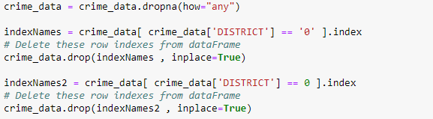
Removing data with no importance
There are several rows in the dataset which contains no street, no district, no location etc.
This step is taken to take care of that.

Slide 8
Format the Occurrence dates
The occurrence dates were in the format of “MM-DD-YYYY HH:MM”. But for the model to work well it was needed for the dates to be in the format of “YYYY-MM-DD”.
The code snippet shown here does that.

Slide 9
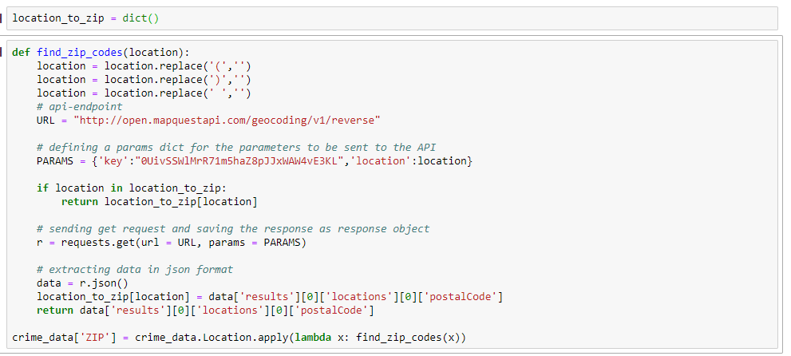
FIND THE zip codes

Slide 10
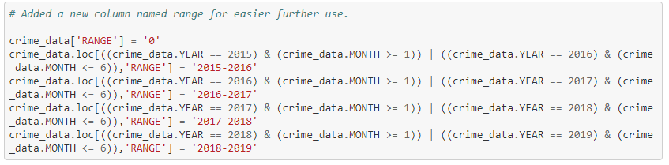
Adding range column
Data was from June instead of January in 2015. Same goes for 2019.
Need of keeping the range for more accurate results.
Hence, made a range for entire dataset starting from June 2015 and so on.
Later on exported it in a CSV and used it rather than running this code snippet every time.

Slide 11
Data and experiment

Slide 12
Crimes we mainly focused on

Slide 13
Why only part one?
What is part one anyways?
Why did we choose to focus only on part one type crimes?
What is the importance of that?

Slide 14
Arima model

Slide 15
Evaluation and results

Slide 16
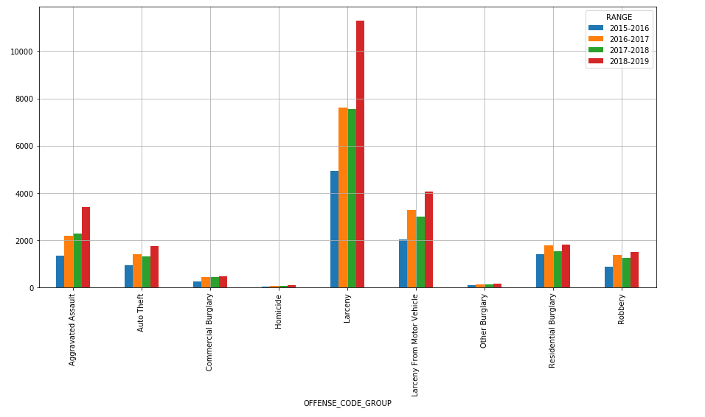
Interesting statistics of crime data
Part one crime statistics.

Slide 17
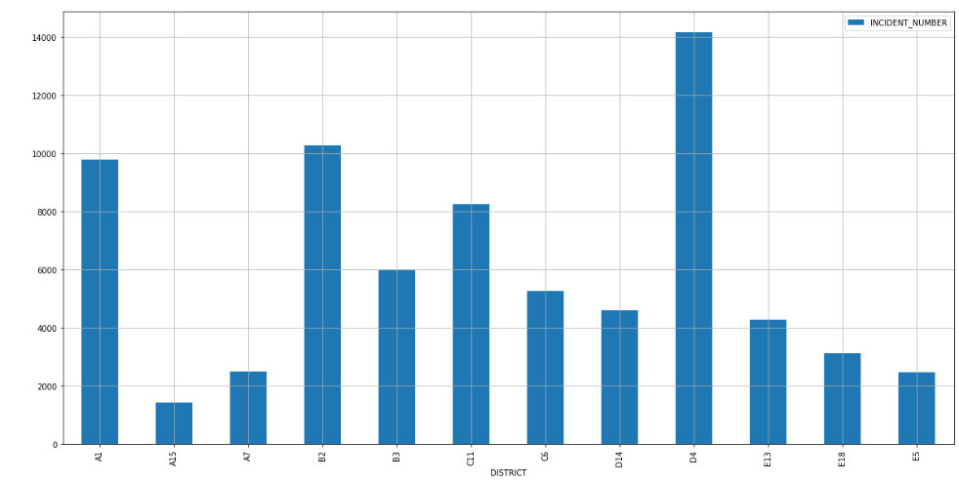
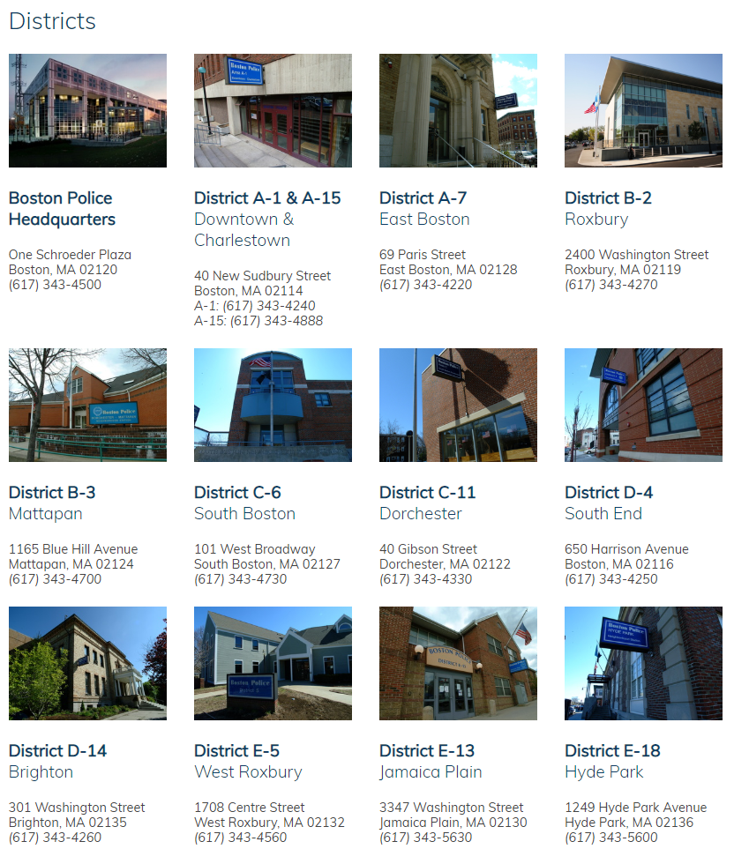
Data according to districts.

Slide 18
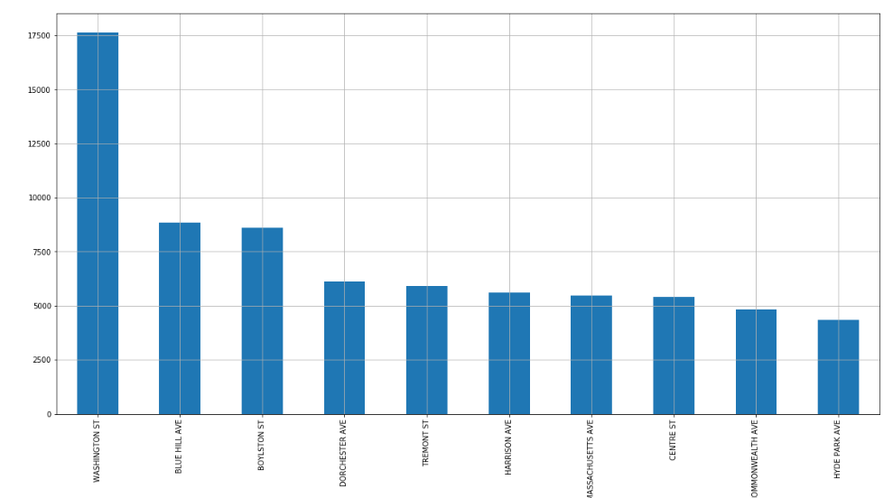
Top 10 unsafe streets.

Slide 19
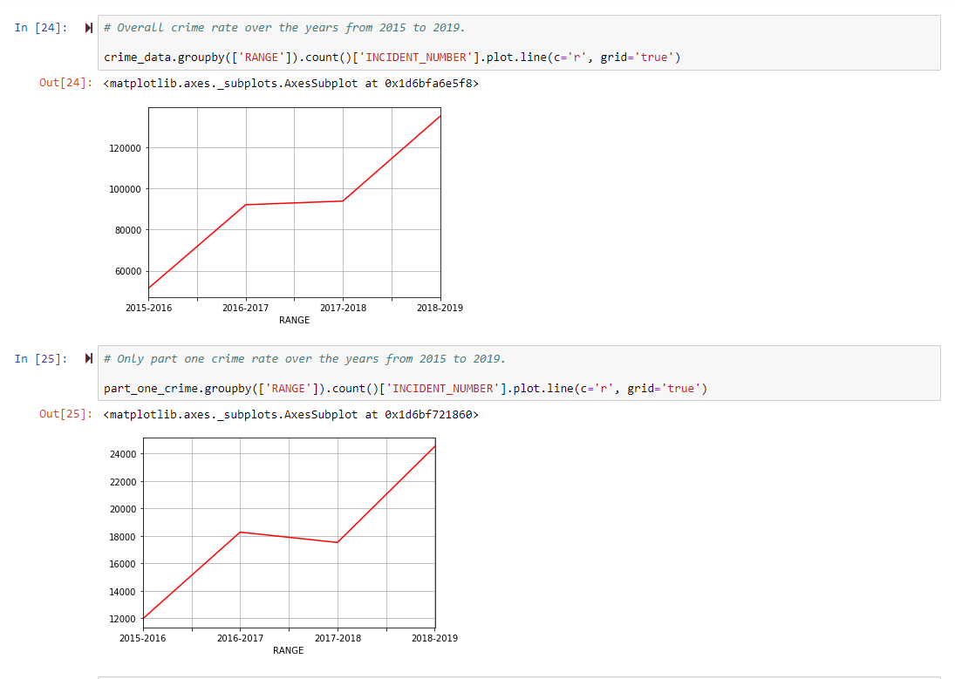
Trend of crime over the years.

Slide 20
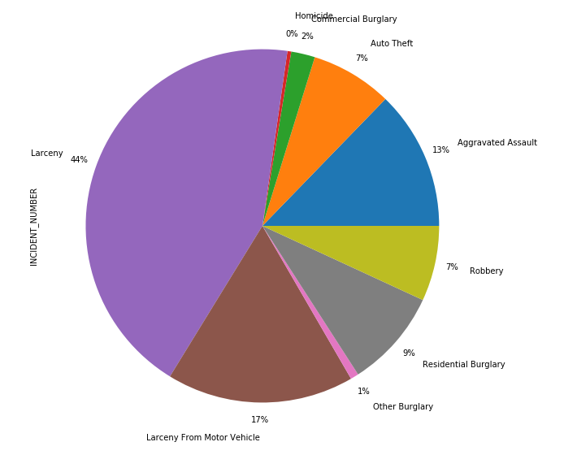
Part one crime distribution among itself.

Slide 21
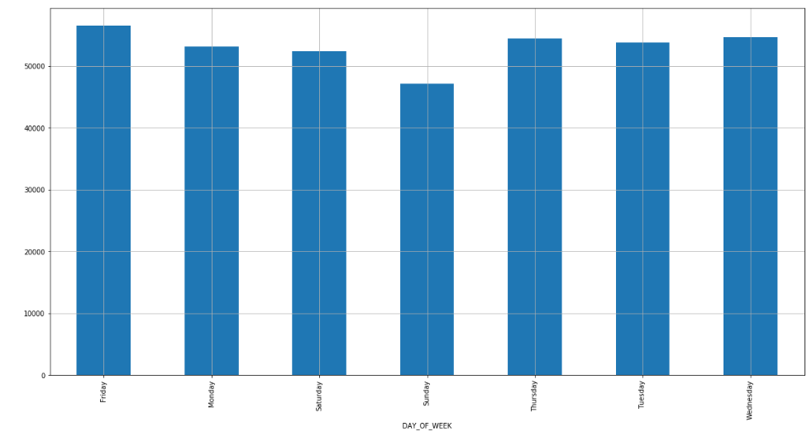
Crimes on which day of the week?

Slide 22
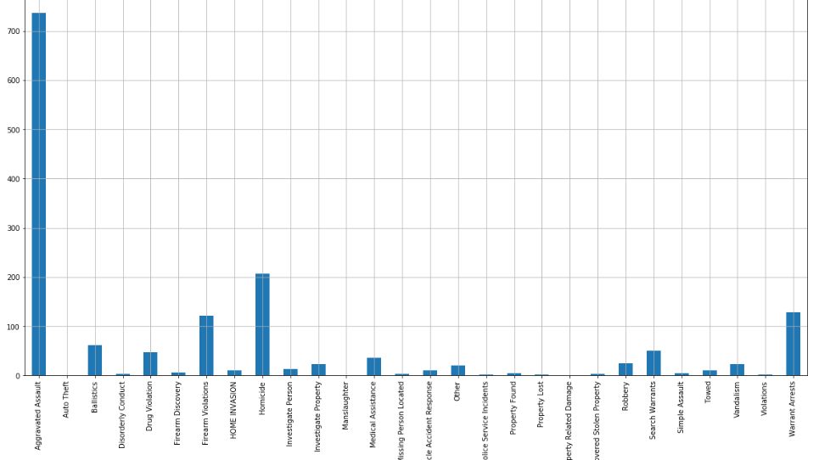
Shooting involved?

Slide 23
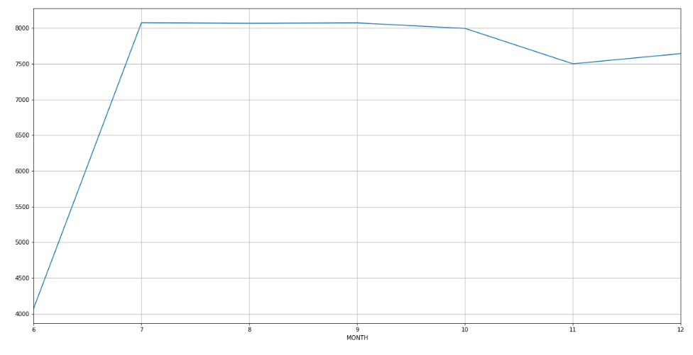
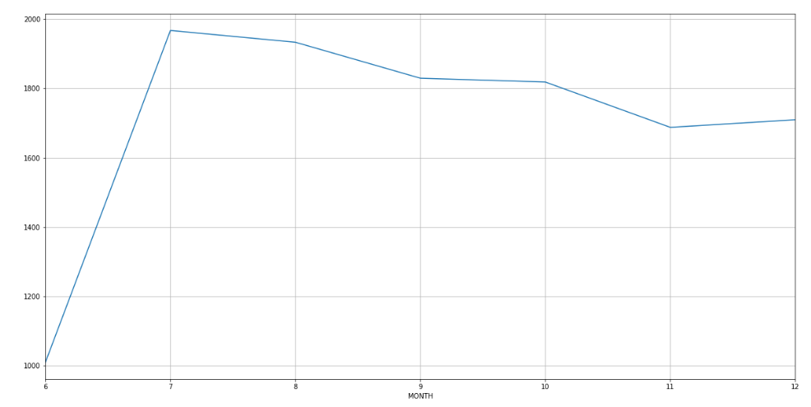
Overall crime vs Part one crime in a year 2015
Overall crime
Part one crime

Slide 24
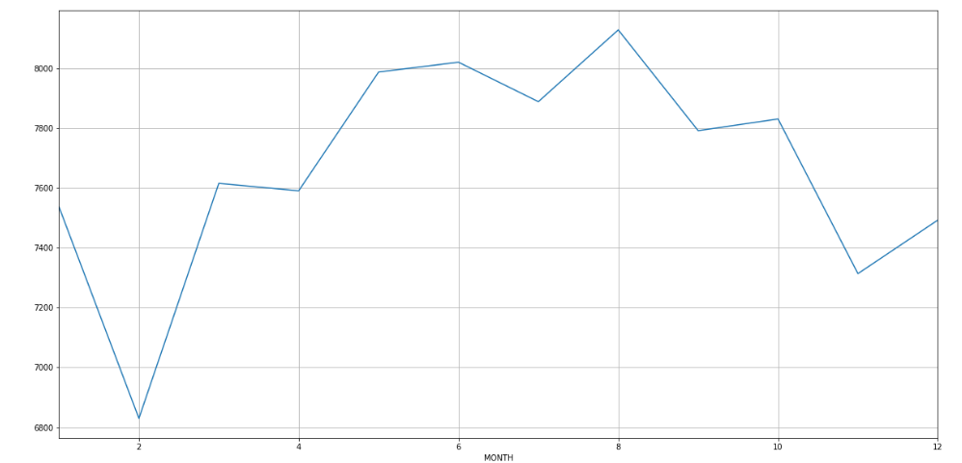
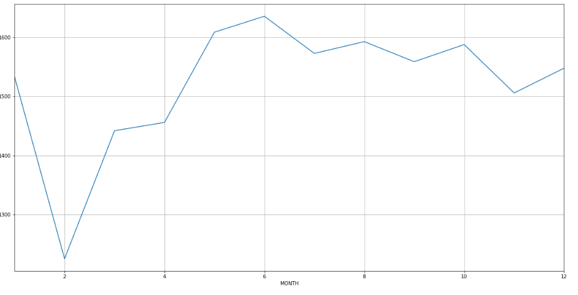
Overall crime vs Part one crime in a year 2016
Overall crime
Part one crime

Slide 25
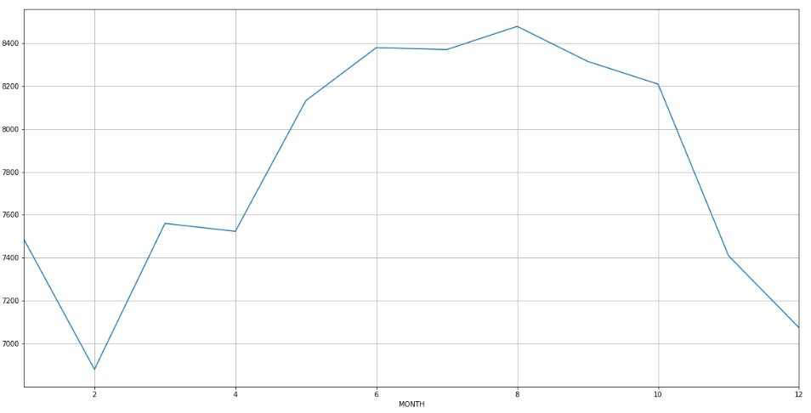
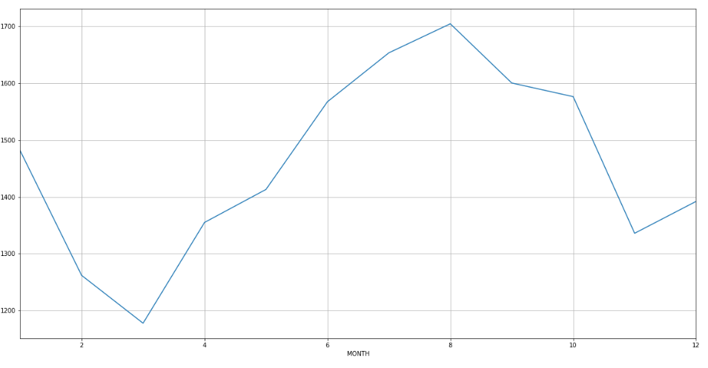
Overall crime vs Part one crime in a year 2017
Overall crime
Part one crime

Slide 26
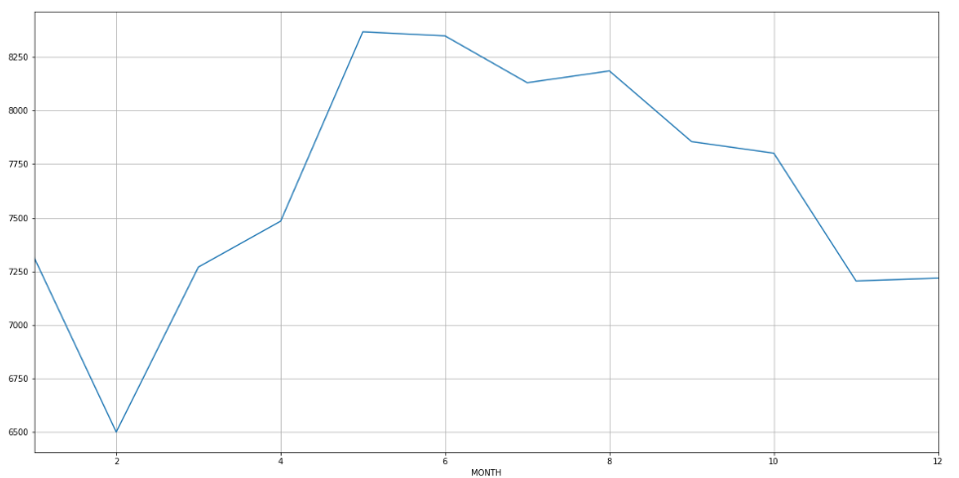
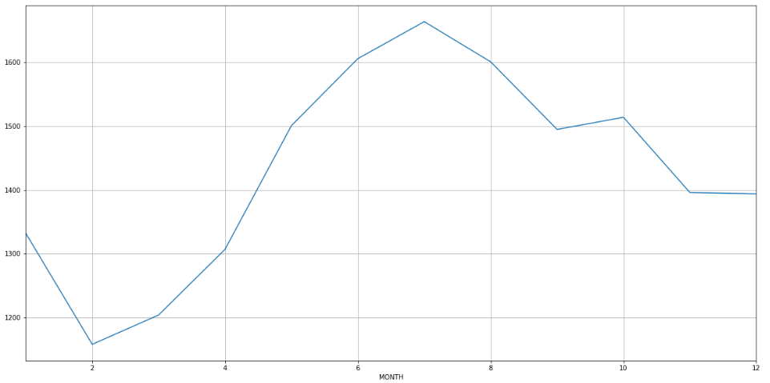
Overall crime vs Part one crime in a year 2018
Overall crime
Part one crime

Slide 27
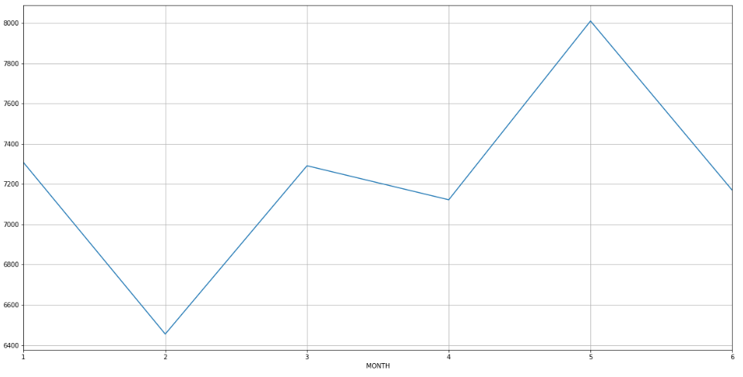
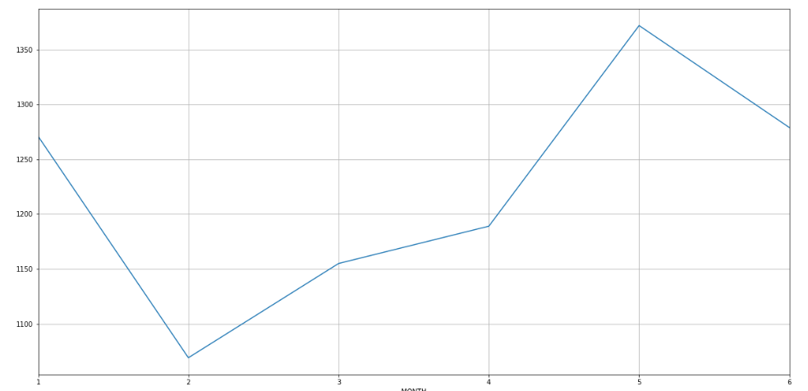
Overall crime vs Part one crime in a year 2019
Overall crime
Part one crime

