Slide 1
ENGI 301 Wristband Lab Assistant Proposal
10.05.2021
Andrei Mitrofan

Slide 2
Problem background
A) In laboratories, there is a frequent need for basic, but mentally exhaustive calculations
Contaminated gloves prevent researchers from using conventional calculators
Taking gloves off and putting them back on is burdensome while doing an experiment
B) Substances in the lab are heated and cooled to temperatures that can be harmful to humans handling them
Often no visual distinguishing factor between a boiling hot flask and a room temp one

Slide 3
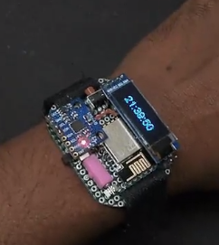
Proposed solution
Proposed solution solves both of the problems through a portable wristband that can act as a calculator using gestures and is equipped with an infrared sensor for temperature measurements from a distance
Similar projects already exist that incorporate 6-axis IMUs for gesture interpretation:
Wearable device to translate sign language to Txt/speech - Hackster.io
Somatic - Data Glove for the Real World : 6 Steps (with Pictures) - Instructables
This project would differ from previous projects in that gestures will be translated to numerical and operator inputs into a calculator. Additionally, this project will implement a IR temperature sensor that would alert the user if they are about to touch something excessively hot/cold.
Python-compatible libraries exist for all the sensors used:
Adafruit MPU6050, Adafruit CircuitPython MLX90614, Adafruit SSD1306
Picture from “Smart Fitness Watch With ESP8266”

Slide 4

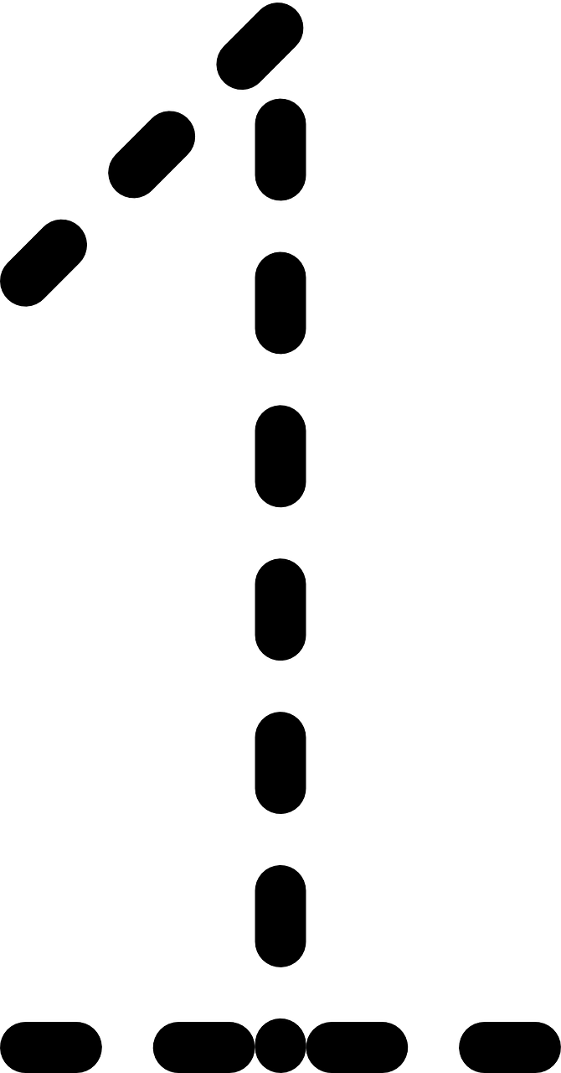


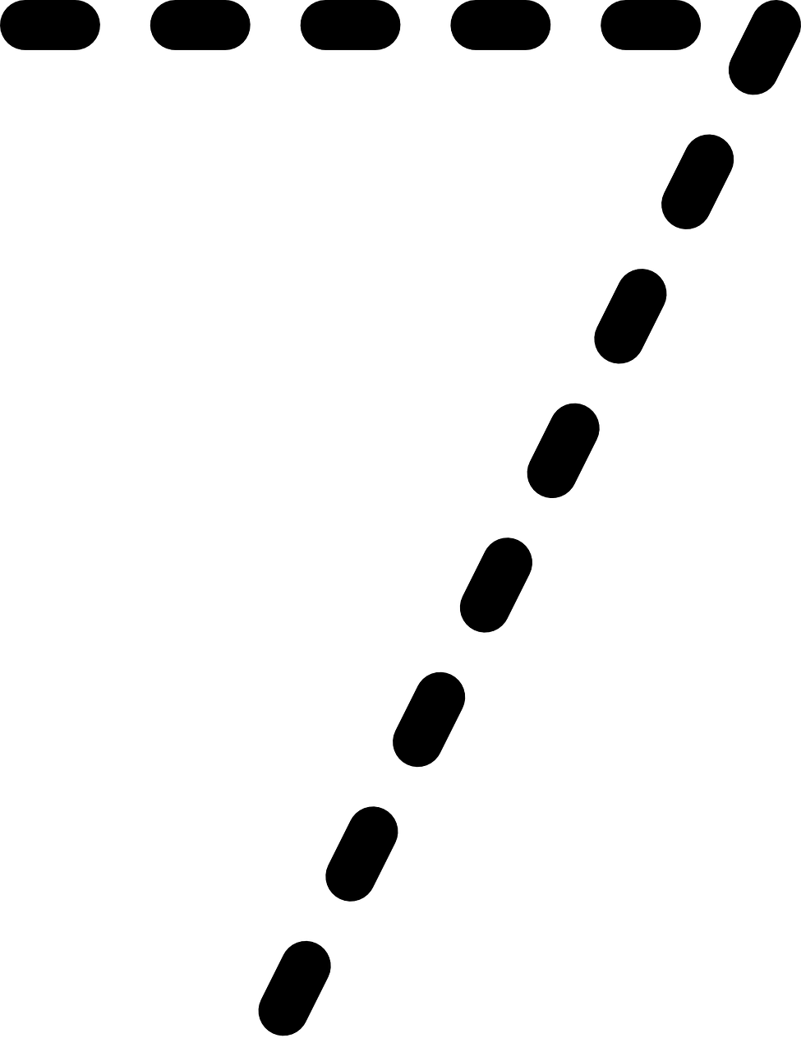
Gestures to capture
The user will be able to draw out numbers and mathematical operators in the air using their finger/hand and the device will show both the equation inferred and the result on the display.
Pause
Pause

Slide 5
System Block Diagram
IR Temp Sensor
(MLX90614)
PocketBeagle
OLED display
(SSD1315)
I2C2
IMU 6-axis
(MPU6050)
uUSB Host Connector
5 V
PWM
Vibration Motor
(FIT0774)
GPIO
Button

Slide 6
Power Block Diagram
IR Temp Sensor
(MLX90614)
Max 1 mA
PocketBeagle
3.3 V
Max 1 mA
OLED display
(SSD1315)
I2C2
100 uA
IMU 6-axis
(MPU6050)
uUSB Host Connector
5 V
USB+
USB-
50 mA
Vibration Motor
(FIT0774)
(rated current)

Slide 7
Components / Budget
Component | Need to Buy | Cost
0.96 in OLED display (SSD1315) | Yes | $5.50
IR Temperature Sensor (MLX90614) | No | $15
Vibration Motor (FIT0774) | Yes | $0.99
IMU 6-axis (MPU6050) | No | $3.33
Need all components to be purchased by instructor listed; additional components may be purchased by student

