Slide 1
ENGI 301 No Touch Gesture Calculator PCB Proposal
11.16.2021
Andrei Mitrofan

Slide 2
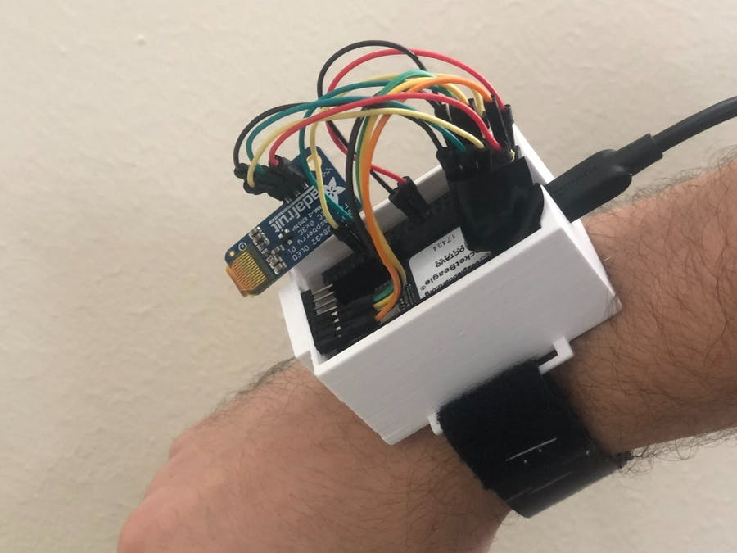
Background Information
This project is a gesture calculator designed for a wearable bracelet. It allows you to do calculations by “drawing out” the numbers in the air and it will automatically detect your intentions, calculate the equation, and display the results on an OLED screen. More information can be found on the hackster page: No Touch Gesture Calculator - Hackster.io
The project will be integrated on a PCB in order to allow for more stable anchoring of components, which should allow for more replicable results and allow the connections to remain stable as the electronics are being gestured around. I will also add lead connections for a vibration motor, in order to give feedback to the user on whether the gesture identification was successful and when it happened.

Slide 3
System Block Diagram
PocketBeagle
piOLED
(SSD1306)
I2C2
IMU 6-axis
(MPU6050)
uUSB Host Connector
5 V
PWM
Vibration Motor
(FIT0774)

Slide 4
Mechanical Block Diagram
Front
Back
57 mm
MPU-6050
PocketBeagle
OLED adapter
16 mm
36 mm
USB
21 mm
10 mm
Motor

Slide 5
Components Required
Create a list of all the components that you require for the PCB
Example List:
PocketBeagle
Adafruit PiOLED - 128x32 Monochrome OLED
MPU-6050 Breakout Board
Vibration Motor

