Slide 1

FSDS_Sep_2022
iNeuron AI

Slide 2
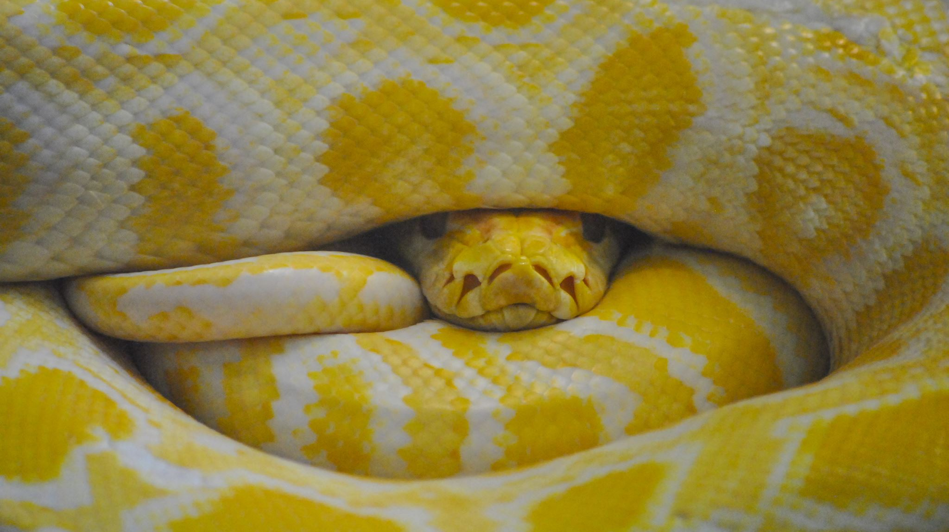
Basics of Python

Slide 3
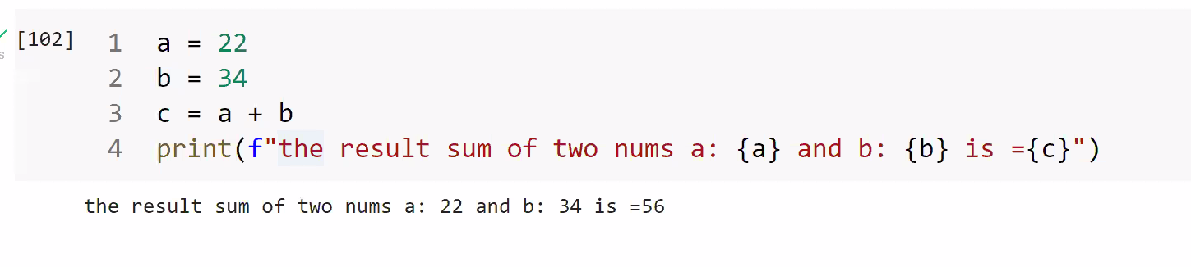
Print method with Variables

Slide 4
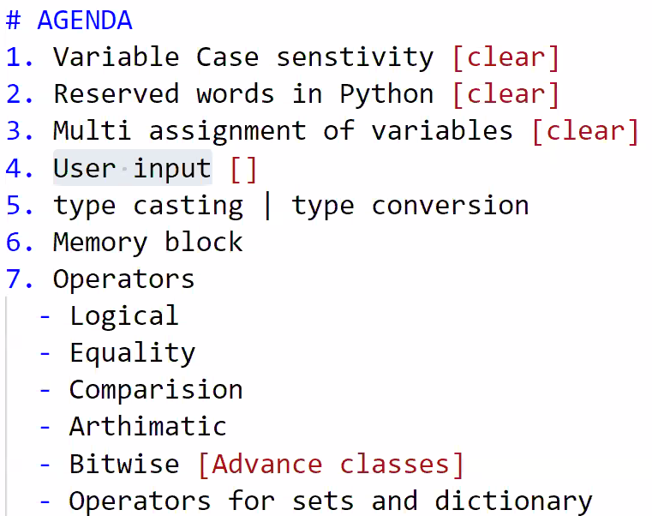
25 SEP22

Slide 5
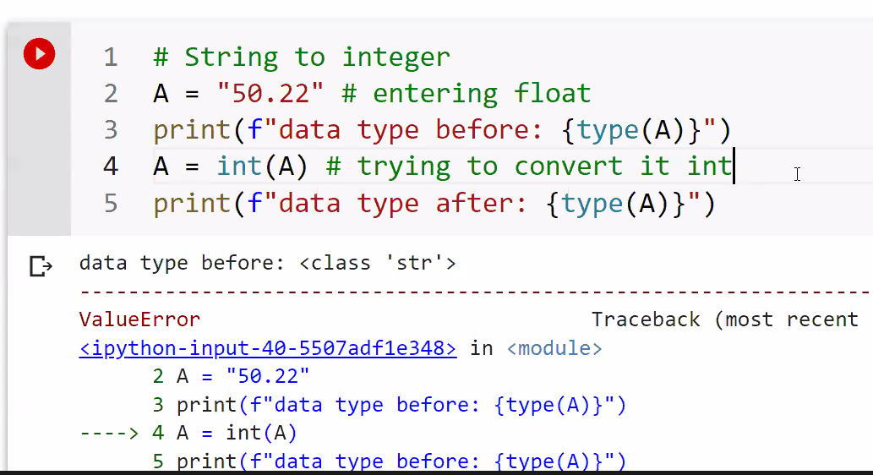
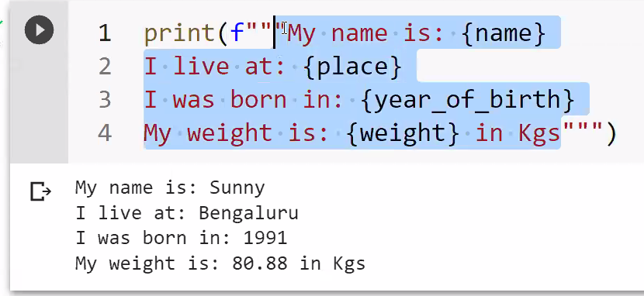
25 SEP22

Slide 6
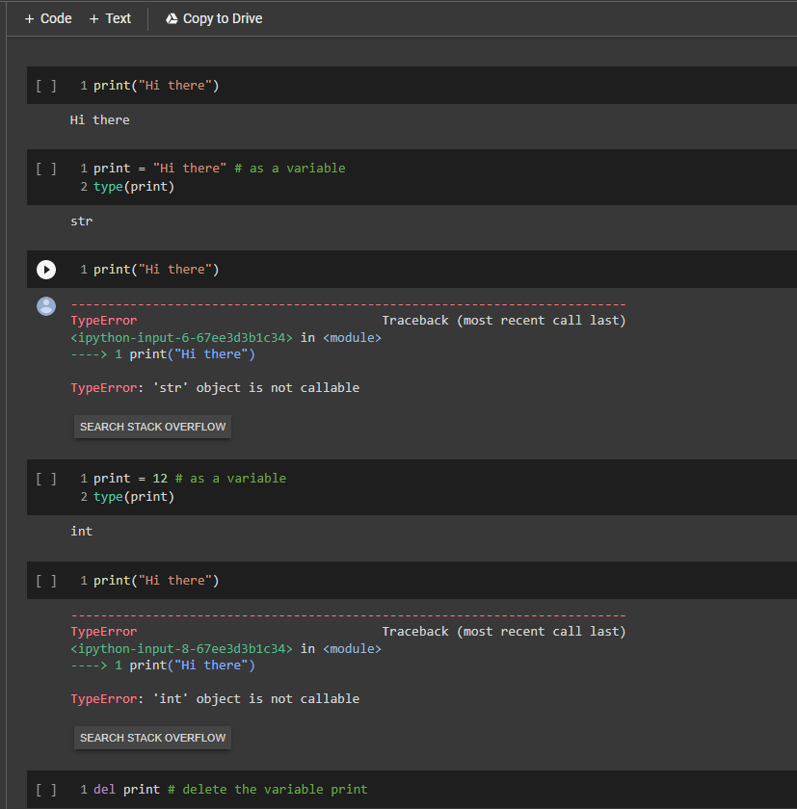
Reserved words in Python
We should not use reserved words as variable names
Also python doesn't restrict the user to use reserved keywords as variable names

Slide 7
